Slide 1

Designing Converged Middleware for HPC, AI, Big Data, and Data Science
Keynote Talk at PPAM Conference (September ‘24)
by
Follow us on
https://twitter.com/mvapich
Dhabaleswar K. (DK) Panda
The Ohio State University
E-mail: panda@cse.ohio-state.edu
http://www.cse.ohio-state.edu/~panda

Slide 2
Computing has been evolving over the last three decades with multiple phases:
Phase 1 (1975-): Scientific Computing/HPC
Phase 2 (2000-): HPC + Big Data Analytics
Phase 3: (2010-): HPC + AI (Machine Learning/Deep Learning)

Slide 3


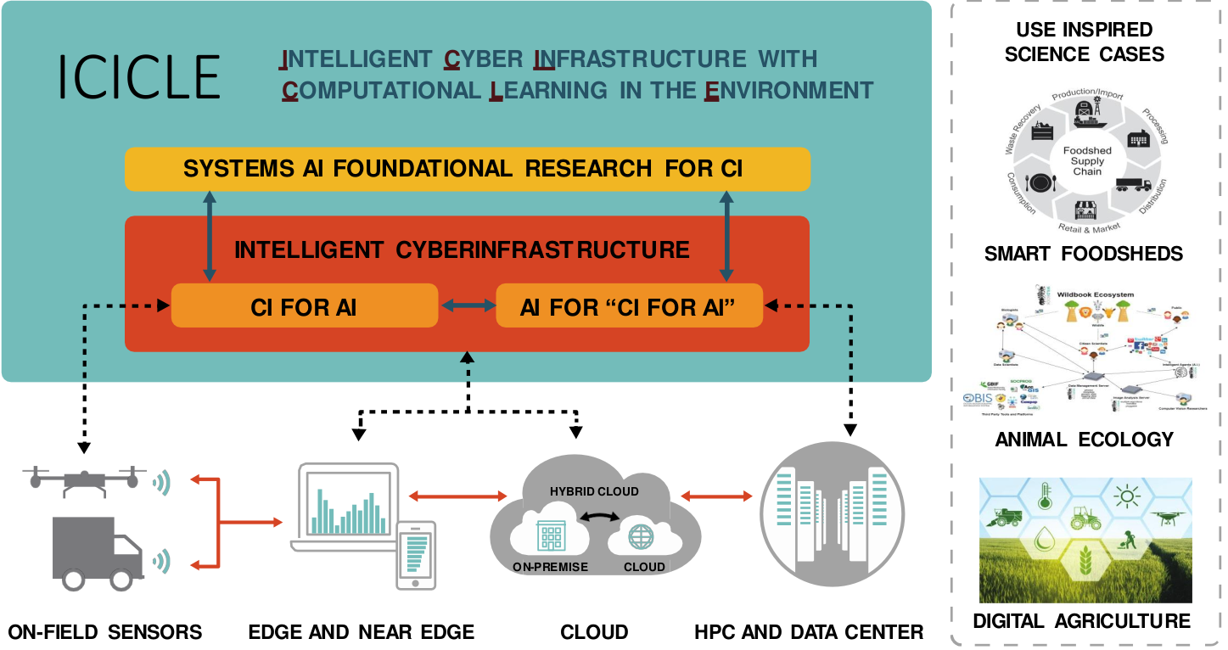
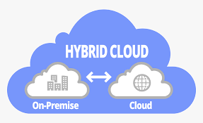
Emergence of the Computing Continuum
Computing Continuum
2. Big Data & Data Science
2. Big Data & Data Science
1. Scientific Computing
1. Scientific Computing
3. Artificial Intelligence
3. Artificial Intelligence
Edge & Near Edge
Clouds
On Field Sensors
HPC Systems & Data Centers
HPC Systems & Data Centers

Slide 4
Broad Challenge:
How to design high-performance and scalable middleware while taking advantage of heterogeneous (CPU + GPU + DPU/IPU (xPU)) HPC and Cloud resources?

Slide 5
Increasing Usage of HPC, AI, and Data Science in multiple Disciplines with Computing Continuum
Deep/
Machine Learning (TensorFlow, PyTorch, cuML, etc.)
Big Data (Hadoop, Spark), Data Science (Dask)
HPC (MPI, PGAS, etc.)
Convergence of HPC, Deep/Machine Learning, and Data Science!
Increasing Need to Run these applications on the Cloud!!
Can MPI-Driven Converged Middleware be designed and used for all three domains?

Slide 6
Presentation Overview
MVAPICH MPI Library Project
High-Performance Deep Learning/Machine Learning (HiDL) Project
Training and Inference
High-Performance Big Data and Data Science (HiBD) Project
Accelerating Spark and Data Science Applications with Dask
Overview of ICICLE NSF-AI Institute
Conclusions

Slide 7
Presentation Overview
MVAPICH MPI Library Project
Overview
Converged software stack for HPC, AI, Big Data, and Data Science
Sample performance numbers on leading systems
Exploiting Smart-NICs (Bluefield-2 and Blufield-3)
Broader Impact
High-Performance Deep Learning/Machine Learning (HiDL) Project
Training and Inference
High-Performance Big Data and Data Science (HiBD) Project
Accelerating Spark and Data Science Applications with Dask
Overview of ICICLE NSF-AI Institute
Conclusions

Slide 8

Overview of the MVAPICH Project
High Performance open-source MPI Library
Support for multiple interconnects
InfiniBand, Omni-Path, Ethernet/iWARP, RDMA over Converged Ethernet (RoCE), AWS EFA, OPX, Broadcom RoCE, Intel Ethernet, Rockport Networks, Slingshot 10/11
Support for multiple platforms
x86, OpenPOWER, ARM, Xeon-Phi, GPGPUs (NVIDIA and AMD)
Started in 2001, first open-source version demonstrated at SC ‘02
Supports the latest MPI-4.1 standard
http://mvapich.cse.ohio-state.edu
Additional optimized versions for different systems/environments:
MVAPICH2-X (Advanced MPI + PGAS), since 2011
MVAPICH2-GDR with support for NVIDIA (since 2014) and AMD (since 2020) GPUs
MVAPICH2-MIC with support for Intel Xeon-Phi, since 2014
MVAPICH2-Virt with virtualization support, since 2015
MVAPICH2-EA with support for Energy-Awareness, since 2015
MVAPICH2-Azure for Azure HPC IB instances, since 2019
MVAPICH2-X-AWS for AWS HPC+EFA instances, since 2019
Tools:
OSU MPI Micro-Benchmarks (OMB), since 2003
OSU InfiniBand Network Analysis and Monitoring (INAM), since 2015
Used by more than 3,400 organizations in 92 countries (listed under the Users Tab of the MVAPICH page)
More than 1.82 Million downloads from the OSU site directly
Empowering many TOP500 clusters (June ‘24 ranking)
13th , 10,649,600-core (Sunway TaihuLight) at NSC, Wuxi, China
33rd , 448, 448 cores (Frontera) at TACC
57th, 288,288 cores (Lassen) at LLNL
75th, 570,020 cores (Nurion) in South Korea and many others
Available with software stacks of many vendors and Linux Distros (RedHat, SuSE, OpenHPC, and Spack)
Partner in the 33rd ranked TACC Frontera system
Empowering Top500 systems for more than 20+ years

Slide 9
MVAPICH Release Timeline and Downloads

Slide 10
MVAPICH Architecture (HPC, DL/ML, Big Data, & Data Science)
HPC
Deep/Machine Learning
Big Data & Data Science
High Performance Parallel Programming Models
Message Passing Interface
(MPI)
PGAS
(UPC, OpenSHMEM, CAF, UPC++)
Hybrid --- MPI + X
(MPI + PGAS + OpenMP/Cilk)
High Performance and Scalable Communication Runtime
Diverse APIs and Mechanisms
Point-to-point Primitives
Collectives Algorithms
Job Startup
Energy-
Awareness
Remote Memory Access
I/O and
File Systems
Fault
Tolerance
Virtualization
Active Messages
Introspection & Analysis
Support for Modern Networking Technology
(InfiniBand, iWARP, RoCE, Omni-Path, EFA, Rockport, Slingshot)
Support for Modern Multi-/Many-core Architectures
(Intel-Xeon, AMD, OpenPOWER, ARM, GPU (NVIDIA, AMD), DPU)
Transport Protocols
Modern Features
Transport Mechanisms
Modern Features
RC
SRD
UD
DC
UMR
ODP
SR-IOV
Multi Rail
Shared Memory
CMA
IVSHMEM
XPMEM
CXL*
NVLink
xGMI*
* Upcoming

Slide 11
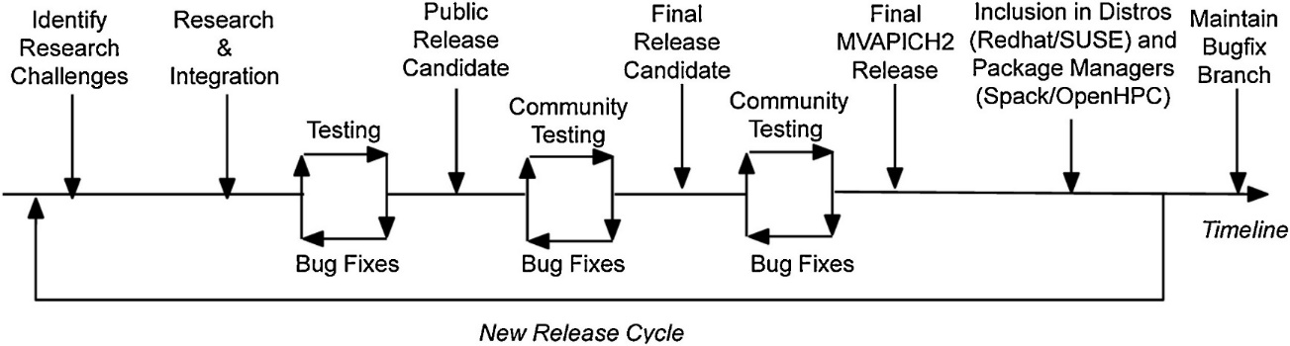
Milestones/Releases Progressing with Community Developments
MVAPICH Research Milestones
MVAPICH2-GDR
MVAPICH2-MIC
MVAPICH2-J
OMB-Py
OMB-J
Scale COSMO
OSU-Caffe
Scale DL
MVAPICH1
MVAPICH2
MPI-3 Support
OMB-GPU
Scale Earthquake Simulation
MVAPICH2-Virt
MVAPICH2-EA
OSU-INAM
MVAPICH2-GDR
On-the-fly
Compression
MPI4Dask
MPI4Spark
OMB
MVAPICH2-Azure
MVAPICH2-X-AWS
MVAPICH2-X
1994
1997
2001
2003
2004
2010
2011
2012
2013
2014
2015
2016
2019
2020
2021
2022
2023
MPI-1
MPI-2
PGAS
GPU Systems
MPI-3
RDMA Cloud
Dense
Multi-GPU
Systems
HPC for Data Science
RDMA InfiniBand
MIC Systems
HPC for DL
HPC Community Developments
GPUDirect RDMA
DK Panda, H. Subramoni, C. Chu, and M. Bayatpour, The MVAPICH project: Transforming Research into High-Performance MPI Library for HPC Community , Journal of Computational Science (JOCS), Special Issue on Translational Computer Science, Oct 2020.

Slide 12
MPI (MVAPICH)-driven Converged Software Stack for HPC, AI, Big Data, and Data Science
HPC
AI
(Deep Learning & machine Learning)
Big Data and Data Science
Unified Support for
On-Premise and Clouds
MVAPICH MPI Library
CPUs
GPUs
DPUs/IPUs
Interconnects
Scaling &
Performance Portability
Vendor Neutrality
CPU (3) x Interconnects (4) x GPUs (3)

Slide 13
MVAPICH-Plus 4.0b
Released on 08/26/2024
Supports all features of MPI 4.1 standard
Advanced MPI with unified MVAPICH2-GDR and MVAPICH2-X features
Support for both OFI and UCX
Support for
Major CPUs (x86-Intel, x86-AMD, and ARM)
Major GPUs (NVIDIA, AMD, and Intel)
Major HPC interconnects (InfiniBand, Omni-Path, ROCE, Slingshot, OPX, Ethernet/iWARP)
Support for CUDA-aware MPI and on-the-fly compression (Allgather, Alltoall, Allreduce, and Reduce_Scatter)
Optimized designs for converged software stack with next-generation workflows
DL (MPI4DL)
Available from hidl.cse.ohio-state.edu
ML (MPI4cuML)
Available from hidl.cse.ohio-state.edu
Big Data (MPI4Spark)
Available from hibd.cse.ohio-state.edu
Data Science (MPI4Dask)
Available from hibd.cse.ohio-state.edu

Slide 14
Presentation Overview
MVAPICH MPI Library Project
Overview
Converged software stack for HPC, AI, Big Data, and Data Science
Sample performance numbers on leading systems
Exploiting Smart-NICs (Bluefield-2 and Blufield-3)
Broader Impact
High-Performance Deep Learning/Machine Learning (HiDL) Project
Training and Inference
High-Performance Big Data and Data Science (HiBD) Project
Accelerating Spark and Data Science Applications with Dask
Overview of ICICLE NSF-AI Institute
Conclusions

Slide 15
Sample Performance Numbers with MVAPICH-Plus 4.0b
AMD CPU + AMD GPU + Slingshot (Frontier@ORNL and Tioga@LLNL)
CPU-based
GPU-based
Grace (ARM) CPU + Hopper (NVIDIA GPU) + Slingshot (Isamabard@Bristol)
CPU-based
GPU-based
Grace (ARM) CPU + Hopper (NVIDIA GPU) + InfiniBand (Vista@TACC)
CPU-based
Intel SPR CPU + Intel GPU + Cornelis Networks (Stampede3@TACC)
CPU-based
GPU-based

Slide 16
Intra-node CPU-CPU Results against Cray-MPICH on Frontier (Slingshot 11)
39%
37.6%
4x
35.6%
2.60x

Slide 17
Large-Scale Collective Performance on Frontier against Cray-MPICH (Slingshot 11)
MPI_Allgather (32N, 32 PPN)
MPI_Gather (64N, 32 PPN)
10%
24%
MPI_Allreduce (32N, 32 PPN)
12%
MPI_Gather (256 N, 16 PPN)
15%

Slide 18
Sample Performance Numbers with MVAPICH-Plus 4.0b
AMD CPU + AMD GPU + Slingshot (Frontier@ORNL and Tioga@LLNL)
CPU-based
GPU-based
Grace (ARM) CPU + Hopper (NVIDIA GPU) + Slingshot (Isamabard@Bristol)
CPU-based
GPU-based
Grace (ARM) CPU + Hopper (NVIDIA GPU) + InfiniBand (Vista@TACC)
CPU-based
Intel SPR CPU + Intel GPU + Cornelis Networks (Stampede3@TACC)
CPU-based
GPU-based

Slide 19
MVAPICH-PLUS on Tioga (AMD MI250X)
28.1%
54.5%
33%
2 nodes, 1 GPN – Small Message (osu_bibw)
2 nodes, 1 GPN – Small Message (osu_alltoall)
1 nodes, 4 GPN – Small Message (osu_allreduce)
56%
52.6%
2 nodes, 1 GPN – Large Message (osu_bibw)
2 nodes, 1 GPN – Large Message (osu_alltoall)
1 nodes, 8 GPN – Small Message (osu_allreduce)

Slide 20
MVAPICH-PLUS on Frontier (AMD MI250X)
62%
68%
1 nodes, 8 GPN – Small Message (osu_allreduce)
2 nodes, 8 GPN – Small Message (osu_allreduce)
62%
56%
4 nodes, 8 GPN – Small Message (osu_allreduce)
8 nodes, 8 GPN – Small Message (osu_allreduce)

Slide 21
Sample Performance Numbers with MVAPICH-Plus 4.0b
AMD CPU + AMD GPU + Slingshot (Frontier@ORNL and Tioga@LLNL)
CPU-based
GPU-based
Grace (ARM) CPU + Hopper (NVIDIA GPU) + Slingshot (Isamabard@Bristol)
CPU-based
GPU-based
Grace (ARM) CPU + Hopper (NVIDIA GPU) + InfiniBand (Vista@TACC)
CPU-based
Intel SPR CPU + Intel GPU + Cornelis Networks (Stampede3@TACC)
CPU-based
GPU-based

Slide 22
Scaling MVAPICH-Plus 4.0b on ISAMBARD (UK Bristol, Grace-Grace)
22.25%
62.80%
47.44%
219.72%

Slide 23
Sample Performance Numbers with MVAPICH-Plus 4.0b
AMD CPU + AMD GPU + Slingshot (Frontier@ORNL and Tioga@LLNL)
CPU-based
GPU-based
Grace (ARM) CPU + Hopper (NVIDIA GPU) + Slingshot (Isamabard@Bristol)
CPU-based
GPU-based
Grace (ARM) CPU + Hopper (NVIDIA GPU) + InfiniBand (Vista@TACC)
CPU-based
Intel SPR CPU + Intel GPU + Cornelis Networks (Stampede3@TACC)
CPU-based
GPU-based

Slide 24
Scaling MVAPICH-Plus 4.0b on ISAMBARD (UK Bristol, Grace-Hopper)
76.48%
349.85%
81.95%
97.43%
54.52%

Slide 25
Sample Performance Numbers with MVAPICH-Plus 4.0b
AMD CPU + AMD GPU + Slingshot (Frontier@ORNL and Tioga@LLNL)
CPU-based
GPU-based
Grace (ARM) CPU + Hopper (NVIDIA GPU) + Slingshot (Isamabard@Bristol)
CPU-based
GPU-based
Grace (ARM) CPU + Hopper (NVIDIA GPU) + InfiniBand (Vista@TACC)
CPU-based
Intel SPR CPU + Intel GPU + Cornelis Networks (Stampede3@TACC)
CPU-based
GPU-based

Slide 26
Scaling MVAPICH-Plus 4.0b on Vista (TACC, Grace-Grace)
7.82x

Slide 27
Sample Performance Numbers with MVAPICH-Plus 4.0b
AMD CPU + AMD GPU + Slingshot (Frontier@ORNL and Tioga@LLNL)
CPU-based
GPU-based
Grace (ARM) CPU + Hopper (NVIDIA GPU) + Slingshot (Isamabard@Bristol)
CPU-based
GPU-based
Grace (ARM) CPU + Hopper (NVIDIA GPU) + InfiniBand (Vista@TACC)
CPU-based
GPU-based
Intel SPR CPU + Intel GPU + Cornelis Networks (Stampede3@TACC)
CPU-based
GPU-based

Slide 28
Scaling MVAPICH-Plus 4.0b on Stampede3 (TACC, Sapphire Rapids)
1.81x
1.52x
11.3x
4.14x

Slide 29
Sample Performance Numbers with MVAPICH-Plus 4.0b
AMD CPU + AMD GPU + Slingshot (Frontier@ORNL and Tioga@LLNL)
CPU-based
GPU-based
Grace (ARM) CPU + Hopper (NVIDIA GPU) + Slingshot (Isamabard@Bristol)
CPU-based
GPU-based
Grace (ARM) CPU + Hopper (NVIDIA GPU) + InfiniBand (Vista@TACC)
CPU-based
GPU-based
Intel SPR CPU + Intel GPU + Cornelis Networks (Stampede3@TACC)
CPU-based
GPU-based

Slide 30
Benchmark-level Evaluations – Allreduce (Intel GPU)
49%
47%
15.8x
1 nodes, 4 GPN – Large Message
2 nodes, 4 GPN – Large Message
4 nodes, 4 GPN – Large Message

Slide 31
Benchmark-level Evaluations – Other Reduction-based Collectives (Intel GPU)
13.8x
20.4x
22.5x
1 nodes, 4 GPN – Reduce
1 nodes, 4 GPN – Reduce_scatter
1 nodes, 4 GPN – Reduce_scatter_block

Slide 32
Presentation Overview
MVAPICH MPI Library Project
Overview
Converged software stack for HPC, AI, Big Data, and Data Science
Sample performance numbers on leading systems
Exploiting Smart-NICs (Bluefield-2 and Blufield-3)
Broader Impact
High-Performance Deep Learning/Machine Learning (HiDL) Project
Training and Inference
High-Performance Big Data and Data Science (HiBD) Project
Accelerating Spark and Data Science Applications with Dask
Overview of ICICLE NSF-AI Institute
Conclusions

Slide 33
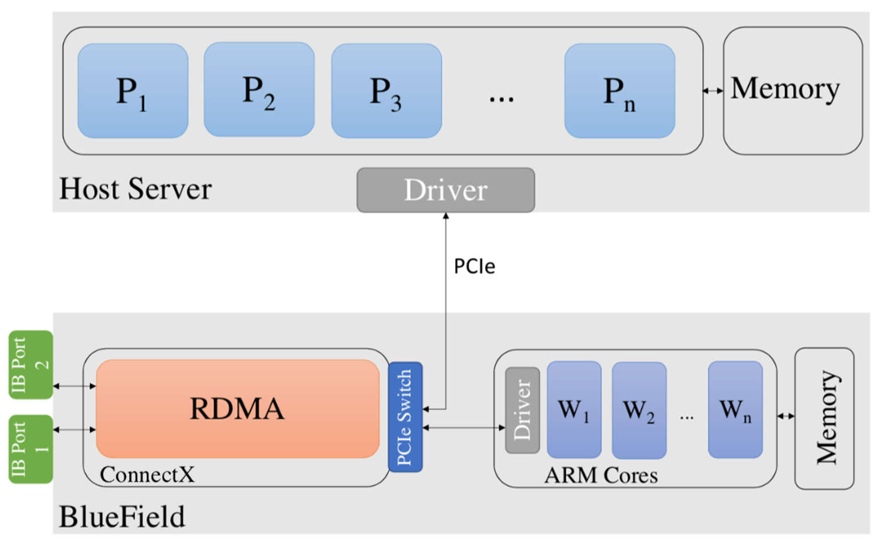
Accelerating Applications with BlueField-3 DPU
InfiniBand network adapter with up to 400Gbps speed
System-on-chip containing 16 64-bit ARMv8.2 A78 cores with 2.75 GHz each
16 GB of memory for the ARM cores

Slide 34

MVAPICH2-DPU 2023.10 Library Release
Released on 10/23
Supports all features available with the MVAPICH2 release (http://mvapich.cse.ohio-state.edu)
Novel GVMI-based framework to offload non-blocking collectives to DPU
Offloads non-blocking Alltoall (MPI_Ialltoall) to DPU
Offloads non-blocking Bcast (MPI_Ibcast) to DPU
Offloads non-blocking Alltoallv (MPI_Ialltoall) to DPU
Available from X-ScaleSolutions, please send a note to contactus@x-scalesolutions.com to get a trial license.

Slide 35
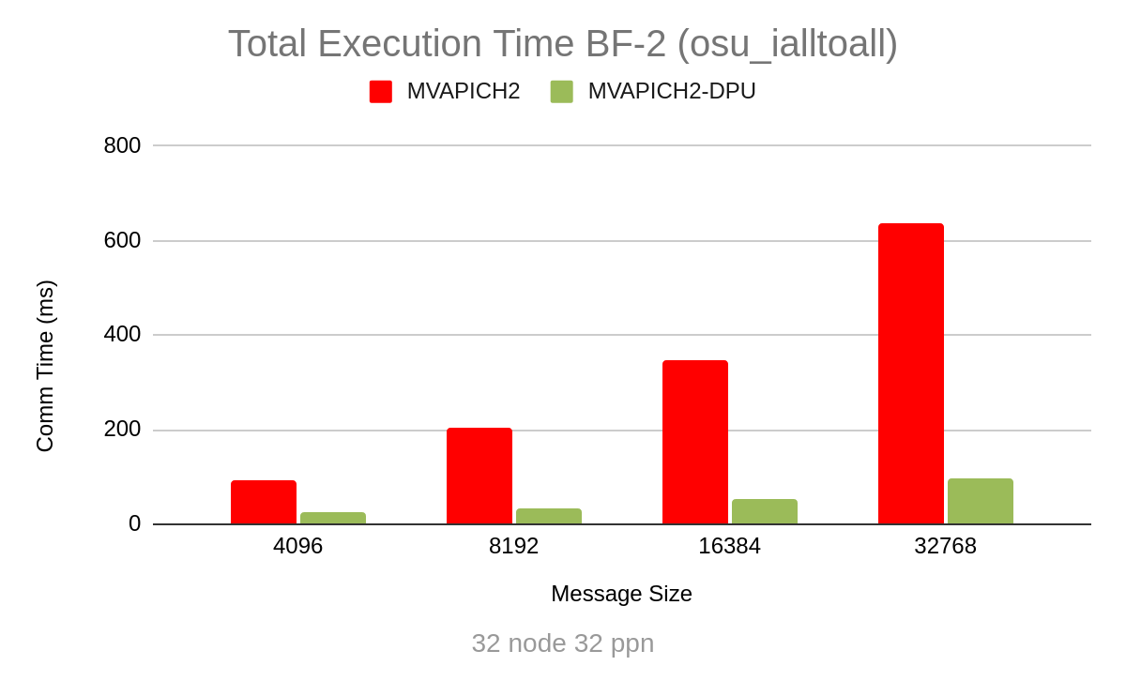
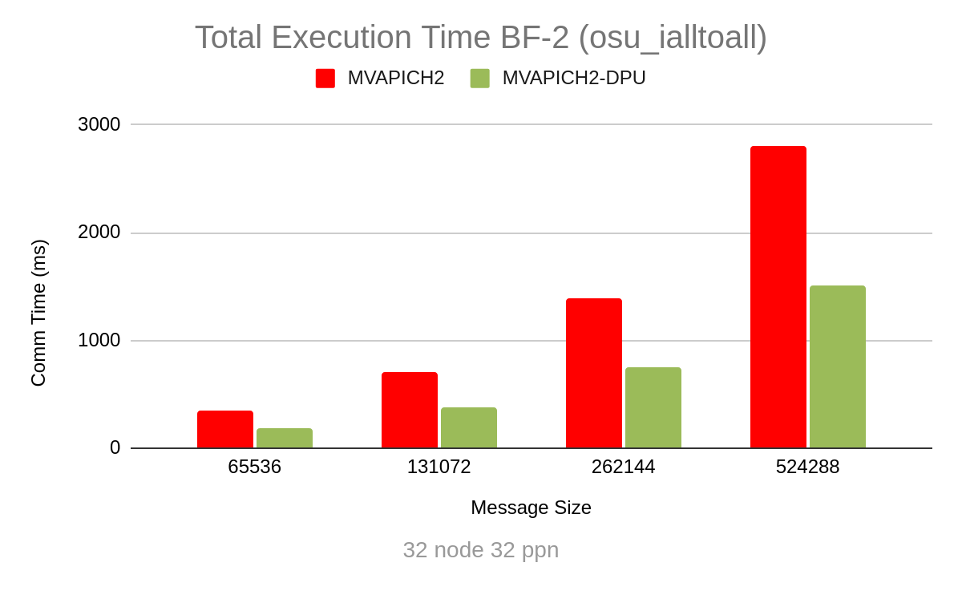
Total Execution Time with osu_Ialltoall (32 nodes), BF-2
46%
84%
46%
84%
84%
46%
75%
46%
Benefits in Total execution time (Compute + Communication)

Slide 36
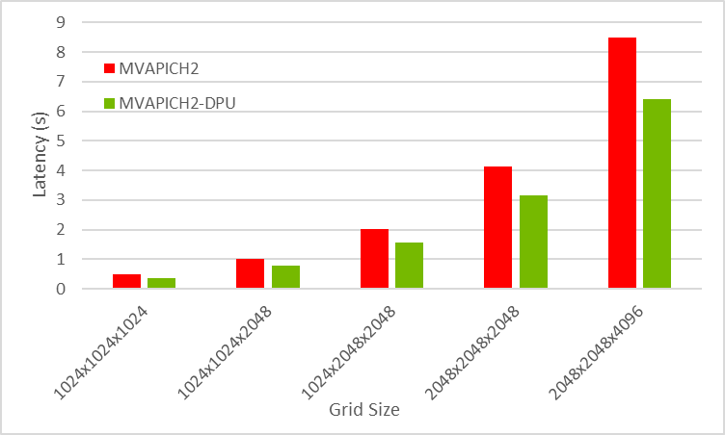
P3DFFT Application Execution Time (32 nodes), BF-2
24%
32 nodes with 32 ppn
(1,024 processes)
24%
23%
32x32 process grid
Benefits in application-level
execution time

Slide 37
Offloading MPI Point-to-Point and Reduction with PETSc (BF-3)
PETSc:
Solves 3D Laplacian with 27-point finite difference stencil
Modified Solver Algorithm to efficiently offload reduction (compute + communication) operations to the DPU
Problem Size: 256X256X256
Strong Scaling Run
% Host-to-DPU data exchange cost increases for large node count
Up to 24% benefits
24%
23%
18%
Benefits in Total execution time (Compute + Communication)
Notes:
For large node count (strong scaling) : host compute per process decreases, data exchange cost increases therefore benefits slightly decrease

Slide 38
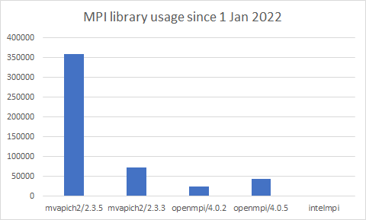
Rapid adoption of MVAPICH2 on INL HPC systems
M. Anderson, Aggressive Asynchronous Communication in the MOOSE framework using MVAPICH2, 10th Annual MVAPICH User Group Conference (MUG), Aug 2022

Slide 39

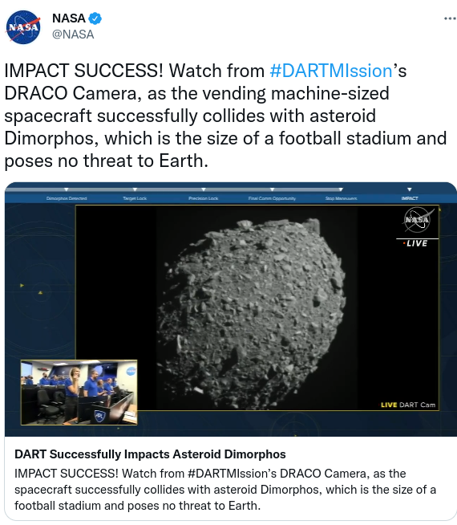
MVAPICH2 enabling life-changing NASA's DART mission
Near-Earth asteroids (NEAs) have caused recent and ancient global catastrophes
LLNL scientists research ways to prevent NEAs using methods known as asteroid deflection
Joint NASA-LLNL research modelled various asteroid deflection methods (NASA's DART mission)
MVAPICH2 lived at the core of the (NASA-DART mission) and enabled scalability
Underneath large-scale hydrodynamical and gravitational simulations required to compute the impact such as Spheral models
https://twitter.com/NASA/status/1574539270987173903?s=20&t=u_4wIV9Cui2xyn9QLj286Q
https://www.cbsnews.com/sanfrancisco/news/i-just-could-not-believe-it-livermore-team-celebrates-nasas-historic-strike-on-distant-asteroid/
http://mug.mvapich.cse.ohio-state.edu/static/media/mug/presentations/18/moody-mug-18.pdf

Slide 40

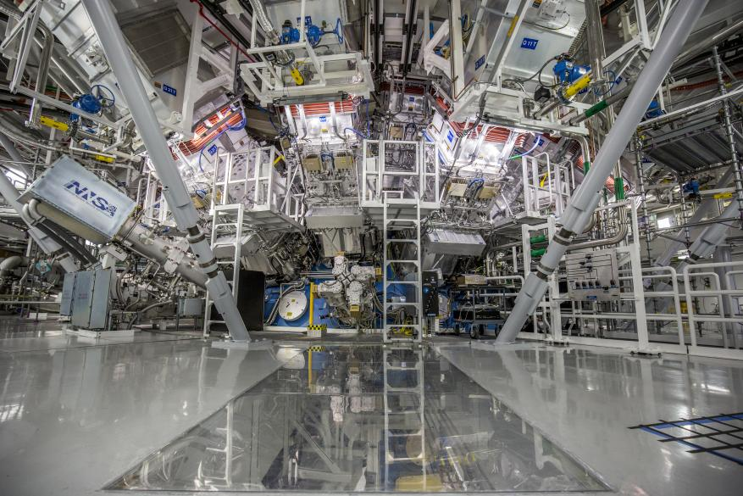
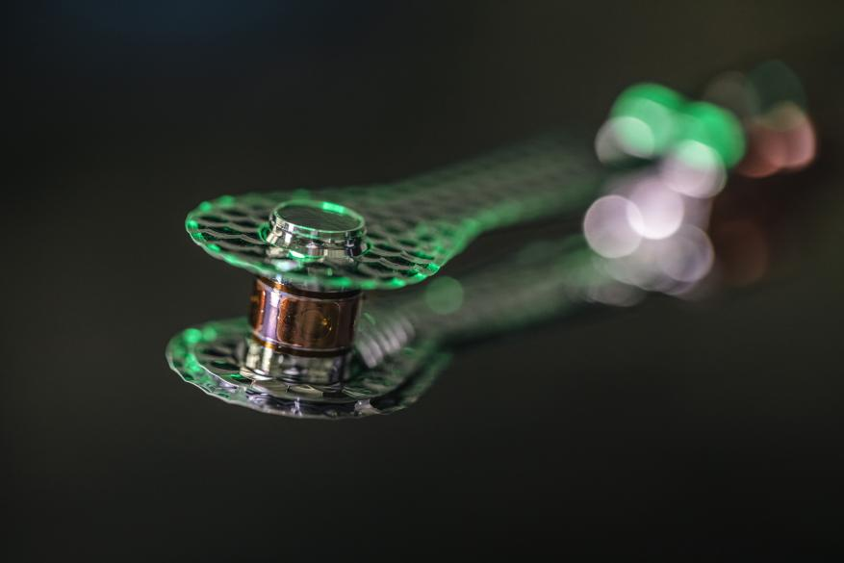
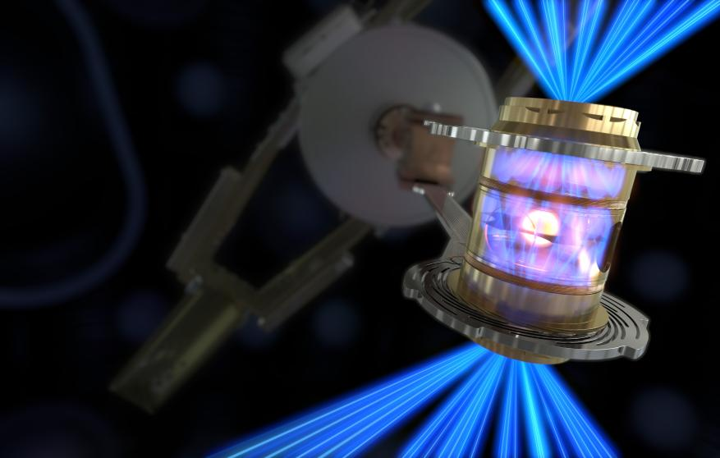
MVAPICH2 enabling Nuclear Fusion Research
LLNL’s National Ignition Facility (NIF) conducted the first controlled fusion experiment in history![1]
MVAPICH, being the default MPI library on the LLNL systems, has been enabling the thousands of simulation jobs that have led to this amazing achievement!
[1] https://www.llnl.gov/news/national-ignition-facility-achieves-fusion-ignition
The target chamber of LLNL’s National Ignition Facility, where 192 laser beams delivered more than 2 million joules of ultraviolet energy to a tiny fuel pellet to create fusion ignition on Dec. 5, 2022.
The hohlraum that houses the type of cryogenic target used to achieve ignition on Dec. 5, 2022, at LLNL’s National Ignition Facility.
To create fusion ignition, the National Ignition Facility’s laser energy is converted into X-rays inside the hohlraum, which then compress a fuel capsule until it implodes, creating a high temperature, high pressure plasma.

Slide 41
Presentation Overview
MVAPICH MPI Library Project
Overview
Converged software stack for HPC, AI, Big Data, and Data Science
Sample performance numbers on leading systems
Exploiting Smart-NICs (Bluefield-2 and Blufield-3)
Broader Impact
High-Performance Deep Learning/Machine Learning (HiDL) Project
Training and Inference
High-Performance Big Data and Data Science (HiBD) Project
Accelerating Spark and Data Science Applications with Dask
Overview of ICICLE NSF-AI Institute
Conclusions

Slide 42
MVAPICH-Driven Converged Software Stack for AI, Big Data and Data Science
Deep/
Machine Learning (TensorFlow, PyTorch, cuML, etc.)
Big Data (Hadoop, Spark), Data Science (Dask)
HPC (MPI, PGAS, etc.)
MPI4DL
MPI4cuML
MCR-DL
ParaInfer-X
MVAPICH

Slide 43
Sample Designs and Solutions
MPI-Driven High-Performance Distributed Training
Exploiting Hybrid (Data and Model) Parallelism for out-of-core training
Exploiting on-the-fly compression for LLM training
Accelerating Parallel Inference
In-flight Batching and MOE Models
Accelerating CuML Applications

Slide 44
MVAPICH2 (MPI)-driven Infrastructure for ML/DL Training: MPI4DL
ML/DL Applications
ML/DL Applications
TensorFlow
PyTorch
MXNet
PyTorch
Horovod
Torch.distributed
DeepSpeed
MVAPICH2 or MVAPICH2-X for CPU Training
MVAPICH2-GDR for
GPU Training
MVAPICH2 or MVAPICH2-X for CPU Training
MVAPICH2-GDR for
GPU Training
More details available from: https://github.com/OSU-Nowlab/MPI4DL and http://hidl.cse.ohio-state.edu

Slide 45
Distributed TensorFlow on ORNL Summit (1,536 GPUs)
ResNet-50 Training using TensorFlow benchmark on SUMMIT -- 1536 Volta GPUs!
1,281,167 (1.2 mil.) images
Time/epoch = 3 seconds
Total Time (90 epochs) = 3 x 90 = 270 seconds = 4.5 minutes!
ImageNet-1k has 1.2 million images
MVAPICH2-GDR reaching ~0.42 million images per second for ImageNet-1k!
*We observed issues for NCCL2 beyond 384 GPUs
Platform: The Summit Supercomputer (#2 on Top500.org) – 6 NVIDIA Volta GPUs per node connected with NVLink, CUDA 10.1
Notes:
Time is calculated based on the images/second performance. It might be different when actual training happens.

Slide 46
Distributed TensorFlow on TACC Frontera (2048 CPU nodes)
Scaled TensorFlow to 2048 nodes on Frontera using MVAPICH2
MVAPICH2 delivers close to the ideal performance for DNN training
Report a peak of 260,000 images/sec on 2048 nodes
On 2048 nodes, ResNet-50 can be trained in 7 minutes!
A. Jain, A. A. Awan, H. Subramoni, DK Panda, “Scaling TensorFlow, PyTorch, and MXNet using MVAPICH2 for High-Performance Deep Learning on Frontera”, DLS ’19 (SC ’19 Workshop).
Notes:
Why performance degrades for BS 64 for PPN8

Slide 47
Application-level Evaluations – PyTorch + Horovod (Intel GPU)
15%
41%
26%
28%
1 nodes, 4 GPN – Large Message
2 nodes, 4 GPN – Large Message
4 nodes, 4 GPN – Large Message

Slide 48
Performance of All-to-All with Online Compression
29.2%
35.8%
Improvement compared to MVAPICH2-GDR-2.3.7 with Point-to-Point compression
3D-FFT: Reduce All-to-All runtime by up to 29.2% with ZFP(rate: 24) on 64 GPUs
DeepSpeed benchmark: Reduce All-to-All runtime by up to 35.8% with ZFP(rate: 16) on 32 GPUs
Q. Zhou, P. Kousha, Q. Anthony, K. Khorassani, A. Shafi, H. Subramoni, and D.K. Panda, “Accelerating MPI All-to-All Communication with Online Compression on Modern GPU Clusters”, ISC ’22.

Slide 49
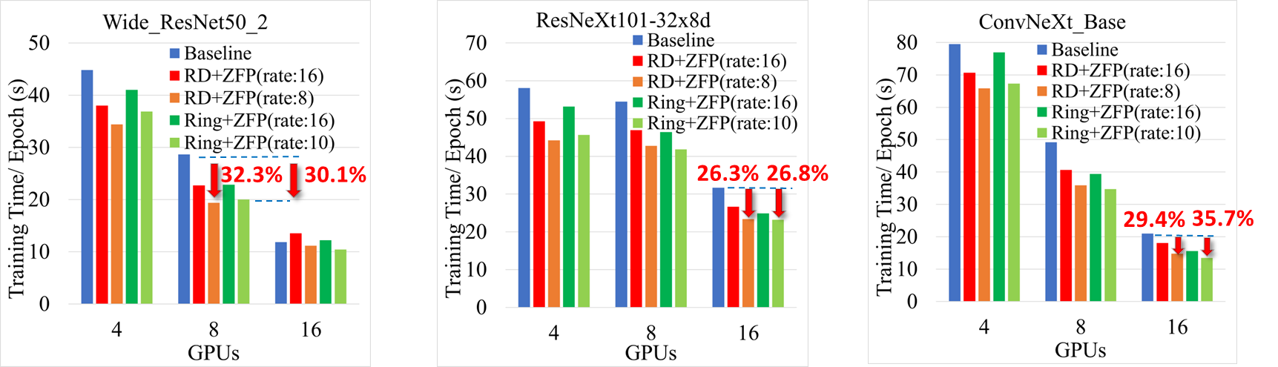
Performance of AllReduce with Online Compression
Cluster: Pitzer (V100 GPUs), Dataset: CIFAR10, Batch Size=128, Learning Rate=0.001
Improvement for DDP training using PyTorch
Use MPI backend with proposed Ring and Recursive-Doubling(RD) AllReduce with Online compression design
Wide_ResNet50_2: Reduces the training time by 30.1% (Ring+ZFP, 8 GPUs, rate: 10), 32.3% (RD+ZFP, 8 GPUs, rate: 8)
ResNeXt101-32x8d: Reduce the training time by 26.8% (Ring+ZFP, 16 GPUs, rate: 10), 26.3% (RD+ZFP, 16 GPUs, rate: 8)
ConvNeXt_Base: Reduce the training time by 35.7% (Ring+ZFP, 16 GPUs, rate: 10), 29.4% (RD+ZFP, 16 GPUs, rate: 8)
Q. Zhou, B. Ramesh, A. Shafi, M. Abduljabbar, H. Subramoni, and D.K. Panda, “Accelerating MPI AllReduce Communication with Efficient GPU-Based Compression Schemes on Modern GPU Clusters”, ISC ‘24.

Slide 50
Sample Designs and Solutions
MPI-Driven High-Performance Distributed Training
Exploiting Hybrid (Data and Model) Parallelism for out-of-core training
Exploiting on-the-fly compression for LLM training
Accelerating Parallel Inference
In-flight Batching and MOE Models
Accelerating CuML Applications

Slide 51
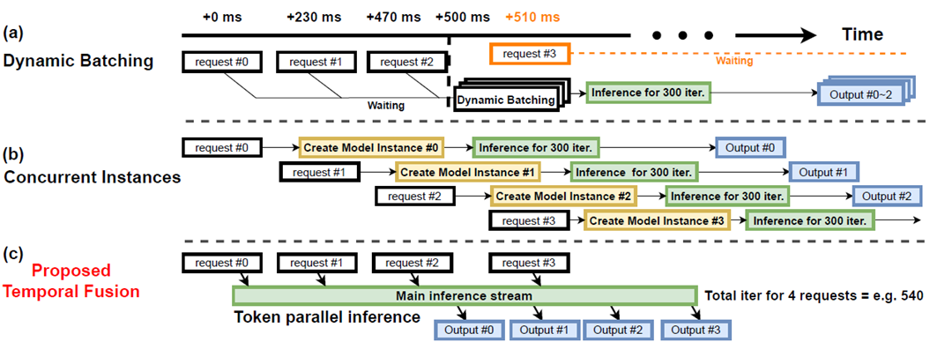
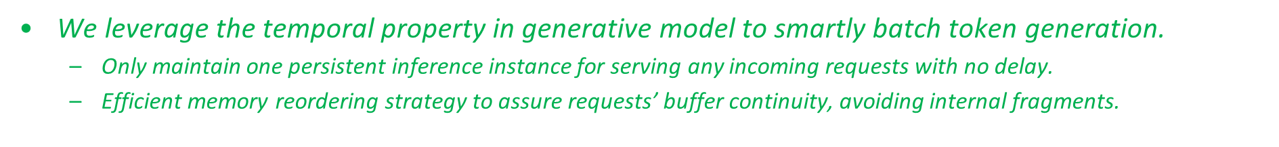
Flover: Efficient Parallel Inference on LLMs with Temporal Fusion^{[1]}
When serving multiple requests, how to deliver both low-latency and high-throughput?
For generative models such as GPT, LLaMA, the generation is sequential and regulated by 'for' loop.
For multiple requests that arrive at different time, how do we schedule the inference?
ParaInfer-X Release,
https://github.com/OSU-Nowlab/Flover
[1] Yao, Jinghan, Nawras Alnaasan, Tian Chen, Aamir Shafi, and Hari Subramoni. "Flover: A Temporal Fusion Framework for Efficient Autoregressive Model Parallel Inference." In Proceeding of HiPC 23

Slide 52
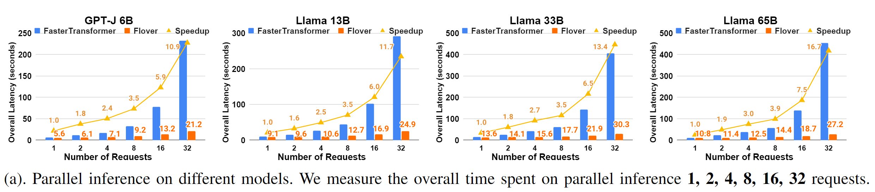
Overall Latency of Inference Requests
This experiment analyzes the performance of Flover when processing multiple requests in parallel.
In this part, we use a constant time interval of 500ms to study the parallel efficiency.
Notice that for all models, the average inference latency for a single request is >> 500ms, therefore it leaves great potential for parallel acceleration.
For GPT-J 6B and Llama 13B, we run on 1 GPU without tensor parallelism.
For Llama 33B, we run on 2 GPUs with tensor parallelism of size 2.
For Llama 65B, we use 4 GPUs to perform degree-4 tensor parallelism.
Compared to FasterTransformer, our method achieves up to 16.7x speedup in latency to finish all requests.

Slide 53
Sample Designs and Solutions
MPI-Driven High-Performance Distributed Training
Exploiting Hybrid (Data and Model) Parallelism for out-of-core training
Exploiting on-the-fly compression for LLM training
Accelerating Parallel Inference
In-flight Batching and MOE Models
Accelerating CuML Applications

Slide 54
Accelerating cuML with MVAPICH2-GDR
Utilize MVAPICH2-GDR (with mpi4py) as communication backend during the training phase (the fit() function) in the Multi-node Multi-GPU (MNMG) setting over cluster of GPUs
Communication primitives:
Allreduce
Reduce
Broadcast
Exploit optimized collectives
Python
Dask
Cython
UCX-Py
mpi4py
UCX
CUDA/C/C++
cuML Algorithms
cuML Primitives
NCCL
MVAPICH2-GDR
CUDA Libraries
CUDA

Slide 55
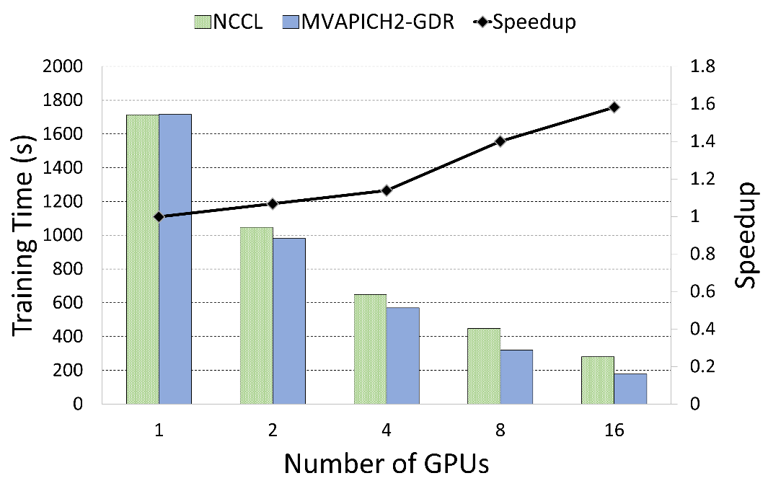
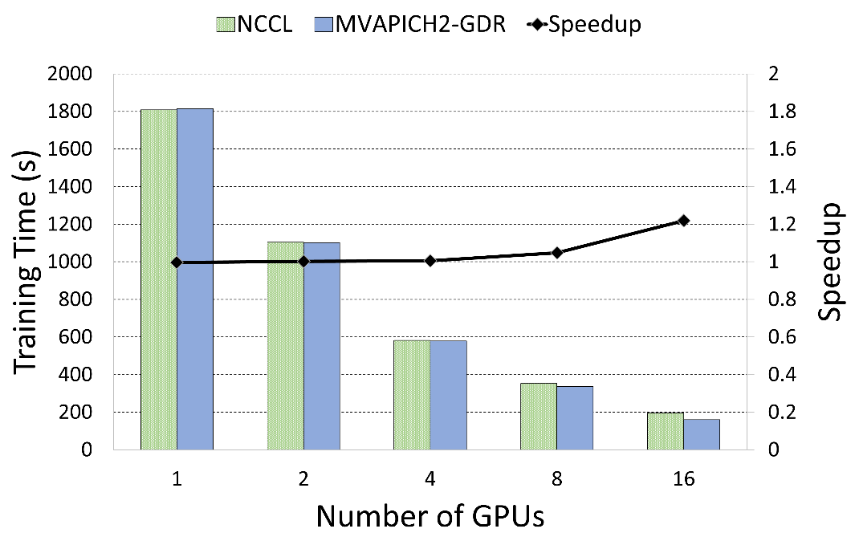
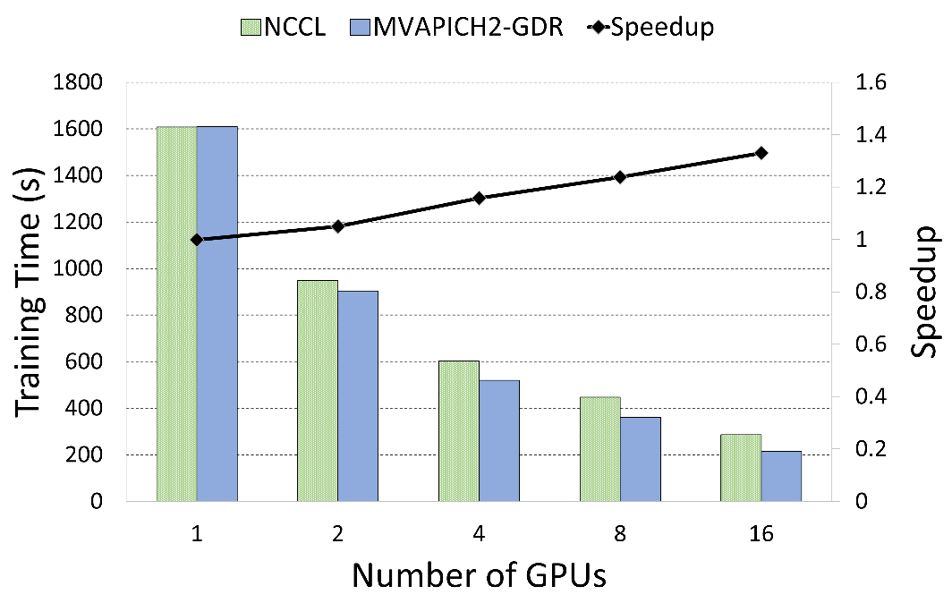
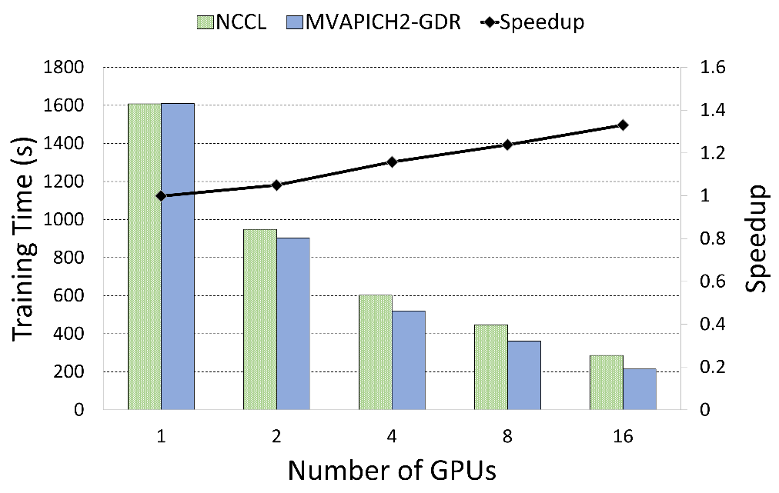
K-Means
Linear Regression
1.6x
MPI4cuML 0.5
1.23x
Expanse GPU System
CPU Model | Intel Xeon Gold 6248
CPU Core Info | 2x20 @ 2.5Ghz
Memory | 384 GB
Interconnect | InfiniBand HDR (200 Gbps)
OS | Rocky Linux 8.5
GPU | NVIDIA V100 (4/Node)
CUDA | CUDA 11.2
Nearest Neighbors
Truncated SVD
1.35x
1.38x
M. Ghazimirsaeed , Q. Anthony , A. Shafi , H. Subramoni , and D. K. Panda, Accelerating GPU-based Machine Learning in Python using MPI Library: A Case Study with MVAPICH2-GDR, MLHPC Workshop, Nov 2020

Slide 56
Presentation Overview
MVAPICH MPI Library Project
Overview
Converged software stack for HPC, AI, Big Data, and Data Science
Sample performance numbers on leading systems
Exploiting Smart-NICs (Bluefield-2 and Blufield-3)
Broader Impact
High-Performance Deep Learning/Machine Learning (HiDL) Project
Training and Inference
High-Performance Big Data and Data Science (HiBD) Project
Accelerating Spark and Data Science Applications with Dask
Overview of ICICLE NSF-AI Institute
Conclusions

Slide 57
MVAPICH-Driven Converged Software Stack for AI, Big Data and Data Science
Deep/
Machine Learning (TensorFlow, PyTorch, cuML, etc.)
Big Data (Hadoop, Spark), Data Science (Dask)
HPC (MPI, PGAS, etc.)
MPI4DL
MPI4cuML
MCR-DL
ParaInfer-X
MVAPICH
MPI4Spark
MPI4Dask

Slide 58
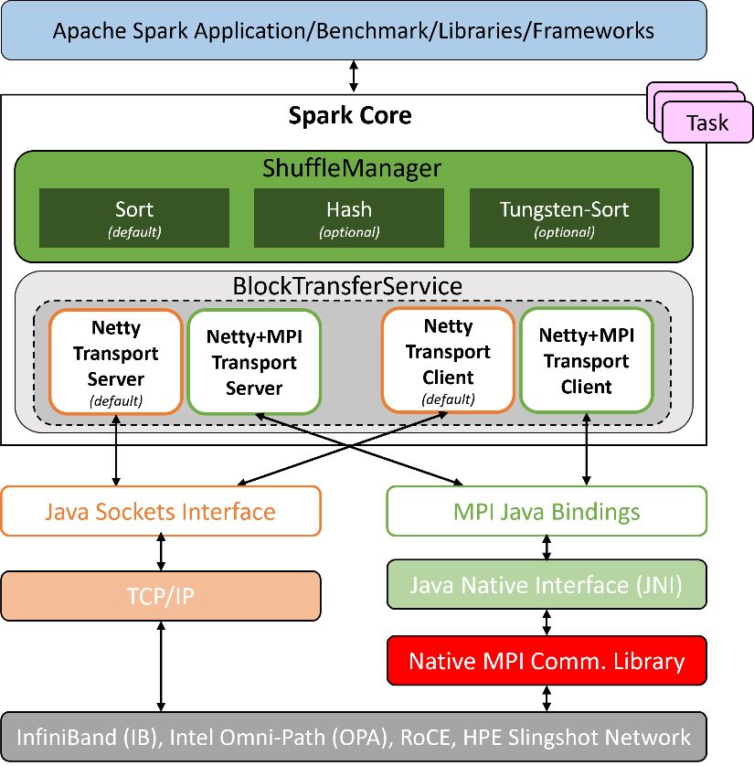
MPI4Spark: Using MVAPICH2 to Optimize Apache Spark
The main motivation of this work is to utilize the communication functionality provided by MVAPICH2 in the Apache Spark framework
MPI4Spark relies on Java bindings of the MVAPICH2 library
Spark’s default ShuffleManager relies on Netty for communication:
Netty is a Java New I/O (NIO) client/server framework for event-based networking applications
The key idea is to utilize MPI-based point-to-point communication inside Netty

Slide 59
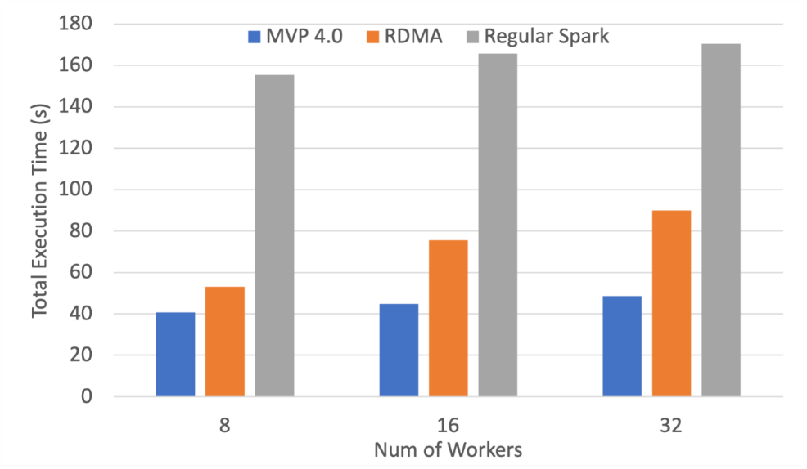
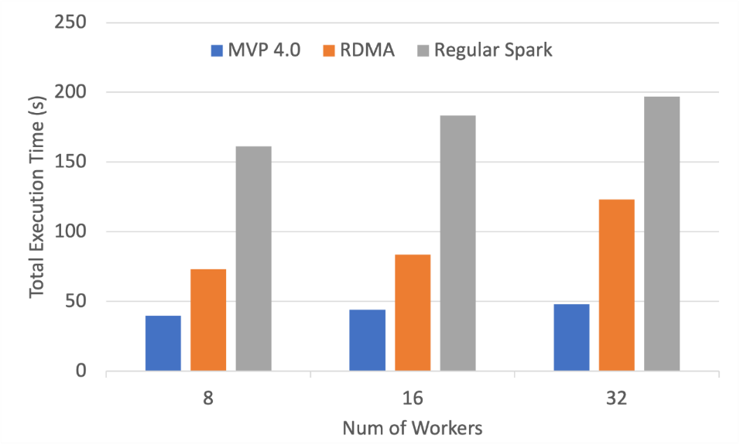
Performance Evaluation with MPI4Spark + MVP 4.0
3.5x
4.1x
1.9x
2.6x
OHB-Sortby
OHB-Groupby
The following are weak-scaling performance numbers of OHB benchmarks (GroupByTest and SortByTest) executed on the TACC Frontera system using MVAPICH version 4.0
Speed-ups for the overall total execution time for 32 workers with GroupByTest is 4.1x and 2.6x compared to (regular) Spark and RDMA Spark, and for SortByTest the speed-ups are 3.5 and 1.9x, respectively.

Slide 60
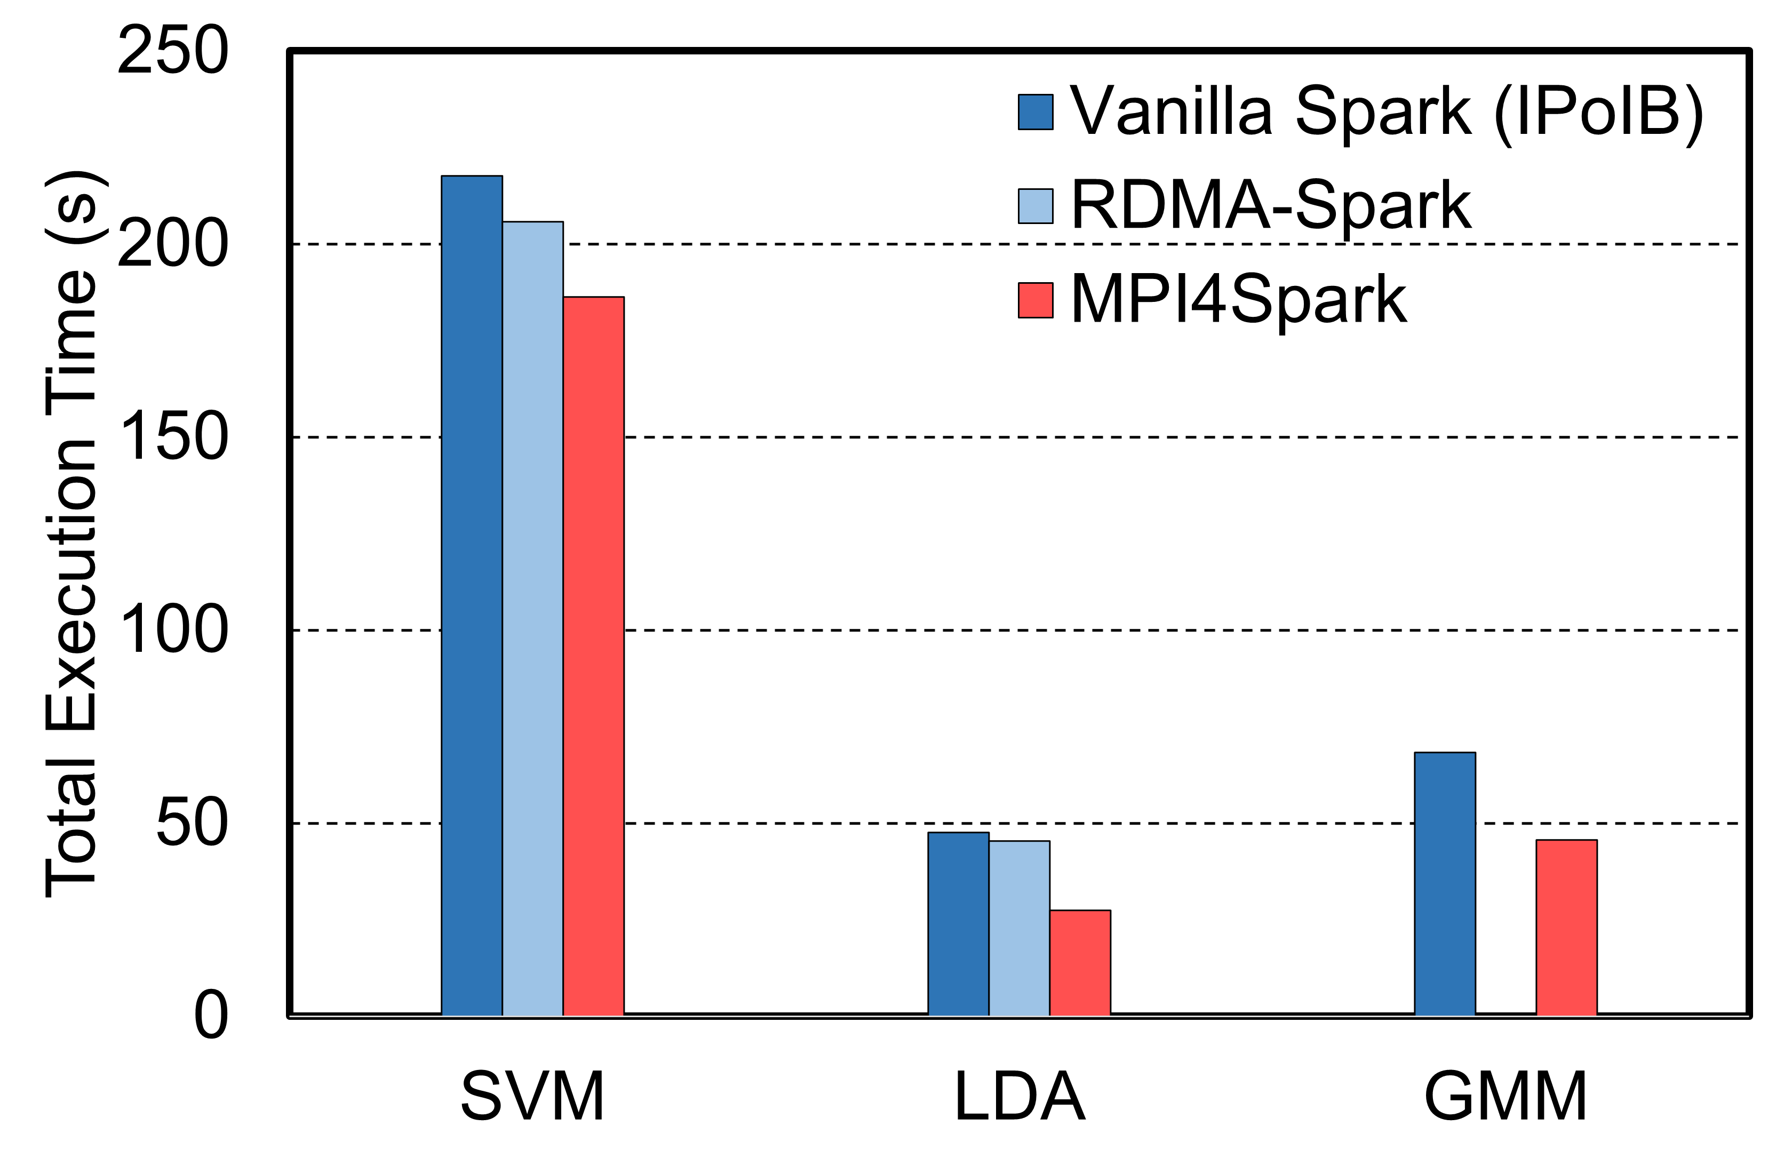
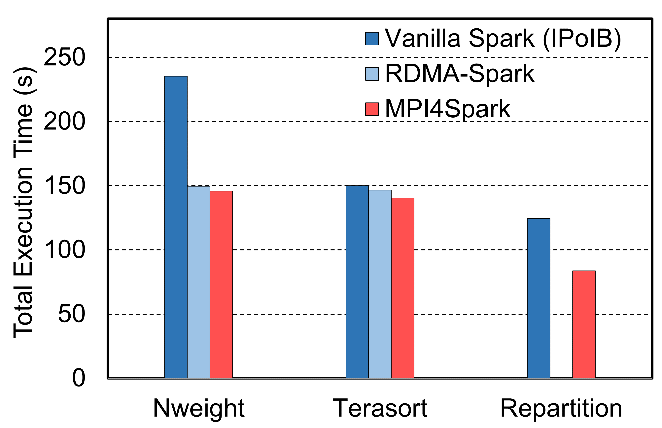
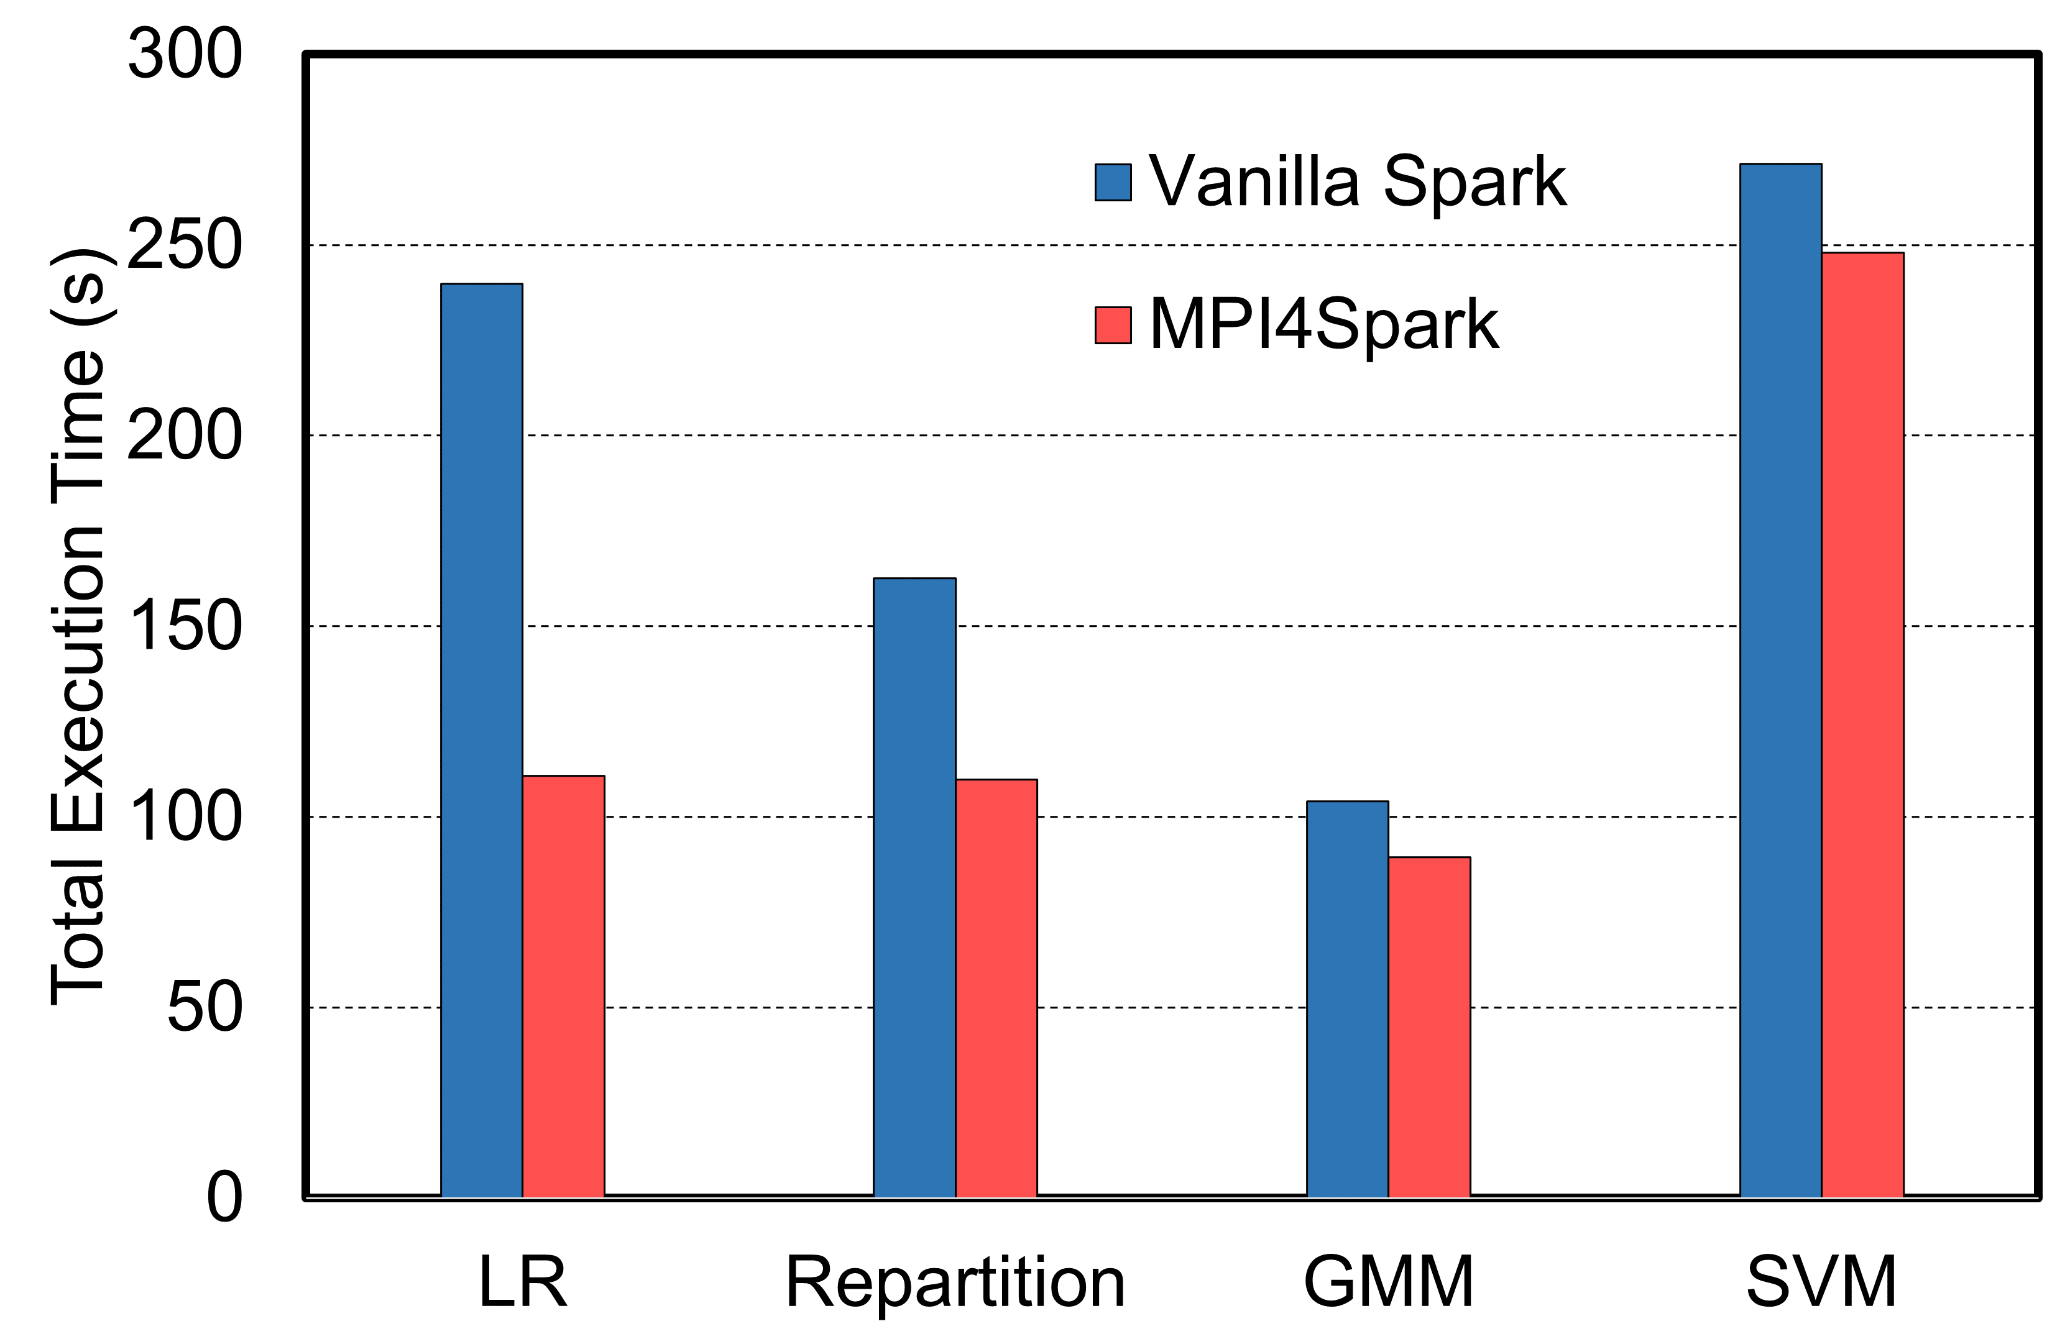
Performance Evaluation with Intel HiBench Workloads - Standalone
1.4x on average than RDMA-Spark
1.5x on average than Vanilla Spark
1.5x on average than Vanilla Spark
1.4x on average than Vanilla Spark
Intel HiBench ML Workloads - Frontera
Intel HiBench Micro/Graph Workloads - Frontera
Intel HiBench Micro/ML Workloads - Stampede2
This evaluation was done on the TACC Frontera (IB) and the TACC Stampede2 (OPA) Systems with the standalone cluster manager
This illustrates the portability of MPI4Spark on different interconnects
We see a speed-up for the LR machine learning workload on Stampede2 of about 2.2x
Speed-ups for the LDA machine learning workload on Frontera are 1.7x and 1.66x compared with IPoIB and RDMA, respectively
K. Al Attar, A. Shafi, M. Abduljabbar, H. Subramoni, D. Panda, Spark Meets MPI: Towards High-Performance Communication Framework for Spark using MPI, IEEE Cluster '22, Sep 2022.

Slide 61
MPI4Dask in the Dask Architecture
Dask
Dask Bag
Dask Array
Dask DataFrame
Delayed
Future
Task Graph
Dask-MPI
Dask-CUDA
Dask-Jobqueue
Distributed
Scheduler
Worker
Client
Comm Layer
tcp.py
ucx.py
MPI4Dask
UCX-Py
(Cython wrappers)
mpi4py
TCP
UCX
MVAPICH2-GDR
Laptops/
Desktops
High Performance Computing Hardware

Slide 62
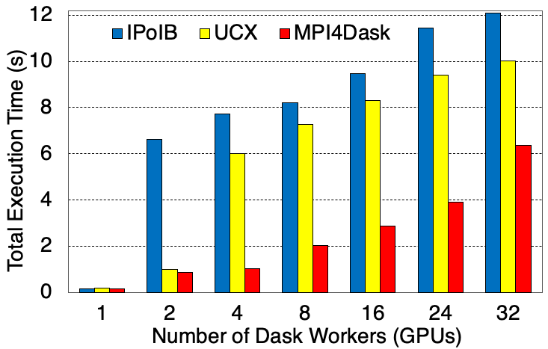
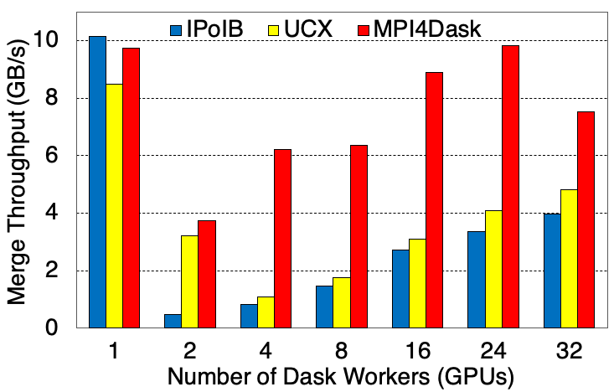
cuDF Merge (TACC Frontera GPU Subsystem)
2.91x better on average
2.90x better on average
A. Shafi , J. Hashmi , H. Subramoni , and D. K. Panda, Efficient MPI-based Communication for GPU-Accelerated Dask Applications, CCGrid ‘21 https://arxiv.org/abs/2101.08878
MPI4Dask 0.2 release
(http://hibd.cse.ohio-state.edu)

Slide 63
Presentation Overview
MVAPICH MPI Library Project
Overview
Converged software stack for HPC, AI, Big Data, and Data Science
Sample performance numbers on leading systems
Exploiting Smart-NICs (Bluefield-2 and Blufield-3)
Broader Impact
High-Performance Deep Learning/Machine Learning (HiDL) Project
Training and Inference
High-Performance Big Data and Data Science (HiBD) Project
Accelerating Spark and Data Science Applications with Dask
Overview of ICICLE NSF-AI Institute
Conclusions

Slide 64
Emergence of the Computing Continuum
Computing Continuum
2. Big Data & Data Science
2. Big Data & Data Science
1. Scientific Computing
1. Scientific Computing
3. Artificial Intelligence
3. Artificial Intelligence
Edge & Near Edge
Clouds
On Field Sensors
HPC Systems & Data Centers
HPC Systems & Data Centers

Slide 65
Data Movement and Control in Computing Continuum
Emerging Computing Continuum
On Field Sensors
Edge & Near Edge
Clouds
HPC Systems & Data Centers
Data Movement and Control
Notes:
Health and Medicine
Agriculture and Environment
Communications and Collaboration
Mobility, Machines and Manufacturing
AI for Social Good

Slide 66
How to Create Intelligent Cyberinfrastructure for Computing Continuum in the Modern AI Era
&
Democratizing AI?
Notes:
Welcome to the BOF on AI4CI4AI and CI4AI: Community Input for ICICLE, the National Cyberinfrastructure for AI. We have an excellent panel of experts to describe the mission of ICICLE, the recently awarded NSF AI Research Institute.
My name is Vipin Chaudhary and I am the Kevin J Kranzusch Professor and Chair of Computer and Data Science at Case Western Reserve University and I will moderate the BOF. In the panel are Professor DK Panda, University Distinguished Scholar of Computer Science and Engineering at The Ohio State University; Professor Beth Plale, the Michael A. and Laurie Burns McRobbie Bicentennial Professor of Computer Engineering and Executive Director of the IU Pervasive Technology Institute at Indiana University; and Professor Rudi Eigenmann, Professor in the Department of Electrical and Computer Engineering at University of Delaware.
ICICLE formally started on Nov 1 of this year, so we are within our first month. Please visit the website, icicle.ai for details as we start ramping up our activities.
Please use the chat in zoom to write your questions, comments, etc. and we will answer and discuss those after the brief presentation.
To get things started, let me start with a short video to motivate the creation of ICICLE.

Slide 67



Creating Intelligent Cyberinfrastructure for Democratizing AI: Overview of the Activities at the NSF-AI Institute ICICLE
Follow us
@icicleai
http://icicle.ai
Notes:
Welcome to the BOF on AI4CI4AI and CI4AI: Community Input for ICICLE, the National Cyberinfrastructure for AI. We have an excellent panel of experts to describe the mission of ICICLE, the recently awarded NSF AI Research Institute.
My name is Vipin Chaudhary and I am the Kevin J Kranzusch Professor and Chair of Computer and Data Science at Case Western Reserve University and I will moderate the BOF. In the panel are Professor DK Panda, University Distinguished Scholar of Computer Science and Engineering at The Ohio State University; Professor Beth Plale, the Michael A. and Laurie Burns McRobbie Bicentennial Professor of Computer Engineering and Executive Director of the IU Pervasive Technology Institute at Indiana University; and Professor Rudi Eigenmann, Professor in the Department of Electrical and Computer Engineering at University of Delaware.
ICICLE formally started on Nov 1 of this year, so we are within our first month. Please visit the website, icicle.ai for details as we start ramping up our activities.
Please use the chat in zoom to write your questions, comments, etc. and we will answer and discuss those after the brief presentation.
To get things started, let me start with a short video to motivate the creation of ICICLE.

Slide 68
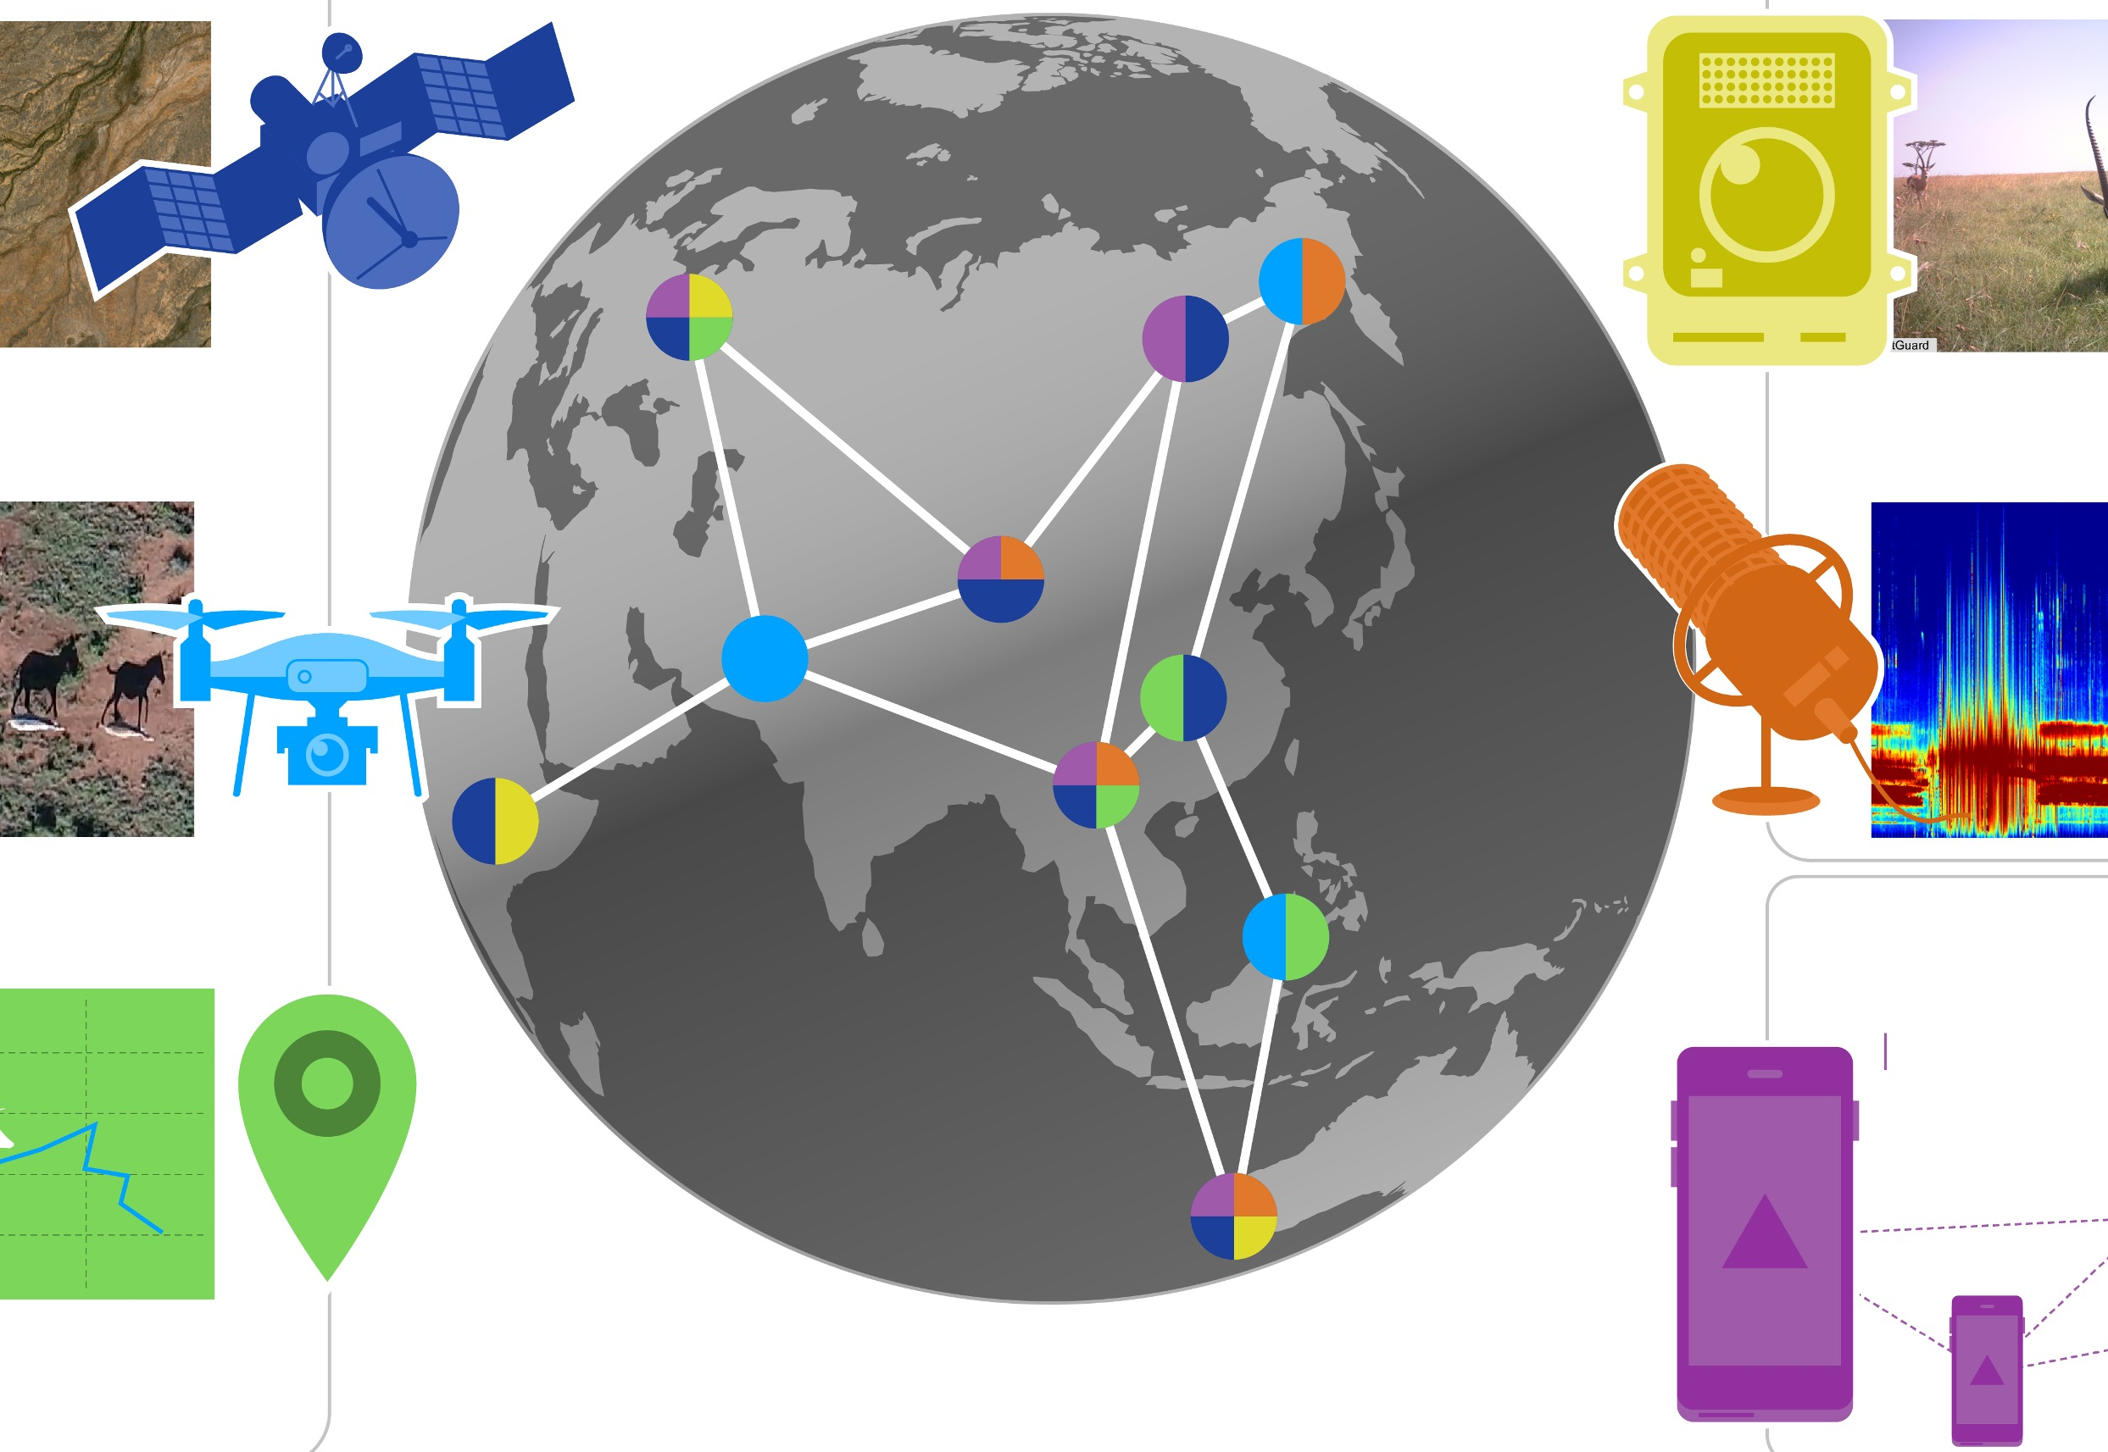
Objectives: Intelligent CyberInfrastructure for Computing Continuum
Use Inspired Science Domains
Digital
Agriculture
Smart
Foodsheds
Animal Ecology
ICICLE: Intelligent CyberInfrastructure with Computational Learning in the Environment
Systems AI Foundational Research for CI
Intelligent Cyber Infrastructure
CI for AI
AI for “CI for AI”
On Field Sensors
Edge & Near Edge
Clouds
HPC Systems & Data Centers
Emerging Computing Continuum
Notes:
Health and Medicine
Agriculture and Environment
Communications and Collaboration
Mobility, Machines and Manufacturing
AI for Social Good

Slide 69
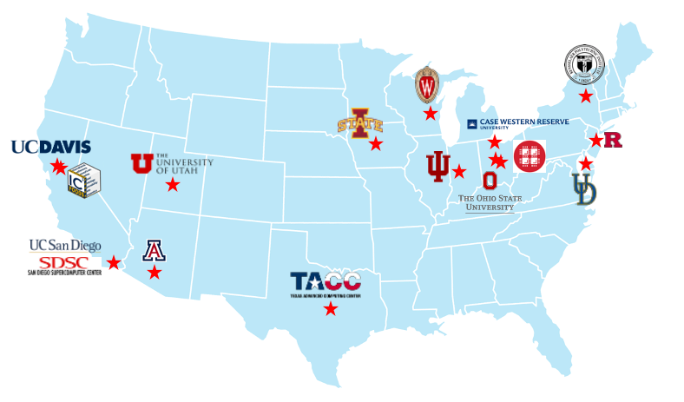



























Participation:
16 Organizations, 33 faculty, 41 staff, (58 PhD, 16 MS, 16 undergrad, 6 K-12) students & many Collaborators
Govt. Agencies & National Labs
International
Industry
Research Institutes
NSF AI Institutes
Hospitals & Universities
Notes:
ICICLE has 13 participating institutes with 46 investigators. These are spread all over the US geographically and has many other collaborators including international institutions, industry, other AI institutes, national labs, and research institutes.

Slide 70





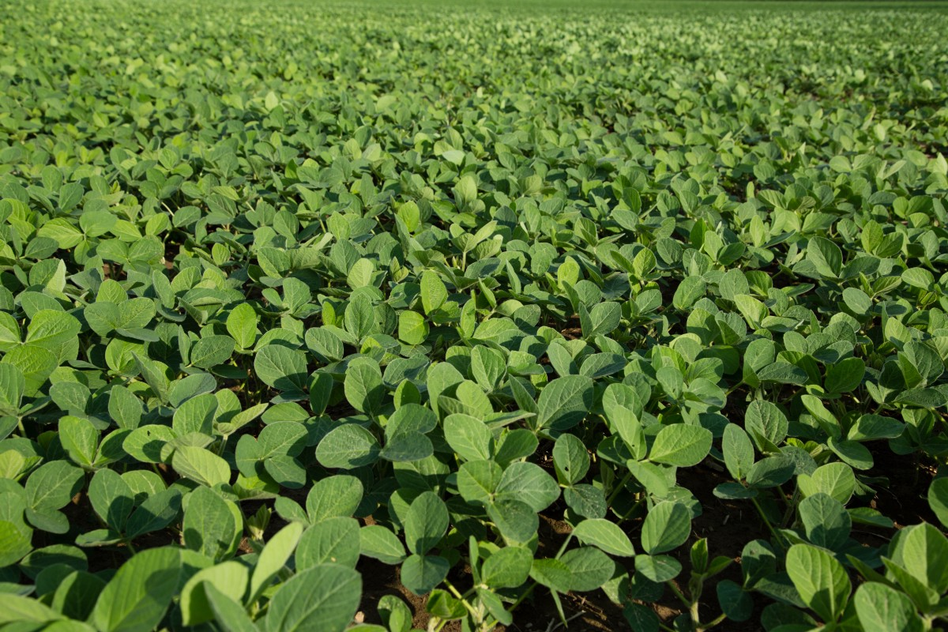
Collaboration: ICICLE and the Technology Innovation Hub (TIH) at the Indian Institute of Technology Bombay (IIT-B), India
Digital Agriculture
Crop Health Modeling
Aerial Crop Scouting
- Sense crop health and level context to predict crop yield
- Detect stressors and diseases for geographically diverse crops
- Apply remedies with little human intervention via Internet of Things (IoT) and sensor systems
- CI for fully autonomous aerial systems
- Simplify deployment of UAV in real fields to capture common crop health conditions
- Provide accurate maps that yield valuable insights for crop management
This research collaboration will contribute novel design paradigms for context-adaptive CI and aims to develop next-generation CI for Digital Agriculture including AI and machine learning methods targeting 3 core areas.
Privacy-Preserving Data Exchange
Create secure, trustworthy, and privacy-preserving platforms that connect farmers and allow them to share information and resources safely.
Building upon the existing ICICLE infrastructure, CI and AI capabilities, researchers will leverage contextual conditions in India for Digital Agriculture that differ from the United States to (1) expose brittle CI components, (2) make AI4CI more robust and expansive in the long-term, (3) devise principles that yield context-aware CI

Slide 71
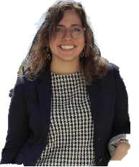
Research Plan: Overall Vision
FOUNDATIONAL SYSTEMS AI
ICICLE
INTELLIGENT CYBERINFRASTRUCTURE
SOFTWARE ARCHITECTURE AND DESIGN
CO-DESIGN FOR USE INSPIRED SCIENCE
CI FOR AI
AI FOR CI-FOR-AI
Intelligent CI
VISUAL ANALYTICS FOR CI AND AI EXPLAINABILITY
PRIVACY, ACCOUNT ABILITY AND DATA INTEGRITY

Slide 72
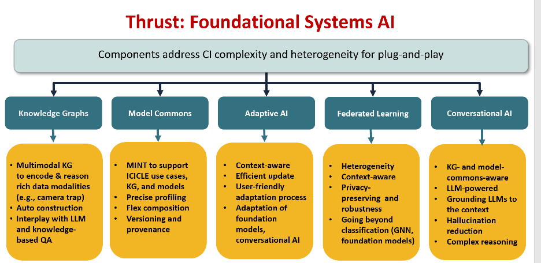
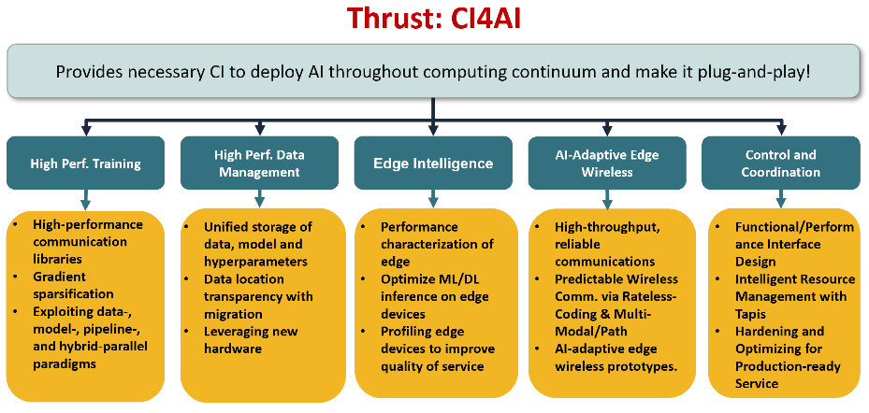
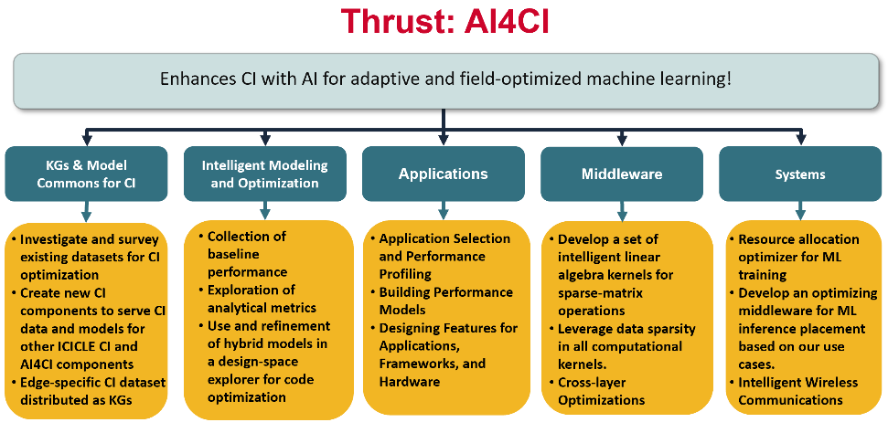
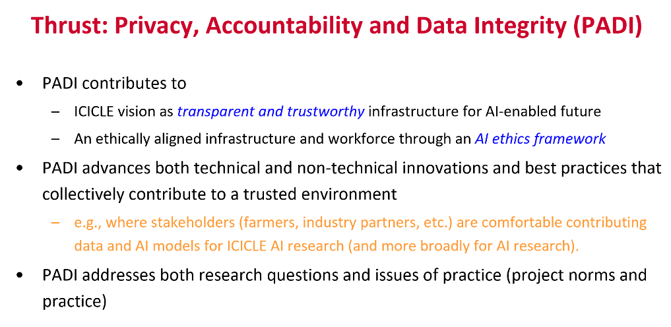
Research Challenges

Slide 73
CI/SOFTWARE RELEASES TILL DATE
https://icicle.osu.edu/cyberinfrastructure/software
Visual Analytics
Dashboard
Region2vec
Species Classification
GitHub Metrics​
1,567 Total Clones​
9,192 Total Views​
PyPI
4 Python Packages​
958 Docker Container
Downloads​
7 Docker Containers
PPOD
Core
CI Components Catalog
PPOD Schema
Grocery Store Closure
Smart Foodsheds
AI Foundations
ICICLE Foodshed Parser
iciflaskn
PPOD Knowledge Graph
Event Engine
Tapis Federated Authentication Service
Tapis Pods Service
Animal Ecology
ICICLE Components
Software Architecture and Design
Camera-Traps Edge Simulator
Base ICICLE Tapis Software
Tapis
UI
TapisCL-ICICLE
ICICONSOLE
Software
Pilot
Digital Agriculture
AI4CI4AI
Far-Edge Edge Simulator
Hello ICICLE
Authentication Clients
In-Field Helper for Crop Scouts
ICICLE Digital Agriculture Hub
Intelligent Sparse Library (iSpLib)
High Performance Computing Applications Dataset
Iluvatar Functions as a Service (FaaS) Control Plane
HPC Application Runtime Predictor (HARP)

Slide 74
Goal: Towards Designing End-to-end Digital Agriculture CI Solutions and make these available as Services for various Stakeholders
Crop Health Issues
HPC-Enabled Data Harvesting & Preparation
HPC for Ag AI
From HPC to the field: Computing Continuum
Crop Management Interventions
Use-Inspired Cyberinfrastructure
End-to-end software workflows that democratize
access, use, and benefits of AI-driven digital agriculture

Slide 75
Overview of ICICLE Workflow for Digital Agriculture
Model Selection
Hyperparameters Selection
Data Labeling
Inference Execution
Data Selection and Class Definition
HPC Training
Model Retrieval
Display Markers on Map
Data Geotagging and Rotation
Model/metadata saving
Inference Data Preprocessing
Display Training Statistics
Individual Sample Analysis
Display Statistics Dashboard
Data Transfer from Drone to Edge
Plot Tiles Extraction
Data Collection via Drone
Data Collection via Drone
Show Heatmap
A1
A2
A3
A4
B1
B2
B3
B4
B5
B6
B7
C1
C2
C3
C4
D1
D2
D3
D4
Data Collection and Preprocessing
Model Training
Inference
Visualization
Timeline

Slide 76

Demo: Semi-Supervised Learning

Slide 77
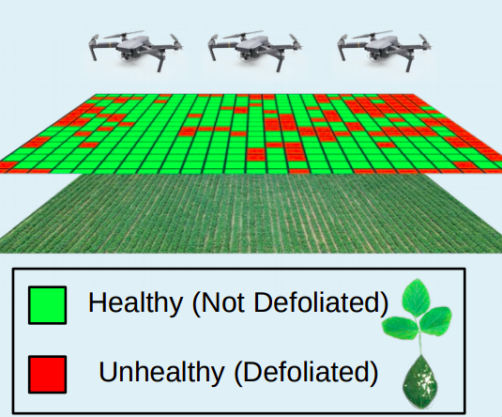
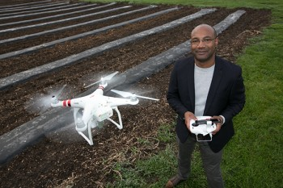
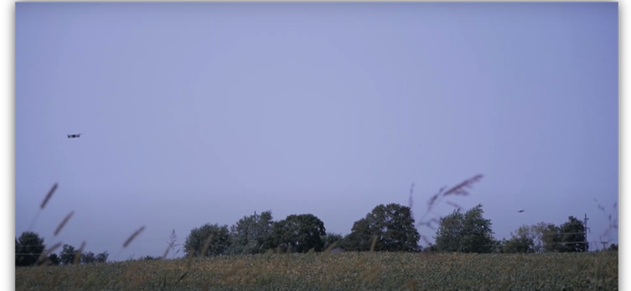
Digital Agriculture: Aerial Crop Scouting
Aerial Crop Scouting: In this workload, we seek to create heat maps that describe crop health for a field
Inform self-driving tractors and sprayers to reduce the application of pesticide and fertilizer
Predict crop yields for harvest and market timing
Identify trends across farms, such as the introduction of resistant weeds
Technology: Unmanned aerial vehicles (UAV) capture high resolution images
Flying low (15 ft above ground): 1 pixel -> mm
Transformative: At mm-granularity, stakeholders can detect biological phenomena invisible to satellites
Soybean leaf defoliation caused by Japanese beetle
Software Pilot (https://pypi.org/project/SoftwarePilot/)
OpenPass (http://149.165.155.188:2298/)
Courtesy of LaRue
Farms Inc.

Slide 78
Similar Progress in Other Areas
Animal Ecology
Smart Foodsheds and Distributions

Slide 79
Collaboration: AI and Other Institutes
MOU with the AI4Opt Institute (Michelle and Alfonso)
Optimize food logistics for the USDA-LFPA collaboration, including the Tribal Elder Food Box program collaboration, in Wisconsin for summer 2023
MOU with AI4Opt: Creating the Food Access Simulation and Strategy ABM
NSF HDR DIRSE Imageomics Institute partnership in research, education, DEI (Tanya and Chuck)
MOU with USDA AI Institute for Resilient Agriculture (AIIRA) at Iowa State University of Science & technology
Collaboration to develop end-to-end training solutions that are deployable on high-performance computing resources to accelerate the training of open-source ag foundational models.
Academic Agreement signed with ISU – Includes ARA work with ICICLE. ICICLE participation at ARA Fest'24 (August 24)
Scheduled Seminar Series with Ag AID & AI Farms to explore future collaboration. Scope of work being defined (MOU).
Potential collaboration discussions (on-going):
Indian Institute of Technology, Bhubaneswar, India
AI-Edge Hub, UK (under the Center-to-Center Initiative by UKRI)
Agrifood Innovation Institute, Australian National University, Australia

Slide 80
Presentation Overview
MVAPICH MPI Library Project
Overview
Converged software stack for HPC, AI, Big Data, and Data Science
Sample performance numbers on leading systems
Exploiting Smart-NICs (Bluefield-2 and Blufield-3)
Broader Impact
High-Performance Deep Learning/Machine Learning (HiDL) Project
Training and Inference
High-Performance Big Data and Data Science (HiBD) Project
Accelerating Spark and Data Science Applications with Dask
Overview of ICICLE NSF-AI Institute
Conclusions

Slide 81
Concluding Remarks
Upcoming Exascale systems and Cloud need to be designed with a holistic view of HPC, Big Data, Deep/Machine Learning, Data Science, and computing continuum
Presented an overview of opportunities and challenges in designing scalable and high-performance middleware for such systems
Presented a set of solutions which enable these communities to take advantage of current and next-generation systems with latest technologies
Presented an overview of the ICICLE NSF-AI Institute activities
Next-generation Zetascale systems will need continuous innovations in designing converged software architectures …..

Slide 82
12th Annual MVAPICH User Group (MUG) Conference http://mug.mvapich.cse.ohio-state.edu/
August 19-21, 2024, Columbus, Ohio, USA
Keynote Speakers:
Sadaf Alam, University of Bristol, UK
Dan Stanzione, Texas Advanced Computing Center (TACC)
Invited Speakers:
Ahmad Abdelfattah, University of Tennessee, Knoxville
Sameh Abdulah, King Abdullah University of Science and Technology (KAUST), Saudi Arabia
HooYoung Ahn, ETRI, South Korea
Matthew Anderson, Idaho National Laboratory (INL)
Alan Ayala, AMD
Ammar Ahmad Awan, Microsoft DeepSpeed
Yifeng Cui, San Diego Supercomputer Center
Donglai Dai, X-ScaleSolutions
Douglas Fuller, Cornelis Networks
Invited Speakers (Cont’d):
Sheikh Ghafoor, National Science Foundation (NSF)
Jithin Jose, Microsoft Azure
Richard Graham, NVIDIA
Gilad Shainer, NVIDIA
Yogeshwar Sonawane, CDAC, India
Sameer Shende, ParaTools and University of Oregon
Mahidhar Tatineni, San Diego Supercomputer Center (SDSC)
Te-Yang Yeh, San Diego Computer Center, SDSC
Tutorials and Demos:
Cornelis Networks
NVIDIA
OSUMVAPICH
OSU HiDL and HiBD
ParaTools
X-ScaleSolutions
Slides and Videos of the
Talks are available

Slide 83






















Funding Acknowledgments
Funding Support by
Equipment Support by

Slide 84
Acknowledgments to all the Heroes (Past/Current Students and Staffs)
Current Students (Graduate)
K. Al Attar (Ph.D.)
N. Alnaasan (Ph.D.)
Q. Anthony (Ph.D.)
C.-C. Chun (Ph.D.)
T. Chen
N. Contini (Ph.D.)
Current Faculty
H. Subramoni
A. Potlapally (Ph.D.)
S. Xu (Ph.D.)
L. Xu (Ph.D.)
G. Kuncham (Ph.D.)
J. Yao (P.hD.)
J. Jani (M.S.)
J. Queiser (M.S.)
J. Hatef (Ph.D.)
S. Lee (Ph.D.)
B. Michalowicz (Ph.D.)
B. Ramesh (Ph.D.)
K. K. Suresh (Ph.D.)
T. Tran (Ph.D.)
Current Research Specialist
R. Motlagh
Current Software Engineers
N. Pavuk
N. Shineman
M. Lieber
A. Guptha
Past Students
A. Awan (Ph.D.)
A. Augustine (M.S.)
P. Balaji (Ph.D.)
M. Bayatpour (Ph.D.)
R. Biswas (M.S.)
S. Bhagvat (M.S.)
A. Bhat (M.S.)
D. Buntinas (Ph.D.)
L. Chai (Ph.D.)
B. Chandrasekharan (M.S.)
S. Chakraborthy (Ph.D.)
N. Dandapanthula (M.S.)
V. Dhanraj (M.S.)
C.-H. Chu (Ph.D.)
R. Kumar (M.S.)
S. Krishnamoorthy (M.S.)
K. Kandalla (Ph.D.)
M. Li (Ph.D.)
P. Lai (M.S.)
J. Liu (Ph.D.)
M. Luo (Ph.D.)
A. Mamidala (Ph.D.)
G. Marsh (M.S.)
V. Meshram (M.S.)
A. Moody (M.S.)
S. Naravula (Ph.D.)
R. Noronha (Ph.D.)
X. Ouyang (Ph.D.)
S. Pai (M.S.)
S. Potluri (Ph.D.)
K. Raj (M.S.)
R. Rajachandrasekar (Ph.D.)
D. Shankar (Ph.D.)
G. Santhanaraman (Ph.D.)
N. Sarkauskas (B.S. and M.S)
V. Sathu (M.S.)
N. Senthil Kumar (M.S.)
A. Singh (Ph.D.)
J. Sridhar (M.S.)
S. Srivastava (M.S.)
S. Sur (Ph.D.)
H. Subramoni (Ph.D.)
K. Vaidyanathan (Ph.D.)
A. Vishnu (Ph.D.)
J. Wu (Ph.D.)
W. Yu (Ph.D.)
J. Zhang (Ph.D.)
Q. Zhou (Ph.D.)
T. Gangadharappa (M.S.)
K. Gopalakrishnan (M.S.)
R. Gulhane (M.S.)
J. Hashmi (Ph.D.)
M. Han (M.S.)
W. Huang (Ph.D.)
A. Jain (Ph.D.)
W. Jiang (M.S.)
J. Jose (Ph.D.)
M. Kedia (M.S.)
K. S. Khorassani (Ph.D.)
S. Kini (M.S.)
M. Koop (Ph.D.)
P. Kousha (Ph.D.)
K. Kulkarni (M.S.)
Past Research Scientists
K. Hamidouche
A. Shafi
S. Sur
X. Lu
M. Abduljabbar
Past Senior Research Associate
J. Hashmi
Past Programmers
A. Reifsteck
D. Bureddy
J. Perkins
B. Seeds
Past Post-Docs
D. Banerjee
X. Besseron
M. S. Ghazimirsaeed
Past Research Specialist
M. Arnold
J. Smith
H.-W. Jin
J. Lin
M. Luo
A. Ruhela
J. Vienne
H. Wang
E. Mancini
K. Manian
S. Marcarelli

Slide 85
Acknowledgments to all ICICLE Participants (Faculty, Students and Staffs)
Current Faculty
E. Ayday, CWRU
V. Chaudhary, CWRU
A. Azad, IU
P. Sharma, IU
H. Zhang, ISU
T. Berger-Wolf, OSU
S. Blanas, OSU
Y. Cai, OSU
W. Chao, OSU
E. Fosler-Lussier, OSU
A. Hyder, OSU
DB. Jackson-Smith, OSU
R. Machiraju, OSU
DK. Panda, OSU
R. Ramnath, OSU
S. Shearer, OSU
H. Shen, OSU
C. Stewart, OSU
Y. Su, OSU
H. Subramoni, OSU
H. Sun, OSU
C. Stewart, RPI
B. Salimi, UCSD
R. Eigenmann, UD
A. Ahmad, Uni Stuttgart
E. Riloff, UU
P. Sadayappan, UU
E. Ely-Ledesma, UW-Madison
S. Gao, UW-Madison
A. Morales, UW-Madison
Past Staff
C. Campbell, IU
S. Sanders, IU
A. Ivanovic, OSU
P. Rose, UCSD
K. Pierce, TACC
Past Faculty
C. Hoy, OSU
T. Tomich, UC Davis
J. Duarte, UC San Diego
M. Norman, UC San Diego
Past Ph.D. Students
FB Saravi, CWRU
MK. Rahman, IU
T. Zhang, ISU
H. Ahn, OSU
P. Chawla, OSU
E. Goetz, OSU
Y. Gu, OSU
A. Jain, OSU
D. Suresh, OSU
S. Raje, UU
H. Park, UW Madison
Current International Faculty TIH – IITB
M. Baghini, IITB
Chalapathi G, IITB
A. Sinha, IITB
R. Velmurugan, IITB
S. Paramane, TIH IITB
Current Staff
M. Lange, IC-Foods
T. Ruemping, IC-Foods
D. Siedband, IC-Foods
M. Biggers, IU
RJ. Ping, IU
BA. Plale, IU
J. Wernert, IU
M. Abduljabbar, OSU
K. Armstrong, OSU
J. Chan, OSU
J. Chumley, OSU
C. Guzman, OSU
W. Michel, OSU
N. Savardekar, OSU
A. Shafi, OSU
S. Khuvis, OSC
S. Oottikkal, OSC
K. Tomko, OSC
D. Choi, SDSC
M. Kandes, SDSC
A. Majumdar, SDSC
P. Rodriguez, SDSC
M. Tatineni, SDSC
R. Cardone, TACC
C. Garcia, TACC
S. Li, TACC
J. Stubbs, TACC
Z. Zhang, TACC
A. Hollander, UC Davis
P. Huber, UC Davis
C. Riggle, IC-Foods
P. Hoover, UCSD
M. Thomas, UCSD
M. Miller, UW Madison
Current International
Students TIH - IITB
A. Borkar, TIH IITB
RM. Chitre, TIH IITB
R. Katole, TIH IITB
S. Khandelwal, TIH IITB
T. Sharma, TIH IITB
A. Thaduri, TIH IITB
S. Zac, TIH IITB
Current K-12 Students
R. Estanislao, SDSC
D. Lee, SDSC
M. Ray, SDSC
S. Samar, SDSC
Past Masters Students
SR. Kalli, OSU
H. Panday, OSU
RR. Loka, UW Madison
D. Sykes, UW Madison
Current Ph.D. Students
P. Kousha, OSU
Z. Li, OSU
V. Pahuja, OSU
R. Qiu, OSU
E. Romero, OSU
C. Tu, OSU
Y. Tu, OSU
S. Vallabhajosyula, OSU
L. Waltz, OSU
B. Wang, OSU
X. Wang, OSU
J. Yao, OSU
X. Yue, OSU
T. Zhang, OSU
K. Zhang, OSU
J. Yan, UU
K. Armendariz, UW-Madison
J. Rao, UW-Madison
J. Kline, OSU
G. Ubbiali, IC-Foods
Z. Zhang, OSU
DD. Vecchia, RPI
M. Rosas, UD
T. Jiang, UU
Y. Xu, UU
Current Institute Evaluators (WFD)
T. McKlin, TFG
C. Wise, TFG
Past K-12 Students
J. Karpinski, SDSC
A. Sarin, SDSC
Past UG Students
S. Ockerman, OSU
KP. Sailaja, OSU
C. Washington, OSU
J.Kim, TACC
C. Skevofilax, TACC
S. Wegner, UW Madison
Current Masters Students
R. Danhi, IC-Foods
J. Cheng, OSU
S. Deshmukh, OSU
M. Han, OSU
A. O'Quinn, OSU
S. Suresh, UW Madison
G. Wilkins, UW Madison
C. Wang, OSU
J. Yang, OSU
Q. Ding, TACC
V. deBella, UW Madison
M. Krempely, UW Madison
Current Undergraduate Students
T. Chen, OSU
KA. Irizarry, OSU
M. Lieber, OSU
E. Luo, OSU
D. Venkataraman, OSU
Educational Fellows (2023)
B. Alston, OSU
TE. Feiten, UC
A. Hingle, GMU
C. Lucken, UC
C. Okolo, CU
S. Shah, UT Austin
A. Karunakaran, UW Madison
M. Kuhn, UW Madison
Y. Qu, UW Madison
K. Sung, UW Madison

Slide 86
Multiple Positions Available in MVAPICH, DL/ML, BigData and Data Science Projects
Looking for Bright and Enthusiastic Personnel to join as
PhD Students
Post-Doctoral Researchers
MPI Programmer/Software Engineer
Spark/Dask/Big Data Programmer/Software Engineer
Deep Learning, Machine Learning, and Cloud Programmer/Software Engineer
If interested, please send an e-mail to panda@cse.ohio-state.edu

Slide 87
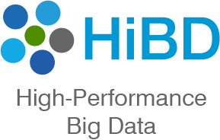
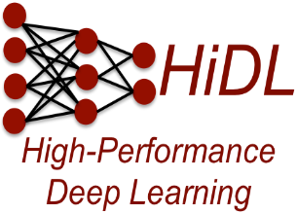

Thank You!
panda@cse.ohio-state.edu
Network Based Computing
Laboratory
Network-Based Computing Laboratory
http://nowlab.cse.ohio-state.edu/
The High-Performance MPI/PGAS Project
http://mvapich.cse.ohio-state.edu/
The High-Performance Big Data Project
http://hibd.cse.ohio-state.edu/
The High-Performance Deep Learning Project
http://hidl.cse.ohio-state.edu/

