Slide 1
From the Edge to HPC – Harnessing the Computing Continuum for Science
Manish Parashar
Director, Scientific Computing & Imaging (SCI) Institute
Chair in Computational Science and Engineering
Presidential Professor, Kahlert School of Computing
PPAM 2024
Ostrava, Czech Republic
September 11, 2024

Slide 2
From the Edge to HPC – Harnessing the Computing Continuum for Science – PPAM 2024
Abstract: Emerging data-driven, AI-enabled scientific workflows integrate distributed data sources with pervasively availably computing resources, spanning HPC to the edge, to understand end-to-end phenomenon, drive experimentation, and facilitate important decision making. Despite the exponential growth of available digital data sources at the edge, and the ubiquity of non-trivial computational power for processing this data, realizing such science workflows remains challenging. This talk will explore a computing continuum spanning resources at the edges, in HPC centers and clouds, and in-between, and providing abstractions that can be harnessed to support science. The talk will also introduce recent research in programming abstractions that can express what data should be processed and when and where it should be processed, and autonomic middleware services that automate the discovery of resources and the orchestration of computations across these resources.

Slide 3

The Computing Continuum
&
Everywhere
Nowhere
Everywhere & Nowhere: Envisioning a Computing Continuum for Science, M Parashar - arXiv preprint arXiv:2406.04480, 2024
Notes:
So, when I try to imagine what HPC, which traditionally has been represented by the term “big-iron” with lots and lots of blinking light and providing extreme performance to specially engineered application, will look like moving forward, this is the image the comes to my mind – everywhere and nowhere – let me explain:
As technology advances, we are already seeing the pervasive integration and availability of non-trivial computing capabilities everywhere, in our cars, in devices that we carry on us, in appliances that we use, etc. Once again, looking around the exhibition floor, we see this. HPC is integrating itself in some form or another, into all aspects of our lives – it is everywhere.
By nowhere, I am referring to how we interact with and use HPC. Traditionally, using HPC has been an involved process – one very carefully developed specialized codes, which are compiled on a special system, and then queued to run on the HPC system – a very deliberate and involved process involving multiple systems that the user had to touch.
This is in contrast with current trends across enterprise software stacks and the abstractions they provide to the user – as-a-services, containers, serverless, notebooks, etc. As the HPC community increasingly embraces these abstractions, we will move to a more transparent way of using HPC that is more seamlessly integrated into our workflows and our lives.
So, HPC will be everywhere and nowhere!
And realizing this vision of HPC will be built on a connected and seamlessly accessible continuum of computational capabilities.
How do we leverage this continuum for science?

Slide 4
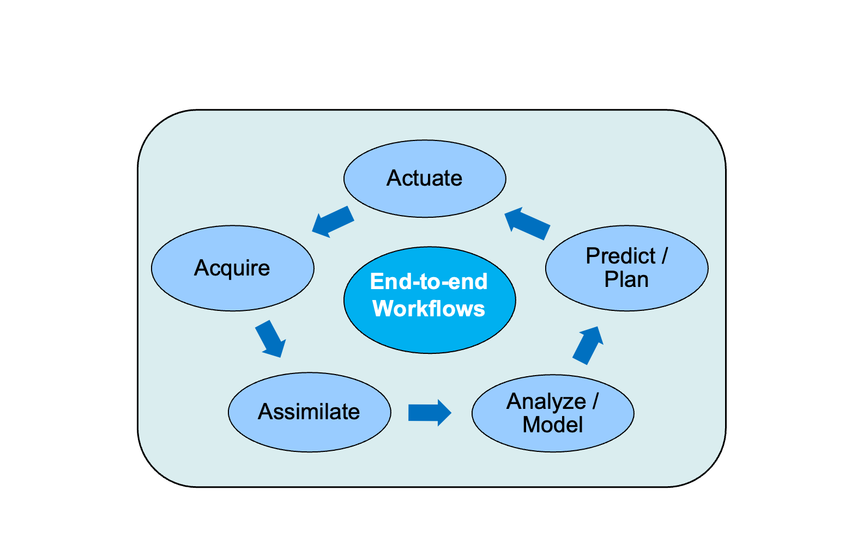
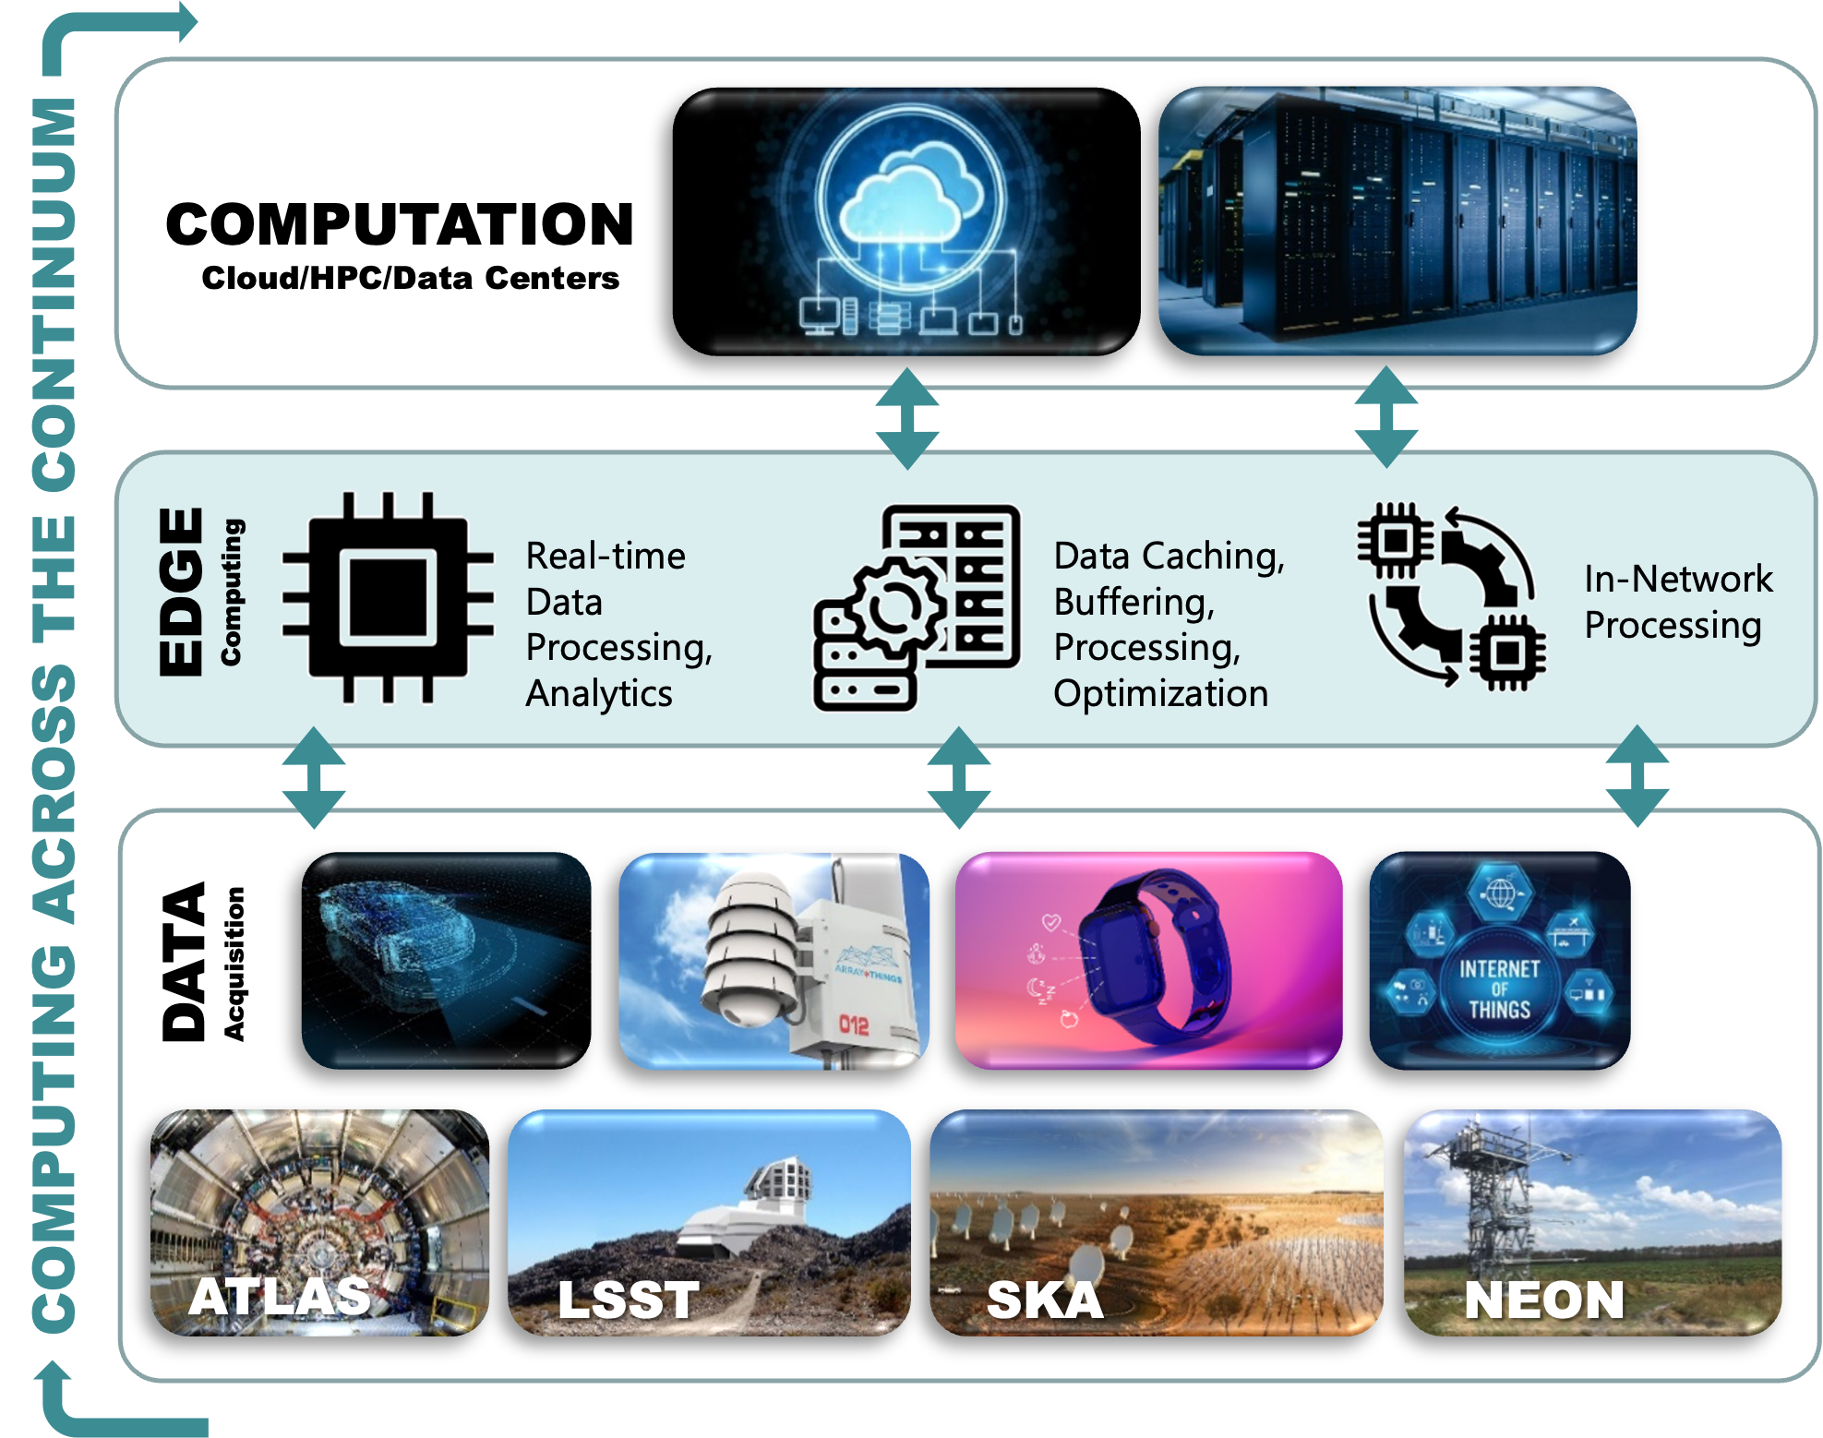
Envisioning a Computing Continuum for Science
Daniel Balouek-Thomert, Ivan Rodero, and Manish Parashar. 2020. Harnessing the Computing Continuum for Urgent Science. SIGMETRICS Perform. Eval. Rev. 48, 2 (September 2020), 41–46. https://doi.org/10.1145/3439602.3439618
Notes:
There exists a natural continuum across the evolving science ecosystem – from large-scale instruments, experimental facilities, observatories, and sensor networks, all streaming data; high-speeds networks (the NSF Fabric project recently announced TeraCore—a ring spanning the continental U.S.—with data transmission speeds of 1.2 Terabits per second (Tbps)), and a range of computing capabilities along the continuum, from edge, to in-network, to large-scale datacenters.
This continuum is also spurring a natural evolution in the types of application workflows that are being developed. These workflows combine sensing and streaming data with simulations and data-driven modeling, and actuations, to understand, analyze, predict, and actuate.
Let me explore a few such workflows.

Slide 5
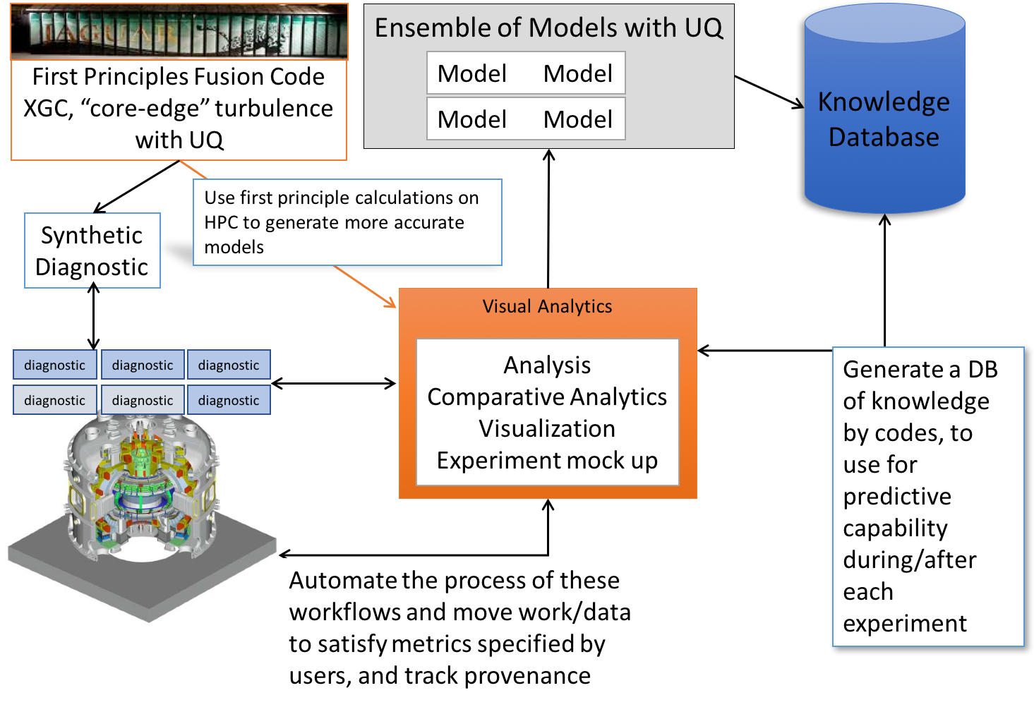
End-to-End Experiment/Instrument Management
End-to-end Workflows
High-fidelity instruments, experiments
Complex coupled simulation workflows composed of coupled simulations and services
Online data analysis, visualization
Tight coupling between experiments/observations, simulations and analytics
Notes:
One class of applications workflows that researchers have been developing for a few years is end-to-end experiment management, where streaming data from an experiment or instrument is analyzed and modeled, and the result of the modeling is used to control, manage, and/or optimize the experiment. We worked on such workflows in the past as part of an instrumented oil-field project – the goal there was to use streaming data from an actual oilfield along with subsurface flow simulations and ML-based optimizers, to manage oil production, reduce environment impacts, etc.
The example shown here is from a fusion workflow and is part of the DOE-funded Whole Device Modeling project led by Amitava Bhattacharjee at PPPL. One specific scenario here is implementing a diagnostics system within the continuum that enables early prediction of anomalies while the tokamak experimental facility operates, which is important as it can damage the instrument.
There are number of such workflows, that leverage the continuum to different extents, and are being effectively deployed, for example, at various of the labs in the US and elsewhere.
Understanding and predicting the characteristics of turbulence at the core-edge plasma boundary in a Tokamak reactor is an important research challenge to the success of ITER and nuclear fusion applications as a whole. However, the behavior of each region is best approximated by a different model, and so coupling these disparate models together is a developing area of research in in-situ workflows.
The goal is to develop a model of turbulence that combines the product of these interdependent sub-models that can be used to predict the future of a running or terminated experiment, typically based on a reduced model. To do this, an ensemble of simulation results for models of various fidelities must be generated, along with uncertainty quantification in order to be able to probabilistically extend the limited diagnoses produced in real-time by experimental reactors. Additionally, a database of simulated and real experimental results can be consulted in order to perform feature matching in order to improve prediction. This involves a complex interconnection of cyber-infrastructure, involving sophisticated feature matching algorithms running in HPC instruments, matching expansive and potentially distributed synthetic experiment data against real-time results from a scientific reactor connected over the WAN. This poses emerging computing, data, and network challenges.
Plasma Disruption Analysis Fusion Workflow
The goal is to implement a plasma visualization diagnostics system that enables early prediction of anomalies while the tokamak operates
Data is a time-series of matrix images obtained via direct 2D/3D visualizations of the tokamak plasma
Analytics include structural analysis and blob detection, filtering & visualization

Slide 6
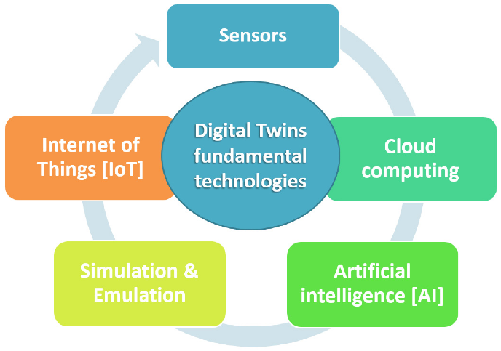
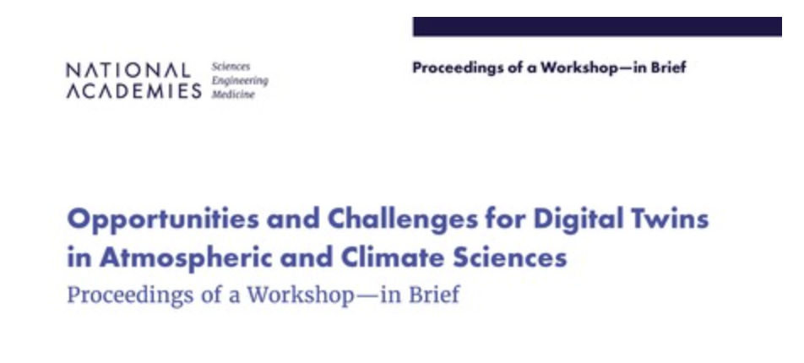
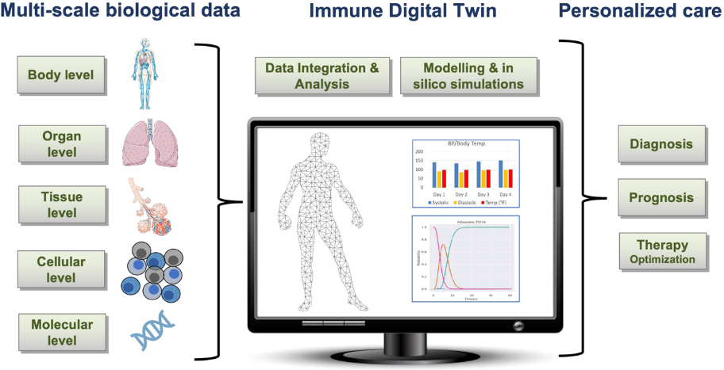
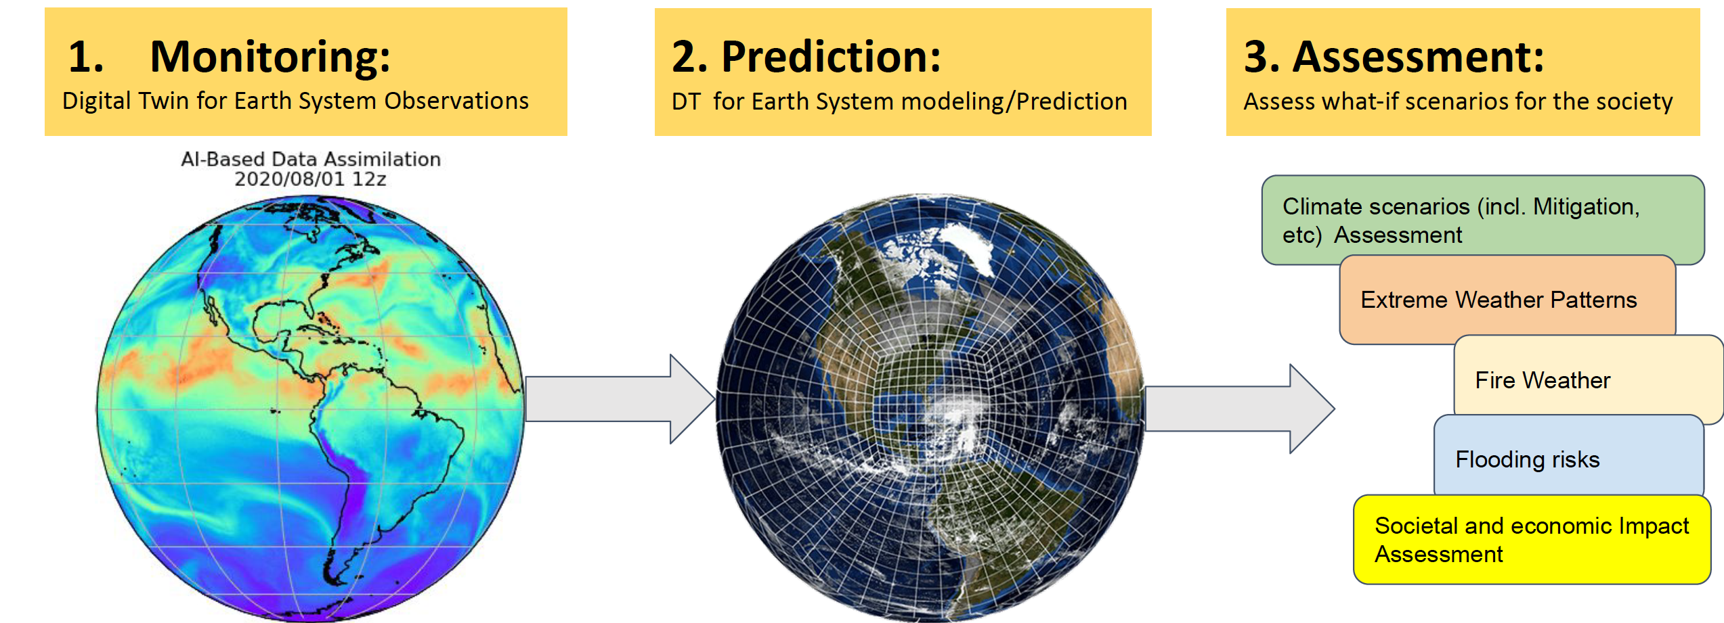
Digital Twins of Complex Systems
A digital representation of an intended or actual real-world physical product, system, or process that serves as the effectively indistinguishable digital counterpart of it for practical purposes, such as simulation, integration, testing, monitoring, and maintenance --Wikipedia
NASEM: Foundational Research Gaps and Future Directions for Digital Twins -- https://www.nationalacademies.org/our-work/foun_dational-research-gaps-and-future-directions-for-digital-twins (Report released:12/2023)
doi.org/10.3390/asi5040065
Digital Twins of the Human Immune System (doi.org/10.1038/s41746-022-00610-z)
Digital Twins for Earth Systems (US NOAA)
Notes:
Another application class, which are in a sense, a natural extension, are digital twins for large-scale complex system. These systems are defined as digital representations of an actual real-world physical, system and can serve as a vehicle for understanding, managing, optimizing, protecting, etc. the physical system.
On the slide, I have shown two examples. The first is from the US National Oceanic and Atmospheric Administration (or NOAA)’s vision for a digital twin for earth systems, and the other is a conceptual view of a digital twin of the human immune system.
There are many examples and similar efforts internationally. In fact, there was a recent Wall Street Journal article about how San Francisco Airport is using a digital twin to manage and optimize its operations.
This is another class of applications that highlight the need for combining real-time data acquisition with large-scale modelling, both data-driven and mathematical, and possible actuation, and the computing continuum will play a large role in making these systems a reality.
I would like to highlight a recent report by the National Academies of Sciences, Engineering, and Medicine on the Foundational Research Gaps and Future Directions for Digital Twins, which is noted on this slide.
Centre for Digital Built Britain completed its five-year mission and closed its doors at the end of September 2022
https://www.cdbb.cam.ac.uk/what-we-did/national-digital-twin-programme
https://doi.org/10.1038/s41746-022-00610-z
Building digital twins of the human immune system

Slide 7
Urgent Computing: Managing uncertainty under constraints
DEFINITION: Computing under strict time and quality constraints to support decision making with the desired confidence within a defined time interval
Identify events
Develop response
Trigger appropriate actions
Urgent applications need to react to unforeseen events and to manage complex cost/benefit tradeoffs to meet constraints
Steer online/on-demand computations based on data/content
Support urgency constraints for timely decision-making
Balance “costs” of computations with value added, availability of resources, etc.
…
Notes:
One class of applications that I have been focusing on recently is urgent computing. As noted on the slide, urgent computing can be defined as computing under strict time and quality constraints to support decision making with the desired confidence, and within a defined time interval.
The goal is here is to leverage the data and computations to support decision making during an emergency. Clearly, the computing continuum is essential to enabling such applications.
Time criticality
Un-predictable – cannot plan – depends on events/data/etc.

Slide 8
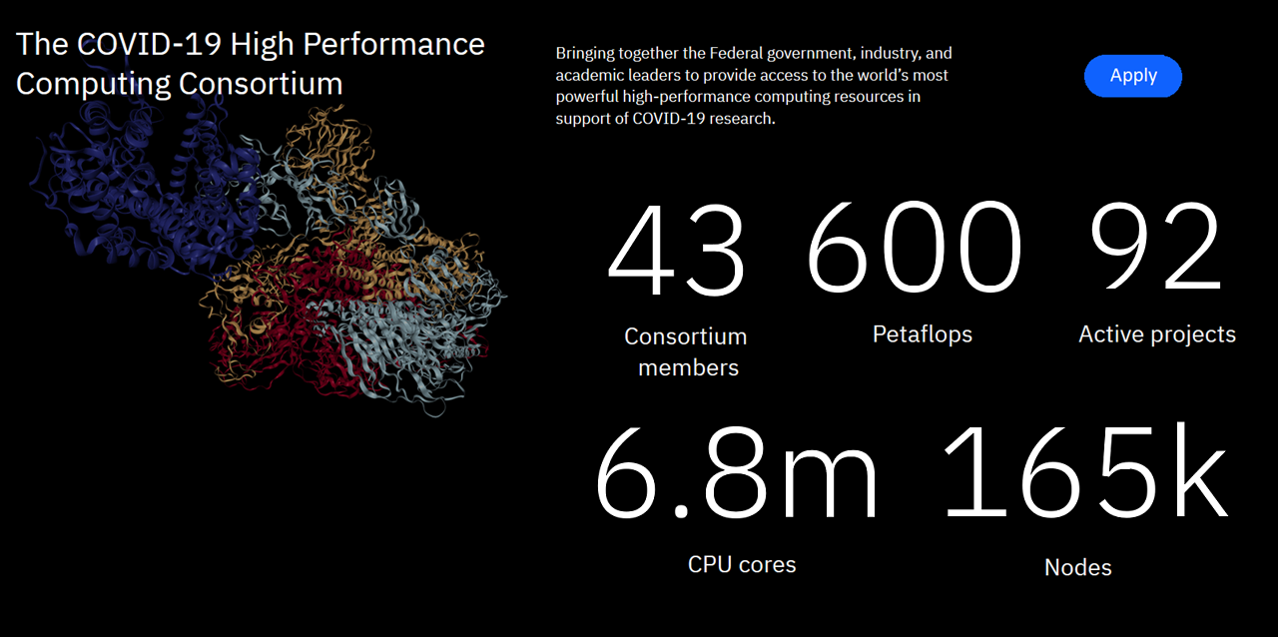
https://covid19-hpc-consortium.org/
Notes:
My interest here was trigged during the COVID-19 pandemic and our experiences with the Covid19 HPC Consortium. For those who may not be aware of it, it was a remarkable international partnership between government, academic and industry, that was stood up in a matter of a week, aiming at providing computing resources for pandemic related research. Started under the leadership of the US Office of Science and Technology Policy along with NSF, DOE and IBM, the consortium brought together over an international group of over 40 resource providers and support over 100 projects, leading important research outcomes spanning drug design, treatments, vaccine research, logistics, etc. I was quite intimately involved in this effort, initially at NSF and then at OSTP.
While the consortium was very effective in highlighting the tremendous potential of computing and data in dealing with emergencies such as the pandemic, extreme weather events, etc. It also highlighted many gaps the prevent us from achieving such an impact in an urgent situation. We, as a community, need to think differently about HPC, technically, operationally, policy wise, etc. I will come back to that as I wrap up my talk.
COVID-19 High Performance Computing (HPC) Consortium
NSF and the US Government quickly drew together a grass-roots ensemble of academic, industry, government and international partners to accelerate COVID-19 computational research.
Pandemic highlights the importance of Open Science principles: shared frameworks, open protocols and interfaces, and reciprocal trust.

Slide 9
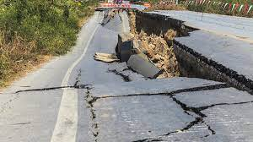
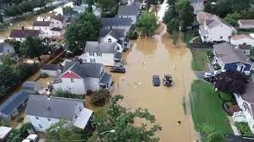
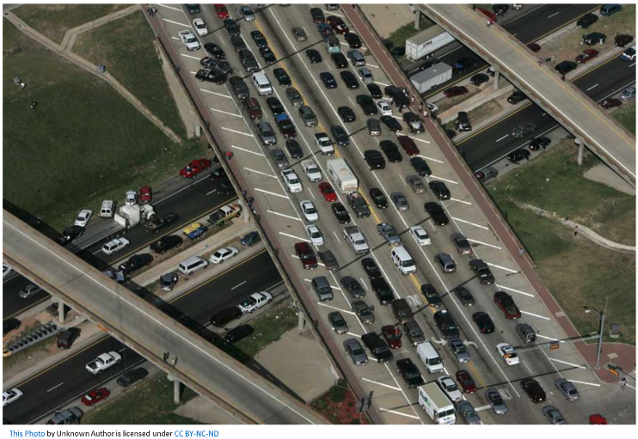
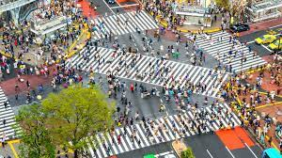

Global Challenges Drive Urgent Science, Computing
Earthquake & Tsunamis
Early warning and rapid response requires highly-accurate near-real-time analysis, simulations, and response.
Extreme Weather and Climate
Hurricane Ida in New Jersey (2021) – Sudden flooding resulted due to months of rain falling in a few hours.
Evacuation traffic management
Traffic jams caused by evacuations from Hurricane Rita in Houston (2005)
Transportation systems Daily influx of 2.5 millions passengers in major train stations (Shibuya, Japan)
Mass events management
2-3 millions attend the Hajj Pilgrimage in Saudi Arabia annually
Urgent events with increasing frequency and increasing impacts.
From 39 natural disasters incidents in 1960
to 396 in 2019 [Institute for Economics and Peace]

Slide 10
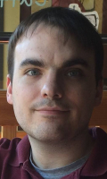
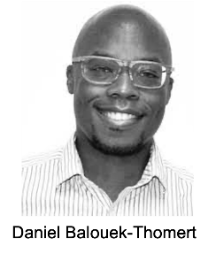


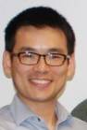

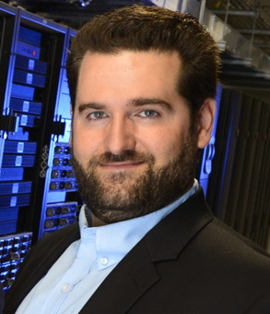

Implementing such urgent workflows can be hard: Technical challenges include
How to drive computation through data?
    R-Pulsar programming system of data-driven workflows (doi: 10.1109/UrgentHPC54802.2021.00007)
How to discover and aggregate resources based on current needs?
    Software defined system driven by constraints (doi:10.1177/1094342017710706)
    Science recommender systems for intelligent data discovery (doi.org/10.1109/MCSE.2022.3179408)
How do you manage execution (and QoS) in a dynamic environment?
    Autonomic runtime management (doi.org/10.1109/MIC.2020.3039551)
    Virtual data collaboratory (doi: 10.1109/MCSE.2019.2908850)
P. Davis
D. Balouek-
Thomert
C. Sicari
M. AbdelBaky
Y. Qin
S. Alhariri
I. Rodero
M. Adair

Slide 11
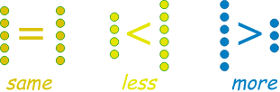
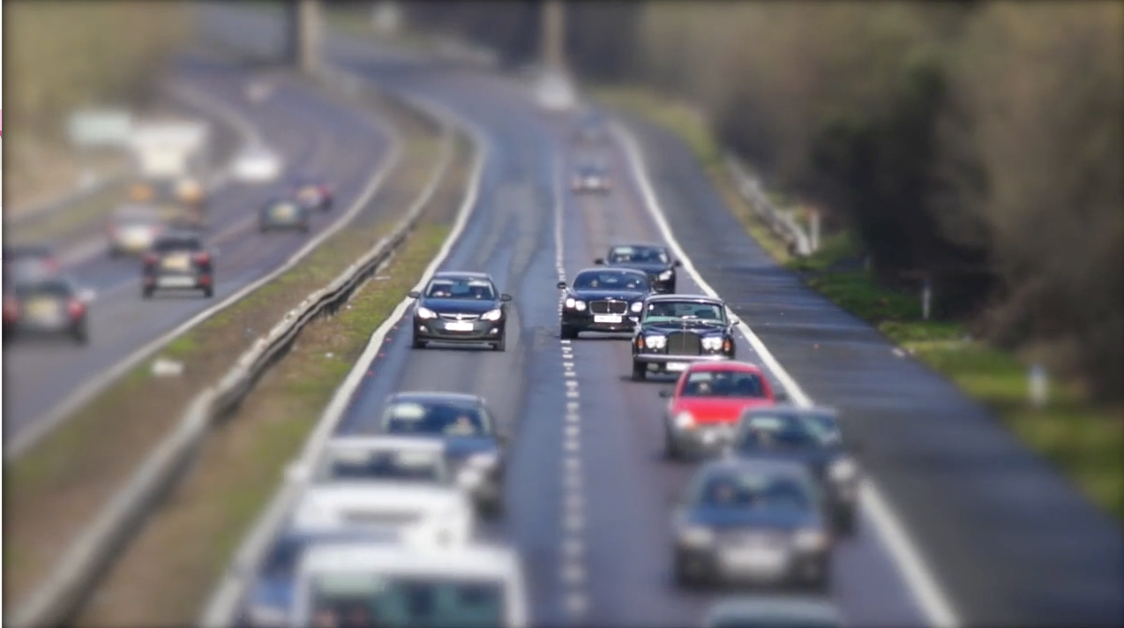
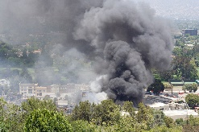
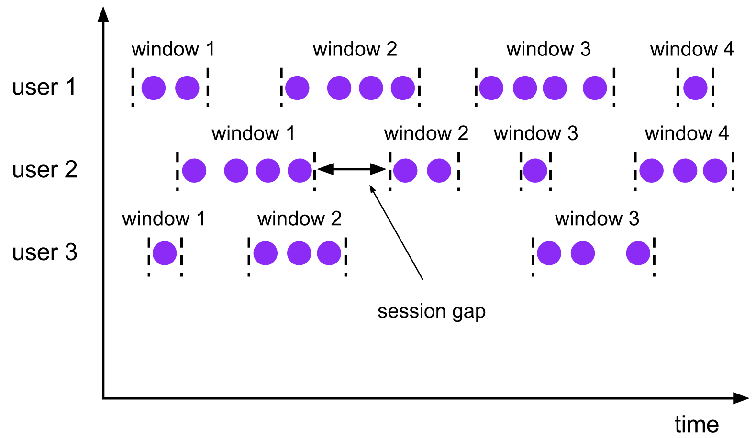
R-Pulsar: Enabling Data-driven Workflows across the Continuum (rpulsar.org)
Express application behavior based on available data and its content
  Programming support for data-driven workflows and application models
  System management for discovery and federation of sensors and computational resources / execution of workflows
Producers
Consumers / Filters
Actions
Traffic
Send a message
Individual values
Smoke
Approximate computations
Change system parameters
or execution mode
Windows
Launching computation (local, cloud, hybrid, etc.)
Any physical/virtual sensors
Data Collection
Filtering / Rule Matching
Action Triggers
D. Balouek-Thomert, I. Rodero and M. Parashar, "Evaluating policy-driven adaptation on the Edge-to-Cloud Continuum," 2021 IEEE/ACM HPC for Urgent Decision Making (UrgentHPC), pp. 11-20, doi: 10.1109/UrgentHPC54802.2021.00007.
Notes:
R-Pulsar is a middleware that allows for building applications across edge and cloud infrastructure
It is a library, a toolbox that offers
Dynamic Profiles as abstractions of any kind of resources in the shape of attribute-based descriptions
Managing runtime events based on other (systemic) models
Driving orchestration with cost/quality/deadline runtime policies (approximation, trends, configuration, etc.)
Interaction with data processing framework and task managers (we know there is Kubernetes cluster close or even apache flink)
ex: If one IoT devices produces “HD (1) videos (2) from the SCI building (3)”, and an application requests “all non-SD videos from campus” – which matches (1)(2)(3)
streaming from one resource to the other is triggered. This dynamic matching is coupled with execution-time rules to determine where computations happens (edge, core, etc…) to make the whole system opportunistic and reactive to runtime changes.
Ex: if it is a crowd, a pack of animals or xxx, do other things
Features
Resources and data profiles based on attributes and contents/description
Workflow execution driven by availability of resources and content of the data
Triggers can be value, trends (statistical), etc.
Autonomic runtime allows the developer to specify tradeoffs and/or selected service configurations
Cost/Quality/Deadline –oriented runtime policies

Slide 12
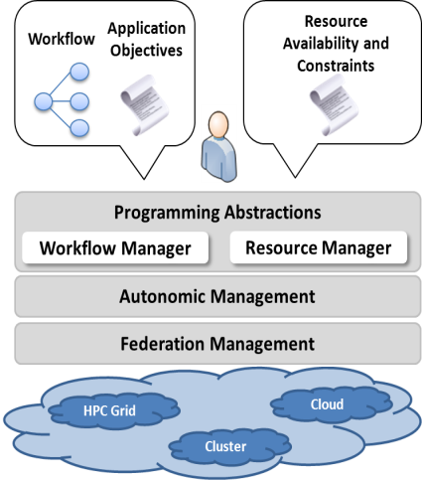
Distributed Software-defined Environments
M. AbdelBaky
Create an agile and programmable computational environment that autonomically evolves over time
  Define composition programmatically using constraints
  Respond to changes in the infrastructure, application requirements
  Allocate computational resources close to digital data sources
  Process data in-situ and/or in-transit
AbdelBaky M, Diaz-Montes J, Parashar M. Software-defined environments for science and engineering. The International Journal of High-Performance Computing Applications. 2018;32(1):104-122. doi:10.1177/1094342017710706
M. Abdelbaky and M. Parashar, "A General Performance and QoS Model for Distributed Software-Defined Environments," in IEEE Transactions on Services Computing, vol. 15, no. 1, pp. 228-240, 1 Jan.-Feb. 2022, doi: 10.1109/TSC.2019.2928300.
Edge
Notes:
How to discover and aggregate resources
Allocate computational power close to digital data sources (geographically distributed sensors, mobile devices, instrumented infrastructure, etc.) and processing such data in-situ and/or in-transit, we will enable efficient data processing in real-time to transform raw data into knowledge and insights that drive critical decisions.
Application workflow can evolve over time and require different types of resources, data sources, etc. At the same time the infrastructure can change. Since we are relying in edge devices, we need to assume their availability can be intermittent due to network issues, battery, etc
Letting users to control this by annotating their applications or establishing policies and rules on how to behave under different situations.

Slide 13
Intelligent Data Discovery and Delivery
Goal: Explore how an understanding of the data and their usage can democratize access to data
Data Delivery
Analyse data and data access
In-network data caching, prefetching, analysis
Data Discovery
Data/data product recommendations
Leverage Knowledge Graphs & Graph Neural Network
Builds on the computing continuum leveraging edge, in-network capabilities
Y. Qin
Yubo Qin, Ivan Rodero, and Manish Parashar. 2022. Toward Democratizing Access to Facilities Data: A Framework for Intelligent Data Discovery and Delivery. Computing in Science and Engg. 24, 3 (May-June 2022), 52–60. https://doi.org/10.1109/MCSE.2022.3179408
Notes:
Introduce the research purposes
Three studies
Analyzing data access patterns lay out the foundation for the data delivery and discovery service
Intelligent data delivery service: leveraging pre-fetching and caching to accelerate user data accessing performance
Intelligent data discovery service: using the user data access affinities and knowledge graph techniques to build up the CKAT recommendation model
Overview of the framework
It builds on top of DMZ network
High-throughput network
Optimized for transferring large-scale scientific data
DTN:
Accessing point to DMZ network
Have computing power and large storage
Framework components
Pattern learning module analyzes the user access pattern, and pass the knowledge to data discovery and delivery service
Data discovery service
Recommendation system
Push recommended data/data products to users
Data delivery service
Pre-fetching data
Cache data
Accelerate data access performance
Collaborative Knowledge Graph (CKG)
Consolidate diverse knowledge graphs
Graph Neural Network (GNN)
Identify connection between indirectly related data items
Attention Network
Guide GNN training process to focus on the important relations
Reduce noise
CKAT accuracy is over 6 - 12% higher than the state-of-the-art models
Note: Recommendations may span multiple facilities
CKAT: Collaborative Knowledge aware Attention network RE model
Connect scattered KGs into a Collaborative KG
First-order connection: data items are directly connected
High-order connectivity: there is a path between two data items across multiple nodes in the graph
The advantage of combining various knowledge sources using the CKG is the ability to identify connections between two indirectly related data items, which requires capturing long-distance paths (i.e., the high-order connectivity) in the graph.
Graph Neural Network (GNN)
Inference and capture the high-order connectivity and thus generate recommendation
Attention network
There are multiple paths between two data items (i.e., multiple knowledge information)
Experiment results shows that, noise knowledge information will reduce the recommendation accuracy
Attention network guides the training process to focus on the important relations

Slide 14
National Data Platform Pilot (NDP):
Services for Equitable Open Access to Data
A federated and extensible data ecosystem to promote collaboration, innovation and equitable use of data using existing and future national cyberinfrastructure capabilities.
Enables data-driven and AI-integrated science workflows that foster discovery, decision-making, policy formation and societal impact related to wildfire, climate, earthquake and food security, among others.
  Build an equitable, broadly accessible data ecosystem
  Foster scientific understanding, decision-making, policy formation and societal impact
  Facilitate data discovery and usage

Slide 15
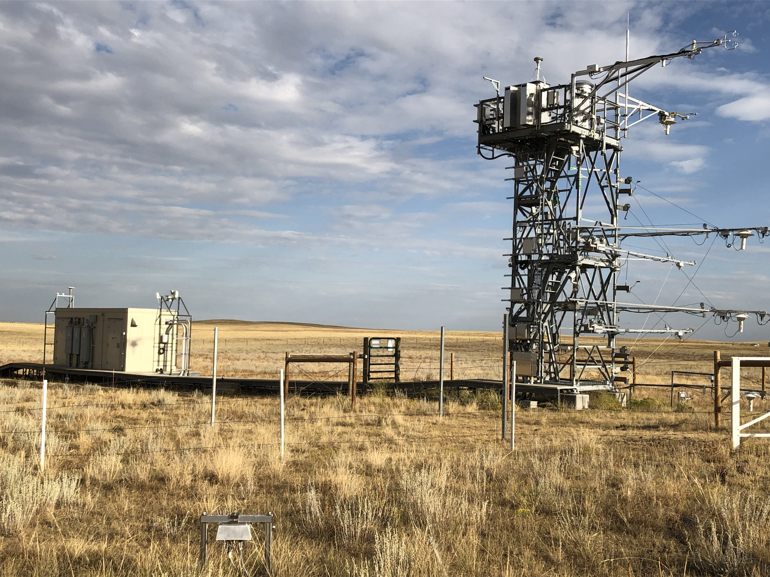

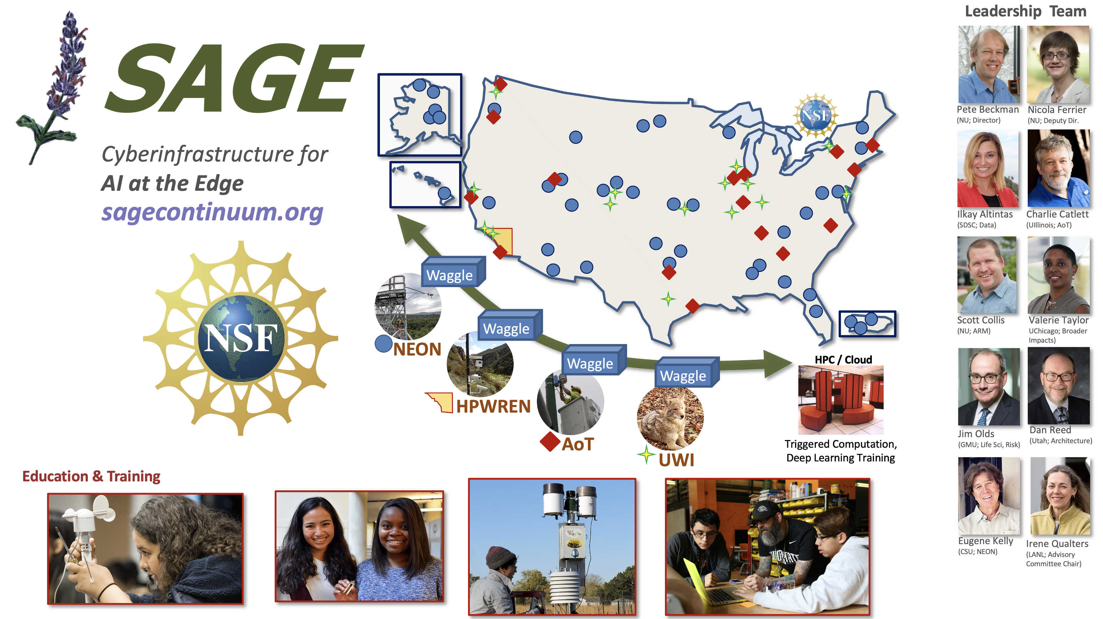
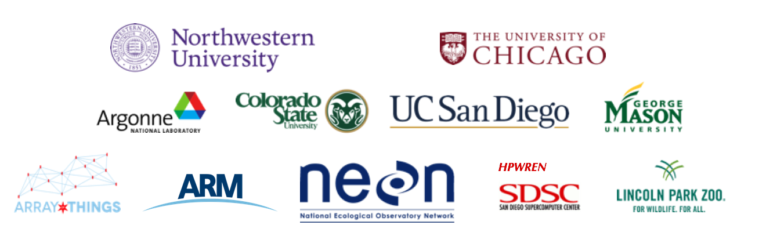
AI@Edge and the Digital Continuum
Sensor/Instrument
HPC/Cloud
Ack: Pete Beckman, ANL

Slide 16
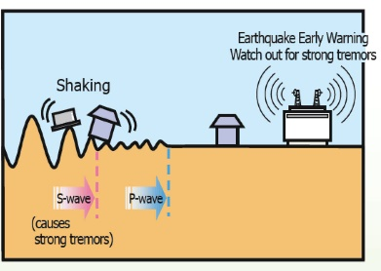
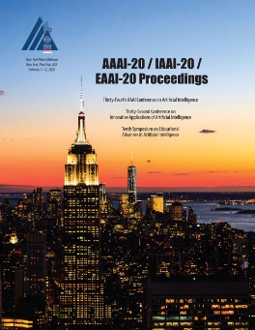
Earthquake Early Warning
Earthquake Early Warning (EEW) requires earthquakes to first be characterized (magnitude, location, speed of displacement, etc.)
  A single data source doesn’t able to cover a whole spectrum of events:
    Seismometers are good for the smaller earthquakes (< 6.5); High-precision GPS are good for larger earthquakes.
  Centralized data processing cannot support real-time, high volume data processing
Goal: Combine multiple data sources to cover the whole spectrum of events; leverage the CI continuum for preserving latency and resiliency
Credit: Japan Meteorological Agency
Fauvel, K, et al. "A distributed multi-sensor machine learning approach to earthquake early warning,” Proceedings of the AAAI 2020, Outstanding Paper Award in Artificial Intelligence for Social Impact.
Notes:
Here is one more example of an urgent computing project -- Early Earthquake Warning. This slide shows some recently published results that uses machine learning to analyze streaming 3-D time-series data along the continuum, at the edge and in-transit within the network. The goal here is to deliver alerts before the ground motion reaches sensitive areas.
Technically, and noting that I am not a seismologist, ground motion is caused by 2 types of waves -- Primary waves (or P-waves) and Secondary waves (or S-waves). P-waves move longitudinally along the Earth’s crust and are around 1.7x faster than S-waves, which move in the transverse direction along Earth’s interior – it is the S-waves that are responsible for severe damage. The goal is to detect P-waves as quickly as possible, and it is important to do this as the data streams in. It is also important to combine data from seismometers and GPS sensors to detect a range of earthquakes. Seismometers can effectively detect medium (5 ≤ magnitude < 6, Richter scale) earthquakes but are not as effective for large earthquakes (6 ≤ magnitude, Richter scale), where GPS sensors are more effective.
As the figures shows, these data streams are integrated and analyzed in-transit and combined with results with modeling results coming from the core, allowing for timely alerts.
This work was recognized as the Outstanding Paper Award in Artificial Intelligence for Social Impact at the AAAI 2020 conference.
Managing data collection at edge sensors
Seismometers and GPS sensors continuously produce 3D time series
Data processing using edge and in-transit resources
Classification step performed in-transit (DTNs) using a window processing scheme
Aggregating and processing results at the core
Filters data streams by region and predicts the magnitude of seismic events
An EEW system needs to be able to detect both medium (5 ≤ magnitude < 6, Richter scale) and large earthquakes (6 ≤ magnitude, Richter scale).

Slide 17
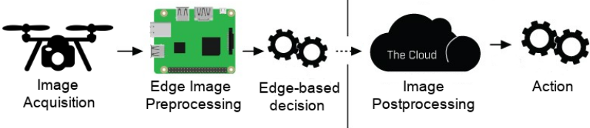
Hurricane Sandy -- Disaster Response
Data-driven disaster response workflow decision stages.
Goal: Quickly and efficiently determine whether the civil infrastructure (buildings, bridges) conditions are safe or not for evacuees to return
Edge Approximation: Canny-edge detection algorithm
Multi-stage algorithm to detect a wide range of edges in images
Ease to apply approximation techniques (substitution, discarding) at function and input parameters level
E. Renart, D .Balouek-Thomert, X.Hu, J. Gong and M. Parashar. Online Decision-Making Using Edge Resources for Content-Driven Stream Processing, eScience’17, 2017
Notes:
E. Renart, D .Balouek-Thomert, X.Hu, J. Gong and M. Parashar. Online Decision-Making Using Edge Resources for Content-Driven Stream Processing, eScience’17, October 2017

Slide 18
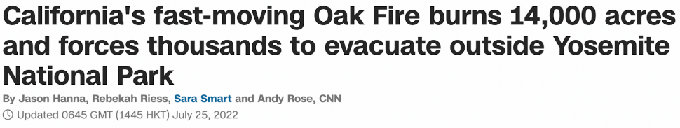
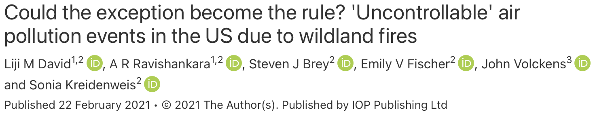
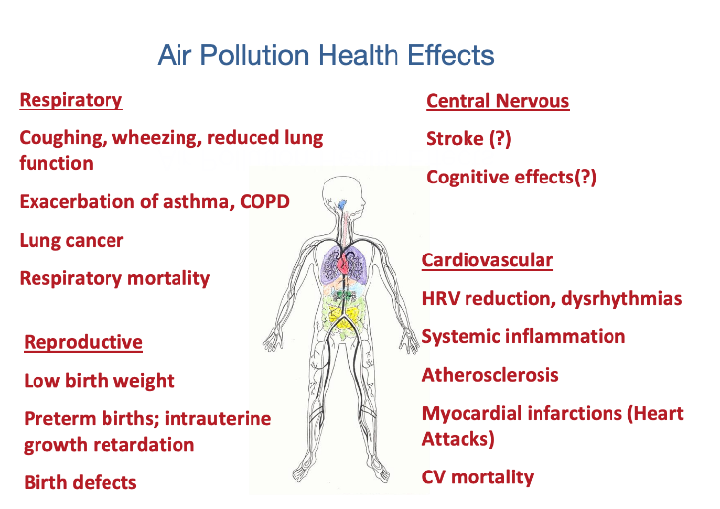
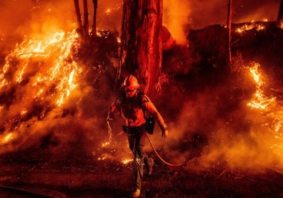
A Motivating Usecase: Wildfire in California leads to Air Pollution in Utah
Detection Emission Transport
Mitigating the negative impacts of wildfires on air quality requires combining knowledge from multiple data sources and integrating it on-demand with distributed computational models.
Balouek-Thomert, D., Caron, E., Lefèvre, L. & Parashar, M., Towards a methodology for building dynamic urgent applications on continuum computing platforms, Combined International Workshop on Interactive Urgent Supercomputing (CIW-IUS), 11/2022.
Notes:
The specific problem we are looking at is the impact of wildfires in CA on air quality in the Salt Lake Valley.
The impact of wildfires on air quality is a broader issue – we may remember how earlier this year a large part of the US Northeast was brought to a standstill due to the smoke from wildfires up north. However, there are particularly significant implications to the Salt Lake Valley due to periodic temperature inversions, which trap cold air underneath a layer of warm air – this act like a “lid” on the Salt Lake Valley—causing particulate pollution to double every day.
And recent study in the Lancet noted that air pollution is the 4th leading health risk factor globally and has wide range of health implications including on mental health, which is also a key regional issue.
Understanding and predicting these impacts requires combining real-time data feeds about the fires, smoke, wind/weather conditions, and integrating atmospheric models, fire models, air quality models, etc. And any action must include an understanding of the layout of the region, population distributions and demographics, road, and traffic conditions, etc.
While this effort is just getting started, let me share some of the underlying research issues we have started addressing.
We also show that wildland fires and windblown dust drive many exceptional events in several EPA regions. We note the importance of growth in the number of exceptional event days due to wildfire smoke in the future due to climate change
- We have everything to do that, every sensors
Improve Fire Detections
Fire detection in current models comes from satellites
Missing data due to time of day, small fires, or cloud cover
Camera network can increase and improve fire detection
Edge-cloud-HPC computing can…..
Improve human health by reducing smoke exposure
Limit time outdoors
Wear mask if working outside
Do not exercise during smoke events

Slide 19
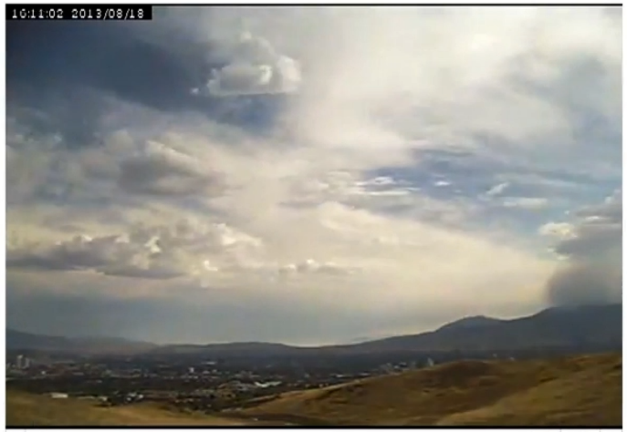
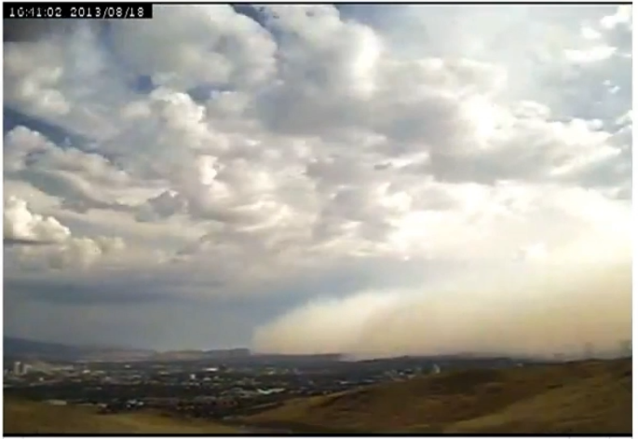
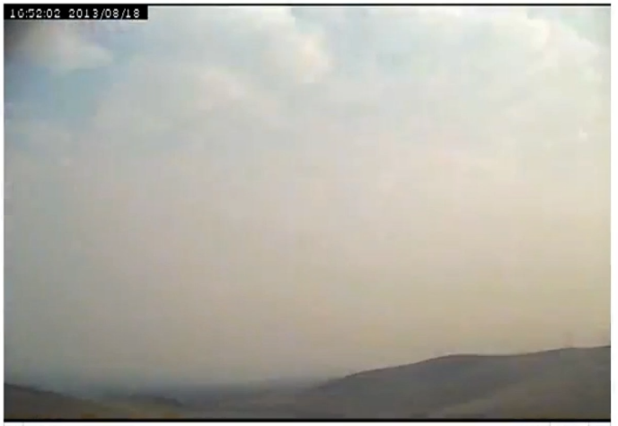
A Motivating Usecase: Impacts of Wildfire Smoke on Air Quality
16:11 16:41 16:52
2013 Rim Fire Smoke (California) to Reno (Nevada) - 190 km (118 miles)
Ack. H. Holmes, U. of Utah
Notes:
What is driving my current thinking in this space is a more local issue – the impact of wildfires on air quality.
The figure on this slide indicates why this is an urgent problem. As you can see in this example, the impacts can happen very quickly, and these impacts are not uniform, typically impacting under-resourced and under-developed neighborhoods the hardest.

Slide 20

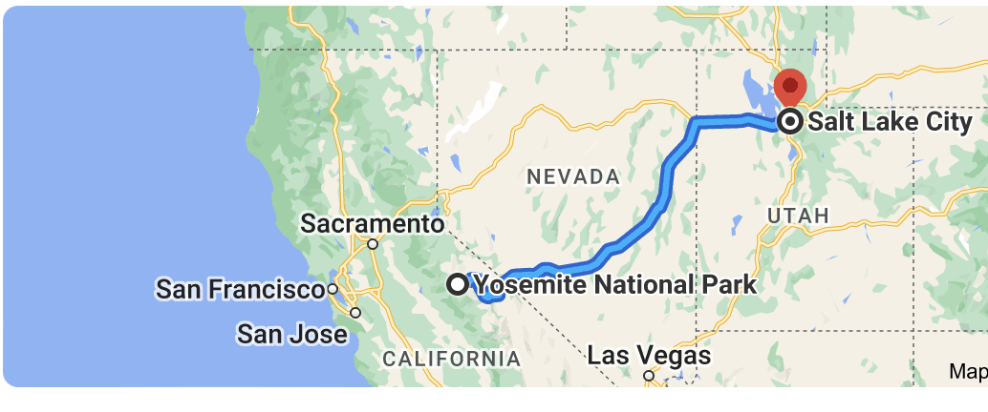




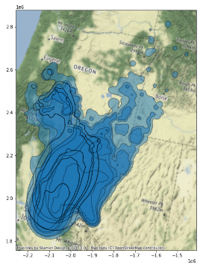
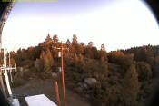
A Motivating Use case: Wildfire in California leads to Air Pollution in Utah
Edge (Field cameras)
Cloud (SDSC)
HPC (Utah)
1. Smoke detection at the edge of the network using Camera Imagery
2. Wildfire simulations to determine the severity and direction of fires
3. Pollution Concentration maps to support decision-making
Balouek-Thomert, D., Caron, E., Lefèvre, L. & Parashar, M., Towards a methodology for building dynamic urgent applications on continuum computing platforms, Combined International Workshop on Interactive Urgent Supercomputing (CIW-IUS), 11/2022.
Notes:
We also show that wildland fires and windblown dust drive many exceptional events in several EPA regions. We note the importance of growth in the number of exceptional event days due to wildfire smoke in the future due to climate change
- We have everything to do that, every sensors

Slide 21
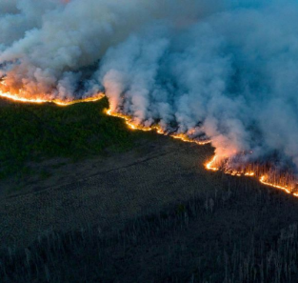
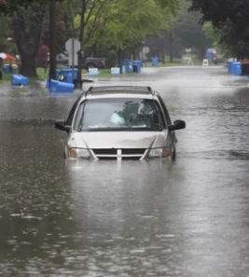
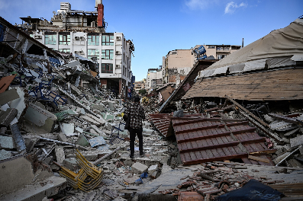
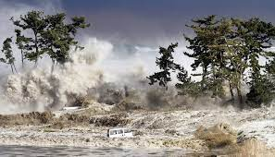
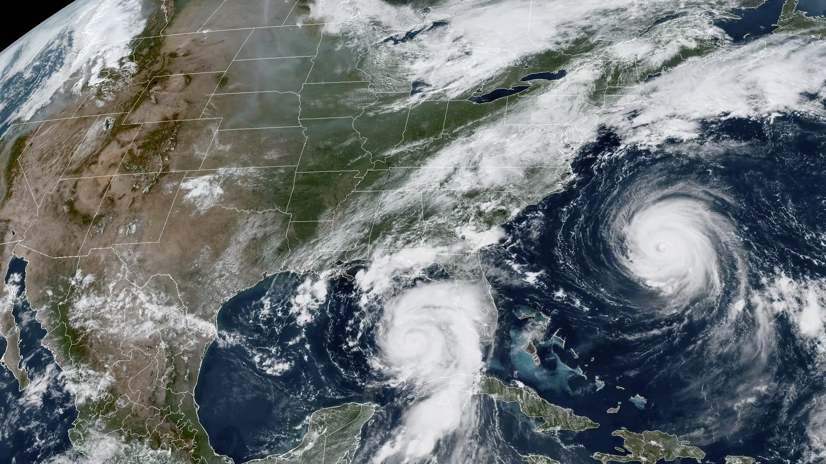

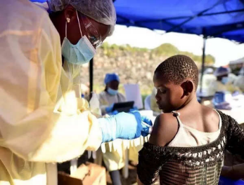
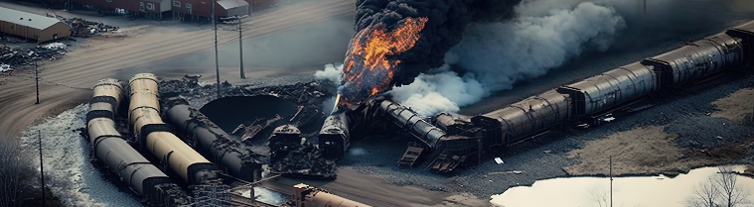
Global Challenges and Urgent Science: A call to action
Earthquakes & Tsunamis
Extreme Weather
Detection / Early Warning
Sensors / Instruments
Response
Evacuations
Lessons
What went right?
Future Action
Infrastructure
Localized Mitigation
Resource Allocation
Accessible Data, Compute
Simulations / AI Models
Coordination
Where can we improve?
What went wrong?
Informed Policy
Targeted Future Investments
Cyber-Attacks
Pandemics
Industrial Disasters
Notes:
Let me end with a call to action. We are witnessing urgent events with increasing frequency and increasing impacts. And we, as community, have an opportunity to collectively leverage our expertise to make a difference.
One recent example is Hurricane Ottis.
When hurricane Ottis, the first Category 5 storm ever to make landfall on the Pacific Coast of North or South America, recently impacted Acapulco, Mexico, no formal hurricane warning had been issued.
In fact, 16 hours before landfall, the National Hurricane Center still forecast only a Category 1 hurricane. Within hours, it grew into a record-breaking, city-splintering Category 5 monster with winds of 165 miles per hour.
Dozens died. The damage was almost certain to make the storm the most expensive one in Mexican history. In a radio interview, NYT’s Judson Jones discussed how real-time sensor data along with the ability to integrate other parameters into the model could have been more effective in predicting this hurricane.
Computing continuum and urgent computing can have a tremendous impact, in how we predict, detect, manage our response. And how can we learn and adapt and evolve to do better.

Slide 22
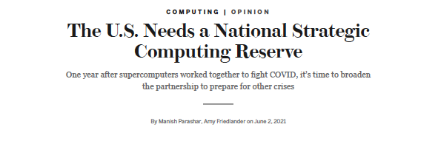
National Strategic Computing Reserve (NSCR)
Advanced computing cyberinfrastructure can be a strategic National asset in emergency response, if mobilized quickly.
Goals for an NSCR:
  Ensure availability of a ready “reserve” of resources (computing, data, software, services) and expertise that can be leveraged nimbly in times of urgent need.
  Establish policies, processes, and agreements to enable agile, effective, and impactful resource mobilization.
  Build on continued longer-term strategic investments in resources (computing, data, software/services), expertise.
  Coordinate across agencies, stakeholder communities, and other national reserves.
Full report available at:
https://www.whitehouse.gov/wp-content/uploads/2021/10/National-Strategic-Computing-Reserve-Blueprint-Oct2021.pdf
Notes:
I mentioned that I would return to the follow up to experiences and lessons learnt from the Covid 19 HPC Consortium.
One effort that I led when I was at OSTP and NSF, and worked with colleagues across the government, is the National Strategic Computing Reserve (NSCR). NSCR envisions an advanced computing cyberinfrastructure as a strategic National asset that can be mobilized during an emergency response. Its goal is to ensure availability of a ready “reserve” of resources (computing, data, software, services) and expertise that can be leveraged nimbly in times of urgent need, and aims to establish policies, processes, and agreements to enable effective resource mobilization, and coordinate across agencies, stakeholder communities, and other national reserves.
The NSCR vision is analogous to the roles of the Civil Reserve Air Fleet and the United States Merchant Marine (among others) that can be called upon to assist the military in a crisis.
The NSRC Blueprint shown on this slide outlines the NSRC vision as well as its many dimensions required to make computing and data resources, services, and expertise available to respond to crises. This effort is currently being led by the NITRD National Coordination Office.

Slide 23
Many Research Challenges
How to drive computation through data? How do you manage complexity through high levels of abstraction?
How to ensure security, privacy and trust across all aspects of the infrastructure?
How to accommodate uncertainties in data and computation? How can swarm intelligence be utilized to enhance system efficiency?
How to build applications and manage workflows so that they adapt to increase value?
How to continuously optimize execution in a dynamic data-driven environment? How can AI-based self-organization and adaptive management be leveraged?
How to develop robust system infrastructure and services to support dynamic execution? How to build, operate, and manage these systems?
How to incorporate appropriate utility models, market models, social/trust models, etc.?
How to formulate the necessary policy and governance structures to manage operation?
What are the implications of widespread adoption of AI across the computing continuum? How can explainability and interpretability be integrated into distributed, decentralized autonomous systems?
…
Notes:
This is an academic conference and with many researchers and students in the audience and I would like to note that many underlying research challenges in making all this a reality – l list a few here.
For example,

Slide 24


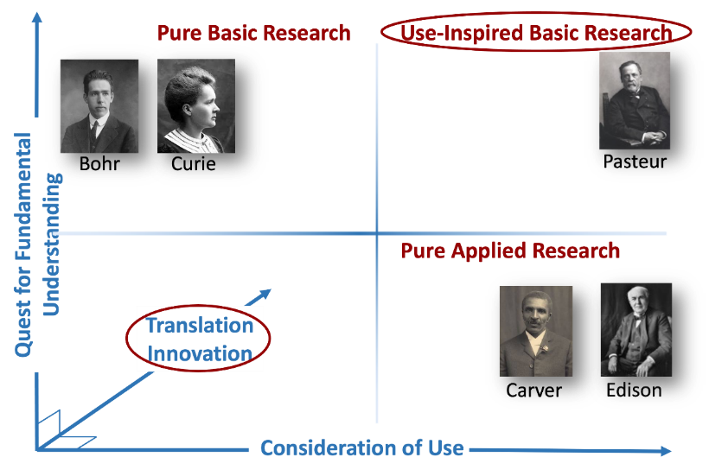
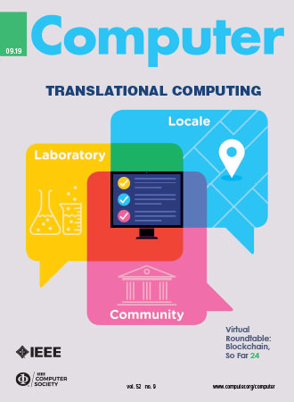
Translational Research and Innovation
Translational Research refers to research that bridges foundational, use-inspired, and applied research with the delivery and deployment of its outcomes to the target community and supports essential bi-direction interplays where delivery and deployment process informs and advances research
Taking research from the Laboratory to the Locale to the Community
Translational Research
Foundational Research
Applied Research
Computational Technology Innovation
Challenge
Problem
Methods/
Formulations
Algorithms/
Processes
Software/
Systems
Scientific
Insights
Stokes, Donald E. (1997). Pasteur's Quadrant – Basic Science and Technological Innovation. Brookings Institution Press. p. 196. ISBN 9780815781776.
https://archive.org/details/pasteursquadrant00stok/page/n9/mode/2up
translational-cs.org
Notes:
Complementing fundamental research advances, I would like to also to emphasize the critical importance of translational research in achieving this vision.
Translational Computer Science Research is something that David Abramson and I have been championing for a few years. It is the bi-directional integration and interplay between foundational research with the delivery and deployment of its outcomes. This something quite natural to this community and something that this community has always done. Our goal is making sure it is recognized, supported, and rewarded.
Translational CS Research is something that I am quite passionate about and would welcome a longer offline conversation on the topics. I would however like to plug that we have a department in the IEEE Computing in Science and Engineering magazine focus on case studies and we welcome submissions.

Slide 25

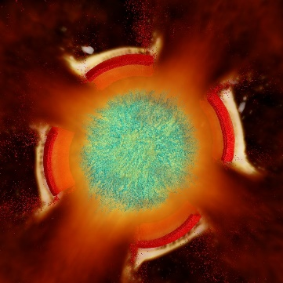
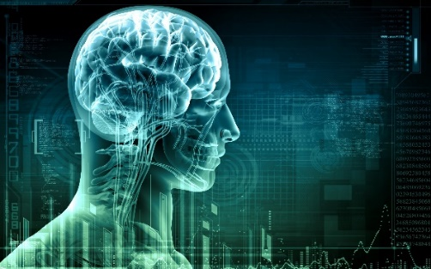
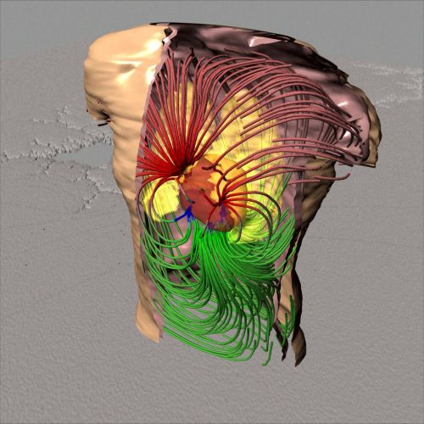





Scientific Computing & Imaging (SCI) Institute
Transformation of science and society through translational research and innovation
One-U Responsible AI Initiative
University of Utah’s $100M AI Research Initiative Led by SCI
Inter/transdisciplinary, collaborative, convergent
Core strengths in: Visualization & imaging; Scalable analytics; Advanced computing & data
Software/system development and distribution integral to our research processes
Advance translational AI to achieve societal good while protecting privacy, civil rights and civil liberties, and promoting fairness, accountability, transparency, and equity.
Initial research focus on regionally important applications
  Environment
  Healthcare, societal wellness, and public services
  Future of teaching and learning
Notes:
I will use the last few minutes that I have, to introduce you to the Scientific Computing and Imaging Institute at the University of Utah that I direct. The SCI Institute, as we refer to it, has built its reputation as the leader in high performance data visualization and imaging, through its translational research impact and transdisciplinary collaborations.
Building on this experience and impact and building on the University of Utah’s long history in translation, from being a node in the original ARPANet deployment, to spurring the field of visualization and graphics, SCI will be leading a large initiative on using translational AI research to address societally important challenges to our regions, such as mental health, air quality, environmental sustainability. If you are interested in learning more about this initiative, I will be happy to talk to you offline.

Slide 26


One-U Responsible AI Initiative
University of Utah’s $100M AI Research Initiative Led by SCI
Responsibly advance translational AI to achieve societal good
  Catalyze transdisciplinary excellence in responsible AI to bring together the use-inspired/applied AI research and technological expertise, advanced cyberinfrastructure, and translational workforce
Initial research focus on regionally important applications
  1. Environment
  2. Healthcare, societal wellness, and public services
  3. Future of teaching and learning

Slide 27

Thank you!
Manish Parashar
Email: manish.parashar@utah.edu
WWW: manishparashar.org / sci.utah.edu / rai.utah.edu
  One-U RAI Opportunities
  Distinguished Visitors Program: Supports visits from a few days to a full year for faculty, up to two years for postdoctoral fellows.
  Postdoctoral Fellows Program: Supports postdocs in areas related to responsible AI for up to 2 years.

