Slide 1
Design, Code Generation, and Synthesis For the Next Generation Science Codes
Anshu Dubey
Argonne National Laboratory
Colloborators: Klaus Weide, Jared O'Neal , Johann Rudi, Youngjun Lee, Tom Klosterman, Wesley Kwiecinski, Mohamed Wahib
PPAM 2024

Slide 2
Acknowledgements
This work was supported by the U.S. Department of Energy Office of Science, Office of Advanced Scientific Computing Research (ASCR), and by the Exascale Computing Project (17-SC-20-SC), a collaborative effort of the U.S. Department of Energy Office of Science and the National Nuclear Security Administration.
This work was performed in part at the Argonne National Laboratory, which is managed by UChicago Argonne, LLC for the U.S. Department of Energy under Contract No. DE-AC02-06CH11357

Slide 3
Motivation
I hear this question often from domain scientists
Should we even bother about porting when platforms are changing so much?
Answer
Can we afford not to – given that calculations do need to use leading edge platforms
Shouldn’t we be thinking about how to design our code so that we are nimble in tuning performance
That gives rise to the question – can we
Here is one attempt to argue that we can
Fairly confident that this will work for many classes of PDE based applications
For others --- similar methodology in approaching design challenges might work

Slide 4
Research Software Challenges
More Scientific Understanding
Many parts of the model and software system can be under research
Requirements change throughout the lifecycle as knowledge grows
Verification complicated by floating point representation
Real world is messy
More Hardware
Resources
Higher Fidelity
Model
More Diverse
Solvers

Slide 5
It Gets Worse
More Scientific Understanding
More Hardware
Resources
Higher Fidelity
Model
AI in the mix
More Diverse
Solvers

Slide 6
Design Considerations And Their Implications
Considerations
Multidisciplinary
Many facets of knowledge
To know everything is not feasible
Two types of code components
Infrastructure (mesh/IO/runtime …)
Science models (numerical methods)
Codes grow
New ideas => new features
Code reuse by others
Design Implications
Separation of Concerns
Shield developers from unnecessary complexities
Work with different lifecycles
Long-lasting vs quick changing
Logically vs mathematically complex
Extensibility built in
Ease of adding new capabilities
Customizing existing capabilities

Slide 7
State of Practice – Abstractions and Runtimes
Still very focused on GPU
Majority of ECP applications park their data on the GPU and just work there
What are the abstractions ---
Data structure libraries (Kokkos) and parallelization of loops
Parallel for / do concurrent etc
Limitations
No way to handle algorithmic variants in a unified way
Getting hard-baked into C++
by no means the best designed language for scientific computations
No way to transfer domain knowledge based possible optimizations to the tools
None of the prevalent languages allow a good way to define data locality
Boutique HPC languages like chapel do – but chicken and egg problem with adoption
So shall we throw up our hands and say computational science is doomed, let’s just find some other way of advancing science?
Or is there a way?

Slide 8
State of Practice – Abstractions and Runtimes
Still very focused on GPU
Majority of ECP applications park their data on the GPU and just work there
What are the abstractions ---
Data structure libraries (Kokkos) and parallelization of loops
Parallel for / do concurrent etc
Limitations
No way to handle algorithmic variants in a unified way
Getting hard-baked into C++ -- by no means the best designed language for scientific computations
No way to transfer domain knowledge based possible optimizations to the tools
None of the prevalent languages allow a good way to define data locality
Boutique HPC languages like chapel do – but chicken and egg problem with adoption
We have been developing one for Flash-X using abstractions, code synthesis and code generation
So shall we throw up our hands and say computational science is doomed, let’s just find some other way of advancing science?
Or is there a way?

Slide 9
Mechanisms Needed by the Code
Mechanisms to unify expression of computation
Minimize maintained variants of source suitable for all computational devices
Reconcile differences in data structures

Slide 10
Mechanisms Needed by the Code
Mechanisms to unify expression of computation
Minimize maintained variants of source suitable for all computational devices
Reconcile differences in data structures
Mechanisms to map work to computational targets
Figuring out the map
Expression of dependencies
Cost models
Expressing the map

Slide 11
Mechanisms Needed by the Code
Mechanisms to unify expression of computation
Minimize maintained variants of source suitable for all computational devices
Reconcile differences in data structures
Mechanisms to move work and data to computational targets
Moving between devices
Launching work at the destination
Hiding latency of movement
Moving data off node
Mechanisms to map work to computational targets
Figuring out the map
Expression of dependencies
Cost models
Expressing the map

Slide 12
Mechanisms Needed by the Code
Mechanisms to unify expression of computation
Minimize maintained variants of source suitable for all computational devices
Reconcile differences in data structures
Mechanisms to move work and data to computational targets
Moving between devices
Launching work at the destination
Hiding latency of movement
Moving data off node
So, what do we need?
Composable components
Code synthesis tools
Code generation tools
Data movement orchestrator
Mechanisms to map work to computational targets
Figuring out the map
Expression of dependencies
Cost models
Expressing the map

Slide 13
Composability
Encoded metadata
Components I need
Components I don’t work with
State variables I need
AMR specific needs
Runtime parameters I want …
Self describing
Building blocks of code
Hierarchy of granularity
Units, subunits, components
Multiple alternative implementations
Null implementations of API
High degree of composability
High degree of customizability
Config files
setup
Alternative
Implementations
Sub components

Slide 14
Philosophy of Design
Let the code developer decide what should be done for optimization on a platform
Make it easy to have that happen without coding to metal
Have a set of tools, each with limited functionality
Tools remain simple and easy to maintain by non-experts
Combination of tools provides a powerful solution
Tools can permute and combine building blocks, do some code translation and compose a full application
As far as possible tools also have building blocks

Slide 15
Orthogonal Axes of Challenges and Optimization
Separate out arithmetic and control flow
Make arithmetic invariant
Turn separate pieces into building blocks using macros
[hy_fluxesSec1]
args= XL, XR,limits
definition =
@M loop_begin(limits)
if (flux(1@M indices) > 0.) then
call doSection1(XL(:@M indices), ……)
else
call doSection1(XR(:@M indices), …….)
end if
@M loop_end
Alternative Definitions
For all spatial points at once For one spatial point at a time
[indices] [indices]
definition = definition =
,i,j,k
[loop_begin] [loop_begin]
args = limits args = limits
definition= definition=
do k = limits(LOW,KAXIS),limits(LOW,KAXIS)
do j = limits(LOW,JAXIS),limits(LOW,JAXIS)
do I = limits(LOW,IAXIS),limits(LOW,IAXIS)
[loop_end] [loop_end]
definition = definition =
enddo
enddo
enddo
Permit alternative definitions for all the macros as needed
Build in arbitration mechanism for picking the right definition
This code section can be invoked as
@M hy_fluxesSec1(uLeft,uRight,blkLimits)

Slide 16
Alternatively
[hy_fluxesSec1]
args= XL, XR,limits
definition =
@M loop_begin(limits)
if (flux(1@M indices) > 0.) then
@M doSection1(XL)
else
@M doSection1(XR)
end if
@M loop_end
Alternative Definitions
For all spatial points at once For one spatial point at a time
[indices] [indices]
definition = definition =
,i,j,k
[loop_begin] [loop_begin]
args = limits args = limits
definition= definition=
do k = limits(LOW,KAXIS),limits(LOW,KAXIS)
do j = limits(LOW,JAXIS),limits(LOW,JAXIS)
do I = limits(LOW,IAXIS),limits(LOW,IAXIS)
[loop_end] [loop_end]
definition = definition =
enddo
enddo
enddo
[doSection1]
args=uDir
definition =
… some computation
uDir(:@M indices) = res
With macros it is possible to use any arbitrary code section as a building block

Slide 17
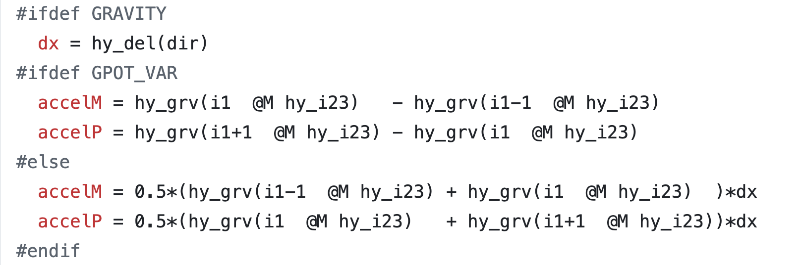
Orthogonal Axes of Challenges and Optimization
We have moved binding of data structure to configuration phase from the development phase – not compilation phase
Another utility reorders indices
Between them, without changing code one can explore performance options

Slide 18
Orthogonal Axes of Challenges and Optimization
We have moved binding of data structure to configuration phase from the development phase – not compilation phase
Another utility reorders indices
Between them, without changing code one can explore performance options
Here we combine composition and synthesis with building blocks

Slide 19
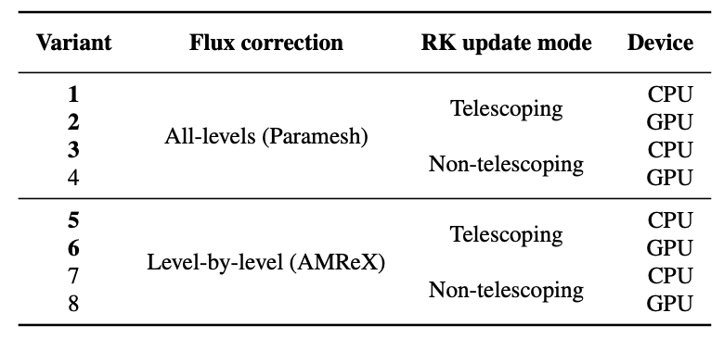
Orthogonal Axes of Challenges and Optimization
Have a method for expressing algorithmic variants
Without delving into the details of the arithmetic
Example -- Flash-X supports two block-structured AMR grid backends
Paramesh: Octree-based, AMReX: Level-based
Each has different preferences for flux correction at fine-coarse boundaries
For higher order RK integration Communication avoidance – telescoping mode

Slide 20
Orthogonal Axes of Challenges and Optimization
Have a way of rearranging data locality and moving data and computation
Let the human-in-the-loop dictate this
CG-Kit – recipes in python
-- templates for different variants
-- express where to compute what
-- emit code in Fortran/C/C++
Milhoja – flatten/decompose data and move it to the target
-- combine multiple units into one packet
-- decompose into smaller units if needed
Insights
If tools only execute what they are told to, they are simpler
Analysis and inferencing is hard – reason why there are no magic compilers
Code generation is our friend – especially when it is simple forward map
And is not entangled with the details of the arithmetic

Slide 21
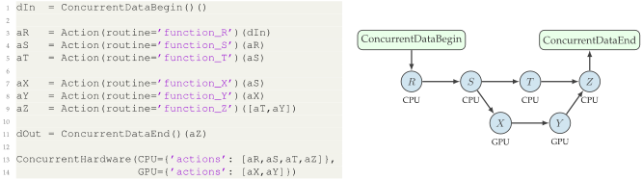
CGkit
Generating Code from Recipes and code Templates
recipes written by humans
Recipe Tool
( Parser)
Control Flow Tool
Source Tree Tool
source code for time stepping
templates (FORTRAN or C/C++)
Orthogonal separation of concerns
Example recipe
Resulting control flow graph
express dependen-
cies
express hardware mapping

Slide 22
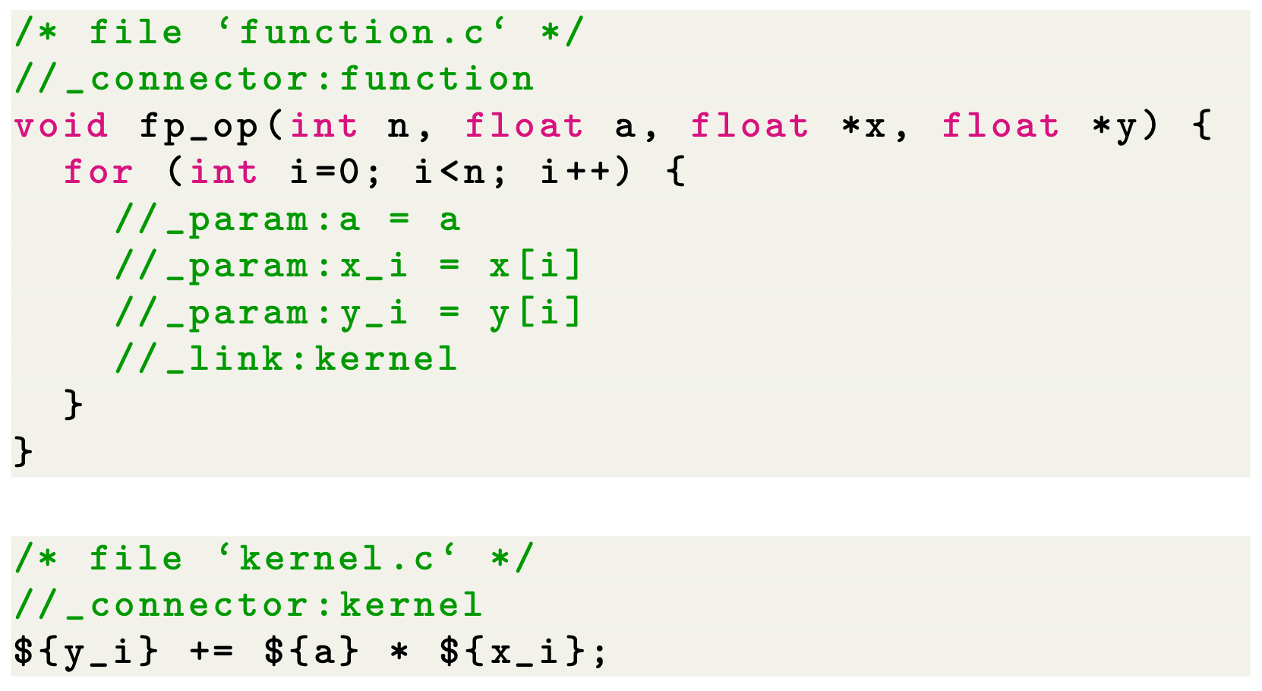
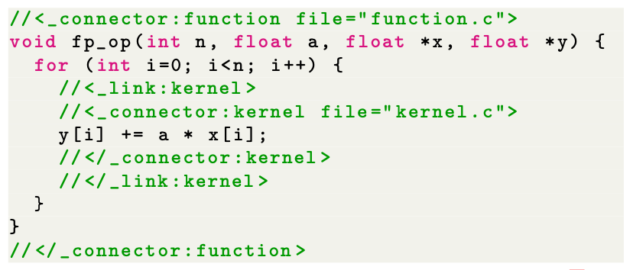
Parametrized Source Tree (PST)
PST represents source codes in a tree topology based on:
Source code
Parameters
Links / Connectors

Slide 23
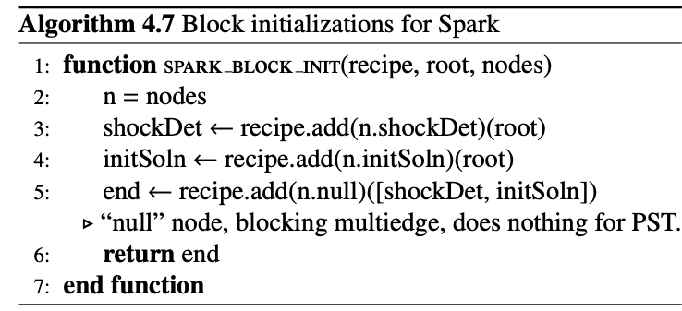
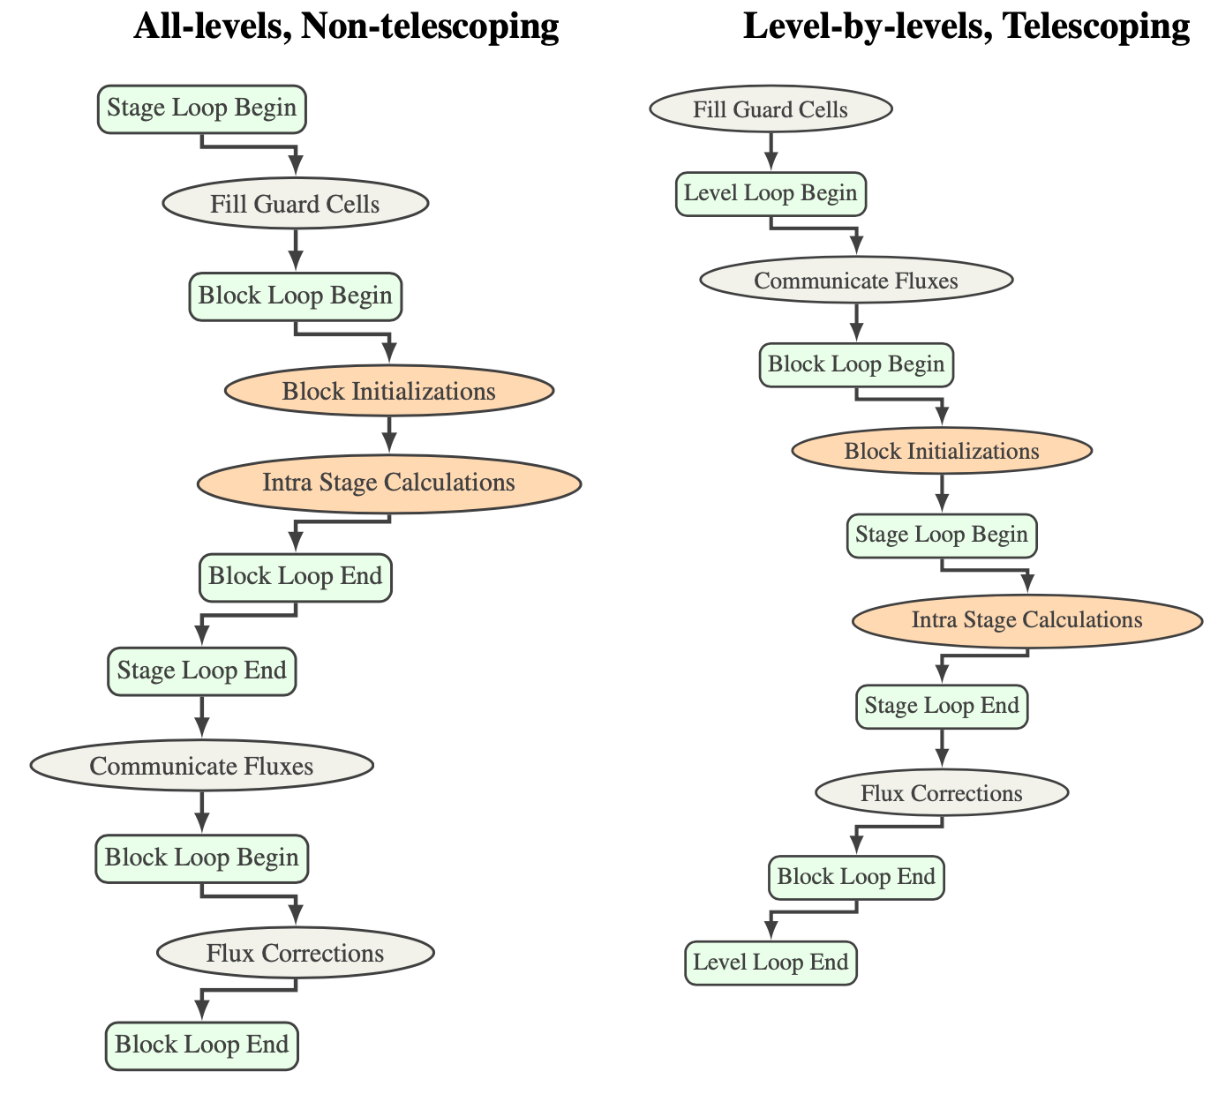
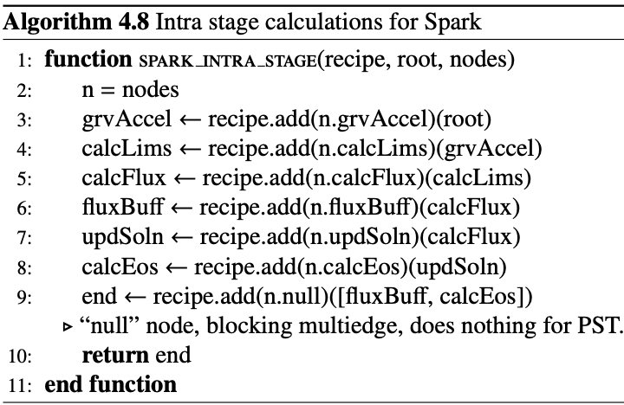
Spark Variants

Slide 24
Milhoja and Code Generation
Packing and unpacking
If N blocks are sent to the device we need N copies of all blockwise scratch
For all data items we need device pointers
Code internally decorated with directives
ConcurrentDataBegin
ConcurrentDataEnd
Task Fcn A (CPU)
Task Fcn C (CPU)
R
S
Distributor
CPU
CPU
T
Z
Task Fcn B (GPU)
Data Packet
DM/Unpack
X
Y

Slide 25
Code Generators
Two Classes
Data packet generators
Parse the interface files
Collect all data to be put into a data packet
Generate code that will flatten all data into data packets
Task function generators
Consolidate functions to be invoked
Bookended by internode communication
Unpack data packets
Decorate interface definitions with needed metadata
Example

Slide 26
Code generation
CG-Kit PST Templates
CG-Kit Recipe
Control Flow Graph
Control Flow Graph & PST
Generated Source code
(Time Stepper)
Platform-specific knowledge
Generated Source code
(Data Packets & Taskfunctions)
JSON generator
Milhoja
(code generator)
What the
Physicists
Code
Static source codes (Fortran or C/C++)
Configuration and arbitration
Fully assembled source code
(Numerics & Macros)
Macro translation
Compiler
Milhoja
(runtime)
Platform-specific executable

Slide 27
Code generation
CG-Kit PST Templates
CG-Kit Recipe
Control Flow Graph
Control Flow Graph & PST
Generated Source code
(Time Stepper)
Platform-specific knowledge
Generated Source code
(Data Packets & Taskfunctions)
JSON generator
Milhoja
(code generator)
What the
Physicists
Code
Static source codes (Fortran or C/C++)
Configuration and arbitration
Fully assembled source code
(Numerics & Macros)
Macro translation
Compiler
What is expected from them –
Enumeration of all data to be managed in the form of comments in the interface in specified syntax
All allocations registered with the tools
All data either transferred as arguments, or be block invariant
Milhoja
(runtime)
Platform-specific executable

Slide 28
Spark Variants (RK Modes)
Performance comparisons on the CPU-only machine (Fugaku)
Performance comparisons on the GPU
(Nvidia RTX 3080)

Slide 29
Advantage of Orchestrating
Offloading performance of Hydro 2D
Offloading performance of Hydro 3D

Slide 30
Porting to a new platform
In an ideal world
Add to the library of runtime pipelines
Add to the library of recipes templates
In real world
Add variants for some solvers with alternative definitions of macros
In the worst case
Develop new algorithms and add whole alternative implementation for some solvers

Slide 31
References
Dubey, Anshu, et al. "Flash-X: A multiphysics simulation software instrument." SoftwareX 19 (2022): 101168.
Rudi, Johann, et al. "CG-Kit: Code Generation Toolkit for Performant and Maintainable Variants of Source Code Applied to Flash-X Hydrodynamics Simulations." arXiv preprint arXiv:2401.03378 (2024), accepted for Future Generation Computer Systems
O’Neal, Jared, et al. "Domain-specific runtime to orchestrate computation on heterogeneous platforms." European Conference on Parallel Processing. Cham: Springer International Publishing, 2021.
Dubey, Anshu, et al. "A tool and a methodology to use macros for abstracting variations in code for different computational demands." Future Generation Computer Systems (2023).

