Slide 1
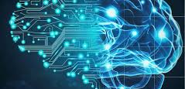
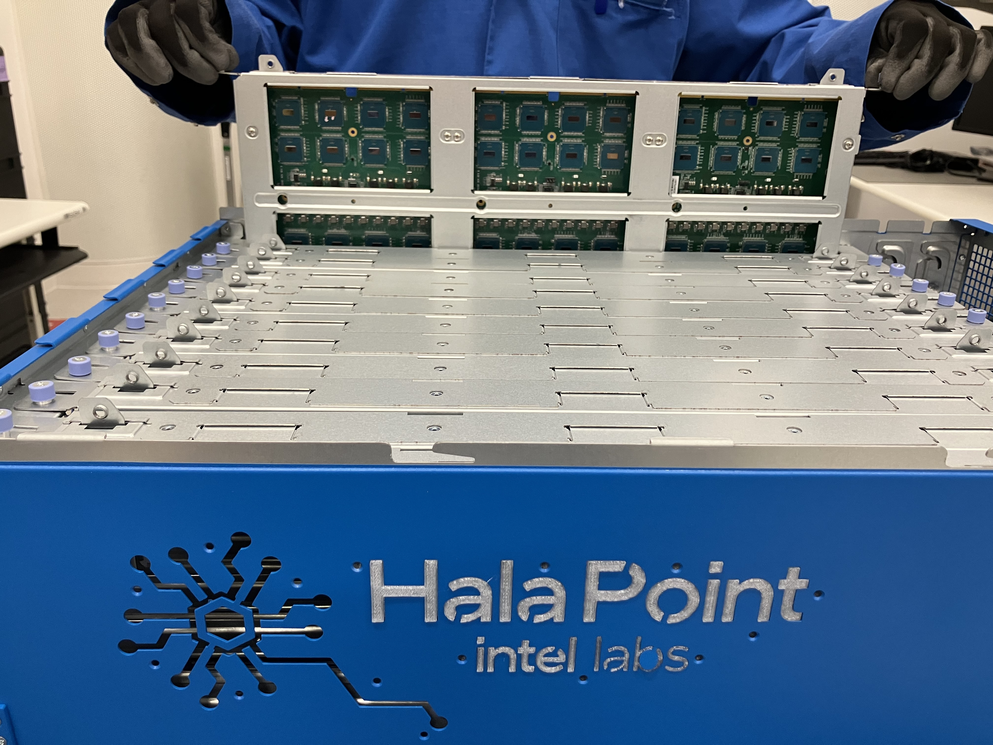
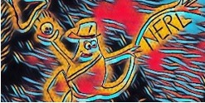
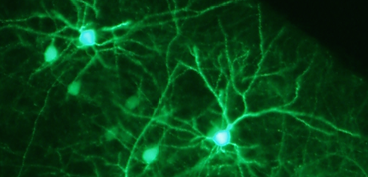
Neuromorphic Computing
Towards Brain-like Energy Efficiency
Suma George Cardwell, PhD
Principal Member of Technical Staff
Sandia National Laboratories, USA
Parallel Processing and Applied Mathematics (PPAM) 2024
Ostrava, Czech Republic
September 9th, 2024
SAND 2024-11671C

Slide 2



MODERN COMPUTING LANDSCAPE
DIGITAL COMPUTING
ANALOG COMPUTING
CPU, GPU, FPGA
Brain , FPAA
Discrete-valued
Deterministic
High-Precision
Simple(r) building blocks
Continuous-valued
Stochastic
Lower-Precision
Complex building blocks (neurons)
FPAA: Field Programmable Analog Array
FPGA: Field Programmable Digital Array
Notes:
this is paradigm shift. I want to challenge you to think differently

Slide 3
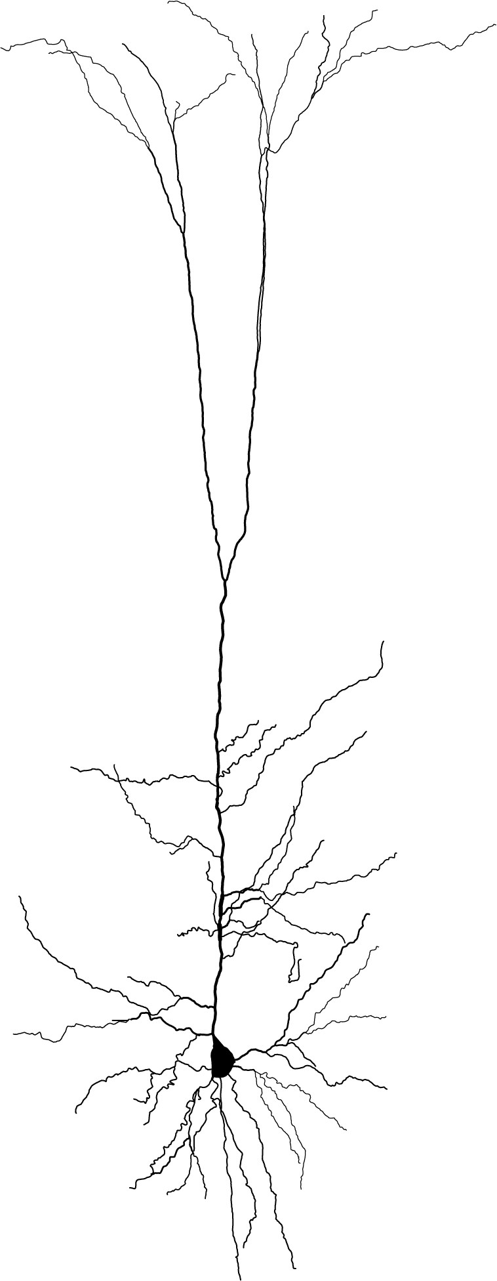

SINGLE NEURON COMPLEXITY
Biological Neurons have rich dynamics
Hodgkin Huxley Neuron
Single Neuron Biological Complexity
(Nonlinear Dynamics, Learnable parameters, etc.)
Perceptron
Leaky Integrate and Fire
Inputs
Output
x1
x2
y
$$w^{T}x$$
Z
x3
Activation Function
Size

Slide 4
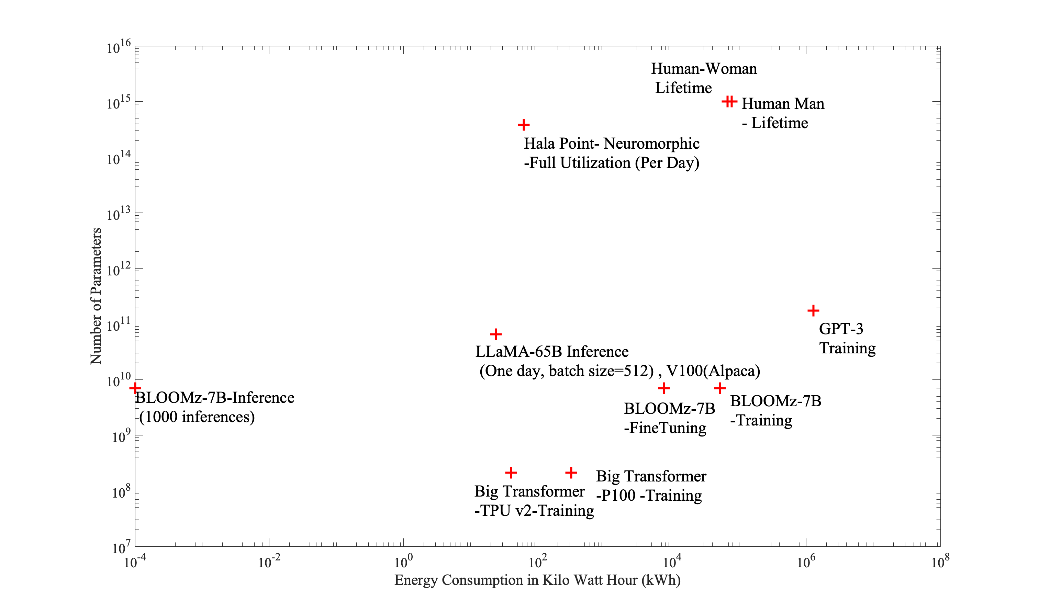
ENERGY CONSUMPTION OF MODERN AI SYSTEMS
1000 T
1T
Neuromorphic Computing gives a path forward for power efficiency scaling and meeting future computing needs.
175 B
Notes:
We compare multiple large language model's training and inference metrics and compare to human energy consumption over report life expectancy in the US (73.6 Years, 2500 calories per day for Men and 79.1 years, 2000 calories for women). 175 Billion parameters- GPT-3 1M KWh, on average humans with 1000 T parameters- two orders of magnitude less.

Slide 5

NEUROMORPHIC COMPUTING
TAKING INSPIRATION FROM BRAINS
Human Brain
Functionality
Solves ill-structured problems with little training
Online learning/ Continual Learning
Transfer learning
Attributes
Computational Memory/In-memory computing
More complexity and computation/ single unit
Self-organizing/ Reconfigurable
Spiking/event-driven communication
Sub-threshold computation
Stochasticity as a feature
Dense local connectivity
Massively parallel computation
Single Neuron
1MMAC/(s)/pW
MMAC: Million Multiply Accumulates
Average CPU
1MMAC/(s)/mW
Hasler 2016
Notes:
what brains can do vs. how they do it.
add a slide for complexity--different neurons

Slide 6
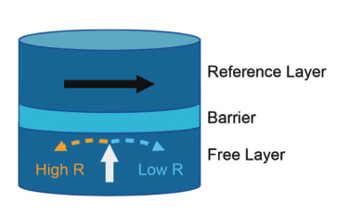
Neuromorphic COMPUTING APPROACHES
Varied solutions proposed spanning digital, mixed-signal and beyond-CMOS
DIGITAL CMOS
ANALOG/ MIXED-SIGNAL CMOS
BEYOND-CMOS
CPU, NPU, FPGA
NVM, Analog, Sub-threshold
Memristors, FeFETs, MTJs etc.
Scaled to 1.15 B/ 2B neurons
Deterministic
High-Precision
Scaled to 1 M
Analog/ Stochastic
Low-Precision
In-memory computing
Analog/ Stochastic
Low-precision
Integration with CMOS

Slide 7
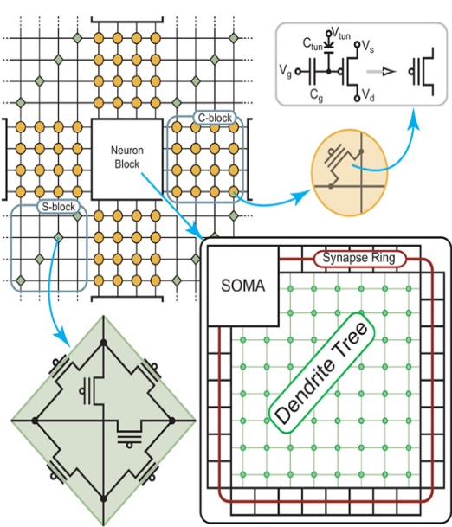
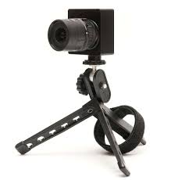
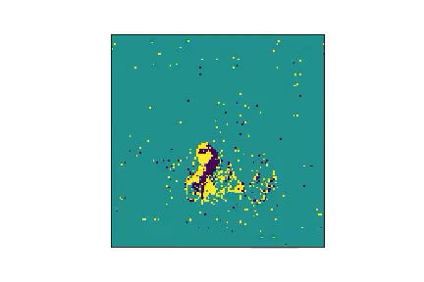
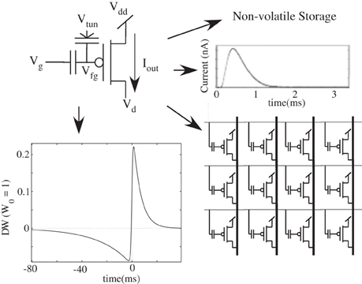

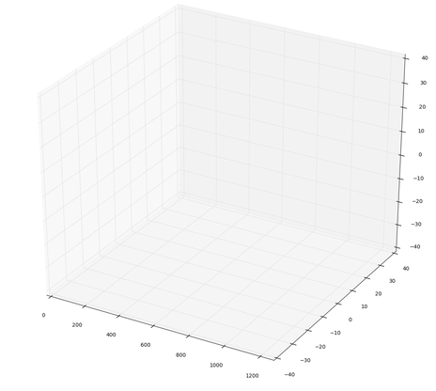
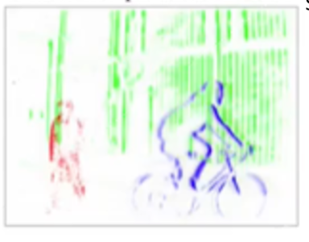
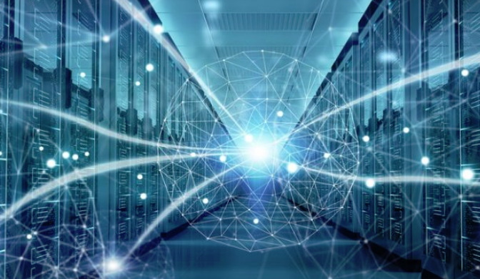
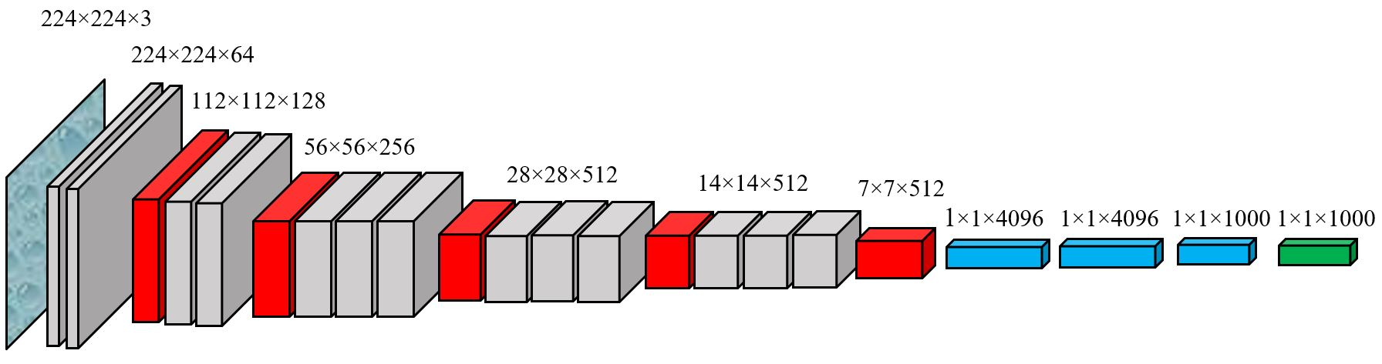
Neuromorphic BUILDING BLOCKS
Neuromorphic offers computational richness
In-memory Computing
With Synapses
Sensory Processing
Neural Processing
Silicon Retina/ Event Sensor
Silicon Cochlea etc.
Dendrites, Learning, Multi-modal
APPLICATIONS
AI/ML
(ANN, SNN)
Brain-Inspired Algorithms
Scientific
Computing
Edge
Computing
High Performance Computing

Slide 8
NEUROMORPHIC SUPERCOMPUTER
Neuromorphic systems with billions of neurons
SNL hosts Intel’s Hala Point, which utilizes the Loihi 2 chips to realize one of the largest neuromorphic supercomputers in the world.
1.15 Billion neurons and trillions of synapses with a total power consumption of only 2600 W
The Hala Point system incorporates 1,152 Loihi 2 processors, each of which can simulate a million neurons.
Capable of 15 TOPS-per-watt at 8-bit precision and does not require extensive data-processing or batching in advance.

Slide 9
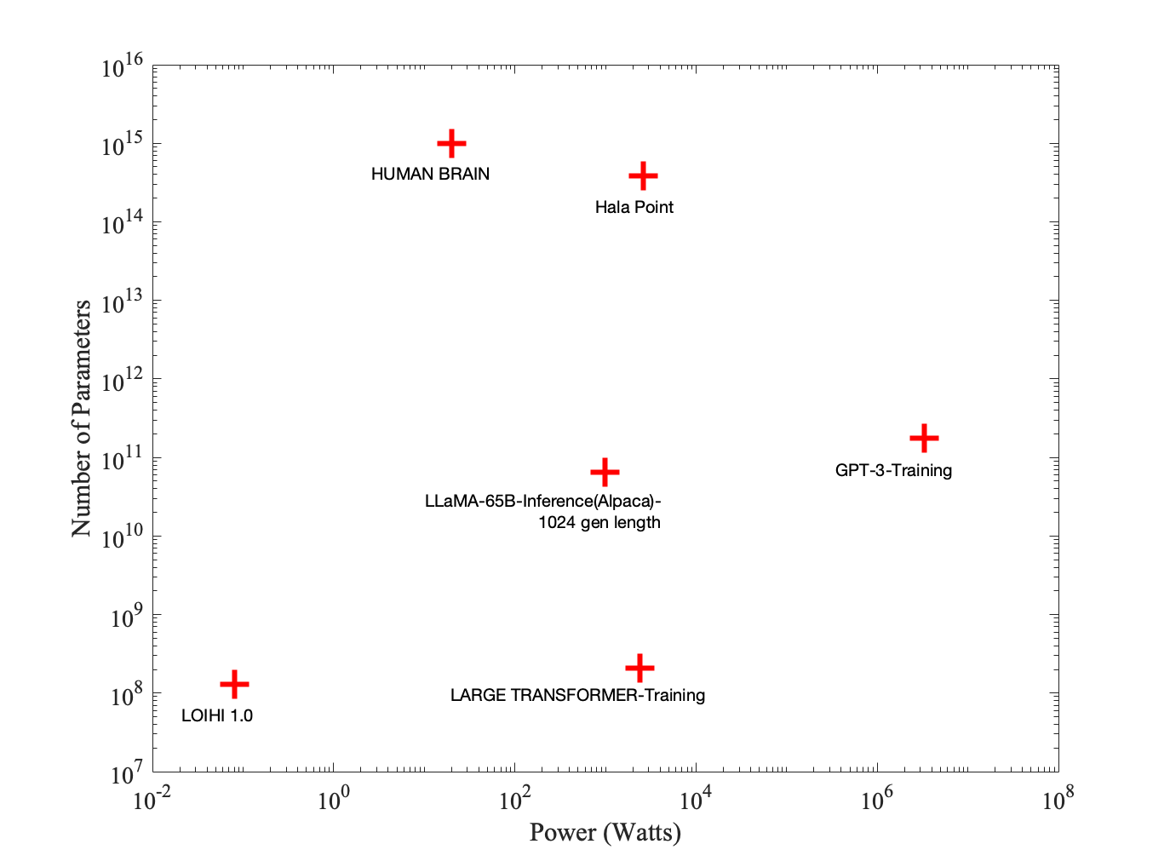
NEUROMORPHIC COMPUTING FOR PERFORMANCE
Next-generation Neuromorphic Architectures for HPC and Edge
Key attributes we need:
Leverage stochasticity as a feature
Scalability and Complexity
Codesign across scales
Software tools for Codesign
Application specific Solutions
Design of Heterogeneous Architectures
BRAINS
AI/ML with
CONVENTIONAL
DIGITAL
NEUROMORPHIC
COMPUTING
More Computation
Less Power
Cardwell et al., Neuromorphic IOP 2024
Under Review

Slide 10
OPPORTUNITIES IN NEUROMORPHIC
COMPUTING

Slide 11

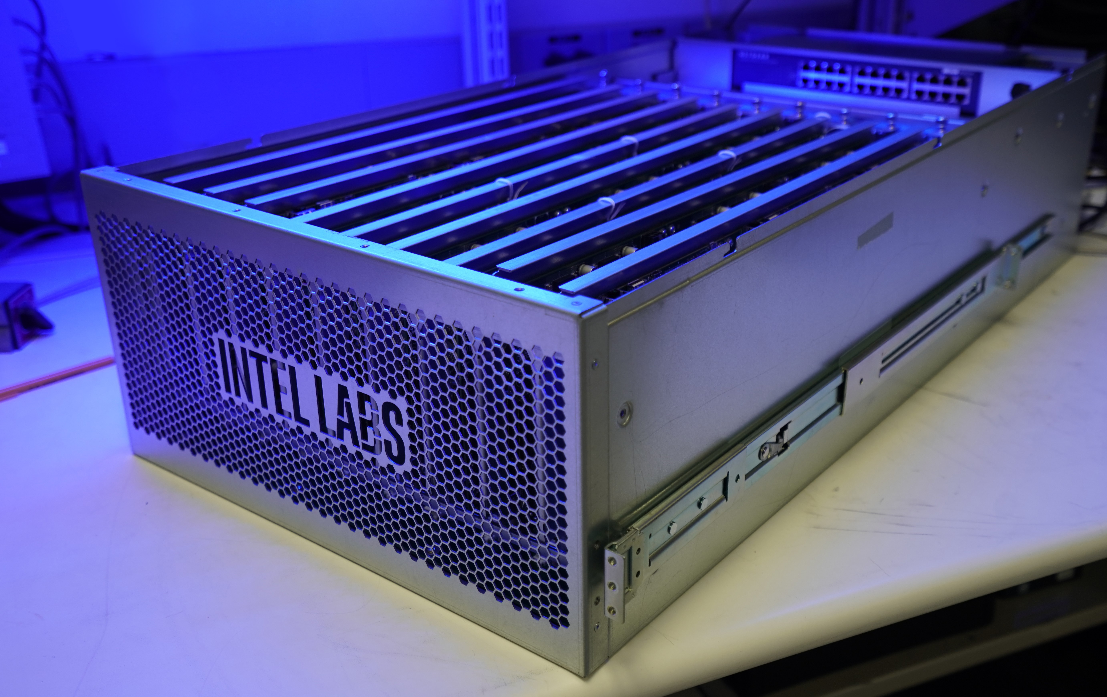
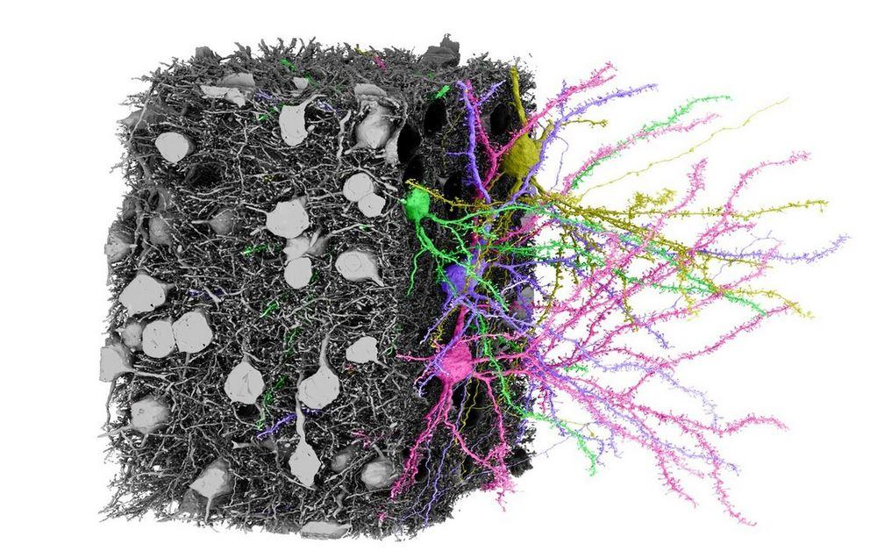
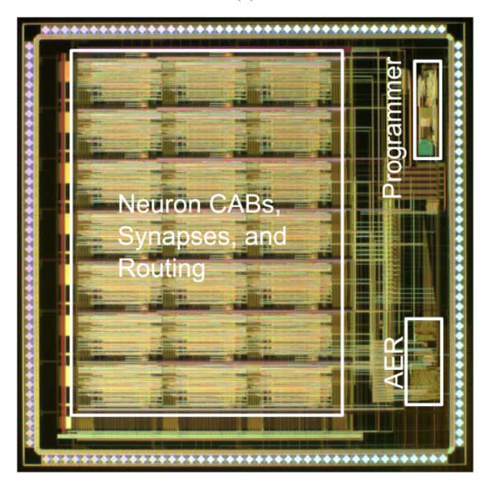
SCALABILITY VS. COMPLEXITY
NEUROMORPHIC COMPUTING NEEDS BOTH!
We need to increase computational efficiency as well as computational density for neuromorphic systems.
We can improve the complexity of a single neuron.
Novel devices and materials can help bridge this gap but codesign is a challenge.
Human Brain
(100 Billion)
Mouse Brain
100 Million Neurons
Dragonfly Brain
1 Million Neurons
Biological Complexity
(Nonlinear Dynamics, Learnable parameters, etc.)
Intel Hala Point
(Loihi 2)
1.15 Billion neurons
NeuroGrid
1 Million Neurons
Intel Loihi
100 Million neurons
IBM TrueNorth
1 Million
GT Neuron, 21 HH
with dendrites
Biological neurons have rich dynamics and a lot more computational power.
Scalability (# of Neurons)

Slide 12
DENDRITES IMPROVE COMPUTATION WITHIN A SINGLE NEURON
SIMPLE NEURONS
COMPLEX NEURONS
Simpler neuron models requires larger neural networks.
  Power hungry ANNs
  Inefficient scaling
  Inefficient hardware implementations
  Focus only on synapses and
Active Dendrites improves performance of Artificial Neural Networks
  More energy efficiency (“Neural Network within a neuron”), non-linear filtering
  Heterogeneity
  More computations/unit
  Better Connectivity and fan-in (3D architectures)
  Scalable with CMOS+X approaches.
Plastic Synapses
Learning Mechanisms
  Our Current Research
  Dendrites supporting shunting Inhibition
    Pattern Recognition (NICE 2023, ICONS 2023)
    Direction-Selective (ICONS 2024)
  Software library for analog hardware-based dendrites (NeurIPS workshop, NICE 2023)
  DEND-NET: SNN with dendrites (Neuro IOP 2024 -In Review)
  Neuromorphic Design Space Exploration with SANA-FE tool in collaboration with UT Austin.
Analog devices and circuits well suited to model dendrites efficiently in hardware.
Synaptic Inputs
w1
w2
w3
Raxial
Vmembrane
Rleak
Cleak
DENDRITE CABLE

Slide 13
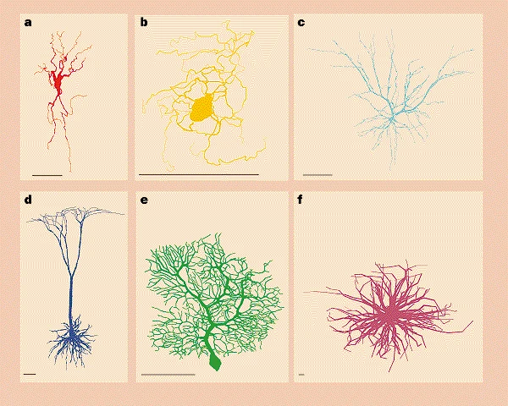
COMPUTATION USING THE DENDRITES
Dendrites are not just wires!
Over 70% of the neuron’s volume (Stuart 2016)
Great diversity of dendrites within a single brain and across animal species.
Insights from neuroscience are foundational to the pursuits of neuromorphic computing.
Biological dendrites are known for their complex physical structures that incorporate significant fan-in (~10,000 inputs).
Segev, Nature 1998
Notes:
A) Traces of dragonfly TSDN MDT5 dendrites [44]. (B)Trace of a layer 5 (L5) pyramidal neuron with basal and apical dendrites.Image (A) reproduced courtesy Dr. Paloma Gonzalez-Bellido. Image (B) courtesy of Dr. Hysell Oviedo, Department of Neuroscience, Washington University School of Medicine in St. Louis, USA.

Slide 14
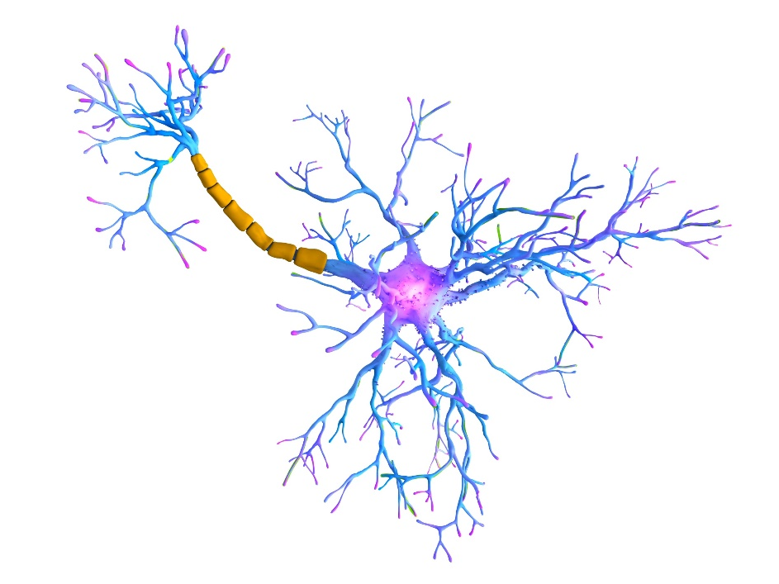
DENDRITIC TOOLKIT FOR COMPUTATION
Dendrites are tree-like structures that connect neurons synapses to its soma.
Dendrites
Dendrites are not just wires!
They can perform interesting computation like:
  Coincidence Detection
  Current Summation
  Directional selectivity
  Non-linear filtering
  Amplification of Synaptic inputs
Increased Connectivity and Computation
Vmem
Resistor Capacitor Circuit
Rleak
Cleak
Vaxial
Dendrites using Transistors
London 2005, Poirazi 2020
Raxial
Vmem
Vleak
Rleak
Cleak

Slide 15
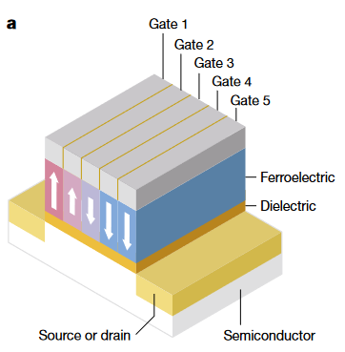
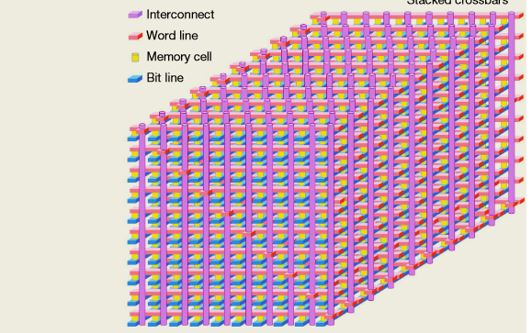
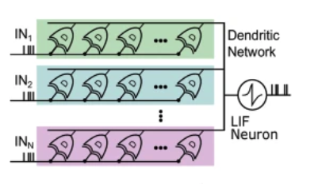
NEUROMORPHIC ARCHITECTURES WITH DENDRITES
Dendrites have been modeled to different degrees in neuromorphic hardware.
Active Dendrites with Calcium and NMDA channels: BrainScales
Floating-gate based active dendrites: Georgia Tech Neuron Chips
Dendrocentric Learning with multi-gate FeFETS (Boahen 2020)
DenRAM: Dendrites with Resistive RAM (Payvand 2024)
Hodgkin Huxley Neurons with Active Dendrites
Ramakrishnan, 2013
NanoDendrite Multi-gate FeFET
Proposed Dendrite 3D Architecture
DenRAM with RRAM dendrites

Slide 16
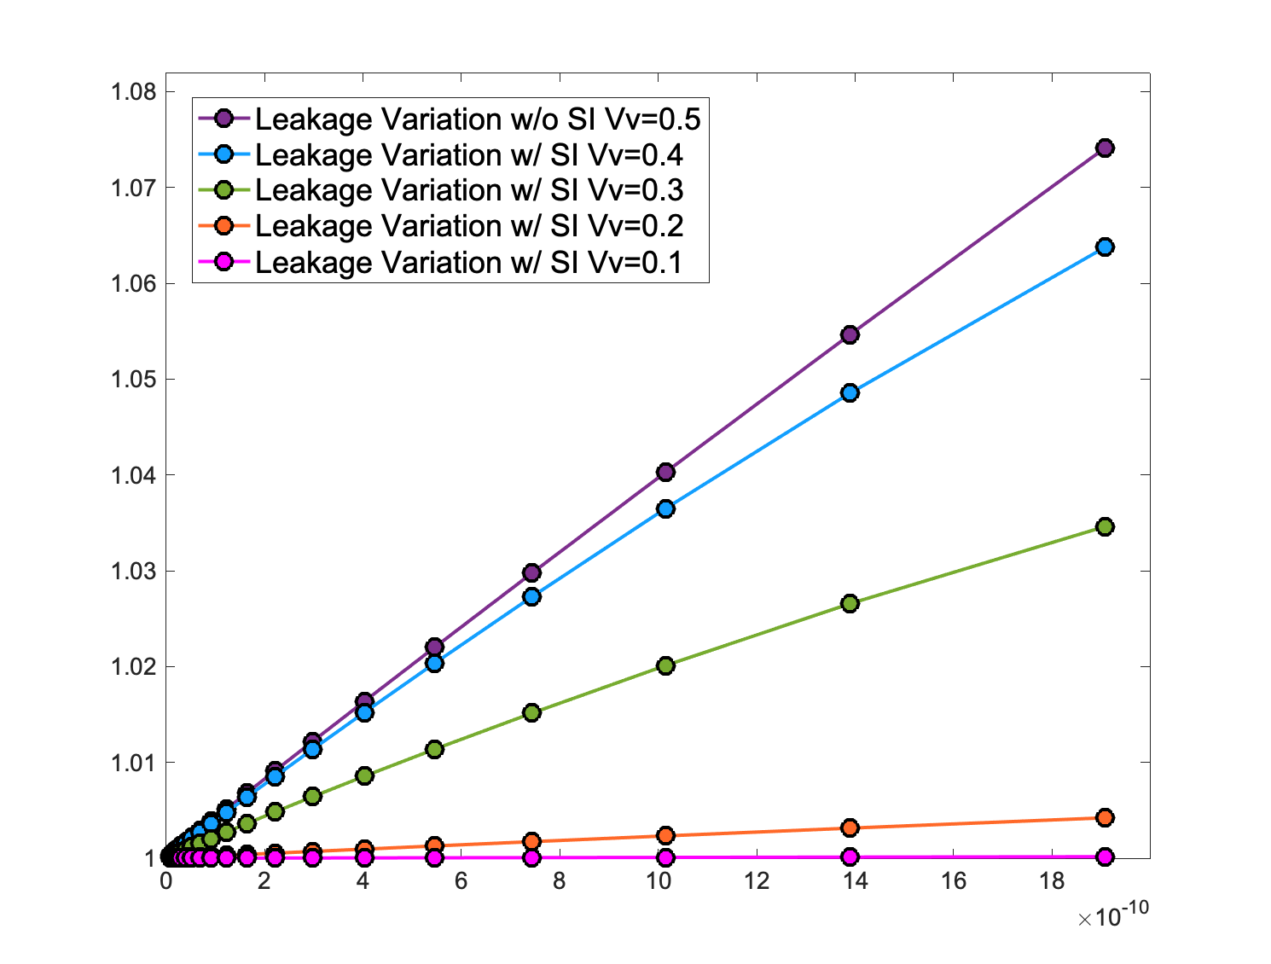
ACTIVE DENDRITES
Using shunting inhibition for gain modulation
Excitatory Input
Shunt Input
out
Vaxial
Raxial
Vmem
out (V)
Vleakage
Rleakage
Cleakage
peak input (A)

Slide 17
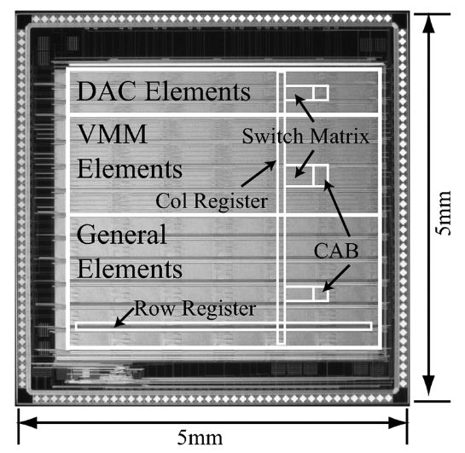
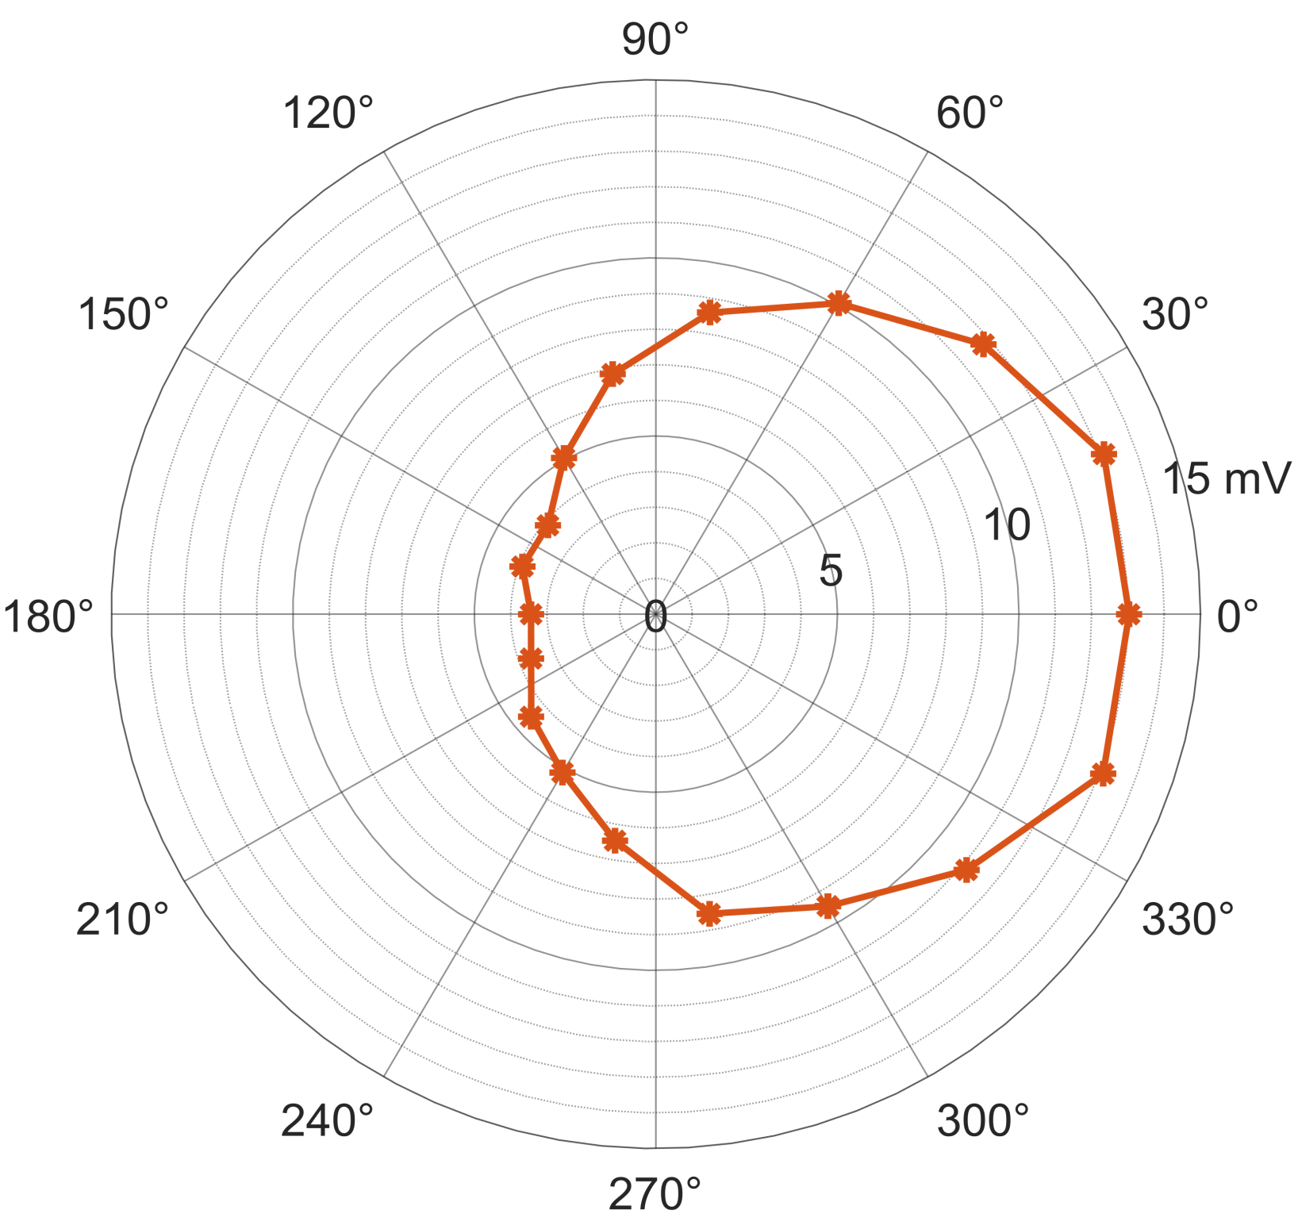
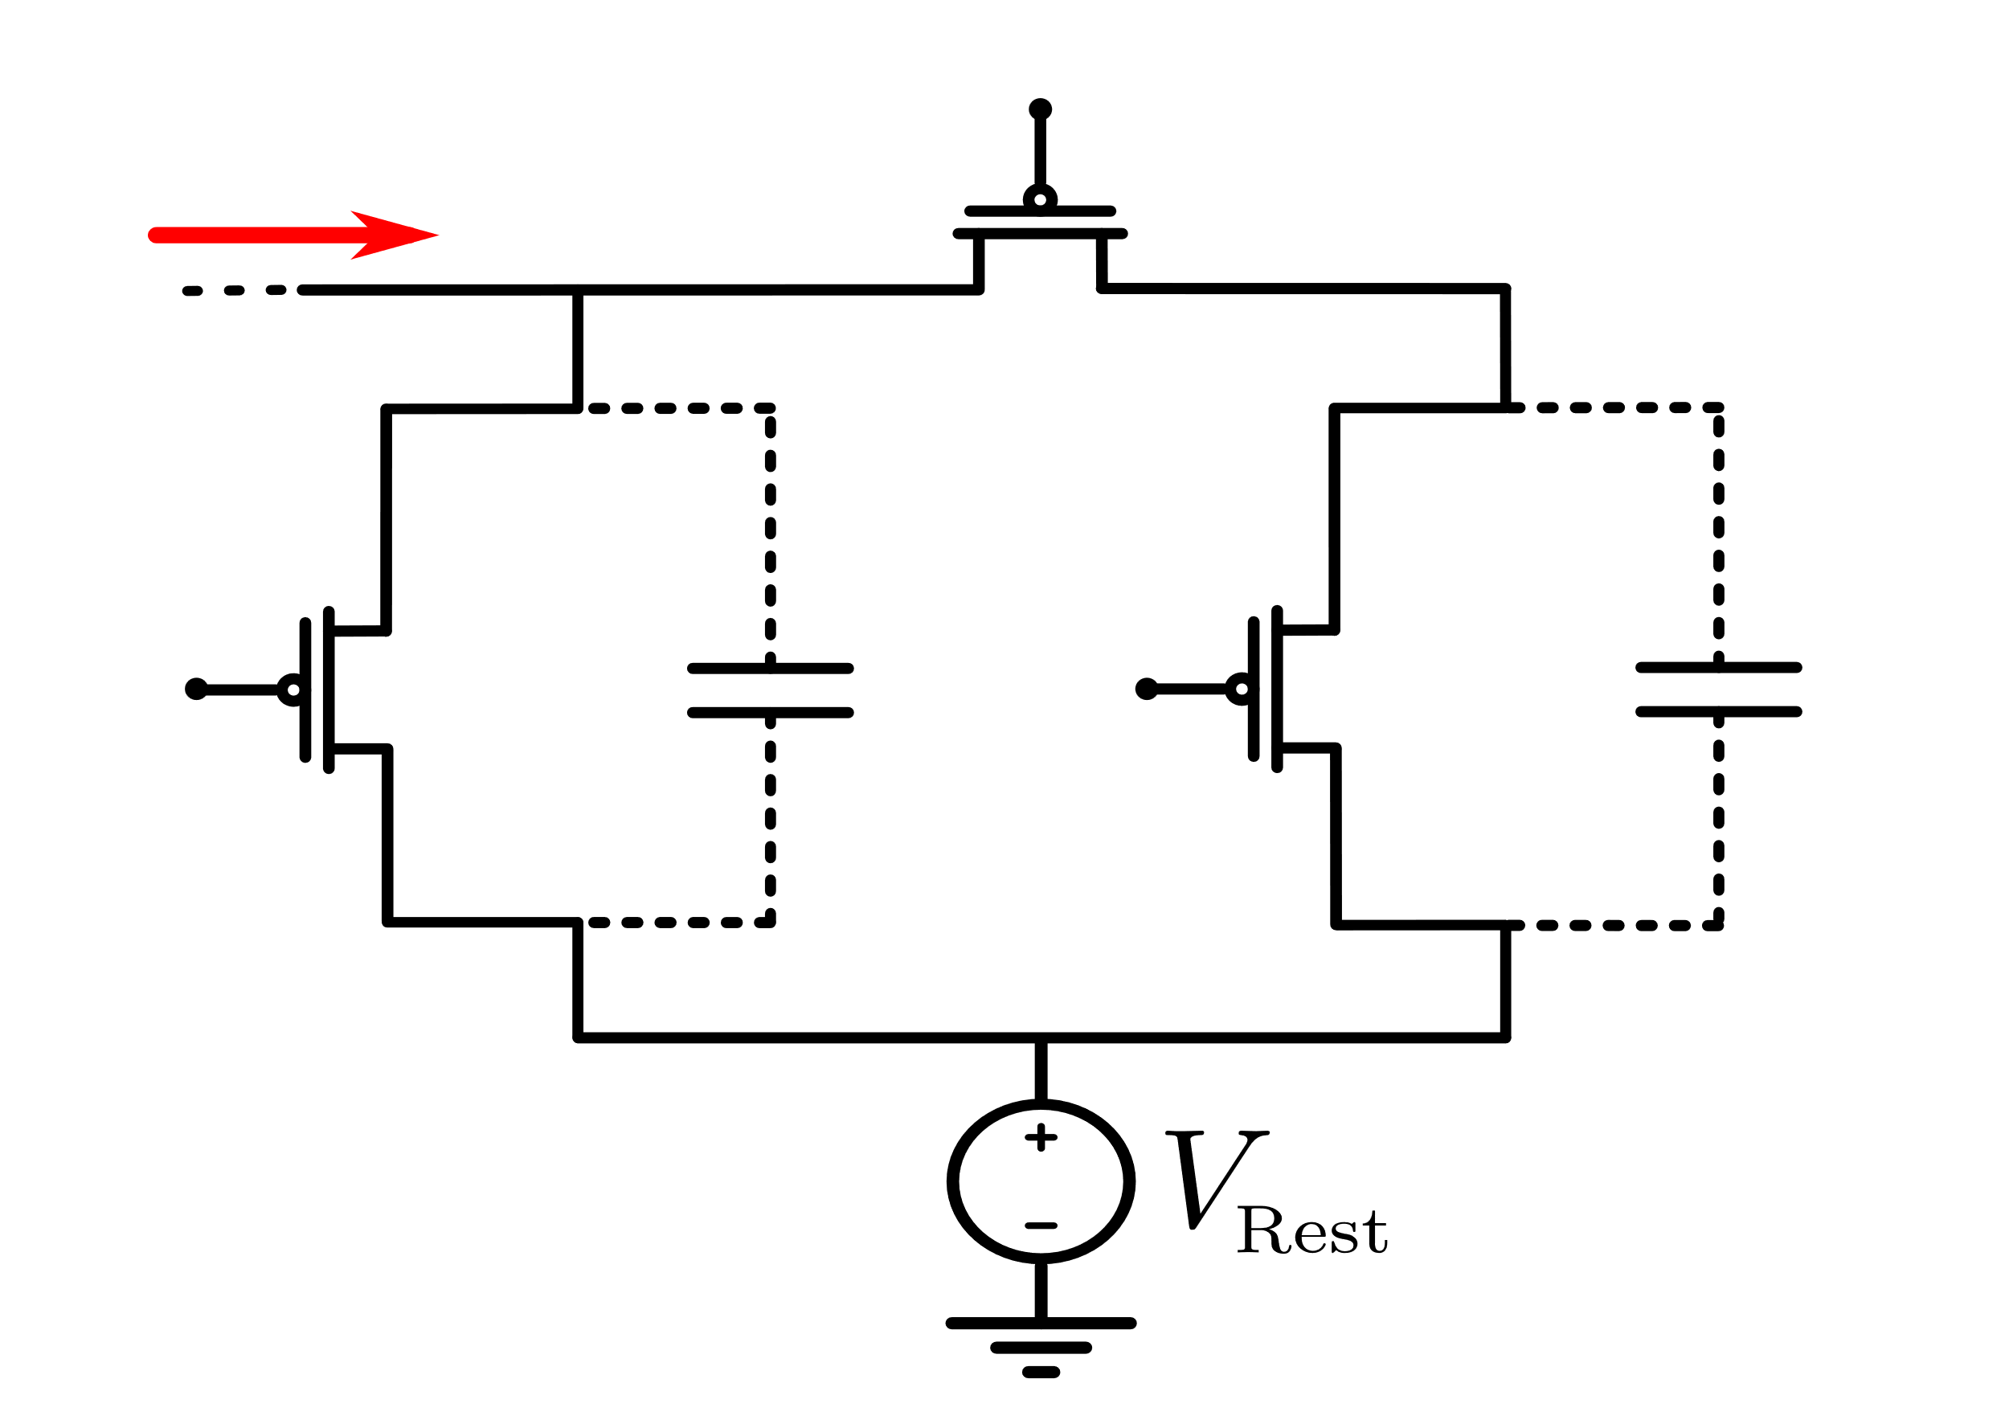
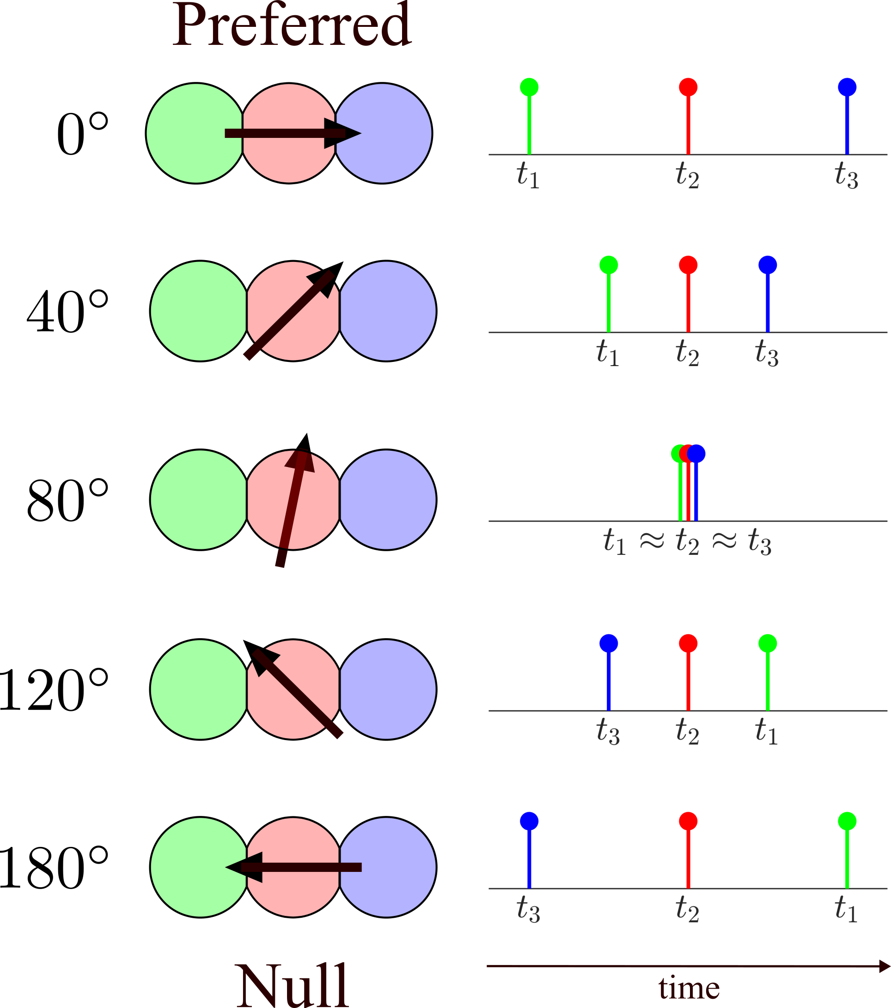
DENDRITES FOR DIRECTION SELECTIVITY
Experimental Demonstration using analog circuits
Dendrite Circuit
FPAA 2.9V
Parker et. al IEEE ICONS 2024

Slide 18
DENDRITES FOR DIRECTION SELECTIVITY
Dendrites for pattern and velocity estimation
Super-Pixel
w11
w12
w13
w21
w22
w23
…
wn1
wn2
wn3
Image Sensor (NXM pixels)
Feature Extraction
Complex
Features

Slide 19
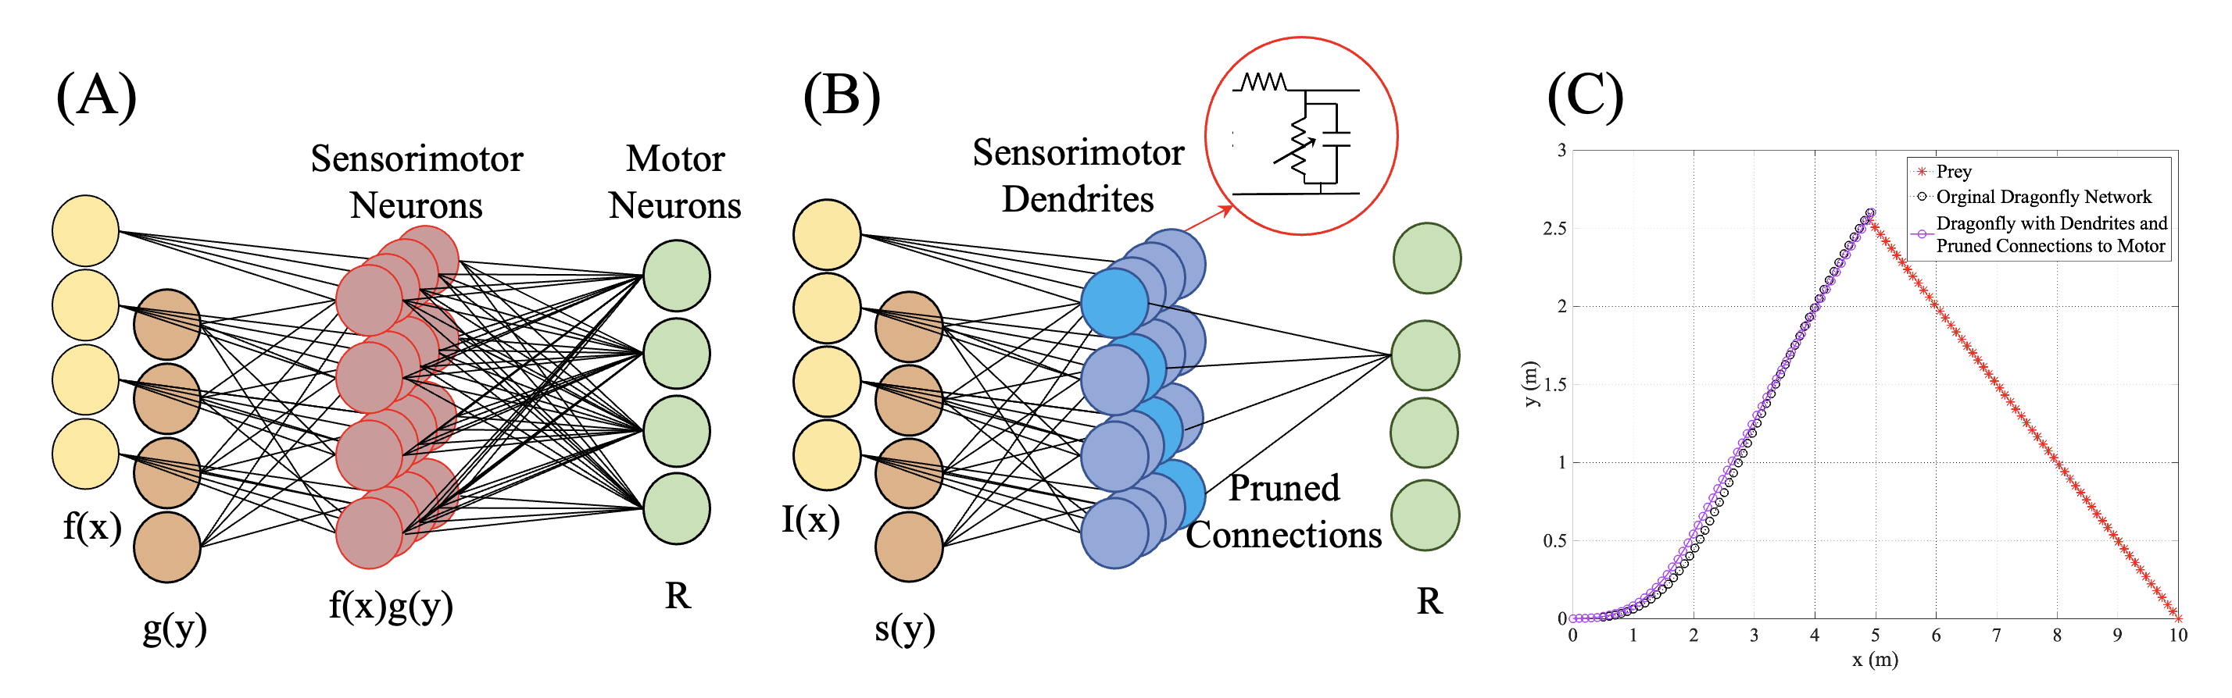
DRAGONFLY WITH DENDRITES
Using shunting inhibition for gain modulation
Cardwell et al. In Review
Original Dragonfly Interception Circuit (Chance 2020)
Dragonfly NN with Dendrites
Comparison with original interception circuit

Slide 20
DendriteS in SPIKING NEURAL NETWORKS
Comparing networks with LIF and LIF +Dendrites
256 / 16 Signals to LIF Neuron
16 Signals to LIF Neuron
Notes:
To demonstrate SNN improvements we implemented a simple demonstration
Using examples from the SNN Torch library we trained MISH & SQRT - Mish is a newer activation function.
The dynamics of dendrites should embed more information reducing the needed communication across layers
We used:
A SNN with a hidden layer size of 256 LIF neurons - so the input is broadcast to 256 LIF neurons, which then send 256 spikes to an output neuron.
A 16x16 dendrite network. This consists of 16 dendrites with 16 inputs or taps each. This network sends 16 spikes to the LIF neuron
And as a comparison, a 16 LIF hidden layer network
The output of these networks is the last neuron's membrane potential.
We trained for 100 epochs, using a random sample of the function space .

Slide 21

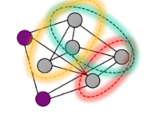

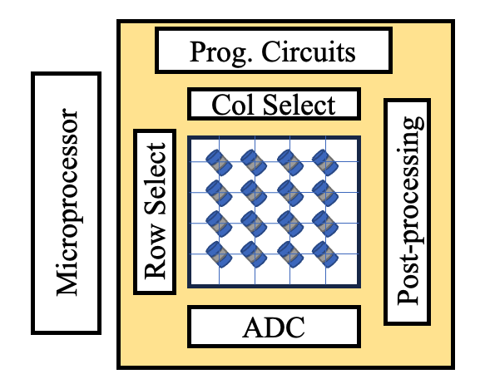
CO-DESIGN IS CHALLENGING
Software tools are critical for design and co-optimization
Application/ Algorithm Design
System Architecture Design
Codesign
Circuits/ System Design
Materials/Device Design

Slide 22
DENDRITE ENABLED SPIKING NEURAL NETWORKS
Leveraging inherent properties of dendrites
Implemented a “Dendrite Pooling Layer” for use in ANN
Trained ResNet18 on CIFAR-10 for 300 epochs
  ResNet + Dendrite layer took significantly longer to train
  Simplified ODE layer adds state and loops
Found accuracy to be comparable
Dendritic pooling has potential in ANNs
Pooling Layer Hardware | Energy
Digital Nvidia Jetson | 504.41 uJ
Dendritic pooling | 0.265 uJ
Plagge et al., IEEE ICRC 2024

Slide 23
DENDRITE ENABLED SPIKING NEURAL NETWORKS
Implemented Torch library with a dendritic chain
  Simplified version of the complex ODE dendrite solution.
  Wrapped dynamics into a set of constants and parameters.
Dendrites support SNNTorch & Non-Spiking Torch.
Provides a trainable 1-D chain of dendrites
Value | Type
Lambda | ”Spatial” constant: Represents Distance
Tau | “Temporal” constant: Capacitance and Resistance
Leak | Signal loss for each tap
Input Weight | Increases or Decreases signal strength
Hardware Constraints
Learned Parameters
Plagge et al., IEEE NICE 2024

Slide 24
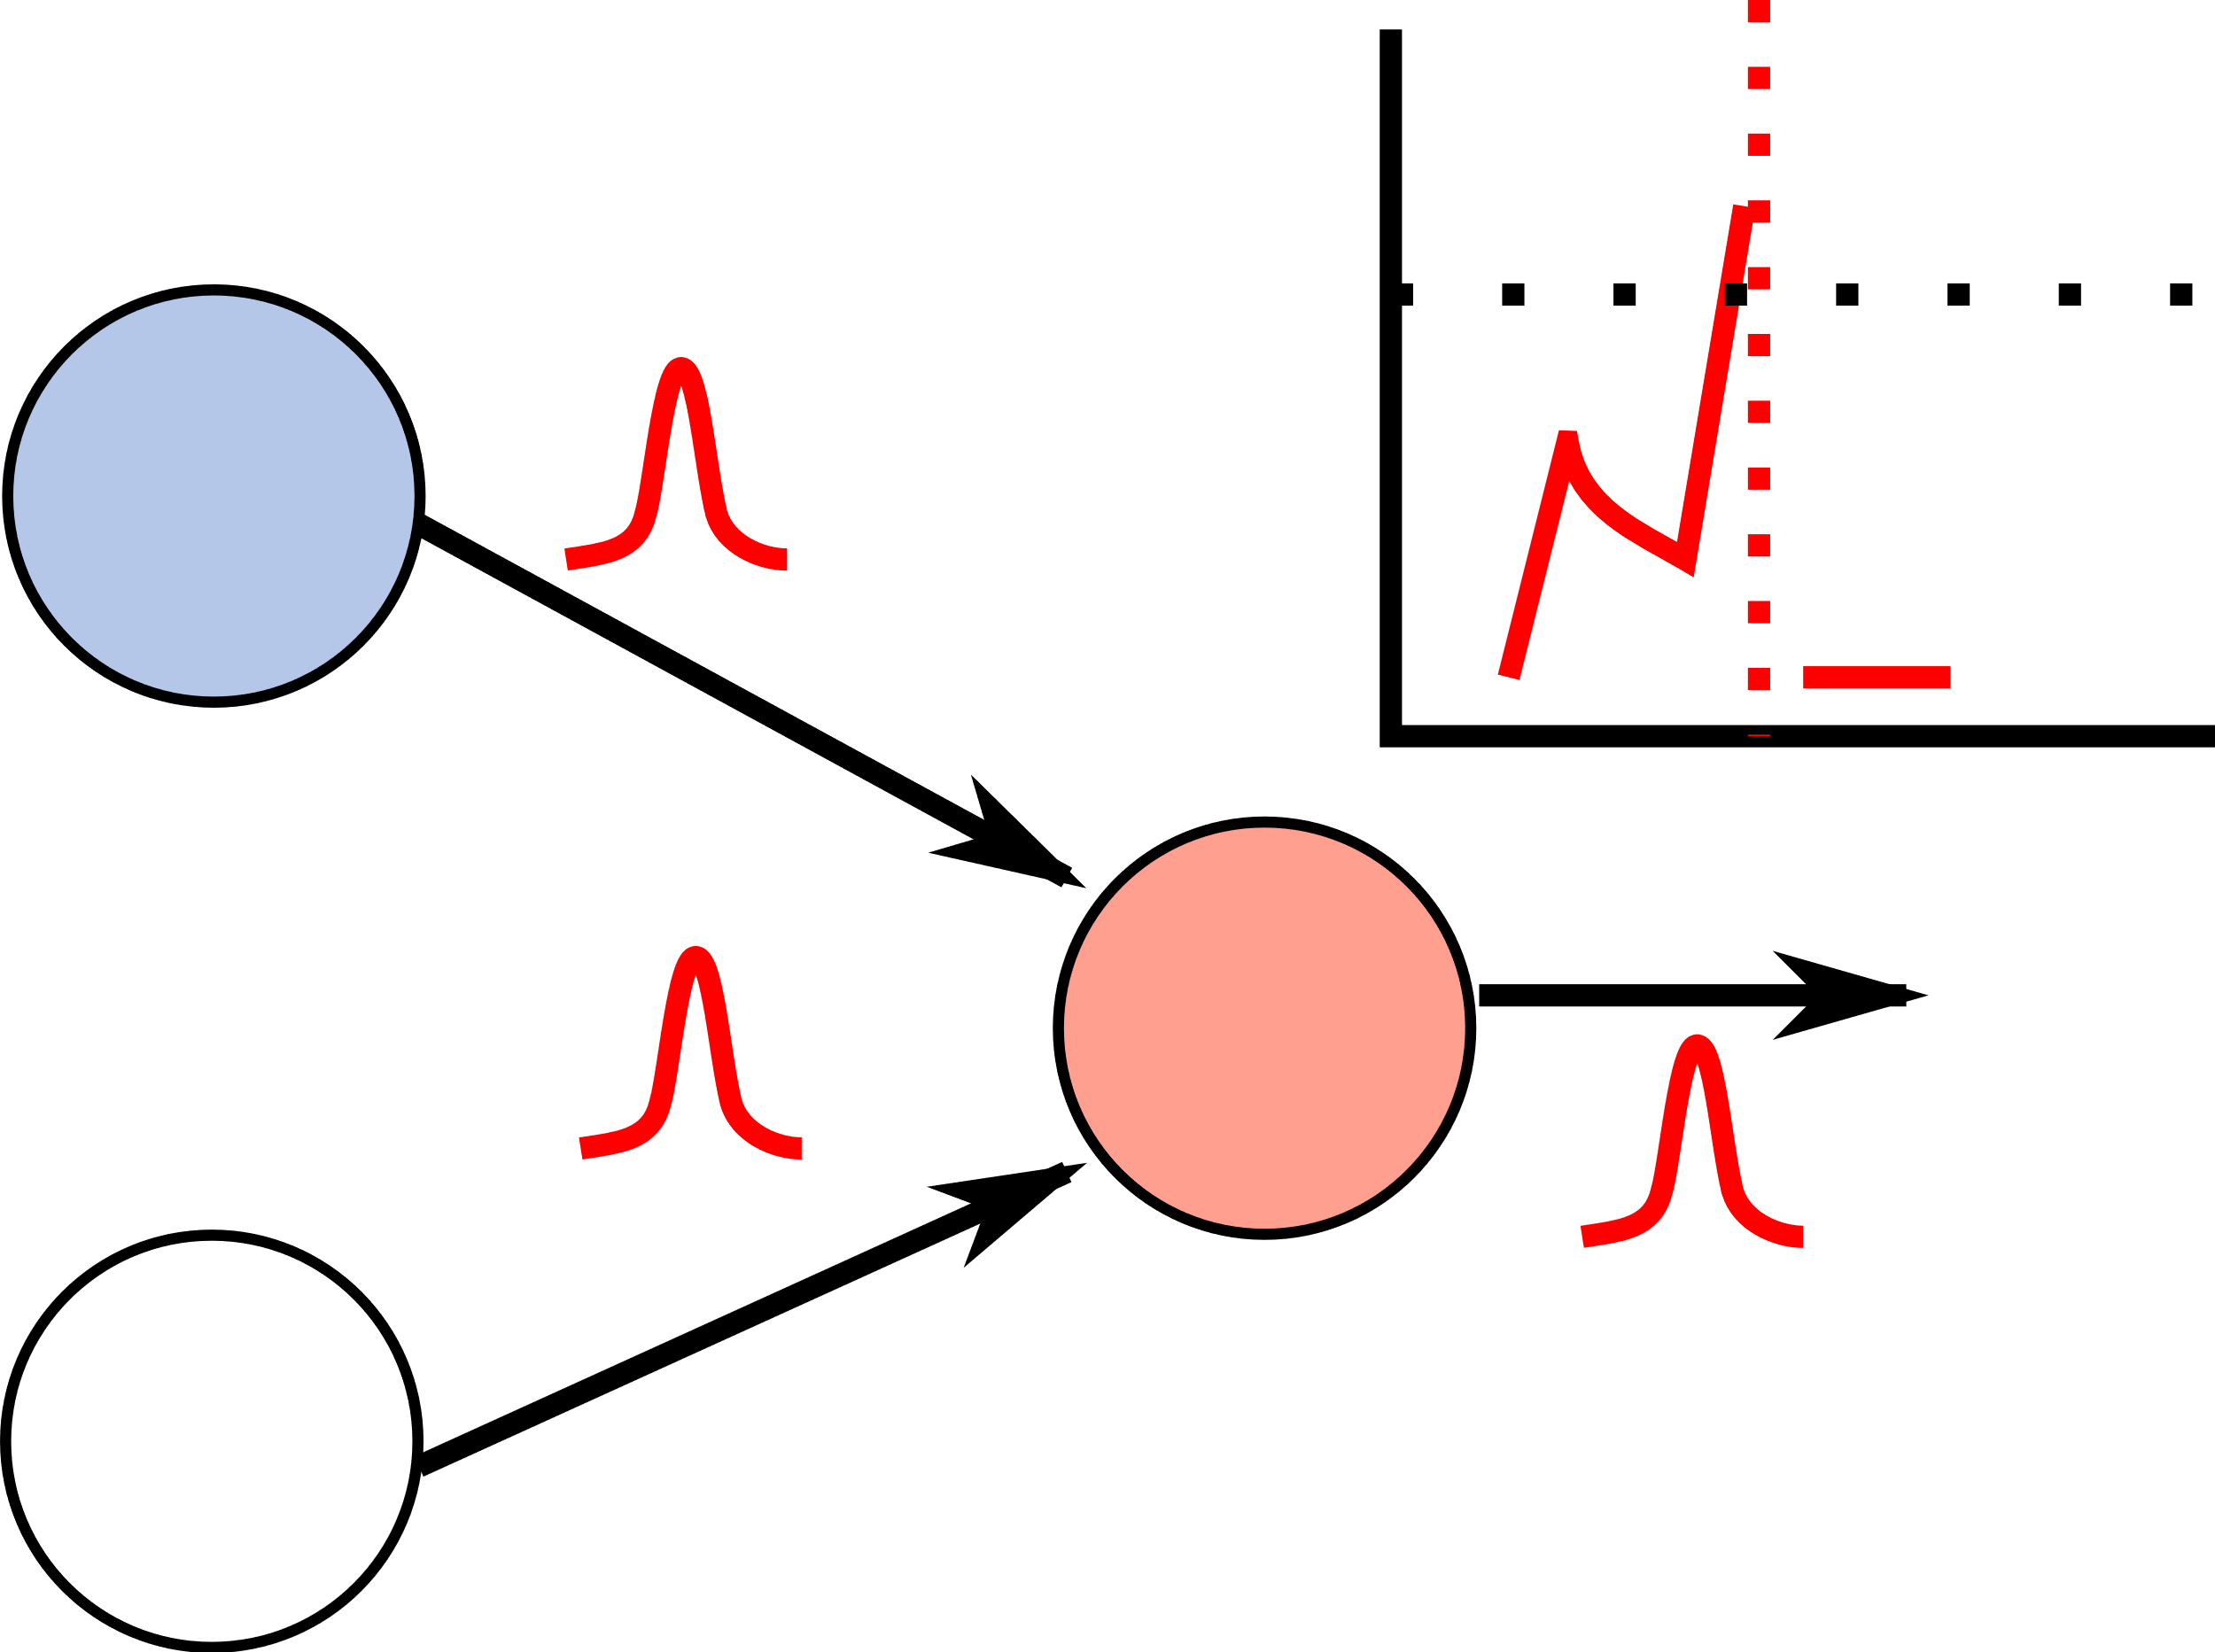

CHALLENGE: NOVEL CODESIGN TOOLS
SANA-FE: Specialized tool to explore novel neuromorphic architectures
  Rapidly estimate performance of neuromorphic architectures for design space exploration.
  General & extensible spiking H/W simulator
  Model functional behavior & track performance
  Schedule messages & intra-core interactions
  Calibrate simulator to real-world systems
  Accurately predicts latency & energy of gesture categorization spiking neural network (SNN)
SANA-FE: Simulating Advanced Neuromorphic Architectures for Fast Exploration
Configuration & Input Spikes
Architecture Description
Simulator Kernel
build architecture
initialize network
for all timesteps:
get external inputs
for all tiles:
for all cores:
process neuron
send messages
write results
Mapped Spiking Neural Network
Performance Estimates
J. Boyle et al. ICONS 2023

Slide 25
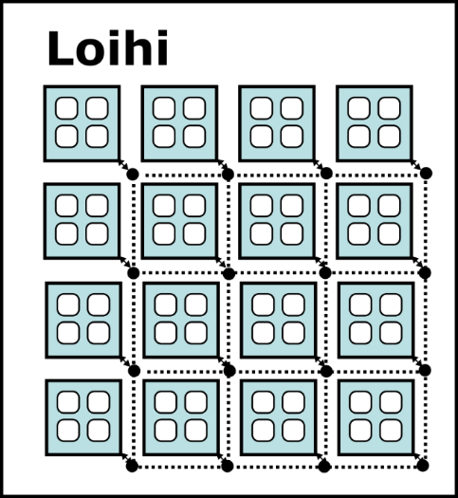
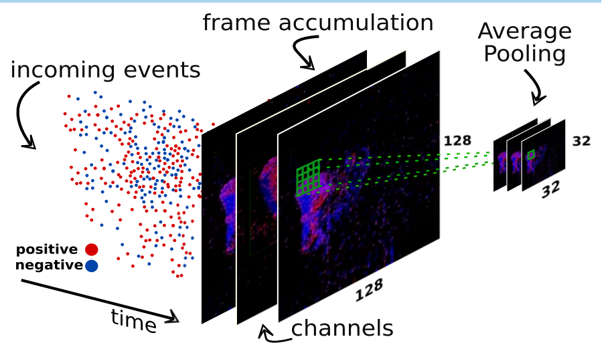
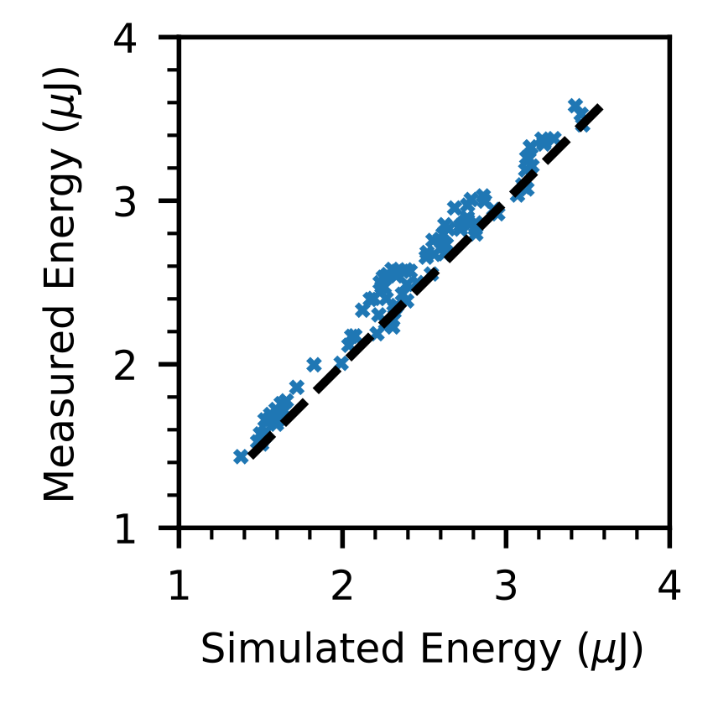
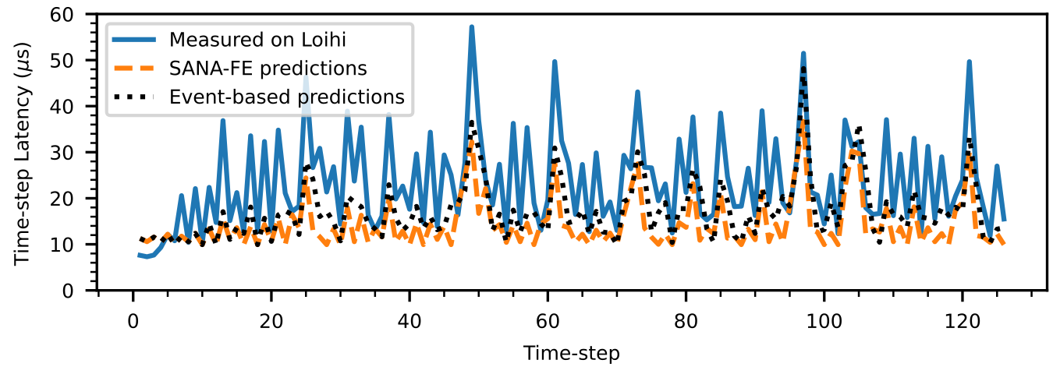
DVS Gesture Recognition Application
Predict energy & performance for larger real-world neuromorphic applications
  SNN trained on DVS gesture data-set [Massa’20]
  18,678 neurons across 6 layers
  Mapped to 45 Loihi cores out of 128
Image reproduced from [Massa,’20]
Notes:
Adapted and predicted energy for larger real-world applications such as hand gesture categorization of dynamic vision sensor data
Here predicted latency

Slide 26
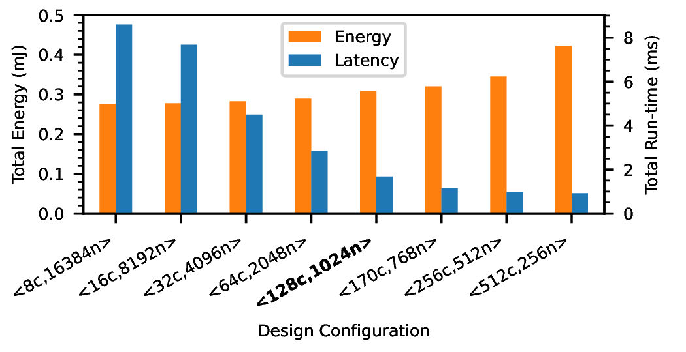
DVS Gesture Design Space Exploration
Design-space exploration using DVS gesture application
  Loihi-based designs, traded-off core count (c) vs neurons per core (n)
  Optimum design had 170 cores, 21% faster than Loihi (128 cores)
  Design-space sweep took 29 s
Image reproduced from [Massa,’20]

Slide 27
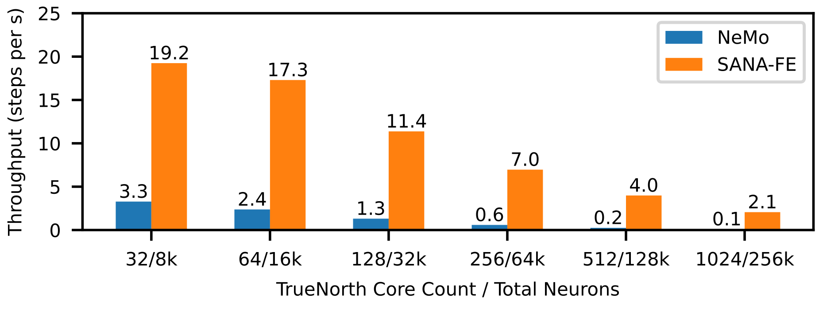
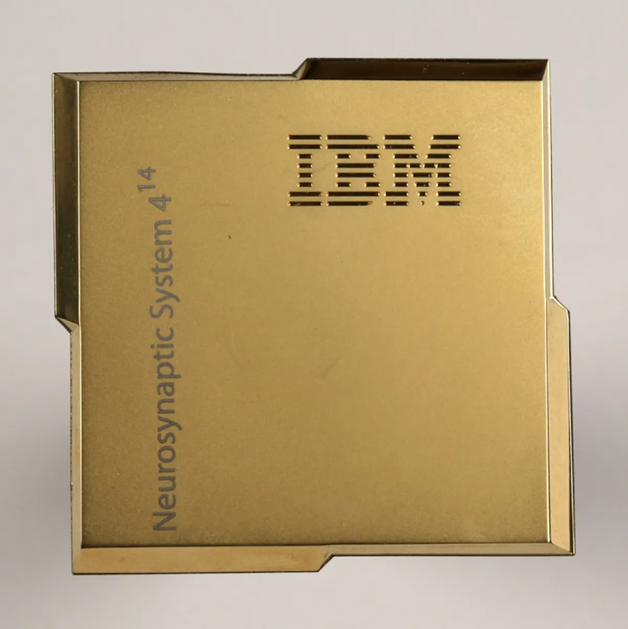
Simulator Speed Results
Compared to existing discrete-event based spiking simulator (NeMo)
  Simulating IBM TrueNorth architecture
  Randomized SNN with 80% of spikes intra-core, 20% spikes between cores
Over 20x faster than NeMo for 1024 cores
Notes:
Two things here
Modeling another spiking architecture TrueNorth (point to chip)
Compared against NeMo an existing TrueNorth simulator
And shown that we are faster

Slide 28

DENDRITES IN NEUROMORPHIC ARCHITECTURE
Further develop links with Dendrite-SNN hardware simulations – SanaFe
Work on a spiking self-attention network with dendrites:
  Dendritic attention layer (Temporal coherence and context)
  Dendritic pooling layers (More efficient summary layer)
Other compelling network designs
Release as stand-alone library or as SNNTorch add-on
SanaFe – Hardware Simulator
An in-progress tool to estimate timing and energy of neuromorphic systems.
Currently supports Loihi.
Analog components are WIP

Slide 29
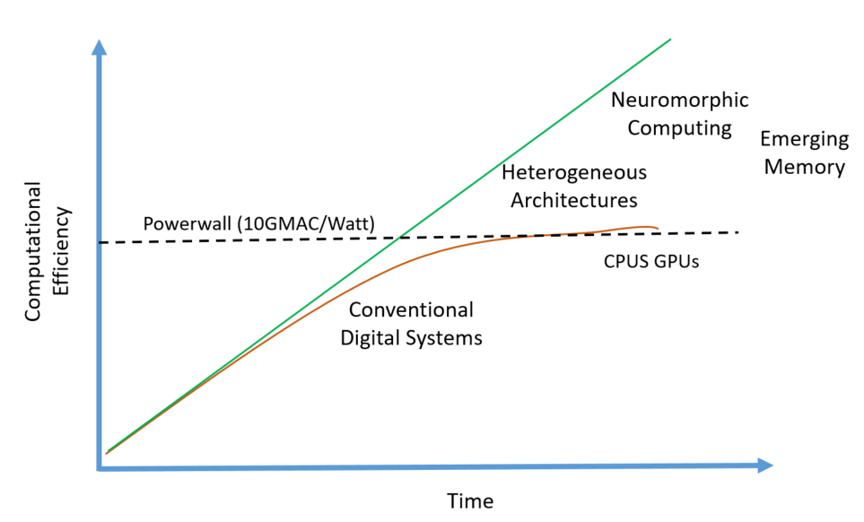
heterogeneous architectures
Embracing Heterogeneity
Move past general-purpose solutions and only use them for prototyping
Heterogeneous and reconfigurable systems
Get the best performance based on system needs.
System designed with application in mind for optimization
Near-sensor processing
‘Truly Heterogeneous Computing’,
Cardwell et al., SMC 2020

Slide 30
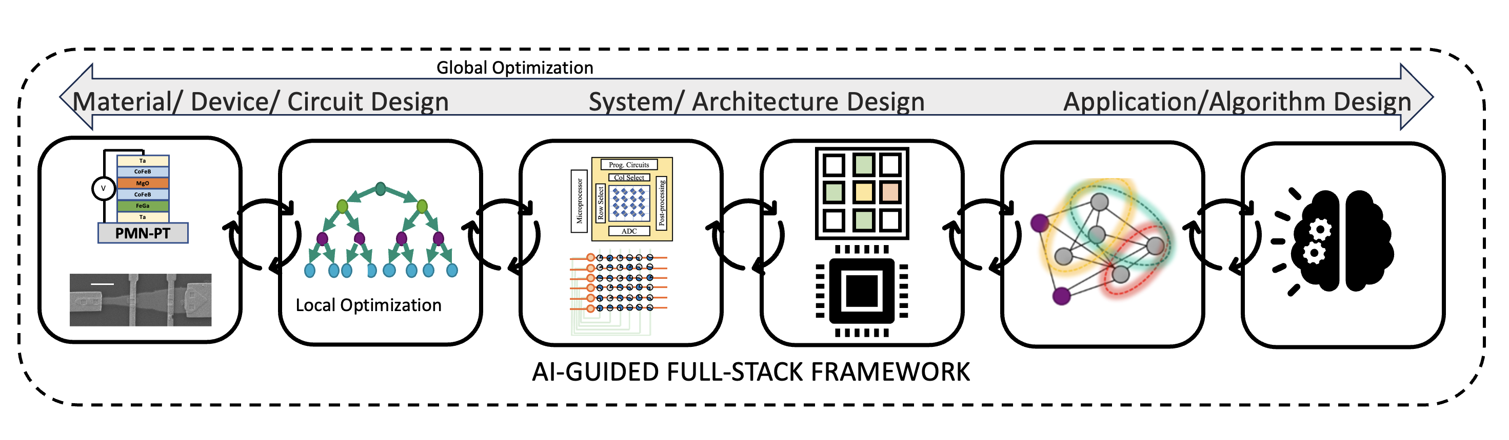
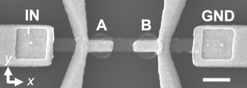
APPLICATION SPECIFIC SOLUTIONS
We are in the ”golden-age of computer architectures”
Hennessey &Patterson 2019
2
1
1
Cui et al. arXiv 2024
Karki et al. Journal of Materials Research 2024
Notes:
We took our neuromorphic approach and applied to a very different problem space

Slide 31
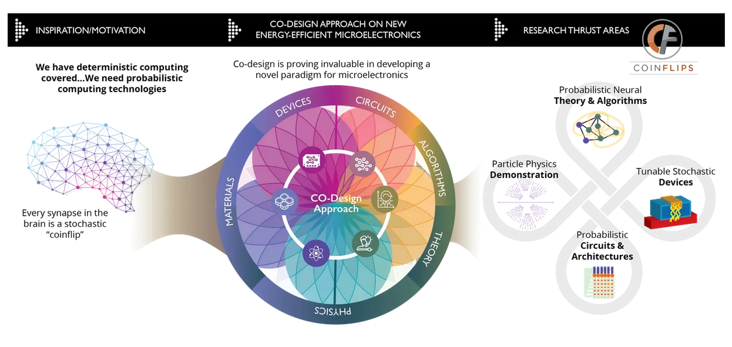
PROBABILISTIC NEURAL SYSTEMS: COINFLIPS
OBJECTIVE: Leverage stochasticity in computing by exploiting the underlying physics of emerging random number generator (RNG) devices to build probabilistic neural architectures.
Collaborators: NYU, ORNL, Temple University, UT-Austin and UT-Knoxville, USA

Slide 32
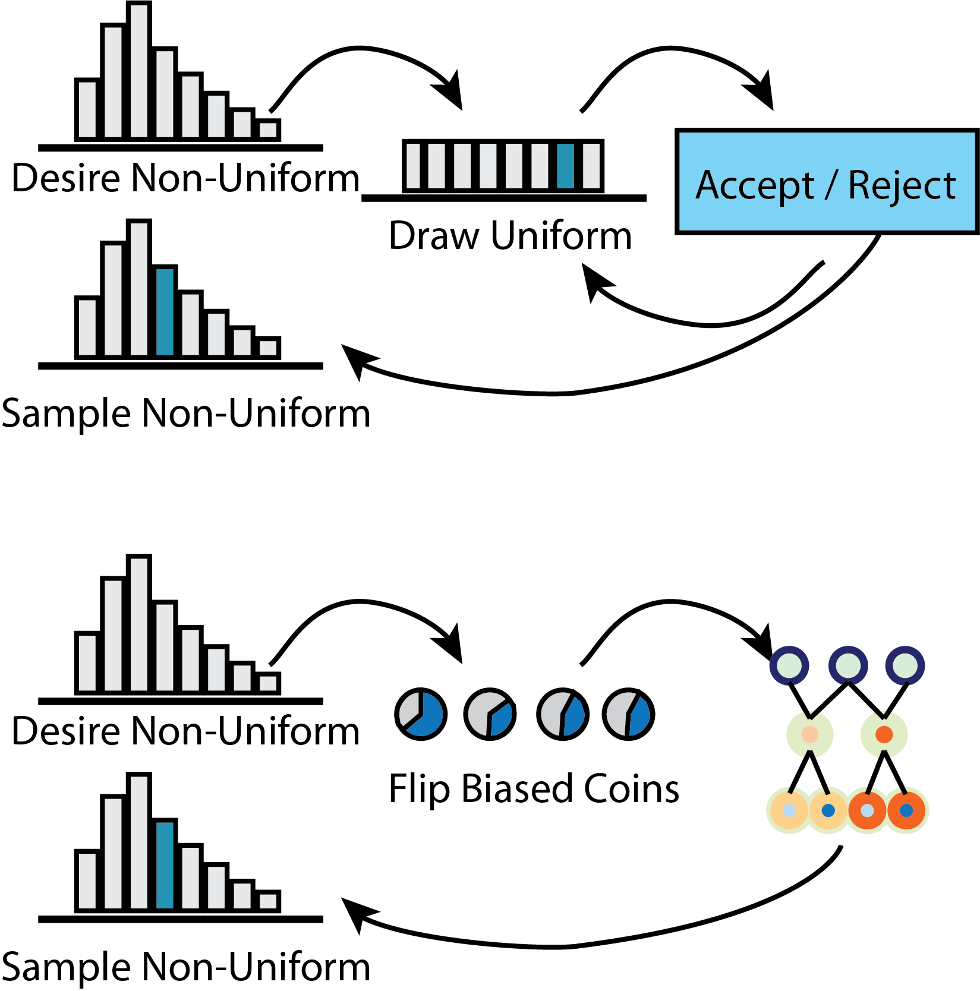
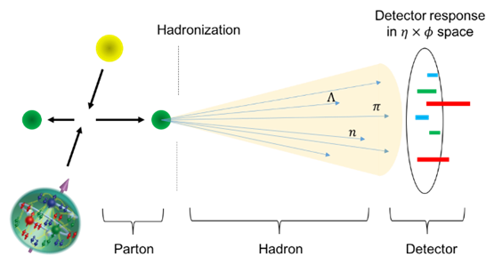
TRUE RANDOM NUMBER GENERATION (tRNG)
APPLICATION: HIGH ENERGY PHYSICS
RNG TODAY
Current PRNG Methods take 40—50% of CPU compute time.
TRNGs leveraging stochastic devices can lead to significant energy and latency savings.
Expensive
COINFLIPS APPROACH
Efficient
Pierog et al., Phy Rev. 2022
Misra et al., Adv. Materials 2022

Slide 33

AI TO ACCELERATE CODESIGN FOR EMERGING COMPUTING
AI-Guided Tools a force multiplier for large design space
Application/ Algorithm Design
System Architecture Design
Computing demands are constantly increasing.
Emerging computing techniques can alleviate these challenges.
However, the design space is huge and optimization is needed across the stack.
AI-guided techniques can alleviate these challenges.
AI-Guided Codesign
Misra et al., Adv. Materials 2022
Circuits/ System Design
Materials/Device Design

Slide 34
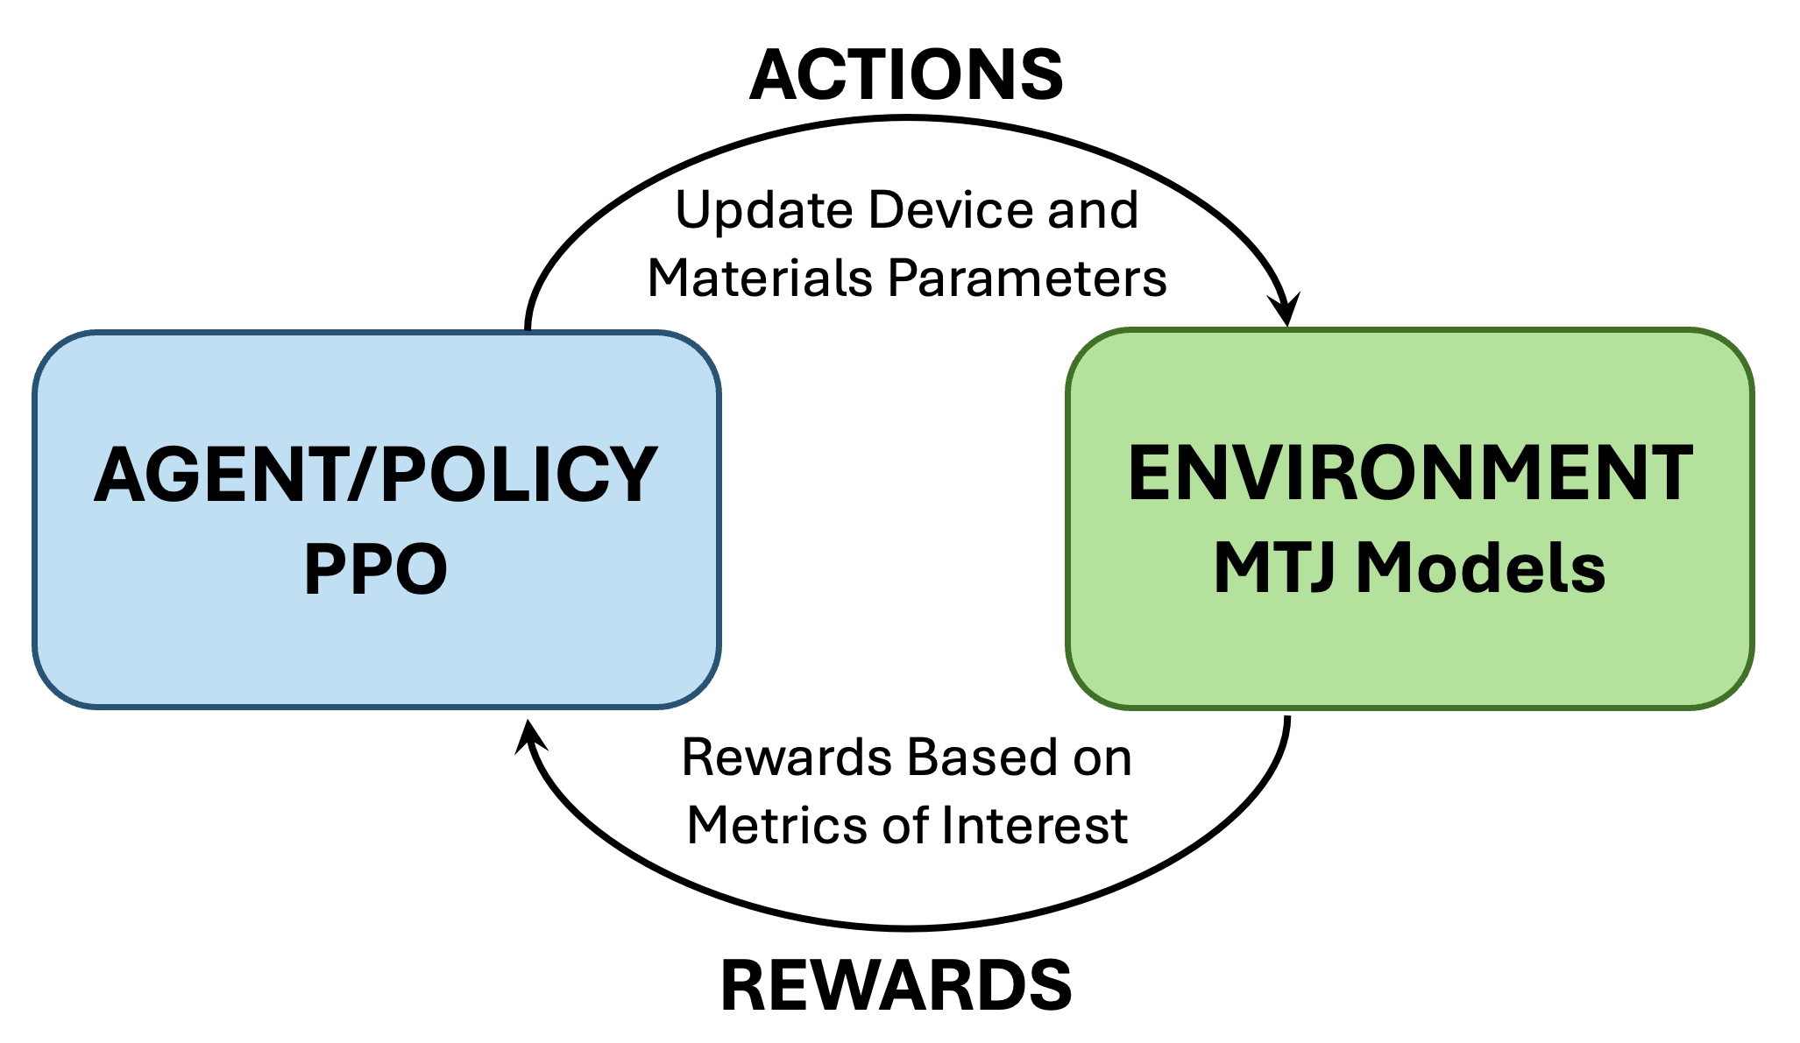
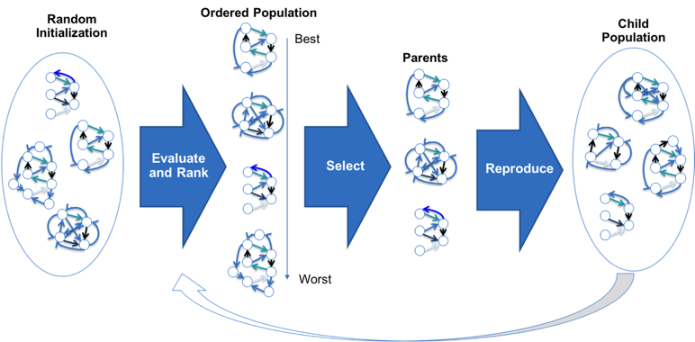
AI-GUIDED METHODS FOR EMERGING COMPUTING
EVOLUTIONARY OPTIMIZATION
REINFORCEMENT LEARNING
Evolutionary algorithms
  LEAP: Library of Evolutionary Algorithms in Python
  EONS: Evolutionary Optimization for Neuromorphic Systems
Trains agent to make optimal decisions in an environment to maximize rewards.
  Agent trained on PPO policy
  Environment: Physics-based Device model
Other AI Approaches: Physics-aware machine learning, Generative AI, Neural ODEs

Slide 35
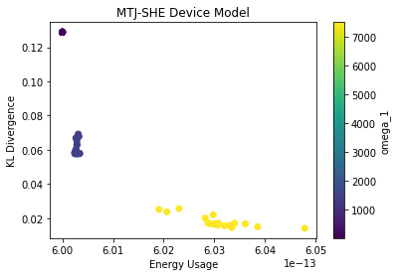
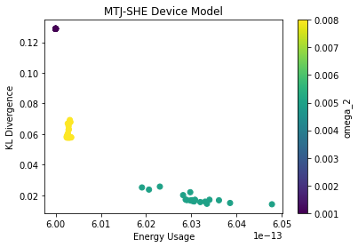


EA FOR CIRCUITS: MULTI-OBJECTIVE OPTIMIZATION
FITNESS FUNCTION
$${f(w,p1,p2,q1,q2)}^{}={\text{ω}}_{1}KL\left(p_{1},p_{2},q_{1},q_{2}\right)+{\text{ω}}_{2}(\sum_{i=1}^{2}{\left|p_{i} −0.5\right|+\sum_{i=1}^{2}{\left|q_{i} −0.5\right|)+ }{\text{ω}}_{3}EN (p_{1},p_{2},q_{1},q_{2})}$$
Kullback-Leibler
Divergence
Difference of weight from a fair coin
Energy of a coinflip
Multi-objective optimization of weights ω1, ω2, ω3 for optimal KL divergence and energy usage of MTJ-SHE devices
Cardwell et al., IEEE ICRC 2022
SHE: Spin Hall Effect

Slide 36

REINFORCEMENT LEARNING FOR DEVICE CODESIGN
Discover best device and material characteristics for TRNG
Device Check
RL agent trained using PPO policy to find best device and material configuration.
Device validity checked.
Best configuration found normalizing for energy and KL-divergence.
Metric | Best Config
Energy (J) | 2.568x10⁻¹⁴
KL-Divergence | 0.0532
Metrics: Energy, KL Divergence
Cardwell et al., IEEE ISCAS 2024

Slide 37


DEVICE PERFORMANCE TRADEOFFS
TRAINING RL AGENT
BENCHMARKING TRNGS
Agent had to balance both energy and KL-divergence for optimization which seemed to have an inverse relationship.
Reward schema is extremely important.
Comparing CMOS pRNG, tRNG, memristor tRNG and MTJ tRNG
Energy and KL-Divergence
Cardwell et al., IEEE ISCAS 2024
Maicke et al., IOP Nano 2024

Slide 38

NEXT-GENERATION NEUROMORPHIC ARCHITECTURES
Re-think how we design computer architectures
We need more dynamics and complexity per computational unit.
Leverage Stochasticity as a feature not a bug.
We need systems that do not just process, but can learn, adapt and reconfigure.
Novel integration: 3D architectures, wafer scale etc. for scaling and dense connectivity
Many areas where neuromorphic can have impact from HPC to edge.
Codesign tools can accelerate design space exploration and lead to creative solutions.
AI/ML
(ANN, SNN)
Edge
Computing
Brain-Inspired Algorithms
High Performance Computing
Scientific
Computing
Probabilistic
Computing

Slide 39

sgcardw@sandia.gov
Sandia National Laboratories
NEUROMORPHIC
Thank you!
https://neuroscience.sandia.gov/

Slide 40
BACKUPS

Slide 41


ATHENA
(Analytical Tool to Evaluate Heterogeneous Neuromorphic Architectures)
  ATHENA will quickly evaluate performance metrics of analog architectures
  Developed as part of a larger ecosystem
    Tools to enable next-generation hardware design prototyping
Digital Accelerators
Novel Computing
Plagge et al., International Conference on Rebooting Computing (ICRC) 2022

Slide 42
ATHENA – HARDWARE PERFORMANCE
ATHENA was used to compare the performance of multiple hardware devices against various deep learning networks
The SONOS tile-based architecture performed well across networks, with one notable exception: the Inception v3 network
This performance difference could be explored – showing ATHENA’s potential for codesign work
Plagge et al., International Conference on Rebooting Computing (ICRC) 2022

Slide 43
ANN Network Applications – ResNet18
  Working with a graduate student intern at SNL
  Implemented a “Dendrite Pooling Layer” for use in AI ML
  Replaced traditional pooling layer with Dendrite Layer
  Trained ResNet18 on CIFAR-10 for 300 epochs
    ResNet + Dendrite layer took significantly longer to train
    Simplified ODE layer adds state and loops
  Found accuracy to be comparable
    Dendritic pooling has potential in ANNs
Working with Priyam Mazumdar
Notes:
To also demonstrate our library’s compatibility with Torch, we swapped the pooling layer in RESNET18 with dendrites
This work is in collaboration with Priyam Mazumdar a graduate intern SNL
We dubbed it "DendNet18", but the only difference is that the pooling layer was replaced with Dendrites in Torch.
We trained on CIFAR-10 for 300 epochs
And found validation accuracy to be comparable

Slide 44

ML Network Applications – ResNet18
  ResNet18 – Was slower to train with a dendritic layer
    In hardware however, dendrites will be highly efficient
  Rough estimate of efficiency based on
    Energy = $C\left(V_{mem}−Ek\right)V_{dd}=500fJ$
      C = 10pF
      $V_{dd}$=2.5V
      $V_{mem}−Ek$ = 100mV
    Nvidia Jetson values from Rodrigues, et. al
Pooling Layer on Digital Nvidia Jetson | 504.41 Micro Joules
Dendritic pooling | 0.265 Micro Joules
Rodrigues, Crefeda Faviola, Graham Riley, and Mikel Luján.
"Energy predictive models for convolutional neural networks on mobile platforms."
arXiv preprint arXiv:2004.05137 (2020).
Notes:
Now we have some preliminary ideas as to how efficient these dendrites could be. In training, the network was significantly slower on GPU.
However - if we assume 140nm CMOS node size implementing dendrites:
Basic computation of a ResNet18 Pooling Layer
#Used ATHENA to compute energy

