Slide 1


Building blocks of Quantum-Accelerated Supercomputing
Dr. Vincenzo De Maio
TU Wien
Faculty of Informatics
HPC Research Group
vincenzo@ec.tuwien.ac.at
15th International Conference on Parallel Processing & Applied Mathematics
Ostrava, Czech Republic, September 9th , 2024
FWF START Prize 2015

Slide 2
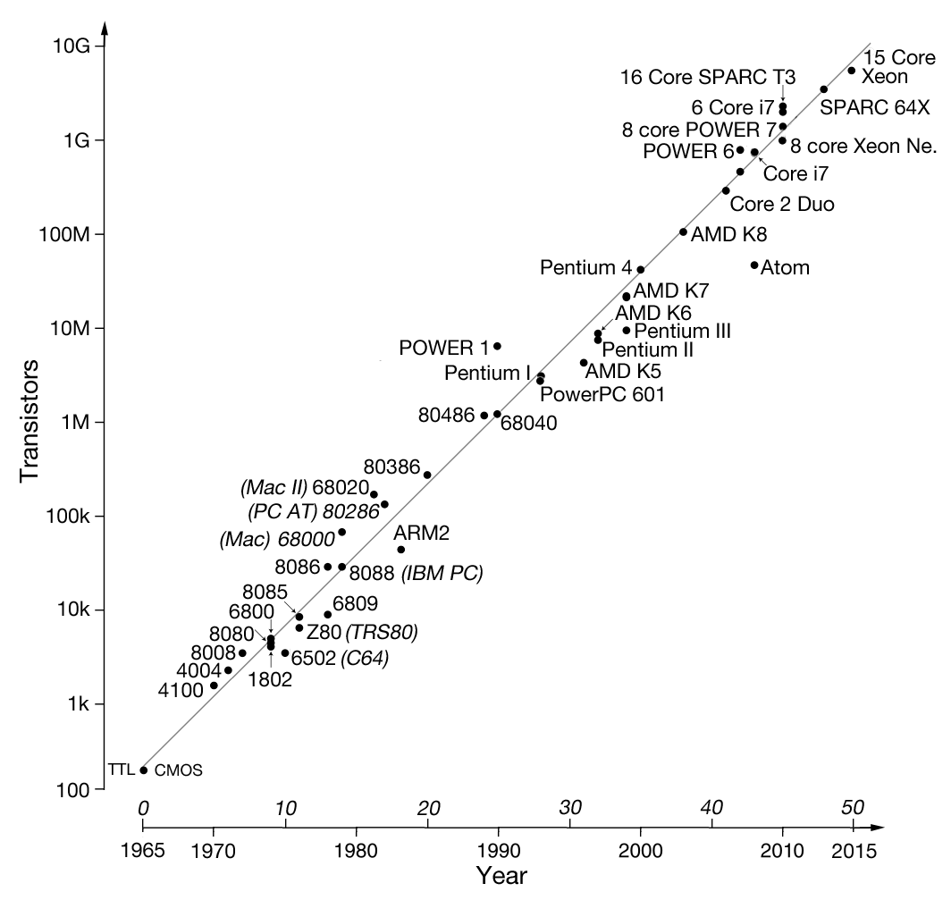
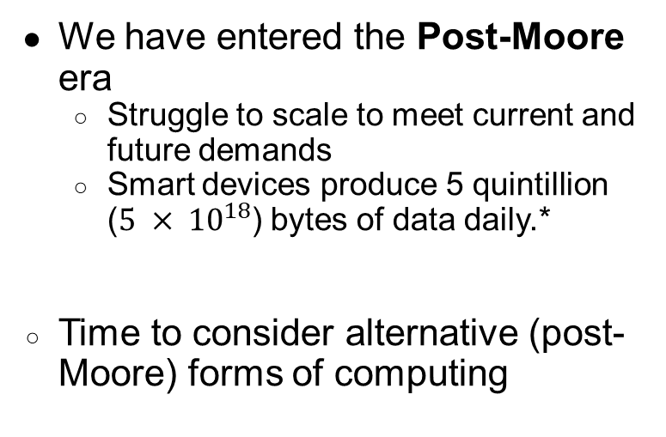
Motivation
We have entered the Post-Moore era
  Struggle to scale to meet current and future demands
  Smart devices produce 5 quintillion ($5 × {10}^{18}$) bytes of data daily.*
Time to consider alternative (post-Moore) forms of computing
Image source: https://www.elektormagazine.com/articles/moores-law
*“How Much Data Do We Create Every Day?” – Bernard Marr, Forbes, 21th May 2018

Slide 3
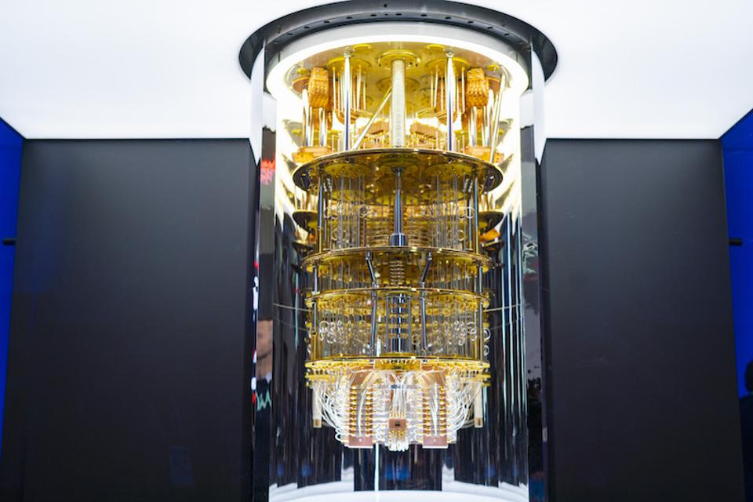
Quantum Computing
Based on principles of quantum mechanics
Exploitation of quantum effects
Theoretical speedups
IBM Q System One*
*https://www.forschungsfabrik-mikroelektronik.de/en/focus-topics/next-generation-computing/ibm-q-system-one.html

Slide 4
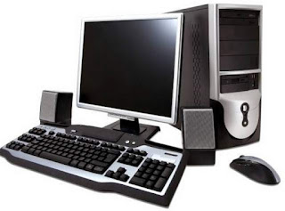
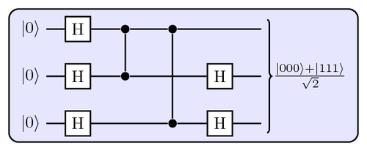
State of the art of Quantum Computers
Noisy Intermediate Scale Quantum (NISQ) architectures
Translation from classic input in quantum state
Quantum compilation (from source code to circuit)
Error correction
Pre-processing
Classic hardware
Post-processing
IBM Q Quantum System
at Semicon West
Limited number of qubits available
Limited accessibility (IBM Quantum, Amazon BraKet, Quandela…)

Slide 5
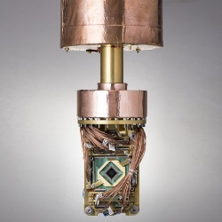
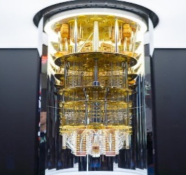
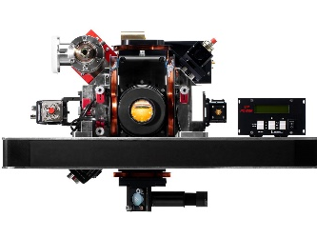
Challenges of programming Quantum-Accelerated Applications
Intrinsic non-determinism
  Different measurement ⇒ different results
  Correct results should appear with higher probability
Quantum Effects
  Superposition, Entanglement
  To achieve exponential quantum speedup, we MUST exploit entanglement (Jozsa/Linden 2003)
Hardware heterogeneity
D-WAVE**
SUPER CONDUCTING
TRAPPED
ION*
*Courtesy of AQT
**https://www.dwavesys.com/company/newsroom/press-release/d-wave-announces-quantum-hybrid-strategy-and-general-availability-of-d-wave-hybrid/

Slide 6







Our Experience: The HPQC Project
Quantum Austria Call 3.2.2.4, “Funding Instrument: Flagship Project”
Duration: 36 months (from 31/12/2022)
GOAL: Developing a dedicated quantum acceleration ecosystem connecting QC and HPC nodes
Interdisciplinary collaboration between physicists, computer engineers, and computer scientists

Slide 7
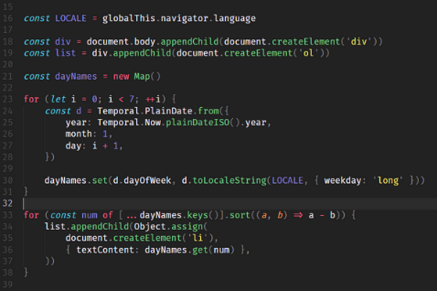




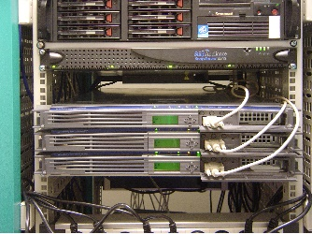
Our Building Blocks
DEFINITION
B
D
A
DECOMPOSITION
C
E
FRAMEWORKS
DEVELOPER
HARDWARE

Slide 8
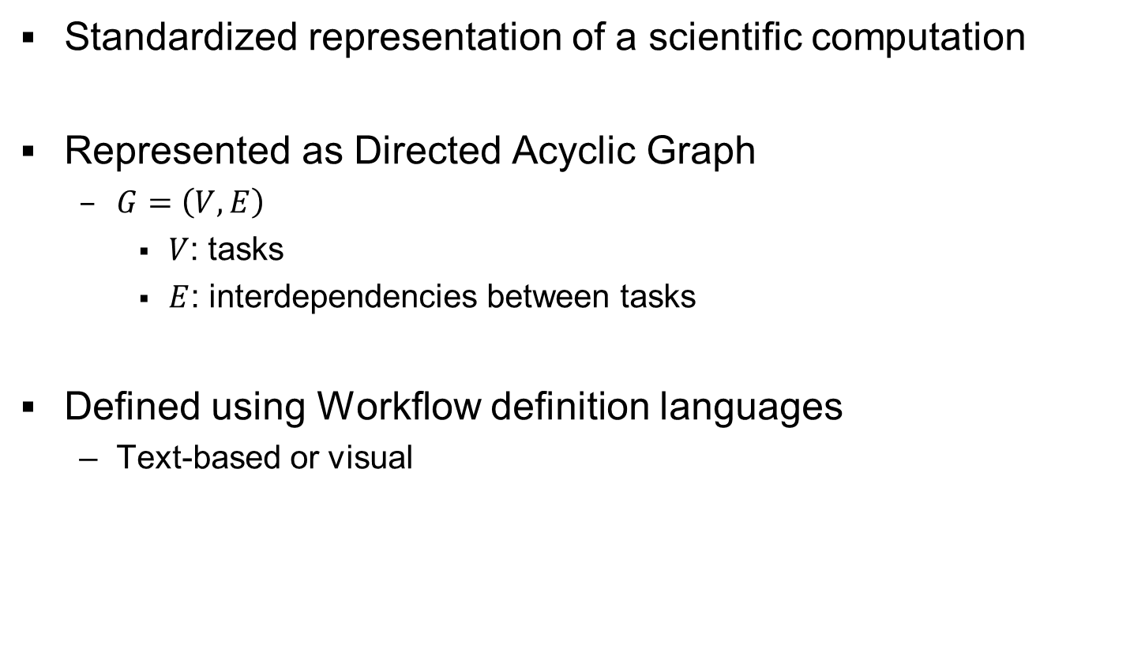
Scientific Workflows
Standardized representation of a scientific computation
Represented as Directed Acyclic Graph
  $G=\left(V,E\right)$
    $V$: tasks
    $E$: interdependencies between tasks
Defined using Workflow definition languages
  Text-based or visual
B
D
A
C
E

Slide 9





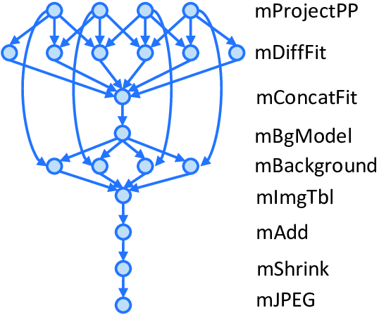




Hybrid Quantum-Classical Workflow Execution
QPU
QUANTUM TASK
MAPPER
HARDWARE CATALOG
WMS
CLASSICAL TASK
CPU
Problems:
Circuit decomposition
Mapping
Interoperation

Slide 10






















Decomposition into Hybrid Quantum-Classical Workflows
1.
2.
3.
$$A$$
$$B$$
$$C$$
$$D$$
$$A$$
$$B$$
$$C$$
$$D$$
$$A$$
$$B$$
$$C$$
$$D$$
CLASSICAL WORKFLOW
IDENTIFICATION OF QUANTUM CANDIDATES
$$B_{0}$$
$$C_{0}$$
$$B_{1}$$
MAPPING OF CANDIDATES INTO QUANTUM TASKS
4.
$$B$$
$$C$$
$$A$$
D1
D2
$$D$$
$$B_{0}$$
$$C_{0}$$
$$B_{1}$$
ADDING DECISION NODES

Slide 11



Anatomy of a Decision Node
DATA FLOW
HARDWARE CATALOG
CONTROL FLOW
Classical task
QUANTUM HARDWARE
CLASSICAL HARDWARE
HARDWARE PERFORMANCE MODEL
Quantum condition?
MONITORING LAYER
DECISION NODE
QUANTUM TASK REPOSITORY
Quantum
Task
DATA ENCODING
POST
PROCESSING

Slide 12
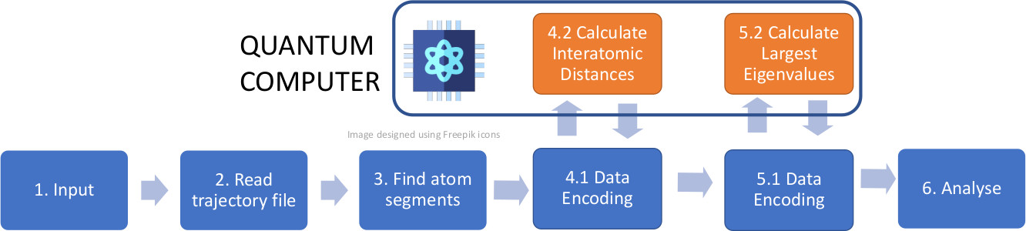
A Molecular Dynamics Use Case
Sandeep Suresh Cranganore, Vincenzo De Maio, Ivona Brandic, Tu Mai Anh Do, Ewa Deelman: Molecular Dynamics Workflow Decomposition for Hybrid Classic/Quantum Systems. e-Science 2022: 346-356
Sandeep Suresh Cranganore, Vincenzo De Maio, Ivona Brandic, Ewa Deelman: Paving the Way to Hybrid Quantum-Classical Scientific Workflows. Future Generation Computer Systems, Volume 158, 2024, Pages 346-366

Slide 13
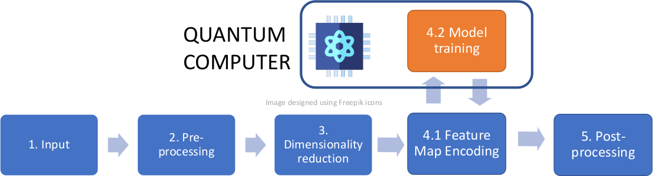
A Quantum Machine Learning Use Case
Sabrina Herbst, Vincenzo De Maio, Ivona Brandic: Streaming IoT Data and the Quantum Edge: A Classic/Quantum Machine Learning Use Case. Euro-Par Workshops (1) 2023: 177-188
Sabrina Herbst, Vincenzo De Maio, Ivona Brandic: On Optimizing Hyperparameters for Quantum Neural Networks. ArXiv, abs/2403.18579 (2024) [TO APPEAR IN IEEE QCE 2024]

Slide 14


Circuit Execution
CONTROL FLOW
DATA FLOW
PRE
PROCESSING
CPU
QPU
CPU

Slide 15


Task execution
CONTROL FLOW
DATA FLOW
$s <shots$ ?
PRE
PROCESSING
CPU
QPU
CPU

Slide 16
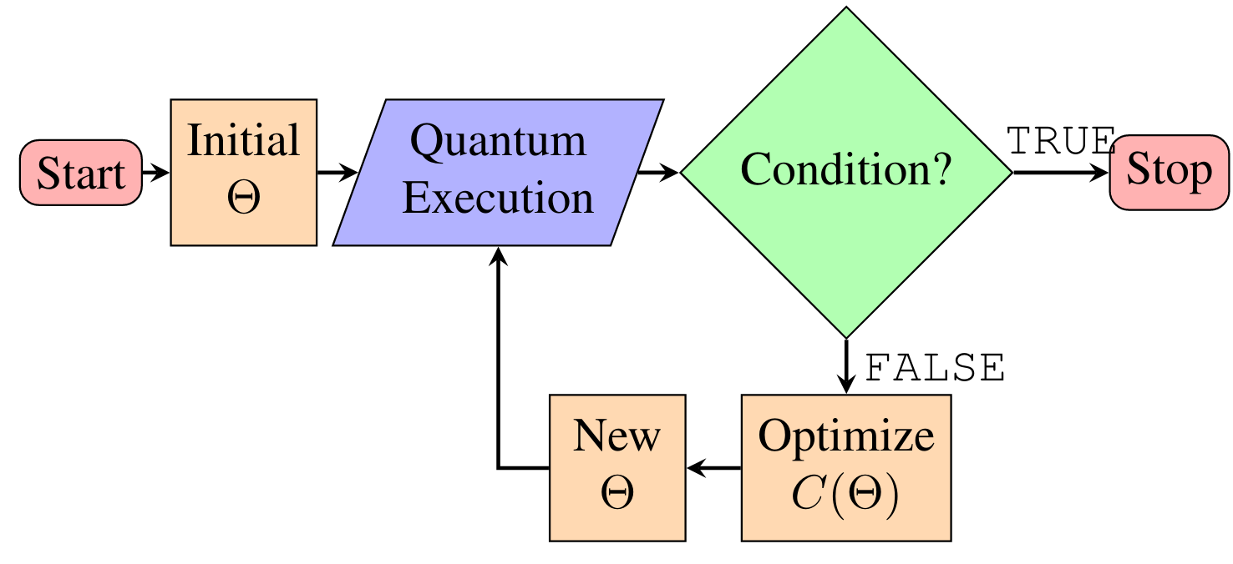
Variational Quantum Algorithms

Slide 17

Hybrid execution
CONTROL FLOW
DATA FLOW
CLASSICAL OPTIMIZER
PRE
PROCESSING
$$COND=TRUE?$$
CPU
QPU
CPU

Slide 18
Workflow definition languages
Activity definition
  Execution Model
  Declarative
  Visualization
Data-Control Flow
  Parameters and Output
  Order and conditions
Integration
  Scalability
  Extensibility

Slide 19
RIGOLETTO
woRkflow defInition lanGuage fOr quantum-cLassical sciEnTific applicaTiOns
Expressivity
Interoperability
Low redundancy
Vincenzo De Maio, Dominik Bork, Ivona Brandic: RIGOLETTO: A Workflow Definition Language for Hybrid Quantum-Classical Scientific Applications [TO APPEAR IN IEEE CBI 2024]

Slide 20



Hybrid Quantum-Classical Framework
RIGOLETTO
HYBRID WORKFLOW DEFINITION
USER
QUANTUM-CLASSICAL TASKS
QUANTUM-CLASSICAL MAPPER
ORCHESTRATION
HYBRID MIDDLEWARE
QPU
Image designed using Freepik icons
HARDWARE CATALOG
HYBRID INTER
COMMUNICATION
CPU
WORKFLOW MANAGEMENT SYSTEM
HYBRID SYSTEM

Slide 21
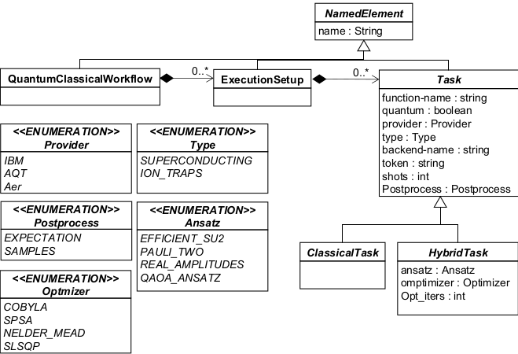
Meta-model

Slide 22
Use case : Molecular Dynamics
{
"task":
[
{
"function-name": "dist-calc",
"quantum": true,
"provider": "AQT",
"type": "ion-traps",
"backend-name": "name",
"token": "ANY",
"shots": 250,
"postprocess": "expectation"
}
]
}

Slide 23
Use Case: Quantum Machine Learning
{
"hybrid":
[
{
"function-name": "training",
"quantum": true,
"provider": "IBM",
"type": "superconducting",
"backend-name": "name",
"token": "ANY",
"shots": 1000,
"postprocess": "expectation",
"ansatz": "EfficientSU2",
"optimizer": "cobyla",
"opt_iters": 1000
}
]
}

Slide 24
The developer
Experience in
  HPC
  Software engineering
  System integration
Knowledge of
  Quantum computing
  Quantum Information Theory
  Quantum hardware
Capability of decomposing classical application into Hybrid Quantum-Classical Applications

Slide 25
Hybrid Quantum-Classical Systems Lecture
Elective Lecture in the Winter Semester 2023, TU Wien
Properties
  Semester hours: 3.0
  Credits: 4.5
  Type: Lecture and Exercise

Slide 26
Learning Outcomes
LO1: Explain how the physics of quantum computation is different from classical computational models;
LO2: Describe the theoretical performance improvements that quantum algorithms offer compared to classical algorithms;
LO3: Analyze the life cycle of hybrid applications and their execution on a hybrid classical-quantum continuum;
LO4: Describe some of the most prominent (hybrid) quantum algorithms and implement them on (real or simulated) quantum computers using quantum toolkits such as Qiskit
Vincenzo De Maio, Meerzhan Kanatbekova, Felix Zilk, Nicolai Friis, Tobias Guggemos, Ivona Brandic: Training Computer Scientists for the Challenges of Hybrid Quantum-Classical Computing [Published in IEEE/ACM CCGRID 2024]

Slide 27
Conclusion
Integration of quantum and HPC could be a promising way to address challenges of Post-Moore computing
But
  Technology is limited for now
  Heterogeneity
  Short-term research focused on small-scale applications for noisy devices
Still
  Known theoretical quantum speedup for certain tasks
  Growing interest from industry players

Slide 28
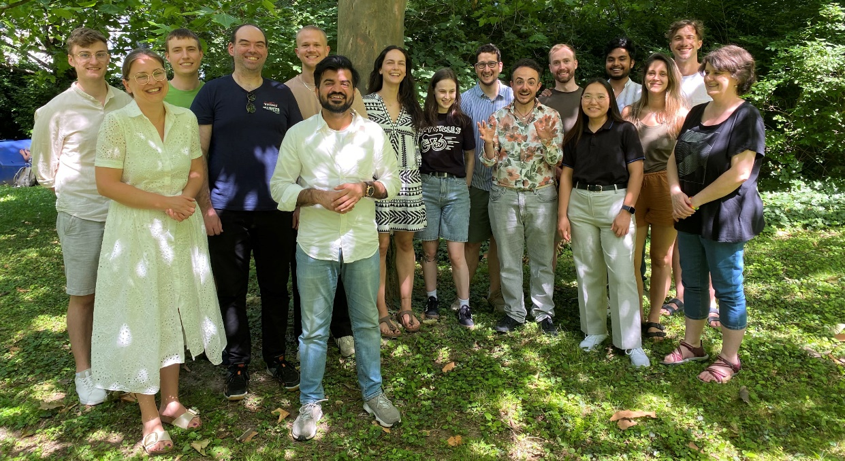

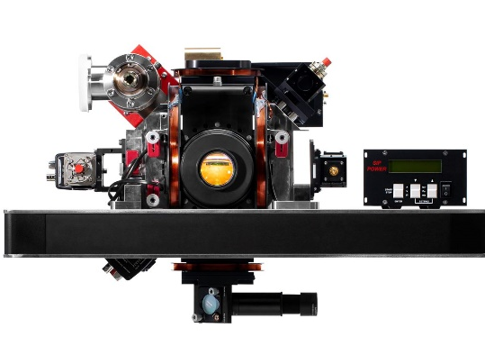
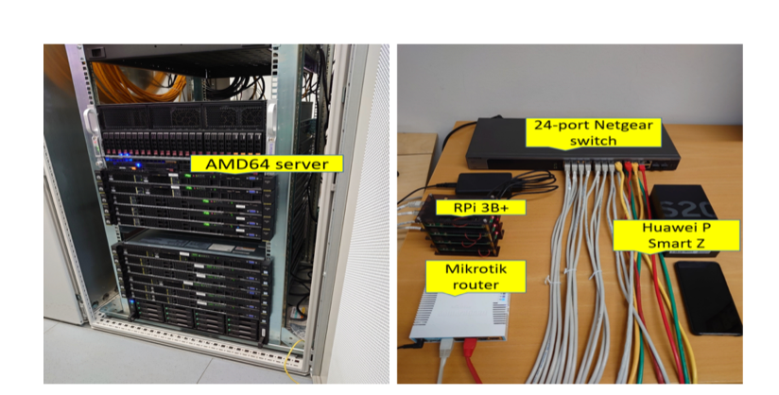
Questions?
HPC Research Group
Dr. Vincenzo De Maio
vincenzo@ec.tuwien.ac.at | https://vindem.github.io | http://hpc.ec.tuwien.ac.at
FWF START Prize 2015

