Slide 1
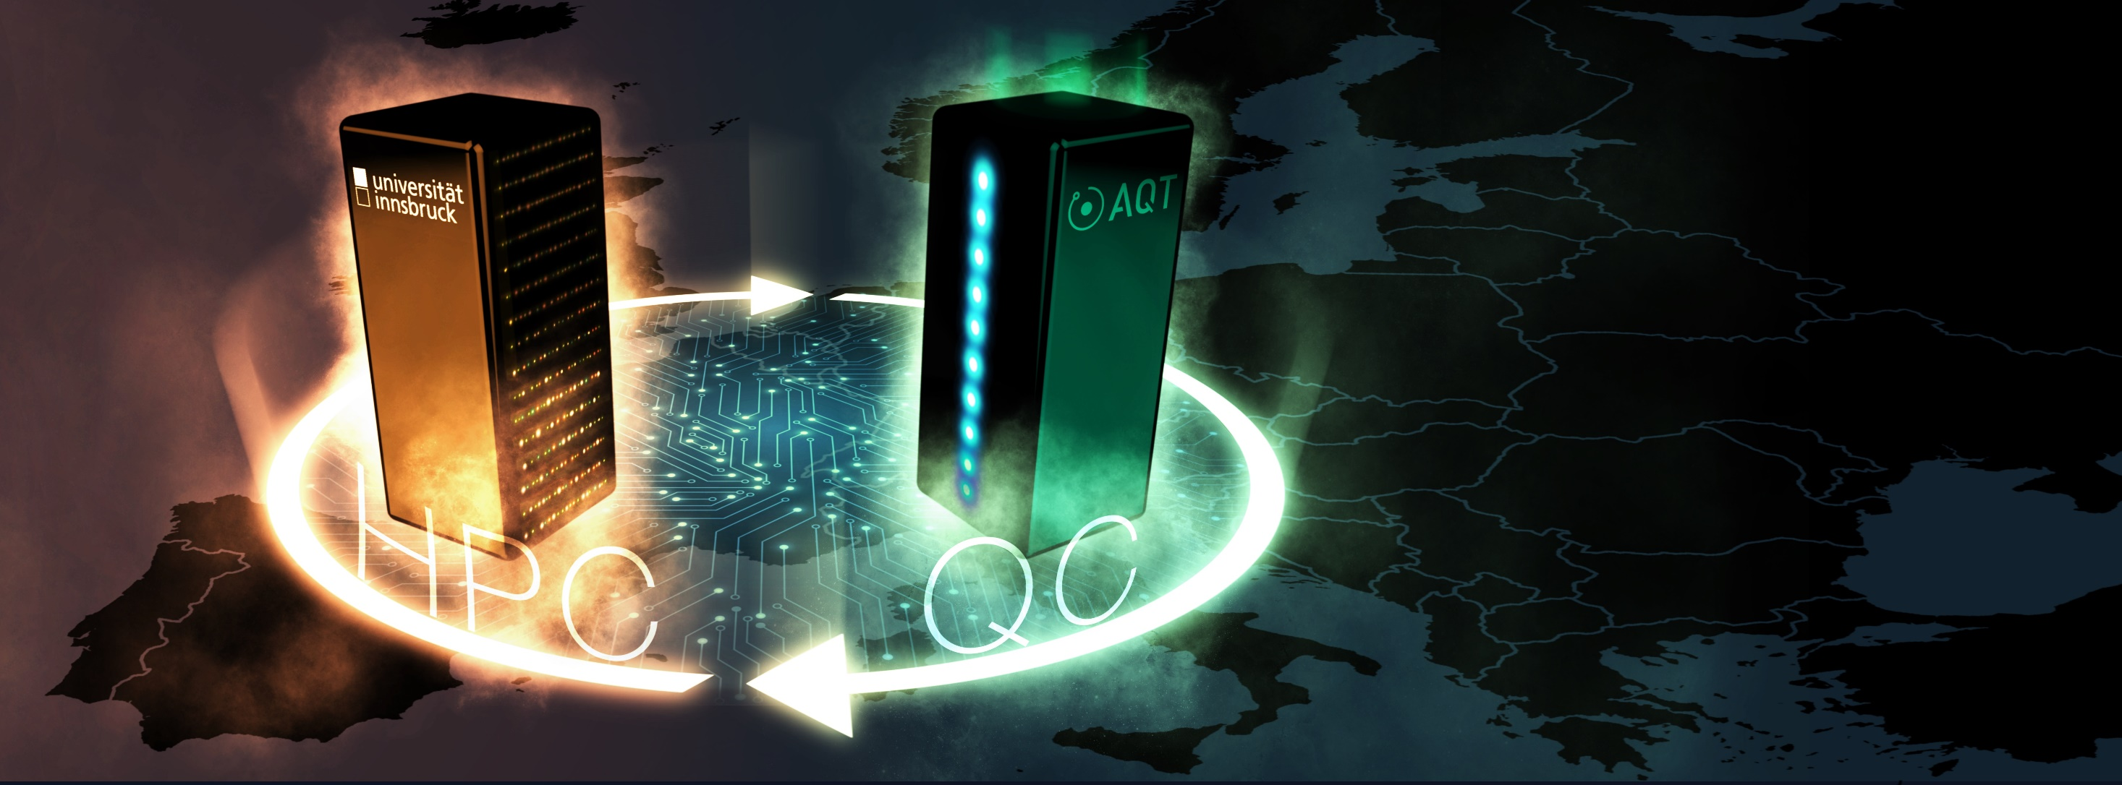
© AQT 2024
Bridging the gap: quantum accelerators (with ions) for HPC
Dr. Juris Ulmanis
PPAM 2024
9 September 2024

Slide 2
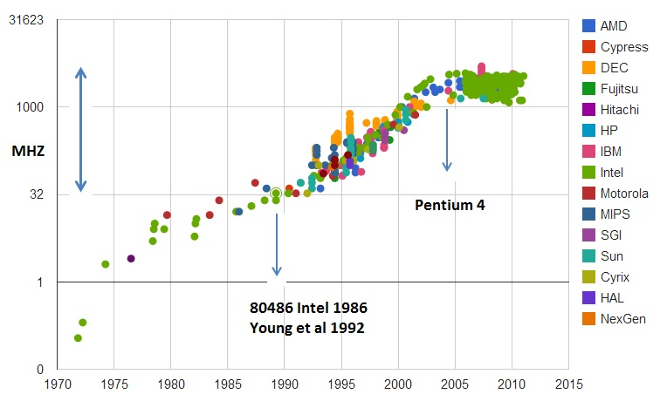

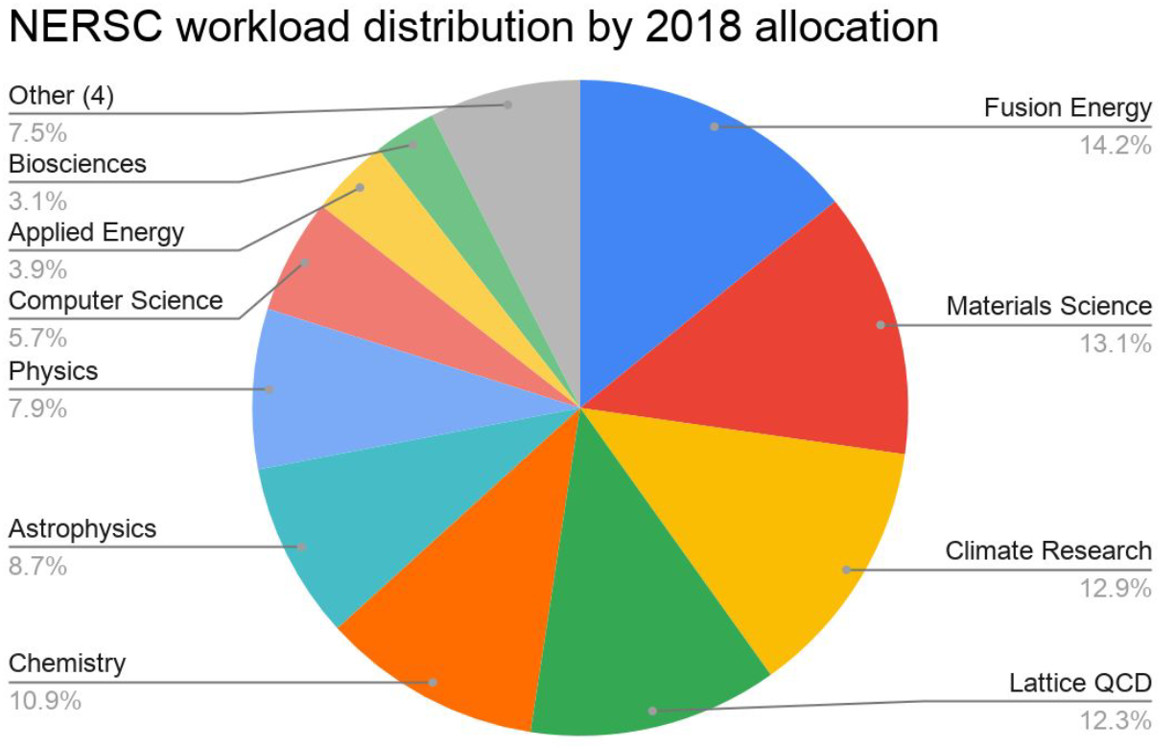




The Problem
https://en.wikipedia.org/wiki/Beyond_CMOS
https://www.nersc.gov/systems/nersc-10/workload-analysis/

Slide 3


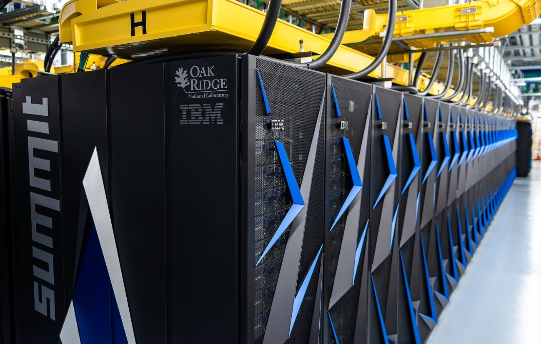
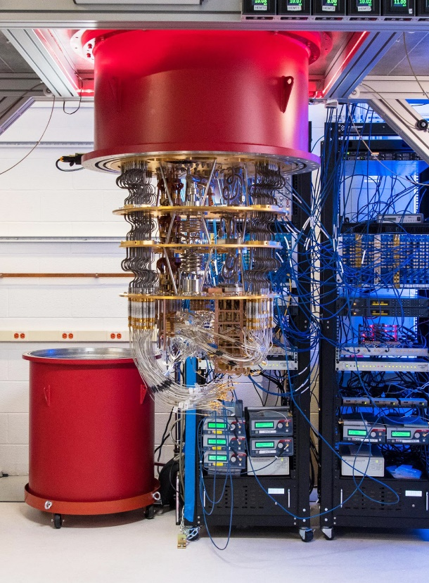
Reaching beyond classically possible
VS
Cores: 2 414 592
Linpack (Rmax): 148.60 PFlop/s
Power: 10 096.00 kW
Qubits: 0
Cores: 1
Linpack (Rmax): 0 PFlop/s
Power: ~ 15.00 kW
Qubits: 54
Cross-entropy correlation benchmark: 216 000 s (2.5 days)
Cross-entropy correlation benchmark: 200 s
https://www.top500.org/system/179397/
Nature 574, 505 (2019), arXiv:1910.09534, arXiv:2406.02501

Slide 4
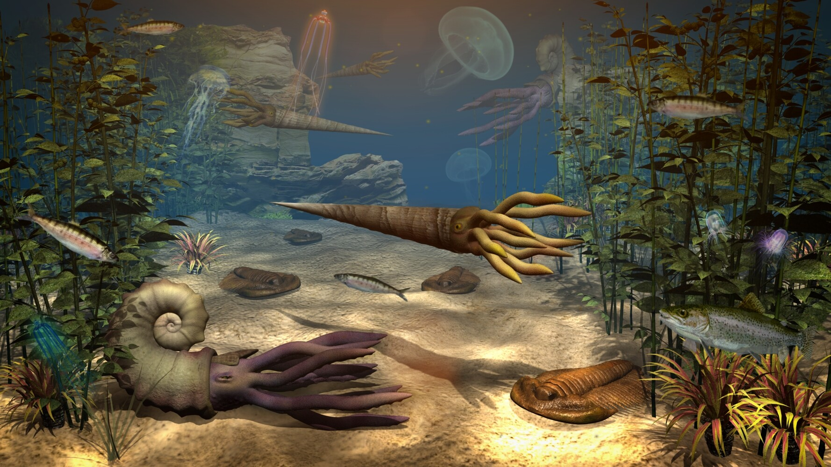
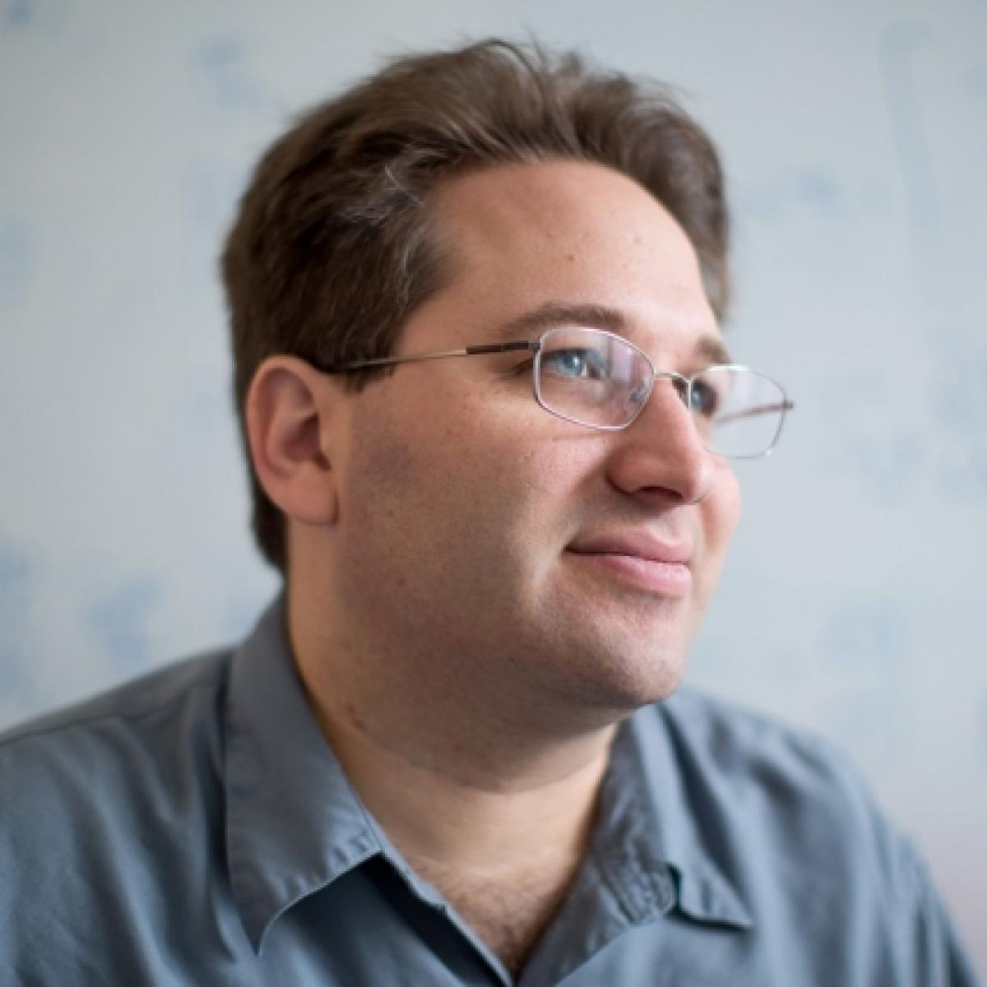
Silicon
It is sort of like visiting a nursery school to decide which of the toddlers will become basketball stars. Scott Aaronson, UT
Colour Centers
Trapped Ions
Photons
Superconducting Circuits
Ultracold atoms

Slide 5
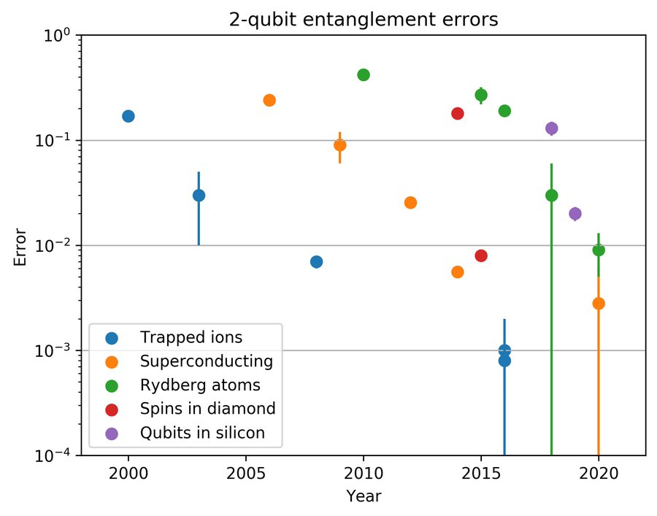
QC performance – Gate fidelities
IBK
IBK
https://twitter.com/quantumpod/status/1355467206881062912

Slide 6
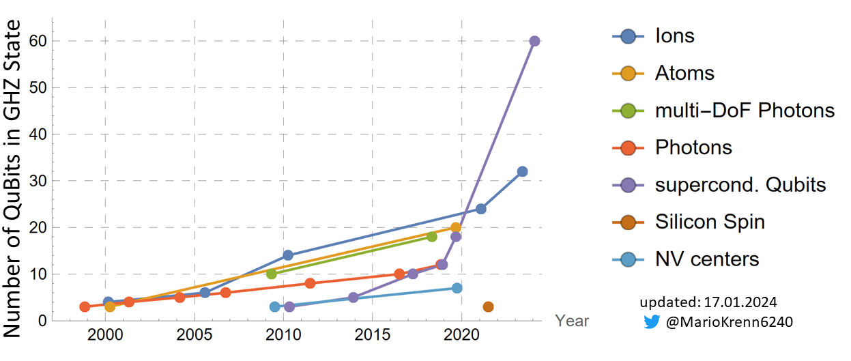
QC performance – Entanglment generation
AQT/IBK
IBK
IBK
https://mariokrenn.wordpress.com/2021/01/29/reference-list-for-records-in-large-entanglement-generation-number-of-qubits-in-ghz-states/

Slide 7
Focusing on quality, not quantity
UIBK/AQT
O. Ezratty, arXiv:2305.09518

Slide 8
Identical by nature
Longest coherence time
Optically controlled

Slide 9
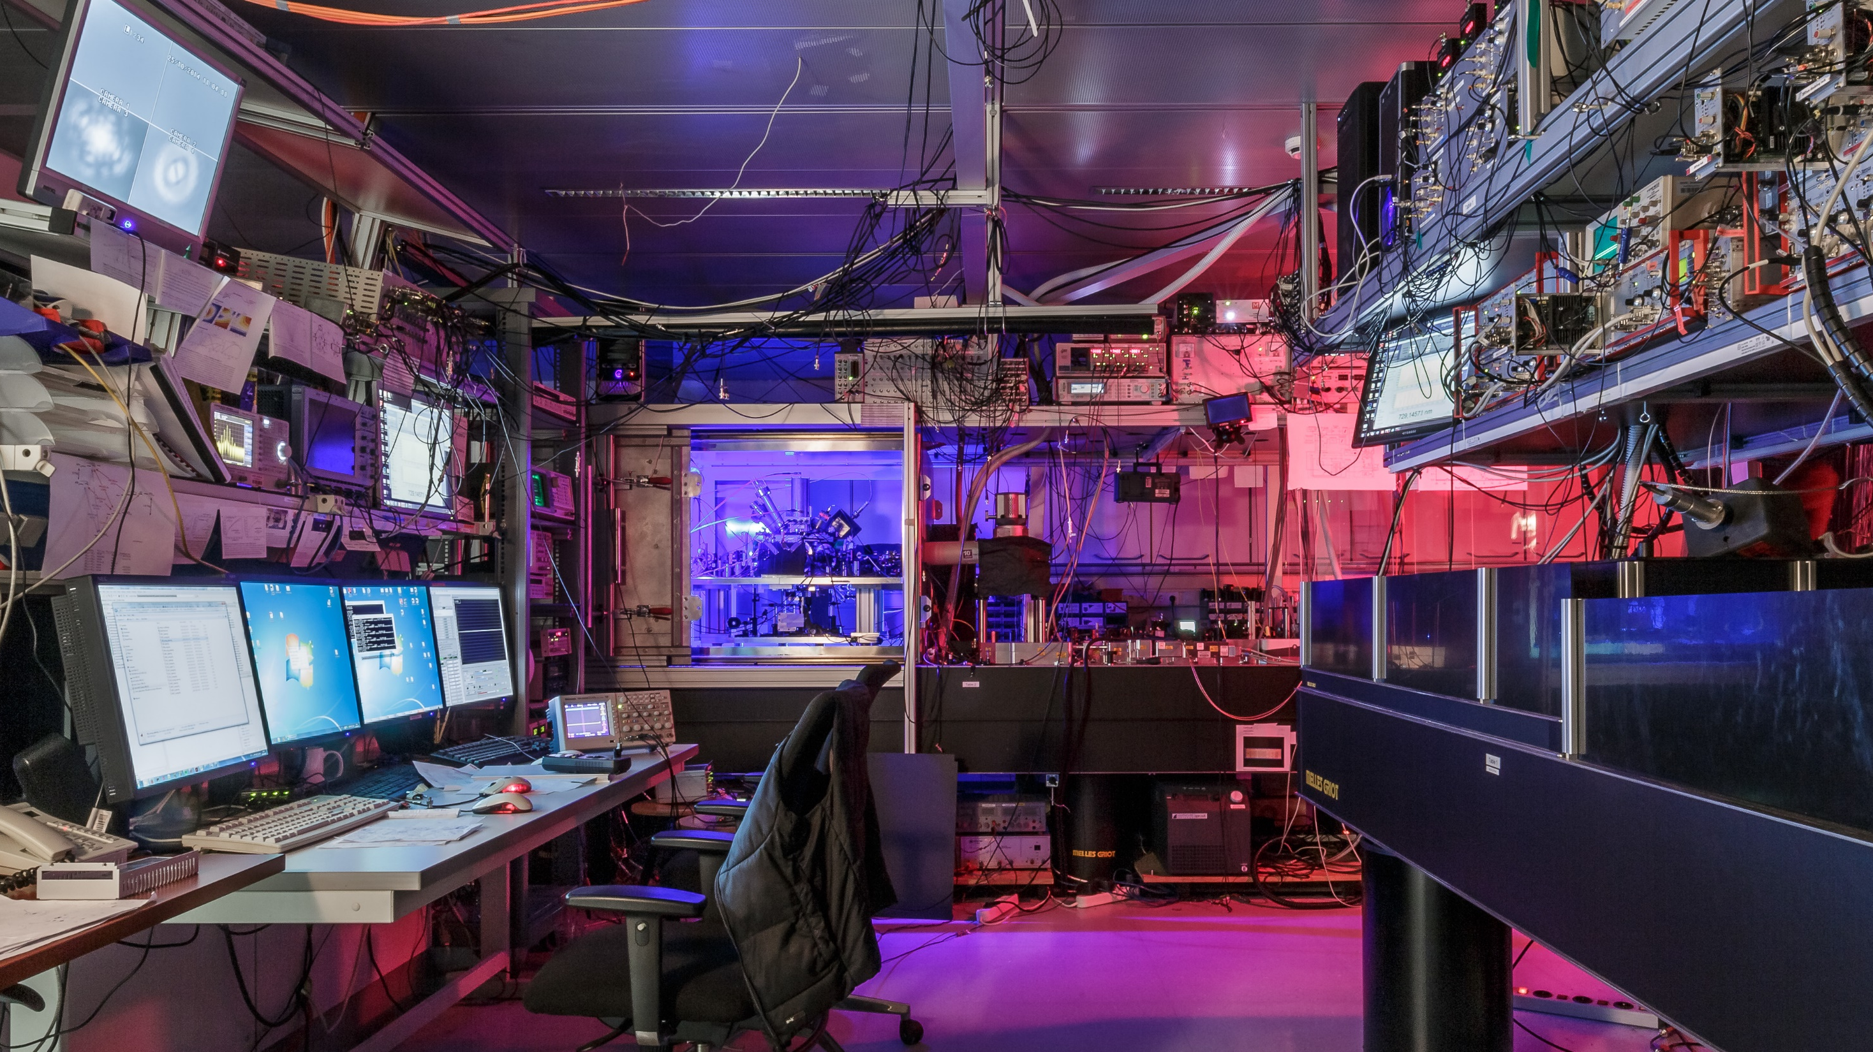

Lab-Based Quantum Computing with Trapped Ions

Slide 10
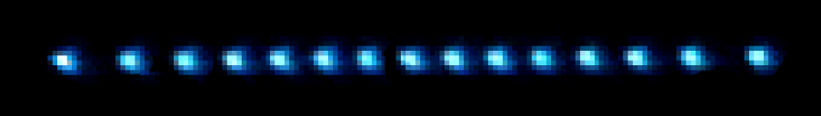
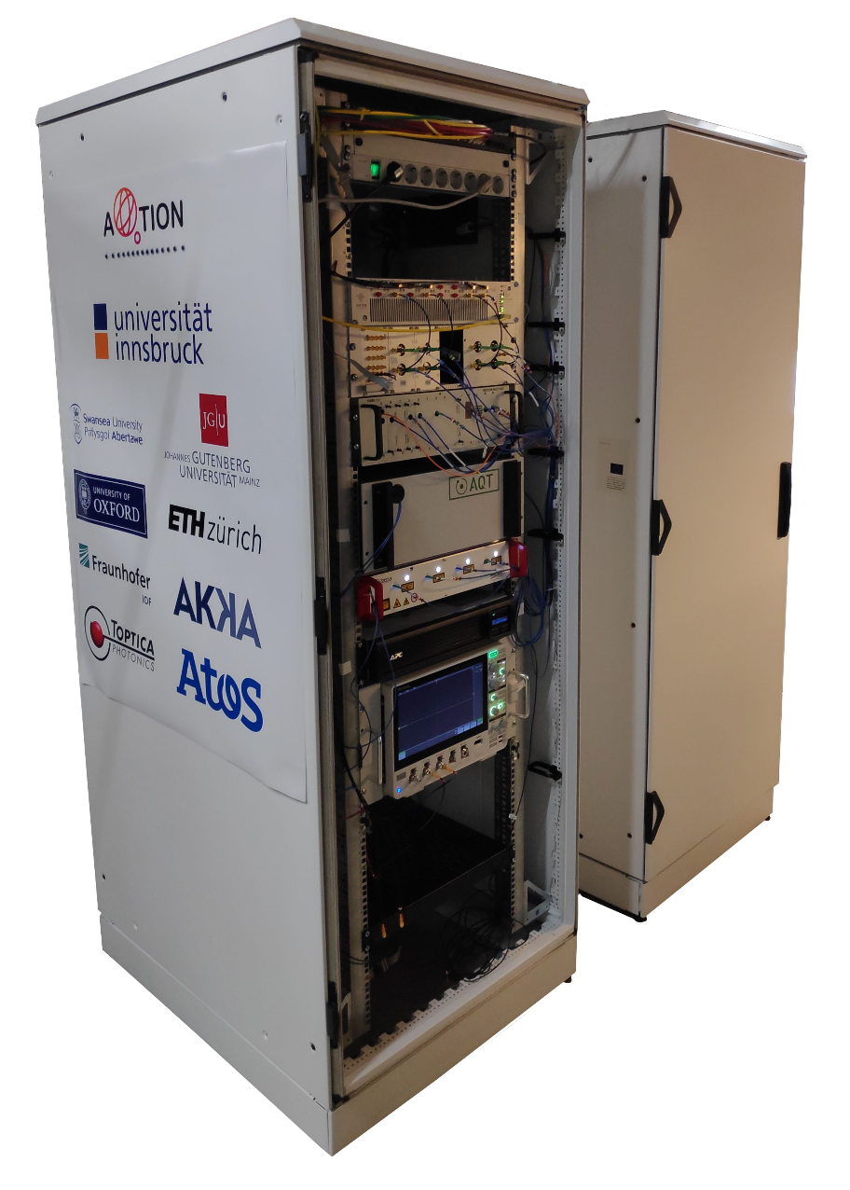



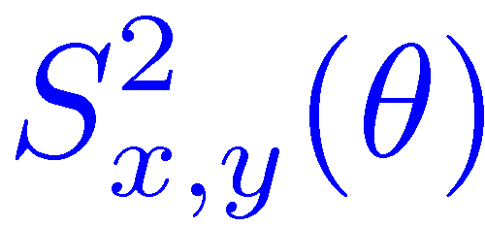
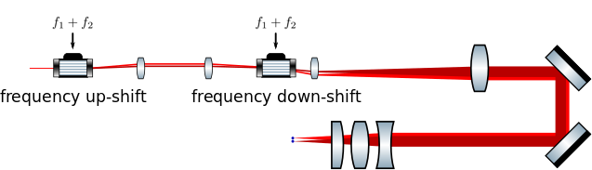
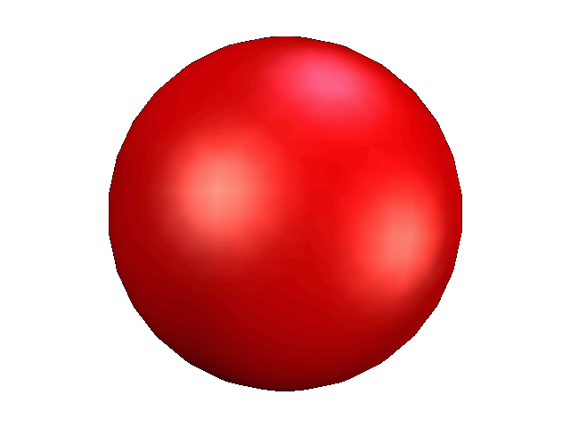
The workhorse at UIBK …
Individual (and parallel) local operations
Control capabilities
⁴⁰Ca⁺
D_{5/2}
T1 approx 1s
T2 approx 500 ms
Routinely work with 20+ ions
Demonstrated 24q-GHZ state
Supports Qiskit/Cirq/…
resonant
manipulation
off-resonant
manipulation
+
+
+
S_{1/2}
τ = 20μs
F > 99%
Local Mølmer- Sørensen entangling gate
Automated tune-up
Single-qubit control
Single-setting MS up to 20 q despite full connectivity N² speed-up
Tune-up to > 99% in 30 sec
Simultaneous addressing of multiple ions
+
+
+
+
τ = 100μs
F ~ 99%
PRX Quantum 2, 020343 (2021)

Slide 11
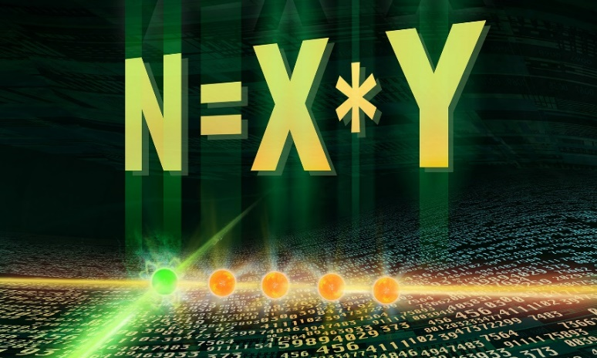
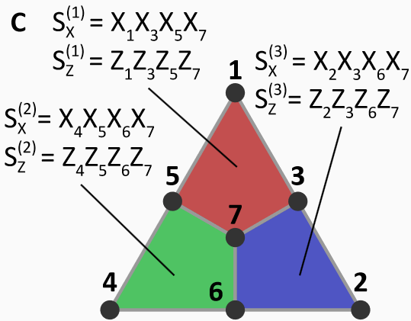
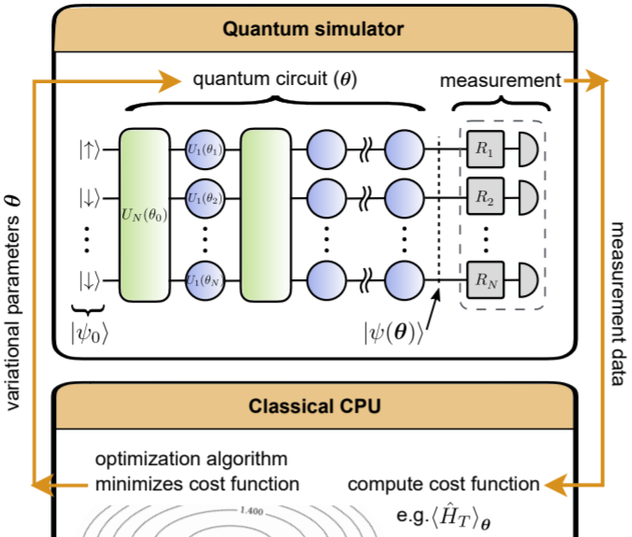
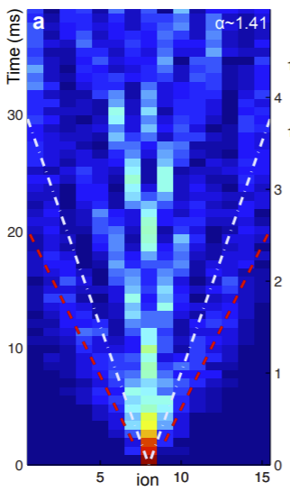
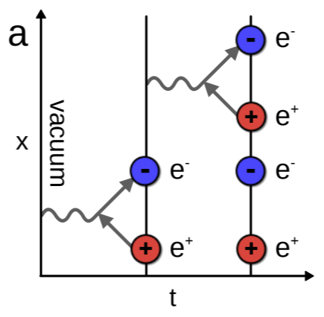
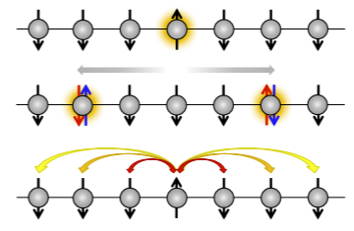
Some Highlights: Algorithms and Applications
Shor‘s Algorithm
Quantum Error Correction
Variational quantum simulations
T. Monz et al., Science 351, 1068 (2016)
L. Postler et al., PRX Quantum 5, 030326 (2024)
C. Kokail et al., Nature 569, 355 (2019)
Qubit surgery
Lattice gauge theories
Quasiparticle engineering
A. Erhard et al., Nature 589, 220 (2021)
E. A. Martinez et al., Nature 534, 516 (2016)
P. Jurcevic et al., Nature 511, 202 (2014)

Slide 12

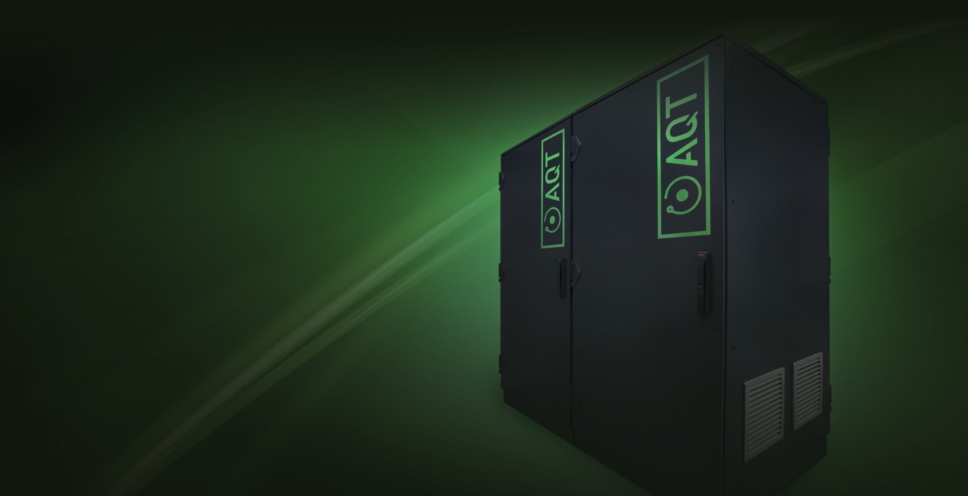
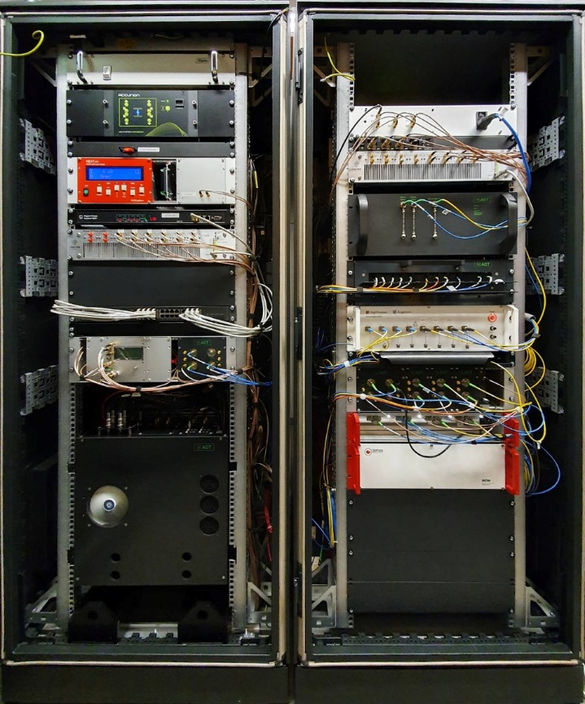
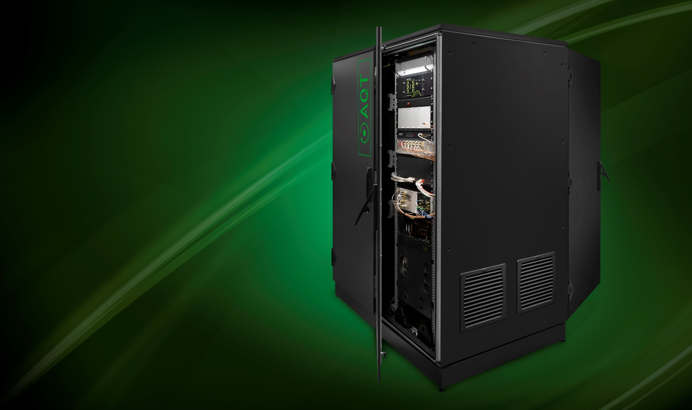
AQT QUANTUM COMPUTING SYSTEMS
INSIDE INDUSTRY-STANDARD 19’’ RACK
AQT DEMONSTRATED
50+ ion-qubits
Universal gate set
24-qubit entanglement
Quantum Error Correction
Fault-tolerant performance
Quantum Volume of 128
Numerous use cases
WITH THE SYSTEM BEING
Rack-mounted
Cloud-accessible
Data-center compatible
© AQT 2024
https://www.aqt.eu/qc-systems/

Slide 13
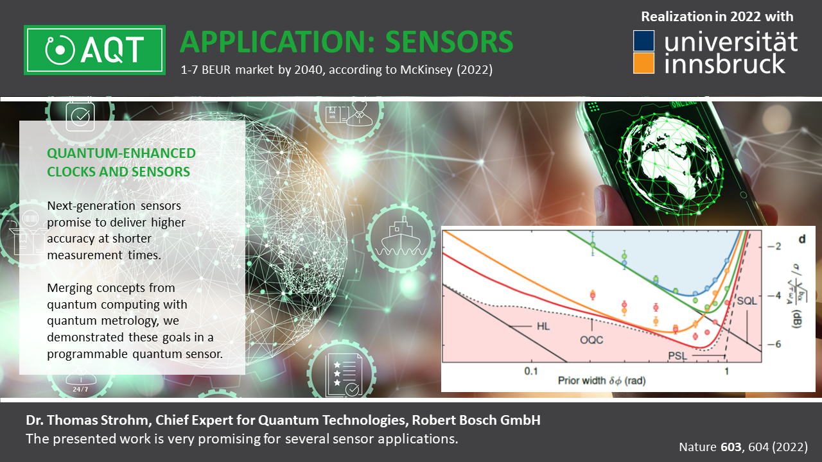
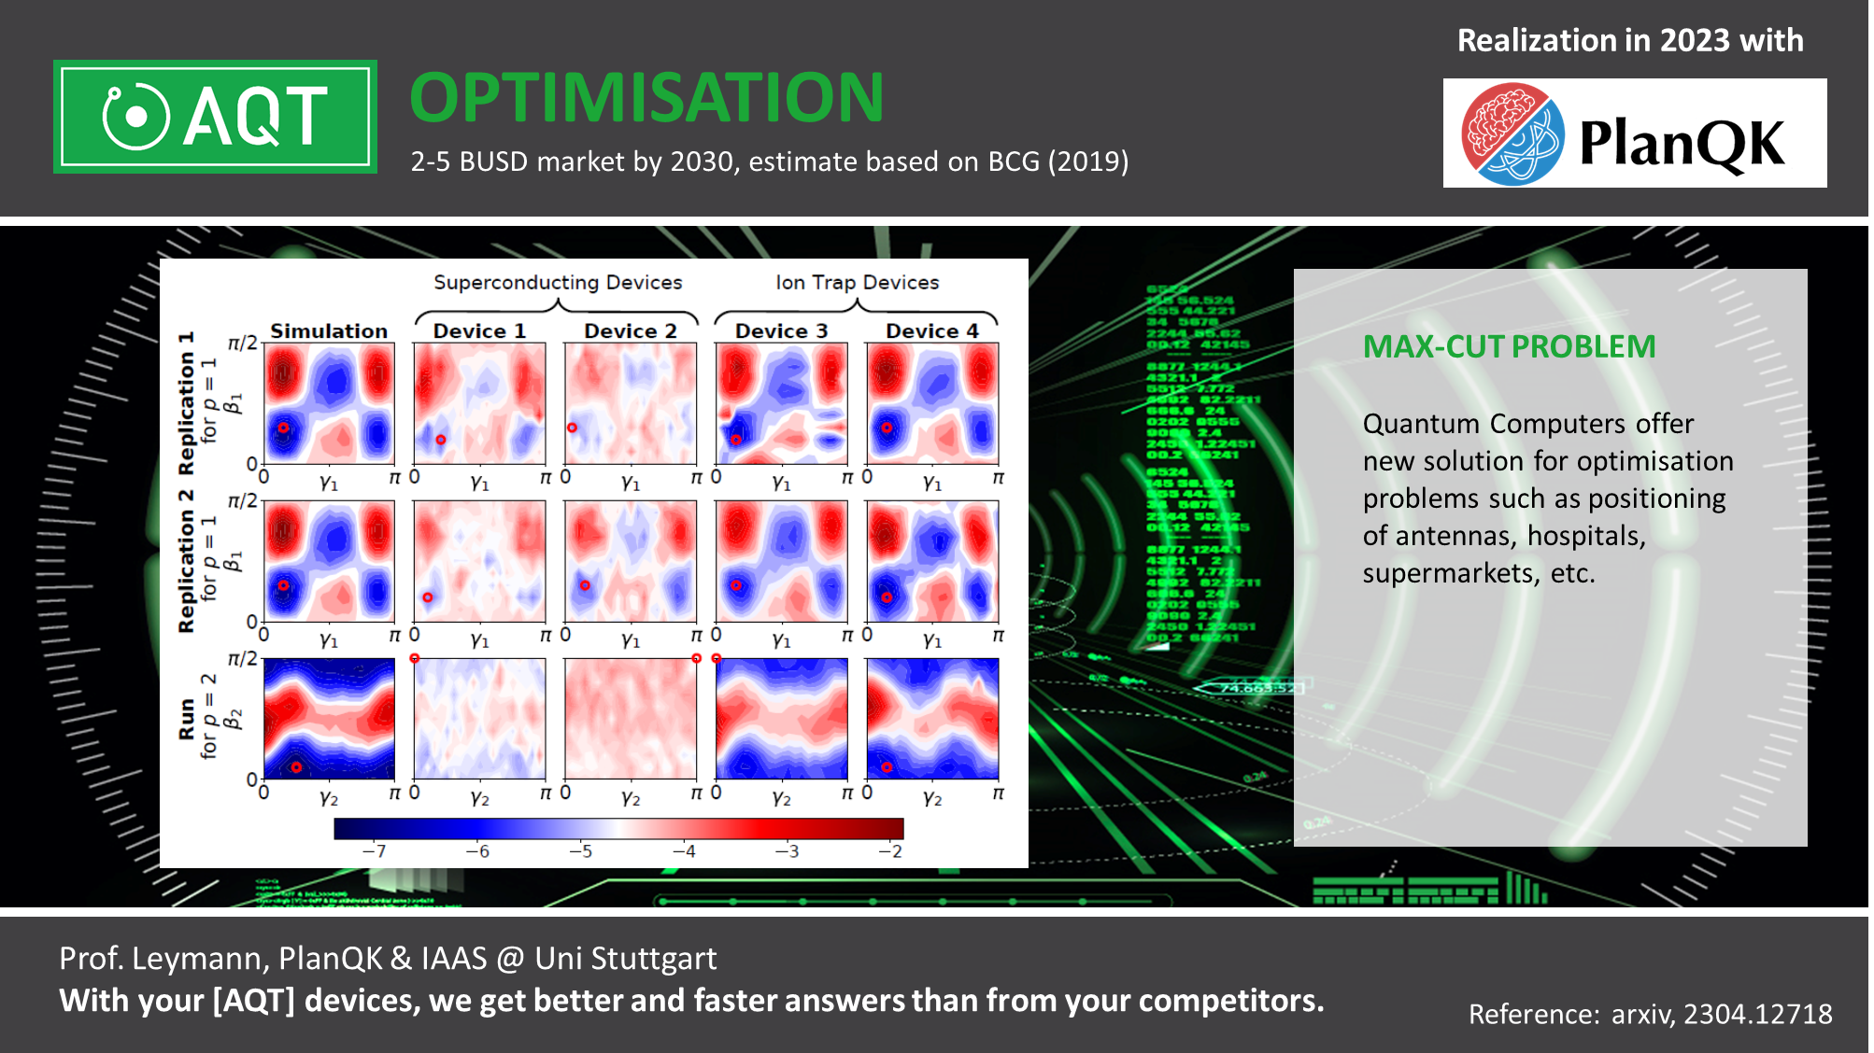
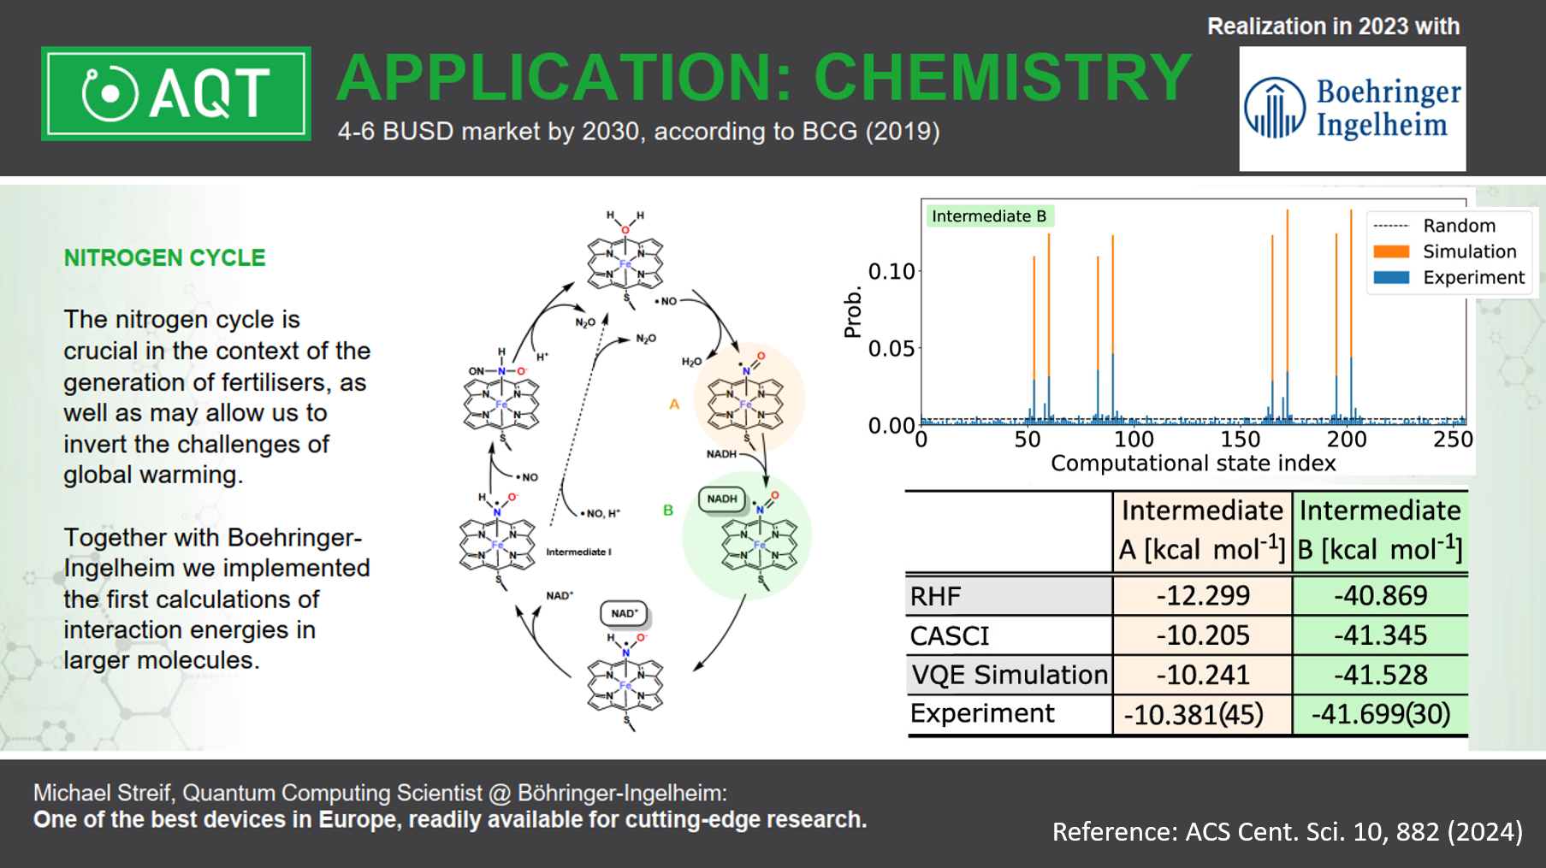
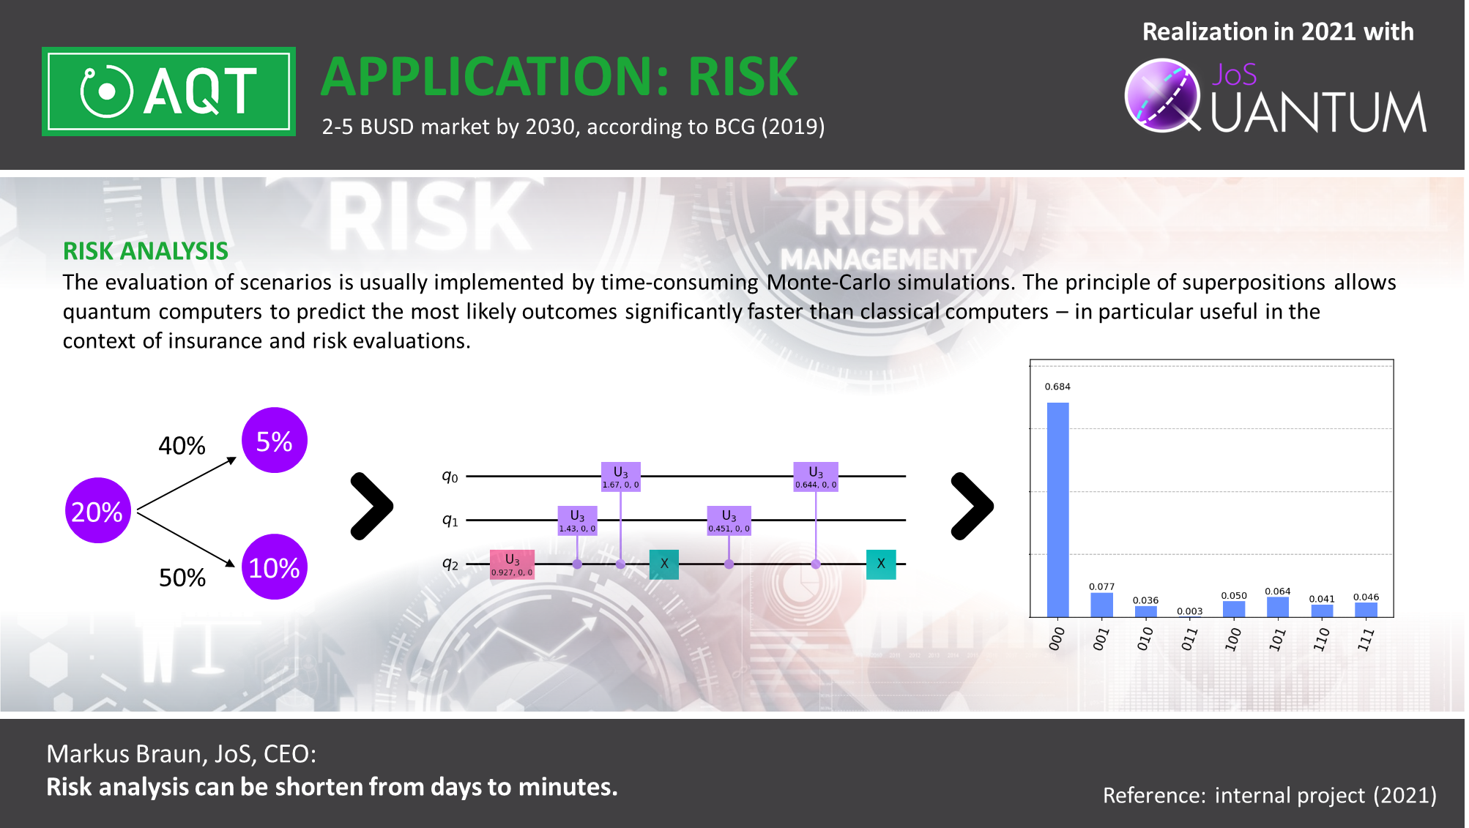
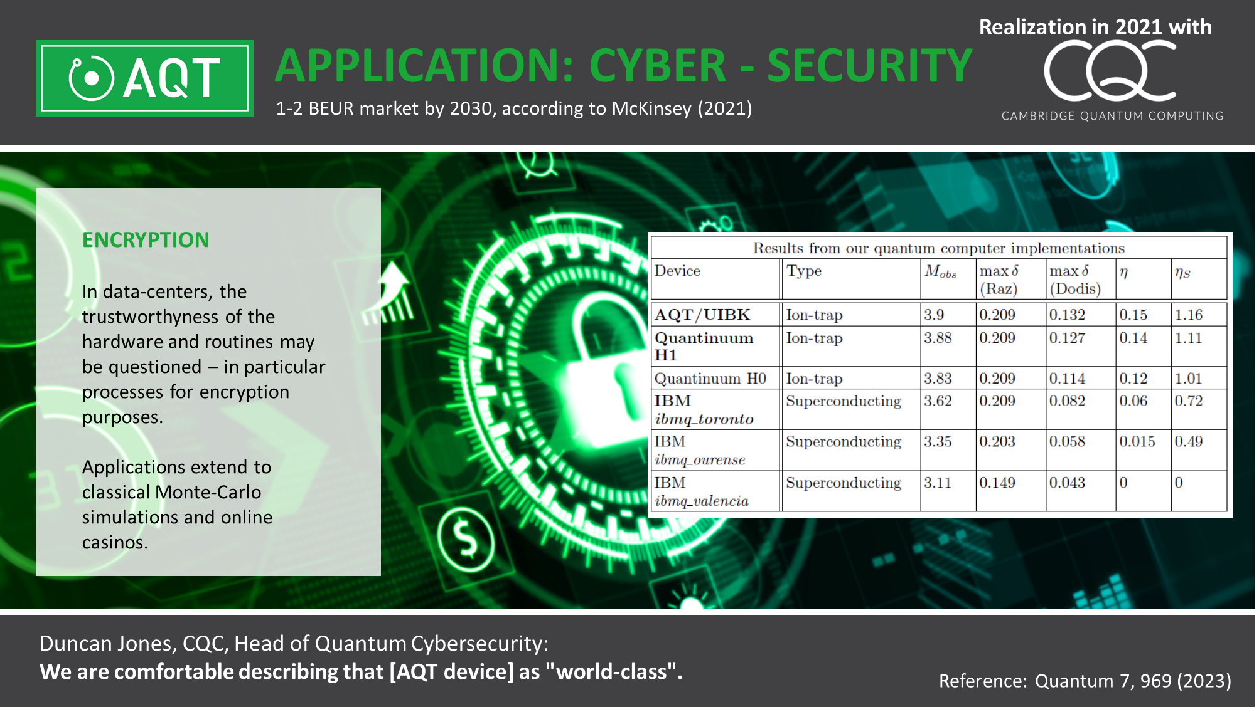
Reference: IEEE QCE 2, 181 (2023)

Slide 14
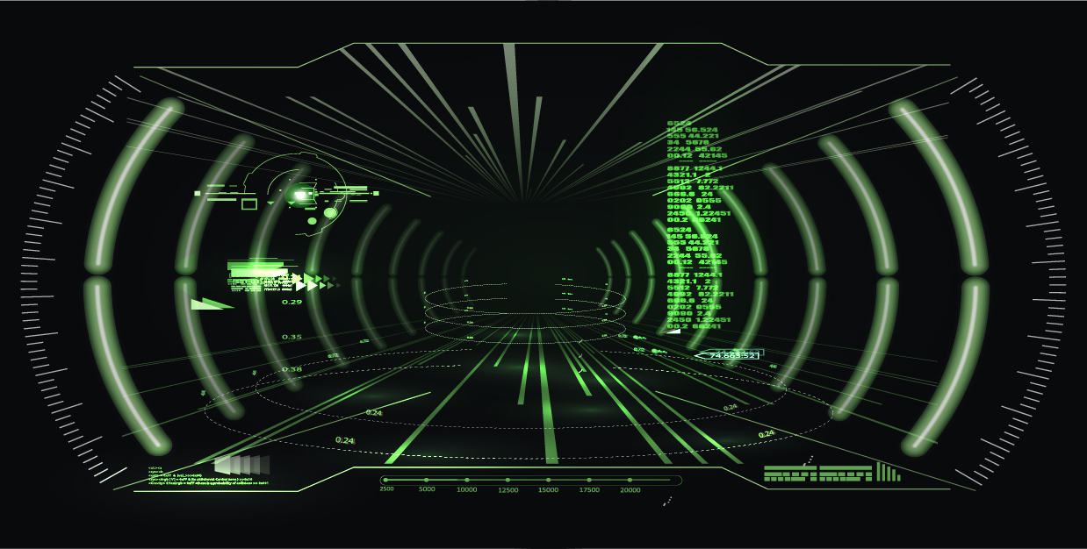
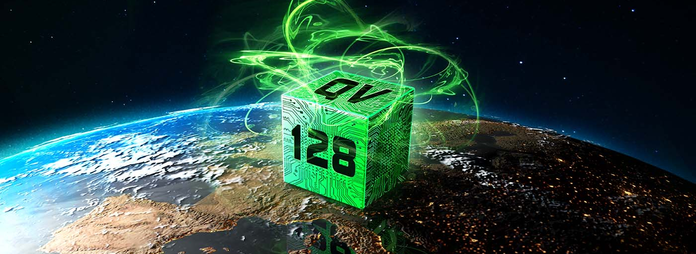
Holistic Performance
Evaluating the quality of our quantum computer
QUAntum Volume
Achieving high fidelity control in continously larger registers, while maintaining versatile computations, and achieving sufficient output quality is highly challenging.
We demonstrate a quantum volume of 128, which outperforms all devices in Europe.
https://www.aqt.eu/quantum-volume-128/

Slide 15
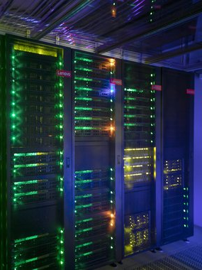
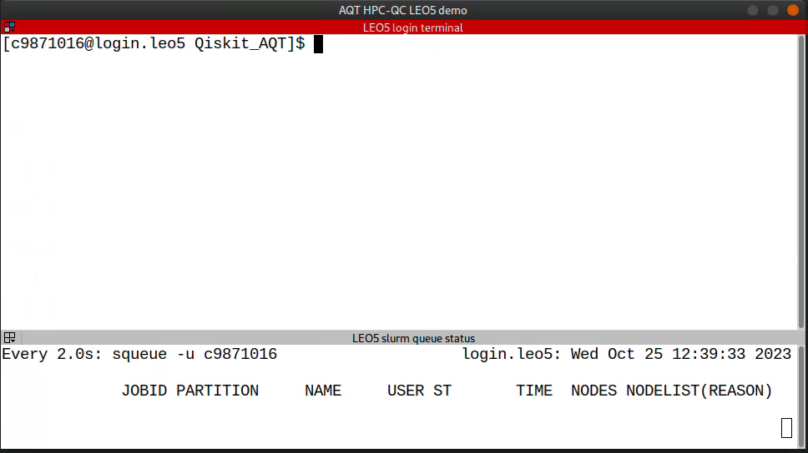
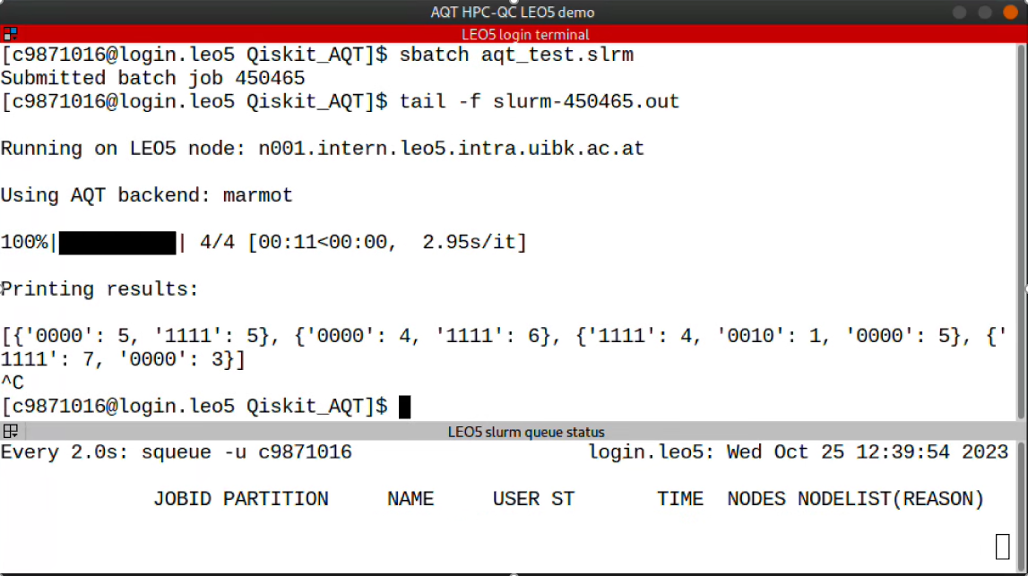



Hybrid HPC-QC execution
We demonstrate the first integration of a QC into an HPC infrastructure within Europe!
Next steps: “Quantum-aware” libraries, hybrid applications, …

Slide 16

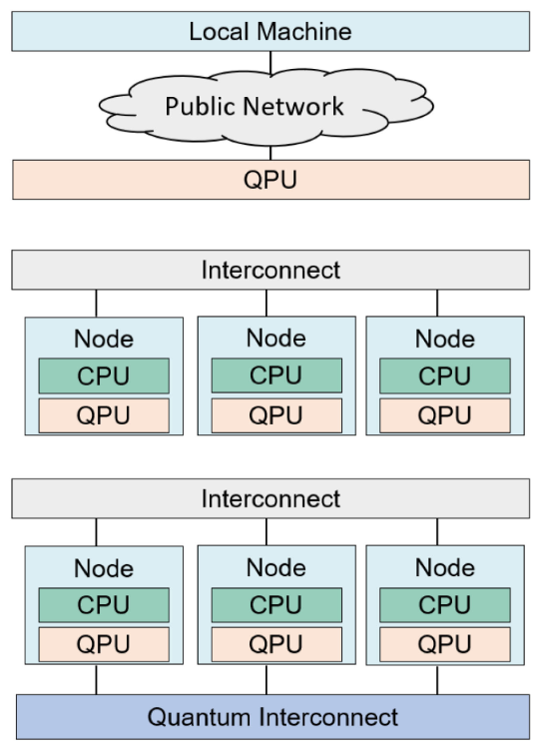

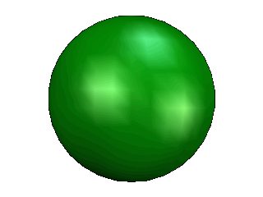
INTEGRATING CLASSICAL AND QUANTUM
Macroarchitecture design paradigms
Macroarchitecture design paradigms
LOOSE INTEGRATION
TIGHT INTEGRATION
Hybrid workloads with classical and quantum co-processing within coherence time of the qubit
Enabler for quantum error correction and quantum advantage
Requires co-location of QC and CPU
IEEE Micro (Volume: 41, Issue: 5, 01 Sept.-Oct. 2021)

Slide 17
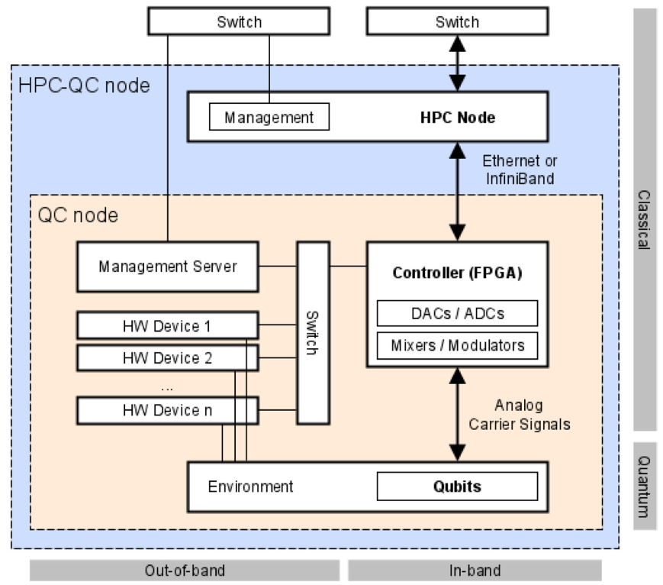
Tight HPC-QC integration
In-band scope
Within the coherence time of the qubit (within a quantum circuit)
Analog/digital signal generation
Quantum gate implementation
Mid-circuit measurements and operations
Quantum Error Correction
Out-of-band scope
Longer than the coherence time of the qubit (overarching several quantum circuits)
Workload management and scheduling
Compilation/transpilation
Environment monitoring and calibration
IEEE Micro (Volume: 41, Issue: 5, 01 Sept.-Oct. 2021)

Slide 18
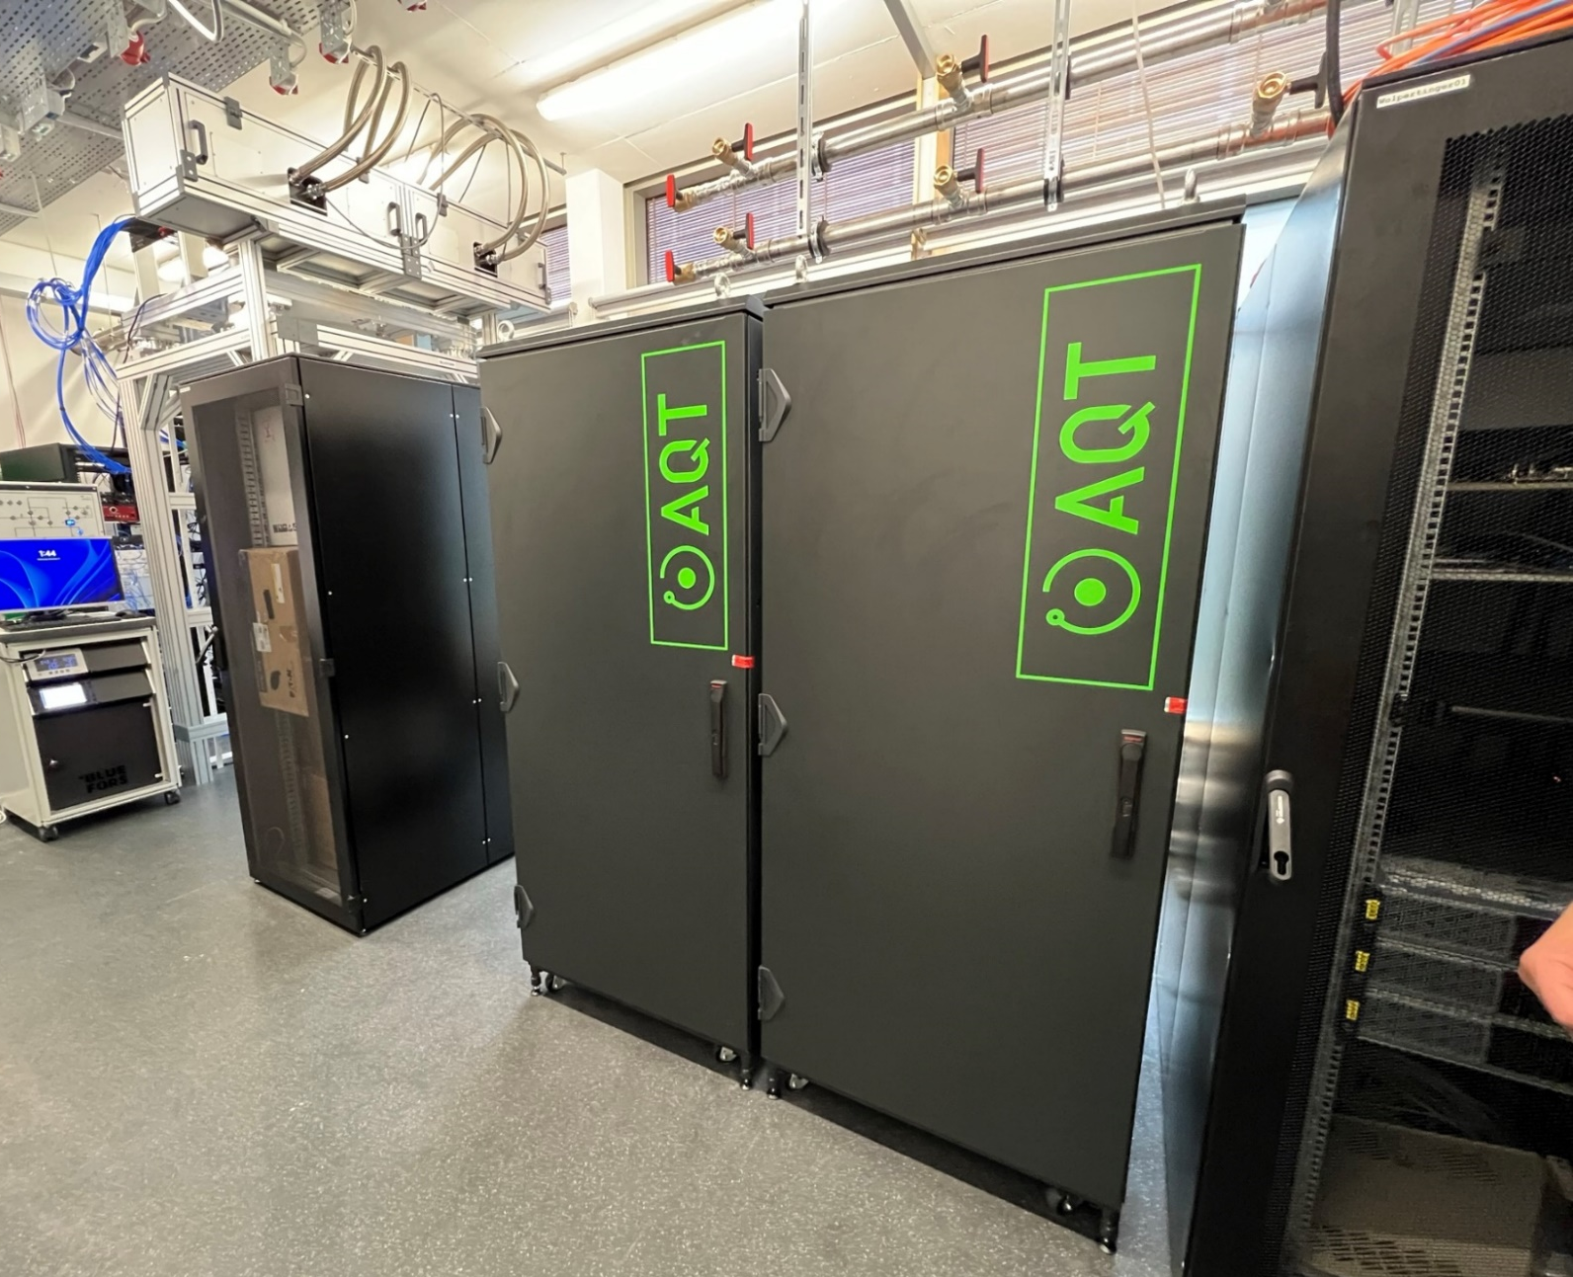


System deployed at LRZ in Munich
MARMOT is deployed at LRZ
Quality-Control and acceptance procedure being finalized:
Loading and controlling up to 20 qubits
Generation of GHZ states
Demonstration of Quantum Volume
…
Looking into tight integration in the local HPC infrastructure
https://www.quantum.lrz.de/bits-of-qubits/detail/a-trapped-ion-quantum-computer-for-the-munich-quantum-valley

Slide 19
Macroarchitecture design paradigms
LOOSE INTEGRATION
TIGHT INTEGRATION
QUANTUM INTERCONNECTS
Hybrid workloads with classical and quantum co-processing within coherence time of the qubit
Enabler for quantum error correction and quantum advantage
Requires co-location of QC and CPU
Distribution of entanglement resources between geographically distributed QC (hybrid) nodes
Enabler for distributed quantum computing
Confidential blind quantum computing
IEEE Micro (Volume: 41, Issue: 5, 01 Sept.-Oct. 2021)

Slide 20
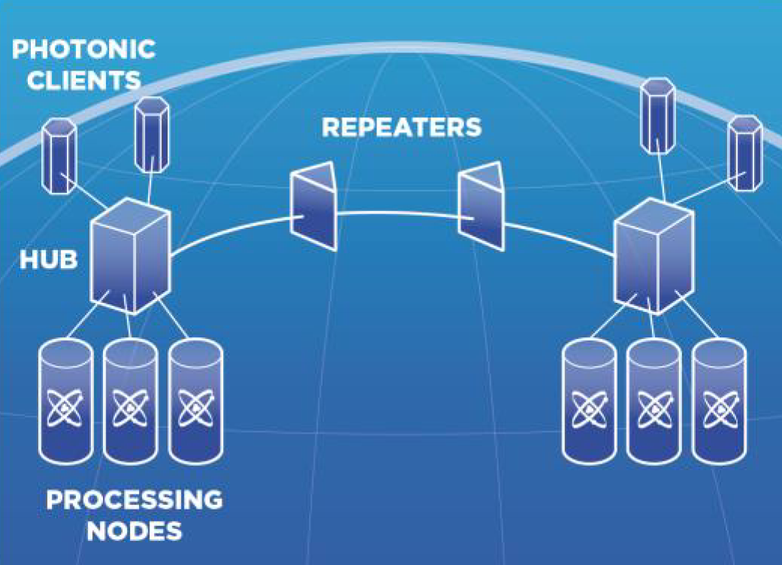
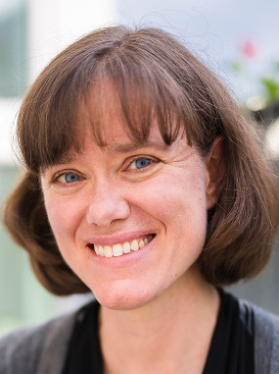
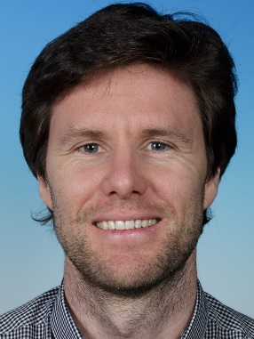
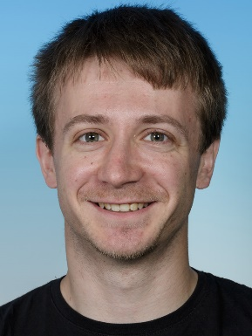
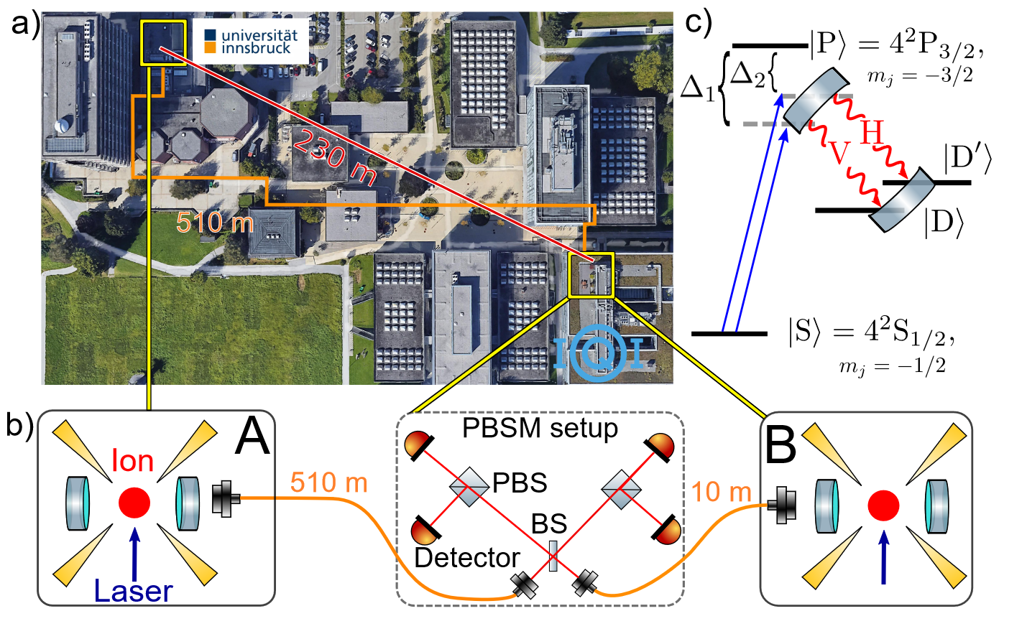
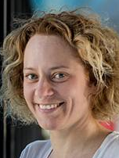

Scaling out - Quantum interconnects
Tracy Northup
Ben Lanyon
Viktor Krutianskii
S. Wehner
https://quantuminternetalliance.org
Phys. Rev. Lett. 130, 050803 (2023)

Slide 21
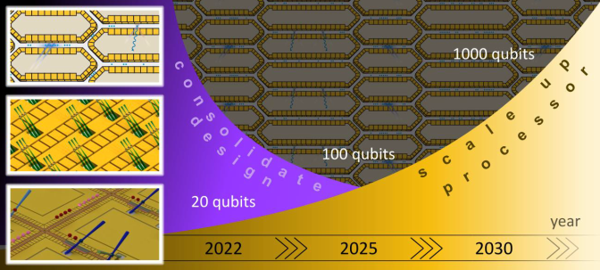





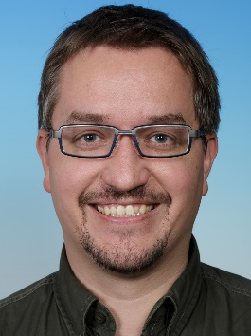
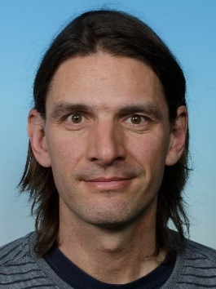

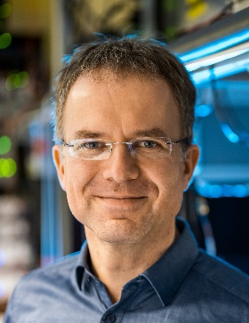
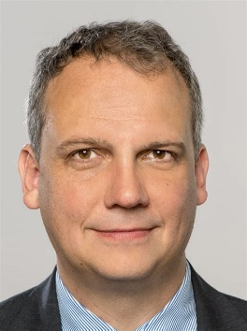
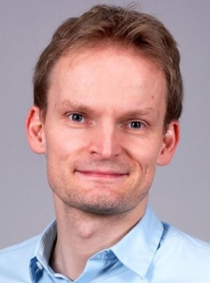
Scaling up – more good qubits
… and many more
https://www.millenion.eu/
T. Monz
P. Schindler
F. Schmidt-Kaler
C. Ospelkaus
M. Schulz
R. Wille

Slide 22






2D linear trap concept
DC Shuttling
M. Valentini
RF Shuttling
1 mm
M. Valentini et al., arXiv:2406.02406

Slide 23






Towards scalable error-corrected ion-trap quantum processors
Quantum Spring Array (QSA) architecture
Connectivity via radial and axial ion transport
Demonstrated coupling between lattice sites
Demonstrated generation of entangled states
Maps of code primitives for fault-tolerant quantum error correction
M. Valentini et al., arXiv:2406.02406

Slide 24




2D architectures for fault-tolerant quantum computing
● 2D ion trap arrays
● 2D ion crystals
Roos group
Monz group / Schindler group
Bollinger group
● Cold atoms in optical lattices & other AMO systems
● Solid-state platforms
Home group
Lukin group
Saffman group
Browaeys group
… and many more
Wallraff group

Slide 25































The European Ion-Trap Value-Chain
End-Users
Architecture
Fabrication
Integration
Software
Platforms
End-Users
Enabling Tech
Platforms
Software
Enabling Tech
Fabrication
Architecture
Integration

Slide 26


















The team

Slide 27




Challenging & fun Research & engineering Hiking & skiing
QC

