Slide 1
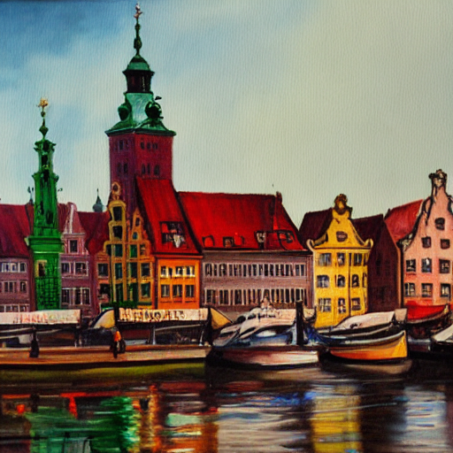
Post-Moore spatial computing: from chips to clusters.
Torsten Hoefler
Keynote at 14th International Conference on Parallel Processing and Applied Mathematics
Sept. 2022, Gdansk, Poland
contributions by Tommaso Bonato, Daniele De Sensi, Salvatore Di Girolamo, Shigang Li, Marco Heddes, Jon Belk, Deepak Goel,
Miguel Castro, Steve Scott, Thomas Haener, Matthias Troyer Tal Ben-Nun, Alexandros Ziogas, Johannes de Fine Licht, Tiziano de Matteis, Timo Schneider, Andreas Kuster, Manuel Burger, Philip Schaad,
Dominic Hofer and the whole DAPP team @ SPCL
“A painting of Gdansk”

Slide 2
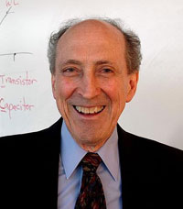
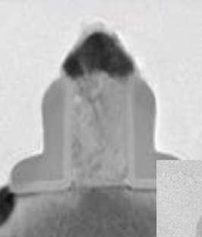
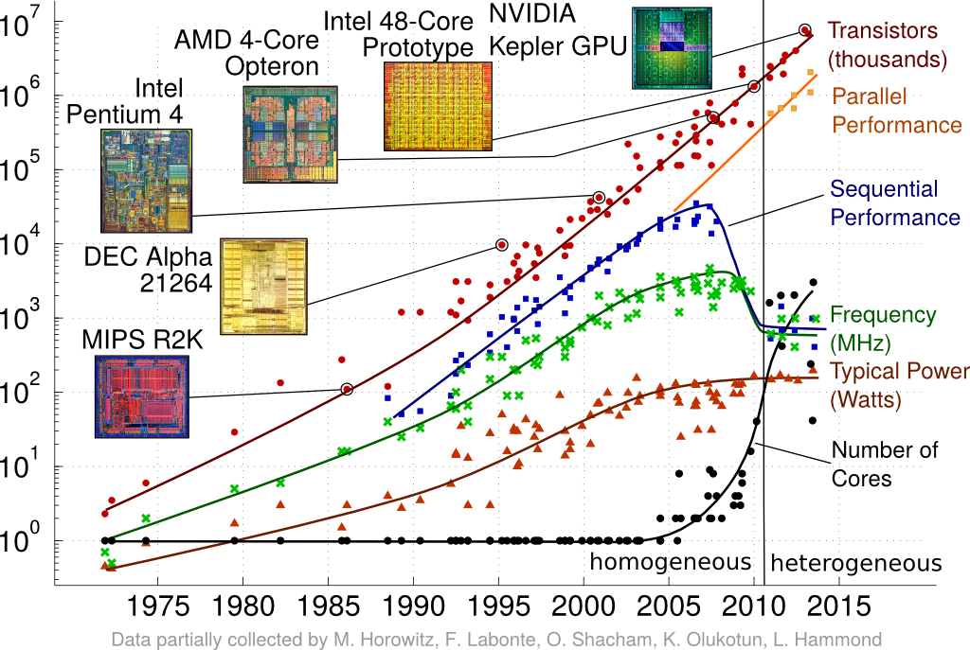
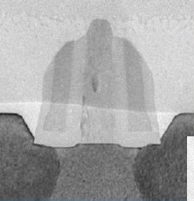
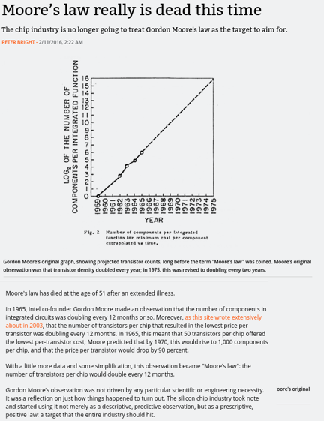
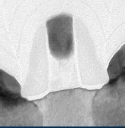
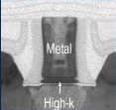
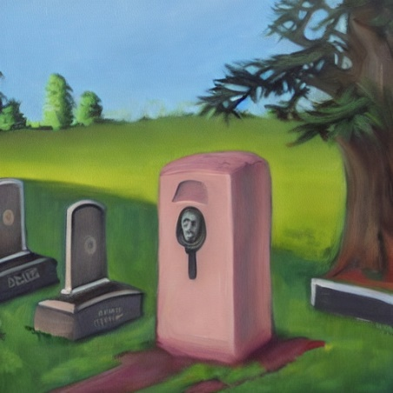


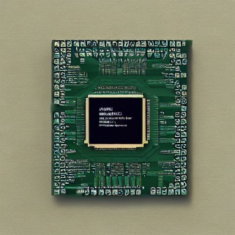



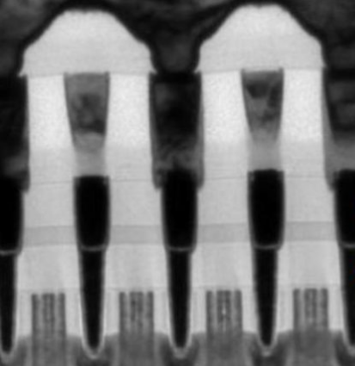
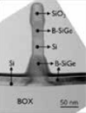
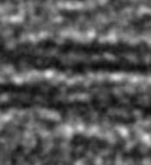
Changing hardware constraints and the physics of computing
Three key aspects of silicon scaling over the last four decades
            Shrinking feature size
            Tighter integration of units
            Smaller distances
0.9 V [1]
32-bit FP ADD: 0.9 pJ
32-bit FP MUL: 3.2 pJ
2x32 bit from L1 (8 kiB): 10 pJ
2x32 bit from L2 (1 MiB): 100 pJ
2x32 bit from DRAM: 1.3 nJ
130nm
Passing away with Moore’s law
(at the nano-/transistor-level)
90nm
Continued design for integration
(at the package/node/system-levels)
65nm
45nm
Landauer limit 3 * 10⁻²¹ (32-bit FP, >0.2*10⁻⁶ pJ)
Electrical data movement:
loss ~ resistancy * length / cross-section-area
32nm
22nm
14nm
10nm
5nm
2nm
…
[1]: Marc Horowitz, Computing’s Energy Problem (and what we can do about it), ISSC 2014, plenary
[2]: Moore: Landauer Limit Demonstrated, IEEE Spectrum 2012
1nm
Notes:
Mark Horowitz talk: https://www.youtube.com/watch?v=7gGnRGko3go
45nm, 0.9V → 32bit FADD: 0.9pJ, FMUL: 3.7pJ, 2 operand (64bit) load from L1 (8kiB): 10pJ, from L2 (1MiB): 100pJ, from DRAM: 1.3-2.6nJ [1]
FP computation approaches Landauer limit (3e-21 J) [2]
Assuming all bits are switched in 32 bit FP, ~0.2aJ (atto Joules = 10e-6pJ)
Electrical data movement suffers from resistance
Heat loss: ~ resistancy * length / cross-section-area
→ process shrinkage benefits computation energy but increases communication energy

Slide 3
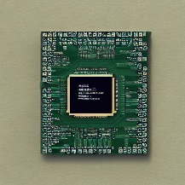
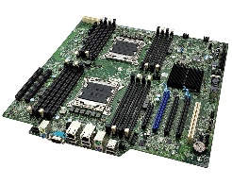
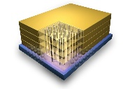
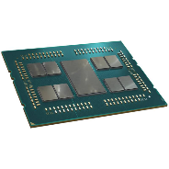
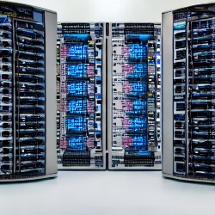
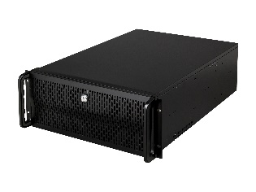
Beyond Moore’s Law - Design for integration
challenges: cooling and inexpensive connectivity
3d integration
boards
clusters
TSVs bring DRAM memory and compute closer
NUMA vs. UMA in an interesting design space
C2C links with PCB or flyover cables
cf. NVIDIA DGX-station
    4xA100 on board
Very short electrical is cheap, long fiber very expensive!
Local electrical or global optical cables
  Fat Tree, Dragonfly, Slim Fly (optimal)
Workload specialization
Those are free but have very limited connectivity
chiplets
nodes
Interposer connects chiplets for flexibility + cost saving per package
Simple topologies today, developing
  cf. SlimNOC [1]
Flyover or local copper cables
e.g., Dragonfly groups
cf. DGX-2 (16xA100)
“the world’s largest GPU”
Design AI-specialized
networks!
M. Besta et al.: Slim NoC: A Low-Diameter On-Chip Network Topology for High Energy Efficiency and Scalability, ASPLOS 2018
Notes:
Mark Horowitz talk: https://www.youtube.com/watch?v=7gGnRGko3go
45nm, 0.9V → 32bit FADD: 0.9pJ, FMUL: 3.7pJ, 2 operand (64bit) load from L1 (8kiB): 10pJ, from L2 (1MiB): 100pJ, from DRAM: 1.3-2.6nJ [1]
FP computation approaches Landauer limit (3e-21 J) [2]
Assuming all bits are switched in 32 bit FP, ~0.2aJ (atto Joules = 10e-6pJ)
Electrical data movement suffers from resistance
Heat loss: ~ resistancy * length / cross-section-area
→ process shrinkage benefits computation energy but increases communication energy

Slide 4
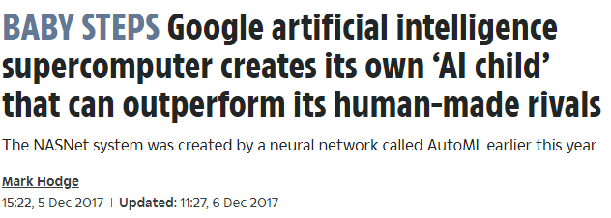

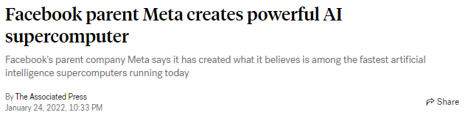
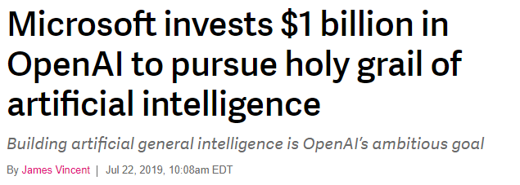
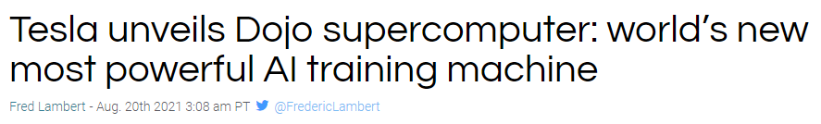



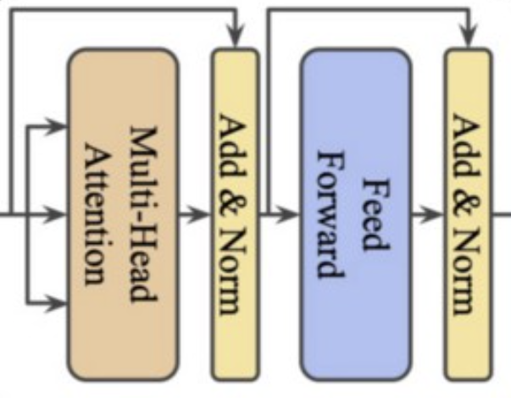
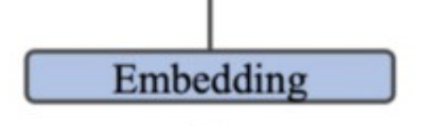
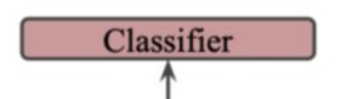
Modern Deep Learning Workloads
10k GPUs
f(x)
A robot
may __ injure a human being or, through inaction, allow a human
being to come
to harm.
not
0.74
not
1.00
sometimes
0.28
sometimes
0.00
…
always
0.07
always
0.00
never
0.04
never
0.00
and
0.33
and
0.00
boat
0.02
boat
0.00
house
0.02
house
0.00
layer-wise weight update
  GPT-3: 500 billion tokens
  ImageNet (22k): A few TB
  Soon: the whole internet!
  GPT-3: 96 (complex) layers
    175 bn parameters (700 GiB in fp32)
    2048-token “sentences”
  GPT-3: 30-50k dictionaries
  takes weeks to train
T. Ben-Nun, TH: Demystifying parallel and distributed deep learning: An in-depth concurrency analysis, ACM Computing Surveys (CSUR), 2019

Slide 5
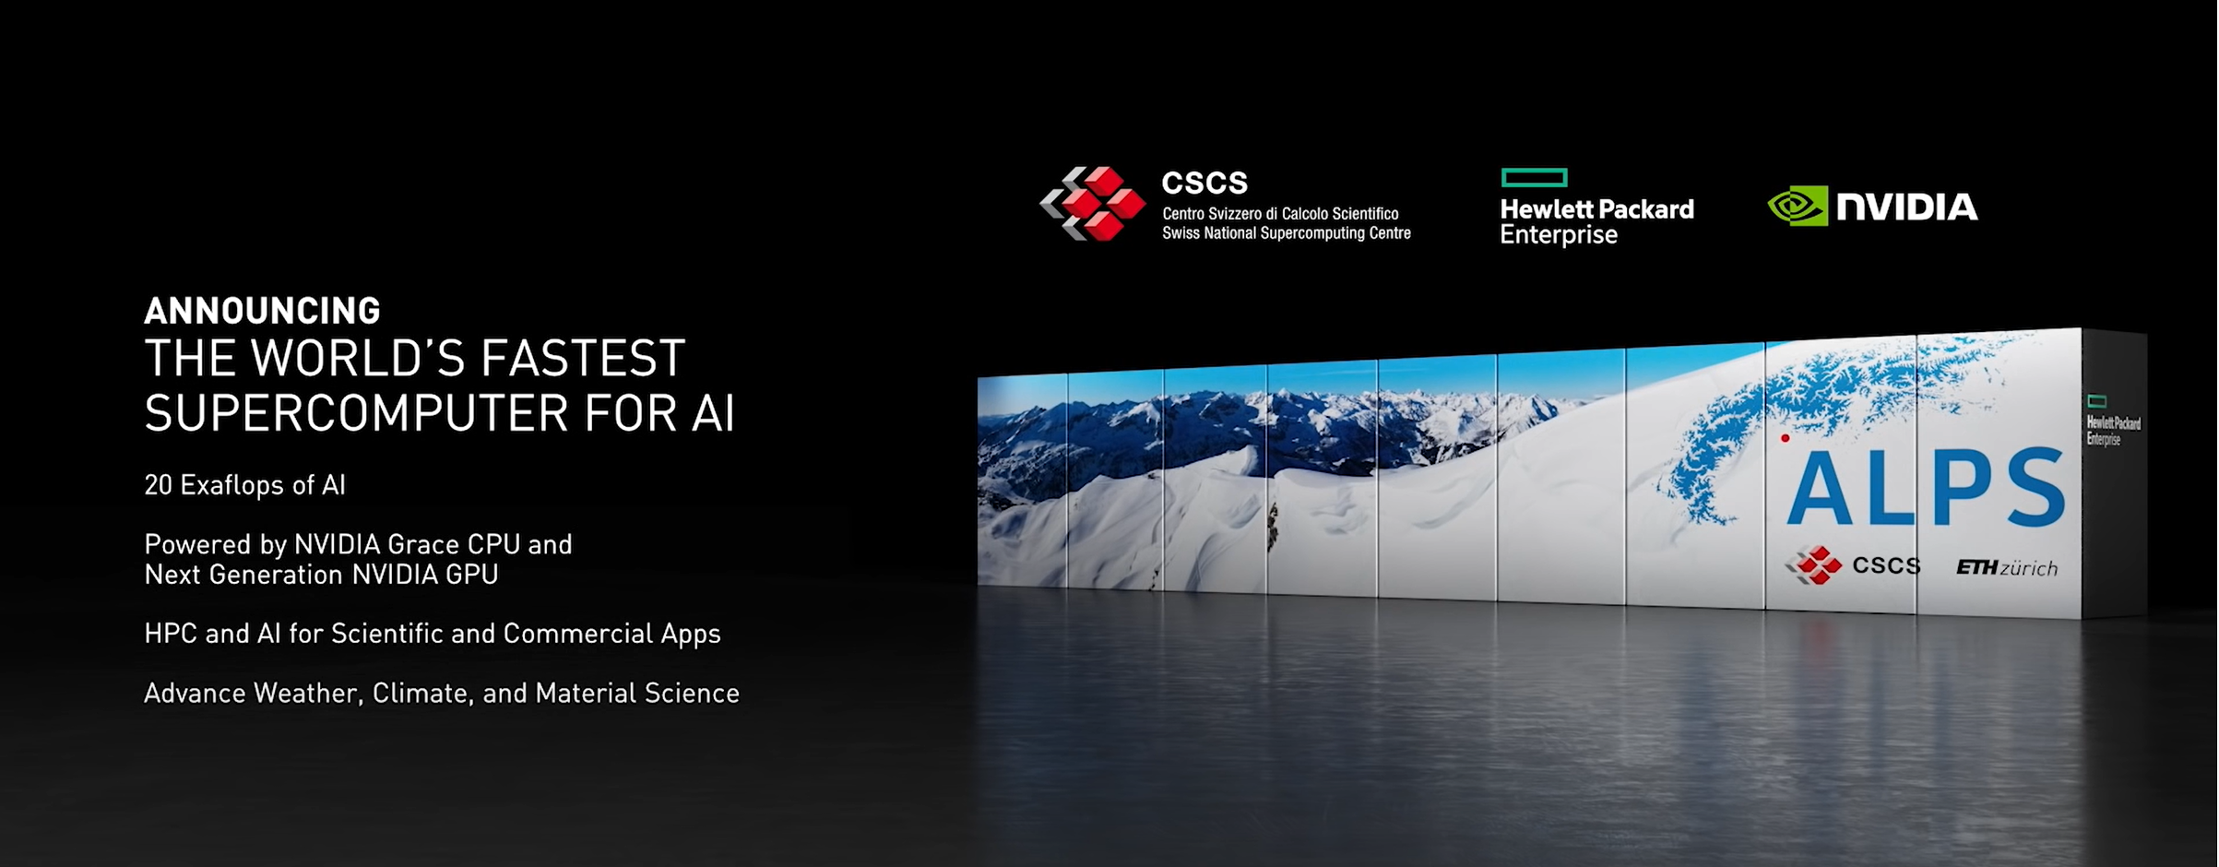
Academia and research are catching up fast!

Slide 6



Data parallelism – limited by batch-size
minibatch 1
…
minibatch 2
…
minibatch 3
…
minibatch 4
Simple and efficient solution, very easy to implement
Duplicate parameters at all processors (d’oh memory is expensive and scarce!)
T. Ben-Nun, TH: Demystifying parallel and distributed deep learning: An in-depth concurrency analysis, ACM Computing Surveys (CSUR), 2019

Slide 7
Pipeline parallelism – limited by number of layers
minibatch 1
minibatch 2
…
minibatch 3
minibatch 4
Layers/parameters can be distributed across processors
Sparse communication pattern (only pipeline stages)
Mini-batch has to be copied through all processors and latency doesn’t decrease!
T. Ben-Nun, TH: Demystifying parallel and distributed deep learning: An in-depth concurrency analysis, ACM Computing Surveys (CSUR), 2019

Slide 8
Operator parallelism – limited by operator or layer size
minibatch 1
minibatch 2
…
…
1
3
minibatch 3
minibatch 4
Parameters can be distributed across processors
Mini-batch has to be copied to all processors
Forward and backward requires extremely high communication (cut MMMs)
T. Ben-Nun, TH: Demystifying parallel and distributed deep learning: An in-depth concurrency analysis, ACM Computing Surveys (CSUR), 2019
Notes:
- Htor: discuss - all-to-all even for conv and pooling???

Slide 9
“3D” Hybrid parallelism
Data Parallelism
Operator Parallelism
minibatch 1
…
minibatch 2
…
minibatch 3
…
minibatch 4
Pipeline Parallelism
Layers/parameters can be distributed across processors
Can distribute minibatch
Often specific to layer-types (e.g., distribute fc layers but handle conv layers data-parallel)
  Enables arbitrary combinations of data, model, and pipeline parallelism – very powerful!
T. Ben-Nun, T. Hoefler: Demystifying Parallel and Distributed Deep Learning: An In-Depth Concurrency Analysis, arXiv Feb 2018
Notes:
Should we add the survey here as mentioning all of them together?
[tal] Done

Slide 10
Communication characteristics of 3D parallelism in Deep Learning
Data Parallelism
Pipeline Parallelism
Operator Parallelism
allreduce ring
communication
D
1
2
2
P
1
1
2
O
Can be overlapped
Can be overlapped
allreduce ring or neighbor communication
3D - Data, Pipeline, and Operator Parallelism
Can not be overlapped
1,1,D
1,2,D
1,P,D
1,1,2
1,2,2
1,P,2
1,1,1
1,2,1
1,P,1
Communication is (largely) a logical 3D Torus
2,1,1
2,2,1
2,1,1
2,2,1
2,P,D
2,P,2
2,1,1
2,2,1
2,P,1
3,1,1
3,2,1
O,P,D
3,1,1
3,2,1
O,P,2
O,1,1
O,2,1
O,P,1
TH et. al.: HammingMesh: A Network Topology for Large-Scale Deep Learning, SC22

Slide 11
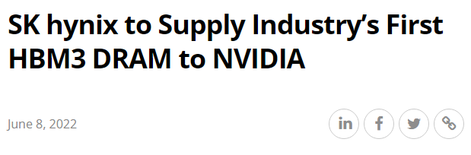
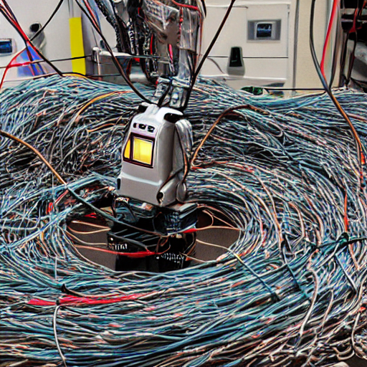
(Network and memory) bandwidth is the new oil in AI supercomputing
Memory bandwidth can be satisfied using HBM3 and friends
  Technologies are quickly becoming available
Network bandwidth is more complex and requires full-system
and packaging tricks
HPC:
  Slingshot (‘21): 200G per GPU
  InfiniBand CX-7 (‘22): 400G per NIC
AI:
  Google TPUv2 (‘21): 1T
  AWS Trainium (‘21): 1.6T
  DGX-2 (A100, ‘21): 4.8T (islands of NVLINK)
  Tesla Dojo (‘22): 128T → Broadcom TH5 / NVIDIA Spectrum 4: 51.2T
Performance models indicate even higher demands
  Massive transformer EDAGs have really bad cuts
Conventional HPC topologies may be unaffordable for AI bandwidths!
A fat tree with 16k accelerators and 1.6T would cost $680M!
☹ ☹ ☹
“AI system entangled in cables”
640x
TH et. al.: HammingMesh: A Network Topology for Large-Scale Deep Learning, to appear at SC22 and arXiv (today?)

Slide 12


Co-designing an AI supercomputer with unprecedented and cheap bandwidth
N1
packet
switch
each plane fully-connected in x
N2
N3
accelerator
package
N4
four directions
per plane (N,S,E,W)
…
axb accelerators
per board
1,1
1,2
1,3
1,x
four planes
per accelerator
inexpensive short
PCB connections
on board
W1
E1
W2
E2
…
W3
E3
W4
E4
2,1
2,2
2,3
2,x
S1
…
S2
S3
S4
2x2
board
3,1
3,2
3,3
3,x
4x4 board
…
…
…
…
each plane fully-connected in y
…
…
y,1
y,2
y,3
y,x
TH et. al.: HammingMesh: A Network Topology for Large-Scale Deep Learning, to appear at SC22 and arXiv (today?)

Slide 13





A bandwidth-cost-flexibility tradeoffs
Global Topology
(e.g., Fat Tree)
HammingMesh
(many configurations)
Local Topology
(e.g., 2D Torus)
(large) reduce bandwidth
global bandwidth
-
placement flexibility
-
injection bandwidth
TH et. al.: HammingMesh: A Network Topology for Large-Scale Deep Learning, to appear at SC22 and arXiv (today?)

Slide 14

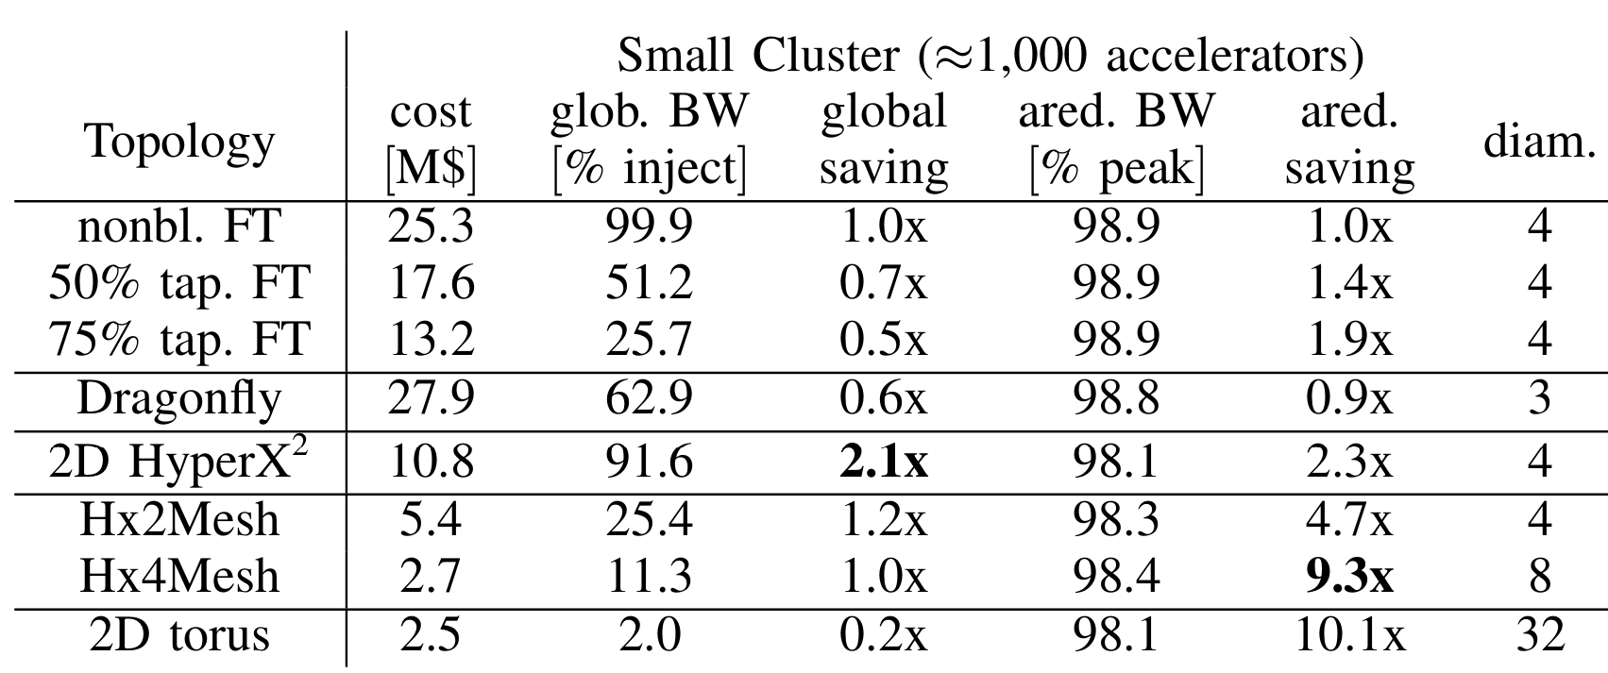
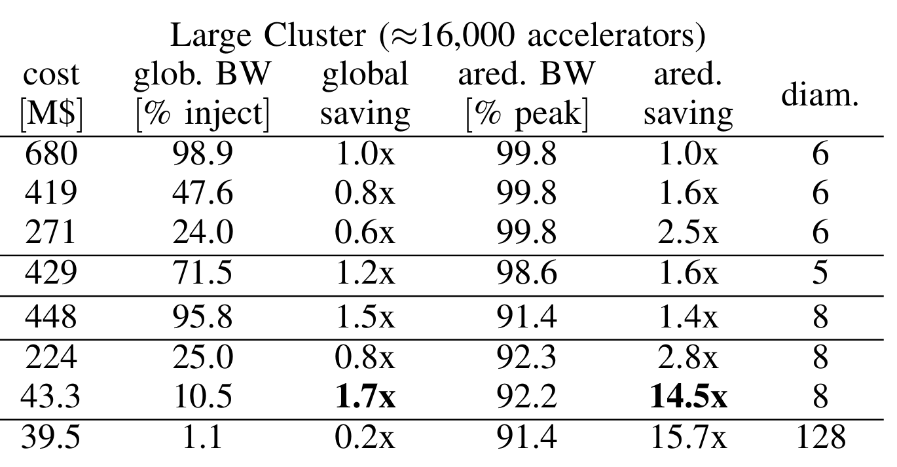
HammingMesh cost vs. bandwidth – simulated using SST (0.6M core hours)
“an AI coin”
Single switch per row/column
TH et. al.: HammingMesh: A Network Topology for Large-Scale Deep Learning, to appear at SC22 and arXiv (today?)

Slide 15
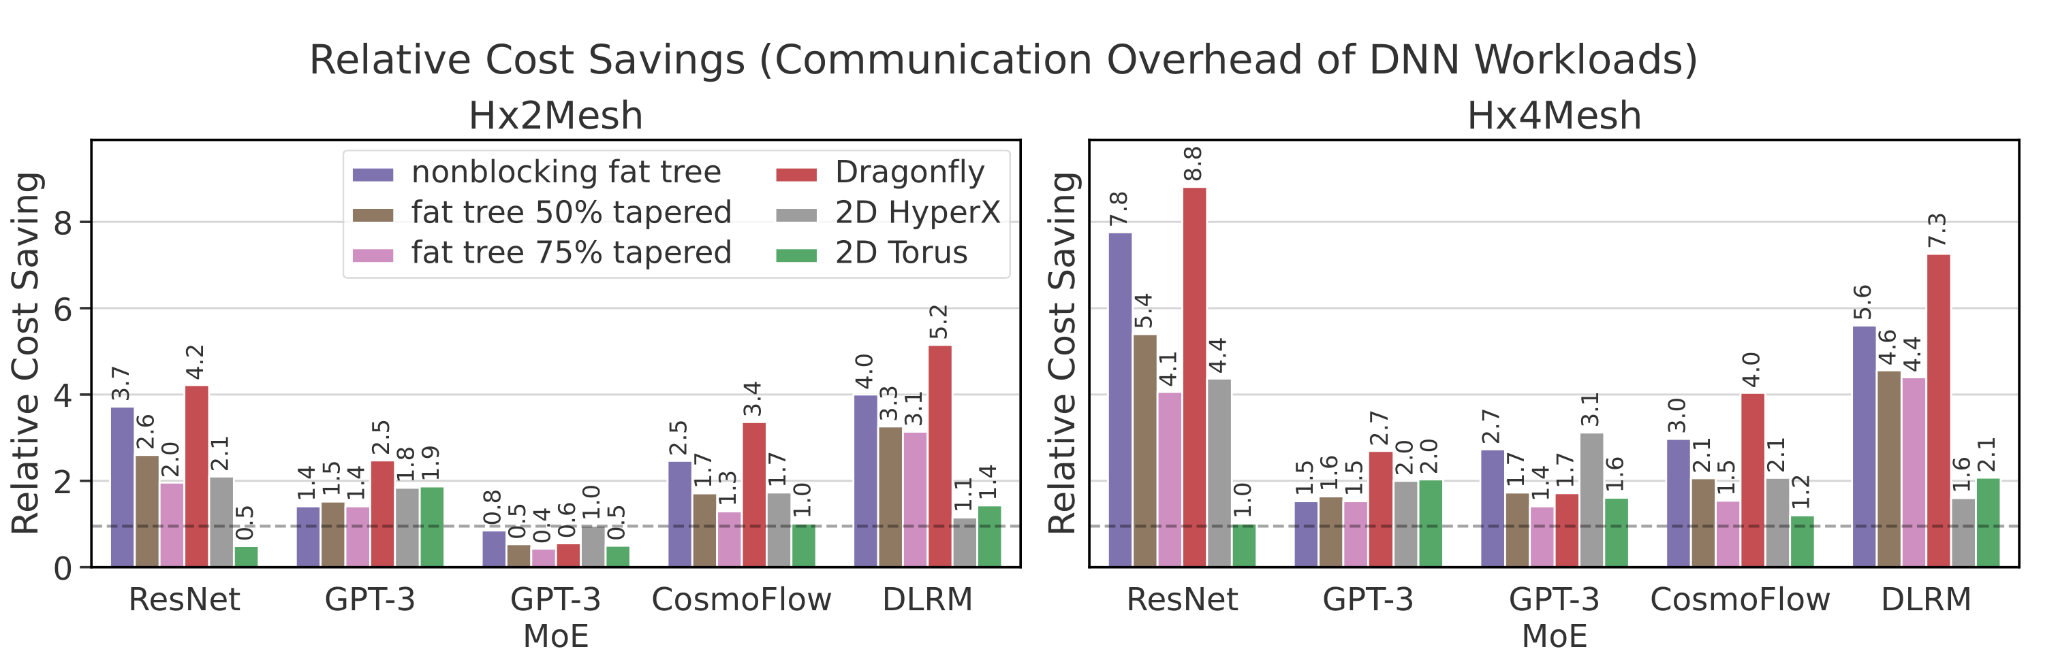
Full network simulations (using SST with MPI-style driver)
Network is always cheaper, needs to be weighed against full system cost!
TH et. al.: HammingMesh: A Network Topology for Large-Scale Deep Learning, to appear at SC22 and arXiv (today?)

Slide 16


Changing hardware constraints and the physics of computing
Back to our three key aspects of silicon scaling over the last four decades
                Shrinking feature size
                Tighter integration of units
                Smaller distances
0.9 V [1]
32-bit FP ADD: 0.9 pJ
32-bit FP MUL: 3.2 pJ
2x32 bit from L1 (8 kiB): 10 pJ
2x32 bit from L2 (1 MiB): 100 pJ
2x32 bit from DRAM: 1.3 nJ
How can we achieve this?
130nm
Passing away with Moore’s law
(at the nano-/transistor-level)
90nm
Continued design for integration
(at the package/node/system-levels)
65nm
45nm
Landauer limit 3 * 10⁻²¹ (32-bit FP, >0.2*10⁻⁶ pJ)
Electrical data movement:
loss ~ resistancy * length / cross-section-area
32nm
Programming spatial devices
(at all levels)
22nm
14nm
10nm
5nm
2nm
…
[1]: Marc Horowitz, Computing’s Energy Problem (and what we can do about it), ISSC 2014, plenary
[2]: Moore: Landauer Limit Demonstrated, IEEE Spectrum 2012
1nm
16
Notes:
Mark Horowitz talk: https://www.youtube.com/watch?v=7gGnRGko3go
45nm, 0.9V → 32bit FADD: 0.9pJ, FMUL: 3.7pJ, 2 operand (64bit) load from L1 (8kiB): 10pJ, from L2 (1MiB): 100pJ, from DRAM: 1.3-2.6nJ [1]
FP computation approaches Landauer limit (3e-21 J) [2]
Assuming all bits are switched in 32 bit FP, ~0.2aJ (atto Joules = 10e-6pJ)
Electrical data movement suffers from resistance
Heat loss: ~ resistancy * length / cross-section-area
→ process shrinkage benefits computation energy but increases communication energy

Slide 17

Beyond Moore’s Law – Towards spatial programming
Temporal parallel programming
Spatial parallel programming
MPI, OpenMP, CUDA, …
Principles:
  Work/Depth
  Compute Tasks
  Temporal scheduling
  Temporal locality
Procedural reasoning (this then that)!
RTL, HLS, …
Principles:
  Pipelining
  Dataflow / data movement
  Spatiotemporal scheduling
  Spatial locality
Spatial thinking (this here, that there)!
Zooming in …
We know this since decades!
Notes:
Mark Horowitz talk: https://www.youtube.com/watch?v=7gGnRGko3go
45nm, 0.9V → 32bit FADD: 0.9pJ, FMUL: 3.7pJ, 2 operand (64bit) load from L1 (8kiB): 10pJ, from L2 (1MiB): 100pJ, from DRAM: 1.3-2.6nJ [1]
FP computation approaches Landauer limit (3e-21 J) [2]
Assuming all bits are switched in 32 bit FP, ~0.2aJ (atto Joules = 10e-6pJ)
Electrical data movement suffers from resistance
Heat loss: ~ resistancy * length / cross-section-area
→ process shrinkage benefits computation energy but increases communication energy

Slide 18
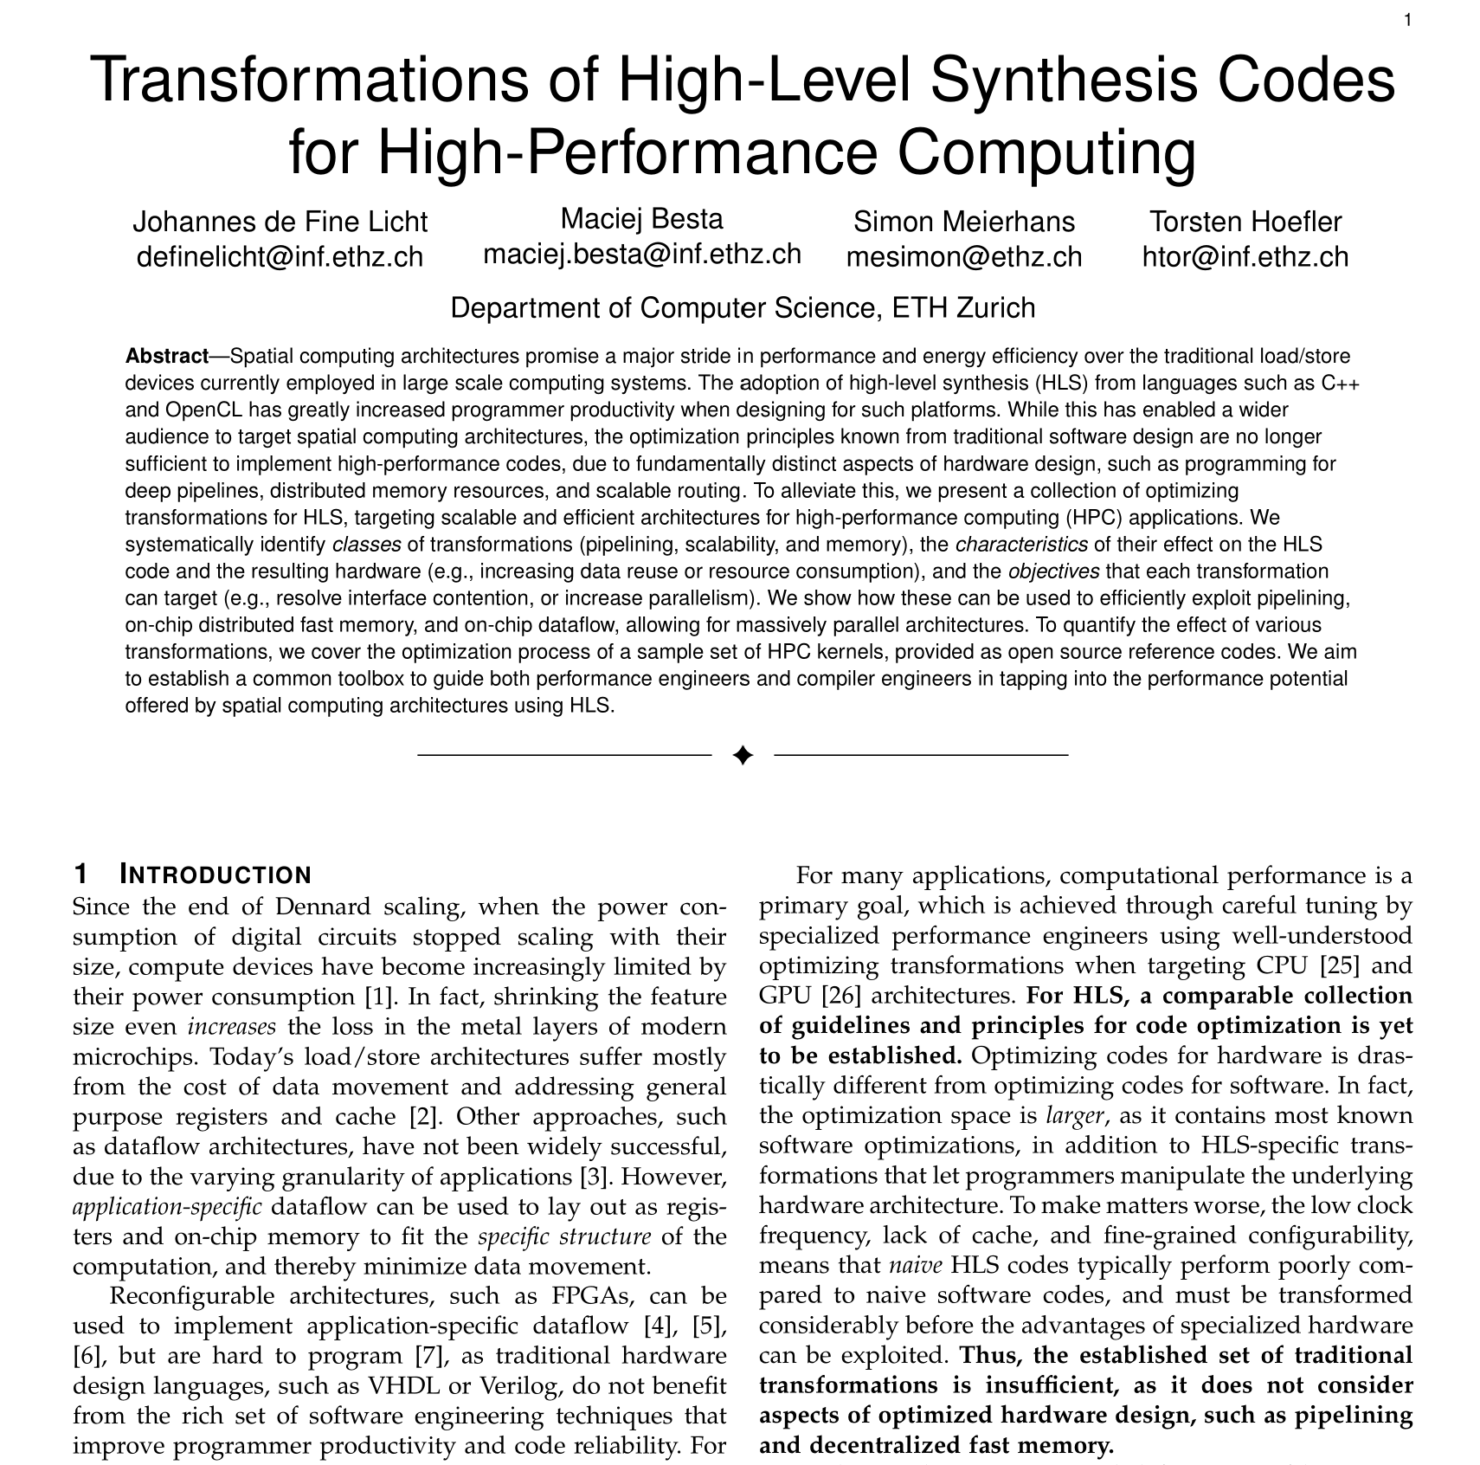
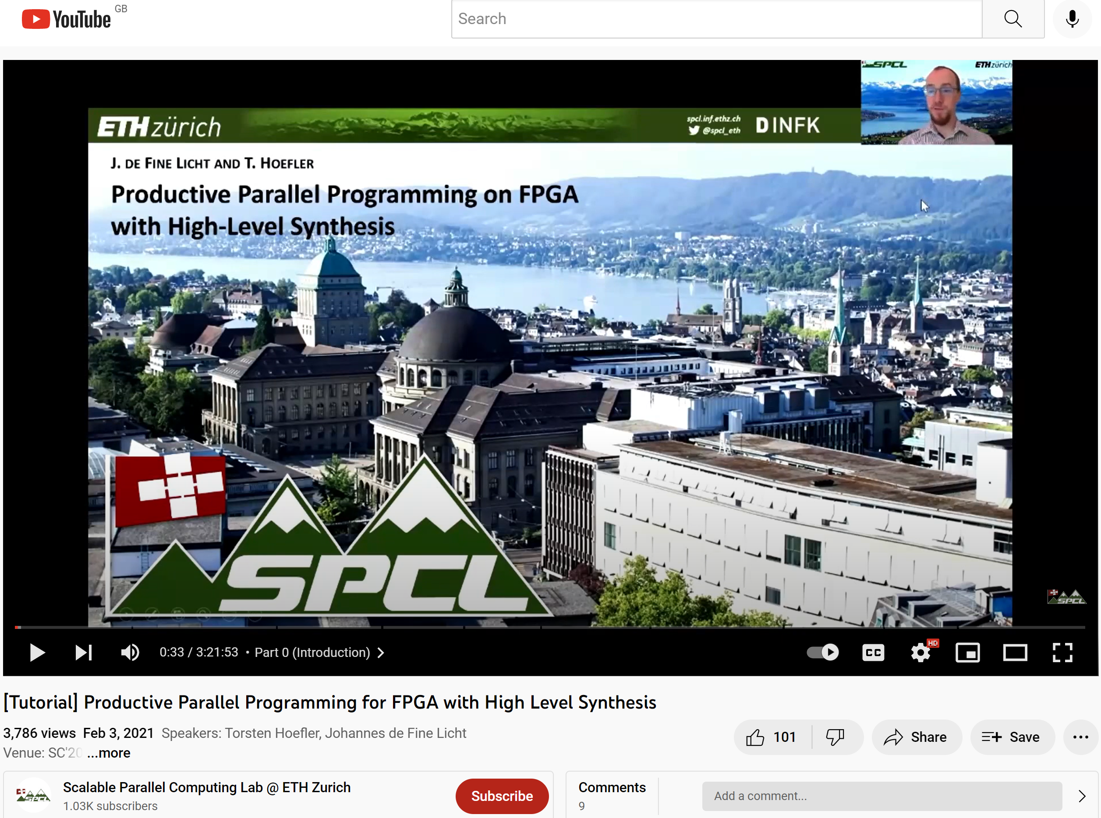
Writing fast spatial programs for FPGAs and CGRAs (in productive HLS)
Welcome to #pragma hell!

Slide 19




Beyond Moore’s Law – Towards spatial programming
Temporal parallel programming
Spatial parallel programming
MPI, OpenMP, CUDA, …
Principles:
  Work/Depth
  Compute Tasks
  Temporal scheduling
  Temporal locality
Procedural reasoning (this than that)!
RTL, HLS, …
Principles:
  Pipelining
  Dataflow / data movement
  Spatiotemporal scheduling
  Spatial locality
Spatial thinking (this here, that there)!
Relatively simple ☺!
Very hard
(for me) ☹!
Temporal algorithms
Spatial optimizations
Data-Centric Intermediate Representation (DCIR)
Data Centric Python (DaCe)
Notes:
- Is spatial strictly harder than temporal? They’re both NP complete?

Slide 20













Upleveling programming in the 21st century – Performance Portability
10s of SLOC
Domain Scientist
Performance Engineer
$$\frac{∂u}{∂t}−α∇^{2}u=0$$
1000s of auto-generated SLOC
100s of reusable SLOC
DSLs
Specialized
Code Generation
Transformed
Dataflow
Parametric Dataflow
Graphs (SDFG)
CPU Code
Applied Scientist
$$L$$
$$R$$
Performance
Results
translate DSL into
parametric dataflow graphs
*
Runtime
GPU Code
*
*
*
FPGA Code
SDFG Builder API
Multi-Level
Library Nodes
*
*
Graph Transformations
(API, Interactive)
C++ code generation/runtime
Ben-Nun, de Fine Licht, Ziogas, TH: Stateful Dataflow Multigraphs: A Data-Centric Model for High-Performance Parallel Programs, SC19

Slide 21



All about the IR – DaCe translates to Parametric Dataflow Graphs (SDFGs)
$$x$$
Tasklet
$$y=x^{2}+\sin{\frac{x}{π}}$$
Memlets
$$y$$
Ben-Nun, de Fine Licht, Ziogas, TH: Stateful Dataflow Multigraphs: A Data-Centric Model for High-Performance Parallel Programs, SC19

Slide 22
Data-Parallelism in Parametric Dataflow Graphs (SDFGs)
A
A[0]
A[1]
A[N-1]
Tasklet
Tasklet
Tasklet
…
B[0]
B[1]
B[N-1]
B
Ben-Nun, de Fine Licht, Ziogas, TH: Stateful Dataflow Multigraphs: A Data-Centric Model for High-Performance Parallel Programs, SC19

Slide 23
Data-Parallelism in Parametric Dataflow Graphs (SDFGs)
Iteration space (map)
A
A
A[0:N]
A[0]
A[1]
A[N-1]
[i=0:N]
A[i]
Tasklet
Tasklet
Tasklet
…
Tasklet
B[i]
B[0]
B[1]
B[N-1]
[i=0:N]
B
B[0:N]
B
Ben-Nun, de Fine Licht, Ziogas, TH: Stateful Dataflow Multigraphs: A Data-Centric Model for High-Performance Parallel Programs, SC19

Slide 24
States in Parametric Dataflow Graphs (SDFGs)
A
C
A[0:N]
C[0:N]
[i=0:N]
[i=0:N]
A[i]
C[i]
Tasklet
Tasklet
B[i]
A[i]
[i=0:N]
[i=0:N]
B[0:N]
A[0:N]
B
A
Ben-Nun, de Fine Licht, Ziogas, TH: Stateful Dataflow Multigraphs: A Data-Centric Model for High-Performance Parallel Programs, SC19

Slide 25
States in Parametric Dataflow Graphs (SDFGs)
State s0
State s1
A
C
A[0:N]
C[0:N]
[i=0:N]
[i=0:N]
A[i]
C[i]
Tasklet
Tasklet
B[i]
A[i]
[i=0:N]
[i=0:N]
B[0:N]
A[0:N]
B
A
Ben-Nun, de Fine Licht, Ziogas, TH: Stateful Dataflow Multigraphs: A Data-Centric Model for High-Performance Parallel Programs, SC19

Slide 26








Parametric Dataflow Graphs - Concepts
Store volatile (buffers, queues, RAM) and
nonvolatile (files, I/O) information
Can be sources or sinks of data
Data Containers
Stateless functions that perform computations at any granularity
Data access only through ports
Computation
Data flowing between containers and tasklets/ports
Implemented as access, copies, streaming, …
Data Movement / Dependencies
Map scopes provide parallelism
States constrain parallelism outside of datatflow
Parallelism and States
Ben-Nun, de Fine Licht, Ziogas, TH: Stateful Dataflow Multigraphs: A Data-Centric Model for High-Performance Parallel Programs, SC19

Slide 27
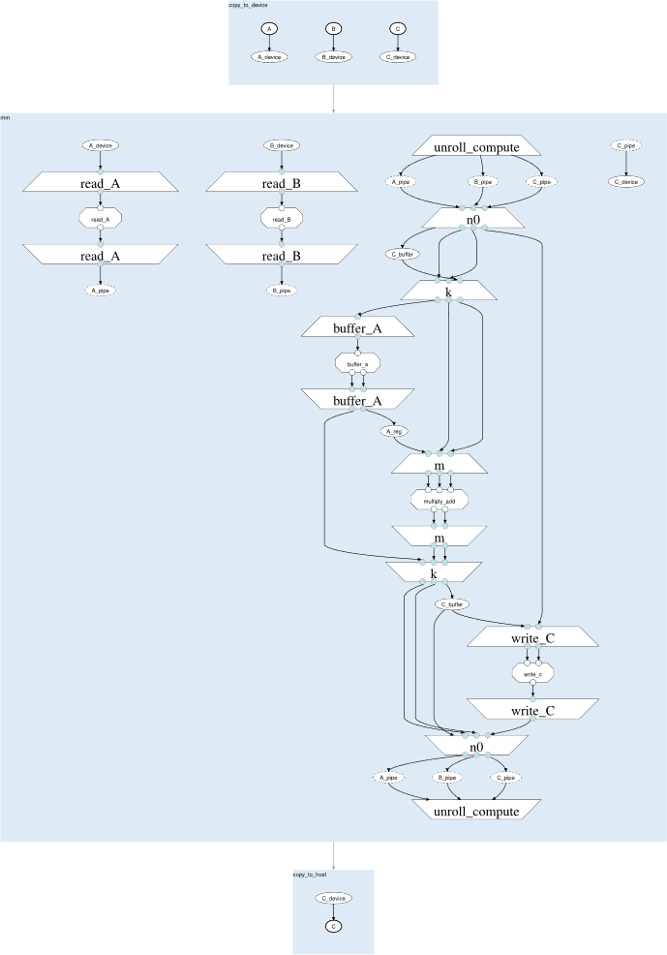


Generating spatial hardware descriptions
Stateful DataFlow multiGraph (SDFG)
Code generated for CPU, GPU, FPGA.
Performance Engineer
for (int n0 = 0; n0 < (N / P); n0 += 1) {
dace::vec<float, 4> C_buffer[(M / 4)];
for (int k = 0; k < K; k += 1) {
float A_reg;
for (int n1 = 0; n1 < P; n1 += 1) {
#pragma HLS PIPELINE II=1
#pragma HLS LOOP_FLATTEN
{
float a_in = (A_pipe[p]).pop();
///////////////////
// Tasklet code (buffer_a)
if ((n1 == ((P - p) - 1))) {
A_reg = a_in;
}
if ((p < (P - 1))) {
A_pipe[(p + 1)].push(a_in);
}
///////////////////
}
}
for (int m = 0; m < (M / 4); m += 1) {
#pragma HLS PIPELINE II=1
#pragma HLS LOOP_FLATTEN
{
float a_in = A_reg;
dace::vec<float, 4> b_in = (B_pipe[p]).pop();
dace::vec<float, 4> c_in = C_buffer[m];
...
All data movement
is explicit
Graph Transformations
$$L$$
$$R$$
*
*
Fluent mapping to spatial architectures!
*
*
Parametric Dataflow
Graphs (SDFG)
*
*
Pure dataflow sections.
de Fine Licht et al.: Transformations of High-Level Synthesis Codes for High-Performance Computing IEEE Transactions on Parallel and Distributed Systems (TPDS). 2021

Slide 28
Code generation
Cross-vendor support
…
Xilinx
Vivado HLS
Intel
OpenCL
for (int n0 = 0; n0 < (N / P); n0 += 1) {
dace::vec<float, 4> C_buffer[(M / 4)];
for (int k = 0; k < K; k += 1) {
float A_reg;
for (int n1 = 0; n1 < P; n1 += 1) {
#pragma HLS PIPELINE II=1
#pragma HLS LOOP_FLATTEN
{
float a_in = (A_pipe[p]).pop();
///////////////////
// Tasklet code (buffer_a)
if ((n1 == ((P - p) - 1))) {
A_reg = a_in;
}
if ((p < (P - 1))) {
A_pipe[(p + 1)].push(a_in);
}
///////////////////
}
}
for (int m = 0; m < (M / 4); m += 1) {
#pragma HLS PIPELINE II=1
#pragma HLS LOOP_FLATTEN
{
float a_in = A_reg;
dace::vec<float, 4> b_in = (B_pipe[p]).pop();
dace::vec<float, 4> c_in = C_buffer[m];
...
for (int n0 = 0; n0 < (N / P); n0 += 1) {
float4 C_buffer[(M / 4)];
#pragma ivdep
for (int k = 0; k < K; k += 1) {
float A_reg;
#pragma loop_coalesce
for (int n1 = 0; n1 < P; n1 += 1) {
float a_in = read_channel_intel(A_pipe[p]);
float *a_reg = &A_reg;
#define a_out A_pipe[(p + 1)] // God save us
///////////////////
// Tasklet code (buffer_a)
if ((n1 == ((P - p) - 1))) {
*a_reg = a_in;
}
if ((p < (P - 1))) {
write_channel_intel(a_out, a_in);
}
///////////////////
#undef a_out
}
#pragma loop_coalesce
#pragma ivdep
for (int m = 0; m < (M / 4); m += 1) {
float a_in = A_reg;
float4 b_in = read_channel_intel(B_pipe[p]);
float4 c_in = C_buffer[m];
...
de Fine Licht et al.: Transformations of High-Level Synthesis Codes for High-Performance Computing IEEE Transactions on Parallel and Distributed Systems (TPDS). 2021

Slide 29
Code generation
…
N = dace.symbol("N")
K = dace.symbol("K")
M = dace.symbol("M")
P = dace.symbol("P")
W = dace.symbol("W")
def make_sdfg():
# ...do stuff...
return sdfg
if __name__ == "__main__":
P.set(8) # 8 processing elements
W.set(4) # 4-way vectorization
# Matrix of size 1024x1024x1024
M.set(1024)
K.set(1024)
N.set(1024)
gemm = make_sdfg()
# Initialize arrays: Randomize A and B, zero C
A = np.ndarray([N.get(), K.get()], dtype=np.float32)
B = np.ndarray([K.get(), M.get()], dtype=np.float32)
C = np.ndarray([N.get(), M.get()], dtype=np.float32)
A[:] = np.random.rand(N.get(), K.get()).astype(np.float32)
B[:] = np.random.rand(K.get(), M.get()).astype(np.float32)
C[:] = np.random.rand(N.get(), M.get()).astype(np.float32)
gemm(A=A, B=B, C=C, N=N, K=K) # M is fixed at compile-time
SDFGs defined or loaded using Python API
DaCe successfully runs 30/30 Polybench applications
directly from NumPy (Xilinx + Intel)!
Interfaces with NumPy arrays
DaCe programs are exposed as Python functions

Slide 30
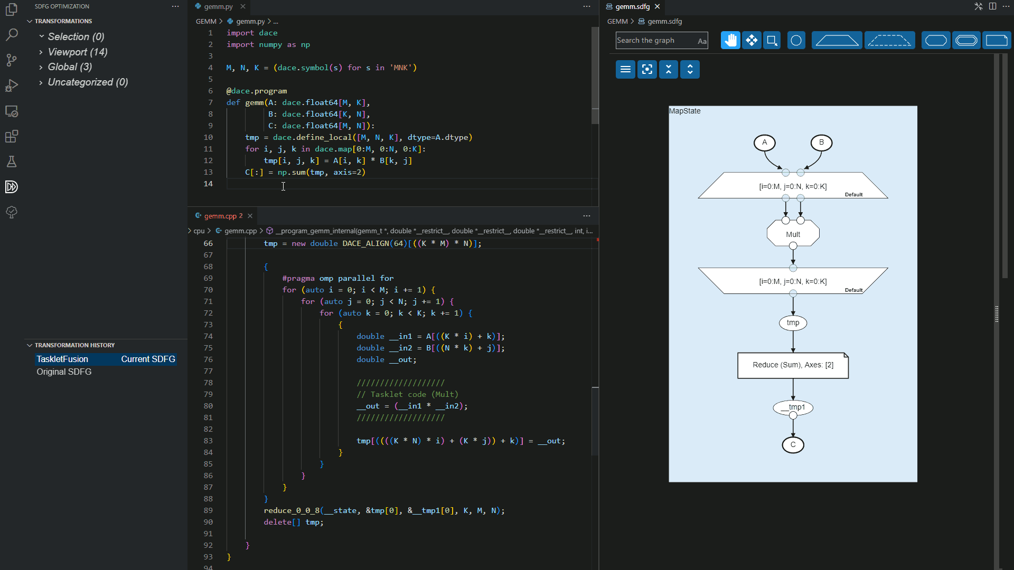
Visual Studio Code integration
Plugin "DaCe SDFG Viewer (SDFV)"

Slide 31
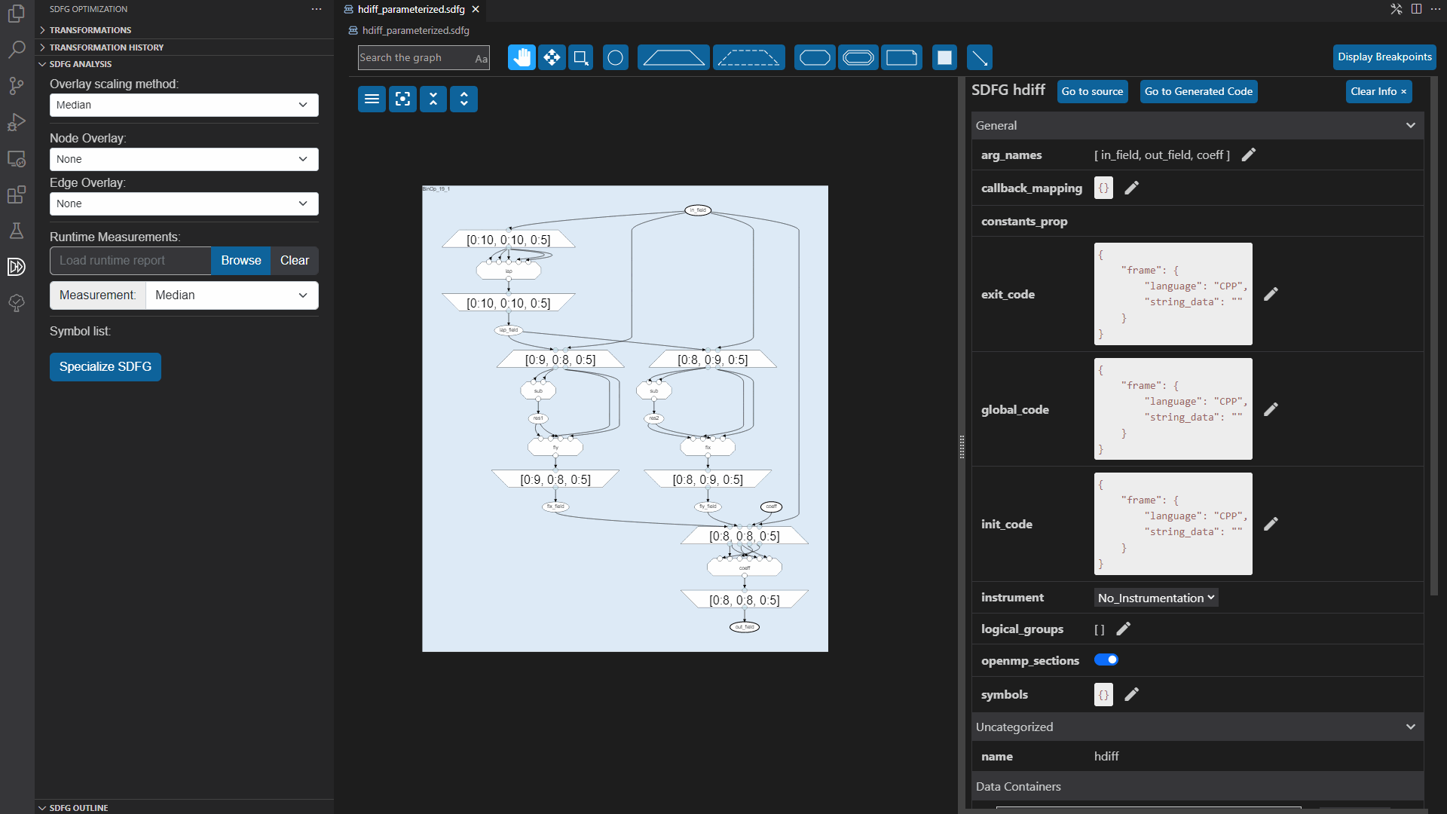

Slide 32
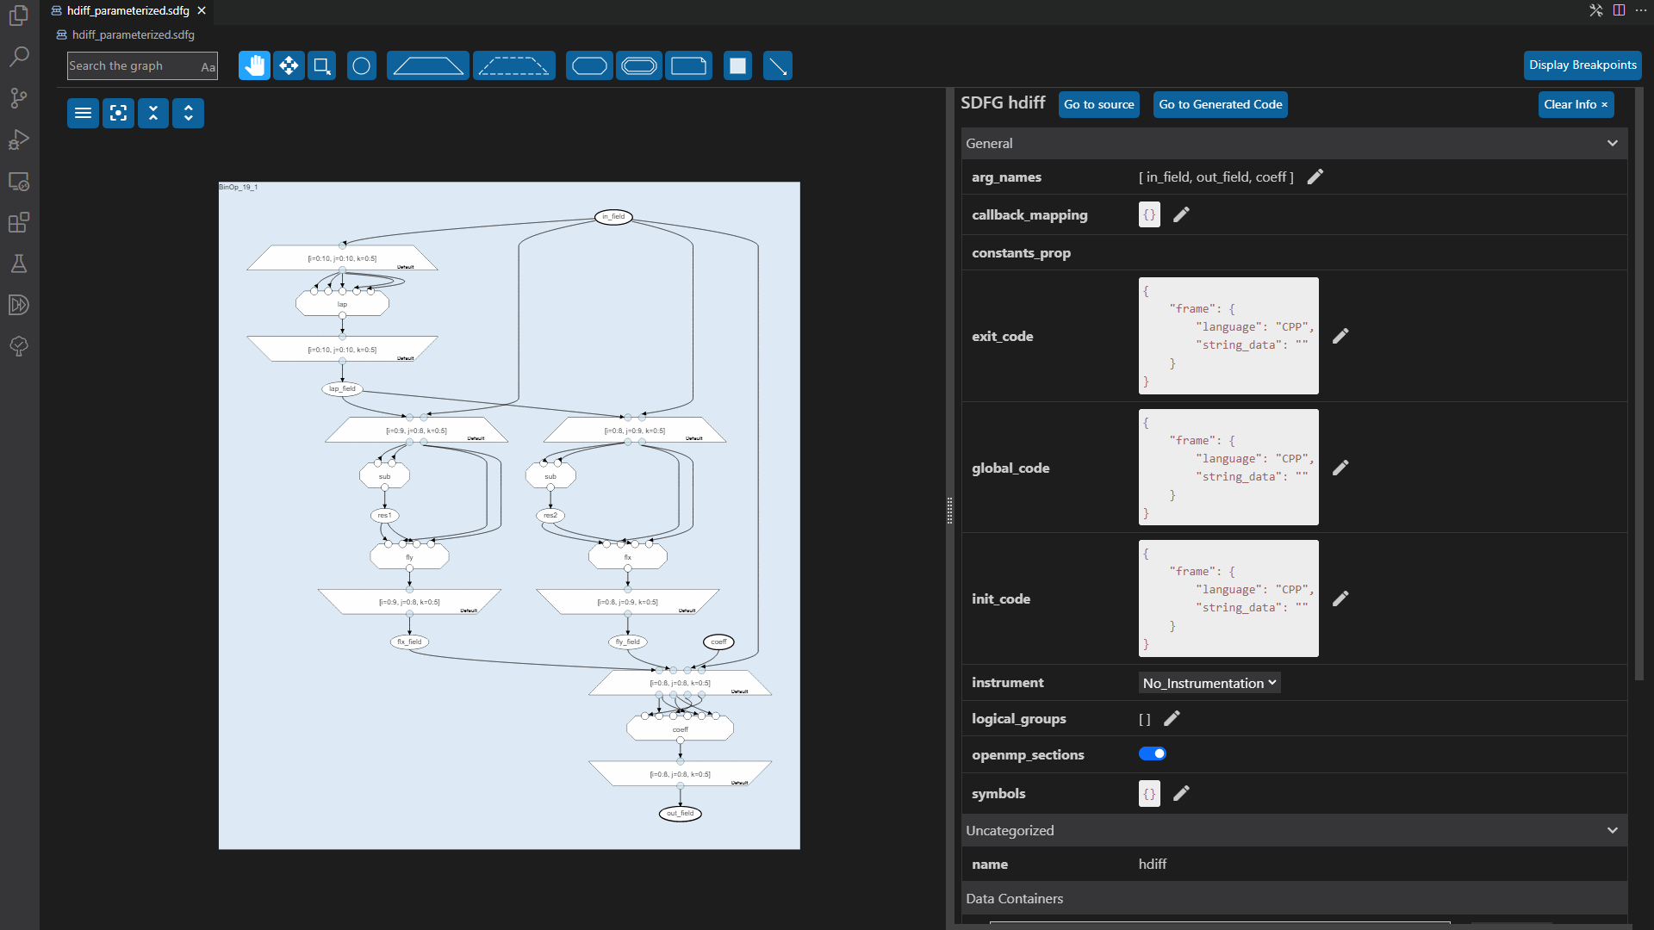

Slide 33
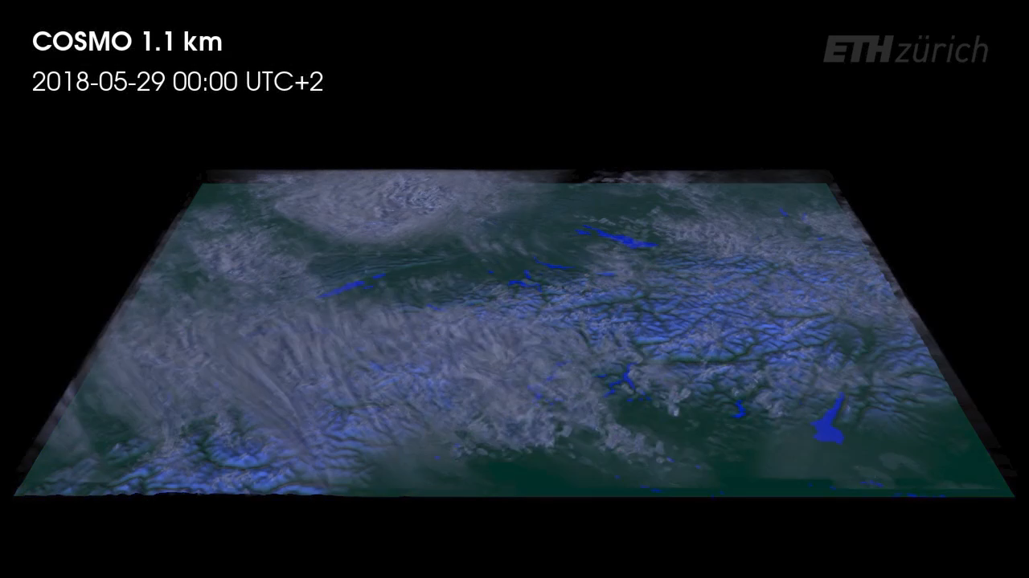
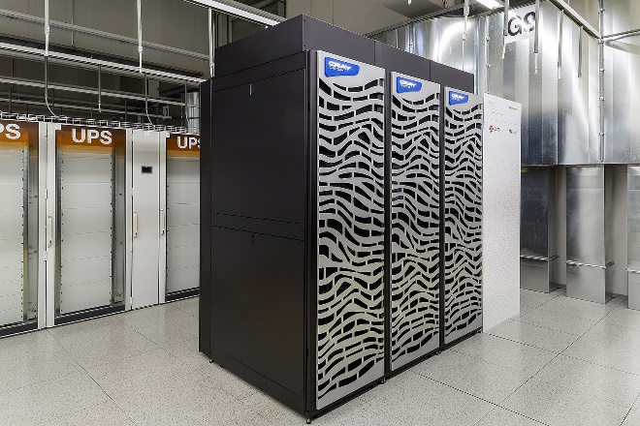
Case study: Weather simulation at MeteoSwiss
[1]
Weather service is currently GPU-powered [2]
[1] Institute for Atmospheric and Climate Science and Computer Graphics Laboratory, ETH Zürich [https://vimeo.com/389292423]
[2] Swiss National Supercomputing Center (CSCS) [https://www.cscs.ch/computers/arolla-tsa-meteoswiss]

Slide 34
Weather stencil programs
Idea: Pipeline dependencies in a fine-grained manner on a spatial computing architecture.
Gysi et al.: MODESTO: Data-centric Analytic Optimization of Complex Stencil Programs on Heterogeneous Architectures, 29th International Conference on Supercomputing (ICS'15)

Slide 35
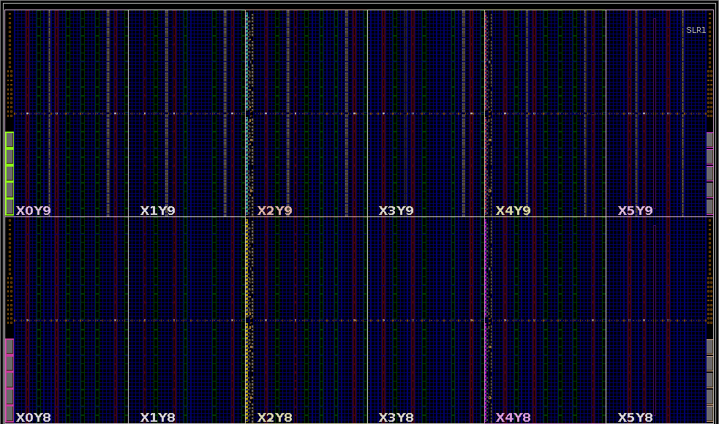
StencilFlow
Map the entire stencil program to a fully-pipelined parallel streaming hardware architecture.
Transparently expose this mapping from
a high-level scientific DSL.
Gysi et al.: MODESTO: Data-centric Analytic Optimization of Complex Stencil Programs on Heterogeneous Architectures, 29th International Conference on Supercomputing (ICS'15)

Slide 36
Taming the weather
We can now generate and process the stencil DAG.
Performs 130 floating point operations per grid point (including sqrt, min, and max operations).
20 data-dependent branches
Arithmetic intensity of
65/18 Op/Byte.
de Fine Licht et al.: StencilFlow: Mapping Large Stencil Programs to Distributed Spatial Computing Systems 19th ACM/IEEE International Symposium on Code Generation and Optimization (CGO'21), 2021

Slide 37
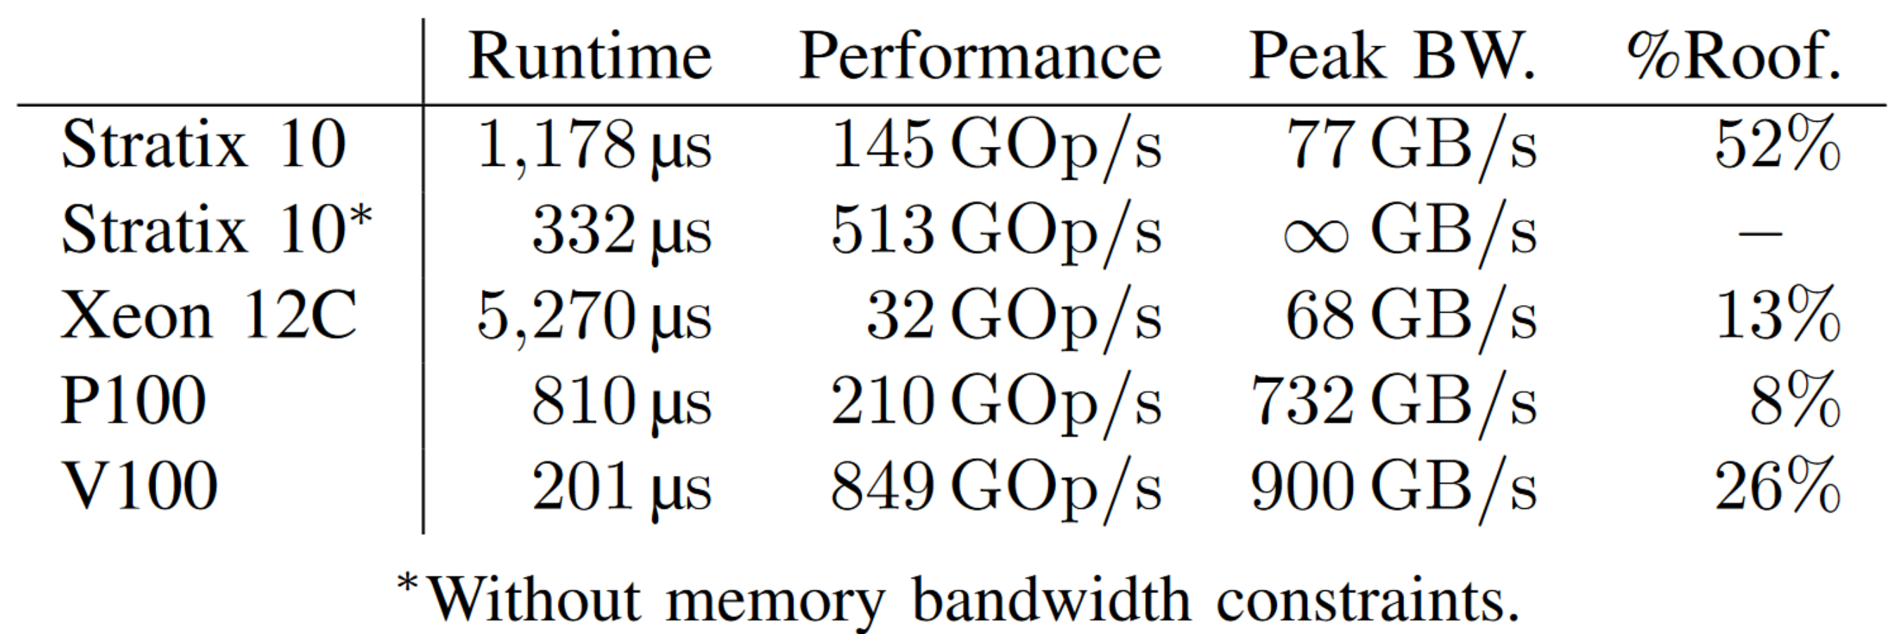
Taming the weather
CPU and GPU results are highly optimized codes produced by the DAWN framework [1].
all memory bound
318 MHz at 48% DSP utilization
The Stratix 10 is held back by insufficient bandwidth.
FPGAs are good at deterministically exploiting bandwidth,
but require a lot of pipeline parallelism.
[1] Osuna et al.: Dawn: a High Level Domain-Specific Language Compiler Toolchain for Weather and Climate Applications, Supercomputing Frontiers and Innovation 2020

Slide 38

aCe is a versatile platform
NumPy
NVIDIA GPU
DaCeML
(PyTorch/ONNX)
AMD GPU
x86 CPU
C
(C99)
ARM SVE
GridTools
(Weather & Climate)
Intel FPGA
Xilinx AMD FPGA
Fortran
(in planning)
RTL
(soon)
Your favorite language/DSL
(through SDFG builder)
Your favorite processor
(through C++ codegen)
Ben-Nun et al. "Stateful dataflow multigraphs: A data-centric model for performance portability on heterogeneous architectures." Supercomputing 2019 (SC'19).

Slide 39
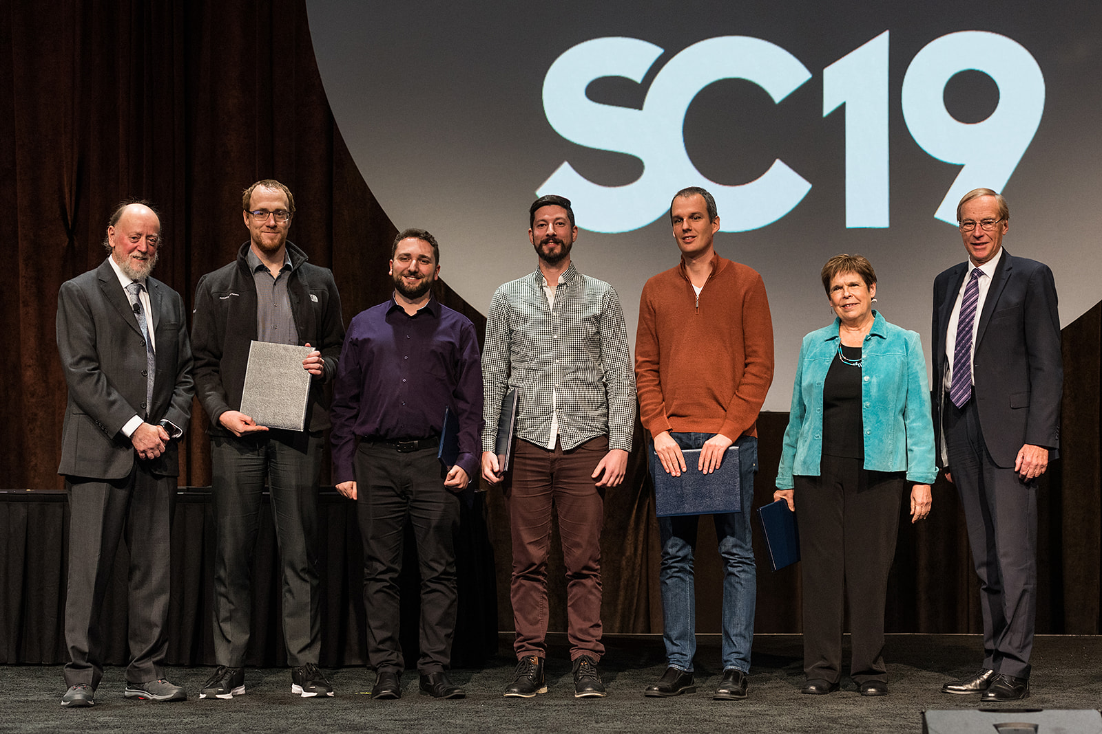
Last example: Gordon Bell Prize 2019 on ORNL’s Summit (Top-1 Machine)
pip install dace
Gordon Bell Prize 2019
  Quantum Nano Transport
  simulation
    Design of future micro-
    processors
Now working on large-scale:
  Deep Learning (transformers)
  Climate (COSMO, icon, fv3)
  Green’s functions solvers
  … your project?
http://spcl.inf.ethz.ch/DAPP

Slide 40
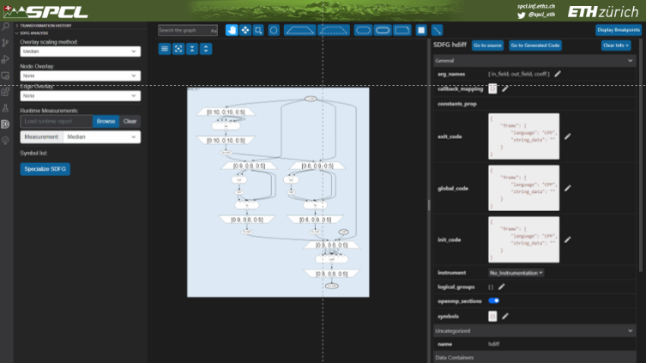
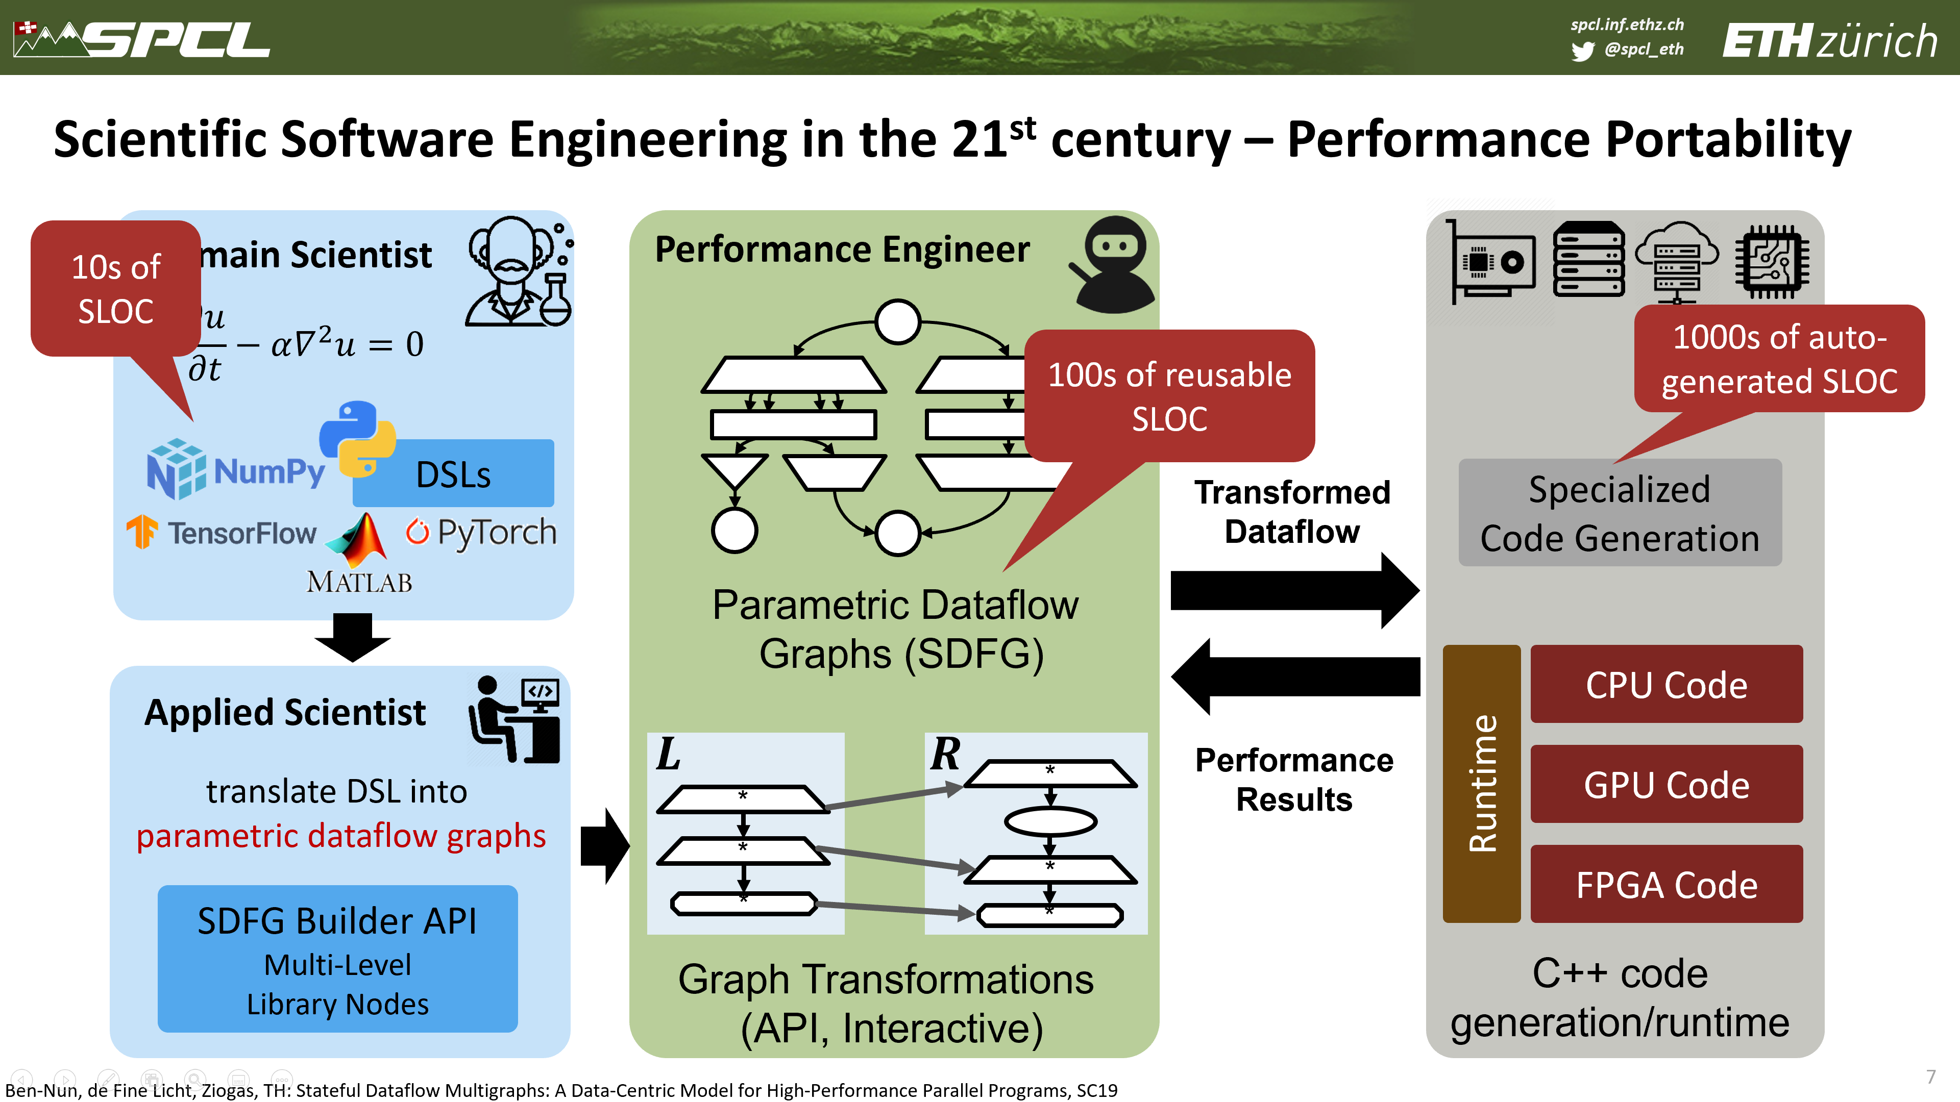
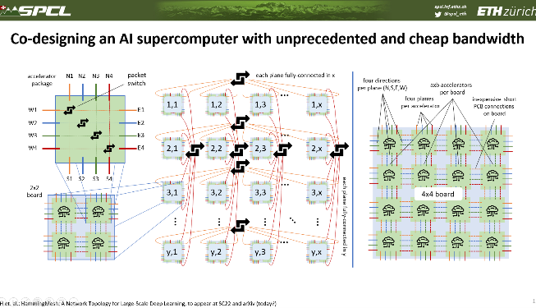
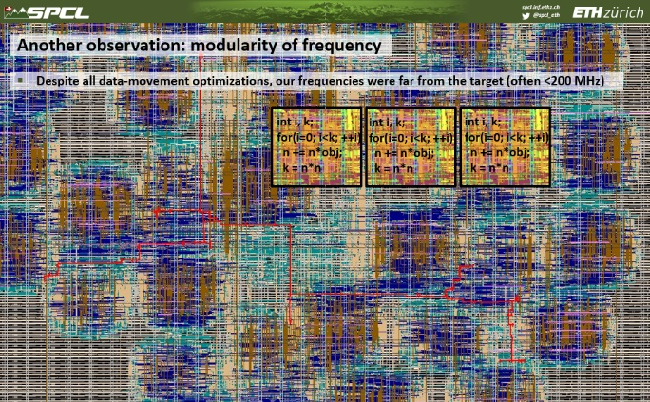
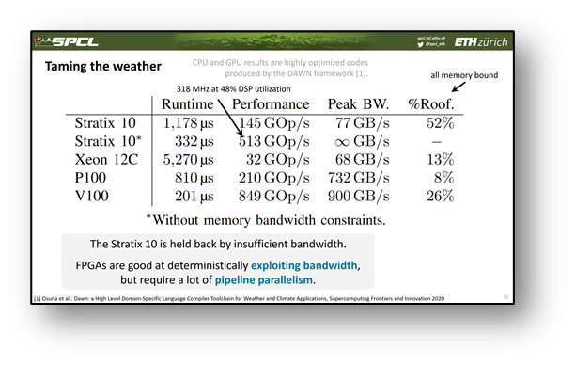
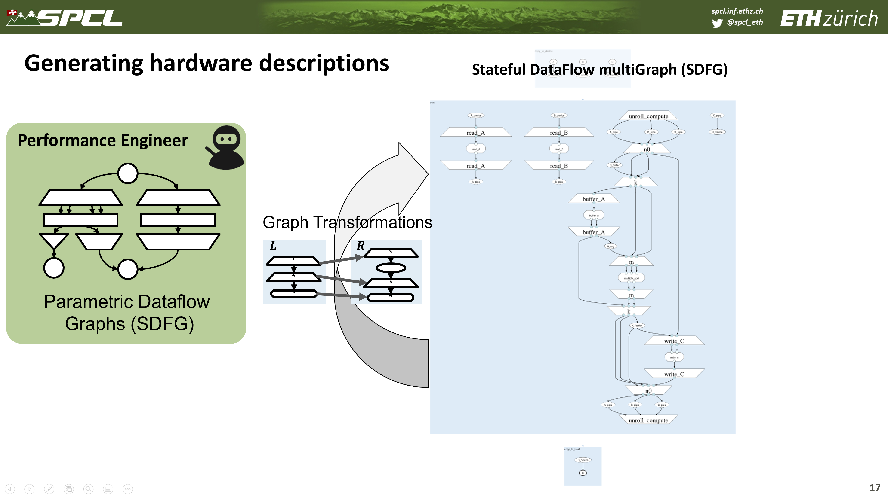




Overview and wrap-up
We need effective
tool support!
Future hardware must be spatial!
Spatial reasoning is too hard!
Combine temporal algorithms and spatial optimizations!
Modularity will
be important!
Early results
Look promising
DaCe offers ideas for spatial design
https://www.youtube.com/c/ScalableParallelComputingLabETHZurich
This project has received funding from the European Research Council (ERC) under grant agreements "DAPP and PSAP (PI: T. Hoefler)".

Slide 41






Coming soon: Mapping Deep Learning Codes to FPGAs and CGRAs
Key principle: minimize data movement and optimize data layout
MLSys’20
Rausch et al. “A Data-Centric Optimization Framework for Machine Learning”, in ICS’22

Slide 42


Another observation: modularity of frequency
Despite all data-movement optimizations, our frequencies were far from the target (often <200 MHz)
int i, k;
for(i=0; i<k; ++i)
n += n*obj;
k = n*n
int i, k;
for(i=0; i<k; ++i)
n += n*obj;
k = n*n
int i, k;
for(i=0; i<k; ++i)
n += n*obj;
k = n*n

Slide 43

A little trick: temporal vectorization aka. automatic multi-pumping
[1] Johnsen et al.: Temporal Vectorization: A Compiler Approach to Automatic Multi-Pumping, ICCAD 2022

Slide 44

How can temporal vectorization be implemented?
[1] Johnsen et al.: Temporal Vectorization: A Compiler Approach to Automatic Multi-Pumping, ICCAD 2022

Slide 45



Performance of temporal vectorization on a Xilinx AMD Alveo U280
Hand-optimized comm-avoiding.
Standard HLS
Temporal vectorization
Matrix Multiplication
Jacobi 3D stencil
Diffusion 3D stencil
Nearly 2x frequency increase due to shorter paths (modularity) mapping
[1] Johnsen et al.: Temporal Vectorization: A Compiler Approach to Automatic Multi-Pumping, ICCAD 2022

