Slide 1
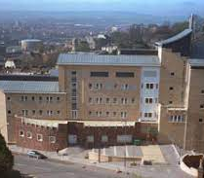
Future Proof Applications
Prof. Simon McIntosh-Smith, University of Bristol, UK
PPAM 2022
Performance Portability in the Age of Diverse Computer Architectures

Slide 2
Next-generation supercomputers are largely heterogeneous
The emerging generation of Exascale systems include a diverse range of architectures at massive scale; most (but not all) are heterogeneous:
  Fugaku: Fujitsu A64FX Arm CPUs
  Perlmutter: AMD EYPC CPUs and NVIDIA GPUs
  Frontier: AMD EPYC CPUs and Radeon GPUs
  Aurora: Intel Xeon CPUs and Xe GPUs
  El Capitan: AMD EPYC CPUs and Radeon GPUs
The Next Platform, Jan 13th 2020: “HPC in 2020: compute engine diversity gets real”
https://www.nextplatform.com/2020/01/13/hpc-in-2020-compute-engine-diversity-gets-real/

Slide 3
Performance Portability
In Bristol we’ve been exploring performance portability for a long time
  See https://uob-hpc.github.io/
At the P3HPC workshops (2019-2021), we have presented surveys of how attainable performance portability is
  Across many different computer architectures and programming languages
These studies provide valuable datasets for performance portability research, and feedback to compiler writers
We add exciting new parallel programming models into these studies as they emerge

Slide 4
What do I mean by “performance portability?”
“A code is performance portable if it can achieve a similar fraction of peak hardware performance on a range of different target architectures.”
Questions:
Does it have to be a “good” fraction? YES! Within 20% of “best achievable”, i.e. of hand-optimized OpenMP, CUDA, …
How wide is the range of target architectures? Depends on your goal, but important to allow for future architectural developments

Slide 5
A bit of history on Performance Portability in Bristol

Slide 6
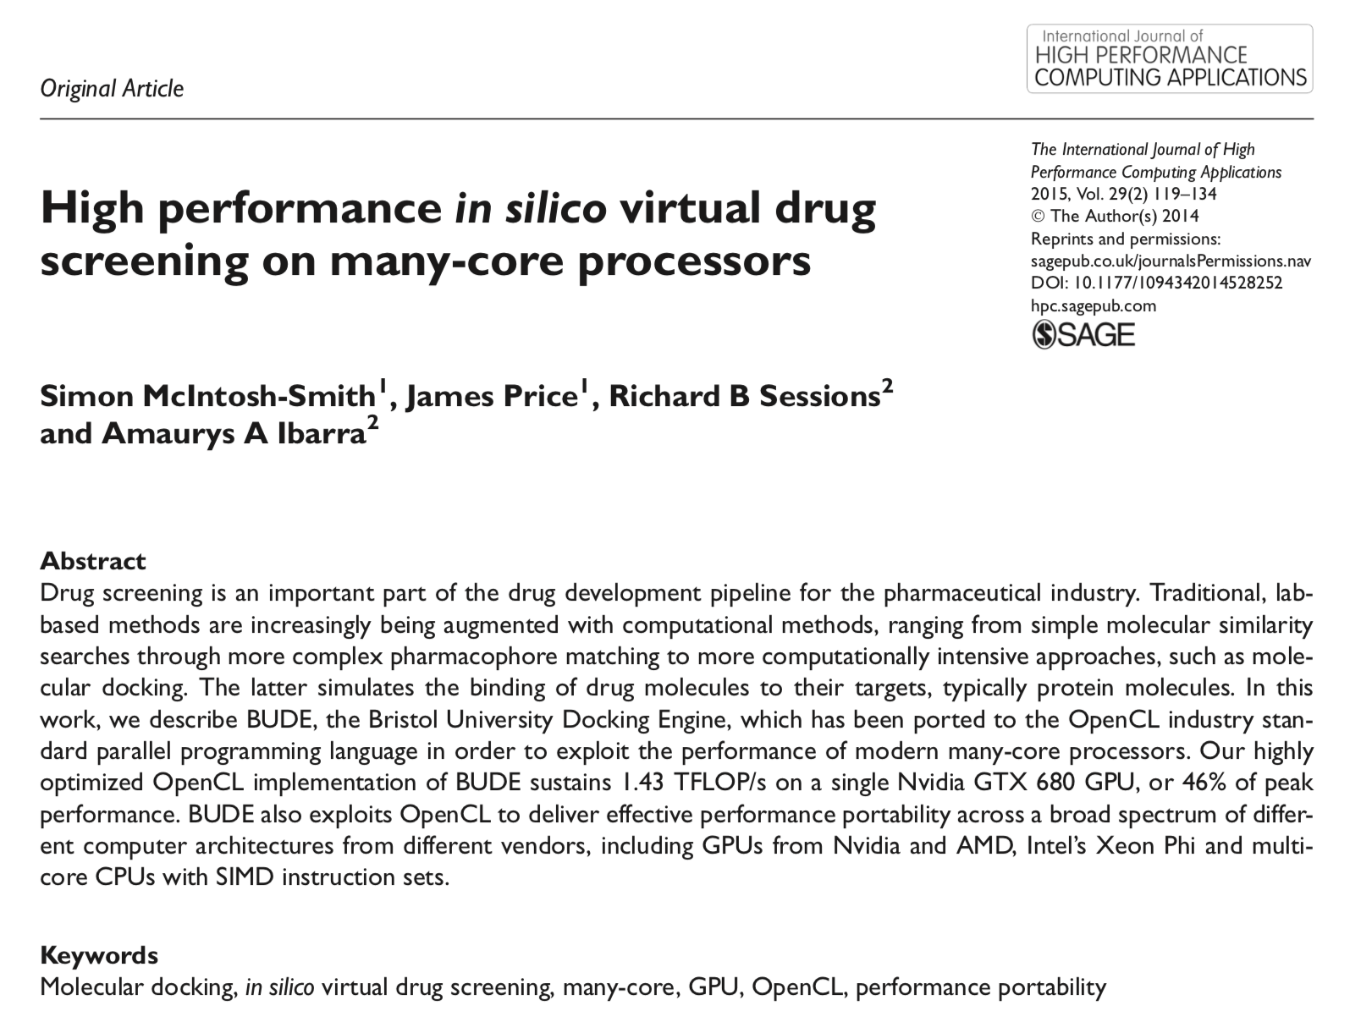
Notes:
Work from 2013

Slide 7
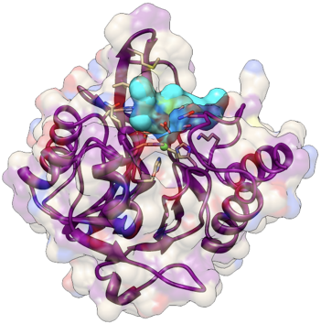
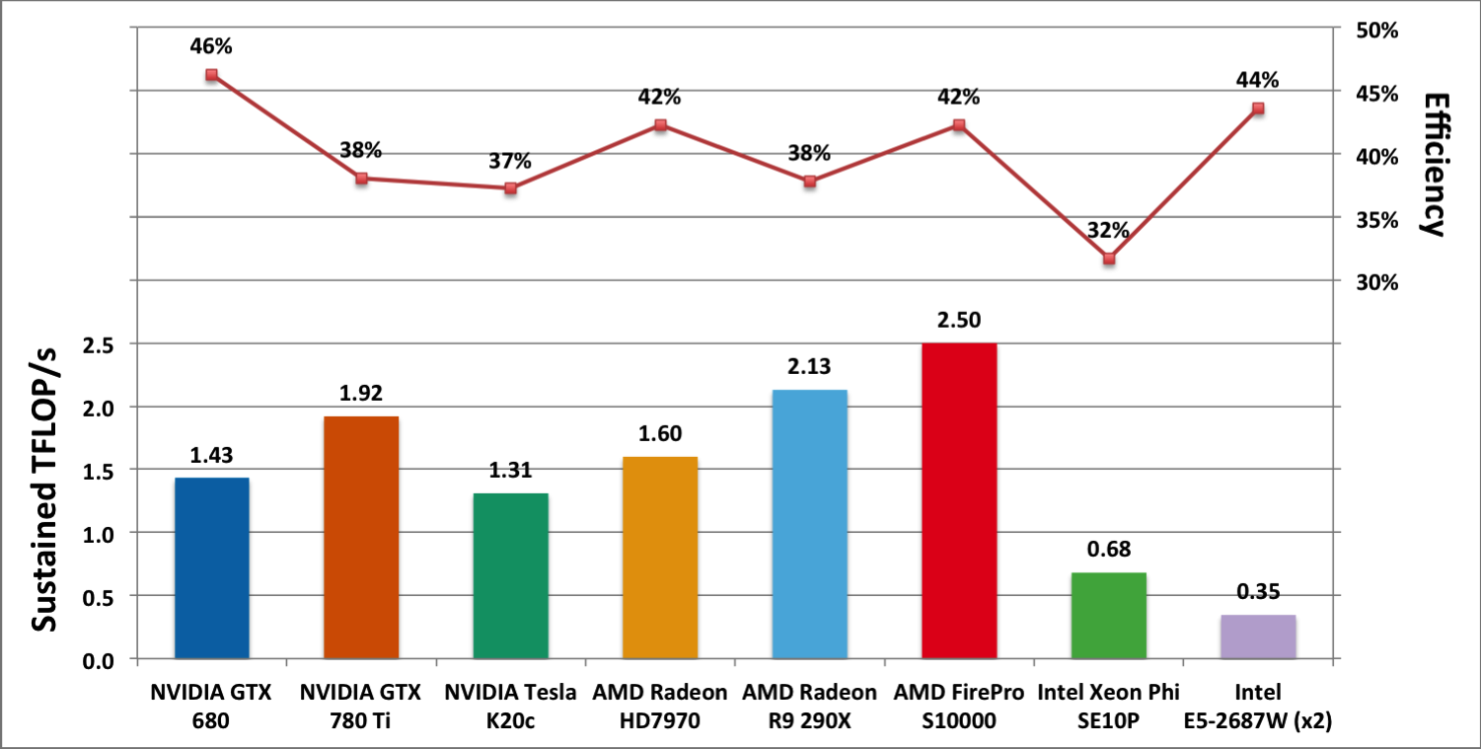
Bristol’s first performance portable project:
The BUDE molecular docking code
"High Performance in silico Virtual Drug Screening on Many-Core Processors",
S. McIntosh-Smith, J. Price, R.B. Sessions, A.A. Ibarra, IJHPCA 2014
Notes:
We'd done some work optimising a molecular docking code called BUDE for a specific Nvidia GPU. We used OpenCL, and when we then looked at the performance of the optimised code on a wide range of devices, we noticed that the code was achieving a very similar fraction of floating point performance across all the devices

Slide 8

What about bandwidth bound codes?
We developed “BabelStream” to measure the achievable fraction of peak memory bandwidth (formerly known as “GPU-STREAM”)
Cross platform
  CPUs, GPUs, …
Cross language
  C/C++, OpenMP inc. target, CUDA, OpenACC, Kokkos, SYCL, …
http://uob-hpc.github.io/BabelStream/
Deakin, T., Price, J., Martineau, M., & McIntosh-Smith, S. Evaluating attainable memory bandwidth of parallel programming models via BabelStream. International Journal of Computational Science and Engineering, April 2017.

Slide 9
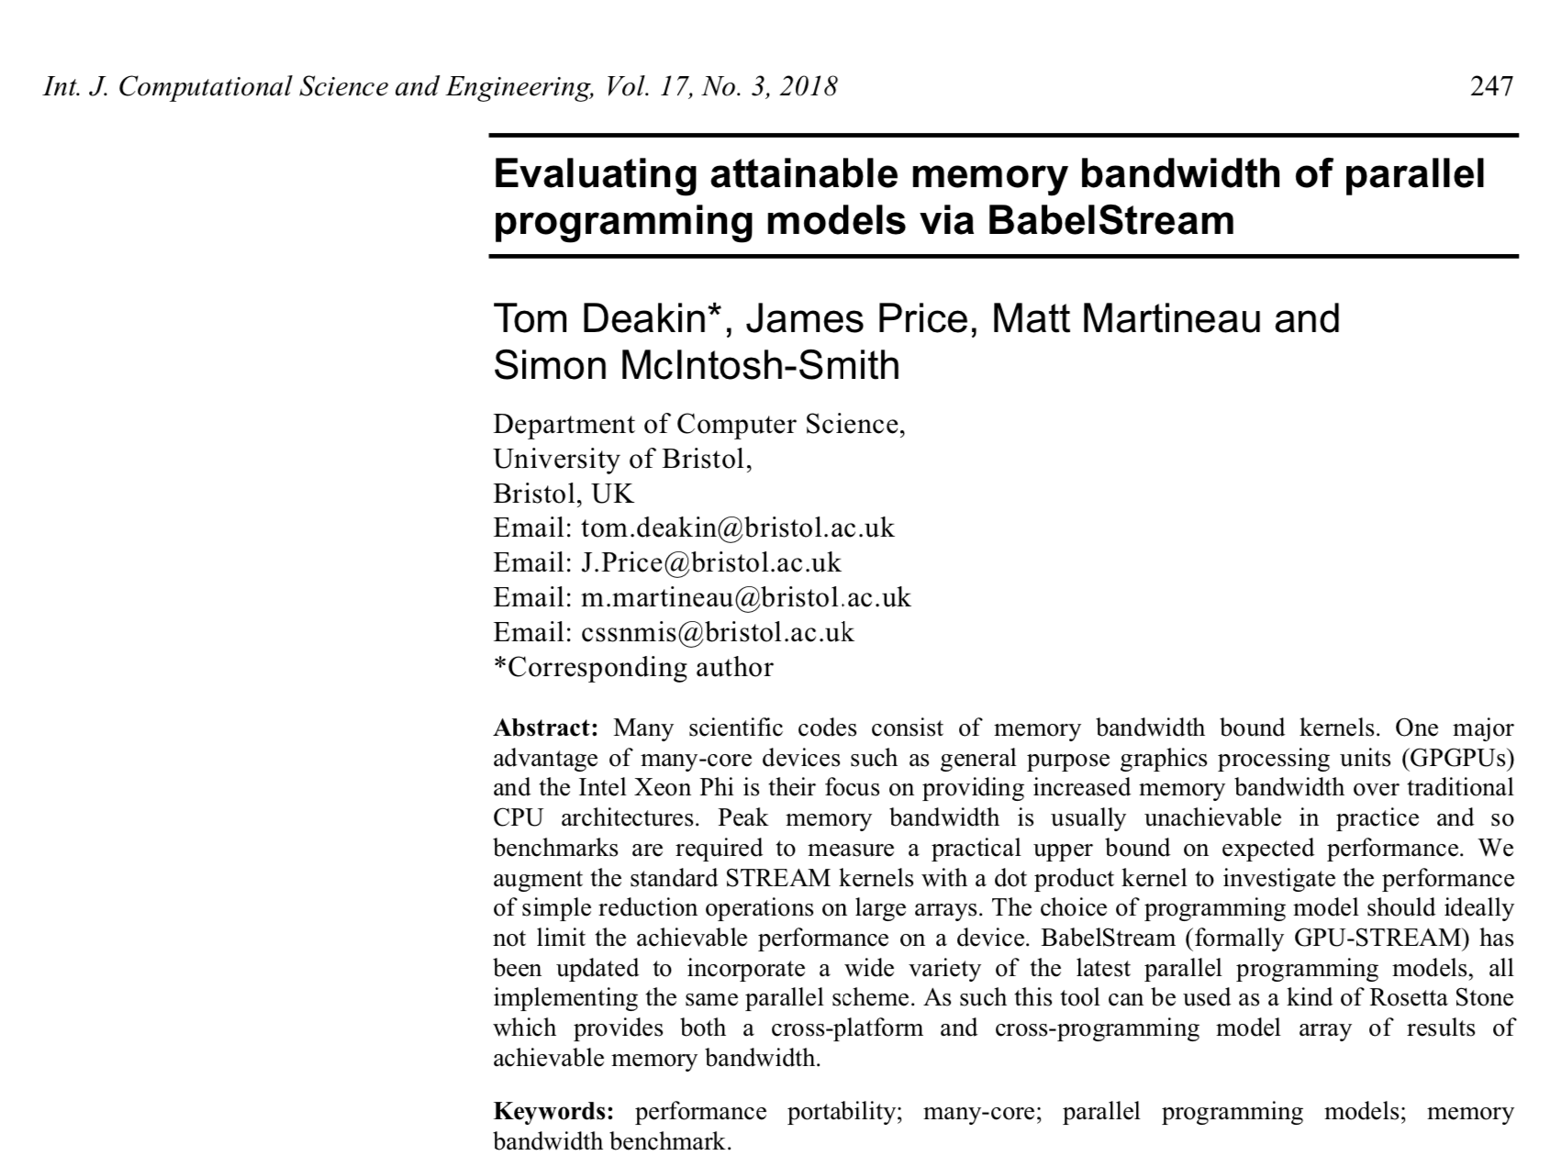

Slide 10
From: http://uob-hpc.github.io/BabelStream/results/

Slide 11
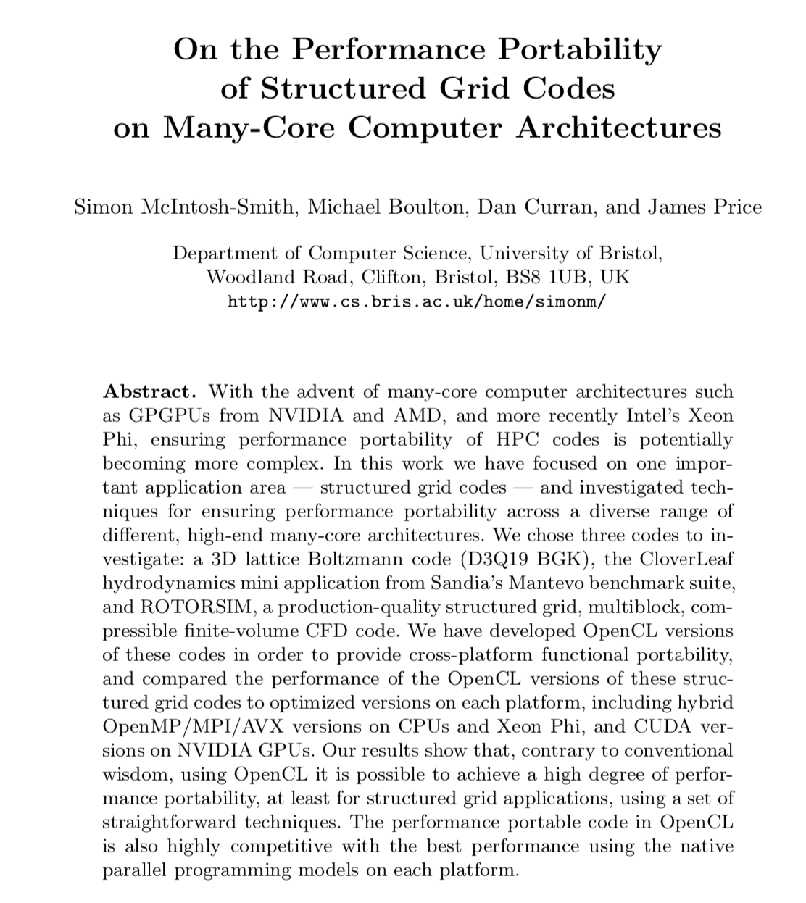
ISC 2014

Slide 12
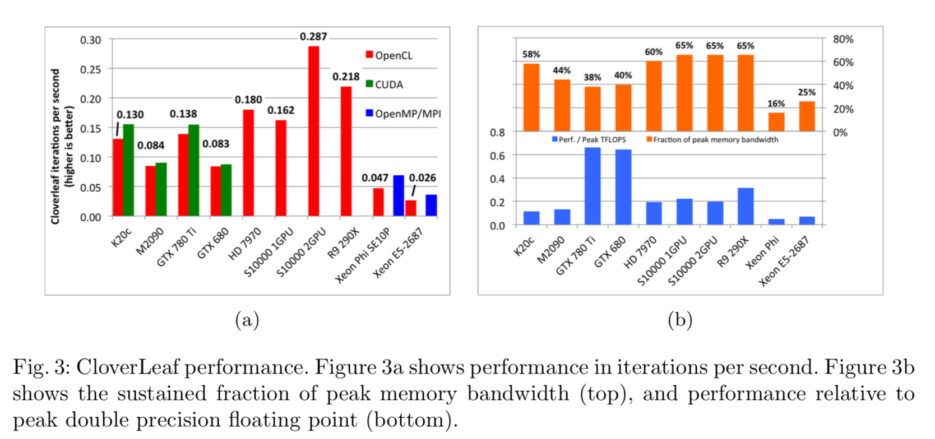
After BabelStream, more realistic bandwidth bound codes
S.N. McIntosh-Smith, M. Boulton, D. Curran, & J.R. Price, “On the performance portability of structured grid codes on many-core computer architectures”, ISC, Leipzig, June 2014. DOI: 10.1007/978-3-319-07518-1_4

Slide 13
Performance Portability: the next phase

Slide 14
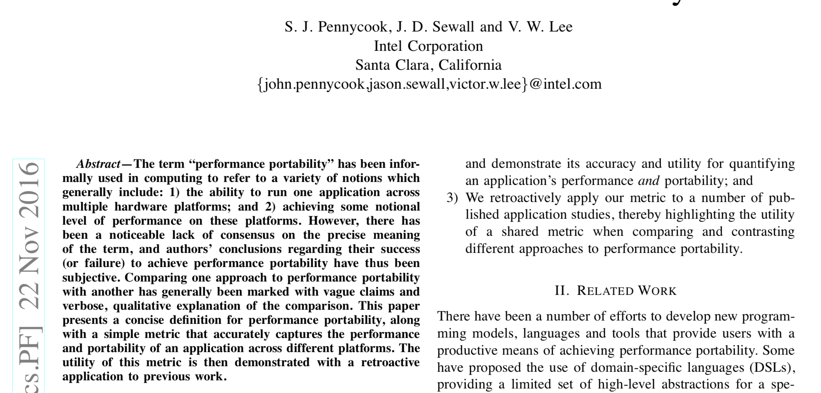

Slide 15
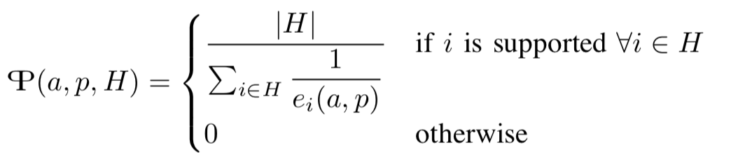
A more rigorous metric for Performance Portability
For a given set of platforms H, the performance portability P of an application a solving problem p is:
Where e_{i}(a,p) is the performance efficiency of application a solving problem p on platform i.

Slide 16
Two ways to measure Performance Portability
Definitions from the Pennycook, Sewall and Lee paper:
Architectural efficiency:
Achieved performance as a fraction of peak theoretical hardware performance. This represents the ability of an application to utilize hardware efficiently;
Application efficiency:
Achieved performance as a fraction of best observed performance. This represents the ability of an application to use the most appropriate implementation and algorithm for each platform

Slide 17
A systematic evaluation of Performance Portability
Studying Performance Portability is hard!
  Have to be rigorous about doing as well as possible across a wide range issues: architectures, programming languages, algorithms, compilers, …
In Bristol, we set up a wide-ranging, ongoing evaluation of
Performance Portability:
  Across many codes
  Across many programming languages
  Across many architectures
Our goal is to share these codes and results to further the fundamental understanding of performance portability and what can be achieved

Slide 18
Some of the codes in the Bristol Performance Portability study
BabelStream: simple measure of achievable memory bandwidth
CloverLeaf: structured grid hydrodynamics (SPEChpc)
TeaLeaf: structured grid heat diffusion (SPEChpc)
Neutral: Monte Carlo neutral particle transport
MiniFMM: fast multipole method
SNAP: structured grid deterministic neutral particle transport
MiniBUDE: unstructured grid deterministic neutral particle transport
MiniCombust: combustion code: particle tracking and CFD combined

Slide 19
Parallel programming languages in the Bristol PP study
OpenMP
Kokkos
Raja
OpenACC
CUDA
OpenCL
SYCL
Julia
Rust
HPX
ISO C++
Fortran DO CONCURRENT

Slide 20
Target hardware platforms
CPUs:
Intel Skylake, Cascade Lake, Icelake
Intel KNL
AMD Naples, Rome, Milan
IBM POWER9
Marvell ThunderX2
Ampere eMAG, Altra
Fujitsu A64fx
AWS Graviton 2, 3
Accelerators:
NVIDIA P100, V100, A100
AMD Radeon, Mi50, Mi100, Mi200
Intel GPUs
NEC Aurora

Slide 21
Bristol Performance Portability study
Latest results

Slide 22
Performance portability with existing approaches
Via open standards: OpenMP, SYCL, ISO C++, …
Vendor provided approaches: OpenACC, HIP, …
No magic – none of these can make your program performance portable for you. Instead, they enable performance portable programs to be written

Slide 23
Performance portability with OpenMP
One criticism of OpenMP is that, while you can write PP programs using OpenMP, you currently need to write two different styles of parallelism for CPUs and GPUs:
#pragma omp parallel for
vs
#pragma omp target enter data map(alloc: A[:N], B[:N], C[:N])
#pragma omp target loop
But what if one OpenMP version ran well on both CPUs and GPUs?

Slide 24
Comparing OpenMP target performance on CPUs
Compared OpenMP target code for GPUs to OpenMP CPU code, Kokkos and SYCL
Used bandwidth bound (BabelStream) and compute bound (MiniBUDE) codes
CPUs from Intel (Icelake, 2x32 cores @2.0GHz), AMD (Milan, 2x64 cores @2.0GHz), Fujitsu (A64fx, 1x48 cores @1.8GHz), and AWS (Graviton 3, 1x64 cores @2.6GHz)
Compilers: Cray, Intel, LLVM, GCC; SYCL – DPC++ and hipSYCL

Slide 25
Cascade plots of architectural efficiency on Intel Icelake
BabelStream
MiniBUDE
Heterogeneous Programming for the Homogeneous Majority.
Tom Deakin, James Cownie, Wei-Chen Lin and Simon McIntosh-Smith

Slide 26
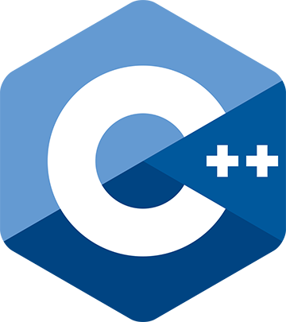
Performance portability with ISO C++ standard parallelism
For the first time, standard language parallelism for GPUs
and CPUs is becoming possible
Enabled by C++17 (and later)
  Execution Policies allow threaded and/or vectorized execution of common standard algorithms
Can easily express parallelism in a simple, uniform way
This standard parallelism C++ code can then be compiled and run efficiently on both CPUs and GPUs
How to Develop Performance Portable Codes using the Latest Parallel Programming Standards
Simon McIntosh-Smith, Tom Deakin and Tom Lin, GTC Spring 2022

Slide 27
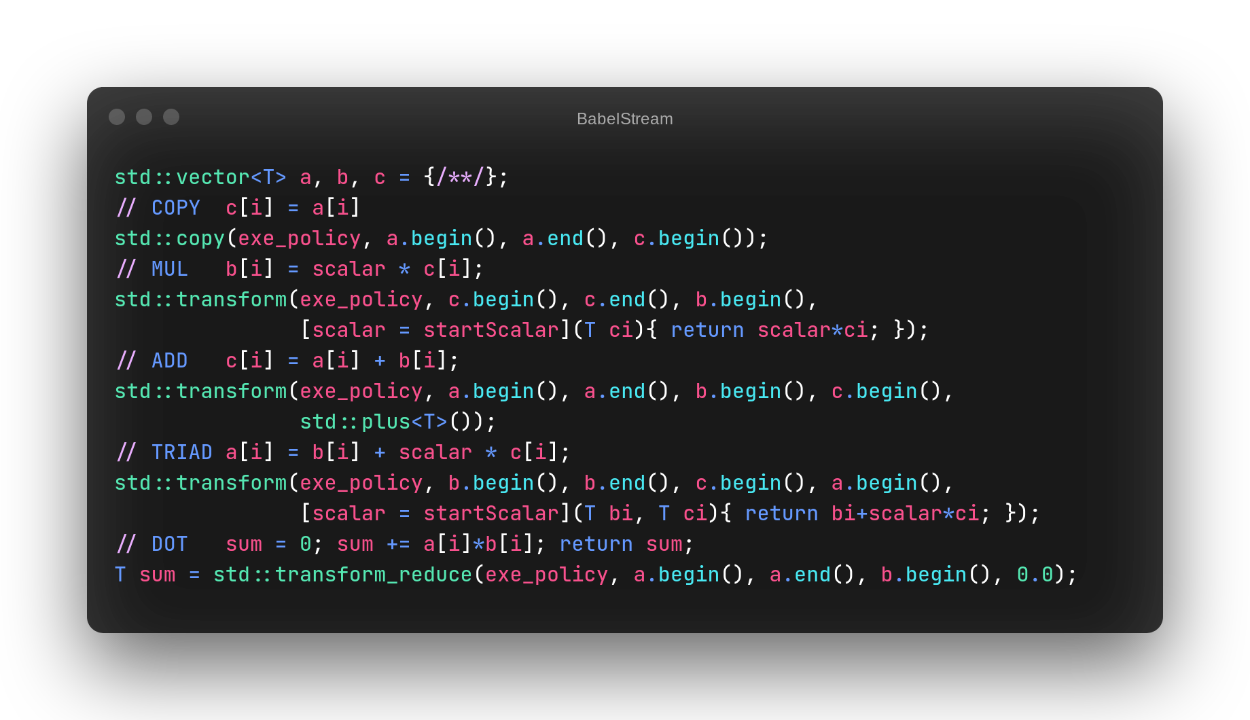
BabelStream ISO C++ code
Notes:
std::execution::par_unseq

Slide 28
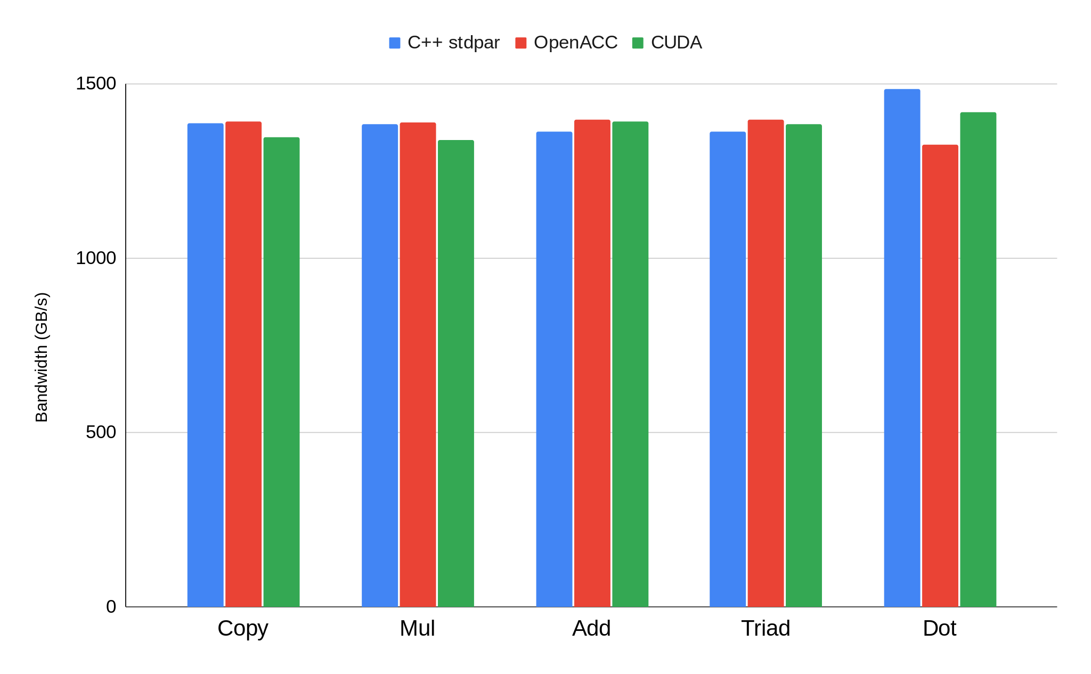
BabelStream results (A100-40GB)
Higher is better
https://github.com/UoB-HPC/BabelStream
Notes:
Results for BabelStream is unsurprising.
We see all kernels performing similarly across C++ stdpar, OpenACC, and CUDA.

Slide 29
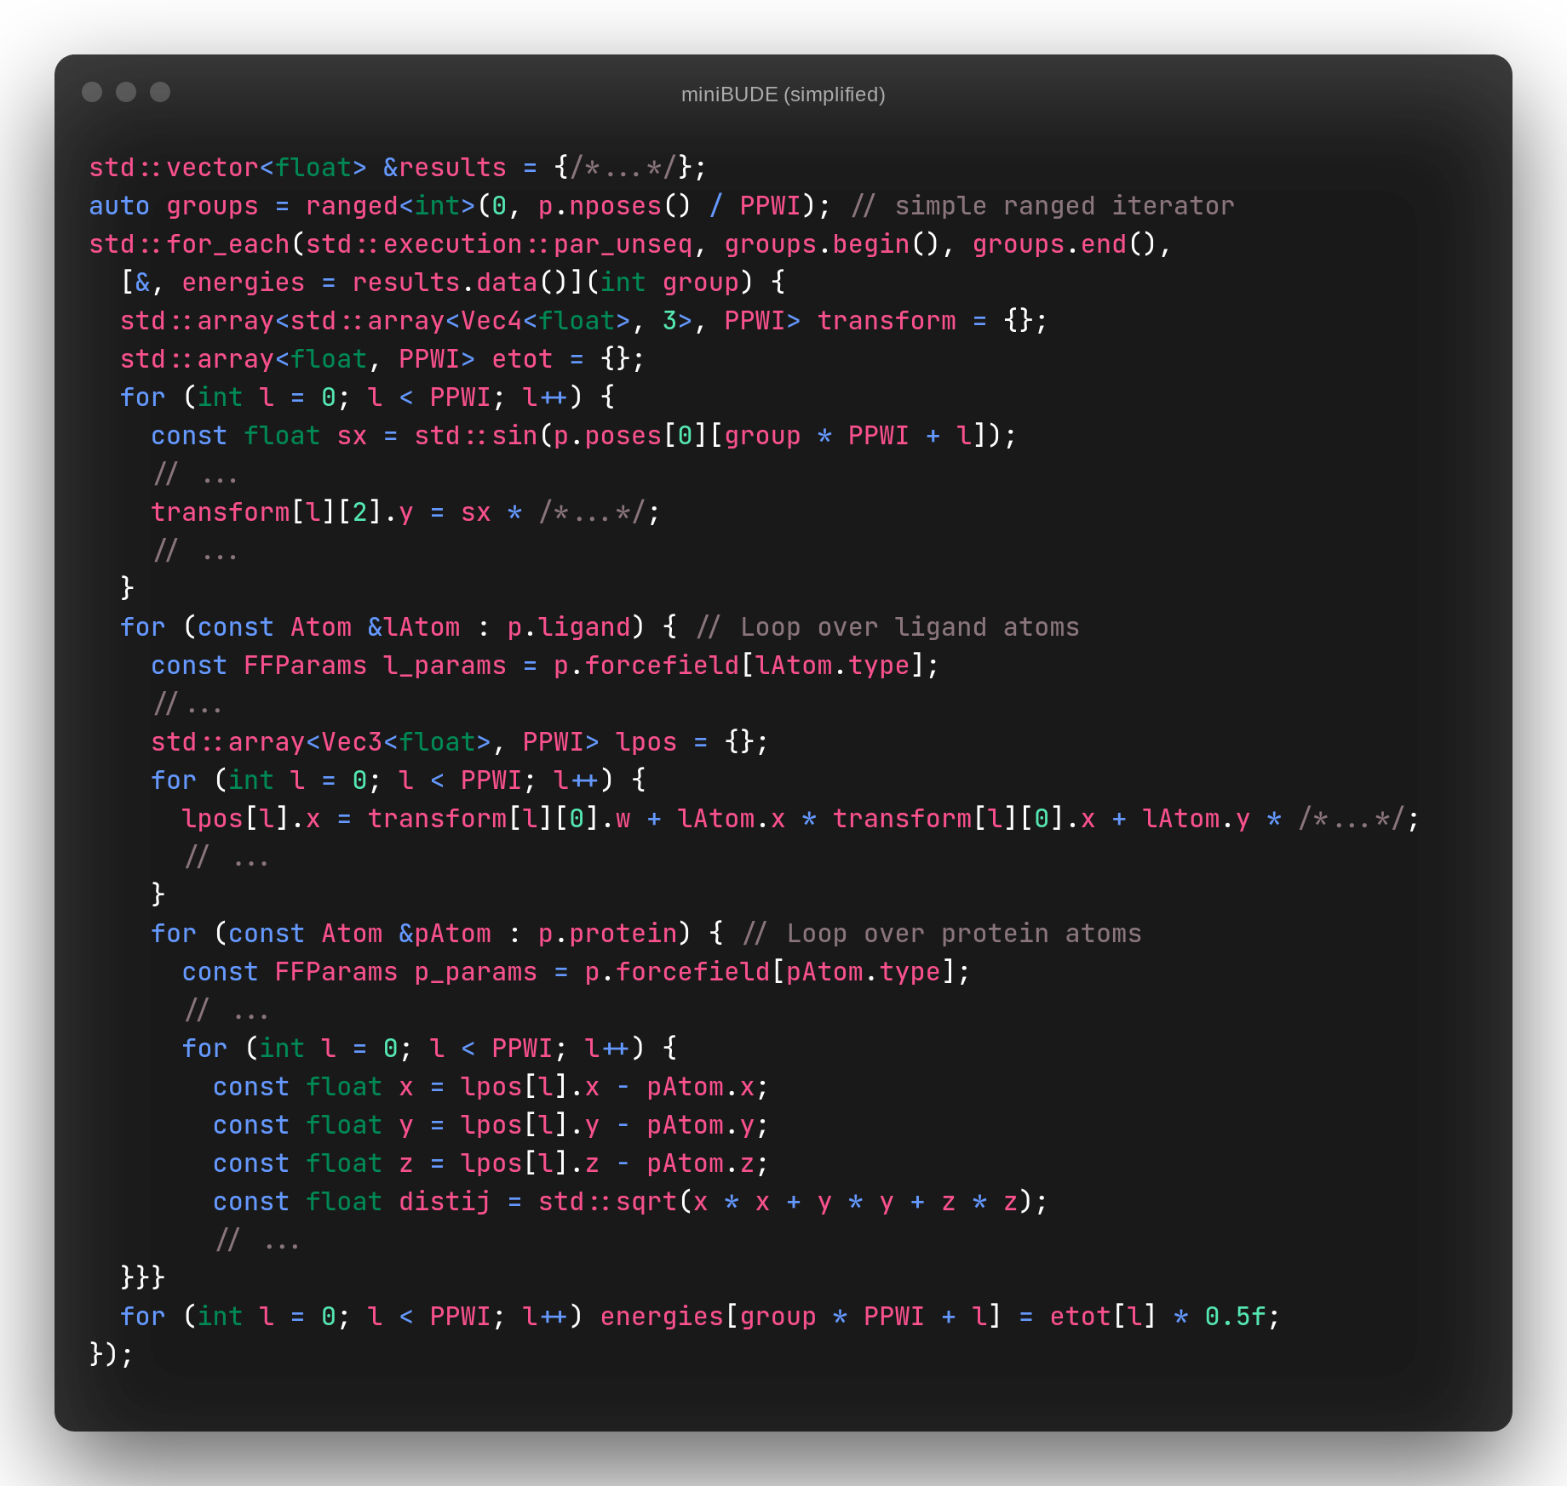
miniBUDE
ISO C++ code
Range-based for loop
STL containers
  std::array<T, N>
  std::vector<T>
  (captured by-ref)
<cmath> calls via std namespace
Data movement via captures
Custom counting iterator
https://github.com/UoB-HPC/miniBUDE

Slide 30
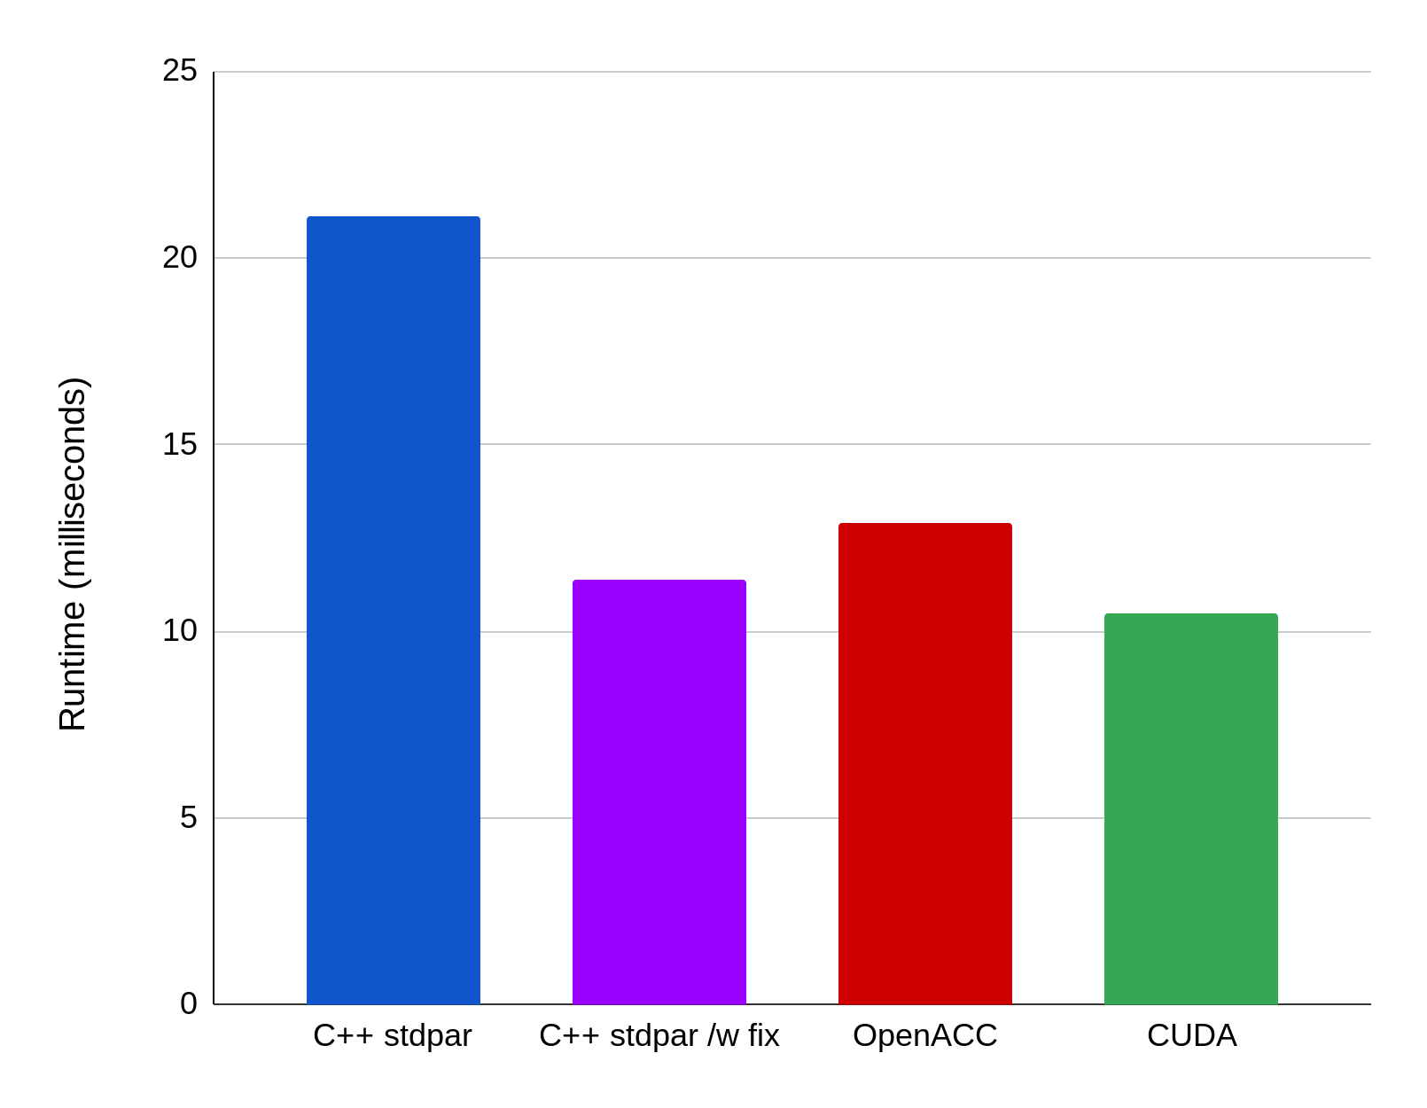
miniBUDE Results (A100-40GB)
Lower is better
Notes:
Results for miniBUDE is less clear-cut.
We’ve created a port for miniBUDE written in standard C++ parallel algorithms and compiled it with the latest NVHPC toolchain.
The benchmark results are conducted on Isambard Phase 3’s 40GB A100 nodes.
The BM1 runtime results on the left shows stdpar appears to be less performant than both OpenACC and CUDA by a significant margin if we simply look at the best runtime.
However, as miniBUDE has a set of tuning parameters, we can delve deeper and see what’s really going on.
For all three implementations, miniBUDE exposes the PPWI parameter.
This is the kernel’s inner-loop unroll count and it affects the final vector width of the kernel.
For CUDA, we also get the block dimension (wgsize) parameter as part of the kernel launch.
The chart on the right presents the results of miniBUDE runtime with multiple parameterisations on both PPWI and in the case of CUDA, the block size.
We suspect the suboptimal performance of the stdpar is the result of poorly selected block size by the stdpar runtime.
It is unclear based on the current stdpar documentation whether fine tuning of kernel launch parameters is possible.
However, the stdpar implementation is simply standard C++, making use of common high-productivity C++ features such as templates and iterator-based for-loops.
The codebase essentially remained identical for both CPU and GPU and is not tied to a particular offload implementation.

Slide 31
Normalised CloverLeaf results, lower is better
Evaluating ISO C++ Parallel Algorithms on Heterogeneous HPC Systems.
Wei-Chen Lin, Tom Deakin and Simon McIntosh-Smith (submitted)

Slide 32
Fortran DO CONCURRENT – stream triad
do concurrent (i=1:N)
c(i) = a(i) + s * b(i)
end do
vs
!$omp parallel do simd
for CPUs, or for GPUs,
!$omp target teams loop

Slide 33
Fortran DO CONCURRENT – GPUs
Benchmarking Fortran DO CONCURRENT on CPUs and GPUs Using BabelStream.
Jeff R. Hammond, Tom Deakin, James Cownie and Simon McIntosh-Smith (submitted)

Slide 34
Fortran DO CONCURRENT – CPUs
Benchmarking Fortran DO CONCURRENT on CPUs and GPUs Using BabelStream.
Jeff R. Hammond, Tom Deakin, James Cownie and Simon McIntosh-Smith (submitted)

Slide 35
General lessons learned about achieving performance portability
Use open (standard) parallel programming languages supported by multiple vendors across multiple hardware platforms
  E.g. OpenMP, Kokkos, SYCL, ISO C++ and Fortran DO CONCURRENT
Expose maximal parallelism at all levels of the algorithm and application
Avoid over-optimising for any one platform
  Optimise for at least two different platforms at once
Multi-objective autotuning can significantly improve performance
  Autotune for more than one target at once
  See: Exploiting auto-tuning to analyze and improve performance portability on many-core architectures, J.Price and S. McIntosh-Smith, P3MA, ISC’17

Slide 36
References – scholar.google.com McIntosh-Smith
Interpreting and Visualizing Performance Portability Metrics
Sewall, Pennycook, Jacobsen, Deakin, McIntosh-Smith
P3HPC’20
Which performance portable programming model should I use?
http://uob-hpc.github.io/2020/05/05/choosing-models.html
Performance Portability across Diverse Computer Architectures
T. Deakin, S. McIntosh-Smith, J. Price, A. Poenaru, P. Atkinson, C. Popa, J. Salmon, P3HPC at SC 2019
https://doi.org/10.1109/P3HPC49587.2019.00006
Evaluating the performance of HPC-style SYCL applications
T. Deakin, S. McIntosh-Smith, IWOCL 2019
https://doi.org/10.1145/3388333.3388643
Evaluating attainable memory bandwidth of parallel programming models via BabelStream
T. Deakin, J. Price, M. Martineau, S. McIntosh-Smith, IJCSE 2018
https://doi.org/10.1504/IJCSE.2017.10011352
High performance in silico virtual drug screening on many-core processors
S. McIntosh-Smith, J. Price, R. B. Sessions, A. A. Ibarra
https://doi.org/10.1177/1094342014528252
Plus others at http://uob-hpc.github.io/publications/

Slide 37
For more information
Bristol HPC group: https://uob-hpc.github.io/
Email: S.McIntosh-Smith@bristol.ac.uk
Twitter: @simonmcs
ExCALIBUR: https://excalibur.ac.uk
Isambard: https://gw4-isambard.github.io/

