Slide 1
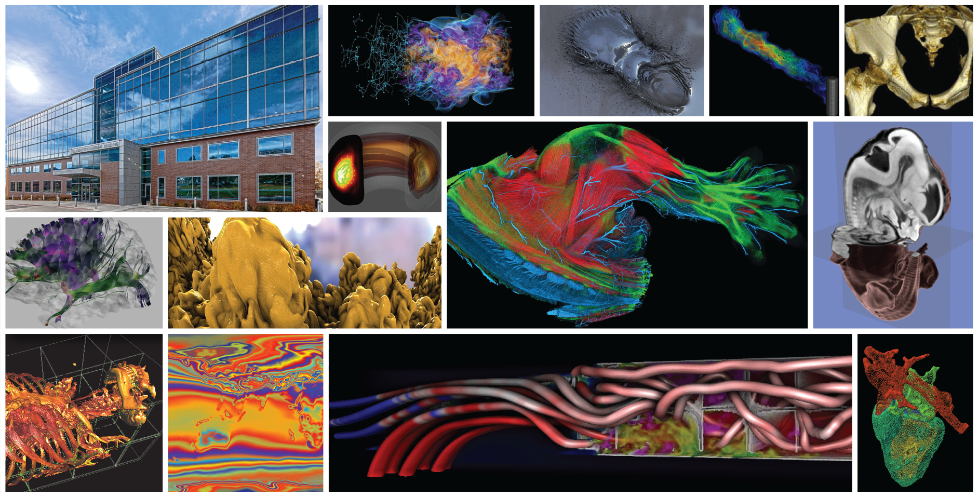

Experiences in Translational Computer Science Research: Data-Management for Extreme Science
Manish Parashar*
Director, Scientific Computing & Imaging (SCI) Institute & Chair in Computational Science and Engineering
Presidential Professor, School of Computing
University of Utah
PPAM 2022, Gdansk, Poland
September 14, 2022
*with David Abramson

Slide 2
Outline
Introducing Translational Computer Science (TCS)
Experiences in TCS Research: Data-Management for Extreme Science
Important Issues for TCS
Conclusion

Slide 3
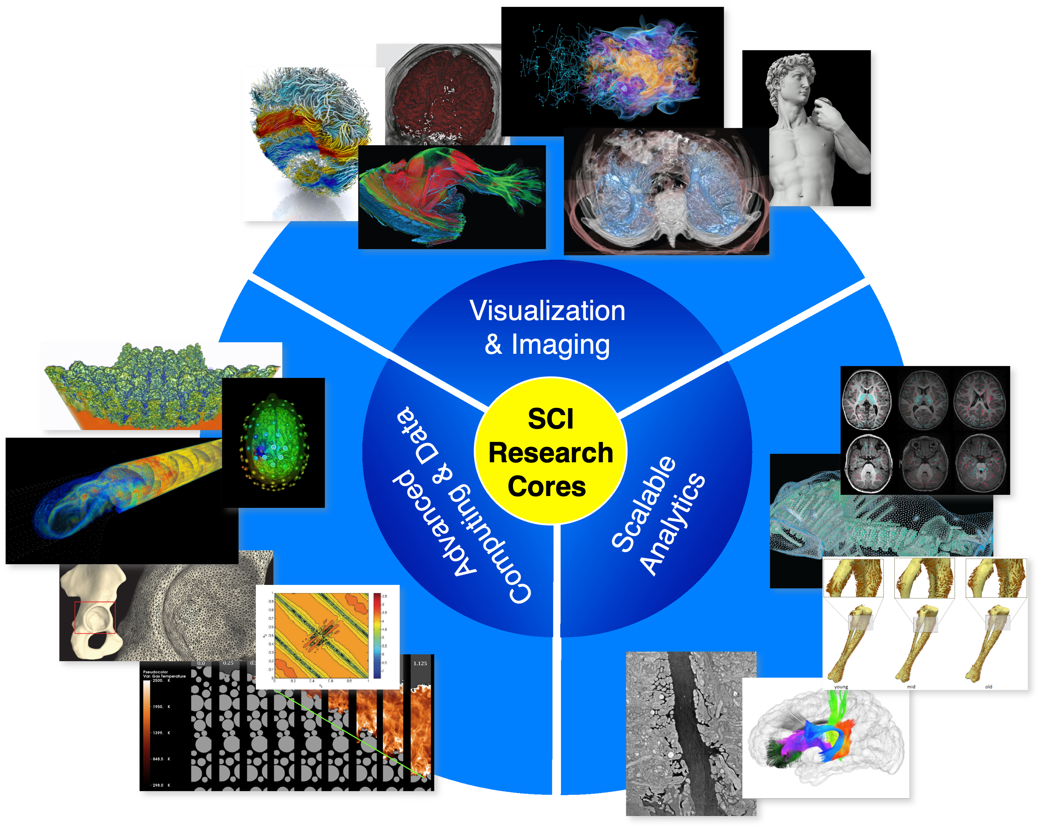
Scientific Computing & Imaging (SCI) Institute
Goal: Transformation of science and society through translational research and innovation in computer, computational and data science
Multidisciplinary, convergent, collaborative
Simulation, imaging, visualization, data management/analytics, advanced computing
Software/system development and distribution

Slide 4
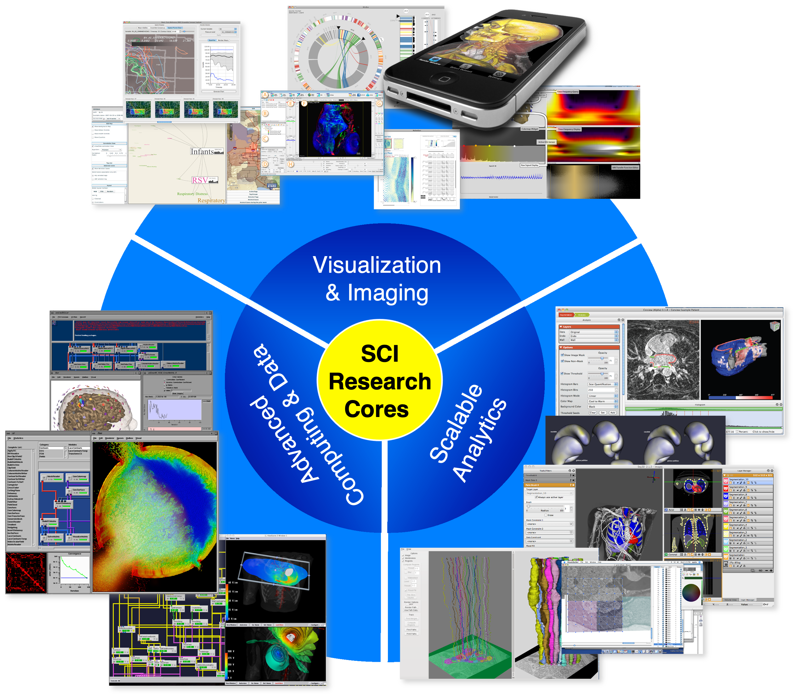
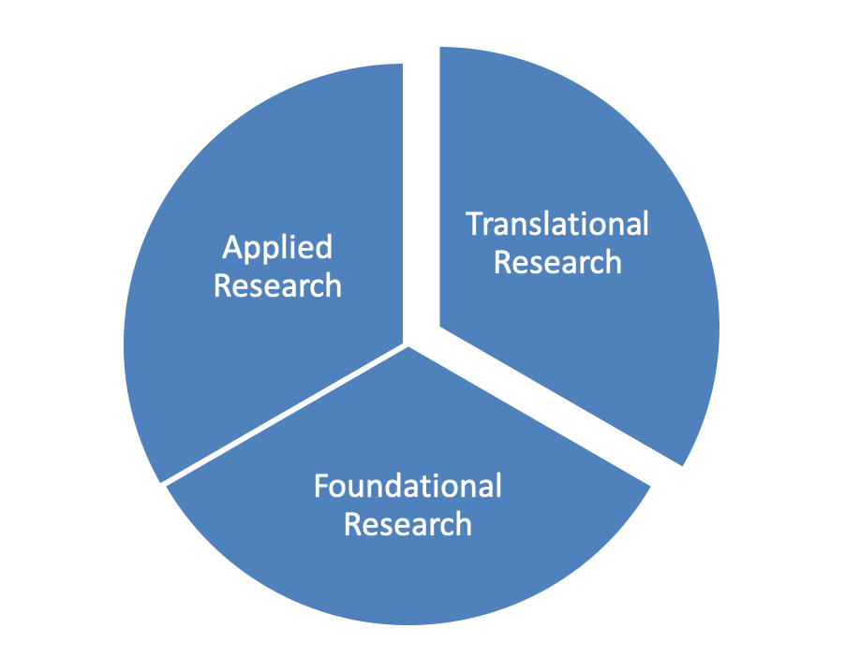
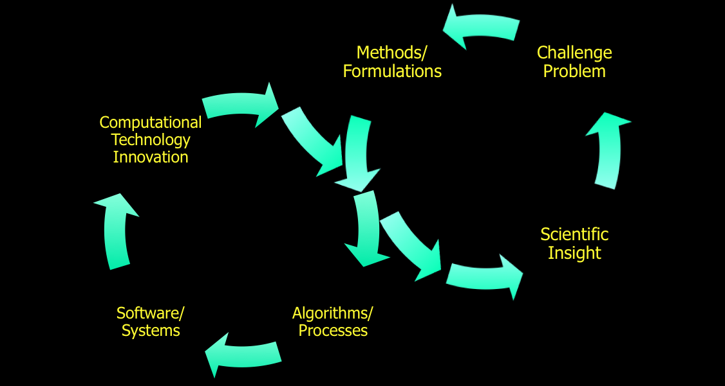
Scientific Computing & Imaging (SCI) Institute
Goal: Transformation of science and society through translational research and innovation in computer, computational and data science

Slide 5


Scientific Computing & Imaging (SCI) Institute
Goal: Transformation of science and society through translational research and innovation in computer, computational and data science
We are
hiring…

Slide 6
Outline
Introducing Translational Computer Science (TCS)
Experiences in TCS Research: Data-Management for Extreme Science
Important Issues for TCS
Conclusion

Slide 7
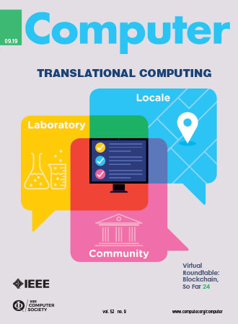
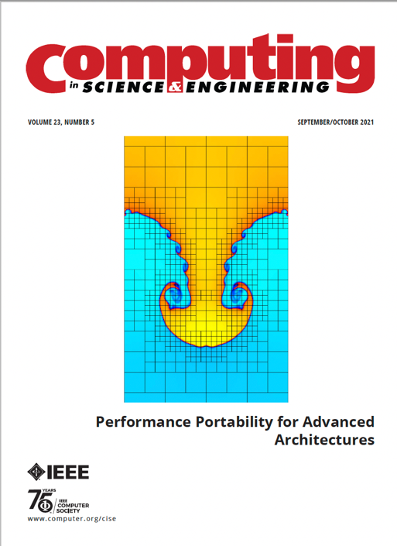



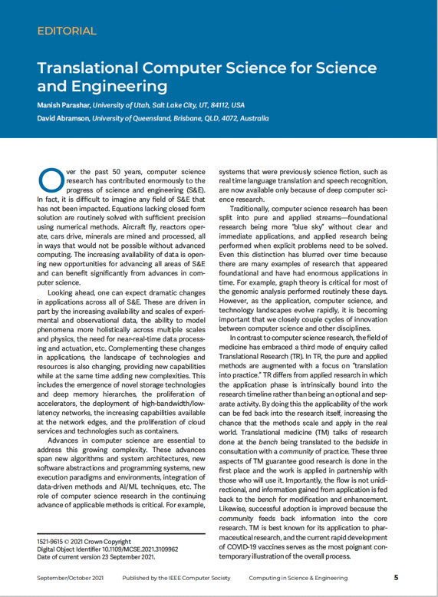
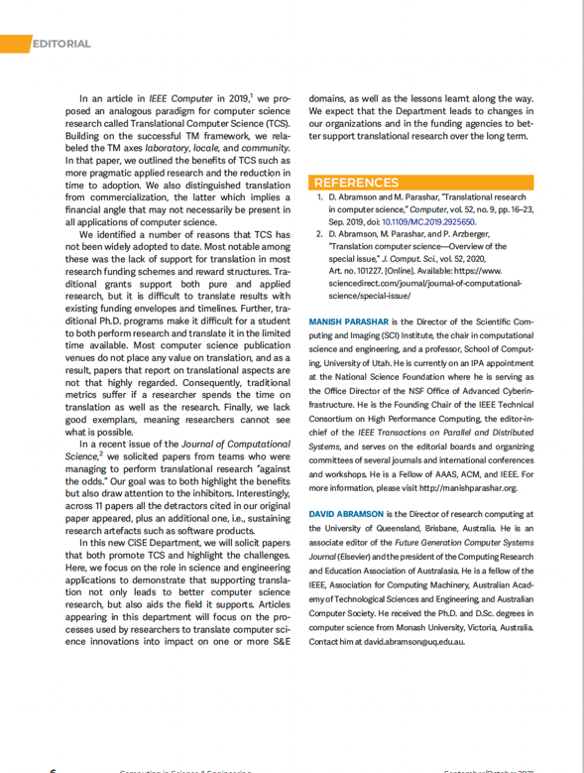
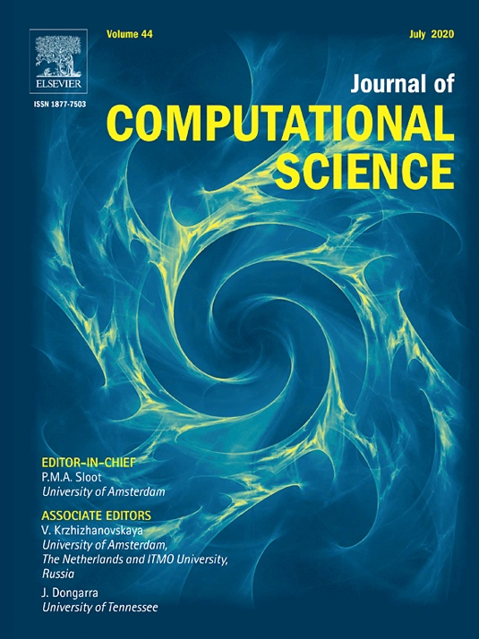
The role of a French chateaux and red wine … with David Abramson
Workshop on CCDSC, Lyon France, 2018
Jack Dongarra, Bernard Tourancheau
Notes:
Clusters, Clouds and Data for Scientific Computing
Jack Dongara and Bernard Tourancheau’s special workshop
David Abramson
Director, Research Computing Centre
Professor of Computer Science, FACM, FIEEE, FTSE, FACS
The University of Queensland, St Lucia, 4072
Tel: (07) 3365 6131. Mobile 0417 375 635
Skype: davidabramson

Slide 8

Background: Translational Medicine
An interdisciplinary branch of the biomedical field supported by three main pillars:
  Benchside, Bedside and Community
  Combines disciplines, resources, expertise, and techniques within these pillars to promote enhancements in prevention, diagnosis, and therapies
Differs subtly from applied biomedical research, in which a research problem has a potential real-world application
  Findings are applied as a specific phase of the research plan
  This not only demonstrates applicability and practicality, but also generates tangible outcomes
Now well understood and has become a de-facto standard for much of biomedical research
Intrinsically helps generate outcomes because the research is applied as part of the original plan, as opposed to being an afterthought once the project has completed
Notes:
In TM, translation relies on
Taking research from the laboratory Bench to the Bedside
More recent refinements involve Community
healthy populations, patients and medical practitioners.
TM is defined as an “interdisciplinary branch of the biomedical field supported by three main pillars: bench, bedside, and community. The goal of TM is to combine disciplines, resources, expertise, and techniques within these pillars to promote enhancements in prevention, diagnosis, and therapies”
It intrinsically helps generate outcomes because the research is applied as part of the original plan, as opposed to being an afterthought once the project is complete.
TM differs subtly from applied biomedical research, in which a research problem has a potential realworld application (driver). In TM, the findings are applied as a specific phase of the research plan. This not only demonstrates applicability and practicality, but it also generates tangible outcomes.
National Center for Advancing Translational Sciences FY22 Budget Request: >$880M

Slide 9
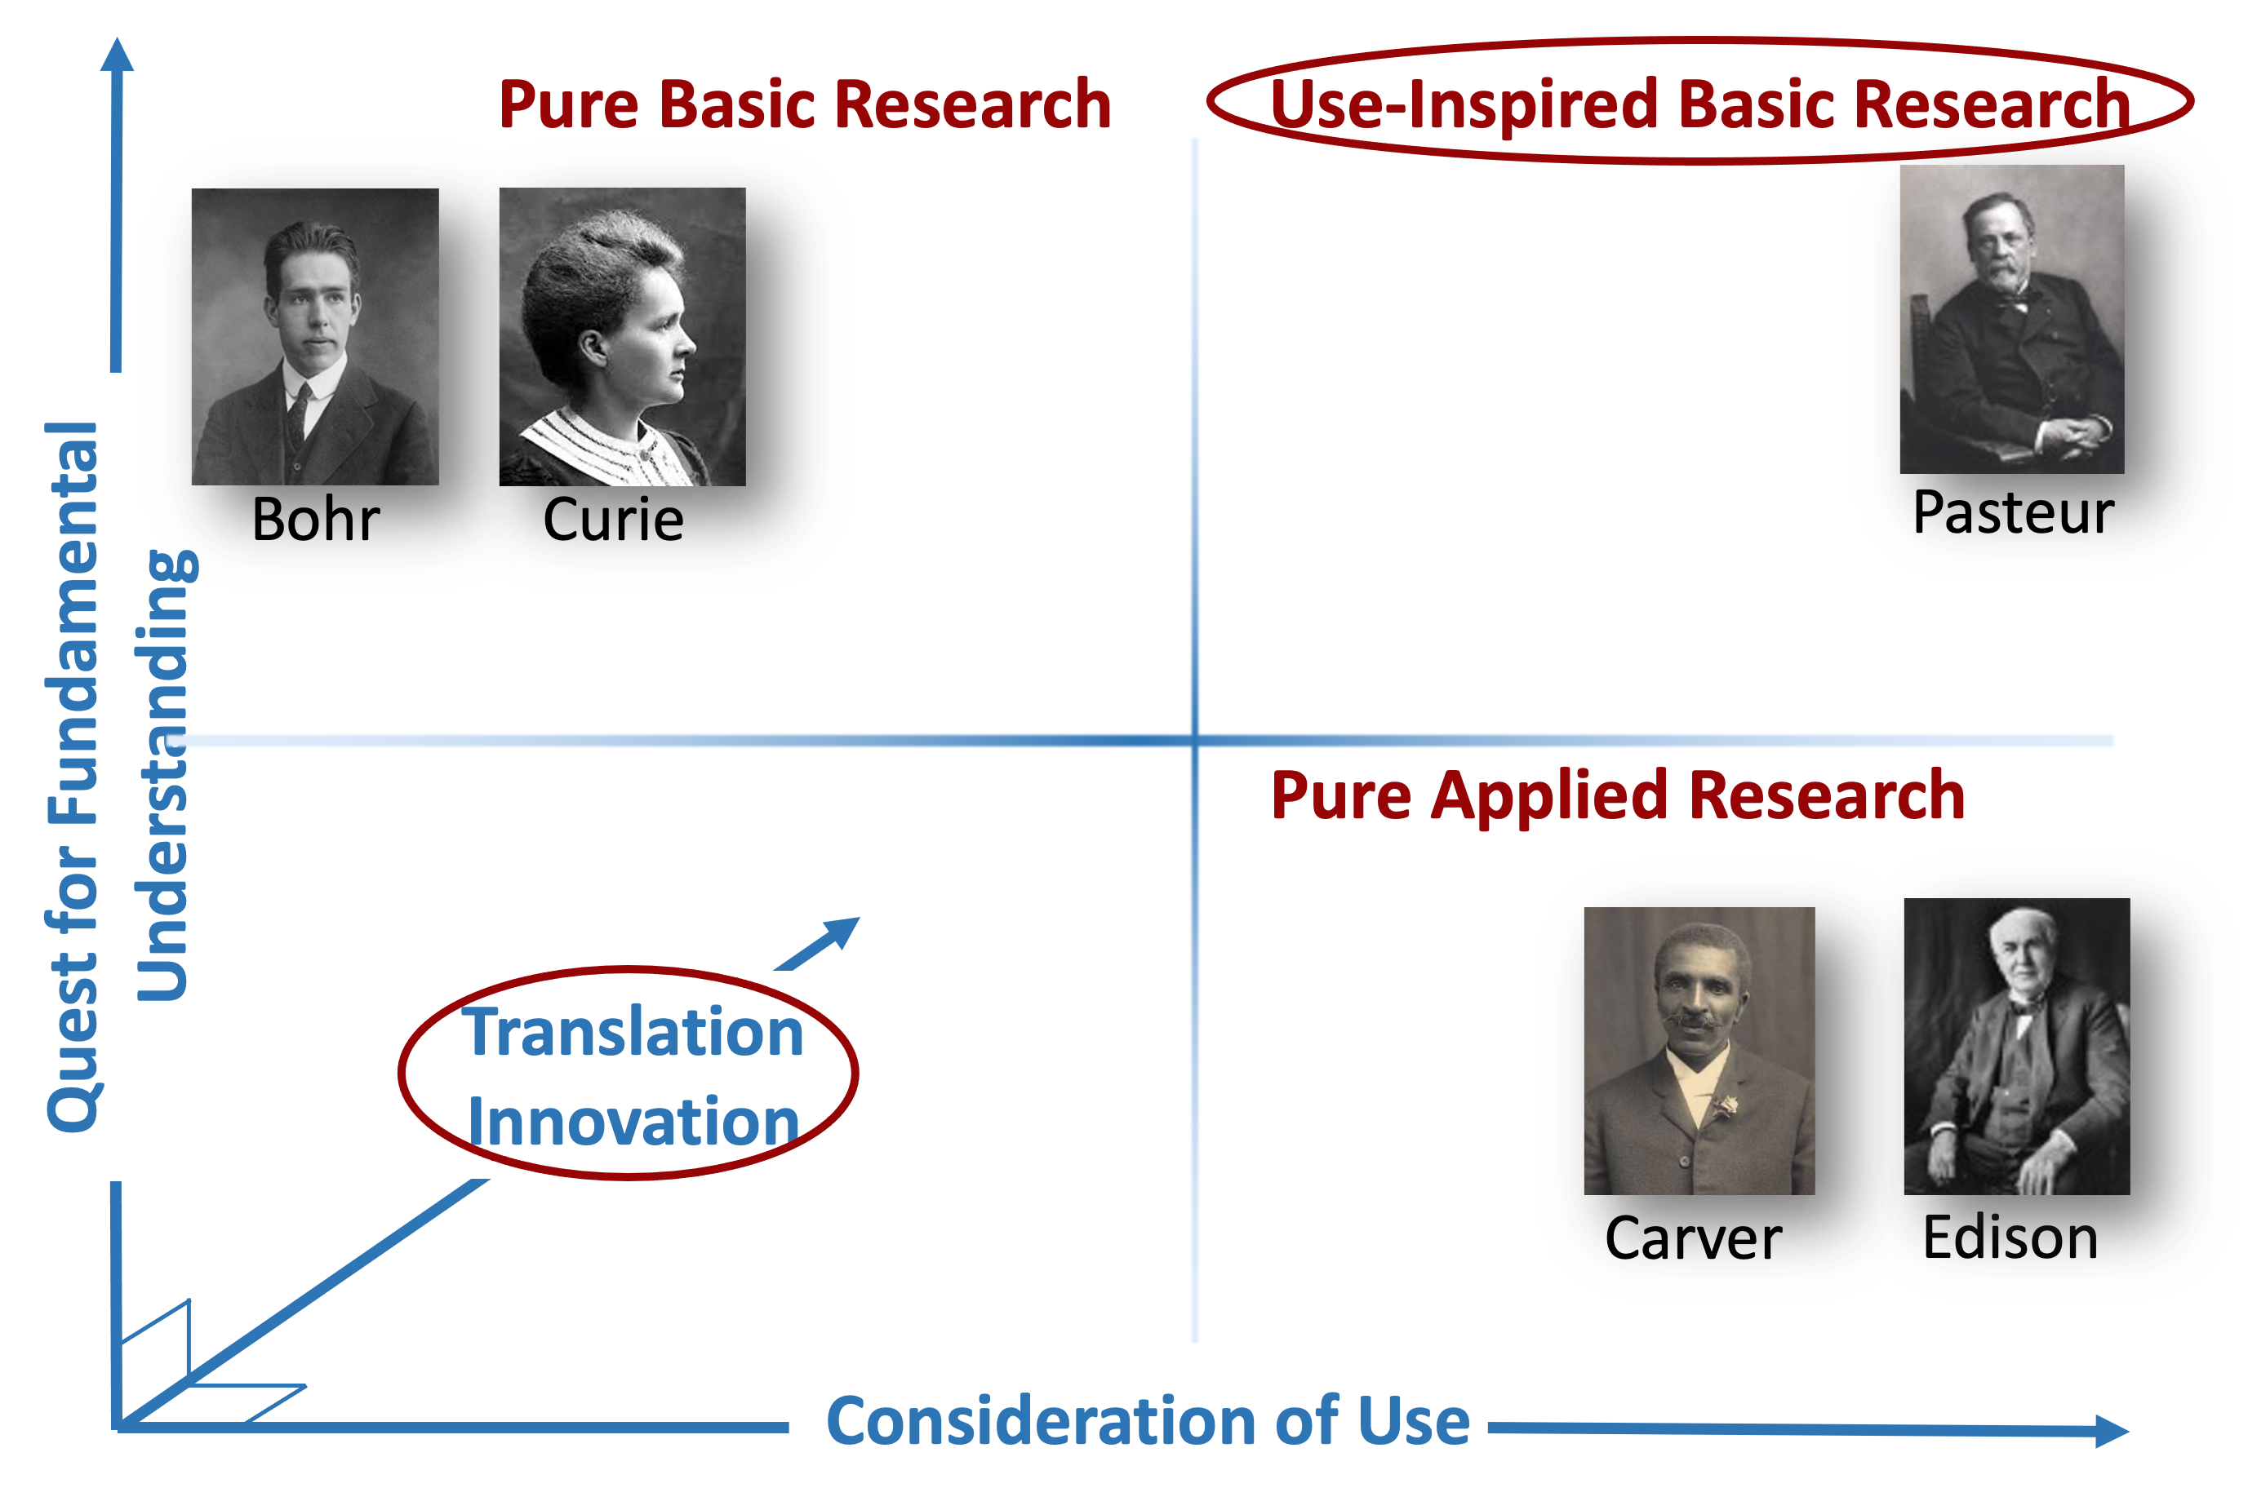
Translational Computer Science (TCS)
TCS refers to research that bridges foundational and use-inspired (and applied) research with the delivery and deployment of its outcomes to the target community and supports essential bi-direction interplays where delivery and deployment process informs the research
Motivated by the growing importance of computing and data across all of science and society
Aimed at accelerating the impact of computer, computational and data science
Inspired by the definition and impact of Translational Medicine
Focused on taking research from the Laboratory to the Locale to the Community
  Laboratory, Locale might be physical or virtual
  Community: Users and early adopters who work with the technology, and can include public bodies that would help in the evaluation
Notes:
D. Abramson and M. Parashar, "Translational Research in Computer Science," in Computer, vol. 52, no. 9, pp. 16-23, Sept. 2019, doi: 10.1109/MC.2019.2925650.
D. Abramson, M. Parashar, P. Arzberger, Translation computer science – Overview of the special issue, Journal of Computational Science, 2020, ISSN 1877-7503, https://www.sciencedirect.com/journal/journal-of-computational-science/special-issue/.
Can range from
theory to practice
“soft” to “hard”
Theory
Might be some fundamental advance in theory of computation
New algorithms (ways of solving problems)
Leads to better “science”
Practice
New solutions (i.e. practical algorithms)
Applying new technologies
Leads to better “engineering”
Theories and experimental results
Papers published in reviewed journals, conferences
Patents
Published by the patents office
Prototypes
Computer programs
Hardware

Slide 10
Some Exemplars of TCS Research

Slide 11
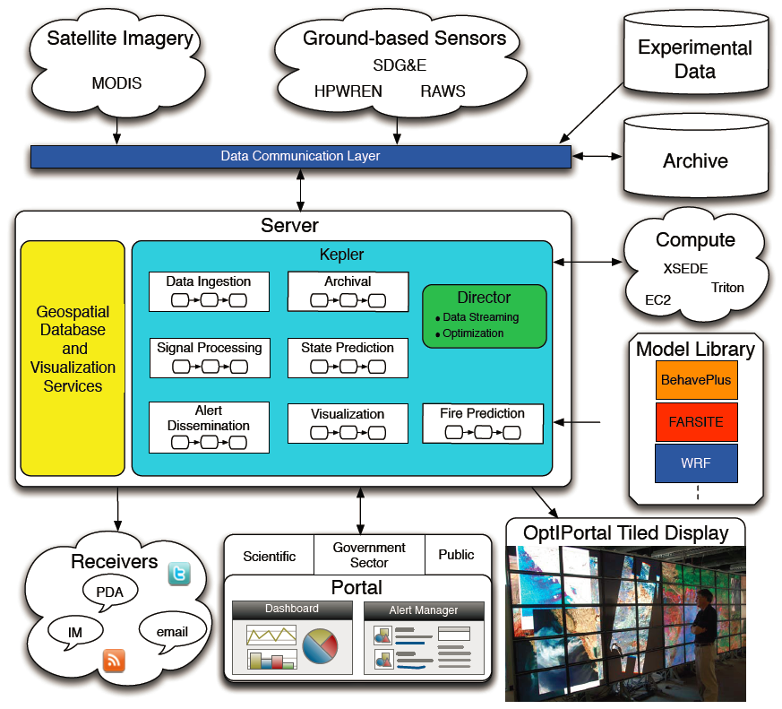
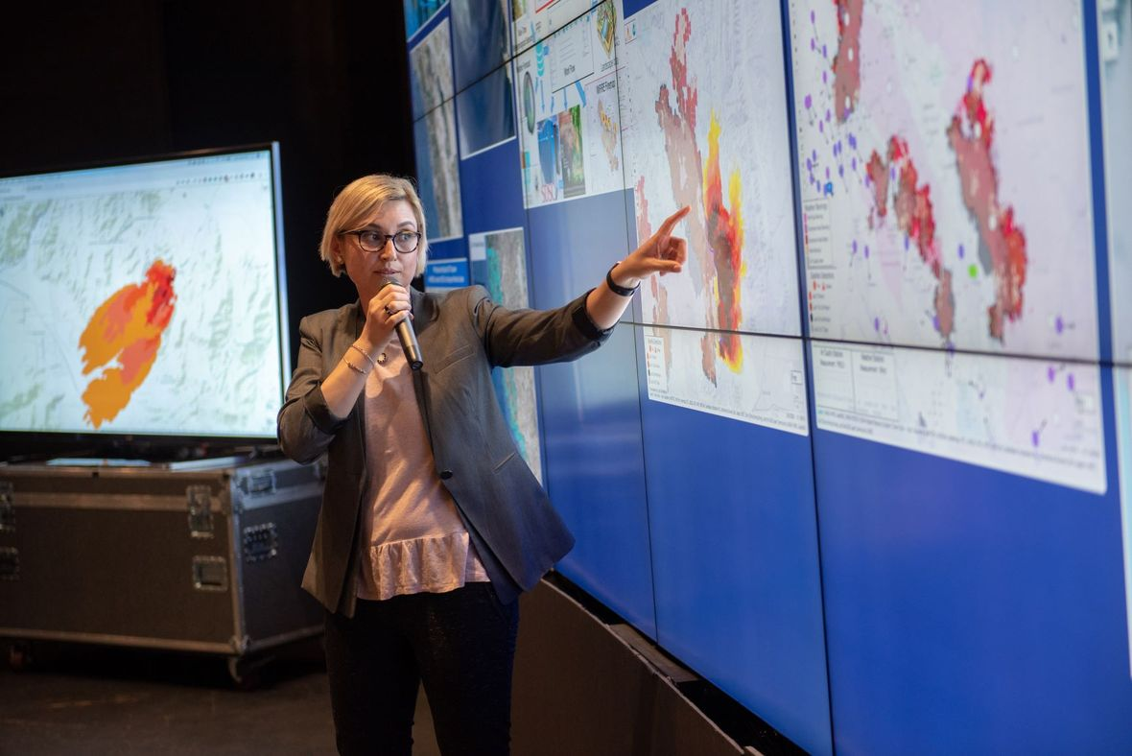

NSF WIFIRE Project
NSF-1331615
Notes:
A Scalable Data-Driven Monitoring, Dynamic Prediction and Resilience Cyberinfrastructure for Wildfires

Slide 12

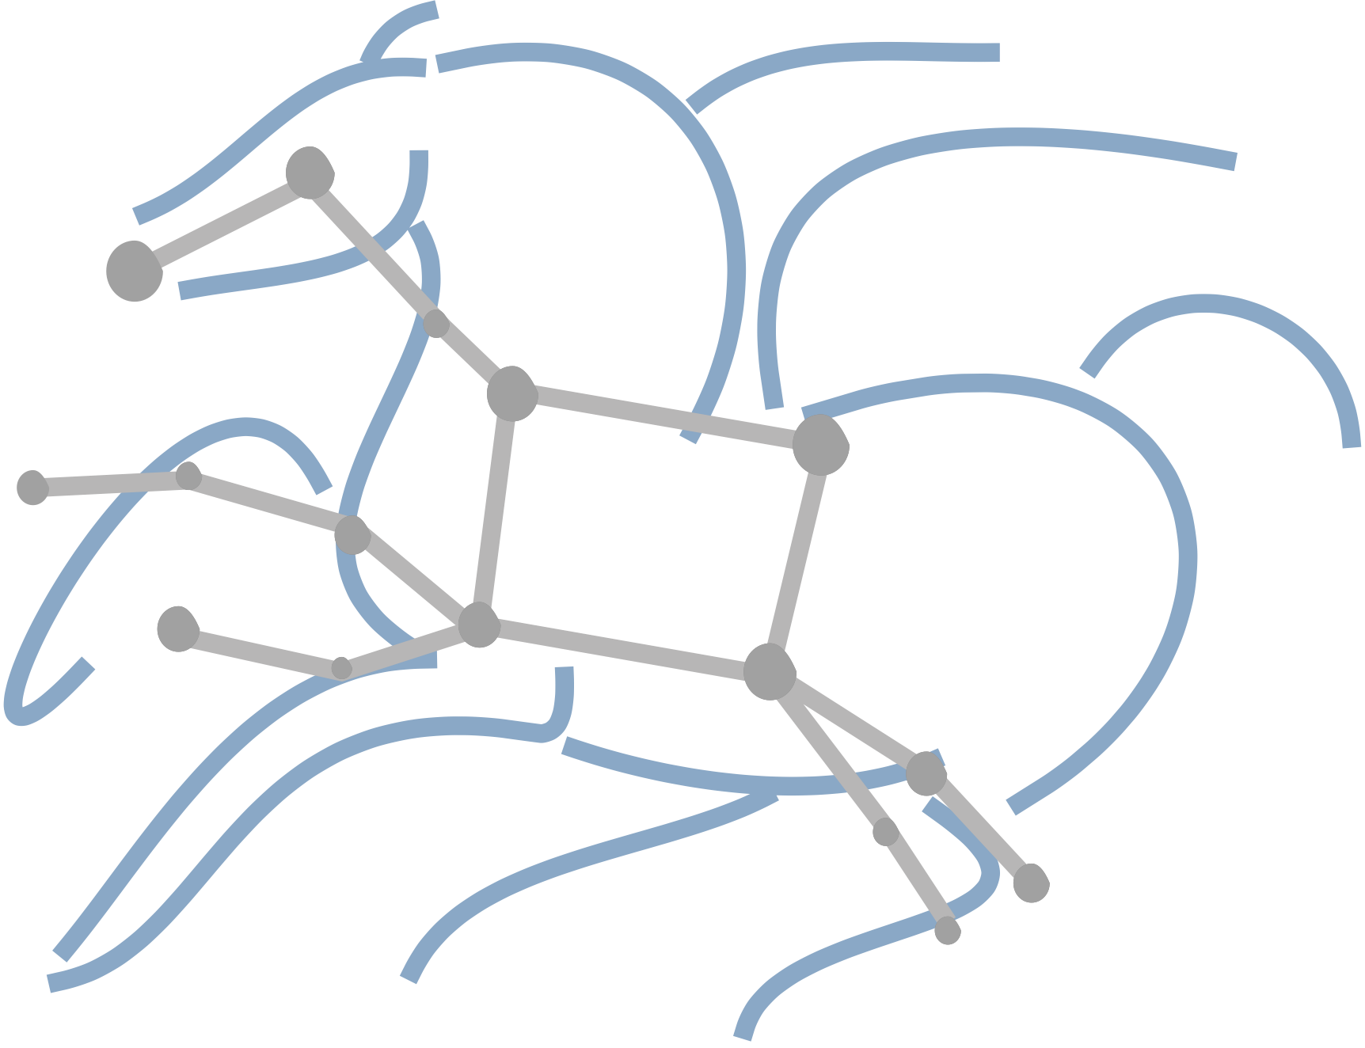

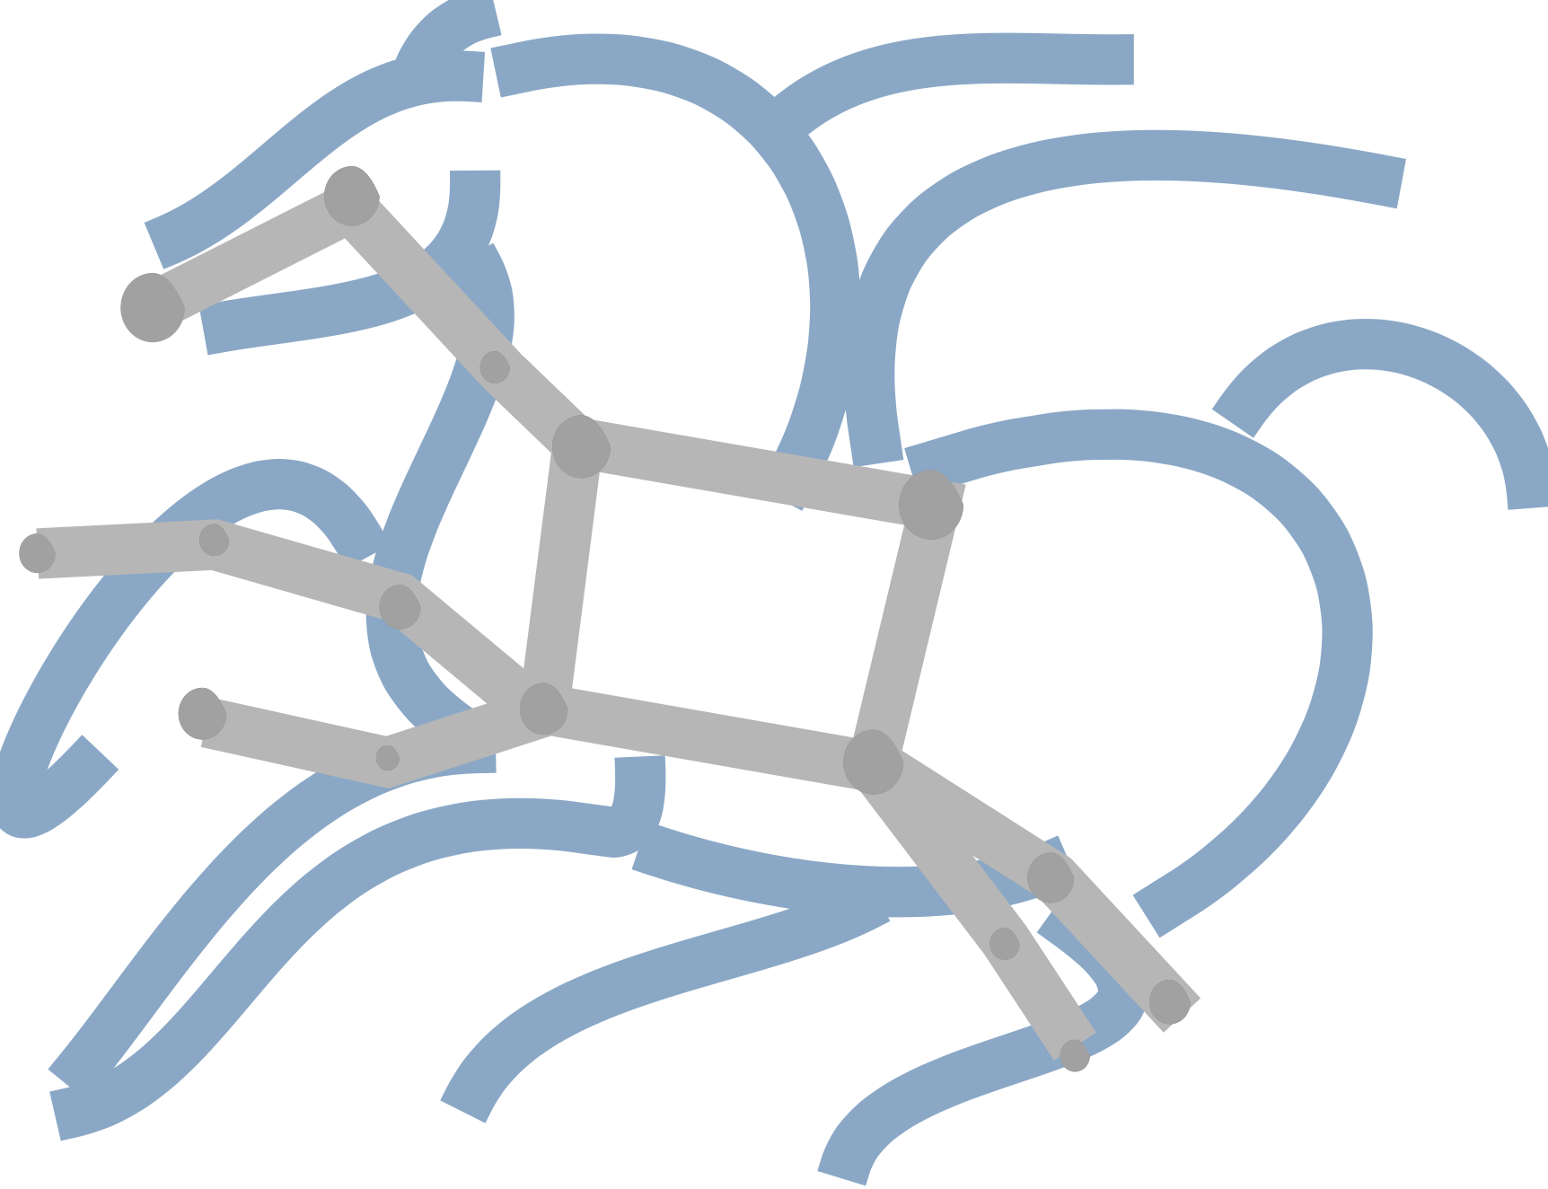


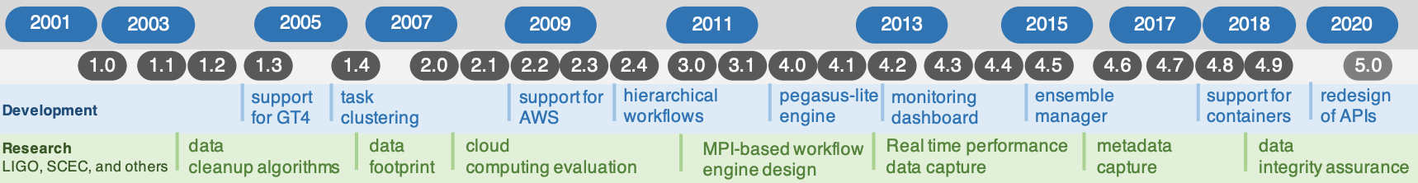


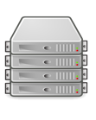
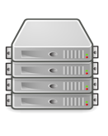
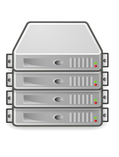
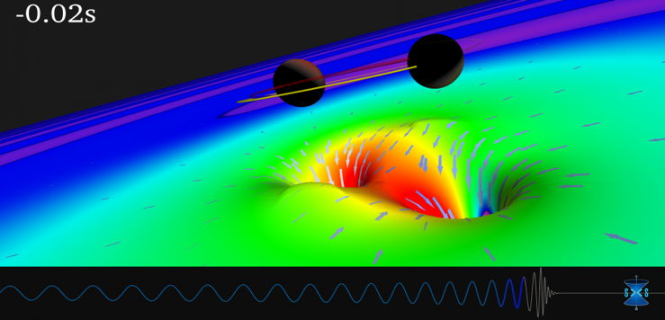
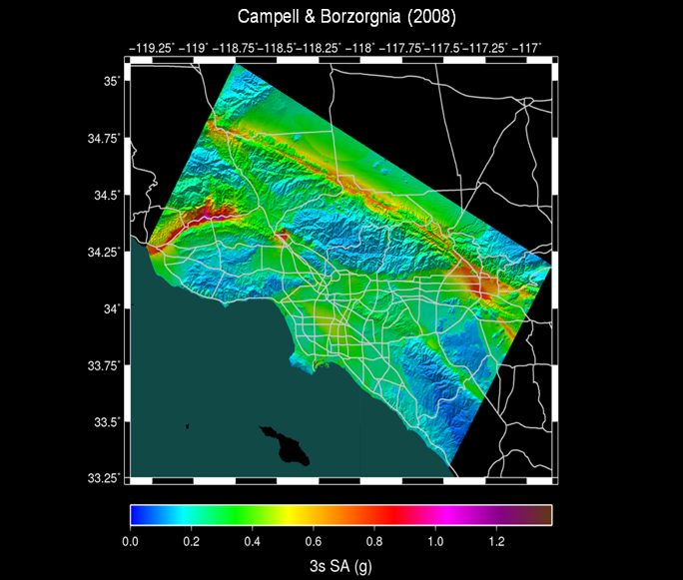
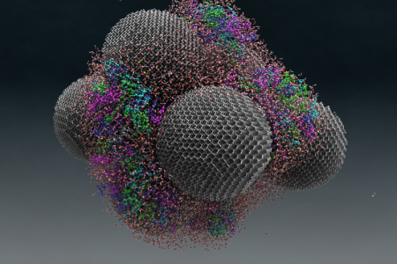
Pegasus Workflow Management System
Ewa Deelman - University of Southern California - PI - deelman@isi.edu
Funded Under National Science Foundation Grant #1664162
pegasus.isi.edu
End To End Workflow Management and Execution
Develop portable scientific workflows in Python, Java, and R
Compile workflows to be run on heterogenous resources
Monitor and debug workflow execution via CLI and web-based tools
Recover from failures with built-in fault tolerance mechanisms
Regular release schedule incorporating latest research and development
Pegasus WMS
Planner
Monitoring & Provenance
Engine
Scheduler
Job Queue
Cloud Resources
Open Science Grid
HPC Systems
HTCondor Pools
jN
j2
j1
Submit Node
Compute Resources
Pegasus In Practice
Laser Interferometer Gravitational Wave Observatory (LIGO) develops large scale analysis pipelines used for gravitational wave detection.
Southern California Earthquake Center (SCEC) CyberShake project generates hazard maps using hierarchical workflows .
Oak Ridge National Lab (ORNL) conducted studies on tRNA and nanodiamonds to improve drug delivery design principles.
LIGO observation of colliding black holes
Hazard map indicating maximum amount of shaking at a particular geographic location generated from SCEC’s CyberShake Pegasus workflow
Visualization of water on nanodiamond spheres from ORNL

Slide 13
So how does this differ from traditional research pipeline?

Slide 14

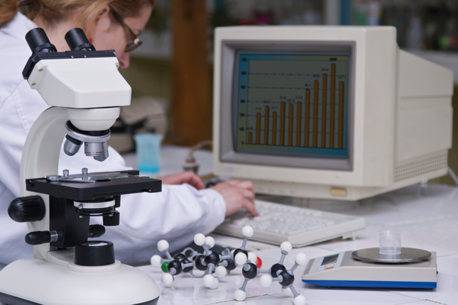
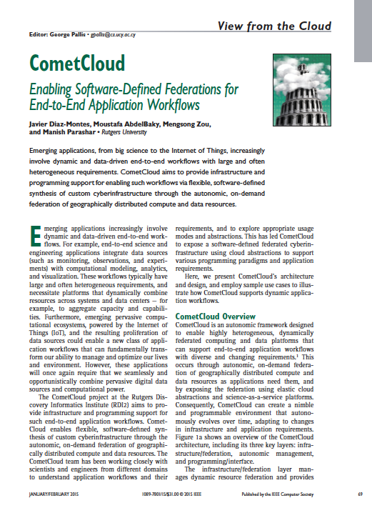
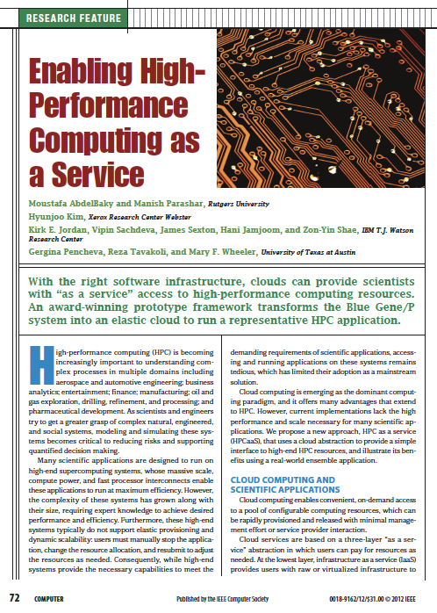

Typical CS research workflow
Code/Data
Propose
Solution
Problem Definition
Prototype
Publish
Evaluate & Refine
Real world
Papers
Commercialize

Slide 15
Translational CS research workflow
Code/Data
Propose
Solution
Problem Definition
Prototype
Publish
Evaluate & Refine
Real world
Papers
Engage Community
Commercialize

Slide 16
Outline
Introducing Translational Computer Science (TCS)
Experiences in TCS Research: Data-Management for Extreme Science
Important Issues for TCS
Conclusion

Slide 17


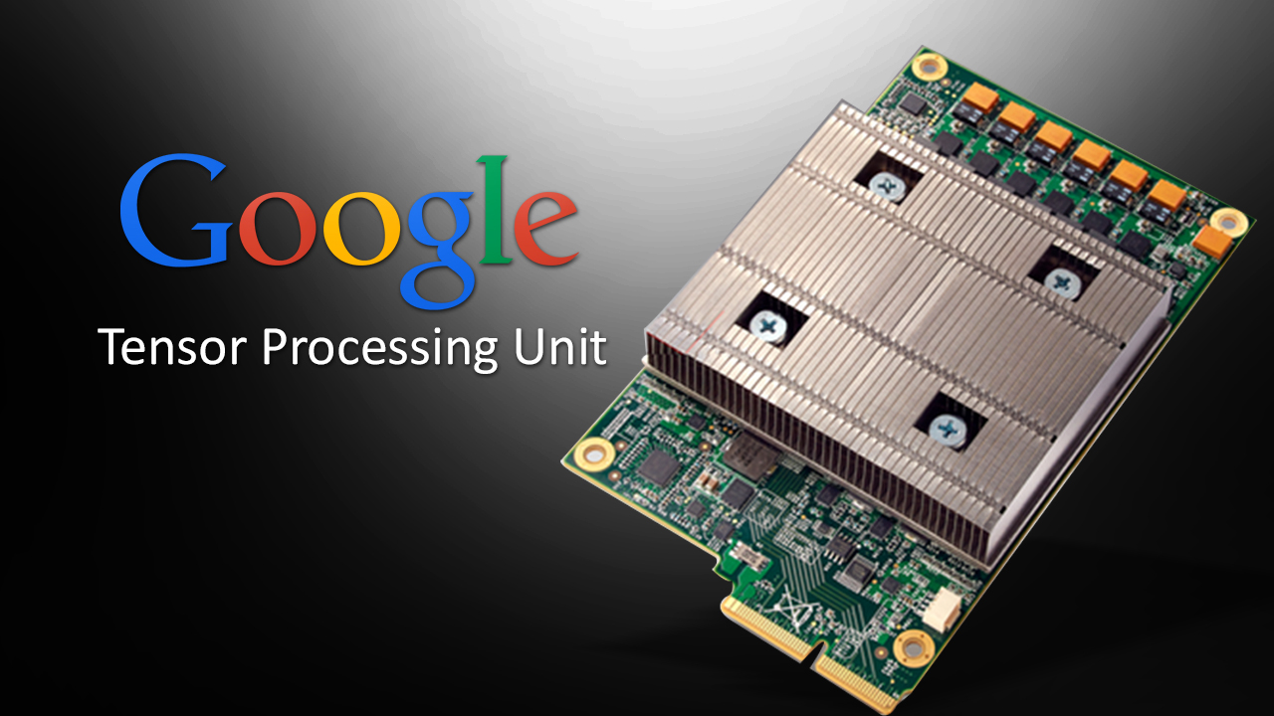
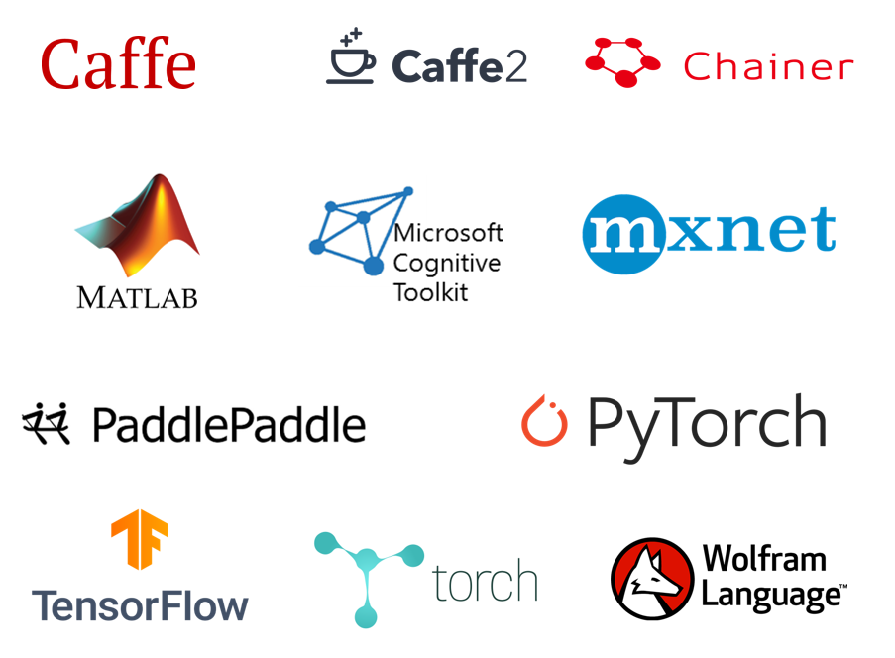
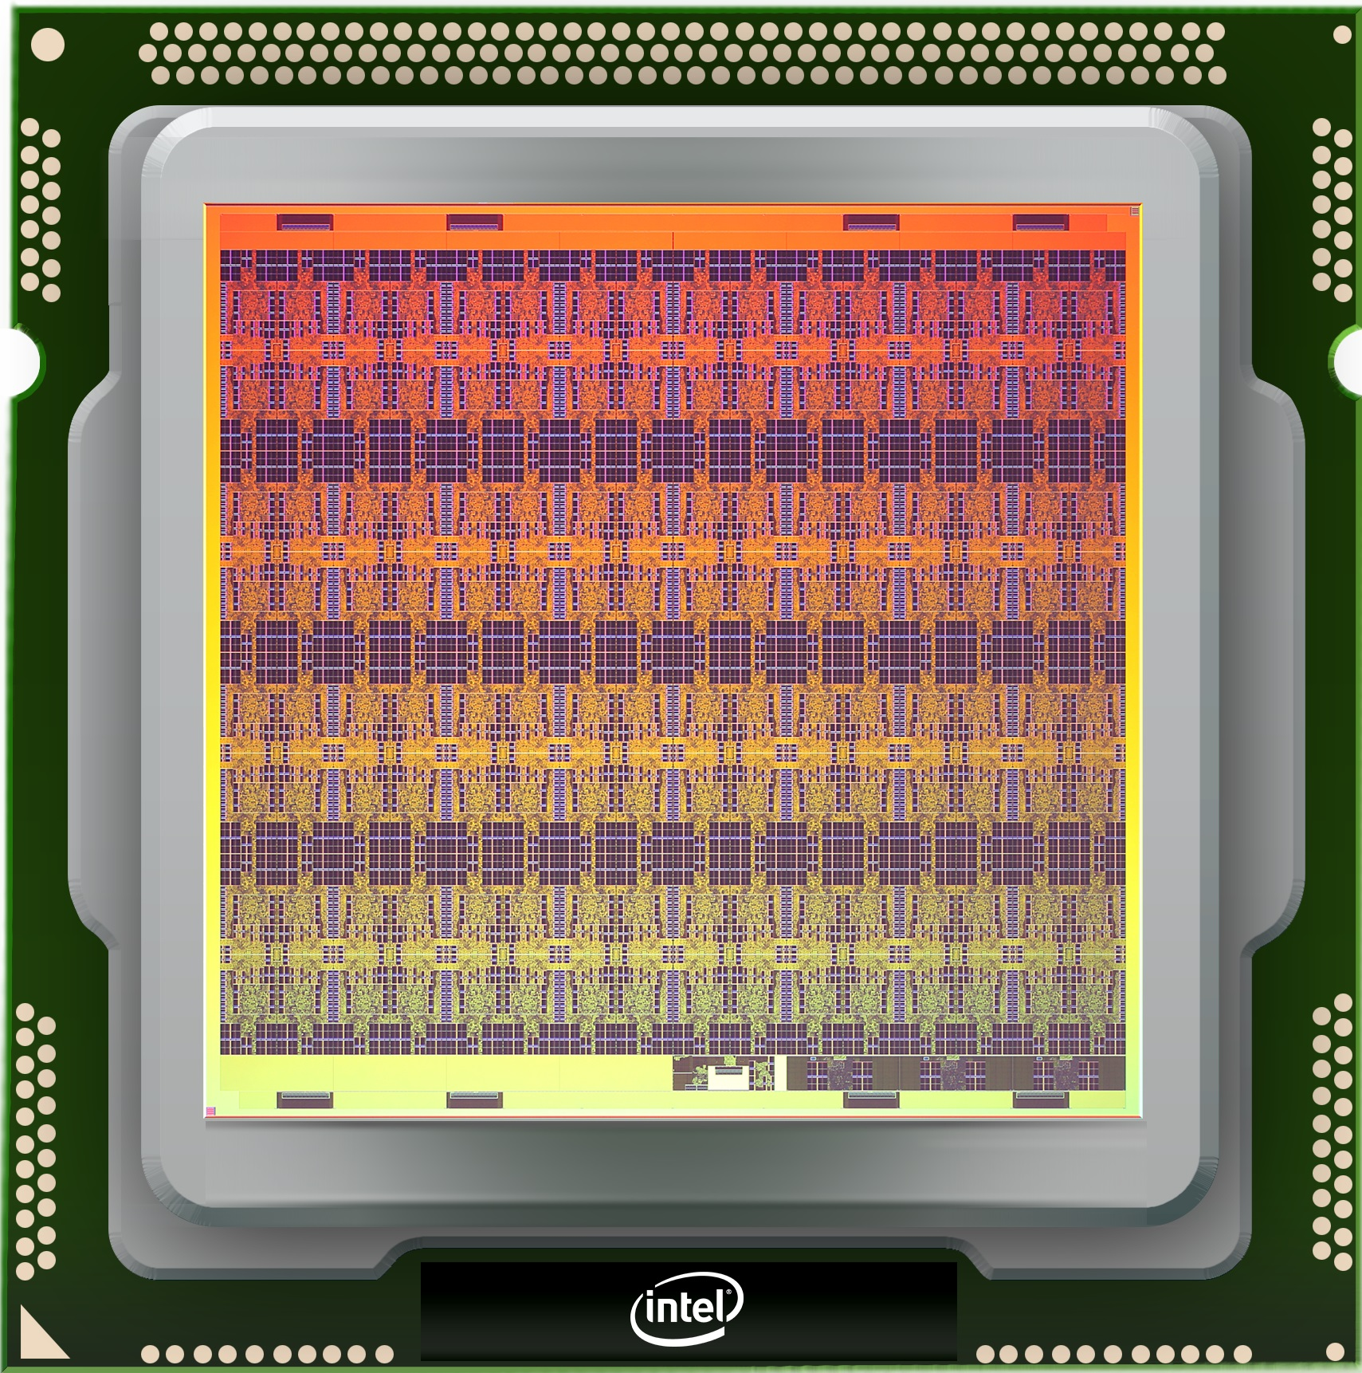
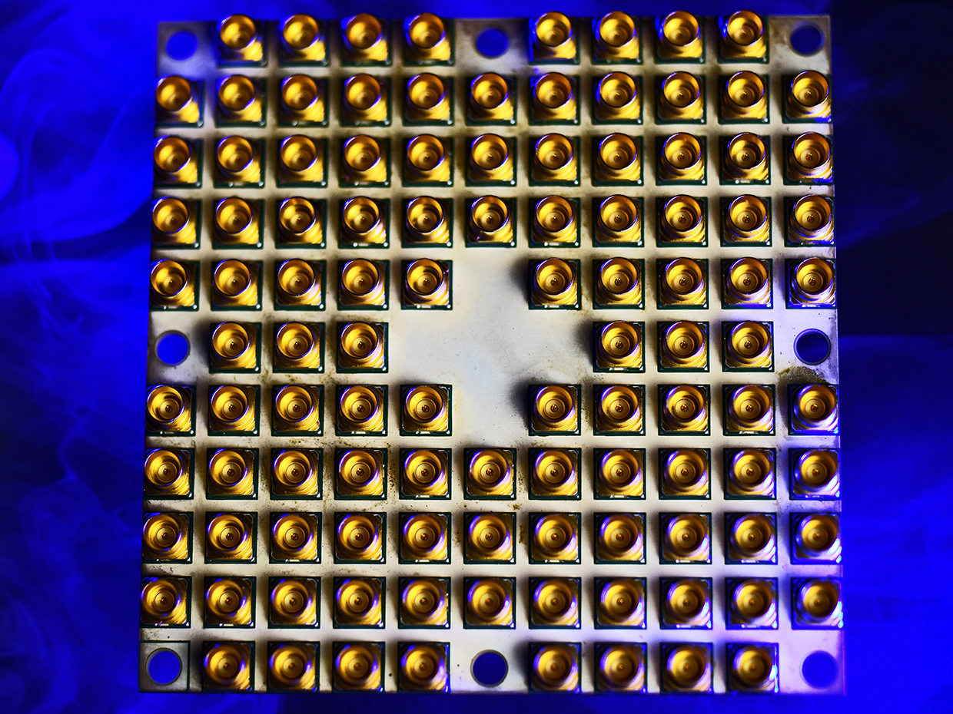
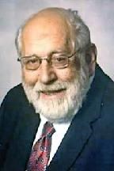
Science transformed by extreme scales, pervasive compute, data
Exascale, and beyond
Disruptive innovations => new opportunities
Novel paradigms / a computing continuum
Unconventional software stacks
“A supercomputer is a device for turning compute-bound problems into I/O-bound problems” – Ken E. Batcher
Notes:
Among the designs he worked on at Goodyear were the:
Massively Parallel Processor (16,384 custom bit-serial processors {8 to a chip} organized in a SIMD 128 x 128 processor array with additional CPU rows for fault-tolerance) which was located at the NASA Goddard Space Flight Center, and is now in the Smithsonian. This unit predates Danny Hillis' Thinking Machines Corporation's Connection Machine
The Goodyear STARAN associative processor arrays, a version of which (called ASPRO) was found in the US Navy Northrop Grumman E-2 Hawkeye radar planes.
He published several technical papers and owns 14 patents of his own. "He discovered two parallel sorting algorithms: the odd-even mergesort and the bitonic mergesort". He is also a discoverer of scrambling data method in a random access memory which allows accesses along multiple dimensions. These memories were used in the STARAN and the MPP parallel processors.^{[3][4]}

Slide 18
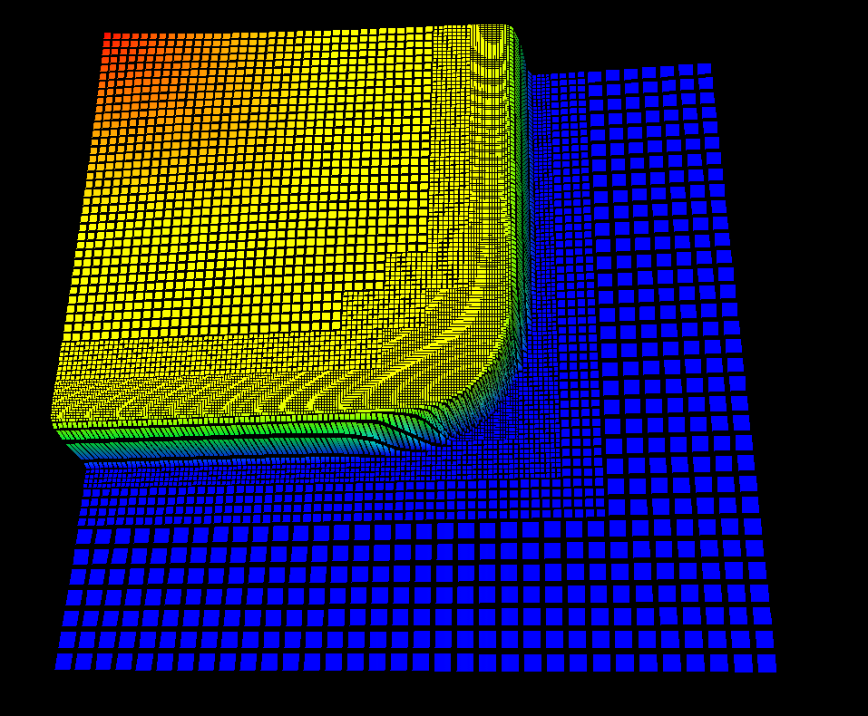
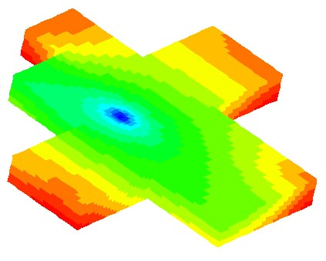
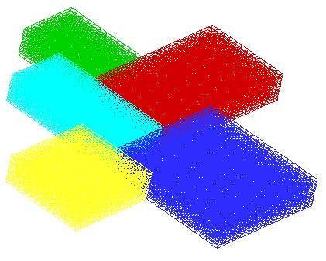
Data Management for Extreme Science: Part I – An Accidental Translationist
Dynamic, adaptive formulations
Coupled models and codes
In-situ workflows/in-transit processing
End-to-end workflows

Slide 19
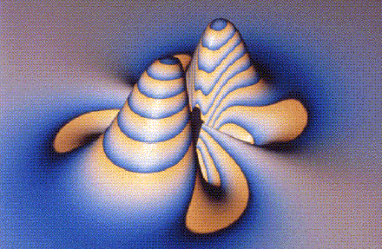
Binary Black Holes, Structured Adaptive Mesh Refinement, & Dynamic Parallel Applications

Slide 20
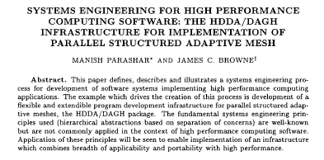
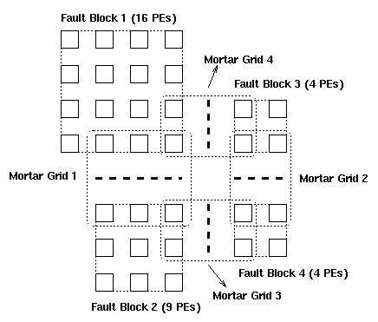
Data Management for Dynamically Adaptive Applications
Semantically Specialized DSM
  Regular access semantics to dynamic, distributed data
  Encapsulates distribution, communications
Hierarchical Distributed Dynamic Array / Distributed Shared Objects
  Hierarchical Index-Space + Extendible Hashing
Adaptive Run-time Management
  Application and system sensitive management
  Policy-based adaptations
Software Deployed:
  GrACE/DAGH, MACE, ArMADA

Slide 21
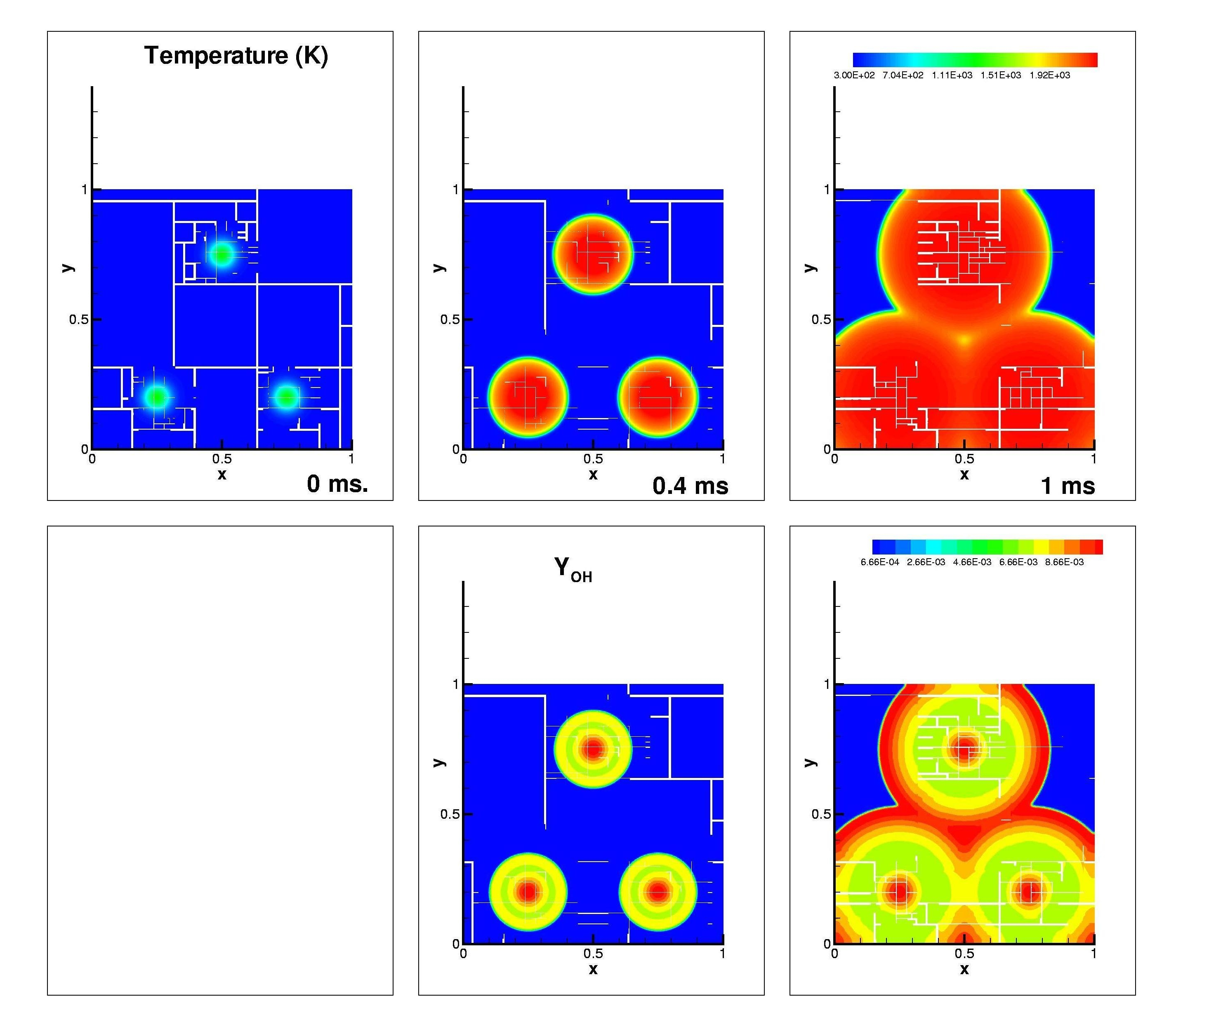
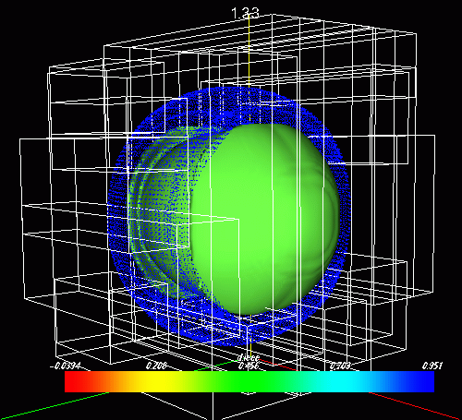
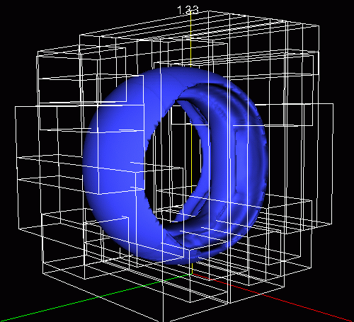
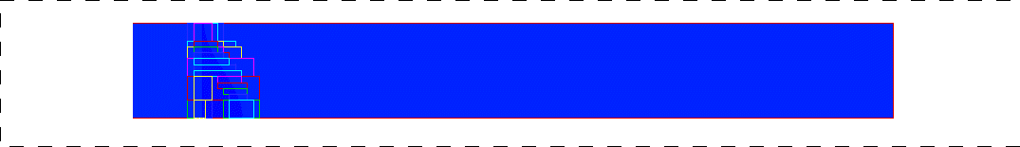
Translations Impacts
Multi-block grid structure and oil concentrations contours (IPARS, M. Peszynska, UT Austin)
Mixture of H2 and Air in stoichiometric proportions with a non-uniform temperature field (GrACE + CCA, Jaideep Ray, SNL, Livermore)
Blast wave in the presence of a uniform magnetic field) – 3 levels of refinement. (Zeus + GrACE + Cactus, P. Li, NCSA, UCSD)
Richtmyer-Meshkov - detonation in a deforming tube - 3 levels. Z=0 plane visualized on the right (VTF + GrACE, R. Samtaney, CIT)
Richtmyer Meshkov (3D) R. Samtaney, CIT
1024x128x128, 3 levels, 2K PE’s
Time: ~ 15% Memory: ~25%

Slide 22
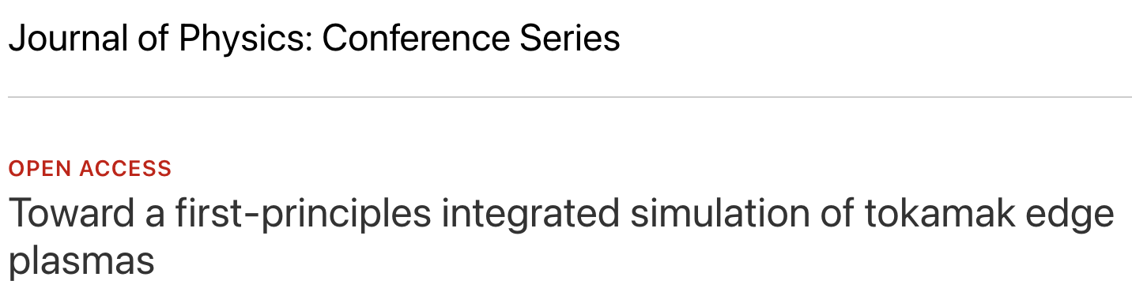

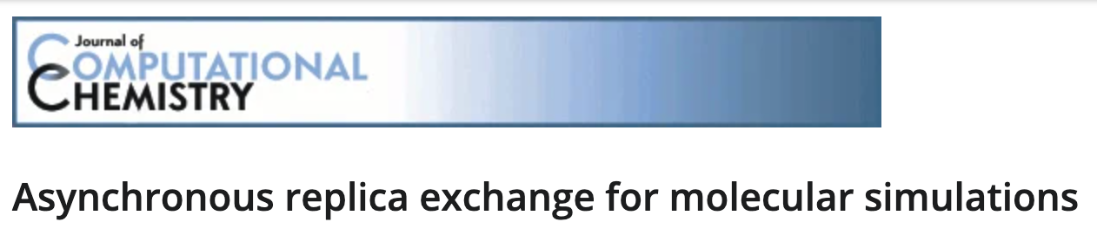



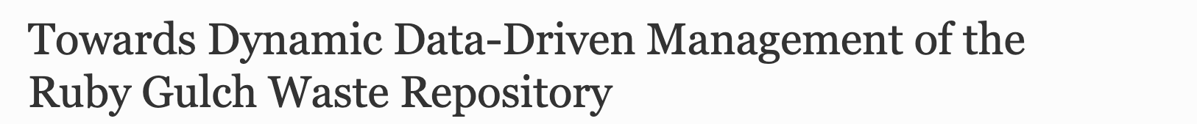
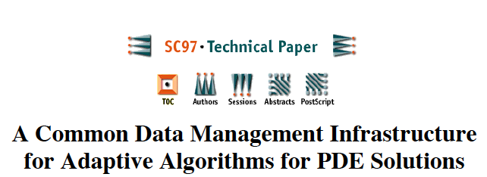
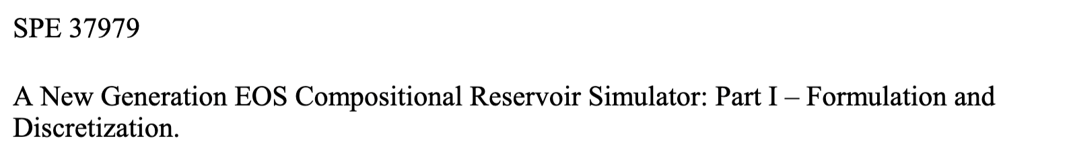
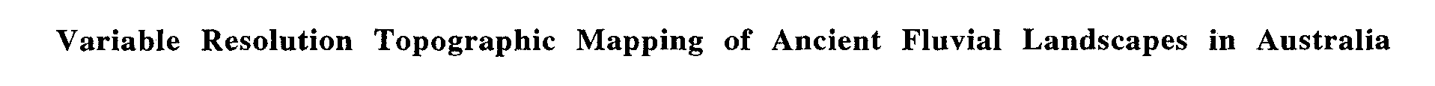
Translational Impacts

Slide 23
Lost in translation… What happened to DAGH/GrACE, MACE?
Lost in translation…could not be sustained
  Translation not part of the research plan
    Time, effort not allocated for user support, addressing user feedback, new requirements, etc.
  Lack of funding/support for translation
    No funding to hire developers/programmers
    PhD student theses research does not focus on translational work
  Academic career-path required reprioritization
    Academic structures don’t value translation
But
  Effective, had rapid uptake, and impact
  Conceptual framework (and some code) persists, used by other frameworks and influences codebases
Many lessons learnt that informed subsequent work
Notes:
However, despite its effectiveness, rapid uptake and impact, the DAGH/GrACE software stack was not successfully translated and could not be sustained. The reasons for this are elaborated in the following section, but the overarching reason was the lack of adequate planning and resources for the translation, and in particular, the move from locale to community. However, the conceptual framework underlying DAGH/GrACE has persisted and has been incorporated into other frameworks, many of which are in use today. In fact, these aspects of DAGH/GrACE have influenced the codebases used in the research efforts that were part of the 2017 detection of gravitational waves, which resulted in a Nobel Prize in Physics in that year.

Slide 24
Data management for Extreme Science: Part II
Dynamic, adaptive formulations
Coupled models and codes
In-situ workflows/in-transit processing
End-to-end workflows
XGC
GENE
Interpolator
Comparative Viz.
Reduction
Reduction
XGC Viz.
XGC output
GENE output
GENE
Viz.
NVRAM
Performance
Viz.
PFS
TAPE

Slide 25
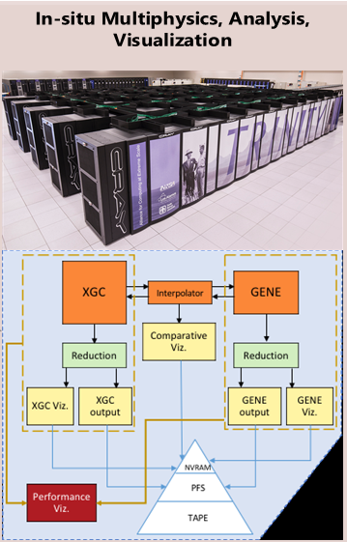
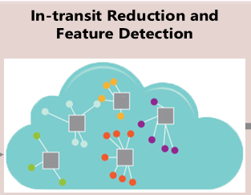
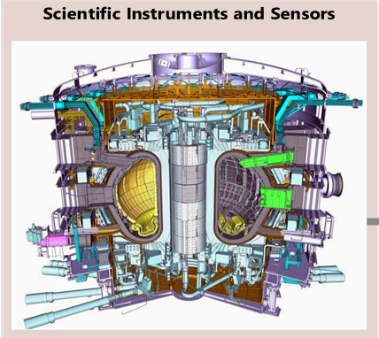
Extreme-Scale, End-to-End Science Workflows
Plasma Disruption Analysis Fusion Workflow
  The goal is to implement a plasma visualization diagnostics system that enables early prediction of anomalies while the tokamak operates
  Data is a time-series of matrix images obtained via direct 2D/3D visualizations of the tokamak plasma
  Analytics include structural analysis and blob detection, filtering & visualization

Slide 26
Rethinking Extreme-Scale Workflows: In-situ Workflows, In-transit Processing
Plasma Disruption Analysis Fusion Workflow
  The goal is to implement a plasma visualization diagnostics system that enables early prediction of anomalies while the tokamak operates
  Data is a time-series of matrix images obtained via direct 2D/3D visualizations of the tokamak plasma
  Analytics include structural analysis and blob detection, filtering & visualization

Slide 27
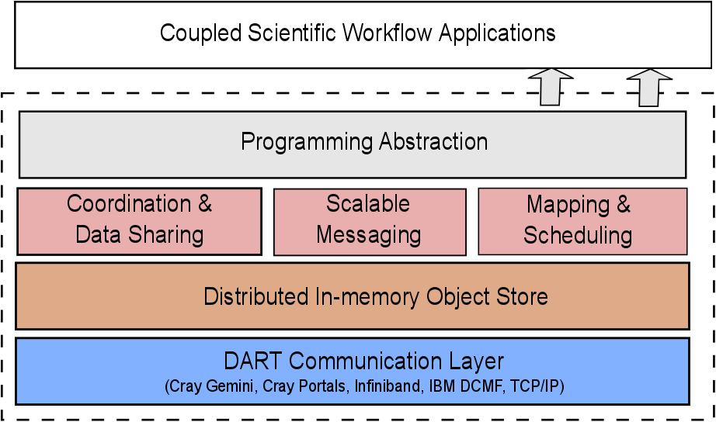

DataSpaces: Data Staging Service for In-Situ Workflows
The DataSpaces Abstraction
Virtual shared-space programming abstraction
  Simple API for coordination, interaction and messaging
Distributed, associative, in-memory object store
  Online data indexing, flexible querying
Cross-layer runtime management
  Hybrid in-situ/in-transit execution
High-throughput/low-latency asynchronous data transport

Slide 28

DataSpaces : Indexing + DHT
Dynamically constructed structured overlay using hybrid staging cores
Index constructed online using SFC mappings and applications attributes
  E.g., application domain, data, field values of interest, etc.
DHT used to maintain meta-data information
  E.g., geometric descriptors for the shared data, FastBit indices, etc.
Data objects load-balanced separately across staging cores
The SFC maps the global domain to a set of intervals
  Intervals are non-contiguous and can lead to meta-data load imbalance
  Second mapping compacts the intervals into a contiguous virtual interval
  Split the contiguous interval equally to the DataSpaces nodes

Slide 29

The DataSpaces Staging Abstraction
Storage distributed across memory hierarchy and a dynamic set of cores/node
Enable in-staging data processing, querying sharing, and exchange
Runtime data
coupling
Data staging
Online data
analysis
and
processing
Notes:
Online data analysis and processing
Runtime data coupling
Both XGC1-XGCa and S3D are production code from application people in different national labs
XGC1-XGCa (princeton plasma physics lab)
S3D (sandia national lab)

Slide 30


The DataSpaces Staging Abstraction
Storage distributed across memory hierarchy and a dynamic set of cores/node
Enable in-staging data processing, querying sharing, and exchange
Communications of the ACM, April 1989 V. 32, No. 4
Notes:
Online data analysis and processing
Runtime data coupling
Both XGC1-XGCa and S3D are production code from application people in different national labs
XGC1-XGCa (princeton plasma physics lab)
S3D (sandia national lab)

Slide 31
Rethinking Extreme-Scale Workflows: In-situ Workflows, In-transit Processing
A. Zamani, D. Balouek-Thomert, J.J. Villalobos, I. Rodero, M. Parashar, An edge-aware autonomic runtime for data streaming and in-transit processing, FGCS, vol. 110, pp. 107-118, 2020.
M. Aktas, J. Diaz-Montes, I. Rodero, M. Parashar, WA-Dataspaces: Exploring the Data Staging Abstractions for Wide-Area Distributed Scientific Workflows. ICPP 2017, pp. 251-260, IEEE.
Notes:
A. R. Zamani, I. Petri, J. Diaz-Montes, O. Rana and M. Parashar, "Edge-Supported Approximate Analysis for Long Running Computations," 2017 IEEE 5th International Conference on Future Internet of Things and Cloud (FiCloud), 2017, pp. 321-328, doi: 10.1109/FiCloud.2017.24.
Ali Reza Zamani, Daniel Balouek-Thomert, J.J. Villalobos, Ivan Rodero, Manish Parashar, An edge-aware autonomic runtime for data streaming and in-transit processing, Future Generation Computer Systems, Volume 110, 2020, Pages 107-118, https://doi.org/10.1016/j.future.2020.03.037.

Slide 32

Translational Impacts

Slide 33



Feedback in Translation: Data Movement, Placement is Important
Storage systems getting deeper and more complex
Access latencies can severely impact performance
Data-placement/movement is dependent on the data
Staging services shared across multiple workflows
Autonomic, “smart” runtime management needed

Slide 34

Stacker: ML-Guided Data Movement across the Staging Hierarchy [SC18]
Pradeep Subedi
Overview of machine learning assisted data placement across deep memory hierarchy
Goal: Reduce the number of read requests to disk using intelligent prefetching; extend in-memory data staging across DRAM, SSDs, burst buffers
Approach: Data prefetching across the multi-tier staging area using an n-gram model to learn and predict the next data access request
  Learn inter-application data access patterns, enabling support for multiple concurrent workflows
  No a priori knowledge of application access pattern or user inputs/hints assumed
Results: Read performance improved by ~40% as compared to no prefetching
Architecture of the Stacker multi-tiered staging framework. Data Placement Module implements the Machine Learning techniques
Notes:
Researchers at Rutgers and Oakridge explored machine learning based approaches to capture the data access patterns between components of staging-based in-situ application workflows, and to use these learned access patterns to move data between the storage layers of the staging service in an autonomous manner. Specifically, Stacker tiers data across SSD and DRAM to enable high capacity data staging and implements autonomous data movement across these tiers by predicting the upcoming sequence of data access requests via use of N-gram (a grammar-based ML model). In contrast to other works, which require previous knowledge about application or some user hints, Stacker doesn't require a priori knowledge of the complex scientific workflow and supports multiple concurrent workflows. Stacker was implemented on top of the DataSpaces framework. This work published at SC’18, enables enable high capacity data staging for in-situ workflows, while maintaining low overheads for extreme scale scientific workflows. This approach is also easily extendible to include deeper levels of storage hierarchy such as parallel file system.

Slide 35

Destiny: Anticipatory Delivery of In-Staging Data [Cluster 19]
Pradeep Subedi
Goal: Reduce data access costs for in-staging data
Approach: Anticipate data accesses using an n-gram ML model, and proactively package and move data close to the consumer
  Amortize expensive data discovery and assembly operations in data staging
Results: Read response time reduced by up to 75% and 53% for co-located application processes and processes residing in separate nodes respectively
Overview of DESTINY. The data is exposed to applications via shared memory abstractions and delivered to the closest staging server before read-request is issued.
Hybrid-Staging represents just exposing data through shared memory. Destiny-A represents applications residing on separate nodes than staging and Destiny-B represents collocated staging and application processes.
Notes:
Researchers at Rutgers and Oakridge explored machine learning based approaches to capture the data access patterns between components of staging-based in-situ application workflows, and to use these learned access patterns to move data between the storage layers of the staging service in an autonomous manner. Specifically, Stacker tiers data across SSD and DRAM to enable high capacity data staging and implements autonomous data movement across these tiers by predicting the upcoming sequence of data access requests via use of N-gram (a grammar-based ML model). In contrast to other works, which require previous knowledge about application or some user hints, Stacker doesn't require a priori knowledge of the complex scientific workflow and supports multiple concurrent workflows. Stacker was implemented on top of the DataSpaces framework. This work published at SC’18, enables enable high capacity data staging for in-situ workflows, while maintaining low overheads for extreme scale scientific workflows. This approach is also easily extendible to include deeper levels of storage hierarchy such as parallel file system.
For co-located consumer processes make data available to the consumer via shared-memory objects.
When consumer processes reside on nodes other than staging nodes, the packaged data is stored in a format the client will likely access in future

Slide 36
RISE: Reducing I/O Contention for Staging-based In-situ Workflows [Cluster 21]
Pradeep Subedi
Goal: Reduce data write access costs using “smart” data offloading
Approach: Models the interactions across staging-based coupled applications to predict periods of server idle-time; determine suitable data objects to drained to staging
Results: RISE captures the data access interval and schedules background drain task, which reduce the write-response time by ∼44% as compared to Naive-Drain method and by ∼31% as compared to native DataSpaces
RISE leverages ML techniques to capture the data access patterns then uses this knowledge to efficiently drain the data from local memory to the staging memory
Notes:
Data-staging frameworks have emerged as effective solutions for addressing data-related challenges at extreme scale and supporting in-situ/in-transit workflows. However, these DRAM based data-staging frameworks either store data purely on the client memory to provide immediate access to the data or on the staging server memory to utilize memory available on the staging servers. Efficient data movement and management in these frameworks remains a challenge. At Utah, we explored RISE, which bridges the gap between DataSpaces-like framework and DIMES-like frameworks to efficiently utilize the memory available on both client and staging server memory. Specifically, RISE makes the data immediately available to the reader/analysis applications by storing it locally and uses machine learning techniques to identify when the network is expected to be idle. During this expected idle period, RISE drains the locally stored data objects to the staging servers to minimize the interference between foreground read/write requests and background data drain. We implemented RISE within the DataSpaces staging framework and deployed it on Summit supercomputer at OLCF. Our experimental results using both synthetic and real-world large scale S3D application demonstrate that RISE can take advantage of staging nodes to offload the data without degrading the application's read and write requests being served by the staging server.
In contrast to existing solutions that exclusively use memory either on simulation nodes or on the staging nodes to write data, RISE offers write latency like solutions that use direct data movement but can also use the staging nodes to offload data.
Although data draining happens between writers and server, all I/O requests coming to staging servers are analyzed to predict when the network is likely to be idle.

Slide 37
Outline
Introducing Translational Computer Science (TCS)
Experiences in TCS Research: Data-Management for Extreme Science
Important Issues for TCS
Conclusion

Slide 38


TCS Roadblocks
In computer science, translation is often confused with commercialization
Open-source techniques are often confused for translation
Funding agencies typically don’t provide support for translation
  Resources to sustain and maintain research artifacts (software, data) are essential.
PhD programs don’t allocate time and resources to translation
  Translation is not considered as an acceptable these topic
Traditional academic structures, publication venues don’t value translation
There are a lack of exemplars

Slide 39
TCS Roadblocks
In computer science, translation is often confused with commercialization
Open-source techniques are often confused for translation
Funding agencies typically don’t provide support for translation
  Resources to sustain and maintain research artifacts (software, data) are essential.
PhD programs don’t allocate time and resources to translation
  Translation is not considered as an acceptable these topic
Traditional academic structures, publication venues don’t value translation
There are a lack of exemplars

Slide 40

Translation is not commercialization
Commercialisation almost always occurs after the research has been completed,
  Almost never funded as part of the original research proposal
  Little or no feed back to the research
Commercialisation implies a financial angle that has little to do with the research per-se
Notes:
Translation and commercialization do, however, complement and support each other. They can be combined in four ways:
no translation and no commercialization (traditional foundational or use-inspired CS research);
translation without commercialization (for example, ‘public good’ research and numerous open-source projects);
commercialization with no translation (applied research that is later commercialized but with no feedback to the research itself); and
translation with commercialization (such as Nimrod).

Slide 41

Use of Open Source
Enables and supports translation, but is not translation
Helps with distribution of a software system, but doesn’t intrinsically drive impact
No direct link between the way the software is used, and the research program. Thus, there is no explicit feedback from lessons learned in the adoption into the research itself
More focussed on producing software that is maintained in a sustainable way, by building a distributed workforce
Notes:
Using open source is not a prerequisite for translation. On the other hand, open-source techniques can assist in translation.
In case of DAGH/GrACE, which was immediately opensourced, rapid uptake in fact negatively impacted translation

Slide 42

Funding bodies don’t typically support translation
Evaluation criteria typically focus on the quality of the investigator team, the project quality and innovation, the feasibility and the benefit
Translation is not usually highlighted as a desirable property; thus, a proposal might be marked down for including translational activities
A budget that allocates resources to items such as a community trial, software distribution, software maintenance, may be pruned back to the basic research program

Slide 43

PhD research and timelines don’t support translation
Typical PhD projects in computer science do not include translation
  Milestones and deliverables include software prototypes, experiments and tests, producing publication outputs along with possibly software and data artefacts, and a thesis
  Translation on its own is not considered a valid research topic
TR adds complexity by requiring a translation phase
  Might extend the timeline beyond that of current PhD programs
Notes:
In the case of the DAGH/GrACE project, the PI performed translation activities.

Slide 44

Traditional academic structures and publication venues don’t value translation
Traditional tenure/promotion processes do not value translation (or dissemination of software/data)
  Focus on metric such as citations to publications
Many editorial boards would argue translation is secondary to their scope
  More focussed on primary research outcomes in computer science
Many translational research projects are interdisciplinary
  Outcomes might not align well with the journal’s primary focus
Most journals do not publish failures
Notes:
As a result, it was essential to balance traditional foundational and applied research with translational work, often prioritizing the former over the latter.

Slide 45

Lack of exemplars
Numerous examples of computer science research being commercialised and adopted
Few documented examples of successful translational research projects and the underlying processes
Changing the culture in an organization is difficult because people don’t know what a good TCS project looks like

Slide 46
Some thoughts for the path forward…

Slide 47

Funding
Currently TCS funding is ad hoc => Sustained funding programs and mechanisms focused on fostering and nurturing TCS
More money alone not solution => Need to build translation into the research plan
Funding must support experimenting with solutions and prototypes (e.g., Transition to Practice)
TCS typically involves substantial interaction with end users => Additional funding for travel, user engagement, provisioning of development resources
Translation process feeds back into the research => May require a loop of research and translation rather than a linear workflow
Research should be free (encouraged) to report on both research successes, but also translation success or failures

Slide 48

Venues, metrics and reward structures
Traditional publications are not well suited to TCS => Similar to TM, establish new journals that explicitly target translation
Metrics, recognitions and rewards structures are lacking, especially in the academic community
  Mechanisms to track their use, citations and impact are a step in the right direction
  Metrics that report uptake, and measure how many of these have resulted in successful translation
  Integrate metrics into promotion processes

Slide 49

Education and Training
Integration of translational approaches and methodologies into more formal computer science curricula
New materials and mechanisms for providing translational skills to practitioners, in both computer and other disciplines
  Institutes/centres have been established that encourage and enable trans-disciplinary research
Extreme example: A PhD could be entirely devoted to the translation of work performed by another researcher, with no original research on the background IP per se

Slide 50
Outline
Introducing Translational Computer Science (TCS)
  Exemplars of TCS Research
Experiences in TCS Research: Data-Management for Extreme Science
Important Issues for TCS
Conclusion

Slide 51
Conclusion
CS research, innovations are transforming science and society
TCS complements traditional CS research models (foundational, use-inspired, applied) and can accelerate and amplify the impact of computer science research
There are benefits to formalizing TCS to complement traditional modes of computer science research
  Several issues: Funding models, reward structures, publication venues, education and training, etc.

Slide 52



Slide 53
Thank you!
Manish Parashar
Email: manish.parashar@utah.edu
WWW: manishparashar.org / dataspaces.org
Acknowledging:
David Abramson
Pradeep Subedi, Philip Davis, Daniel Balouek-Thomert, Zhe Wang, Bo Zhang
Many students, postdocs and collaborators

Slide 54


Data-driven Runtime Management
Fig. 1. Different views for visualizing the HACC data.^{[1]}
Fig. 2. Different data analytics execution time across different iterations and across different ranks for the same step.
Data Staging Requirements:
(Figure 1) Trigger in-situ processing when there interesting data appears.
(Figure 2) Place in-situ tasks where overheads are minimized.
(Figure 3) Adjust resources used for in-situ processing to meet processing constraints.
Fig. 3. Execution time of in-situ processing (distributed visualization) changes with the number of processes and the simulated data size.
[1] The figure comes from https://www.olcf.ornl.gov/wp-content/uploads/2018/10/habib_2019OLCFUserMeeting.pdf
Notes:
We use three examples to motivate this research and to show the benefits of dynamically managing the workflow configurations during its execution.
The first example shown in Figure 1 is the data analysis workflow developed for a cosmological N-body simulation.
In this simulation, the halo region represents a high-density mass containing a large number of particles in a comparatively small region.
The analytics pipeline of HACC first detect these interesting regions and then transfer associated data blocks to the data staging service for further processing.
We can get more detailed scientific insights, such as the size and the center of the halo areas, by analyzing these interesting data blocks.
The research question here is how to extend the data staging service to support the workflow with the data detection service and to trigger the analytics task when there is appearance of interesting data.
For the second example shown in Figure 2, it illustrates a case where there is unbalanced data analtyics execution time. We use the gray-scott simulation as the data source. The data analtyics can extract its isosurface and compute the component with the largest superficial area.
The darker color represents the longer execution time in this figure. We can observe that the data analysis time varies across steps for every single rank and across ranks for the same step. These variations between steps and ranks showcase an opportunity to adopt different analysis placement strategies to reduce workflow execution time. For example, we may transfer the data to the data staging service instead of processing it in the simulation to slow down the simulation computation. The research question here is to estimate where is the proper place to put the analytics task to decrease the overhead of in-situ processing, either in the simulation program by a tightly coupled way or in the data staging service by a loosely coupled way.
For the third example, we run the visualization task in a tightly coupled way to visualize the data in a distributed manner. Figure 3 shows that the in-situ processing execution time is influenced by the size of the simulated data and the number of processes usded for in-situ processing.
If we can predict the relationship between the in-staging processing time and the data size or its number of processes, we may adjust the resources allocated to the data staging service to control the in-staging processing time.
For example, when there are large amounts of simulated data, we may allocate more computing resources to decrease the overhead of the in-staging processing.
It requires the data staging service to provide the capability of resource elasticity and to provide the policy about how to apply these elasticity operations.

Slide 55


Data-driven Autonomic Runtime Management
Overarching goal: Data-driven trigger mechanism for in-situ processing
(When) Dynamiclly adjusting ana/vis task pipeline [CLUSTER20][HPS21]
Hybrid system
In-staging processing^{[2]}
(Where) Adjusting task placement strategy dynamically [HiPC21]
In-situ processing^{[1]}
Loosely-coupled system
Tightly-coupled
system
(Resources) Using right number of computing resources [WORKS21]
[1] Terminologies defined by the “Childs, Hank, et al. "A terminology for in situ visualization and analysis systems." The International Journal of High Performance Computing Applications 34.6 (2020): 676-691.”
[2] There are multiple forms of in-staging processing depending on types of tasks executed in the data staging area, and we focus on ana/vis tasks in this presentation.
Notes:
In summary, this figure illustrates how our contributions can fit in the context of in-situ processing.
We first present an overarching method that shows how to control and organize workflow dynamically in the context of in-situ processing.
With this method, we then achieve workflow optimization from three perspectives, namely:
Where can we execute data analytics tasks to decrease wait time and overhead of in-situ processing
How to use the right number of computing resources to get scientific insights in a timely way
[1] We use the terminologies defined by the “Childs, Hank, et al. "A terminology for in situ visualization and analysis systems." The International Journal of High Performance Computing Applications 34.6 (2020): 676-691.”
[2]There are multiple forms of in-staging processing depending on types of tasks executed in the data staging area, and we focus on ana/vis tasks in this presentation.

