Slide 1
HPC Interconnects at the End of Moore’s Law
John Shalf
Department Head for Computer Science
Lawrence Berkeley National Laboratory
PPAM
September 12, 2022
Gdansk, Poland
jshalf@lbl.gov

Slide 2
Post Exascale Supercomputing
Building a new economic model for HPC using Advanced Packaging
John Shalf
Department Head for Computer Science
Lawrence Berkeley National Laboratory
PPAM
September 12, 2022
Gdansk, Poland
jshalf@lbl.gov

Slide 3
Moore’s Law is Ending
Hennessy / Patterson

Slide 4
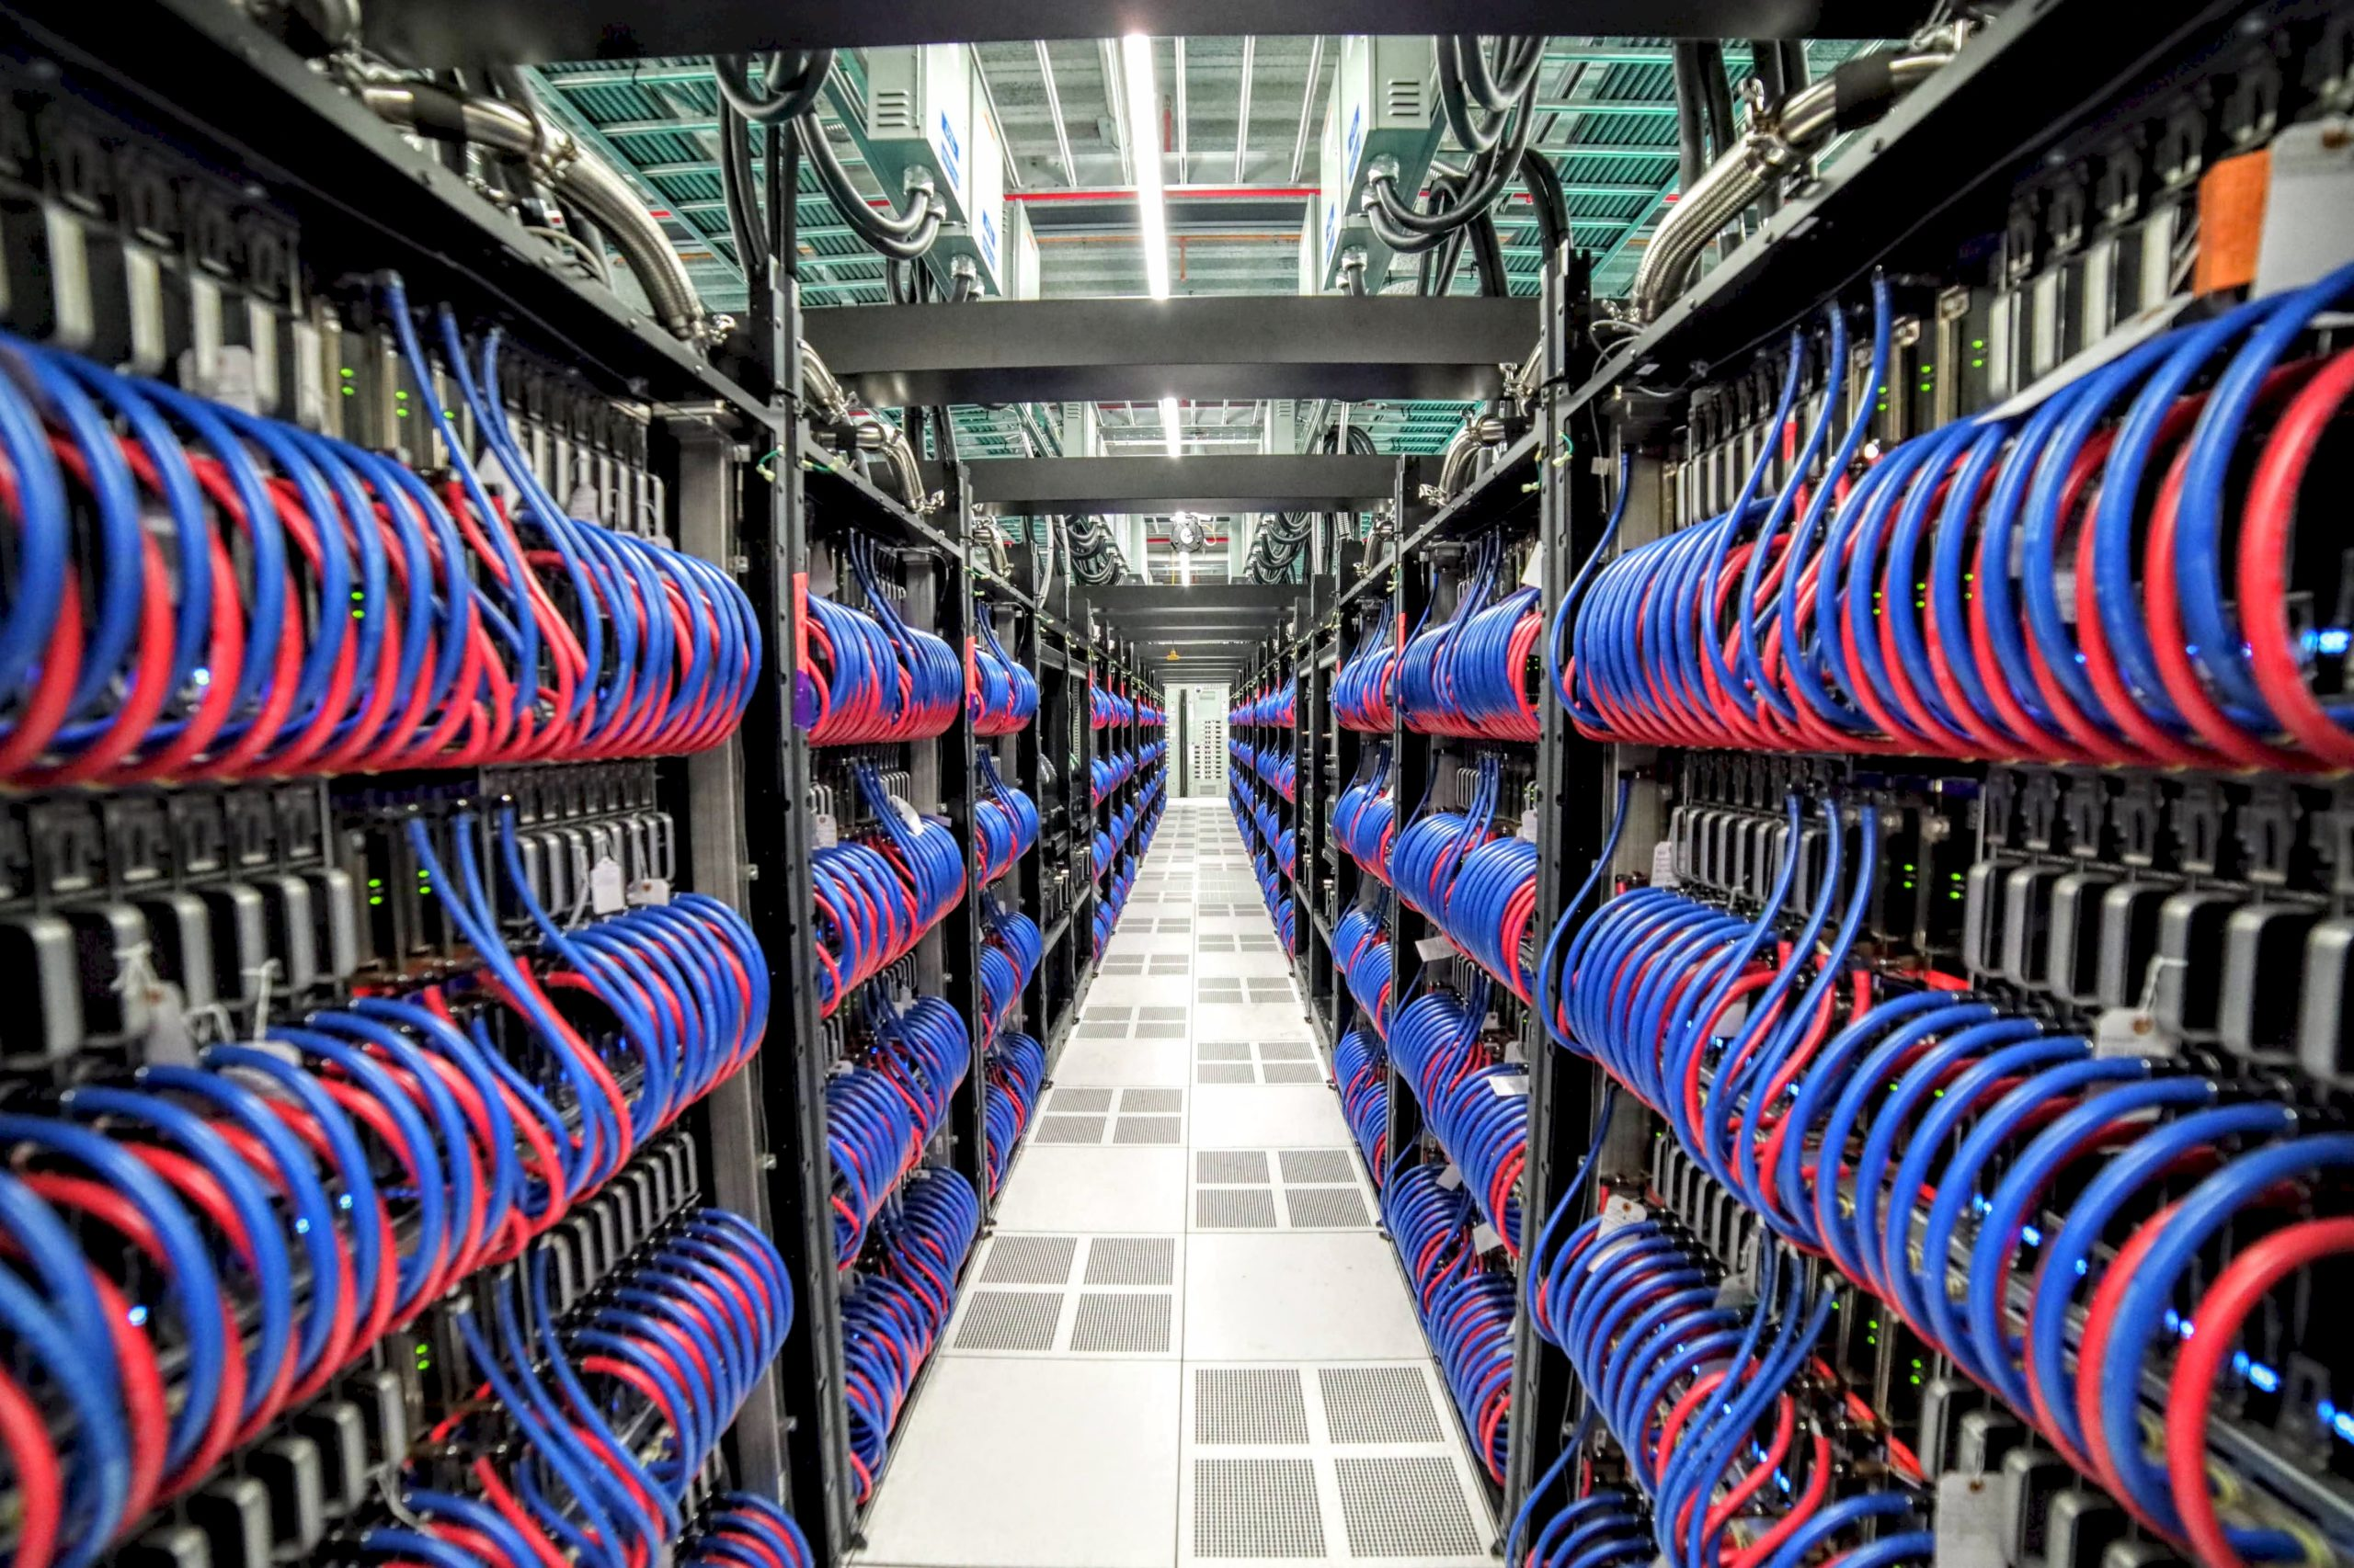
Huge Energy Efficiency Central to Getting to Exascale
2008/2009 Exascale Challenges Report (DARPA/DOE)
  “The primary challenge for getting to exascale computing will be the energy consumption. Most of that energy is attributed to the cost of data movement.”
  Projections for Exascale (done in 2009 for a 2016 target) 67MW-200MW
  Target for ECP 20MW
OLCF Frontier at Oak Ridge National Laboratory
  First Exascale HPC System in the world 1,100,000,000,000,000,000 operations per second!
  Powered by AMD EPYC “Trento” 64core processor co-integrated with 4x MI250 “Instinct” GPUs
  Frontier contains 9,408 CPUs, 37,632 GPUs, and 8,730,112 cores, linked together by 145 kilometers of networking cables.
  #1 on Top500 and #1 on Green500 @ 21MW (that is no coincidence)

Slide 5
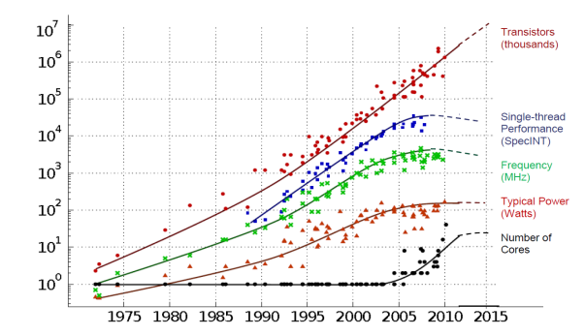
Technology Scaling Trends
Exascale in 2021… and then what?
Transistors
And Then What?
Thread Performance
Clock Frequency
Performance
Power (watts)
# Cores
Exascale in 2022
Year
Figure courtesy of Kunle Olukotun, Lance Hammond, Herb Sutter, and Burton Smith
Notes:
Thomas said he wouldn’t show this diagram….. OK. I will then.
Well at least we’ve got Moore’s Law (lithography scaling)
But in 2025 we won’t have that any more, and our current play of doubling processor cores that gets us to exascale is no longer going to be available as a source of technology scaling.
Could extend this if you build out in 3D! But energy density is already at the limits, so you cant.
And data movement goes lower if you have photonics or if you have lower voltages….

Slide 6
Projected Performance Development
100 Eflop/s
10 Eflop/s
1 Eflop/s
100 Pflop/s
SUM
10 Pflop/s
1 Pflop/s
100 Tflop/s
N=1
10 Tflop/s
1 Tflop/s
N=500
100 Gflop/s
10 Gflop/s
1 Gflop/s
Historically 1000x improvement every 11 years
100 Mflop/s
Erich Strohmaier
Top500.org
Notes:
No500 is lagging 10x by end of decade if this continues

Slide 7
Projected Performance Development
100 Eflop/s
10 Eflop/s
SUM
1 Eflop/s
10 Exaflops in 10 years
Traditionally 1000x
Every 10 years
100 Pflop/s
N=1
10 Pflop/s
N=500
1 Pflop/s
100 Tflop/s
Notes:
No500 is lagging 10x by end of decade if this continues
EXP(0.325x) top500 last old
Exp(0.2124 x ) top500 last new
Exp(0.1843 x) scalar
Exp(0.219 x) accelerator
Exp(0.3061 x) top500 average prior 2013
Exp(0.1379 x) top500 average post 2013 => *2.28 in 6 lists since 2008

Slide 8
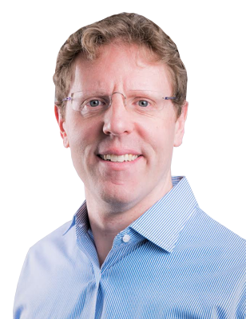


Neil Thompson: Economics of Post-Moore Electronics
http://neil-t.com, MIT CSAIL, MIT Sloan School
Papers
The Economic Impact of Moore’s Law
There’s Plenty of Room at the Top: What will drive computer performance after Moore’s Law?
The Decline of Computers as a General Purpose Technology

Slide 9
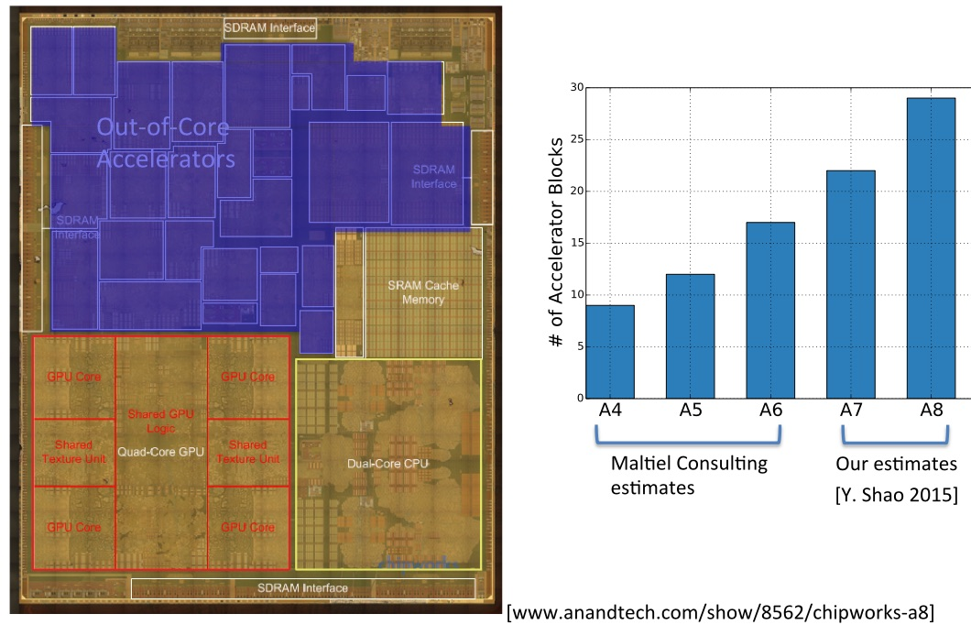
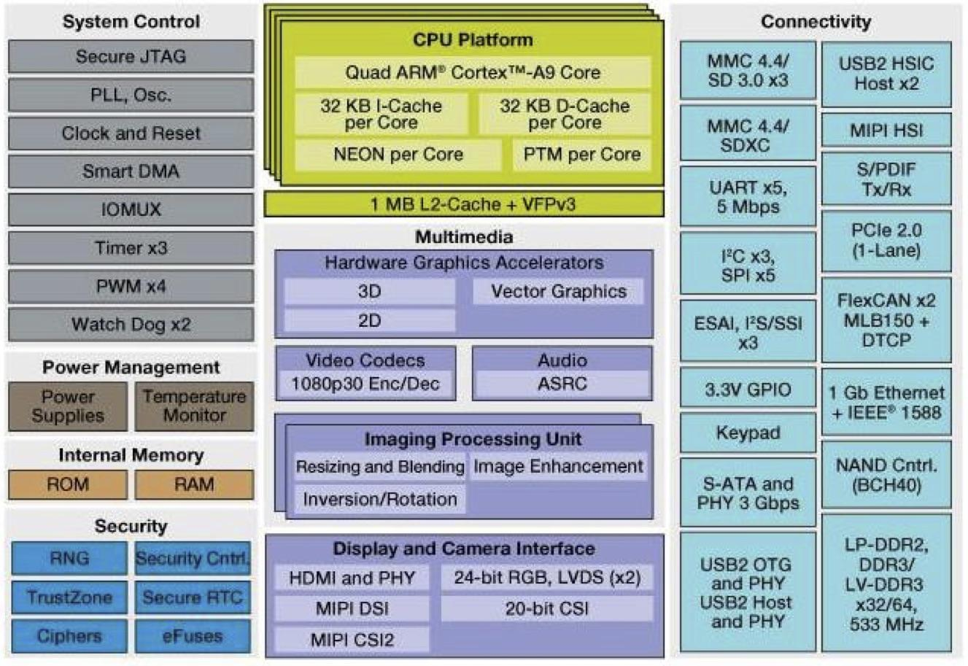
Extreme Hardware Specialization is Happening Now!
This trend is already well underway in broader electronics industry
Cell phones and even megadatacenters (Google TPU, Microsoft FPGAs…)
(and it will happen to HPC too… will we be ready?)
40+ different heterogeneous accelerators in Apple A11 (2019)
29 different heterogeneous accelerators in Apple A8 (2016)
Notes:
Yakun Shao

Slide 10
Large Scale Datacenters also Moving to Specialized Acceleration
The Google TPU
Deployed in Google datacenters since 2015
“Purpose Built” actually works - Only hard to use if accelerators was designed for something else
Could we use TPU-like ideas for HPC?
Specialization will be necessary to meet energy-efficiency and performance requirements for the future of DOE science!
Model | MHz | Measured Watts |  | TOPS/s |  | GOPS/s /Watt |  | GB/s | On-Chip Memory
 |  | Idle | Busy | 8b | FP | 8b | FP
Haswell | 2300 | 41 | 145 | 2.6 | 1.3 | 18 | 9 | 51 | 51 MiB
NVIDIA K80 | 560 | 24 | 98 | -- | 2.8 |  | 29 | 160 | 8 MiB
TPU | 700 | 28 | 40 | 92 | -- | 2,300 |  | 34 | 28 MiB
Notional exascale system:
2,300 GOPS/W →? 288 GF/W (dp) → a 3.5 MW ExaOp system!
Notes:
Norm Jouppi
5 TF double precision for matrix multiply (if its operating at 100% efficiency)
21 TF half-precision for ML

Slide 11
Specialization:
Natures way of Extracting More Performance in Resource Limited Environment
Powerful General Purpose
Many Lighter Weight
(post-Dennard scarcity)
Many Different Specialized
(Post-Moore Scarcity)
Xeon, Power
KNL AMD, Cavium/Marvell, GPU
Apple, Google, Amazon

Slide 12
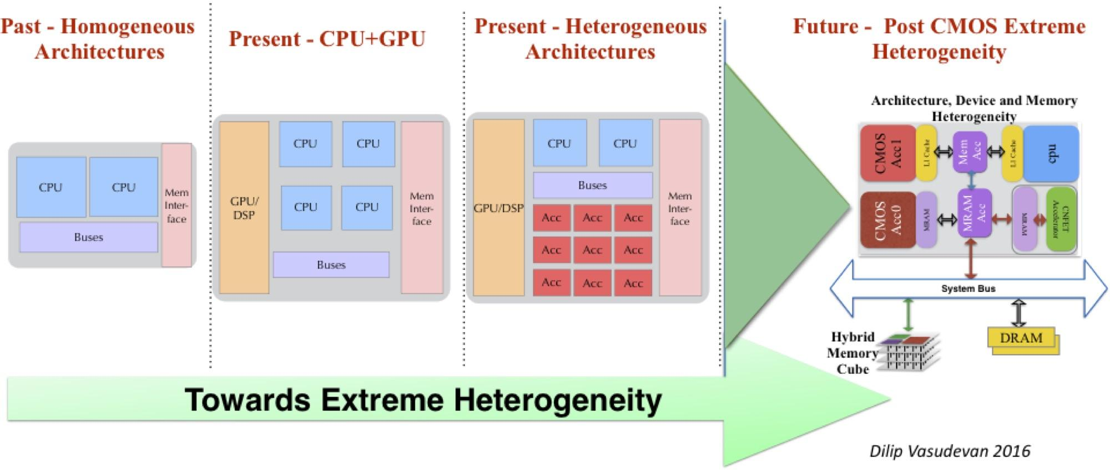
The Future Direction for Post-Exascale Computing
But what are the right specializations to include?
What is the cost model (we know we cannot afford to spin our own chips from scratch)
The ARM licensable IP ecosystem : IP is the commodity (not the chip)
What is the right partnership/economic model for the future of HPC?
Notes:
When faced with end of Dennard scaling, the solution was more parallelism
We said we didn’t like that. But in the absence of alterantives, its what industry did. (and dawn of accelerators)

Slide 13
Industry: Heterogeneous Integration Roadmap
http://eps.ieee.org/hir
HPC and Megadatacenters is 2nd chapter
Note: leading edge design nodes are not ideal
For every component (e.g. SERDES)
Notes:
These are the people who started ITRS
Roadmap necessary for manufacturing equipment

Slide 14
What is Hyperscale Datacenter Strategy
Interconnect on-Chip

Slide 15
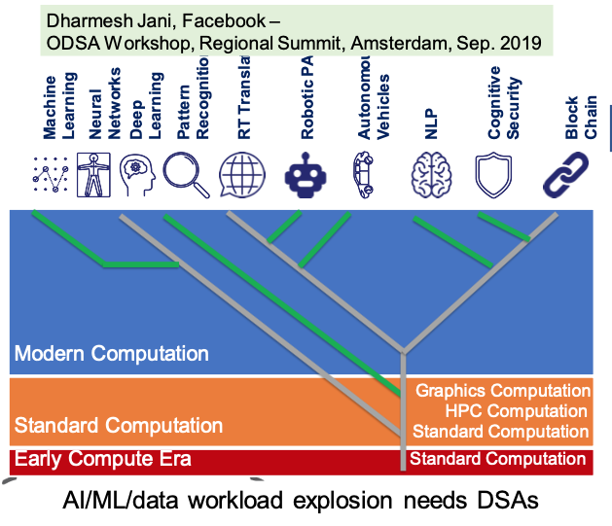
Why? Domain specific Architectures driven by hyperscalers in response to slowing of Moore’s Law (switch to systems focus for future scaling)
Papers
The Economic Impact of Moore’s Law
There’s Plenty of Room at the Top: What will drive computer performance after Moore’s Law?
The Decline of Computers as a General Purpose Technology

Slide 16
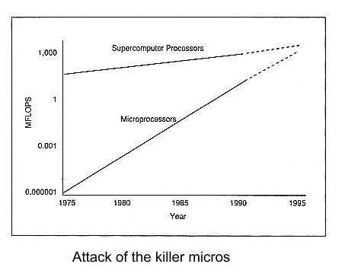
Attack of the Killer Micros
Was more about the economic model than technology alone
John Markoff, May 6, 1991

Slide 17
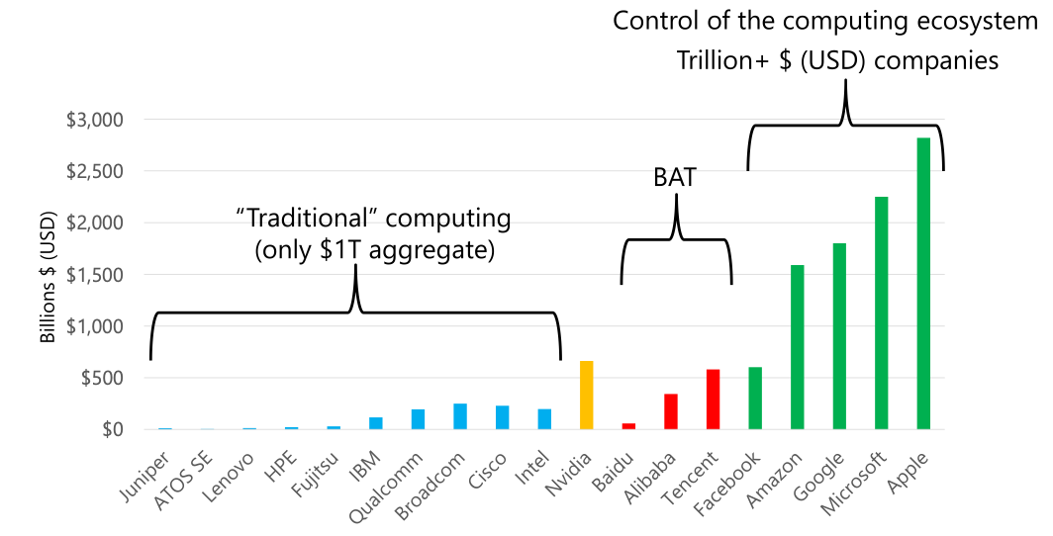
It is not good enough anymore to understand the technology
Now we must also understand the market context
Dan Reed, 2022
https://arxiv.org/pdf/2203.02544.pdf

Slide 18

Opportunity for HPC: New Economic Model
Open Chiplets Marketplace is forming (ODSA and UCIexpress)
  Licensable IP and assembly by 3rd party lowers that barrier
  Leverage the economic model being created by HyperScale
Leverage this baseline and extend to support HPC
  Smaller incremental cost for HPC to “play”
  HPC has become “too small to attack the city”
80:20 Rule: Focus open efforts on what uniquely benefits HPC
  Build up a library of reusable accelerators for HPC.
  Interoperability for sustainability: Interoperate with Arm IP for commercially supported IP where it exists and focus Open on the 20% that doesn’t make commercial sense to license
Mark Seager 2010
Notes:
Why can’t this be “Open Source” AND “Licensed IP” rather than Open vs. Licensed (both are a form of “open” in that they have open interfaces and they overcome opportunity cost.
(ecosystem compatibility and ARB…)

Slide 19
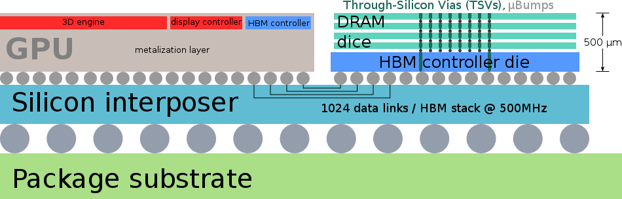
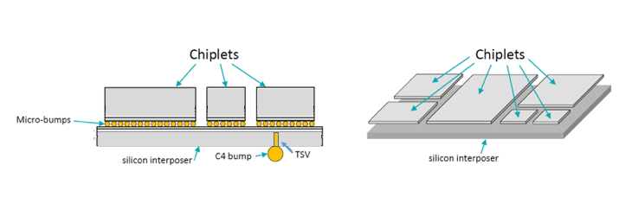
What is a Chiplet?
Solder Microbumps

Slide 20
What is a Chiplet?
Solder Microbumps

Slide 21
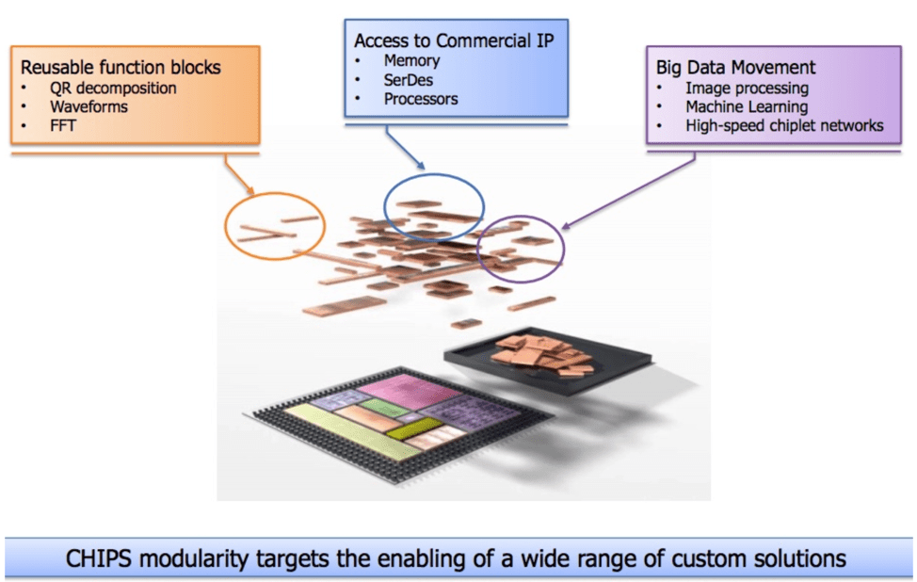
How do chiplets enable domain specialization?

Slide 22
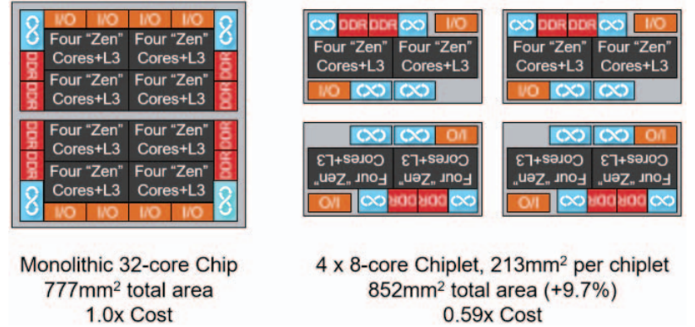
AMDs Chiplets Strategy
Naffziger, S., Noah Beck, T. Burd, K. Lepak, Gabriel H. Loh, M. Subramony and Sean White. “Pioneering Chiplet Technology and Design for the AMD EPYC™ and Ryzen™ Processor Families : Industrial Product.” 2021 ACM/IEEE 48th Annual International Symposium on Computer Architecture (ISCA) (2021): 57-70.

Slide 23
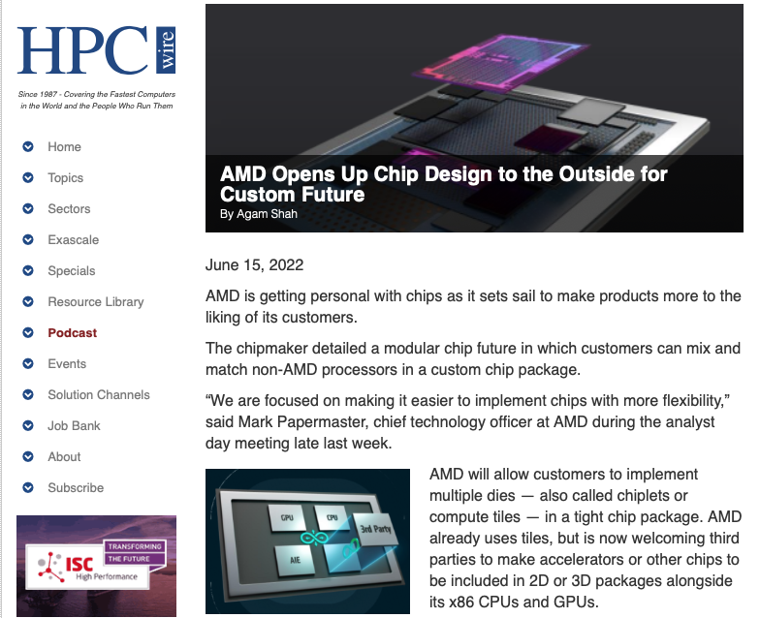

Slide 24
Getting to Critical Mass for IP Reuse for Accelerators

Slide 25
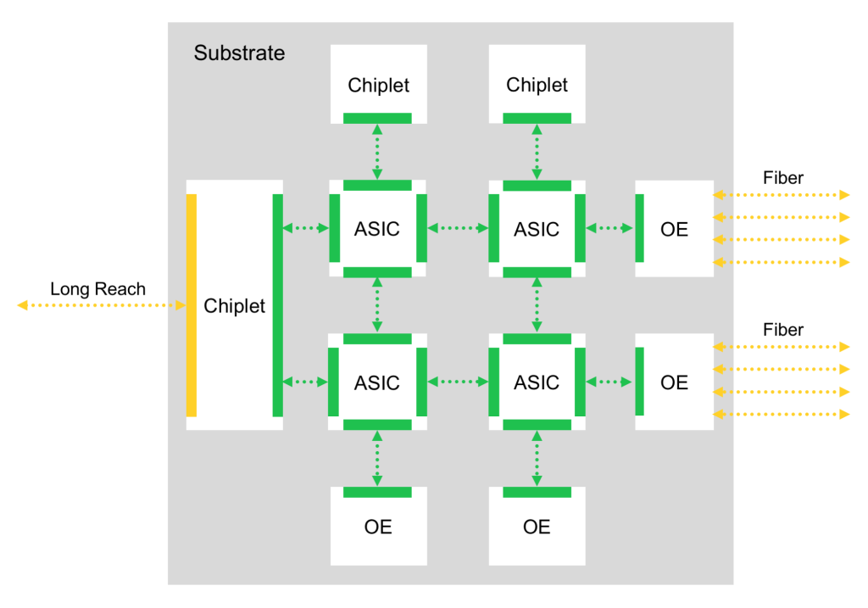
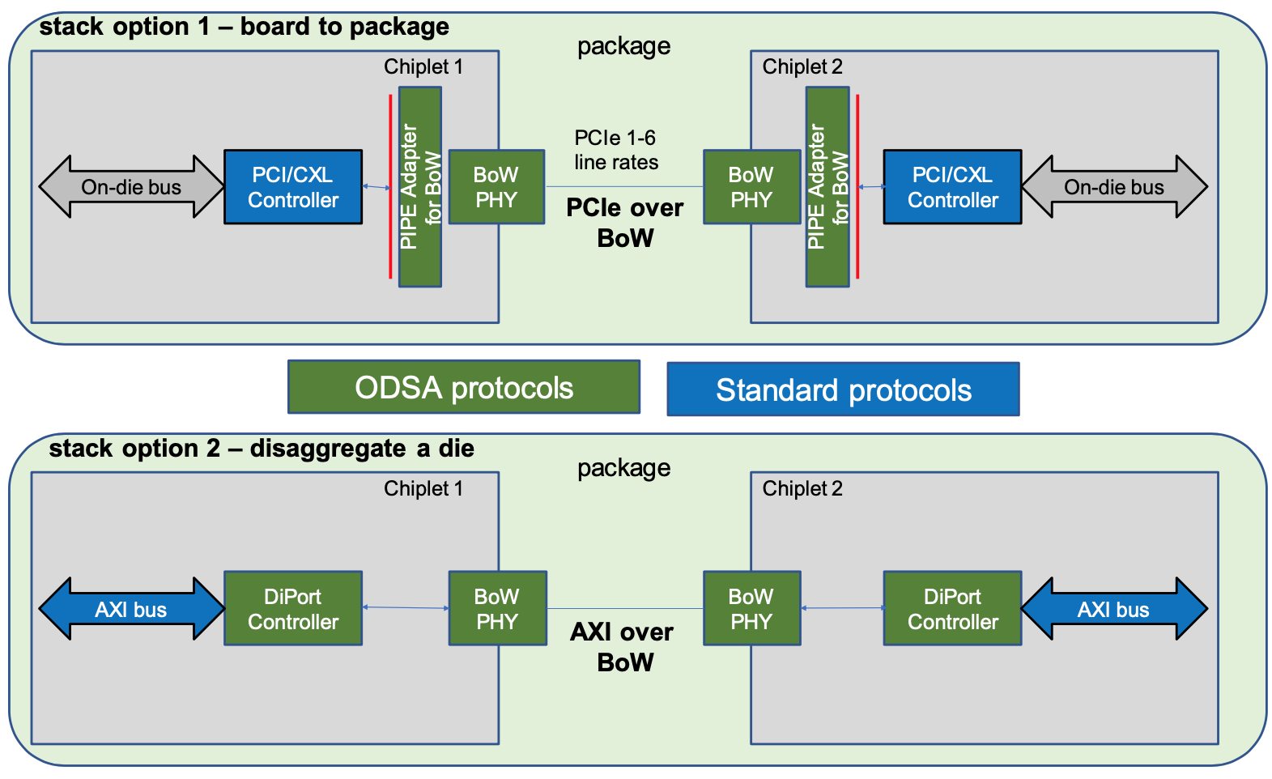
Standardized die-to-die (D2D) Interfaces (ODSA)
D2D
D2D
Blue Cheetah supplies the IP for the Die-to-Die (D2D) Phy.
25

Slide 26
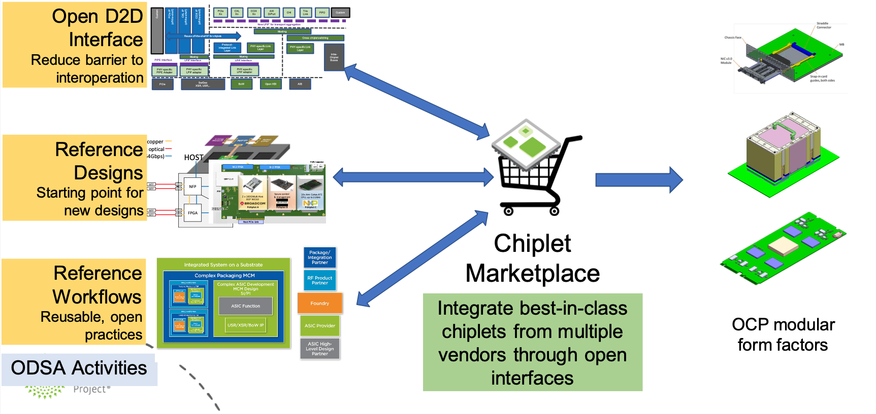
ODSA: Open Domain Specific Architecture
Creating an Open Chiplet Marketplace for Hyperscale Datacenters

Slide 27
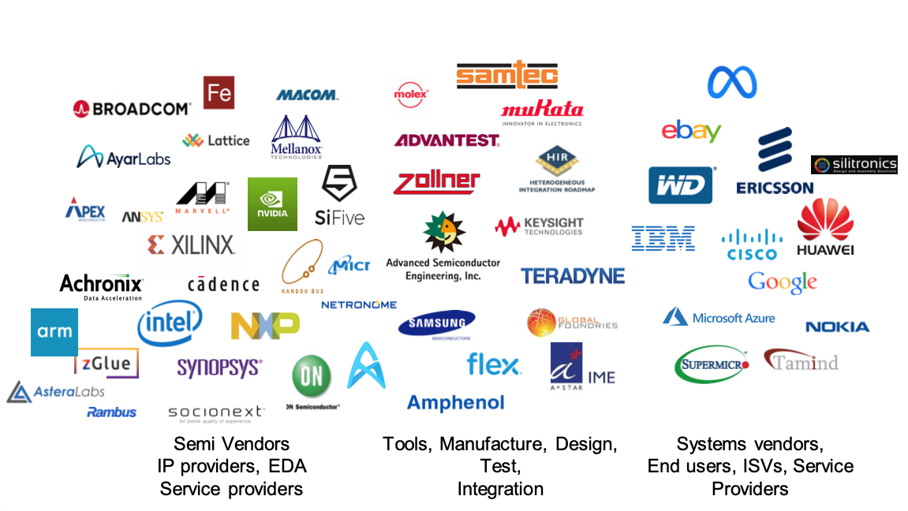
Co-Sponsors of the ODSA Open Chiplets Marketplace

Slide 28
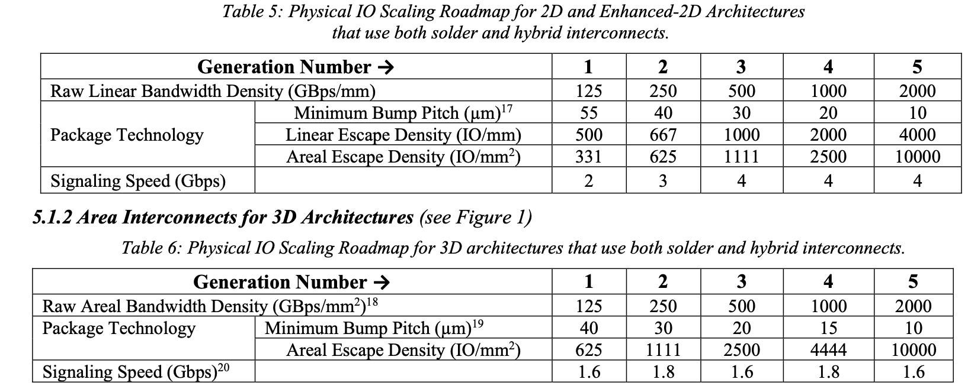
Chiplet Bandwidth Roadmap (5 generations of BW doubling)

Slide 29
Conclusions
Think more seriously about how to use specialization productively for science
  Requires deep understanding of applied mathematics and the underlying algorithms to be successful
Reevaluate the economic model for the design/acquisition of HPC systems
Scaling alone (e.g. Zettaflops) is no longer a rational metric for HPC success
  What metrics demonstrate effectiveness for science (which should == success?)
  How to measure success in this new environment??? You can’t improve what you can’t measure.
Let Us Model Solutions for the Global Climate Crisis without Contributing to Global Warming!
(Carbon Neutral HPC by 2030! Would not be a bad alternative metric)

Slide 30
How Might Chiplets Play out for Science
A Materials Science Code Example

Slide 31
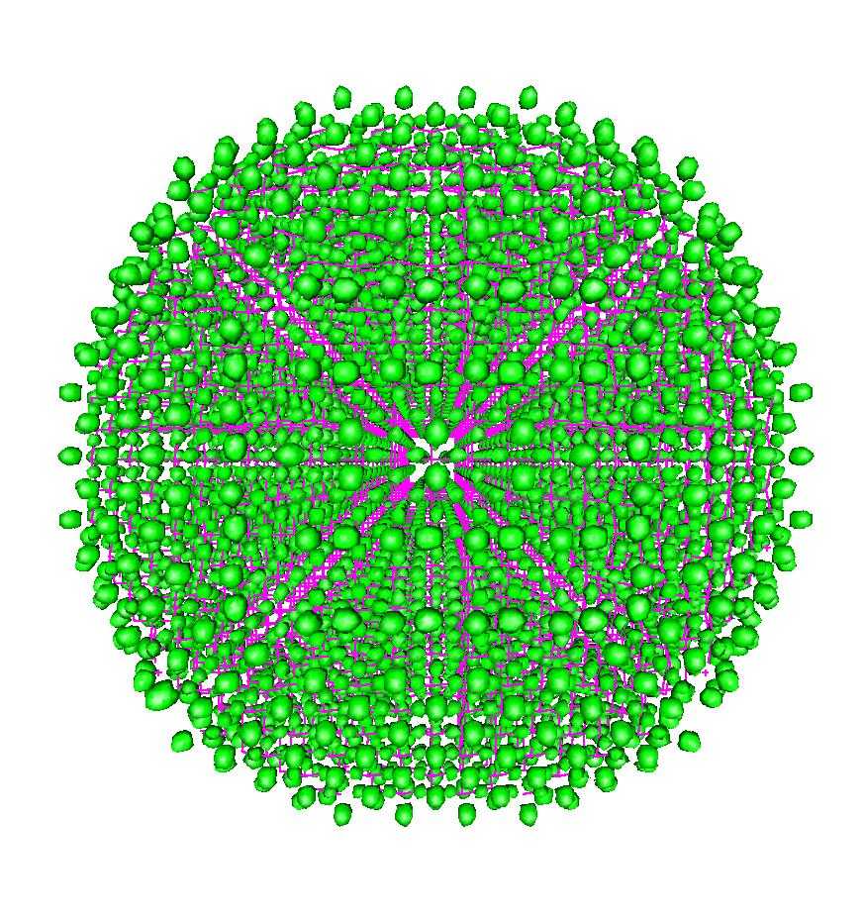
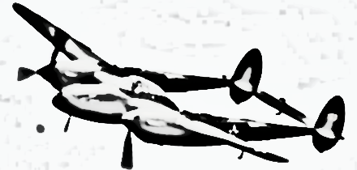
Post Exascale: Heterogeneous Computing Research Directions
Project 38
Heterogeneous Integration
Co-integration of many heterogeneous accelerators
Example: Apple Bionic chip, AWS Graviton2, Project38.
Specialization
Purpose built machines for big science targets.
Example: Google TPU. For DOE, DFT is 25% of workload
Resource Disaggregation
Photonic MCMs to enable reconfigurable nodes/systems
Example: Facebook/Google. Just DRAM utilization diversity in DOE could benefit from this.
Notes:
Architecture Specialization: DFT Beyond Moore’s Law
Density Functional Theory is 25% of NERSC workload
Execution is dominated by FFT and BLAS
Specialized circuits for FFT and BLAS can accelerate performance by 10x-100x.
Accomplishments: Full custom Accelerator design (new algorithm formulation) demonstrated on Samba Nova CGRA showed 60x speedup vs. Cori Haswell and 27x speedup vs. Pascal GPU.
Image: the blue slice of the Pie Chart shows how much of the NERSC workload is DFT. The dataflow graph is the reformulated DFT algorithm for custom dataflow hardware.
Heterogeneous Integration: Project38
Cross-agency hardware architecture
Determine opportunities for diverse heterogeneous accel. to speed up HPC
Work with industry to evaluate feasibility and develop cost models for implementation
Accomplishments: Used hardware simulation to quantify performance for target codes. Sandia engaging Micron and LBL/ANL engaging with AMD+Arm for technology feasibility and cost study.
Disaggregation: PINE: Photonic Integrated Networked Energy Efficient Datacenters
Accomplishments: Developed system architecture with in-package photonics to enable custom re-wiring of node to match application requirements

Slide 33
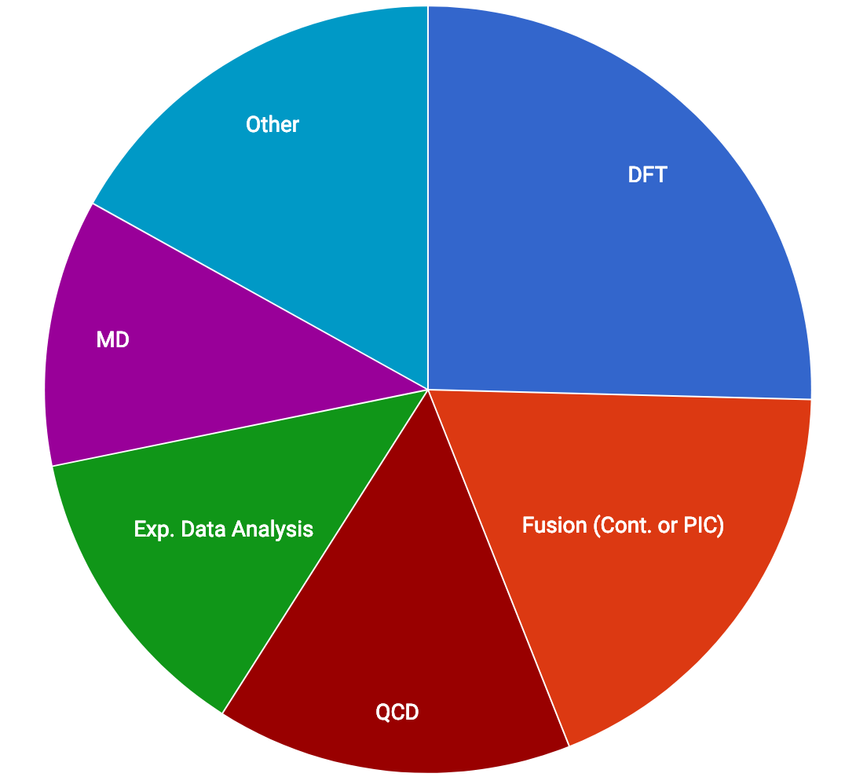
Algorithm-Driven Design of Programmable Hardware Accelerators
Example: LS3DF/Density Functional Theory (DFT)
What: Design the hardware acceleration around the target algorithm/application
  Purpose-built acceleration
  Science-led reference algorithm design
Why: Huge opportunities to improve performance density and efficiency
  FFT hardware accelerator 50x-100x faster than GPU (using SPIRAL generator)
How: Target Density Functional Theory
  Large fraction of the DOE workload
  Mature code base and algorithm
  LS3DF formulation minimizes off-chip communication and scales O(N)
25%+ of DOE workload is Density Functional Theory (DFT)
Notes:
Should be < change to 3 bullets >
Selected DFT code for 3 characteristics
1) It’s a huge part of the workload
2) It’s a mature code (doesn’t change often)
3) LS3DF formulation avoids communication and scales O(N)
Current algorithmic formulation designed to address limits of current SIMD & SIMT requirements
Must revisit many key algorithm design decisions to make best use of hardware specialization
Opportunities
O(N) (LS3DF) algorithmic alternative maximizes spatial locality
FFT accelerator generator (SPIRAL)
Roll back from “all bands” formulation

Slide 34
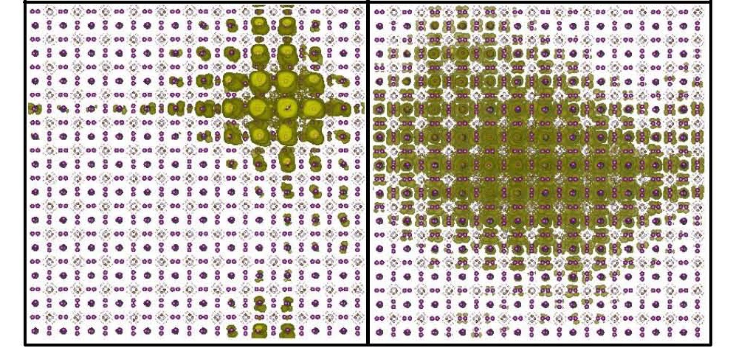
The DFT kernel for each fragment
Communication Avoiding LS3DF Formulation – Scales O(N)
O(N² Log(N))
Comm bound if non-local
Specializations Chiplet
(s)
TSQR & Choelesky
O(N³)
Compute-bound
LS3DF O(N) Algorithm Formulation
Minimizes off-chip Communication
One patch per CGRA
400 bands/patch
Compute Intensive Kernels
Targeted for HW Specialization
Notes:
Key Take-aways
Increase the FLOP density for BLAS and FFT (Spiral)
Minimize data movement (entirely within chip)
And scale with compute rather than adding memory

Slide 35
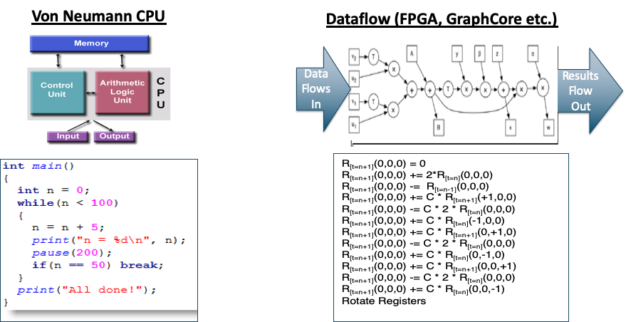
Von-Neumann Instruction Processors vs. Hardware Circuits
(must redesign for static dataflow and deep flow-through pipelines)
FPGA (Field Programmable Gate Array): Granularity of these operations and wires are single bits
CGRA (Coarse Grain Reconfigurable Array): Programmability & ALUs at word granularity
improves speed and density!!
(Cerebras, GraphCore, SambaNova, LPU)
ASIC or Chiplet (custom circuit): Another factor of 10x on density and energy efficiency.

Slide 36
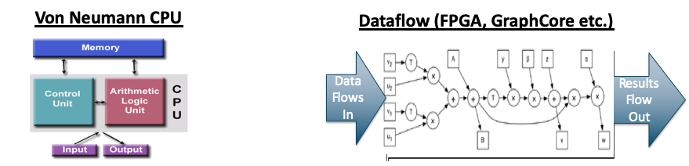
Algorithm Reformulated as Custom Circuit
Point wise
iFFT1D
FFT1D
GEMM
DRAM
See Also Torsten Hoefler “StreamBLAS” for FPGA
Notes:
Frustration is that HLS for FPGAs as we currently know it thinks that I can express my algorithm in VonNeumann fashion like on the left
And then somehow the compiler will be able to translate to dataflow on right.
No way in hell. Really need to reformulate the algorithm for streaming (as Torsten has done for streamBlas and Thom has done for DFT)
But we could come up with more powerful mathematical abstractions that are amenable to such transformations. But HLS as it is today leaves this unaddressed!

Slide 37

Preliminary Performance on CGRA HΨ
Eigenvalue Problem
Dataflow Algorithm Reformulation
Mapping onto Custom Hardware
or GPU
Results
Delivered Speedups (compared to optimized code) of “custom” DFT accelerator running on CGRA
Accelerate the design of full custom accelerators!!
Thom Popovici, Andrew Canning (FFTx), Zhengji Zhang (NERSC)
Franz Francetti (CMU/FFTx)
Notes:
What if I could turn-around an Google TPU or Anton-like design in months rather than years?
Through hardware compiler technology or something that can represent both hardware and software (programmable and fixed function) in the same intermediate semantic representation? It would democratize the creation of targeted accelerators for big science. (whether on programmable logic or on custom ASICs if price were lower)

Slide 38
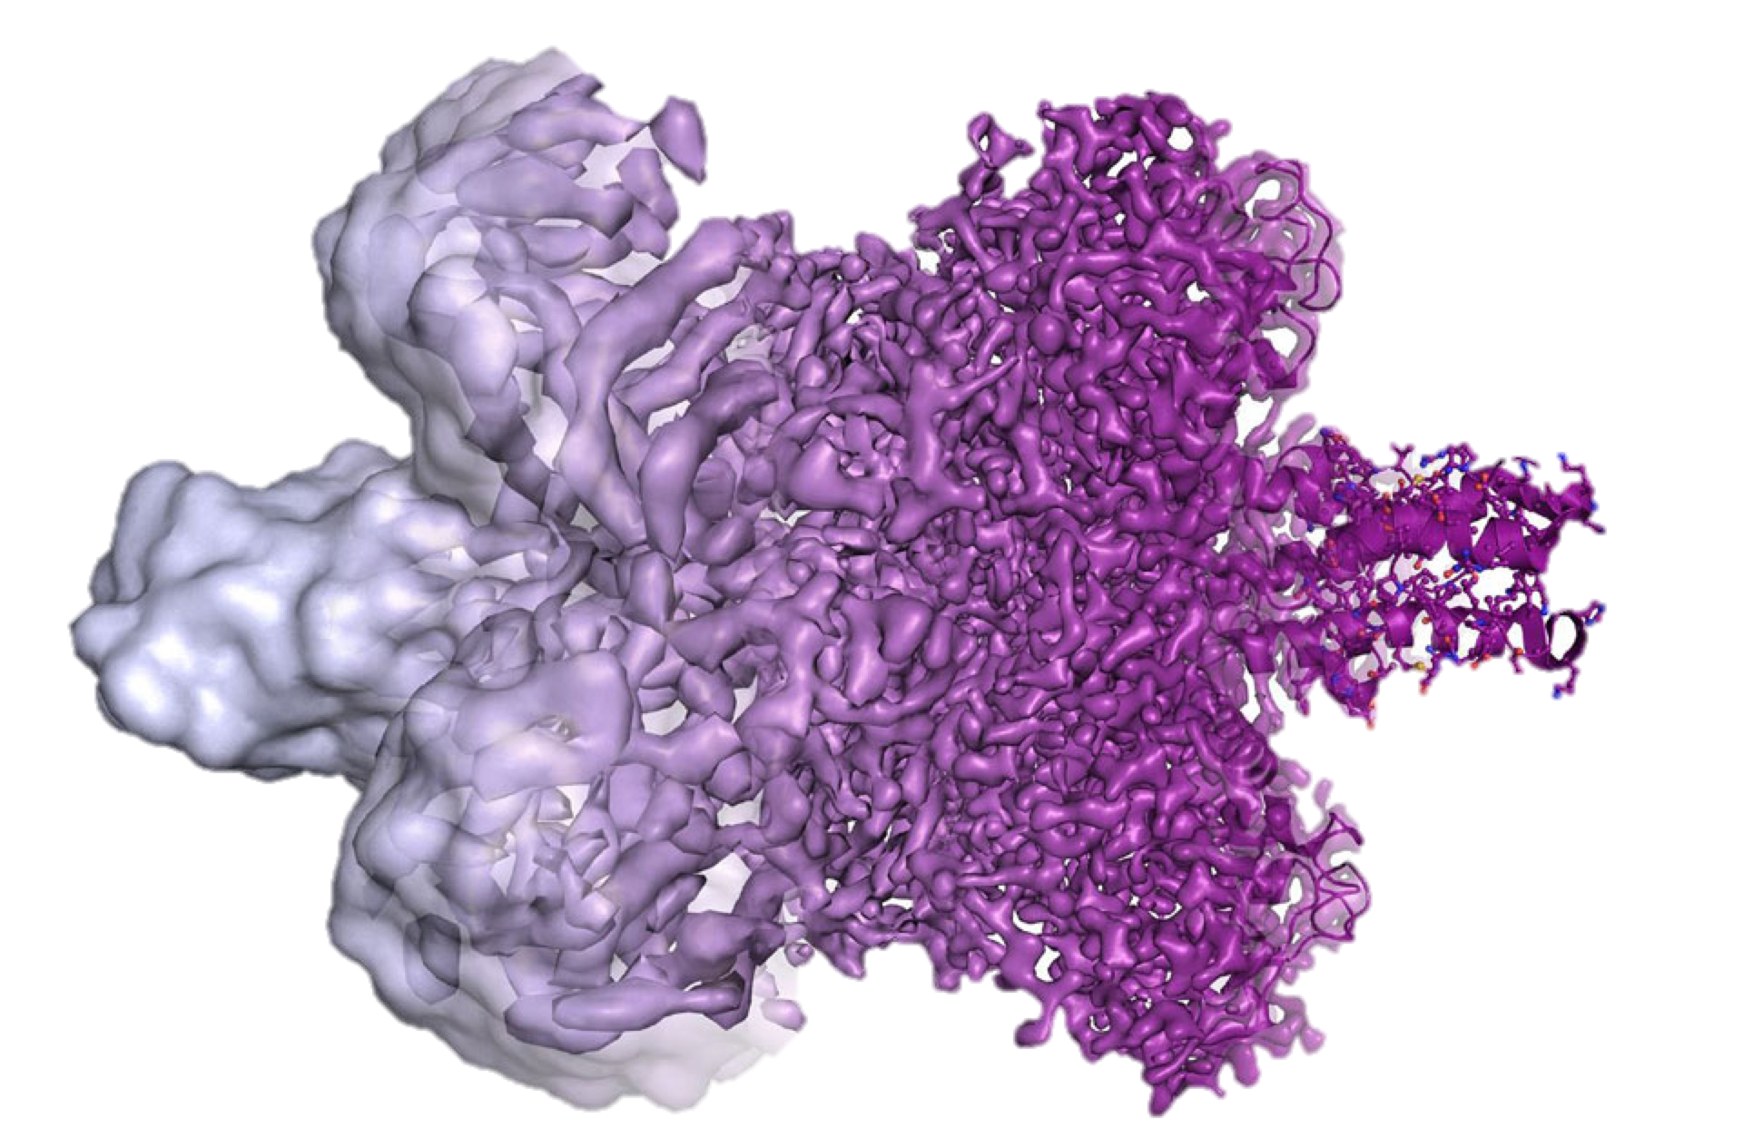
Architecture Specialization for Science
(hardware is design around the algorithms) can’t design effective hardware without applied math
Materials
Density Functional Theory (DFT)
Use O(n) algorithm
Dominated by FFTs
FPGA or ASIC
CryoEM Accelerator
LBNL detector
750 GB / sec
Custom ASIC near detector
Genomics Accelerator
String matching
Hashing
2-8bit (ACTG)
FPGA
Digital fluid Accelerator
3D integration
Petascale chip
1024-layers
General / special HPC solution
This needs to be done in close collaboration with applied mathematics
You cannot specialize effectively without deep understanding of the algorithmic target for those specializations
Need to know degrees of freedom for reformulating the mathematics to match hardware strengths
Notes:
Where are the applied Mathematicians? They are in DOE! WE cannot be successful without applied math
Project 38 → Sherry Li and Sam have been working with us.
Forward Reference to Dave Donofrio Presentation on CryoEM
1) “Nvidia Responds to Google TPU Benchmarking” in HPCWire, April 10, 2017.
2) Scientists engineered a new magnetic ferroelectric at the atomic-scale. A false-colored electron microscopy image shows alternating lutetium (yellow) and iron (blue) atomic planes. An extra plane of iron atoms was inserted every ten repeats, substantially changing the magnetic properties. A major path to reducing energy consumption in digital electronics involves such ferroic materials. Ramamoorthy Ramesh
3. This multi-qubit chip from Irfan Siddiqi’s Lab at UC Berkleey has five superconducting transmon qubits and associated readout resonators. When cooled to absolute zero, such a device can compute things like quantum simulations of advanced materials.

Slide 39
Programming Model Research Issues for Custom Acceleration
Efforts to date are very “artisan” and not scalable…
Need systematic mathematical approach to improve data locality (transform from sequential to pipelined)
  Tensor-based formulations from Thom Popovici for (multidimensional FFTs) and Benoit Meister (linear algebra)
Polyhedral methods are good choice to go from mathematical formulation to automation in compilers
  Move from systematic and interoperable mathematical model to polyhedral model to automate loop transformations
In the long run: accelerate design of accelerators with HW/SW IR
  Expand the mathematical discipline of going from procedural to dataflow across broader algorithm space (sparse problems)
  Have the intermediate representation express both hardware *and* software elements (enables hierarchical abstraction)

Slide 40
Breaking Out of The Chip
Ultra-Performance co-packaged optics/networking for resource disaggregation

Slide 41
Why we Need More Package Escape Bandwidth
Eliminate Memory Bandwidth/Capacity Dichotomy (old problem)
  I can get bandwidth OR capacity
  But I can’t get both in the same package!
Integration of Diverse Hardware Accelerators (new problem)
  Need more flexible (less area-limited) approach to hetero-integration
  Currently limited by copper reach (bandwidth vs. distance)
Rack Disaggregation (a potential remedy to both of the above)
  Limited bandwidth inhibits effectiveness of disaggregation
  Need ultra-low-latency to minimize bandwidth-delay product (balance Little’s Law Concurrency=BW * Latency)
Notes:
This is a solution that has been waiting in the wings for a long time, but never quite gets off the ground due to ineffective chip escape bandwidth

Slide 42
Diverse Node Configurations for Diverse Workload Resource Requirements
Training
  8 connections: GPU
  8 links to HBM (weights)
  8 links: to NVRAM
  1 links: to CPU (control)
Data Mining
  6-links: HBM
  15 links: NVRAM (capacity)
  4 links: CPU (branchy code)
Inference
  16 links to TOR (streaming data)
  8 links HBM (weights)
  1 link: CPU
Graph Analytics
  16 links HBM
  8 links TOR
  1 Link CPU
TOR
NVRAM
GPU
HBM
CPU

Slide 43
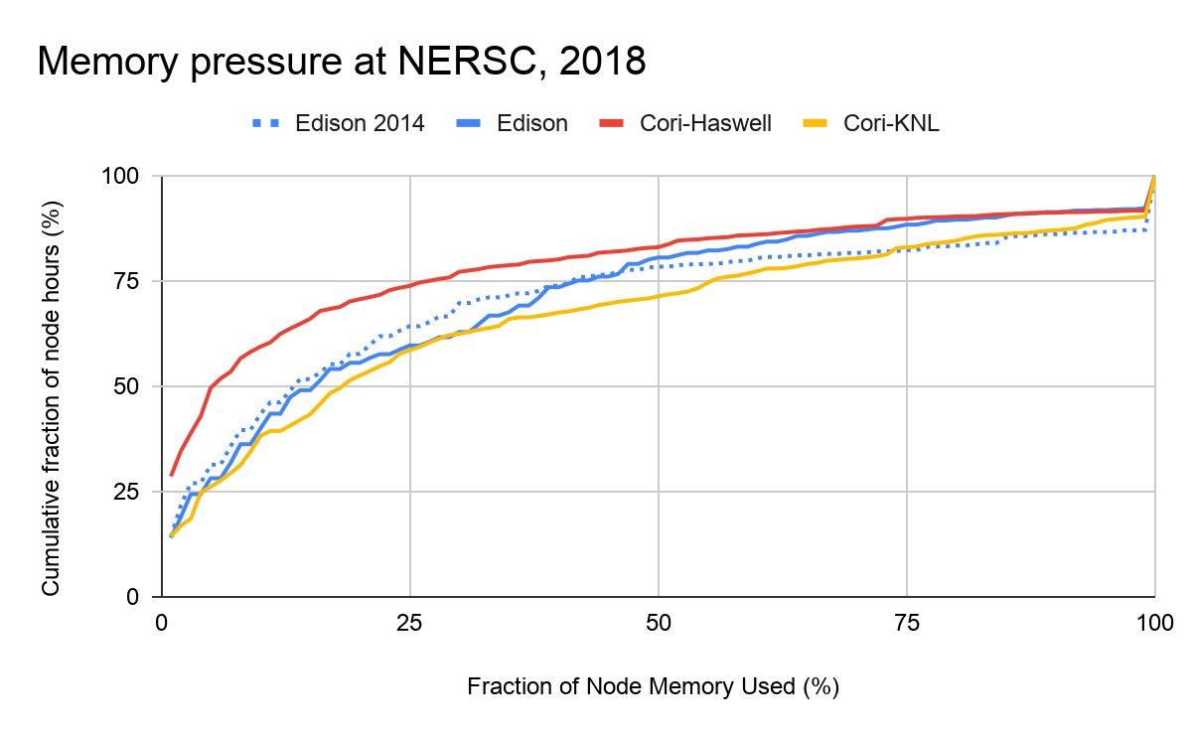
Diverse Capacity Requirements Drive Need for Memory Disaggregation
About 15% of NERSC workload uses more than 75% of the available memory per node.
And ~25% uses more than 50% of available memory.
But 75% of Haswell job hours (60% of KNL) use < 25% memory
Overestimate: maxrss x ranks_per_node
Assumes memory balance across MPI ranks.
Brian Austin: NERSC Workload Analysis
Notes:
Notice spike at 100% - these are the jobs that reported memory use that is physically impossible (more than installed memory)

Slide 44
Disaggregated Node/Rack Architecture
Current server
Disaggregated rack
SSD
SSD
RAM
RAM
RAM
RAM
RAM
RAM
RAM
RAM
RAM
SSD
RAM
CPU
GPU
CPU
CPU
GPU
GPU
CPU
CPU
GPU
GPU
Pool and compose
Current rack
SSD
RAM
RAM
RAM
RAM
SSD
RAM
SSD
RAM
CPU
GPU
CPU
GPU
CPU
CPU
GPU
RAM
RAM
RAM
RAM
RAM
RAM
RAM
SSD
RAM
SSD
RAM
SSD
GPU
RAM
GPU
CPU
GPU
CPU
GPU
GPU
CPU
CPU
Most solutions current disaggregation solutions use Interconnect bandwidth (1 – 10 GB/s)
But this is significantly inferior to RAM bandwidth (100 GB/s – 1 TB/s)

Slide 45
Package Limited Bandwidth
Its been a problem for years,
But we need to claw this back
for disaggregation to work
Source: J. Poulton, Nvidia

Slide 46
Package Performance is Pin Limited
High SERDES rates run
counter to end of
Dennard Scaling
Source: J. Poulton, Nvidia

Slide 47
Datacenters: Worsten climate change without ultra-energy-efficiency
And data movement dominates that power consumption
Gordon Keeler
DARPA
Source: Gordon Keeler (DARPA)
January 2021 SRC report projects datacenter energy growth rates will lead to ~25% consumption of planetary energy by 2040.
Data movement is a dominant contributor to that power consumption

Slide 48
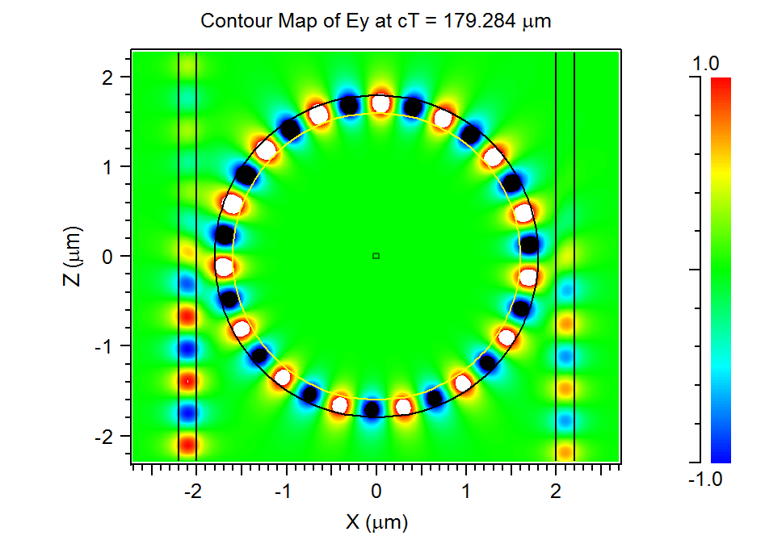
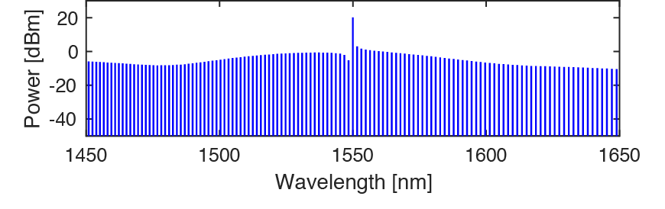
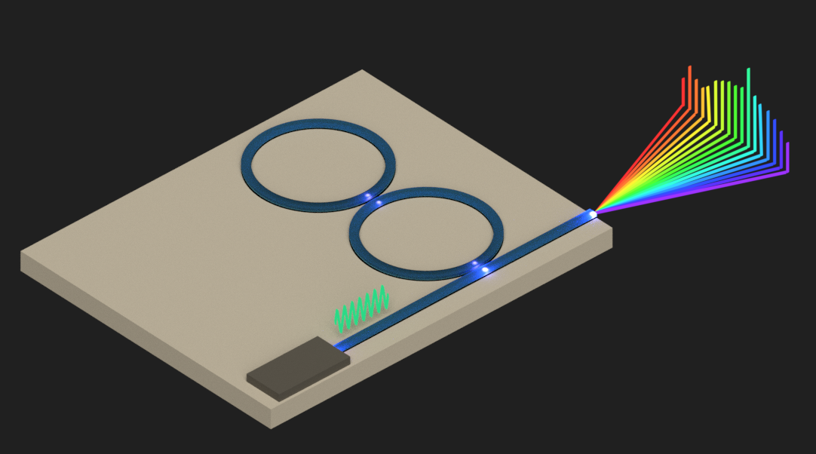
Impedance Matching to Packaging Technology
In-package integration
Solder Microbumps
& Copper Pillars@~10Gbps
Wide and Slow!
DWDM Using Silicon Photonics
Ring Resonators @ ~10-25 Gb/sec per chan
Many channels to get bandwidth density
Wide and Slow!
Comb Laser Sources
Single laser to efficiently generate 100s of frequencies
Wide and Slow!

Slide 49
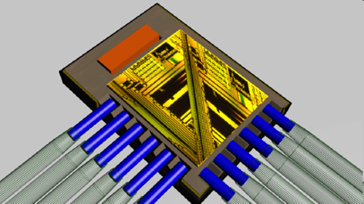



Photonic MCM (Multi-Chip Module)
data
data
data
clk
clk
data
TIA
TIA
TIA
clk gen
clk
R
clk
clk
clk
C
Silicon waveguide
Silicon waveguide
Comb Laser Source with
DWDM Silicon Photonics
Wide-and Slow for high speed links
Photonic SiP
49

Slide 50





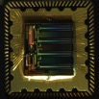


Photonic MCM (Multi-Chip Module)
Fiber carrying 0.5 - 1 Tb/s
CPU
GPU
RAM
NVM
CPU/GPU
Packet Switching MCM
Compute MCM
Fiber coupler
pitch: 10s of um
High-Density fiber coupling array
with 24 fibers = 6-12 Tb/s bi-directional = 0.75 – 1.5 TB/s
To other nodes
Photonic SiP
HBM MCM
NVRAM MCM
HBM MCM
NVM
NVM
NVM
NVM
Optical switch
50

Slide 51
Configure for Training
Configure for Inference

Slide 52
Anatomy of a “Value” Metric
Good Stuff
Bad Stuff

Slide 53
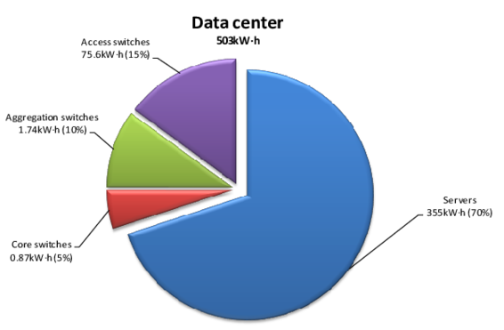
Anatomy of a “Value” Metric
Increase performance with Disaggregation
And Bandwidth Steering!
Deliver bandwidth to where it is needed
By taking it from where it isn’t
Performance
Measured Watt
30% of datacenter power goes to network
So max savings by creating infinitely efficient
optical interconnect is 30%!
Exploit the unique properties of photonics to improve both numerator and denominator!

Slide 54
PINE: Photonic Integrated Networked Energy Efficient Datacenters
Resource Disaggregation to custom-assemble diverse accelerators for diverse workload requirements
1) Energy-bandwidth optimized optical links | 2) Embedded silicon photonics into OC-MCMs | 3) Bandwidth steering for Custom Node Connectivity
data
data
data
data
TIA
TIA
TIA
clk gen
clk
clk
clk
R
clk
clk
clk
C
Silicon waveguide
Silicon waveguide
ENLITENED
54

Slide 55
The Future of Computing is Heterogeneous Acceleration
Convergence of HPC and Datacenter fabrics
Integration of Diverse Hardware Accelerators
  Need more flexible (less area-limited) approach to hetero-integration
  Currently limited by copper reach (bandwidth vs. distance)
Rack Disaggregation
  Limited bandwidth inhibits effectiveness of disaggregation
  Need ultra-low-latency to minimize bandwidth-delay product

Slide 57
Industry: Heterogeneous Integration Roadmap
http://eps.ieee.org/hir
HPC and Megadatacenters is 2nd chapter
Notes:
These are the people who started ITRS
Roadmap necessary for manufacturing equipment

Slide 58
Datacenters: Worsten climate change without ultra-energy-efficiency
And data movement dominates that power consumption
Gordon Keeler
DARPA
Source: Gordon Keeler (DARPA)
January 2021 SRC report projects datacenter energy growth rates will lead to ~25% consumption of planetary energy by 2040.
Data movement is a dominant contributor to that power consumption

Slide 59
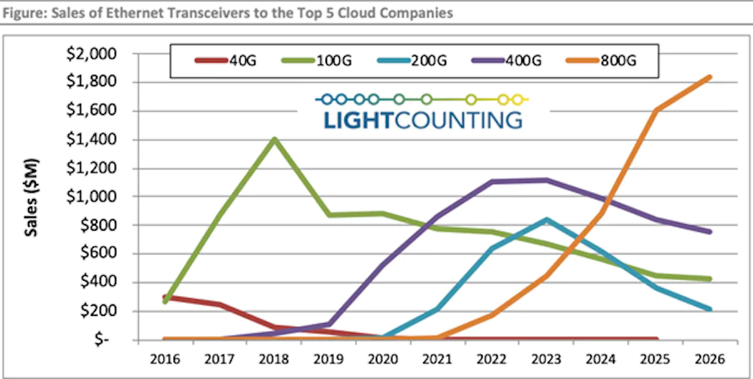
800Gig Optical Transceiver Sales Growth
Nearly all practical implementations of 800Gb are Silicon Photonics based DWDM

