Slide 1
HPC: Where We Are Today And A Look Into The Future
Jack Dongarra
University of Tennessee

Slide 2
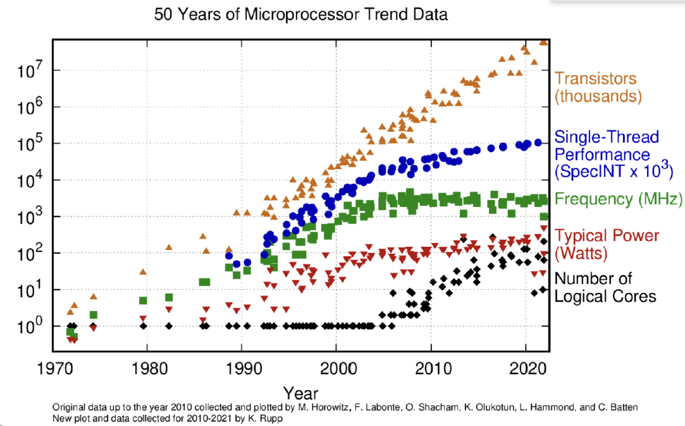
The Message
Computing is in rapid transition
  Smartphones and cloud services are eating the world
HPC change is also in the wind
  Greater performance now requires more $, €, ¥
Transistors are getting more expensive
  End of Dennard scaling and slowing of Moore’s Law
Loci of technology innovation and money have shifted

Slide 3
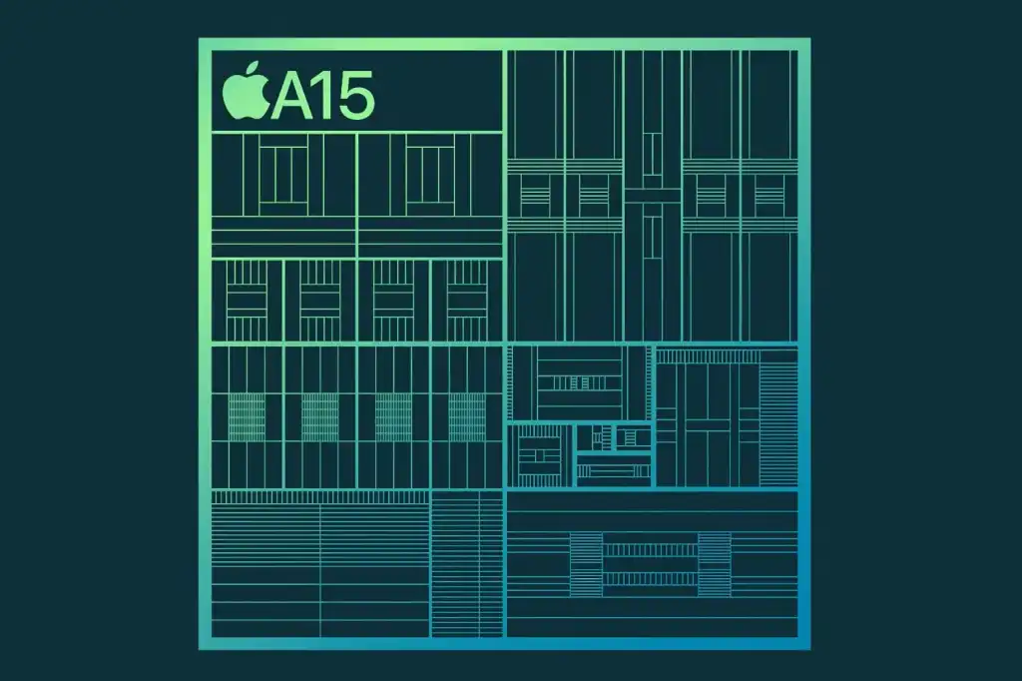
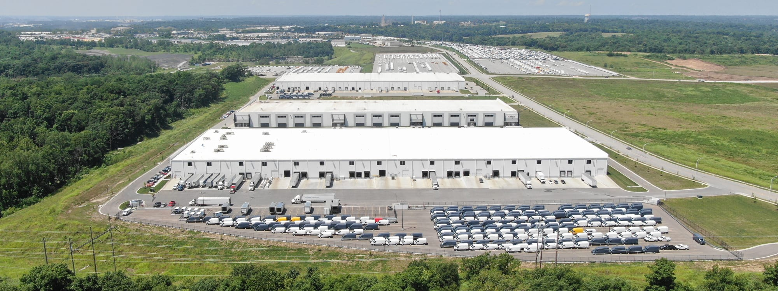
A Changing World
Computing pervades all aspects of society
  Socialization and communication
  E-commerce and business
  Research and development
Apple, Samsung, and Google
  Dominate the world of smartphones
  Design their own silicon
Google, Microsoft, Amazon, Facebook
  Dominate the NASDAQ (market cap > $1T)
  Baidu, Alibaba, and TenCent are not far behind
  Also designing their own silicon

Slide 4
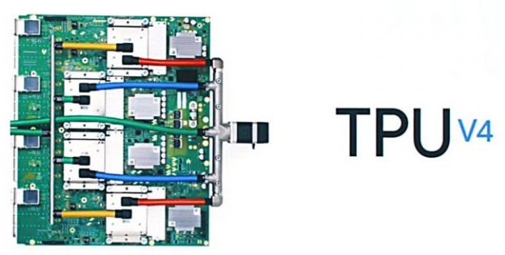
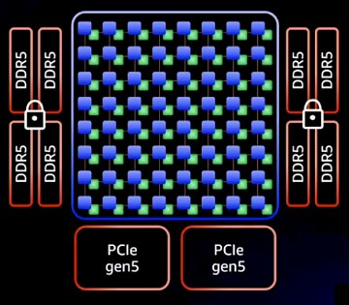
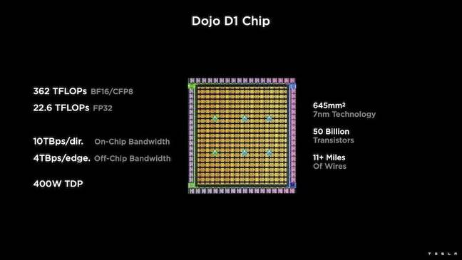
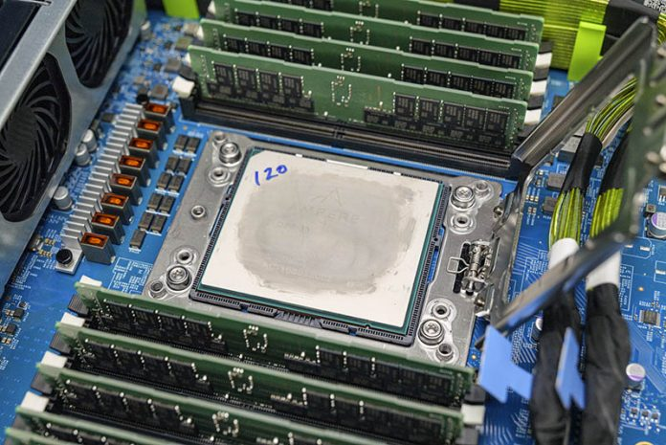
Cloud vendors
Google TPU4
  2X TPU3 performance
  4096 units per “pod”
AWS Graviton3
  64 ARM Neoverse V1 cores, chiplet design
  55 billion transistors, DDR5 memory
  Microsoft Azure
    Ampere Alta ARM processors
    Project Catapult/Brainewave
Even car makers
Tesla

Slide 5
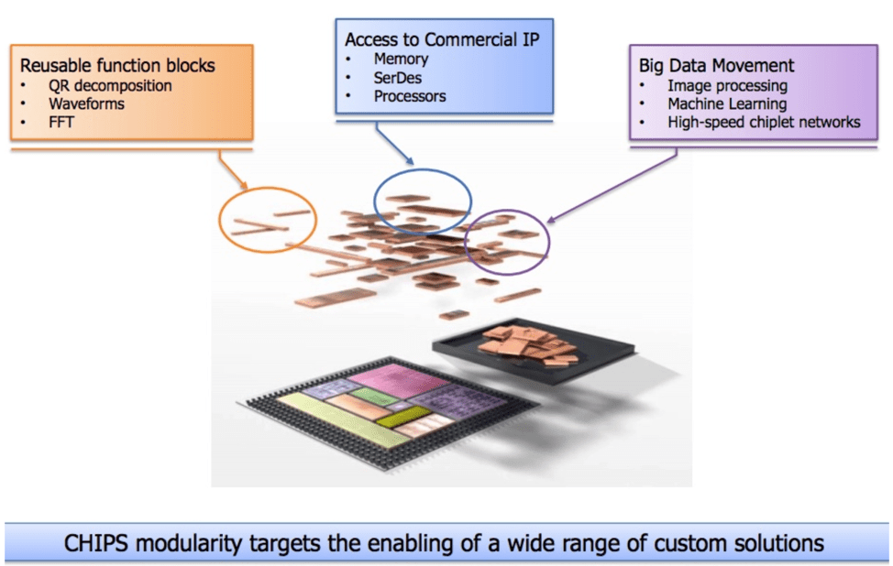
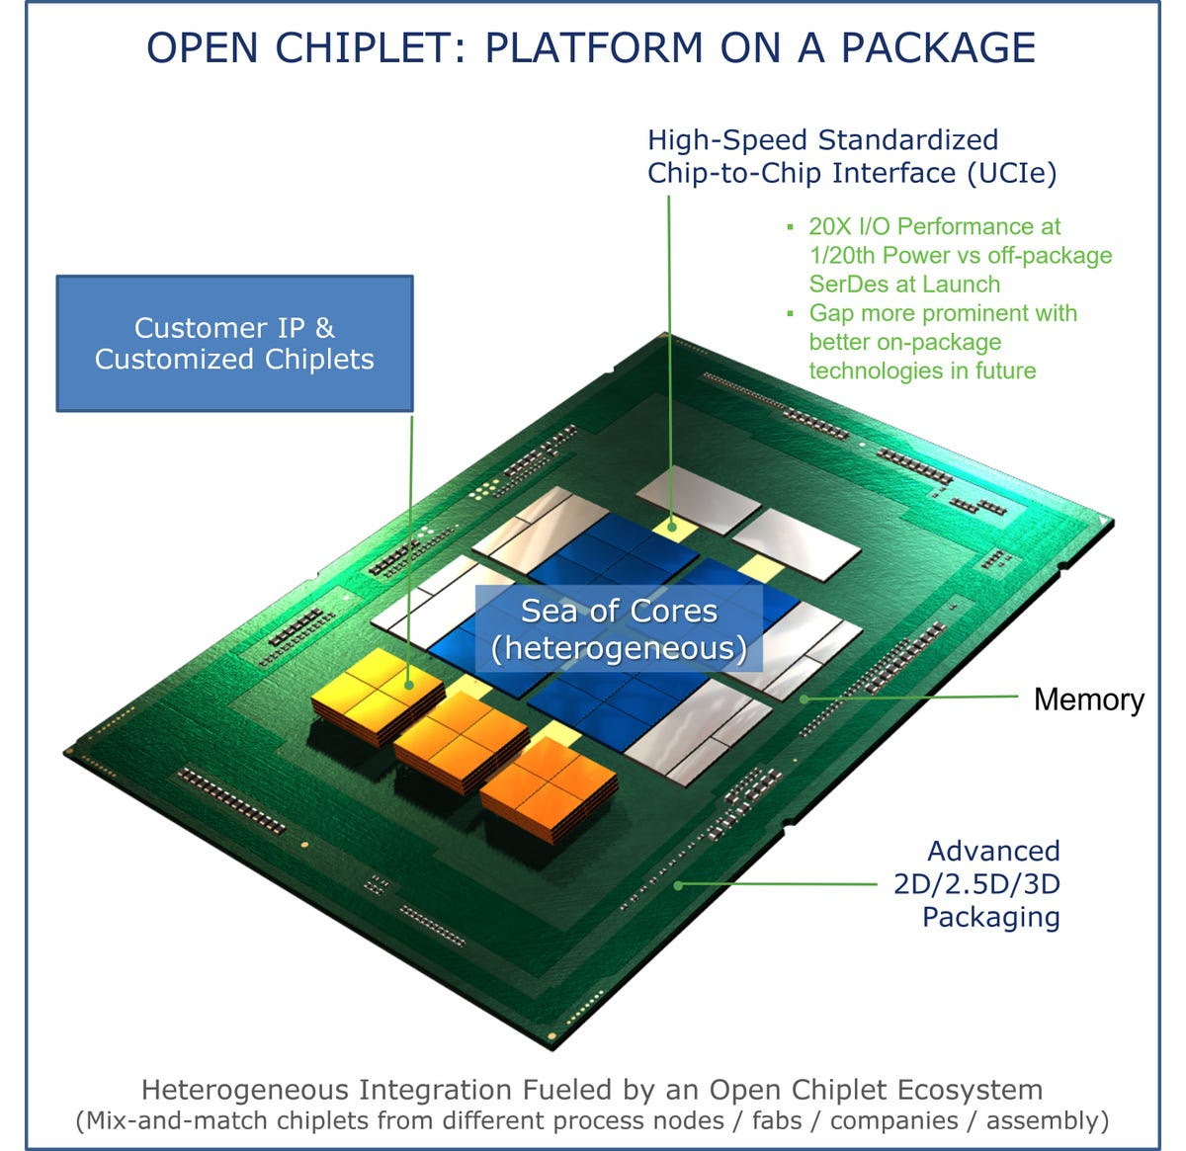
Chiplets: Integrating Multiple Functions
Rather than fabricating a monolithic system-on-a-chip, chiplet technology combines multiple chips, each representing a portion of the desired functionality, possibly fabricated using different processes by different vendors and perhaps including IP from multiple sources
Chiplet designs are part of the recent offerings from Intel and AMD
  Amazon’s Graviton3 also uses a chiplet design with seven different chip dies
  Advanced Query Accelerator (AQUA) for AWS Redshift, Amazon’s powerful and popular data warehouse service, relies on a package of custom ASICs and FPGA accelerators

Slide 6
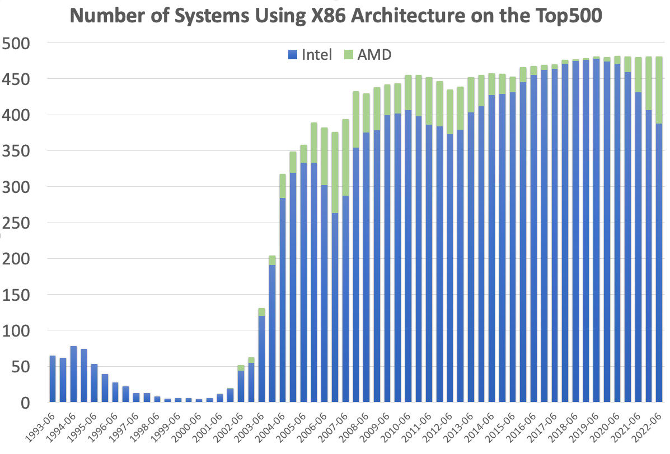
HPC Monoculture – Processors
TOP500 list began in 1993
  65 systems used Intel’s i860 architecture
  Remainder had specialized architectures
Most recent TOP500 list
  78% of systems used Intel processors
  Another 19% used AMD processors
97% of the systems use x86-64 architecture
    Many use GPU accelerators

Slide 7
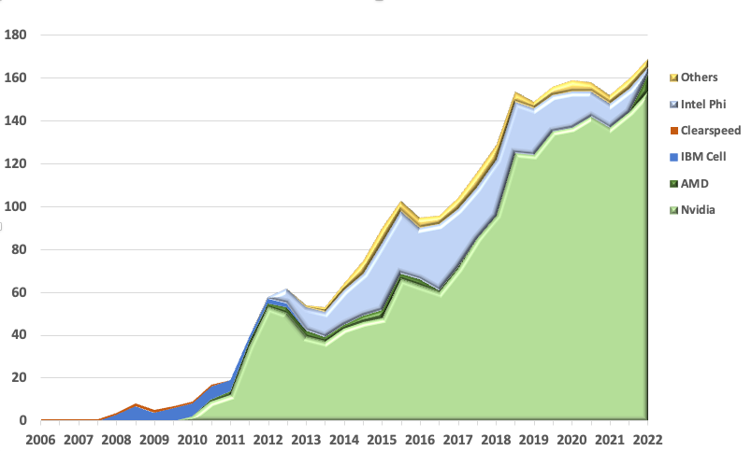
HPC Monoculture – Accelerators/Interconnects/OS
Nvidia dominates accelerators
Interconnects are Ethernet/InfiniBand
Linux is standard everywhere

Slide 8
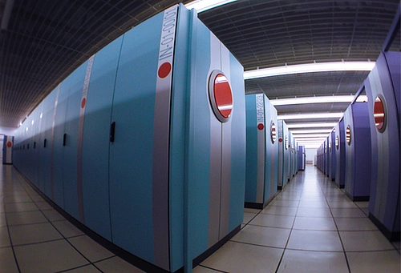
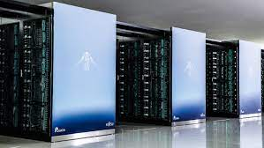
Japan and the United States
U.S. Advanced Simulation and Computing (ASC) program is driven by the national defense
  Systems have been used only for domestic missions
  Involved only modest investments in industrial R&D
  Relied on U.S. produced software and applications
  Commodity microprocessors (and later GPUs)
Japanese Earth Simulator (ES) developed for basic research
  No defense mission
  Access was shared internationally
  Major ES investment supported NEC’s SX-6 vector technology
  Software from abroad, modified and enhanced in Japan
Fujitsu’s development of the Fugaku supercomputer, based on custom processors with ARM cores and vector instructions, has followed in this Japanese tradition

Slide 9
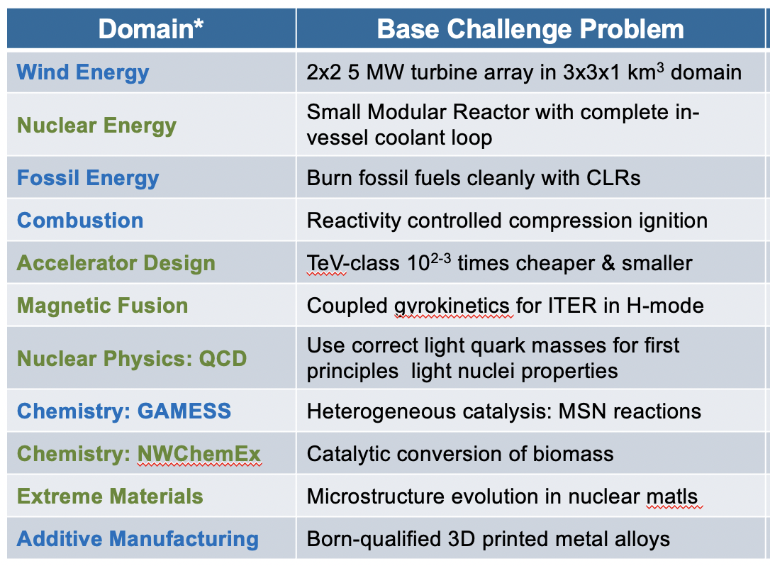
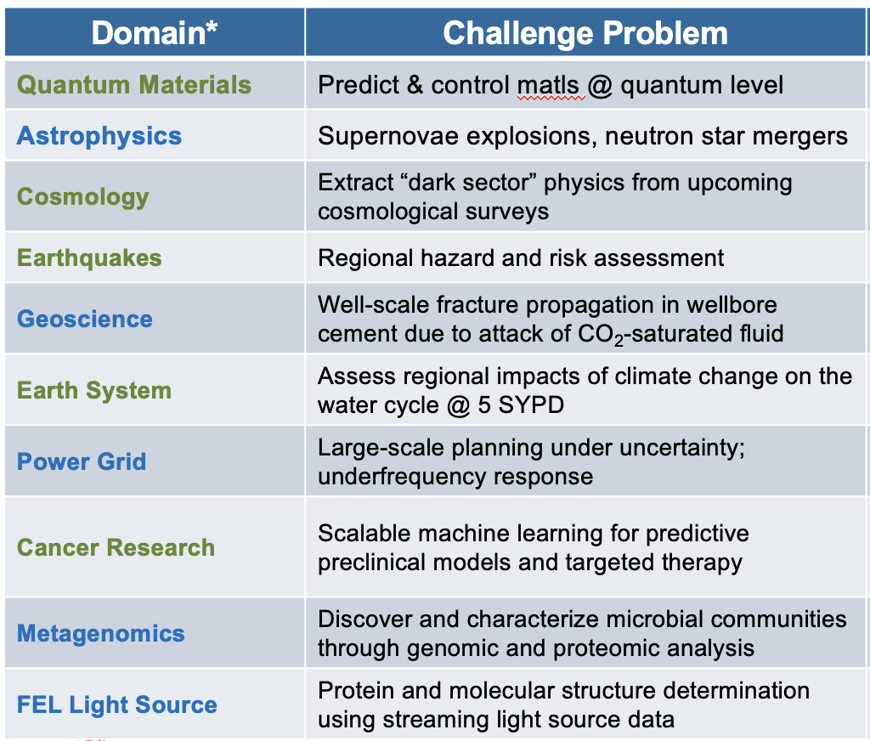
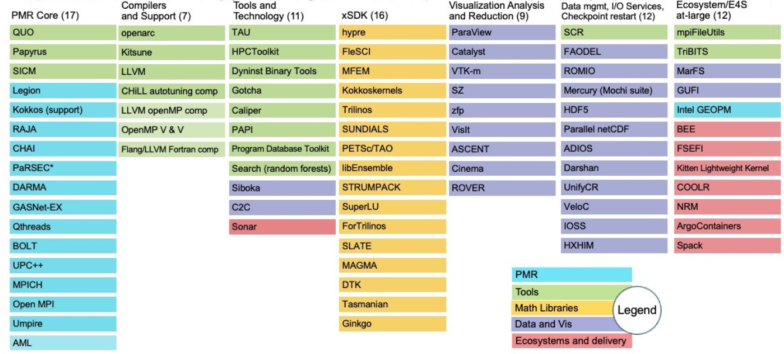
DOE: Exascale investing > $4 B in total, over 7 years
What do you get for $4 B?
3 computers
  $600M each
  $400M Non Reoccurring Engineering (NRE)
21 Applications
A bunch of software (84 projects)

Slide 10
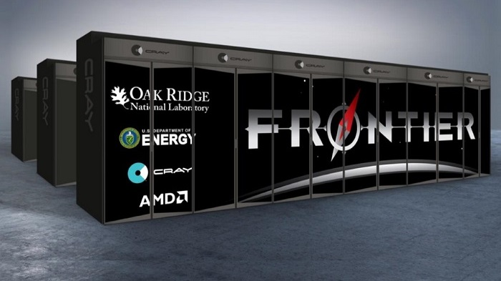
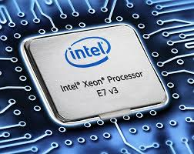
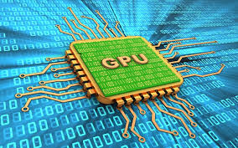
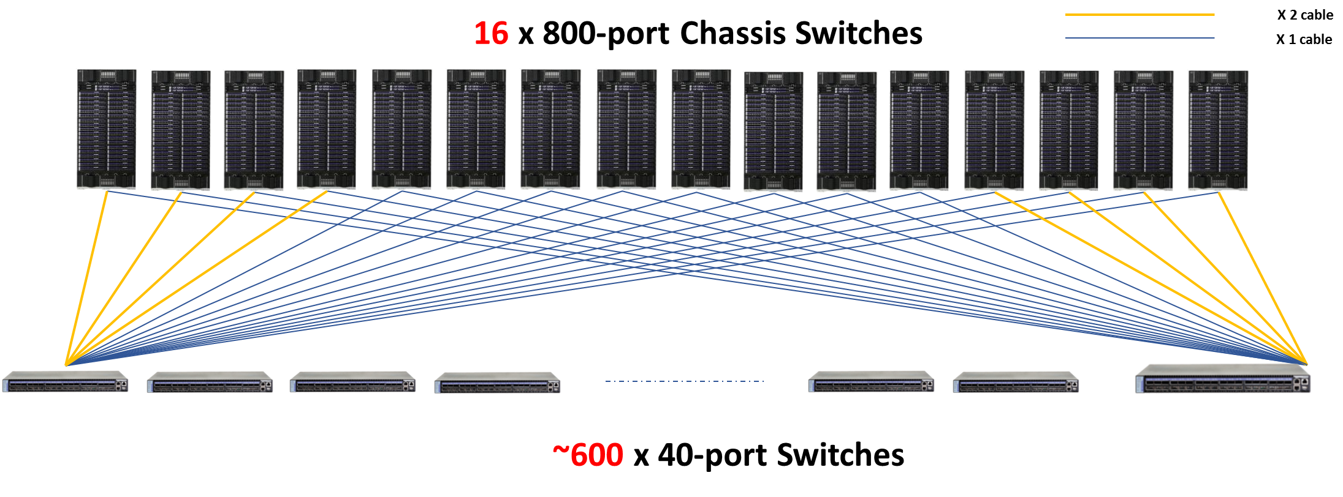
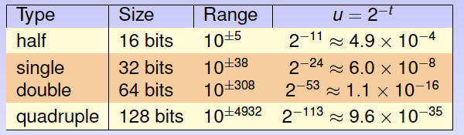
Today’s HPC Environment for Scientific Computing
ORNL Frontier, 2 Eflop/s,
8.8 x 10⁶ Cores, 9408 nodes, 30 MW
(node = 1-AMD CPU + 4-AMD GPUs)
> 98% of performance from GPUs
Highly parallel
  Distributed memory
  MPI + Open-MP programming model
Heterogeneous
  Commodity processors + GPU accelerators
Communication between parts very expensive compared to floating point ops
Floating point hardware at 64, 32, 16, & 8 bit levels

Slide 11
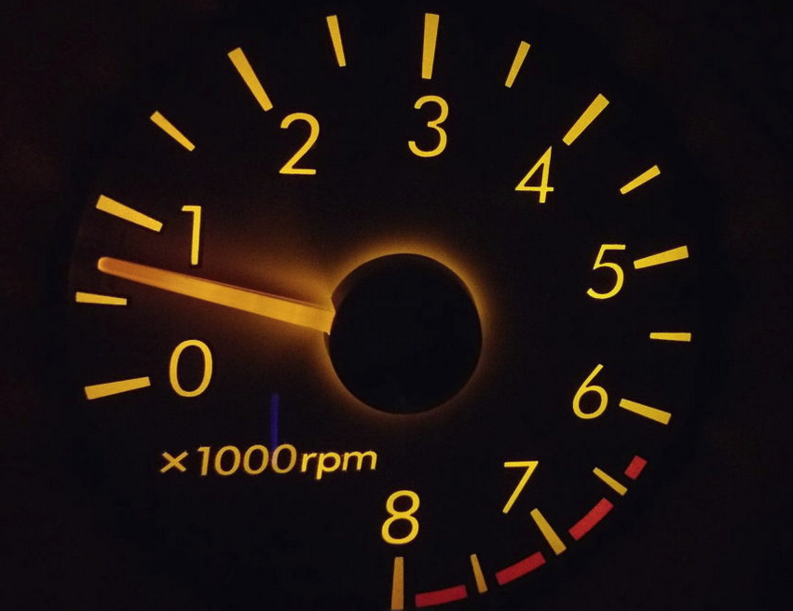

The Fastest Supercomputers are at an Exaflop.
What’s an Exaflop?
1 flop = Addition or Multiplication of 64-bit floating point numbers
Exaflop is a billion-billion (10¹⁸) floating point operations per second
If each person on Earth completed 1 calculation per second, it would take more than 4 years to do what an Exascale computer can do in 1 second.

Slide 12
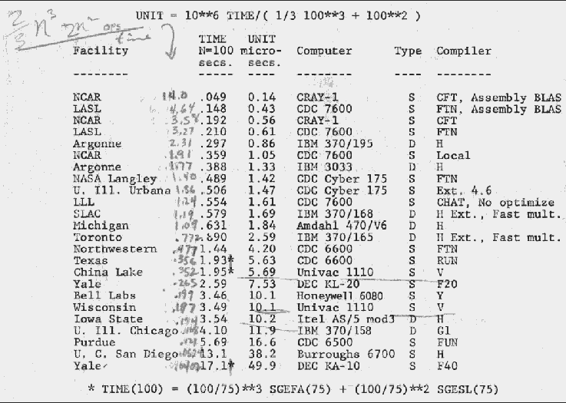
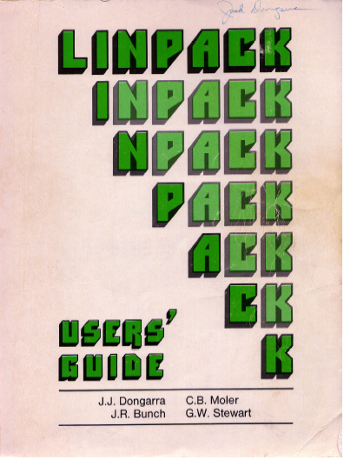
An Accidental Benchmarker
Appendix B of the Linpack Users’ Guide
  Designed to help users estimate the
  run time for solving systems of equation using the Linpack software.
First benchmark report from 1977;
  Cray 1 to DEC PDP-10
LINPACK was an NSF Project w/ ANL, UNM, UM, & UCSD
We worked independently and came to Argonne in the summers
Top 23 List from 1977
Performance of solving Ax=b using LINPACK software
1979
1979

Slide 13
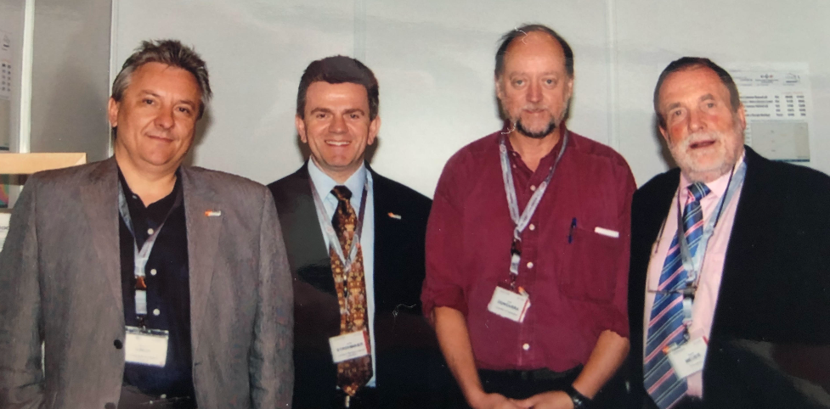

Top500 Since 1993
Hans Meuer and Erich Strohmaier had a list of fastest computers ranked by peak performance.
I had a list of benchmark results and we put the two lists together.
Listing of the 500 most powerful computers in the World.
Yardstick: Performance for
Ax=b, dense problem
Maintained and updated twice a year:
SC‘xy in the States in November
Meeting in Germany in June
TPP performance
Rate
Size

Slide 14
Performance Development of HPC over the Last 29 Years from the Top500
100 Eflop/s
10 Eflop/s
4.4 EFlop/s
1 Eflop/s
100 Pflop/s
1.1 EFlop/s
SUM
10 Pflop/s
#1 in 1997 - Hitachi CP-PAC with 2048 Processors at
Center for Computational Science, University of Tsukuba
1 Pflop/s
1.65 PFlop/s
100 Tflop/s
10 Tflop/s
N=1
1 Tflop/s
1.17 TFlop/s
My Laptop: 426 Gflop/s
100 Gflop/s
N=500
59.7 GFlop/s
Thinking Machine CM-5 with 1024 Processors at
Los Alamos Nat Lab used for nuclear weapons design
10 Gflop/s
1 Gflop/s
422 MFlop/s
100 Mflop/s
Notes:
Statistical significant inflection point in June 2008 for end of the list

Slide 15






June 2022: The TOP 10 Systems (52% of the Total Performance of Top500)
Rank | Site | Computer | Country | Cores | Rmax [Pflops] | % of Peak | Power [MW] | GFlops/Watt
1 | DOE / OS Oak Ridge Nat Lab | Frontier, HPE Cray Ex235a, AMD 3rd EPYC 64C, 2 GHz, AMD Instinct MI250X, Slingshot 10 | USA | 7,733,248 | 1,102 | 55 | 21.1 | 52.2
2 | RIKEN Center for Computational Science | Fugaku, ARM A64FX (48C, 2.2 GHz), Tofu D Interconnect | Japan | 7,299,072 | 442. | 82 | 29.9 | 14.8
3 | EuroHPC /CSC | LUMI, HPE Cray EX235a, AMD 3rd EPYC 64C, 2 GHz, AMD Instinct MI250X, Slingshot 10 | Finland | 1,268,736 | 152. | 71 | 2.94 | 51.6
4 | DOE / OS Oak Ridge Nat Lab | Summit, IBM Power 9 (22C, 3.0 GHz), NVIDIA GV100 (80C), Mellonox EDR | USA | 2,397,824 | 149. | 74 | 10.1 | 14.7
5 | DOE / NNSA L Livermore Nat Lab | Sierra, IBM Power 9 (22C, 3.1 GHz), NVIDIA GV100 (80C), Mellonox EDR | USA | 1,572,480 | 94.6 | 75 | 7.44 | 12.7
6 | National Super Computer Center in Wuxi | Sunway TaihuLight, SW26010 (260C), Custom Interconnect | China | 10,649,000 | 93.0 | 74 | 15.4 | 6.05
7 | DOE / OS NERSC - LBNL | Perlmutter HPE Cray EX235n, AMD EPYC 64C 2.45GHz, NVIDIA A100, Slingshot 10 | USA | 706,304 | 64.6 | 69 | 2.53 | 25.5
8 | NVIDIA Corporation | Selene NVIDIA DGX A100, AMD EPYC 7742 (64C, 2.25GHz), NVIDIA A100 (108C), Mellanox HDR | USA | 555,520 | 63.4 | 80 | 2.64 | 23.9
9 | National Super Computer Center in Guangzhou | Tianhe-2A NUDT, Xeon (12C) , MATRIX-2000 (128C) + Custom Interconnect | China | 4,981,760 | 61.4 | 61 | 18.5 | 3.32
10 | Grand Equipment Nat de Calcul GENCI-CINES | Bull Sequana XH2000 , AMD EPYC 7402 (24C, 2.8GHz), NVIDIA A100 (108C), Mellanox HDR/ParTec ParaStation ClusterSuite | France | 448,280 | 44.1 | 62 | 1.76 | 25.0
Notes:
So it's not that I want to beat China per se; it's that I want us to have parity with them. I don't want to rely on them for the chip technology embedded in the supercomputers we use for national security. I don't want to rely on them for the low level software that runs my supercomputer because they figured out the parallelism before we did. I don't want to rely on them, or anyone else, for my own standard of living, for my safety and security, for the inventions that propel us forward, for open dialog and communications, all of which rely on supercomputing. I want the U.S. to be self reliant, capable and responsible for our own prosperity. »•« If we are to be partners in a world of global competition, I want us to come from a position of strength based on the best U.S. industry, academia and the national labs have to offer. That's what put us and has kept us in the leadership role we enjoy today in supercomputing. It's imperative we now begin to push forward on the necessary technology to ensure a continued leadership position. The stakes are very high
5.2 X Titan
1.4 X all DOE

Slide 16

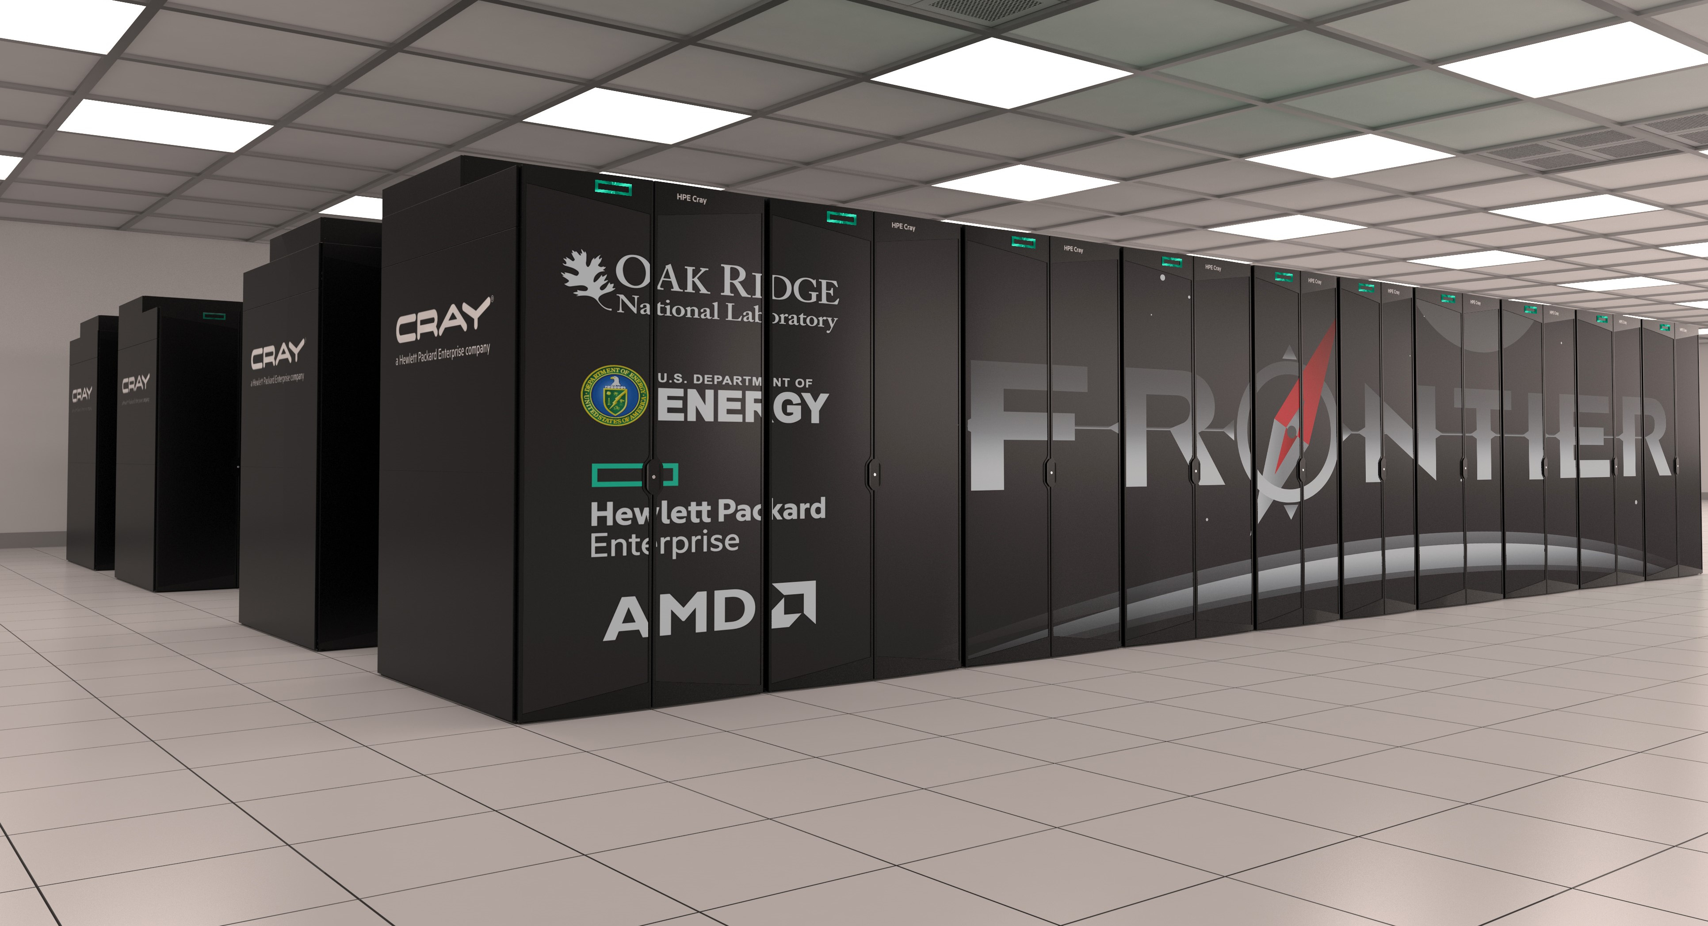
Current #1 System Overview
System Performance
Each node has
The system includes
Peak performance of 2 Eflop/s for modeling & simulation
Peak performance of 11.2 Eflop/s for 16 bit floating point used in for data analytics, ML, and artificial intelligence
  1-AMD EPYC 7A53 CPU w/64 cores (2 Tflop/s)
    < 1% performance of the system
  4-AMD Instinct MI250X GPUs
  Each w/220 cores (4*53 Tflop/s)
    99% performance of the system
  730 GB of fast memory
  2 TB of NVMe memory
  9408 nodes
    37,632 GPUs
    8.88M Cores
  Cray Slingshot interconnect
  706 PB (695 PB Disk + 11 PB SSD)

Slide 17
TOP500 Highlights From June 2022
ORNL’s Frontier is #1 in the TOP500, First Exascale System
  25% of the sum of the TOP500 performance contained in Frontier
  It performed at over 6.8 Exaflop/s on the HPL-AI using mixed precision algorithm (16-bit floating point arithmetic)
TOP10 has three new system, Lumi in Finland and Adastra in France.
  52% of the Top500 performance in the Top10
The entry level to the list is at 1.52 Pflop/s mark on the Linpack benchmark.
China: Top consumer and producer overall.
Intel processors largest share, 78% followed by AMD, 19%.

Slide 18
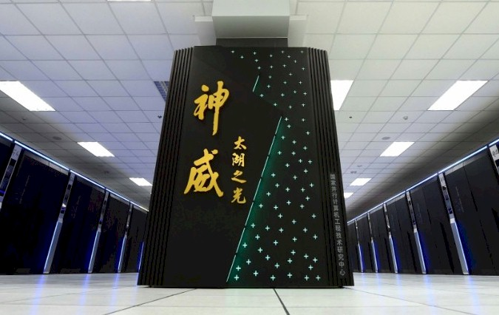
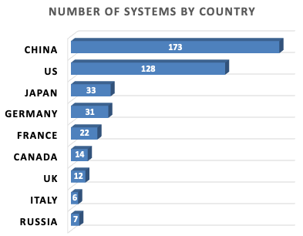
China
Rumored 2 Exascale Systems in Chinese
Qingdao Marine Sunway Pro "OceanLight" (Shandong Prov)
  Completed March 2021, 1.3 EFlops Rpeak and 1.05 EFlops Linpack
  ShenWei post-Alpha CPU ISA architecture with big & small core structure
  Est 96 cabinets x 1024 SW39010 390-core 35MW
  Science on this machine won Gordon Bell Prize in 2021
NSCC Tianjin Tianhe-3
  Dual-chip FeiTeng ARM and Matrix accelerator node architecture
  Est -1.7 EFlops Rpeak
China: Top consumer and producer overall.
5 main producers of HPC in China:
257 systems
Lenovo, Sugon, Inspur, Huawei, NUDT

Slide 19

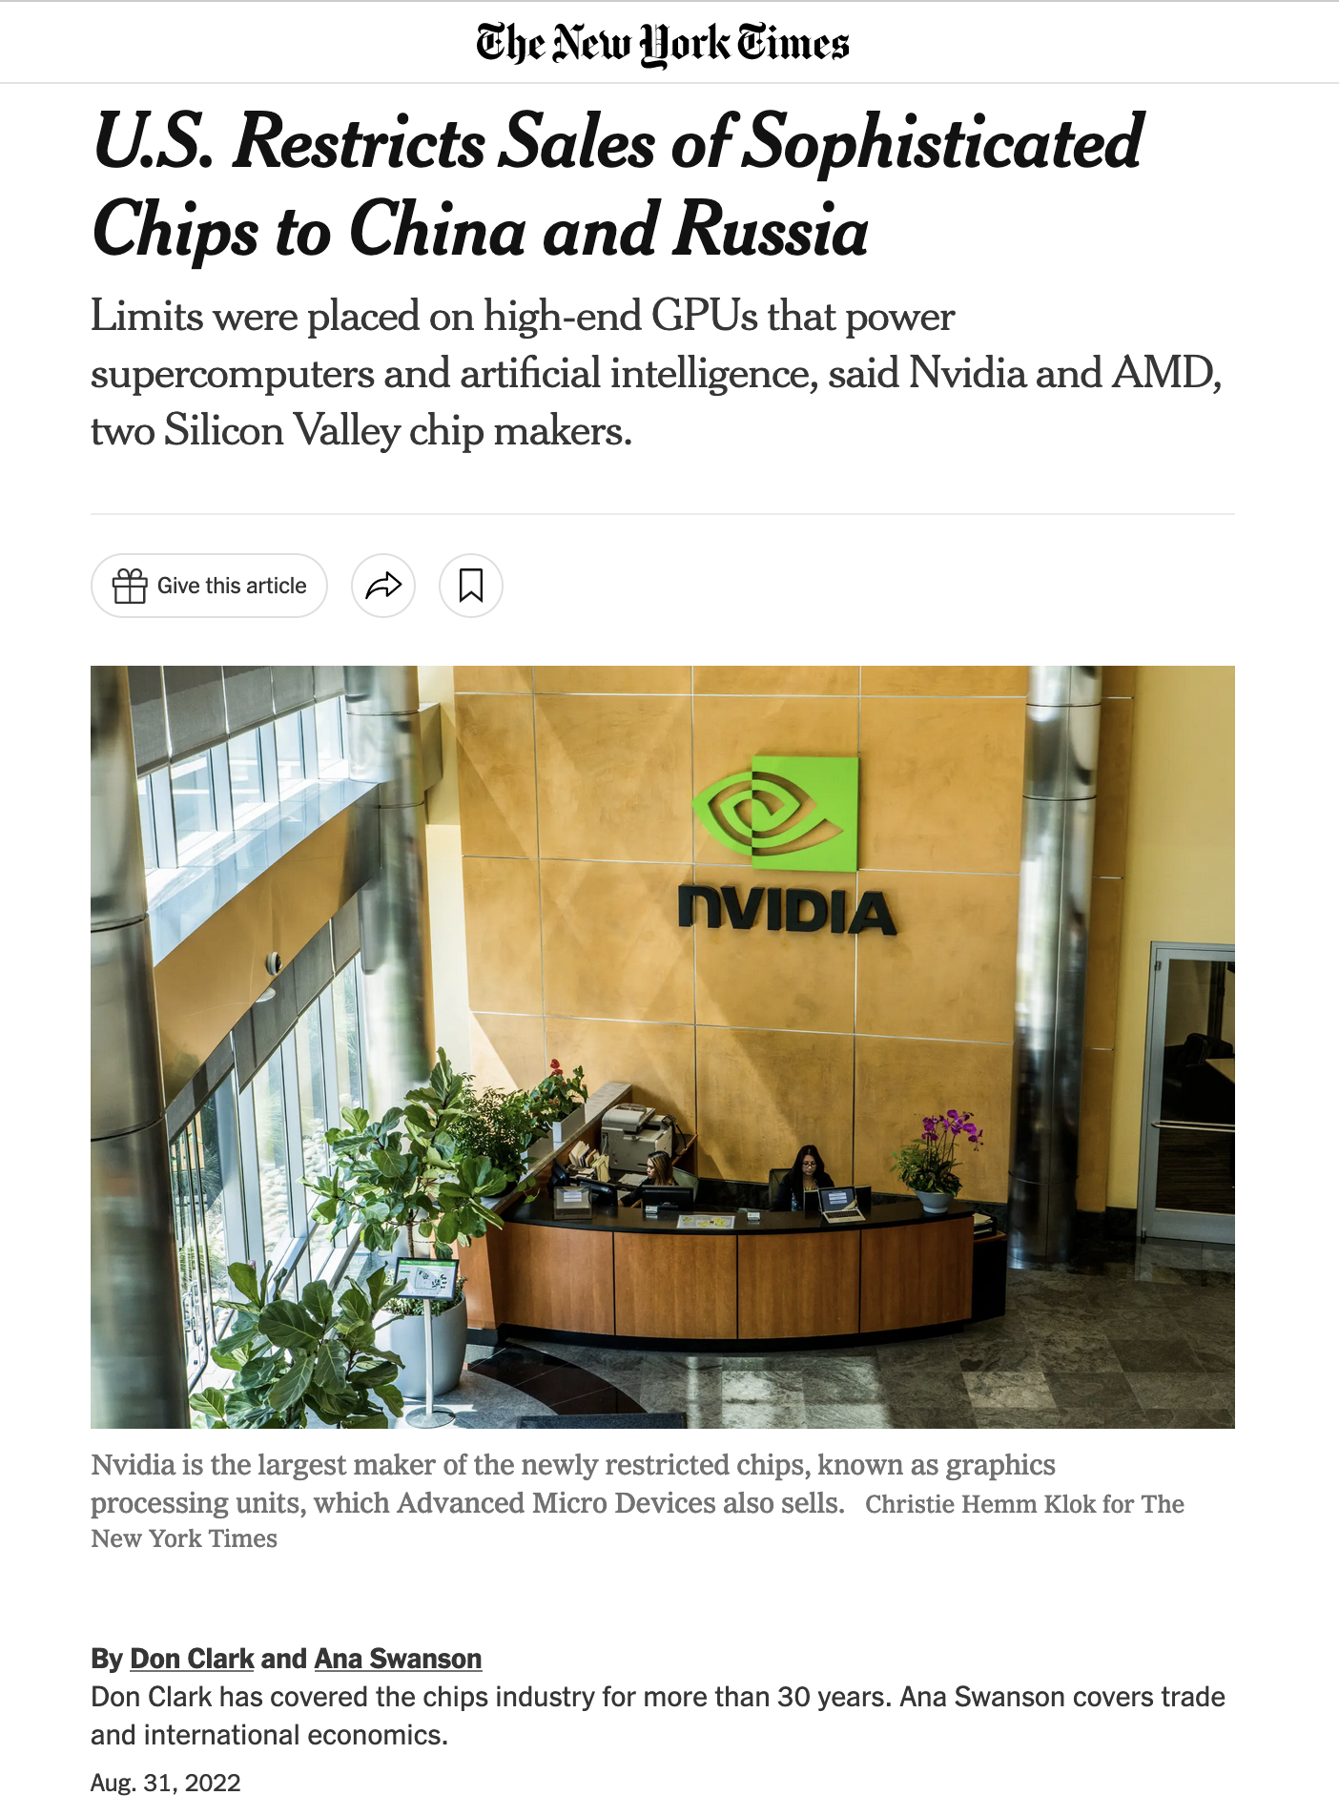
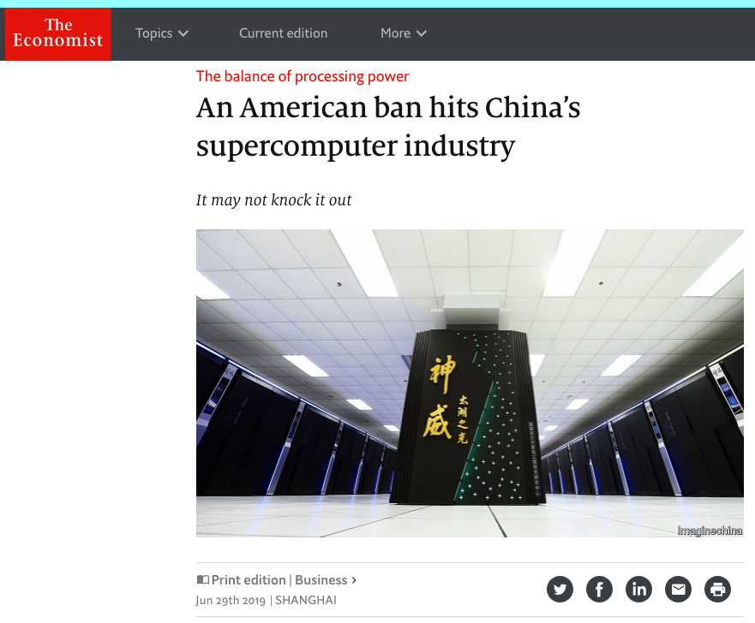

Slide 20
HPC, NRE, and the long tail
Goal of any business is maximizing profits
  Sell MANY units with LOW margin
  Sell a FEW units with HIGH margin
Margin is price MINUS costs
Costs include
  Non-recurring engineering (NRE)
  Manufacturing
  Sales, marketing, …
Performance
Top 10

Slide 21
Performance and Benchmarking Evaluation Tools
Linpack Benchmark - Longstanding benchmark started in 1979.
  Lots of positive features; easy to understand and run; shows trends
However, much has changed since 1979.
  Arithmetic was expensive then and today it is over previsioned and inexpensive
Linpack performance of computer systems is no longer strongly correlated to real application performance.
  Linpack benchmark based on dense matrix multiplication
Designing a system for good Linpack performance can lead to design choices that are wrong for today’s applications.

Slide 22
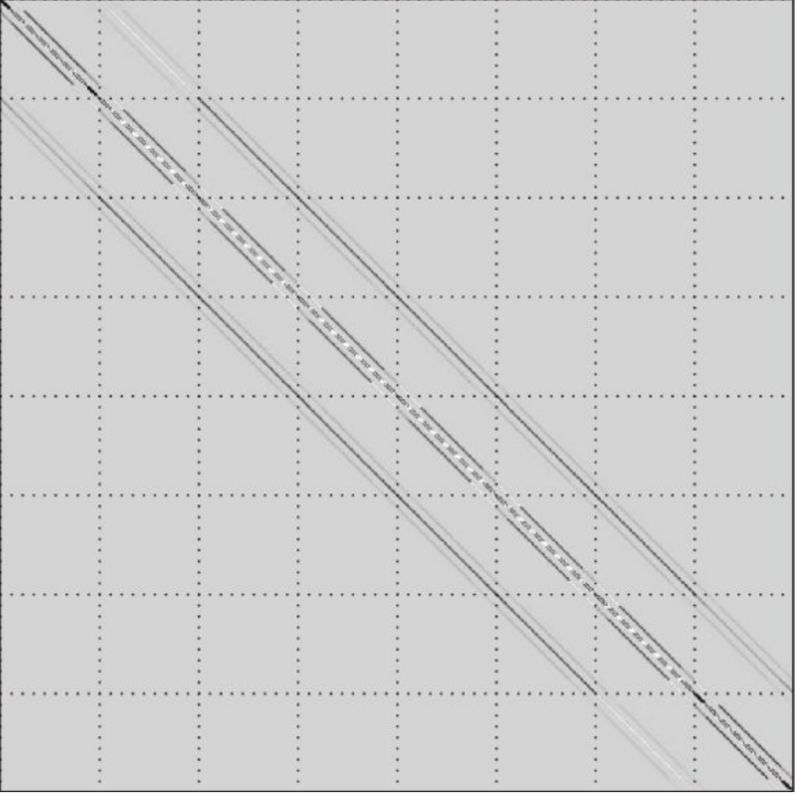
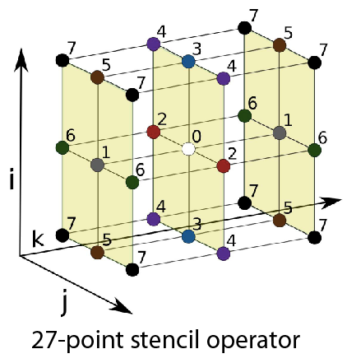
HPCG Results; The Other Benchmark
hpcg-benchmark.org
High Performance Conjugate Gradients (HPCG).
Solves Ax=b, A large, sparse, b known, x computed.
An optimized implementation of PCG contains essential computational and communication patterns that are prevalent in a variety of methods for discretization and numerical solution of PDEs
Patterns:
  Dense and sparse computations.
  Dense and sparse collectives.
  Multi-scale execution of kernels via MG (truncated) V cycle.
  Data-driven parallelism (unstructured sparse triangular solves).
Strong verification (via spectral properties of PCG).

Slide 23
HPCG Top 10, June 2022
Rank | Site | Computer | Cores | HPL Rmax (Pflop/s) | TOP500 Rank | HPCG (Pflop/s) | Fraction of Peak
1 | RIKEN Center for Computational Science Japan | Fugaku, Fujitsu A64FX 48C 2.2GHz, Tofu D, Fujitsu | 7,630,848 | 442 | 2 | 16.0 | 3.0%
2 | DOE/SC/ORNL USA | Summit, AC922, IBM POWER9 22C 3.7GHz, Dual-rail Mellanox FDR, NVIDIA Volta V100, IBM | 2,414,592 | 149 | 4 | 2.93 | 1.5%
3 | EuroHPC/CSC Finland | LUMI, HPE Cray EX235a, AMD Zen-3 (Milan) 64C 2GHz, AMD MI250X, Slingshot-11 | 1,110,144 | 152 | 3 | 1.94 | 0.9%
4 | DOE/SC/LBNL USA | Perlmutter, HPE Cray EX235n, AMD EPYC 7763 64C 2.45GHz, NVIDIA A100 SXM4 40 GB, Slingshot-10 | 761,856 | 70.9 | 7 | 1.91 | 2.0%
5 | DOE/NNSA/LLNL USA | Sierra, S922LC, IBM POWER9 20C 3.1 GHz, Mellanox EDR, NVIDIA Volta V100, IBM | 1,572,480 | 94.6 | 5 | 1.80 | 1.4%
6 | NVIDIA USA | Selene, DGX SuperPOD, AMD EPYC 7742 64C 2.25 GHz, Mellanox HDR, NVIDIA Ampere A100 | 555,520 | 63.5 | 8 | 1.62 | 2.0%
7 | Forschungszentrum Juelich (FZJ) Germany | JUWELS Booster Module, Bull Sequana XH2000 , AMD EPYC 7402 24C 2.8GHz, Mellanox HDR InfiniBand, NVIDIA Ampere A100, Atos | 449,280 | 44.1 | 11 | 1.28 | 1.8%
8 | Saudi Aramco Saudi Arabia | Dammam-7, Cray CS-Storm, Xeon Gold 6248 20C 2.5GHz, InfiniBand HDR 100, NVIDIA Volta V100, HPE | 672,520 | 22.4 | 18 | 0.88 | 1.6%
9 | Eni S.p.A. Italy | HPC5, PowerEdge, C4140, Xeon Gold 6252 24C 2.1 GHz, Mellanox HDR, NVIDIA Volta V100, Dell | 669,760 | 35.5 | 12 | 0.86 | 1.7%
10 | Information Technology Center, The University of Tokyo, Japan | Wisteria/BDEC-01 (Odyssey), PRIMEHPC FX1000, A64FX 48C 2.2GHz, Tofu D | 368,640 | 22.1 | 20 | 0.82 | 3.2%
Think of a race car that has the potential of 300 KPH but only goes 3 KPH!

Slide 24
Peak Performance
HPL Performance
Rank

Slide 25
Peak Performance
HPL Performance
HPCG Performance
Rank

Slide 26
Recently we have seen AI & ML take off
AI and ML have been around for a long time as research efforts.
Why Now?
  Flood of available data (especially with the Internet)
  Increasing computational power
  Growing progress in available algorithms and theory developed by researchers.
  Increasing support from industries.

Slide 27
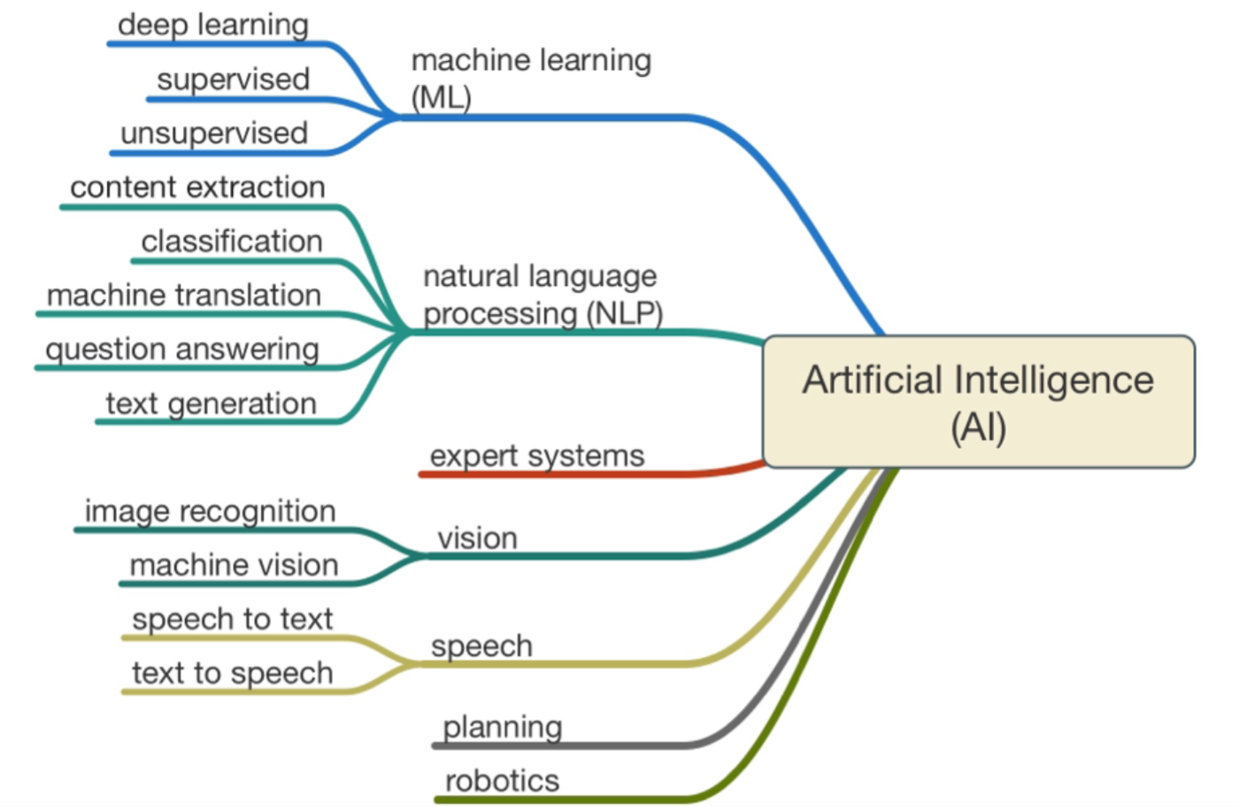

Slide 28
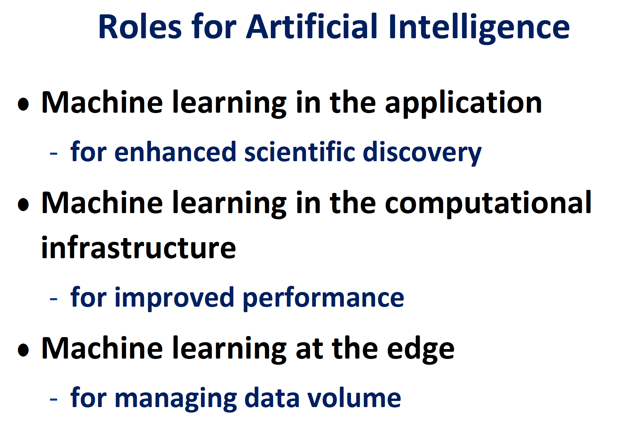

Slide 29


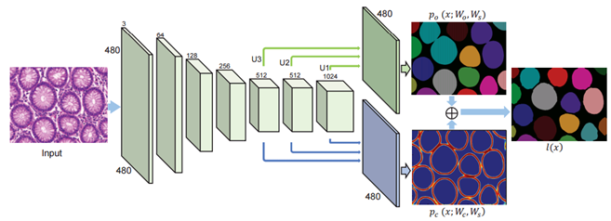
Machine Learning in Computational Science
Many fields are beginning to adopt machine learning to augment modeling and simulation methods
Climate
Biology
Drug Design
Epidemology
Materials
Cosmology
High-Energy Physics
Notes:
Machine learning is a subfield of computer science that evolved from the study of pattern recognition and computational learning theory in artificial intelligence.
Machine learning explores the study and construction of algorithms that can learn from and make predictions on data.
Recently there have been a number of breakthrough examples
Programs that can beat humans at the game of GO (which is much harder than Chess)
(computers used machine learning and played each other plus humans)
Programs that learn how to write letters and symbols after only one example…
Programs that can recognize handwriting with > 99.9 % accuracy
Programs that can identify objects in scenes
Programs that can drive cars (Tesla, Google)

Slide 30
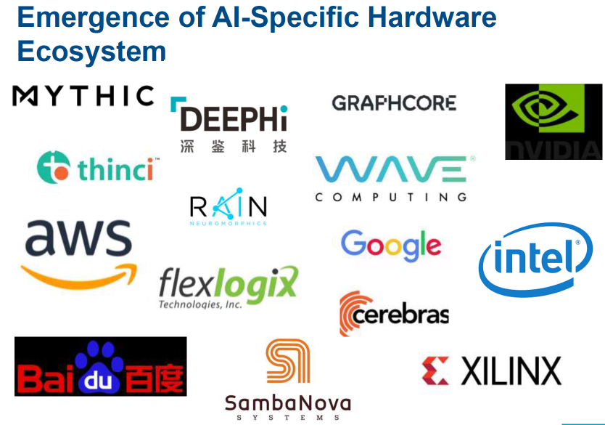
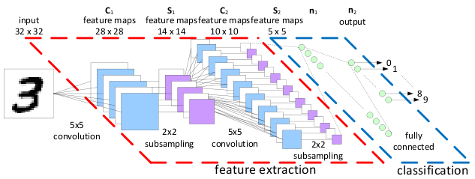
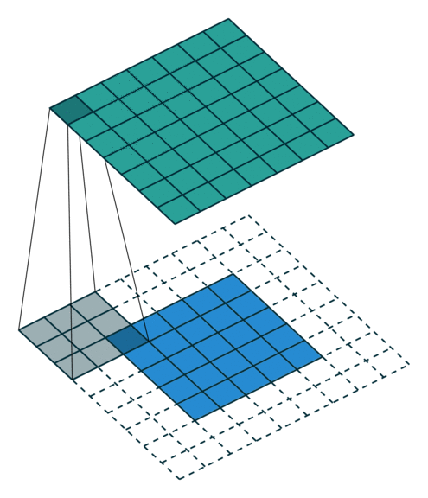
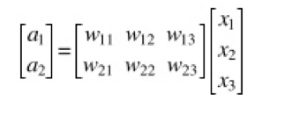
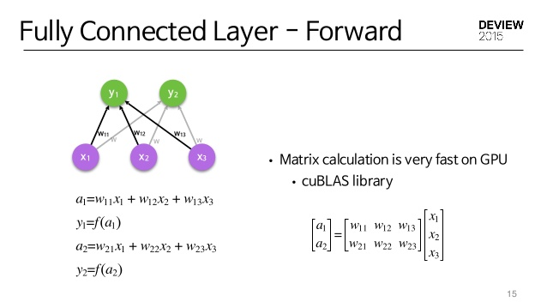
Deep Learning Needs Small Matrix Operations
Matrix Multiply is the time-consuming part.
Convolution Layers and Fully Connected Layers require matrix multiply
There are many GEMM’s of small matrices, perfectly parallel, can get by with 16-bit floating point
x₁
w₁₁
x₁
w₂₁
y₁
x₂
w₁₂
w₁₃
w₂₂
y₂
x₃
w₂₃
Convolution Step
In this case 3x3 GEMM
Fully Connected
Classification

Slide 31
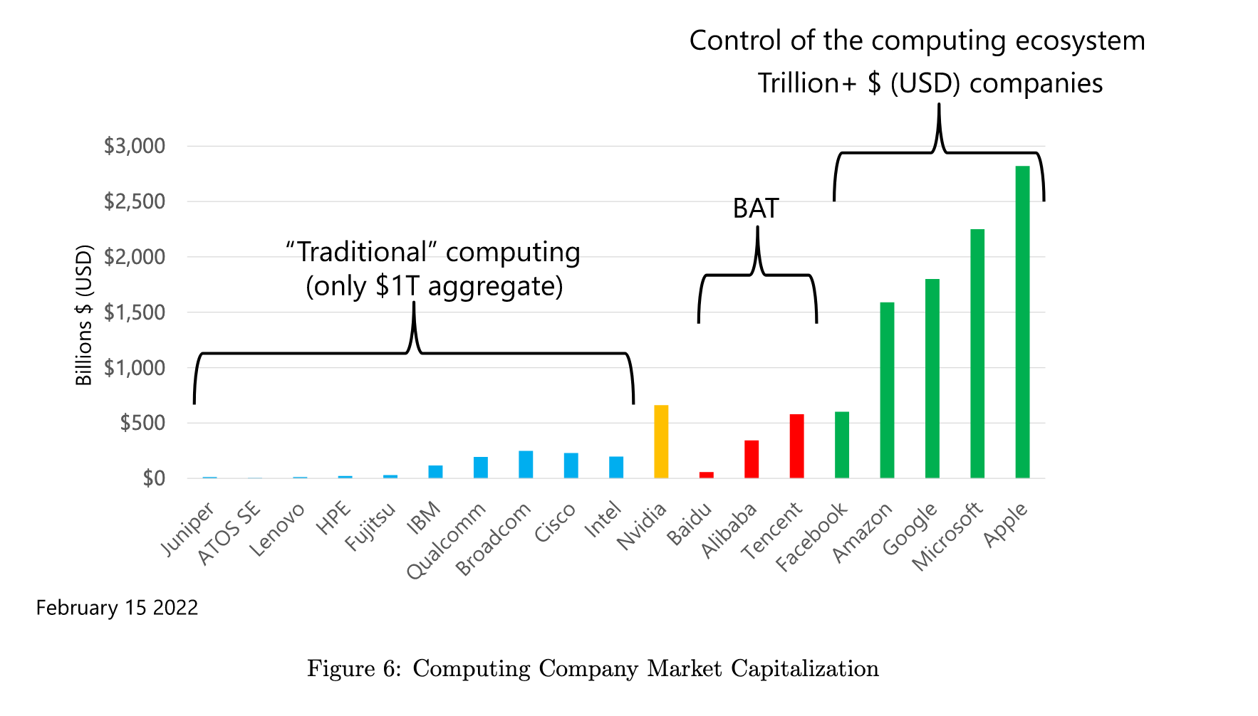
Follow the Money
market capitalizations

Slide 32
Some truisms
Smartphone and cloud services companies are cash rich (i.e., exothermic)
Designing, building, and deploying hardware/software at unprecedented scale
Advanced computing, including HPC, requires ongoing (NRE) investment
  This NRE (i.e., serious money) is required to develop new technologies and systems
Traditional computing vendors are now smaller players in the computing ecosystem
  Many are dependent on government investment (i.e., endothermic) for NRE investments
AI is fueling a revolution among businesses and researchers
  They are rethinking how they approach both problems and their solutions

Slide 33
Some Truisms
The smartphone and cloud services companies are cash rich (i.e., exothermic), and they are designing, building, and deploying their own hardware and software infrastructure at unprecedented scale
Advanced computing of all kinds, including high-performance computing, requires ongoing non-recurring engineering (NRE) investment to develop new technologies and systems
The traditional computing vendors are now relatively small players in the computing ecosystem, and many are dependent on government investment (i.e., endothermic) for the NRE needed to advance the bleeding edge of advanced computing technologies
Dennard scaling has ended and continued performance advances increasingly depend on functional specialization via custom ASICs and chiplet-integrated packages
Moore’s Law is at or near an end, and transistor costs are likely to increase as features sizes continue to decrease
AI is fueling a revolution in how businesses and researchers think about problems and their computational solution
Nimble hardware startups are exploring new ideas, driven by the AI frenzy
Talent is following the money and the opportunities, which are increasingly in a small number of very large companies or creative startups

Slide 34
Conclusions
The computing ecosystem is in enormous flux, creating both opportunities and challenges for the future of advanced scientific computing
Looking forward, it seems increasingly unlikely that future high-end HPC systems will be procured and assembled solely by commercial integrators from only commodity components
Advances will require embracing end-to-end design, testing and evaluating advanced prototypes, and partnering strategically … real co-design.
Leading edge, HPC computing systems are increasingly similar to large-scale scientific instruments (LHC, LIGO, SKA) with limited economic incentives for commercial development

Slide 35
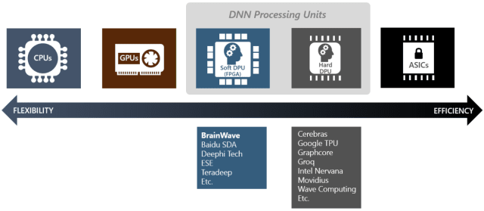


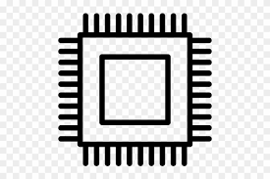
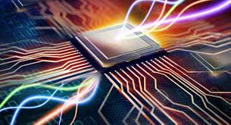
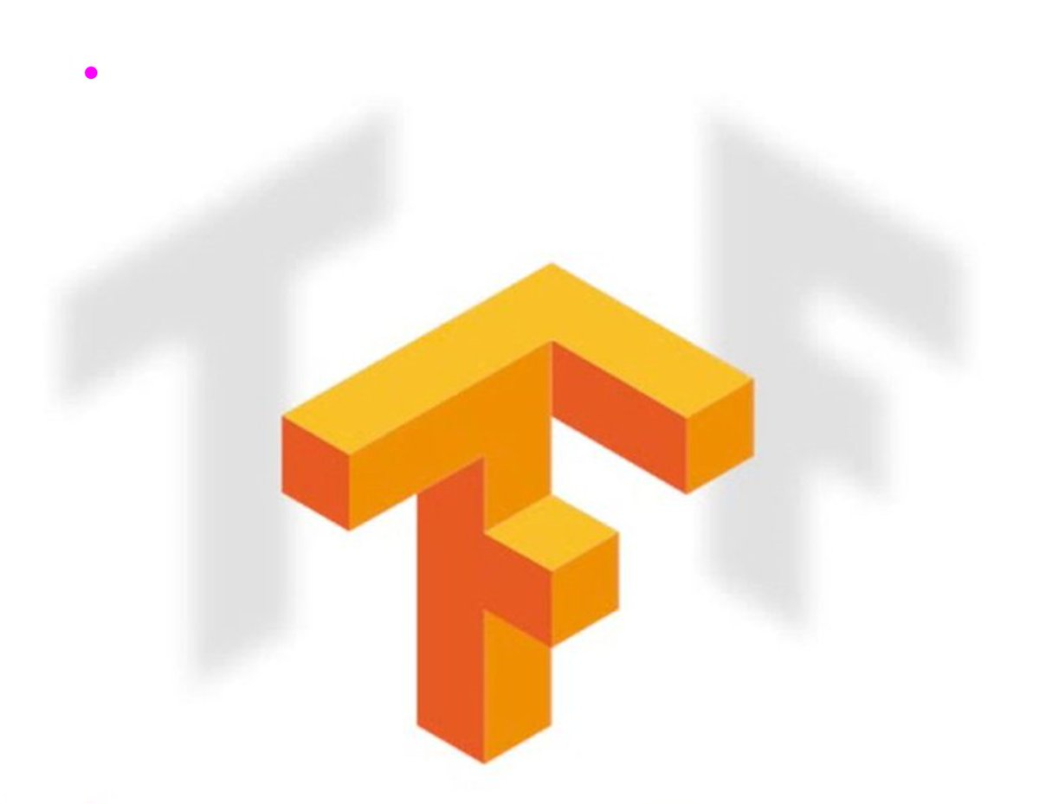
Future HPC Systems Will be Customized…
You will be able to dial up what you need in your computer for your application mix …
CPU
GPU
FPGA
ML
ASIC
Neuromorphic
Quantum
Neural Engine
Tensor
Optical

Slide 36
Future HPC Systems Will be Customized…
You will be able to dial up what you need in your computer for your application mix …
CPU
GPU
FPGA
ML/AI
ASIC
Neuromorphic
Quantum
Neural Engine
Tensor
Optical

Slide 37

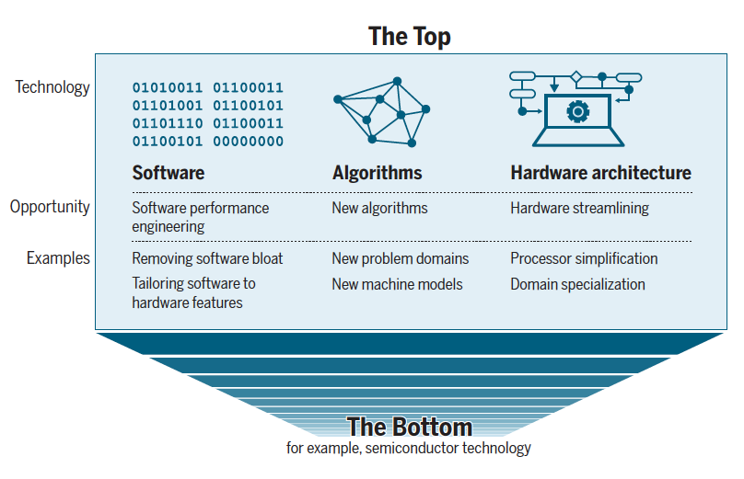

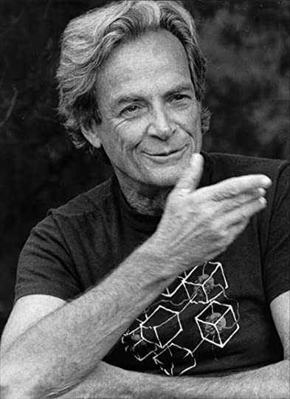
The Take Away
“There’s plenty of room at the Top: What will drive computer
performance after Moore’s law?”
HPC Hardware is Constantly Changing
  Scalar
  Vector
  Distributed
  Accelerated
  Mixed precision
Three computer revolutions
  High performance computing
  Deep learning
  Edge & AI
Algorithm / Software advances follows hardware.
  And there is “plenty of room at the top”
Feynman’s 1959
Lecture @ CalTech
Notes:
Scientists supported by NSF advanced computing increasingly include a “long tail” of users with more modest requirements for advanced computing than those with research applications that require parallel computers with a large number of tightly coupled processors. The latter applications cannot be run (or run with acceptable efficiency) on smaller systems or on current commercial cloud systems.

