Slide 1
Spontaneous Asynchronicity:
Parallel Programs out of Lockstep
Georg Hager, Ayesha Afzal
Erlangen National High Performance Computing Center (NHR@FAU)
PPAM 2022
Gdansk, Poland
September 13, 2022

Slide 2
Analytic performance modeling
Goals and challanges

Slide 3
Starting point
Analytic (first-principles) performance modeling:
Constructing a simplified model for the interaction
between software and hardware in order to understand
lowest-order performance behavior
Basic questions addressed by analytic performance models
  What is the bottleneck?
  What is the next bottleneck after optimization?
  Impact of hardware features → co-design, architectural exploration
What if the model fails?
  We learn something
  We may still be able to use the model in a less predictive way

Slide 4

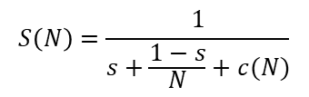


Examples for white-/gray-box models in computing
program speedup
latency
serial fraction
msg. length
$$S\left(N\right)=\frac{1}{s+\frac{1−s}{N}+c(N)}$$
$$T_{PtP}=T_{l}+\frac{L}{B}$$
bandwidth
Amdahl’s Law with communication
Hockney model for message transmission time
time for computation
time for data transfer
$$T_{exec⁡}=max⁡\left(T_{calc⁡},T_{data⁡}\right)$$
non-overlapping execution
Roofline model for loop code execution time
time for data transfer
$$T_{exec⁡}=f⁡(T_{nOL},T_{data},T_{OL})$$
ECM model for loop code execution time
overlapping execution

Slide 5

General application pattern
time
Compute
Compute
Compute
Compute
Communicate
Compute
Communicate
Communicate
Compute
Communicate
Compute
Compute
parallel(i=0..N) { // N>>1
update(data);
}
Runtime model: $T=f(\text{\$}\text{CODE},\text{\$}\text{HARDWARE})$

Slide 6

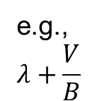
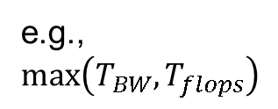
Composite analytic models
Plausible assumption: $T=T_{exec}+T_{nexec}$
In practice, $T≠T_{exec}+T_{nexec}$ and it can go in either direction
e.g.,
$$max\left(T_{BW},T_{flops}\right)$$
e.g.,
$$λ+\frac{V}{B}$$

Slide 7

Idle wave propagation and (de)synchronization phenomena
A. Afzal, G. Hager, and G. Wellein: Propagation and Decay of Injected One-Off Delays on Clusters: A Case Study. Proc. 2019 IEEE International Conference on Cluster Computing (CLUSTER), Albuquerque, NM, September 23-26, 2019. DOI: 10.1109/CLUSTER.2019.8890995
A. Afzal, G. Hager, and G. Wellein: Desynchronization and Wave Pattern Formation in MPI-Parallel and Hybrid Memory-Bound Programs. In: P. Sadayappan, B. Chamberlain, G. Juckeland, H. Ltaief (eds): High Performance Computing. ISC High Performance 2020. Lecture Notes in Computer Science, vol 12151. Springer, Cham. Available with Open Access. DOI: 10.1007/978-3-030-50743-5_20
A. Afzal, G. Hager, and G. Wellein: Delay Flow Mechanisms on Clusters.
Poster at EuroMPI 2019. EuroMPI2019_AHW-Poster.pdf EuroMPI2019-AHW-Summary.pdf
A. Afzal, G. Hager, and G. Wellein: Analytic Modeling of Idle Waves in Parallel Programs: Communication, Cluster Topology, and Noise Impact. ISC High Performance 2021 Digital,
June 24 – July 2, 2021, Frankfurt, Germany. DOI: 10.1007/978-3-030-78713-4_19
A. Afzal, G. Hager, and G. Wellein: An analytic performance model for overlapping execution
of memory-bound loop kernels on multicore CPUs. Concurrency and Computation: Practice
and Experience 34(10), e6816 (2022). Available with Open Access. DOI: 10.1002/cpe.681
Ayesha Afzal

Slide 8
Idle wave propagation and decay

Slide 9
Markidis et al. (2015)
Simulator-based analysis
Idle waves perceived as “damped linear waves”
Classical wave equation postulated for continuum description
S. Markidis et al.: Idle waves in high-performance computing. Phys. Rev. E 91(1), 013306 (2015).
DOI: 10.1103/PhysRevE.91.013306

Slide 10
Research questions
Setting: MPI- or hybrid-parallel bulk-synchronous barrier-free programs
How do “disturbances” propagate?
  Injected idle periods
  Dependence on communication characteristics
How do idle waves interact with each other, with noise, and
with the hardware?
  Idle wave decay
  (noise-induced, bottleneck-induced, topology-induced)
How do computational waves form? Instabilities?
  Core-bound vs. memory-bound
  Amplitude of the computational wave?
Continuum description?

Slide 11
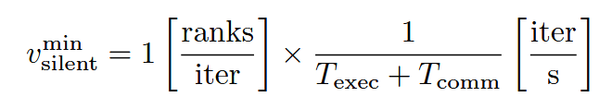
Idle wave propagation speed for scalable code
Assumptions:
Scalable code (on ccNUMA domain)
alternates between execution and communication phases
has inter-process dependencies via point-to-point communication
Simplest case: Next-neighbor (e.g., 1-D halo) communication
Number of communication partners and details of communication grouping influence the speed
DOI: 10.1007/978-3-030-78713-4_19

Slide 12
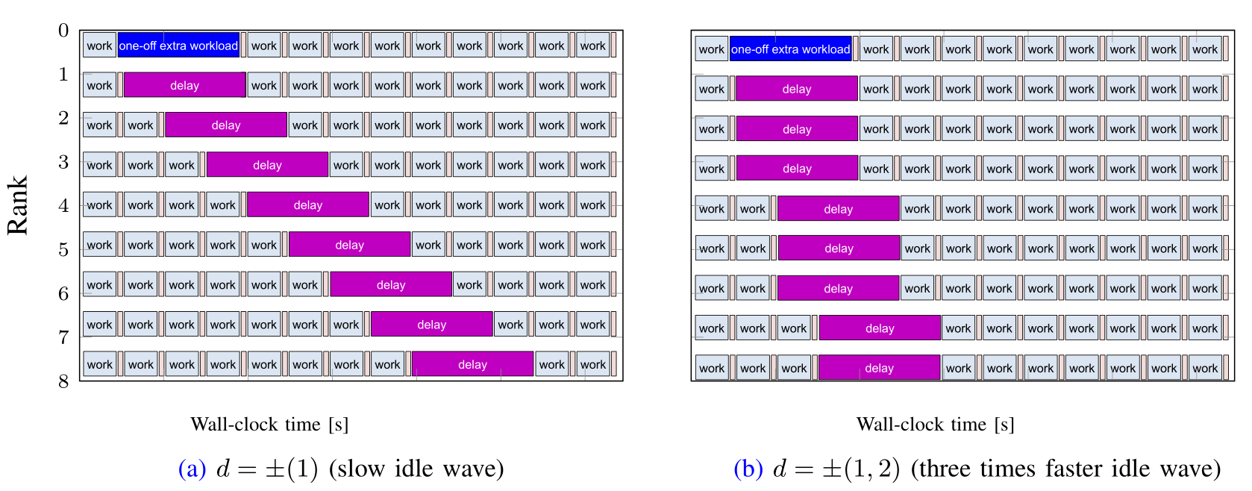
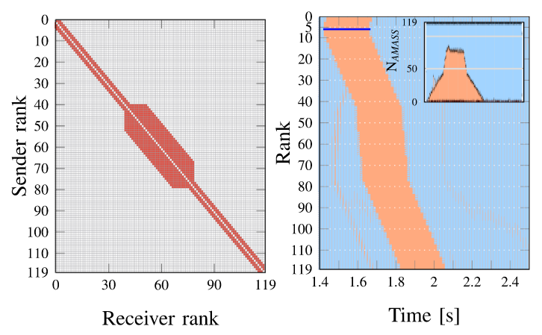
Communication topology and idle wave speed
Long-distance point-to-point communication → fast idle waves
arXiv:2205.04190

Slide 13
Idle waves interact nonlinearly
DOI: 10.1109/CLUSTER.2019.8890995
A wave-like description cannot be based on a linear model
Basis for noise-induced decay of idle waves

Slide 14
Noise-induced idle wave decay
System or application noise “eats away” on the idle wave
Decay rate proportional to integrated noise power
Statistical details do not matter
DOI: 10.1007/978-3-030-78713-4_19

Slide 15
Topological idle wave decay
Topological boundaries (ccNUMA domains, sockets, nodes) cause fine-grained noise which dampens the idle wave
Highly system dependent
No decay in homogeneous situation (round-robin placement)
DOI: 10.1007/978-3-030-78713-4_19

Slide 16
Bandwidth-induced idle wave decay and computational waves

Slide 17
Idle wave propagation and bottleneck-induced decay
Analytical model for idle wave speed with scalalble workload:
DOI: 10.1007/978-3-030-78713-4_19
Decay even on silent system:
DOI: 10.1007/978-3-030-50743-5_20

Slide 18
Intricate dynamics of bottleneck-driven idle wave decay
ccNUMA domain #1
ccNUMA domain #2

Slide 19
Computational wave as an echo of an idle wave
Decaying idle wave leaves many processes desynchronized
Inter-process skew → automatic potential communication overlap
Computational wavefront == rank-time location of all processes at a given iteration
Memory boundedness is a prerequisite

Slide 20
Spontaneous asynchronicity
There are always idle waves, and they have consequences…
Opportunity for automatic communication overlap
“Spontaneous symmetry breaking”?
LBM D3Q19 flow solver,
RRZE Emmy cluster,
10 cores per NUMA domain

Slide 21
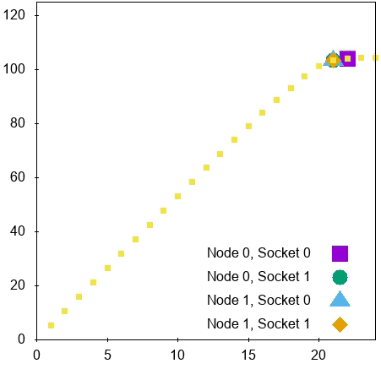
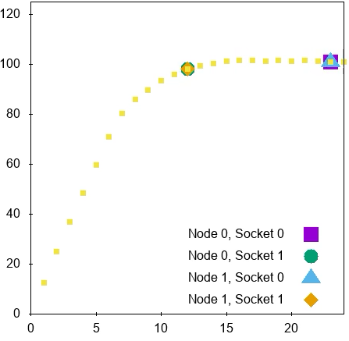
Computational wave settles at the saturation point (sometimes)
DOI: 10.1007/978-3-030-50743-5_20
# of computing processes

Slide 22
Further questions

Slide 23
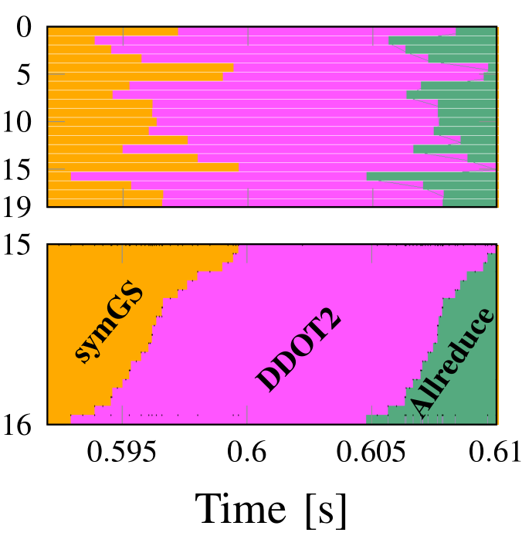
Further questions about desynchronized execution
Performance of different kernels running concurrently on one ccNUMA domain? → DOI: 10.1002/cpe.6816
Decisive parameter: per-kernel
single-thread memory bandwidth fraction
(“memory pressure”)

Slide 24
Further questions about desynchronized execution
Can we inject a delay to make a program faster?
  Yes we can
Do we always have to strictly balance the load?
  No, some variation may be good for performance
Is there a more favorable pattern than compute-communicate-repeat?
  Yes: memory-bound compute – scalable compute – repeat
Can the system (application,computer) be described by coupled oscillators?
$$\dot{θ_{i}}=ω_{i}+α\sum_{j}{sin\left(θ_{j}−θ_{i}\right)} \underset{→}{ } \dot{θ_{i}}=ω_{i}+ζ_{i}(t)+α\sum_{j}{T_{ij} V\left(θ_{j},θ_{i},τ_{ij}(t)\right)}$$

Slide 25

Thank You.

