Slide 1
Harnessing the Capacity of
HPC Facilities to support
Distributed HTC Workloads
Miron Livny
John P. Morgridge Professor of Computer Science
Center for High Throughput Computing
University of Wisconsin-Madison

Slide 2
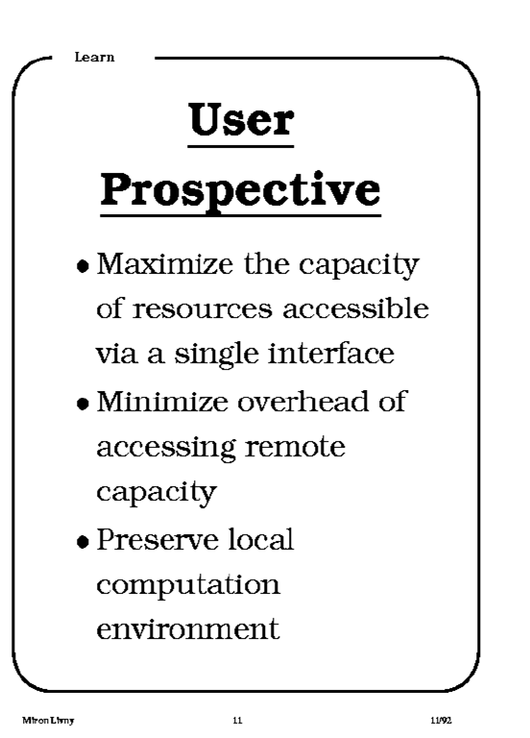
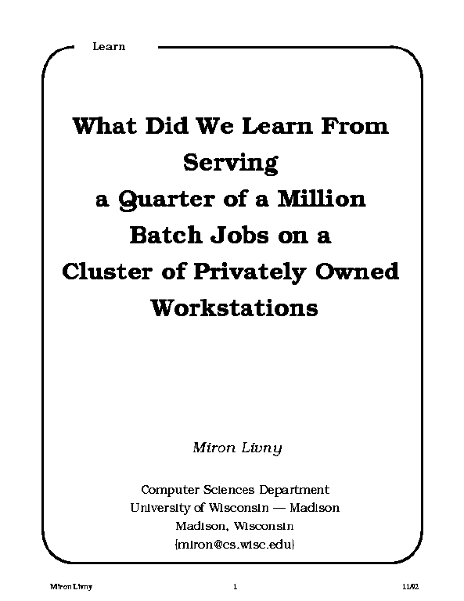
1992

Slide 3
world
region
campus
building
floor
desktop
2003

Slide 4
The current (young) generation of researchers transitioned from the desk/lap top to the Jupyter notebook
Researcher “lives” in the notebook
Bring Python to the HTC environment – bindings and APIs
Bring HTC to Python – the HTMap module
Support testing and debugging of HTC applications/workflows in the notebook

Slide 5
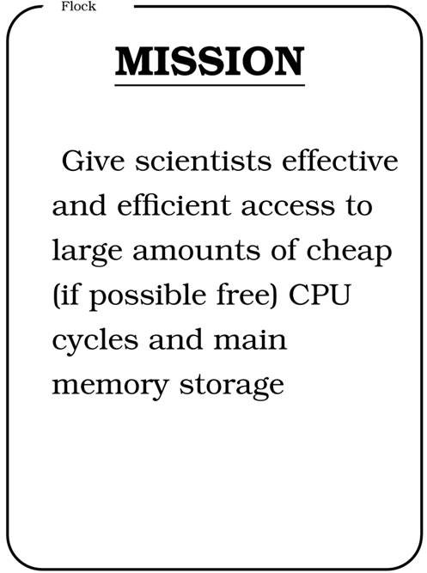
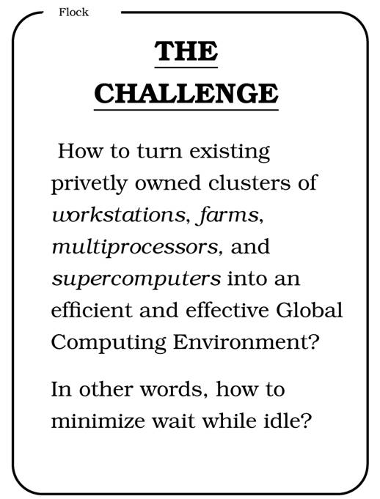

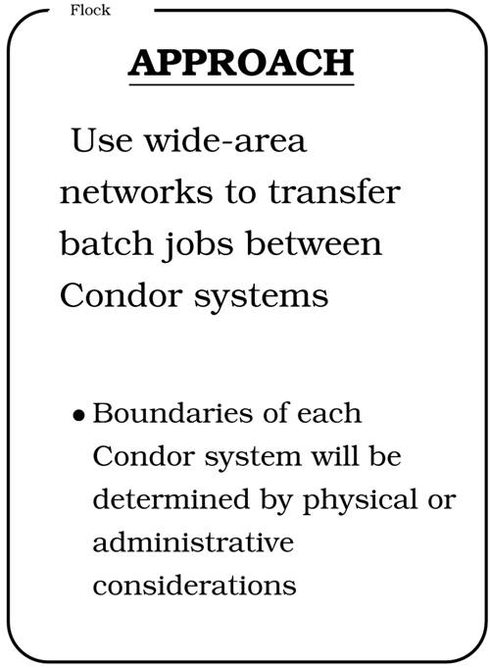
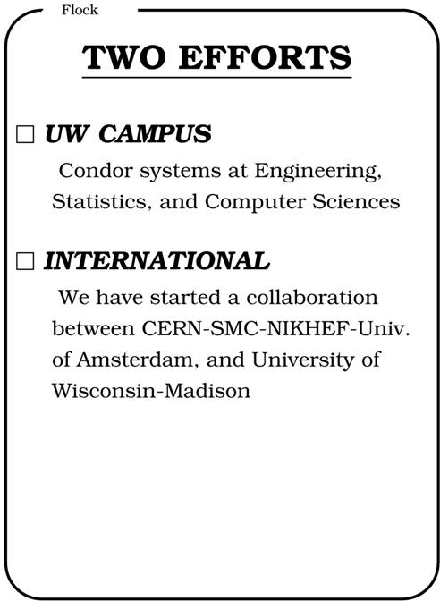
CERN 92

Slide 6
1994 Worldwide Flock of Condors
Delft
Amsterdam
30
200
10
3
3
3
3
Madison
Warsaw
10
10
Geneva
Dubna/Berlin
D. H. J Epema, Miron Livny, R. van Dantzig, X. Evers, and Jim Pruyne, "A Worldwide
Flock of Condors : Load Sharing among Workstation Clusters" Journal on Future
Generations of Computer Systems, Volume 12, 1996

Slide 7
Submit locally
(queue and manage your resource acquisition and job execution locally) and run globally
(acquire and use any resource that is capable and willing to run your jobs)

Slide 8
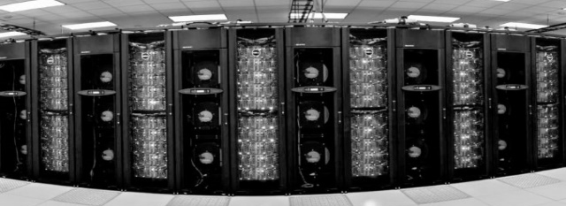
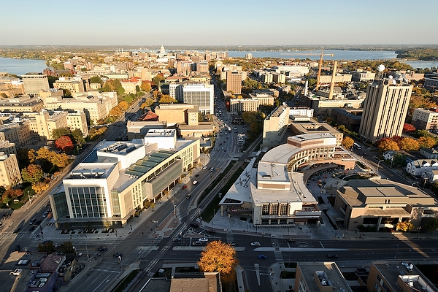
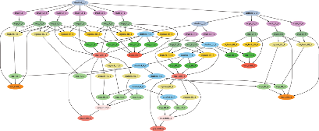

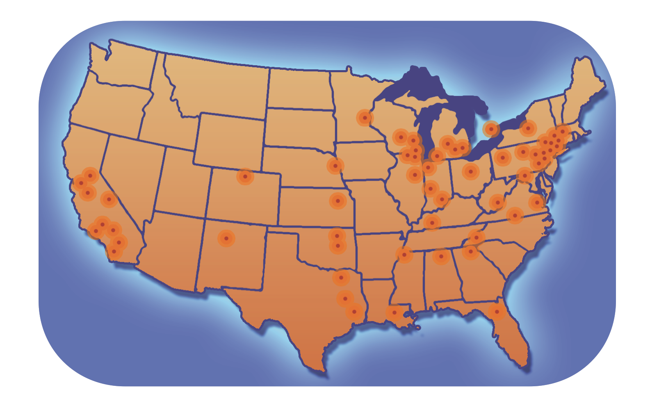
Agile, Shared Computing
“submit locally, run globally”
HPC
Campus Grid
The Cloud
CHTC
Open Science
Grid (OSG)

Slide 9
Researcher always has to pay for the acquired resources
Real money – to a hardware vendor or a commercial cloud provider
Allocation – to a government or university owned facility
Priority/share – to a community or opportunistic (fair-share) facility

Slide 10
The HTC community prefers late binding of work (managed locally) to (global) resources
Separation between acquisition of (global) resources and assignment (delegation) of work to the resource once acquired and ready to serve
Accomplished by a distributed HTC overlay that is deployed on-the-fly and presents the dynamically acquired (global) resources as a unified managed HTC system

Slide 11
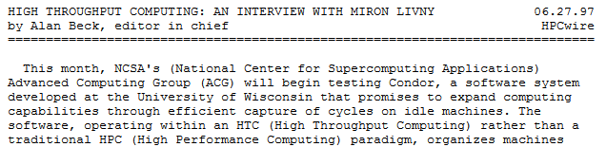
In 1996 I introduced the distinction between High Performance Computing (HPC) and High Throughput Computing (HTC) in a seminar at the NASA Goddard Flight Center in and a month later at the European Laboratory for Particle Physics (CERN). In June of 1997 HPCWire published an interview on High Throughput Computing.

Slide 12
High Throughput Computing requires automation as it is a 24-7-365 activity that involves large numbers of jobs and computing resources
FLOPY ≠ (60*60*24*7*52)*FLOPS
100K Hours*1 Job ≠ 1 H*100K J

Slide 13
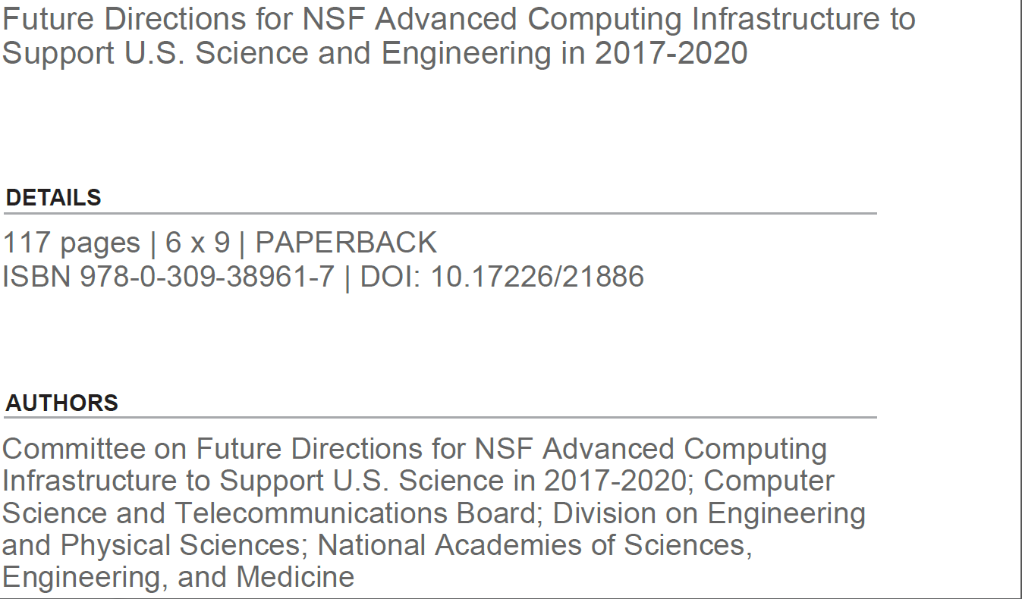
“… many fields today rely on high-throughput computing for discovery.”
“Many fields increasingly rely on high-throughput computing”

Slide 14
The work of more and more researchers depend on more and more HTC computing
Each computation can easily fit on a single (modern) server
Research requires “many” of these computations
  Processing of measured data
  Simulation
  Monte Carlo
  Parameter sweeps

Slide 15

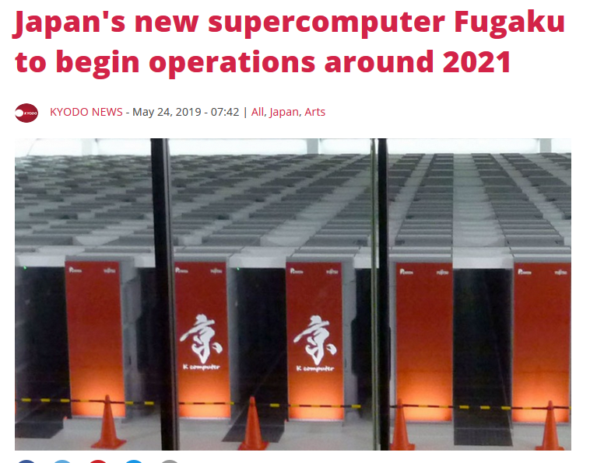
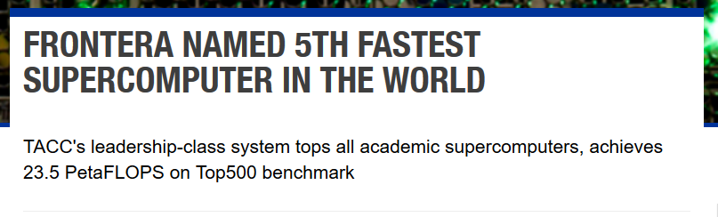

Slide 16
“Recommendation 2.2. NSF should (a) … and (b) broaden the accessibility and utility of these large-scale platforms by allocating high-throughput as well as high-performance workflows to them.”

Slide 17
What does all this mean for researchers with ever growing HTC workloads?
Less money for acquisition of compute resources and more allocations of computing capacity on (very) large (HPC) facilities!

Slide 18
Some (HTC) numbers:
CHTC delivered more than 400M core hours in the past 12 month to more than 250 projects at the UW-Madison campus
OSG delivered more than 2B core hours in the past 12 month to research efforts ranging from single PI to LHC experiments (O(1K) researchers)

Slide 19
HPC facilities present challenges for HTC workloads
Acquisition managed by a batch system that allocates nodes/servers in (very) large chunks for a set time duration at unpredictable times where queuing (waiting) times depends on the dimensions of the requested chunk
Acquisition request must be associated with an allocation
Two factor authentication
Limited (no?) Network connectivity
Limited (no?) support for storage acquisition

Slide 20
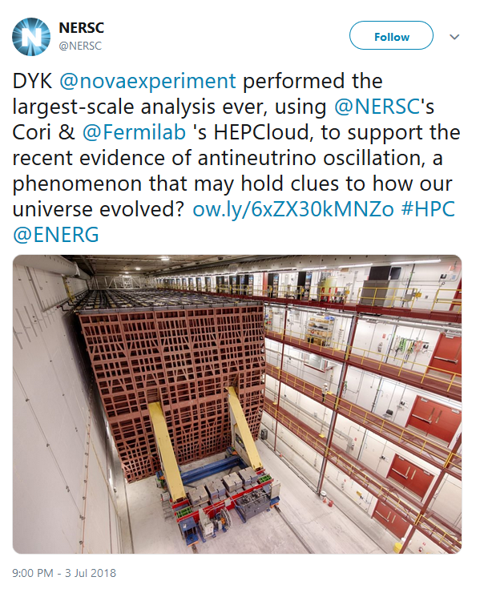

Slide 21

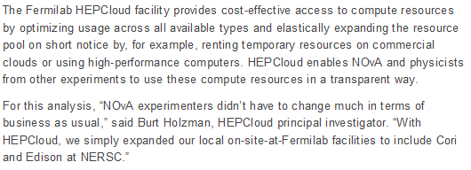

Slide 22
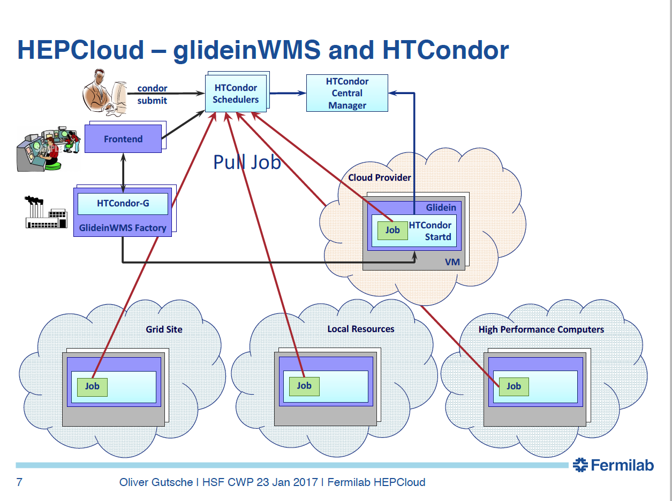

Slide 23
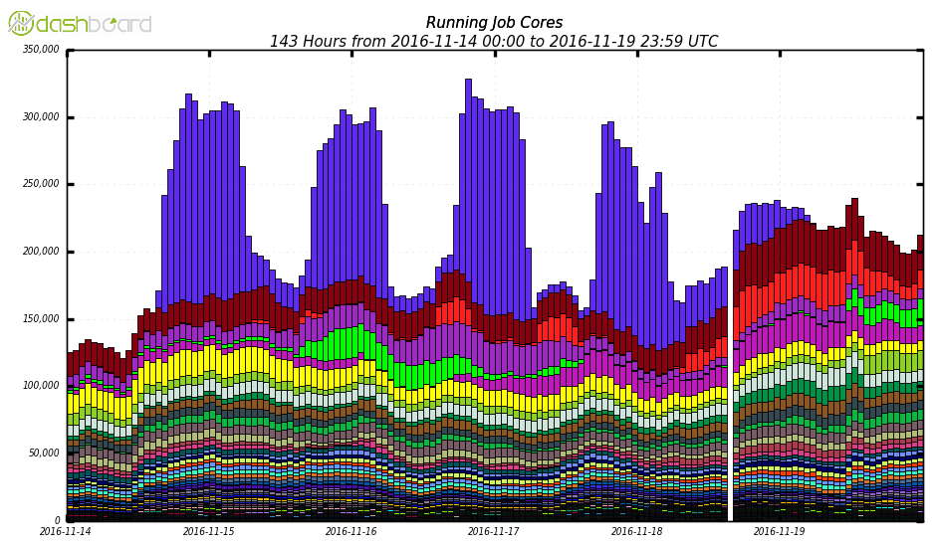
SC16 Demo: On Demand Doubling of CMS Computing Capacity
Joint project
HEPCloud (Fermilab), HTCondor (UW-Madison)
HEPCloud provisions Google Cloud with HTCondor in two ways
  HTCondor talks to Google API
  Resources are joined into HEP HTCondor pool
Demonstrated sustained large scale elasticity (>150K cores) in response to demand and external constraints
  Ramp-up/down with opening/closing of exhibition floor
  Tear-down when no jobs are waiting
350K
Global CMS Running Jobs 11/14-19
Google Cloud Cores
300K
250K
200K
150K
100K
50K
  730,172 jobs consumed 6.35M core hours produced 205M simulated events (81.8 TB) using .5PB of input data
  Total cost ~$100K

Slide 24
The UW-Madison Center for High Throughput Computing (CHTC) was established in 2006 to bring the power of Distributed High Throughput Computing (HTC) to all fields of study, allowing the future of Distributed HTC to be shaped by insight from other disciplines

Slide 25
Agile, Shared Computing
“submit locally, run globally”
HPC
Campus Grid
The Cloud
CHTC
Open Science
Grid (OSG)

Slide 26
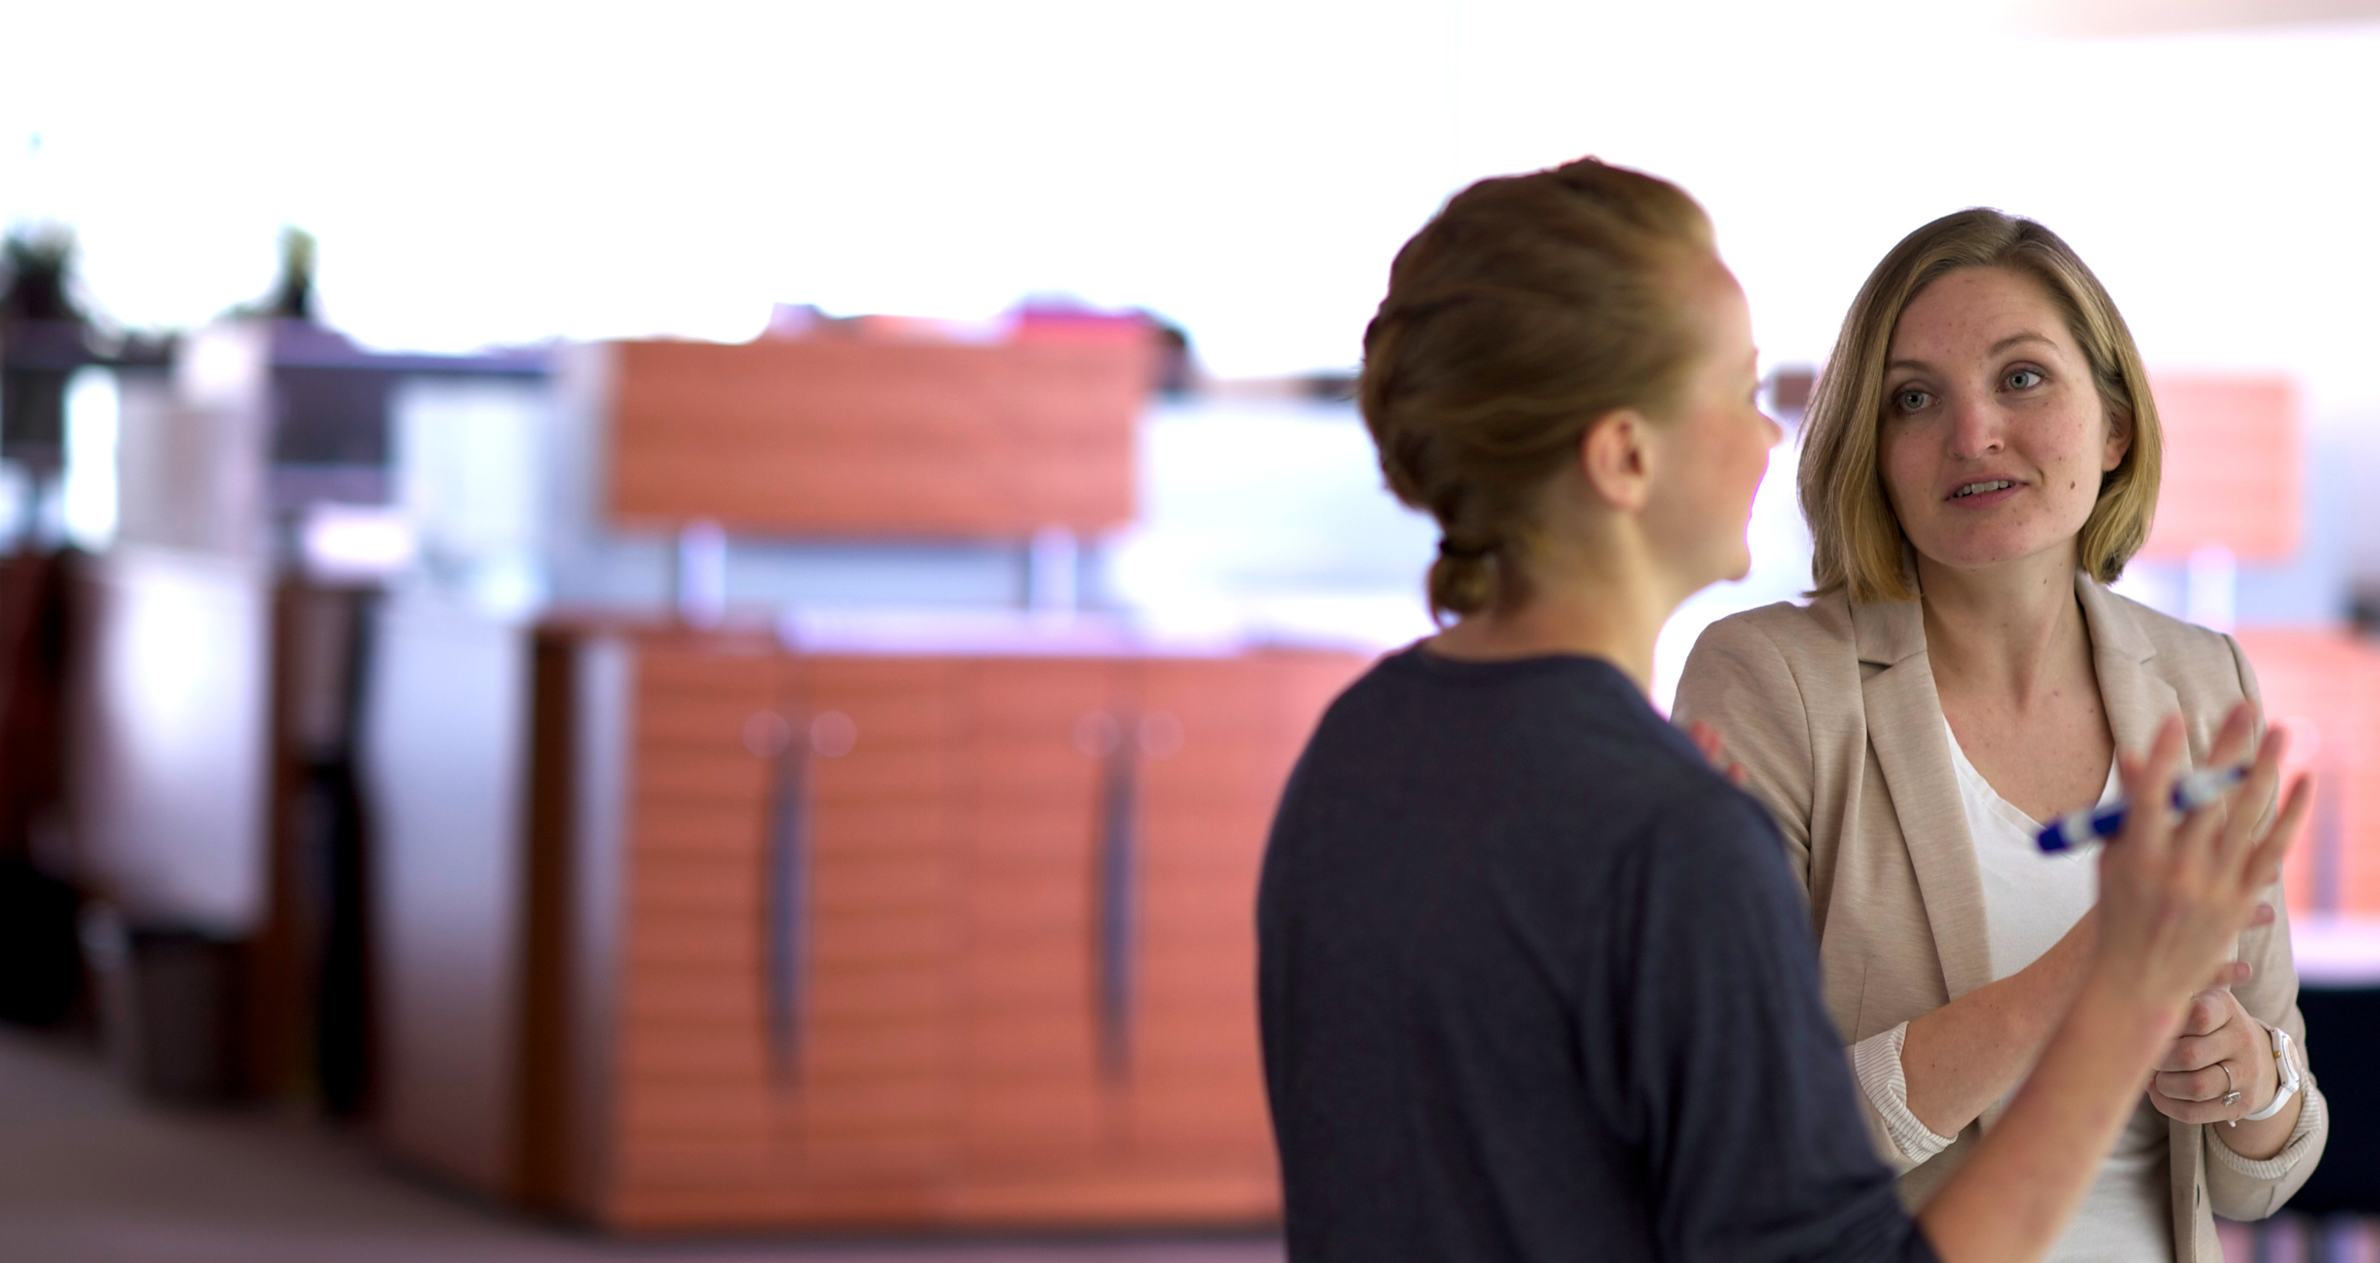
Research Computing Facilitation
accelerating research transformations
proactive engagement
personalized guidance
teach-to-fish training
technology agnostic
collaboration liaising
upward advocacy

Slide 27

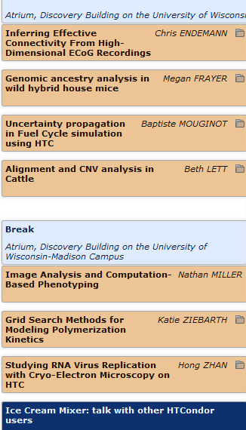


Slide 28
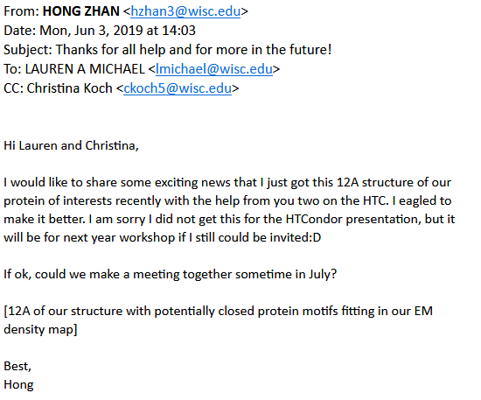
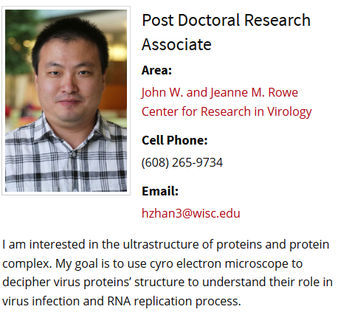
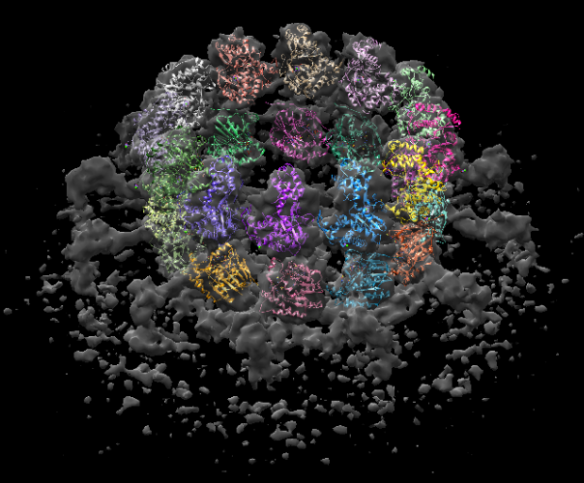

Slide 29


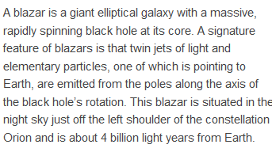

Slide 30
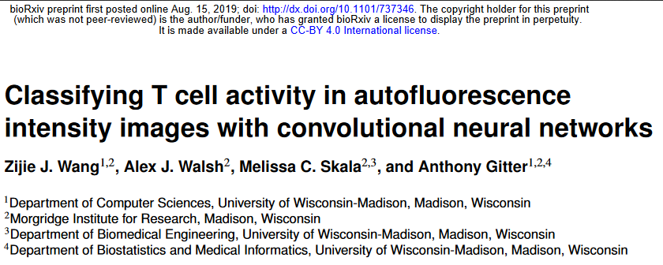


Slide 31
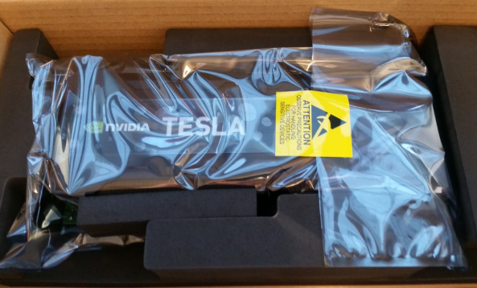





Expanding GPU capacity for HTC ML
UW
grid
condor_annex
Cooley

Slide 32

The Open Science Grid (OSG) national fabric of distribute HTC services across more than
130 (autonomous) clusters at more than 70 sites across the US

Slide 33
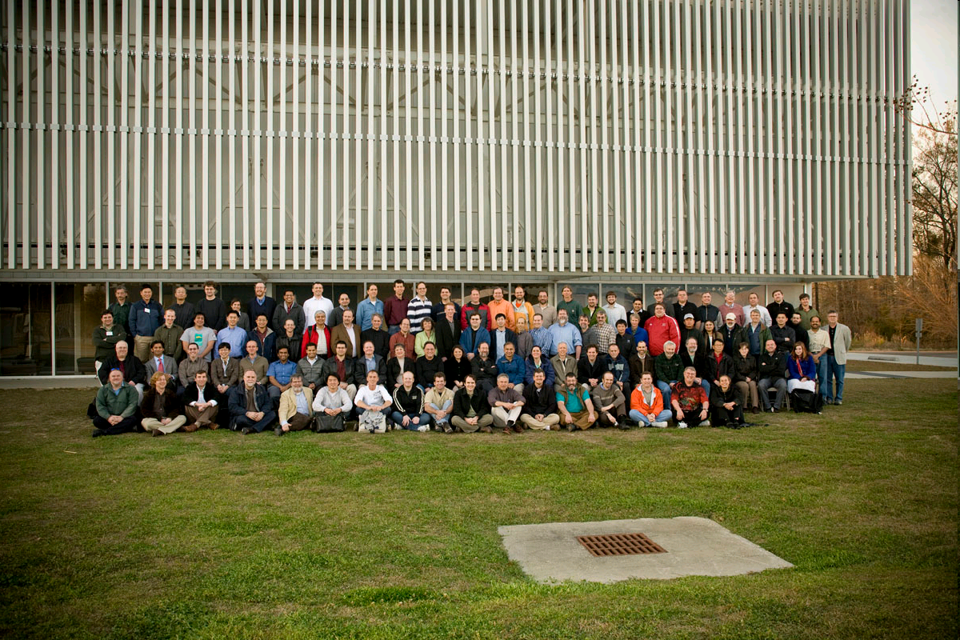
“The members of OSG are united by a commitment to promote the adoption and to advance the state of the art of distributed high throughput computing (DHTC) – shared utilization of autonomous resources where all the elements are optimized for maximizing computational throughput.”

Slide 34

Submit Locally Run Globally
National Supercomputer
Access Point
Collaborator’s Cluster
OSG Deployed HTCondor
sharing
Nationally Shared Clusters
Local Cluster
Commercial Cloud
OSG integrates computing across different resource types and business models.

Slide 35
Work @ CHTC - a progress report

Slide 36
Support for (large) groups (sets) of jobs and resources
Groups are quasi homogeneous
Support for storage acquisition to facilitate staging/buffering of input and output data
Support a range (early-late, eager-lazy) of resource binding

Slide 37
Overcome limited (no) network connectivity to the worker nodes or the head node
Reverse initiation of TCP/IP communication through the Condor Communication Broker (CCB)
Use file transfers as a communication channel for work delegation (dropbox semantic)
Deploy the HTCondor StartD as an edge service

Slide 38
Recognize and fully support Acquisition Management jobs by the HTC services framework
Make the state of the acquisition visible to external observers
Integrate with workload management systems
Minimize impact of faults on waste and cost overruns
Manage account information and produce audit trails

Slide 39
Make “time” a first class element of HTC workload management
Not all resource acquisitions are opportunistic and therefore may have a set (or unlimited) duration
It is OK to request (demand?) run time estimations from users
It is OK to kill jobs (badput) if a job exceeds its runtime estimation
Support heterogeneous execution environement

Slide 40
Agile, Shared Computing
“submit locally, run globally”
HPC
Campus Grid
The Cloud
CHTC
Open Science
Grid (OSG)

