Slide 1
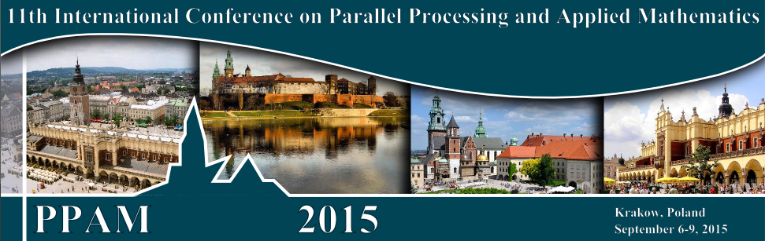
Data Analytics with HPC and DevOps
PPAM 2015, 11th International Conference On Parallel Processing And Applied Mathematics
Krakow, Poland, September 6-9, 2015
Geoffrey Fox, Judy Qiu, Gregor von Laszewski, Saliya Ekanayake, Bingjing Zhang, Hyungro Lee, Fugang Wang, Abdul-Wahid Badi
Sept 8 2015
gcf@indiana.edu
http://www.infomall.org, http://spidal.org/ http://hpc-abds.org/kaleidoscope/
Department of Intelligent Systems Engineering
School of Informatics and Computing, Digital Science Center
Indiana University Bloomington

Slide 2
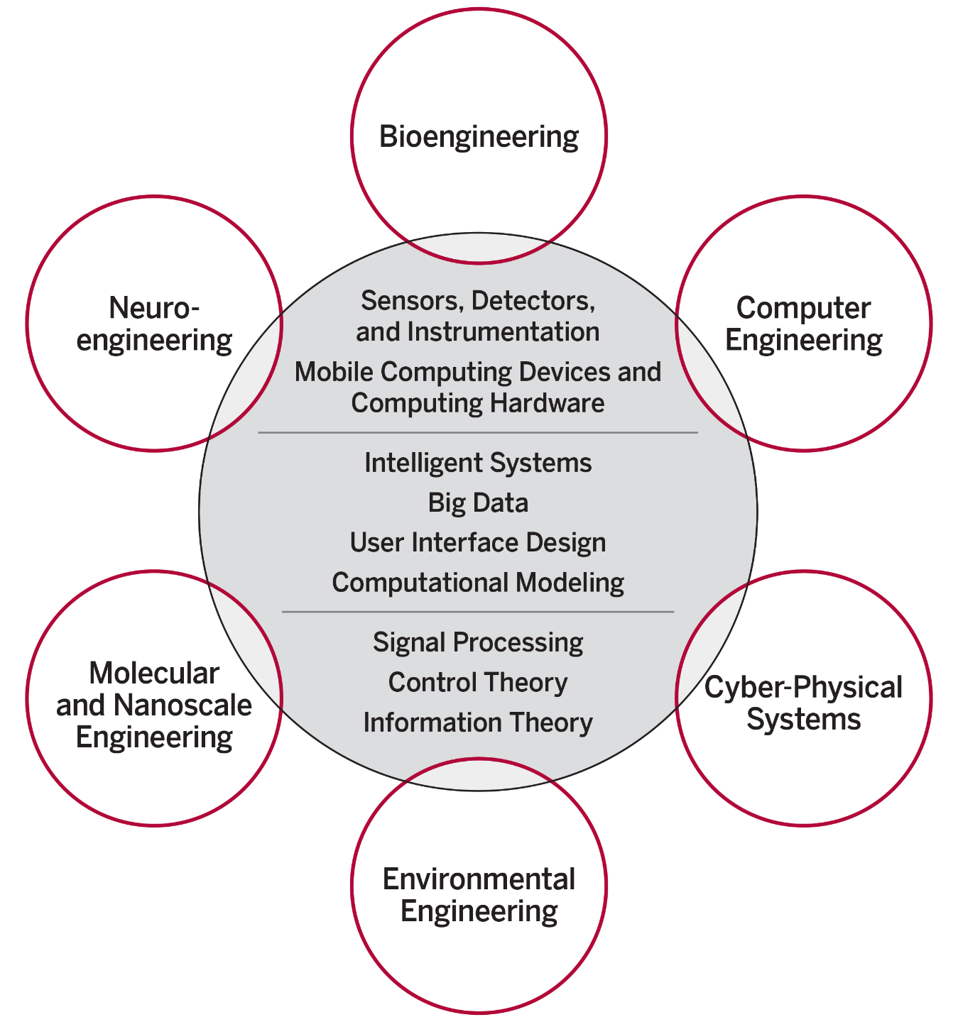
ISE Structure
The focus is on engineering of systems of small scale, often mobile devices that draw upon modern information technology techniques including intelligent systems, big data and user interface design. The foundation of these devices include sensor and detector technologies, signal processing, and information and control theory.
End to end Engineering
New faculty/Students Fall 2016
IU Bloomington is the only university among AAU’s 62 member institutions that does not have any type of engineering program.

Slide 3
Abstract
There is a huge amount of big data software that we want to use and integrate with HPC systems
Use Java and Python but face same challenges as large scale simulations to get good performance
We propose adoption of DevOps motivated scripts to support hosting of applications on the many different infrastructures like OpenStack, Docker, OpenNebula, Commercial clouds and HPC supercomputers.
Virtual Clusters can be used in clouds and Supercomputers and seem a useful concept on which base approach
Can also be thought of more generally as software defined distributed systems

Slide 4
Big Data Software

Slide 5
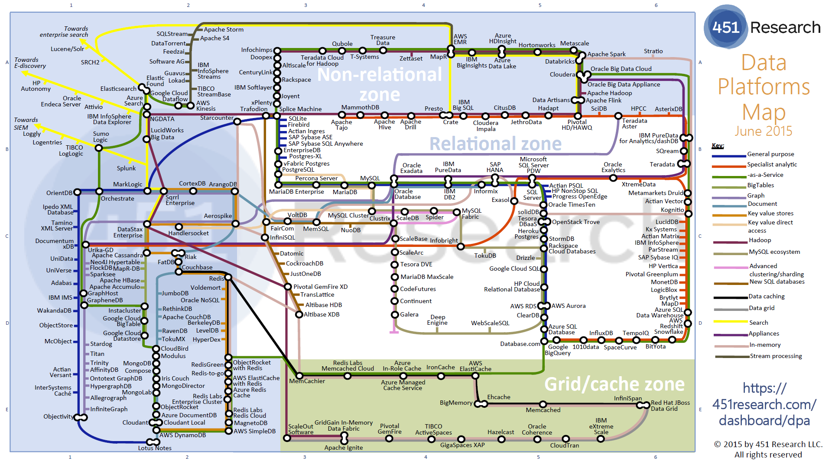
Data Platforms

Slide 6
Green implies HPC
Integration

Slide 8
Java Grande
Revisited on 3 data analytics codes
Clustering
Multidimensional Scaling
Latent Dirichlet Allocation all sophisticated algorithms

Slide 9
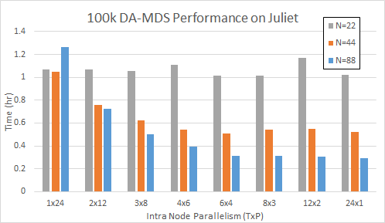
DA-MDS Scaling MPI + Habanero Java (22-88 nodes)
TxP is # Threads x # MPI Processes on each Node
As number of nodes increases, using threads not MPI becomes better
DA-MDS is “best general purpose” dimension reduction algorithm
Juliet is a 96 24-core node Haswell + 32 36-core Haswell Infiniband Cluster
Use JNI +OpenMPI gives similar MPI performance for Java and C
All MPI
on Node
All Threads
on Node

Slide 10
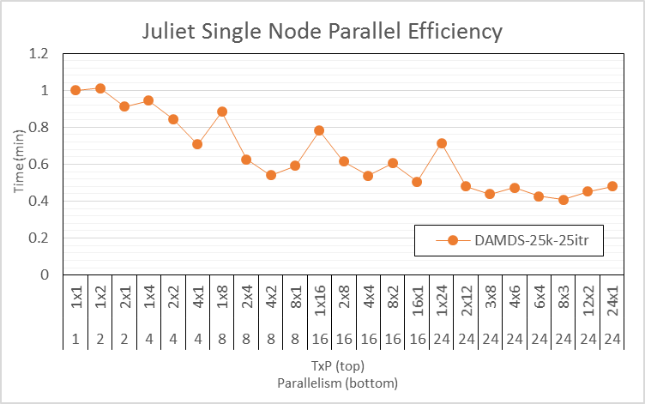
DA-MDS Scaling MPI + Habanero Java (1 node)
TxP is # Threads x # MPI Processes on each Node
On one node MPI better than threads
DA-MDS is “best known” dimension reduction algorithm
Juliet is a 96 24-core node Haswell + 32 36-core Haswell Infiniband Cluster
Use JNI +OpenMPI usually gives similar MPI performance for Java and C
24 way parallel
Efficiency
All MPI

Slide 11
FastMPJ (Pure Java) v.
Java on C OpenMPI v.
C OpenMPI

Slide 12
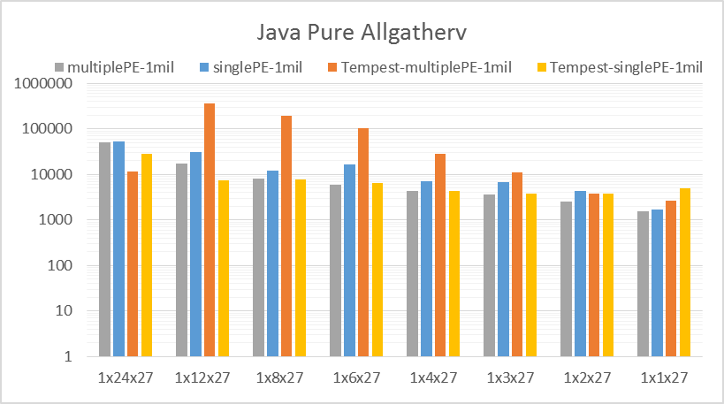
Sometimes Java Allgather MPI performs poorly
TxPxN where T=1 is threads per node and P is MPI processes per node and N is number of nodes
Tempest is old Intel Cluster
Bind processes to 1 or multiple cores
100K Data
Juliet

Slide 13
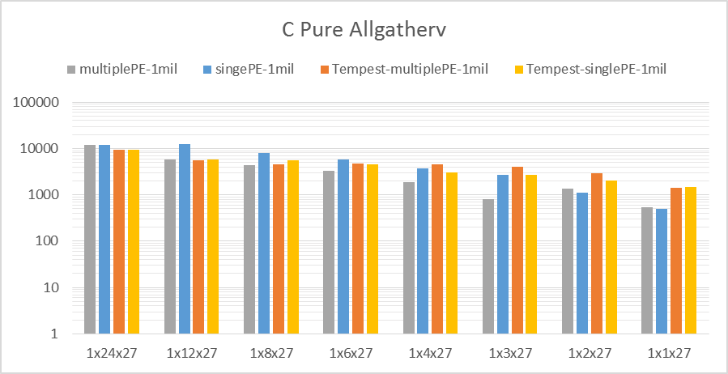
Compared to C Allgather MPI performing consistently
Juliet
100K Data

Slide 14
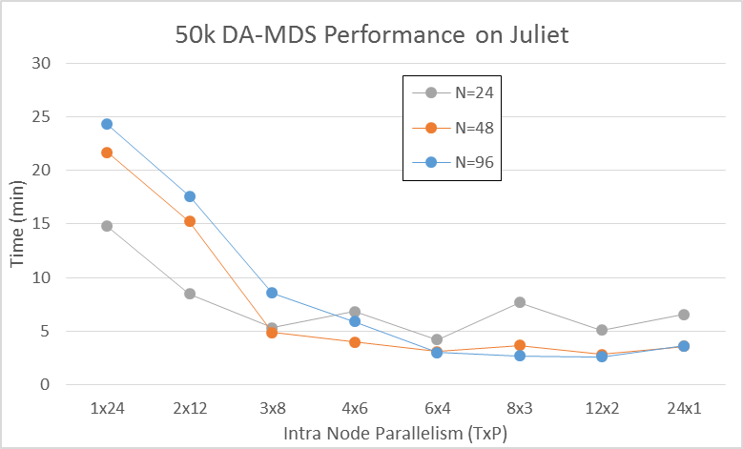
No classic nearest neighbor communication
All MPI collectives
All MPI on Node
All Threads
on Node

Slide 15
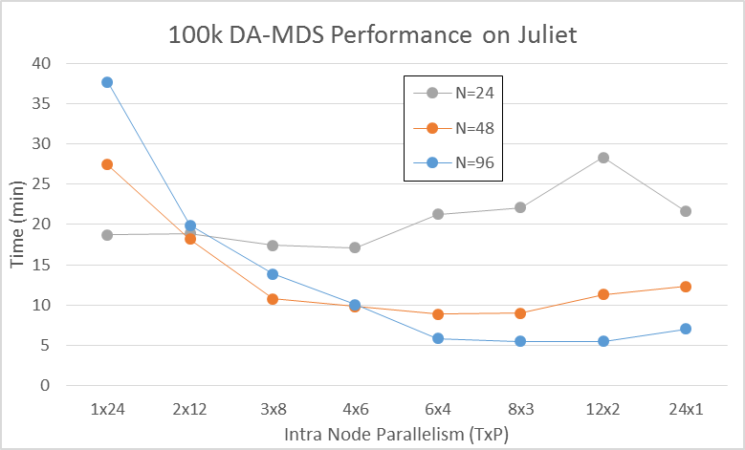
No classic nearest neighbor communication
All MPI collectives (allgather/scatter)
All Threads
on Node
All MPI
on Node

Slide 16
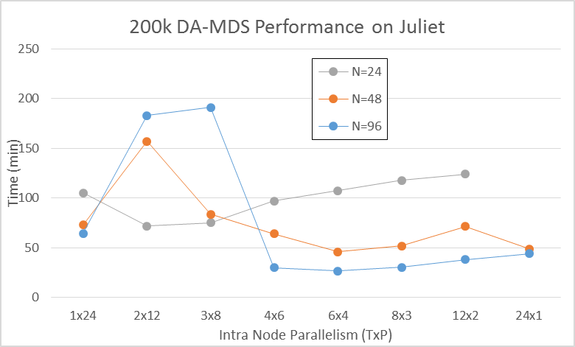
No classic nearest neighbor communication
All MPI collectives (allgather/scatter)
Java
MPI crazy!
All Threads
on Node
All MPI
on Node

Slide 17
DA-PWC Clustering on old Infiniband cluster (FutureGrid India)
Results averaged over TxP choices with full 8 way parallelism per node up to 32 nodes
Dominated by broadcast implemented as pipeline

Slide 18
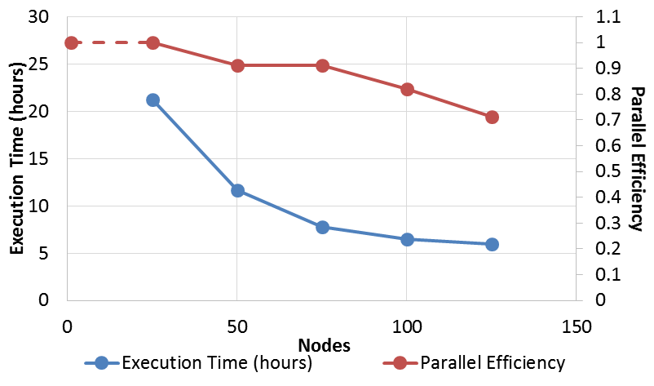
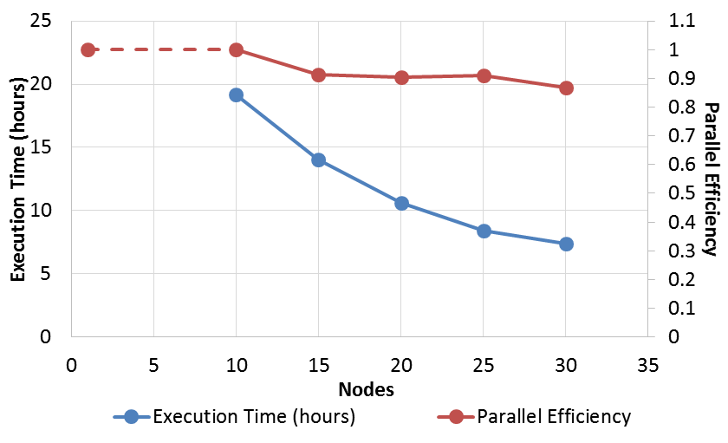
Parallel LDA Latent Dirichlet Allocation
Harp LDA on BR II (32 core old AMD nodes)
Java code running under Harp – Hadoop plus HPC plugin
Corpus: 3,775,554 Wikipedia documents, Vocabulary: 1 million words; Topics: 10k topics;
BR II is Big Red II supercomputer with Cray Gemini interconnect
Juliet is Haswell Cluster with Intel (switch) and Mellanox (node) infiniband
  Will get 128 node Juliet results
Harp LDA on Juliet (36 core Haswell nodes)

Slide 19
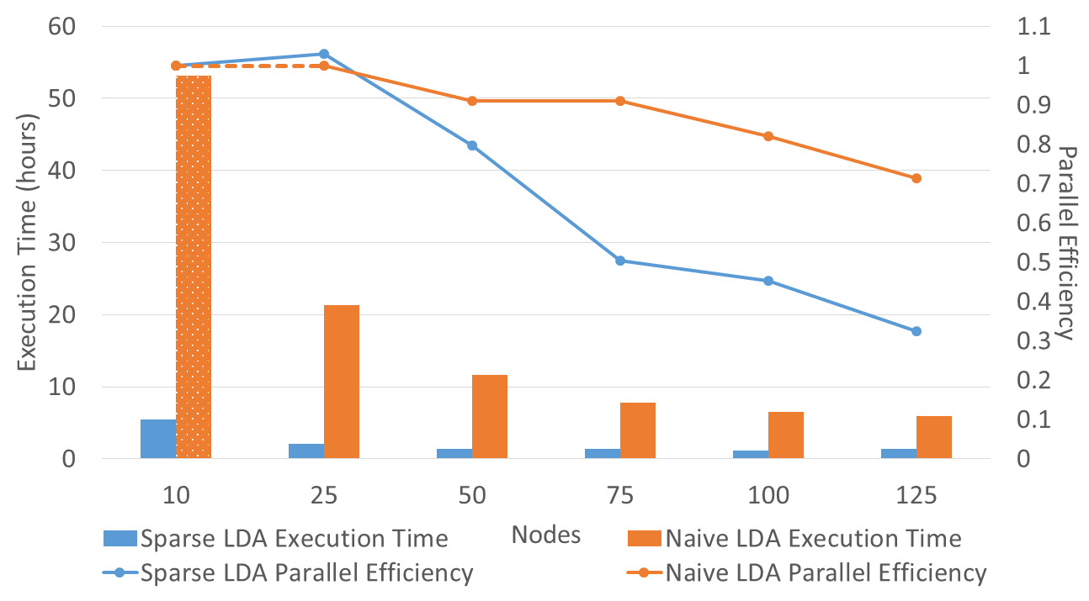
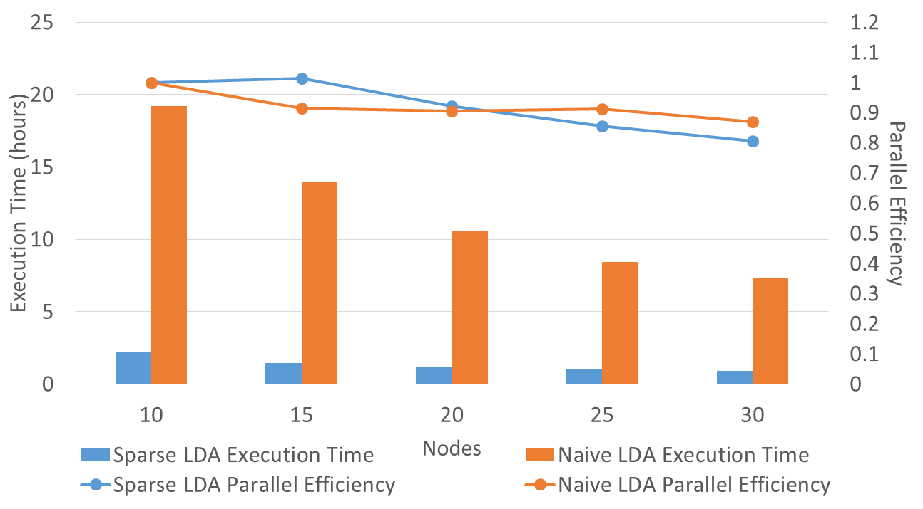
Parallel Sparse LDA
Harp LDA on BR II (32 core old AMD nodes)
Original LDA (orange) compared to LDA exploiting sparseness (blue)
Note data analytics making full use of Infiniband (i.e. limited by communication!)
Java code running under Harp – Hadoop plus HPC plugin
Corpus: 3,775,554 Wikipedia documents, Vocabulary: 1 million words; Topics: 10k topics;
BR II is Big Red II supercomputer with Cray Gemini interconnect
Juliet is Haswell Cluster with Intel (switch) and Mellanox (node) infiniband
Harp LDA on Juliet (36 core Haswell nodes)

Slide 20
Classification of Big Data Applications

Slide 21
Breadth of Big Data Problems
Analysis of 51 Big Data use cases and current benchmark sets led to 50 features (facets) that described important features
  Generalize Berkeley Dwarves to Big Data
Online survey http://hpc-abds.org/kaleidoscope/survey for next set of use cases
Catalog 6 different architectures
Note streaming data very important (80% use cases) as are Map-Collective (50%) and Pleasingly Parallel (50%)
Identify “complete set” of benchmarks
Submitted to ISO Big Data standards process

Slide 22
51 Detailed Use Cases: Contributed July-September 2013
Covers goals, data features such as 3 V’s, software, hardware
26 Features for each use case
Biased to science
http://bigdatawg.nist.gov/usecases.php
https://bigdatacoursespring2014.appspot.com/course (Section 5)
Government Operation(4): National Archives and Records Administration, Census Bureau
Commercial(8): Finance in Cloud, Cloud Backup, Mendeley (Citations), Netflix, Web Search, Digital Materials, Cargo shipping (as in UPS)
Defense(3): Sensors, Image surveillance, Situation Assessment
Healthcare and Life Sciences(10): Medical records, Graph and Probabilistic analysis, Pathology, Bioimaging, Genomics, Epidemiology, People Activity models, Biodiversity
Deep Learning and Social Media(6): Driving Car, Geolocate images/cameras, Twitter, Crowd Sourcing, Network Science, NIST benchmark datasets
The Ecosystem for Research(4): Metadata, Collaboration, Language Translation, Light source experiments
Astronomy and Physics(5): Sky Surveys including comparison to simulation, Large Hadron Collider at CERN, Belle Accelerator II in Japan
Earth, Environmental and Polar Science(10): Radar Scattering in Atmosphere, Earthquake, Ocean, Earth Observation, Ice sheet Radar scattering, Earth radar mapping, Climate simulation datasets, Atmospheric turbulence identification, Subsurface Biogeochemistry (microbes to watersheds), AmeriFlux and FLUXNET gas sensors
Energy(1): Smart grid

Slide 23

Geospatial Information System
Shared / Dedicated / Transient / Permanent
HPC Simulations
Internet of Things
Metadata/Provenance
Archived/Batched/Streaming
Data Source and Style View
10
9
8
HDFS/Lustre/GPFS
7
6
Enterprise Data Model
5
Files/Objects
SQL/NoSQL/NewSQL
4
Search / Query / Index
Local Analytics
Graph Algorithms
Micro-benchmarks
Alignment
Optimization Methodology
Learning
Classification
Streaming
Global Analytics
Linear Algebra Kernels
Recommendations
Visualization
Base Statistics
3
2
1
4 Ogre Views and 50 Facets
Execution View
Pleasingly Parallel
1
2
3
4
5
6
7
8
9
10
11
12
13
14
14
13
12
11
10
9
8
7
6
Classic MapReduce
Map-Collective
5
4
3
2
1
Map Point-to-Point
Single Program Multiple Data
Map Streaming
1
Processing View
Shared Memory
Bulk Synchronous Parallel
2
3
Performance Metrics
4
Volume
Dynamic = D / Static = S
$O\left(N^{2}\right)$ = NN / $O(N)$ = N
Velocity
Variety
Veracity
Communication Structure
Regular = R / Irregular = I
Data Abstraction
Iterative / Simple
5
Metric = M / Non-Metric = N
Flops per Byte; Memory I/O
Execution Environment; Core libraries
6
7
Fusion
Dataflow
8
Problem
Architecture
View
9
Agents
10
Workflow
11
12

Slide 24
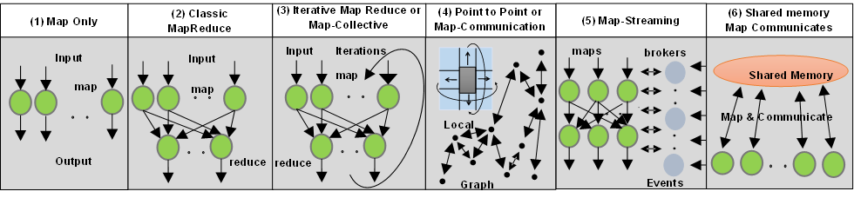
6 Forms of MapReduce cover “all” circumstances
Also an interesting software (architecture) discussion

Slide 25
Benchmarks/Mini-apps spanning Facets
Look at NSF SPIDAL Project, NIST 51 use cases, Baru-Rabl review
Catalog facets of benchmarks and choose entries to cover “all facets”
Micro Benchmarks: SPEC, EnhancedDFSIO (HDFS), Terasort, Wordcount, Grep, MPI, Basic Pub-Sub ….
SQL and NoSQL Data systems, Search, Recommenders: TPC (-C to x–HS for Hadoop), BigBench, Yahoo Cloud Serving, Berkeley Big Data, HiBench, BigDataBench, Cloudsuite, Linkbench
  includes MapReduce cases Search, Bayes, Random Forests, Collaborative Filtering
Spatial Query: select from image or earth data
Alignment: Biology as in BLAST
Streaming: Online classifiers, Cluster tweets, Robotics, Industrial Internet of Things, Astronomy; BGBenchmark.
Pleasingly parallel (Local Analytics): as in initial steps of LHC, Pathology, Bioimaging (differ in type of data analysis)
Global Analytics: Outlier, Clustering, LDA, SVM, Deep Learning, MDS, PageRank, Levenberg-Marquardt, Graph 500 entries
Workflow and Composite (analytics on xSQL) linking above

Slide 26
SDDSaaS
Software Defined Distributed Systems as a Service and Virtual Clusters

Slide 27
Supporting Evolving High Functionality ABDS
Many software packages in HPC-ABDS.
Many possible infrastructures
Would like to support and compare easily many software systems on different infrastructures
Would like to reduce system admin costs
  e.g. OpenStack very expensive to deploy properly
Need to use Python and Java
  All we teach our students
  Dominant (together with R) in data science
Formally characterize Big Data Ogres – extension of Berkeley dwarves – and benchmarks
Should support convergence of HPC and Big Data
  Compare Spark, Hadoop, Giraph, Reef, Flink, Hama, MPI ….
Use Automation (DevOps) but tools here are changing at least as fast as operational software

Slide 28
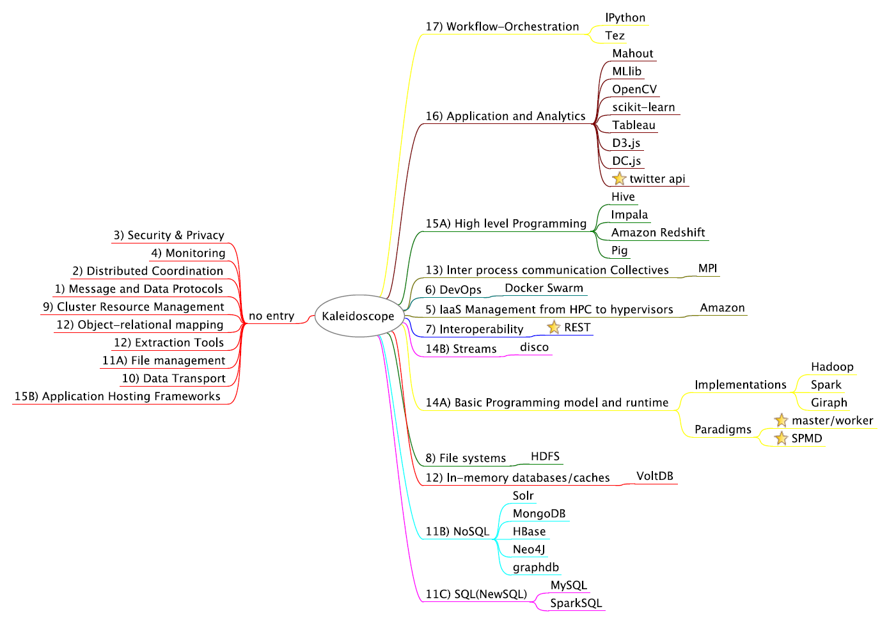
Mindmap of core Benchmarks
http://cloudmesh.github.io/introduction_to_cloud_computing/class/lesson/projects.html
Libraries
Visualization

Slide 29
Automation or
“Software Defined Distributed Systems”
This means we specify Software (Application, Platform) in configuration file and/or scripts
Specify Hardware Infrastructure in a similar way
  Could be very specific or just ask for N nodes
  Could be dynamic as in elastic clouds
  Could be distributed
Specify Operating Environment (Linux HPC, OpenStack, Docker)
Virtual Cluster is Hardware + Operating environment
Grid is perhaps a distributed SDDS but only ask tools to deliver “possible grids” where specification consistent with actual hardware and administrative rules
  Allowing O/S level reprovisioning makes it easier than yesterday’s grids
Have tools that realize the deployment of application
  This capability is a subset of “system management” and includes DevOps
Have a set of needed functionalities and a set of tools from various commuinies

Slide 30
“Communities” partially satisfying SDDS management requirements
IaaS: OpenStack
DevOps Tools: Docker and tools (Swarm, Kubernetes, Centurion, Shutit), Chef, Ansible, Cobbler, OpenStack Ironic, Heat, Sahara; AWS OpsWorks,
DevOps Standards: OpenTOSCA; Winery
Monitoring: Hashicorp Consul, (Ganglia, Nagios)
Cluster Control: Rocks, Marathon/Mesos, Docker Shipyard/citadel, CoreOS Fleet
Orchestration/Workflow Standards: BPEL
Orchestration/Workflow Tools: Pegasus, Kepler, Crunch, Docker Compose, Spotify Helios
Data Integration and Management: Jitterbit, Talend
Platform As A Service: Heroku, Jelastic, Stackato, AWS Elastic Beanstalk, Dokku, dotCloud, OpenShift (Origin)

Slide 31
Functionalities needed in SDDS Management/Configuration Systems
Planning job -- identifying nodes/cores to use
Preparing image
Booting machines
Deploying images on cores
Supporting parallel and distributed deployment
Execution including Scheduling inside and across nodes
Monitoring
Data Management
Replication/failover/Elasticity/Bursting/Shifting
Orchestration/Workflow
Discovery
Security
Language to express systems of computers and software
Available Ontologies
Available Scripts (thousands?)

Slide 32
Virtual Cluster Overview

Slide 33
Virtual Cluster
Definition: A set of (virtual) resources that constitute a cluster over which the user has full control. This includes virtual compute, network and storage resources.
Variations:
  Bare metal cluster: A set of bare metel resources that can be used to build a cluster
  Virtual Platform Cluster: In addition to a virtual cluster with network, compute and disk resources a platform is deployed over them to provide the platform to the user

Slide 34
Virtual Cluster Examples
Early examples:
  FutureGrid bare metal provisioned compute resources
Platform Examples:
  Hadoop virtual cluster (OpenStack Sahara)
  Slurm virtual cluster
  HPC-ABDS (e.g. Machine Learning) virtual cluster
Future examples:
  SDSC Comet virtual cluster; NSF resource that will offer virtual clusters based on KVM+Rocks+SR-IOV in next 6 months

Slide 35
Comparison of Different Infrastructures
HPC is well understood for limited application scope; robust core services like security and scheduling
  Need to add DevOps to get good scripting coverage
Hypervisors with management (OpenStack) are now well understood but high system overhead as changes every 6 months and complex to deploy optimally.
  Management models for networking non trivial to scale
  Performance overheads
  Won’t necessarily support custom networks
  Scripting good with Nova, Cloudinit, Heat, DevOps
Containers (Docker) still maturing but fast in execution and installation. Security challenges especially at core level (better to assign nodes)
  Preferred choice if have full access to hardware and can chose
  Scripting good with machine, Dockerfile, compose, swarm

Slide 36
Tools To Create Virtual Clusters

Slide 37
From Bare metal Provisioning ⬅➔ to Application Workflow
Baremetal | Provisioning | Software | Configuration | State | Service Orchestration | Application Workflow
Ironic
Nova
Heat
disk-mage-bulder
OS config
OS state
MaaS
Juju
Packages
Chef, Puppet, ansible, salt, …
SLURM
Pegasus
Kepler
TripleO : deploys OpenStack

Slide 38
Phases needed for Virtual Cluster Management
Baremetal
  Manage bare metal servers
Provisioning
  Provision an image on bare metal
Software
  Package management, software installation
Configuration
  Configure packages and software
State
  Report on the state of the install and services
Service Orchestration
  Coordinate multiple services
Application Workflow
  Coordinate the execution of an application including state and application experiment management

Slide 39
Some Comparison of DevOps Tools
Score | Framework | Open Stack | Language | Effort | Highlighted features
+++ | Ansible | x | python | low | Low entry barrier, push model, agentless via ssh, deployment, configuration, orchestration, can deploy onto windows but does not run on windows.
+ | Chef | x | Ruby | High | Cookbooks, Client server based, roles
++ | Puppet | x | Puppet DSL / Ruby | medium | Declarative language, client-server based,
(---) | Crowbar | x | Ruby |  | Cent OS only, bare metal, focus on openstack, moved from Dell to SUSE
+++ | Cobbler |  | Python | Medium - high | Networked installations of clusters, provisioning, DNS, DHCP, package updates, power management, orchestration
+++ | Docker |  | Go | very low | Low entry barrier, Container management, Dockerfile
(--) | Juju | x | Go | low | Manages services and applications
++ | xcat |  | Perl | medium | Diskless clusters, manage servers, setup of HPC stack, cloning of images
+++ | Heat | x | Python | medium | Templates, relationship between resources, focuses on infrastructure
+ | TripleO | x | Python | high | OpenStack focused, Install, upgrade OpenStack using OpenStack functionality
(+++) | Foreman | x | Ruby, puppet | low | REST, very nice documentation of REST apis
 | Puppet Razor |  | Ruby, puppet |  | Inventory, dynamic image selection, policy based provisioning
+++ | Salt | x | Python | low | Salt Cloud, dynamic bus for orchestration, remote execution and configuration management, faster than ansible via zeroMQ, ansible is in some aspects easier to use

Slide 40
PaaS as seen by Developers
Platform | Languages | Application staging | Highlighted features | Focus
Heroku | Ruby, PHP, Node.js, Python, Java, Go, Closure, Scala | Source code syncronization via git, addons | build, deliver, monitor and scale apps, data services, marketplace | Application development
Jelastic | Java, PHP, Python, Node.js, Ruby and .NET | Source code syncrhronization: git, svn, bitbucket | PaaS and container based IaaS, Heterogeneous cloud support, plugin support for IDEs and builders such as maven, ant | Web server and database development. Small number of available stacks
AWS Elastic Beanstalk | Java, .NET, PHP, Node.js, Python, Ruby, Go, and Docker | Selection from Webpage/REST API, CLI | deploying and scaling web applications | Apache, Nginx, Passenger, and IIS and self developed services
Dokku | See heroku | Source code synchronisation via git | Mini Heroku powered by docker, docker | Your own single-host local Heroku,
dotCloud | Java, Node.js PHP, Python, Ruby, (Go) |  | Sold by Docker. Small number of examples | managed service for web developers
Redhat Openshift |  | Via git | automates the provisioning, management and scaling of applications | Aplication hosting in public cloud
Pivotal Cloud Foundry | Java, Node.js ,Ruby, PHP, Python, Go | Command line |  | Integrates multiple clouds, develop and manage applications
Cloudify | Java, Python, REST | Command line, GUI, REST | open source TOSCA-based cloud orchestration software platform, can be installed locally | open source, TOSCA, integrates with many cloud platforms
Google App Engine | Python, Java, PHP, Go |  | Many useful services from OAUTH to MapReduce | run applications on Google’s infrastructure

Slide 41
Cloudmesh

Slide 42
CloudMesh SDDSaaS Architecture
Cloudmesh is a open source http://cloudmesh.github.io toolkit:
  A software-defined distributed system encompassing virtualized and bare-metal infrastructure, networks, application, systems and platform software with a unifying goal of providing Computing as a Service.
  The creation of a tightly integrated mesh of services targeting multiple IaaS frameworks
  The ability to federate a number of resources from academia and industry. This includes existing FutureSystems infrastructure, Amazon Web Services, Azure, HP Cloud, Karlsruhe using several IaaS frameworks
  The creation of an environment in which it becomes easier to experiment with platforms and software services while assisting with their deployment and execution.
  The exposure of information to guide the efficient utilization of resources. (Monitoring)
  Support reproducible computing environments
  IPython-based workflow as an interoperable onramp
Cloudmesh exposes both hypervisor-based and bare-metal provisioning to users and administrators
Access through command line, API, and Web interfaces.

Slide 43
Cloudmesh Functionality
Virtual Machine
Management
  IaaS Abstraction
Provisioning Management
  Rain
  Cloud Shifting
  Cloud Bursting
Experiment
Management
  Shell
  IPython
Information Services
  CloudMetrics
Cloudmesh
Accounting
  Internal
  External
User On-Ramp
Amazon, Azure, FutureSystems, Comet, XSEDE, ExoGeni, Other Science Clouds
Notes:
Due to its integrated services Cloudmesh provides the ability to be an onramp for other clouds.
It provides information services to various system level sensors to give access to sensor and utilization data. Internally, it can be used to optimize the system usage.
The provisioning experience from FutureGrid has taught us that we need to provide
the creation of new clouds (rain)
the repartitioning of resources between services (cloud shifting)
and the integration of external cloud resources in case of over provisioning (cloud bursting)
As we deal with many IaaS frameworks, we need an abstraction layer on top of the IaaS framework.
Experiment management is conducted with workflows controlled in shells, Python/iPython, as well as systems such as OpenStack's Heat.
Accounting is supported through additional services such as user management and charge rate management.
Not all features are yet implemented. Figure shows the main functionality that we target at this time to implement.

Slide 44
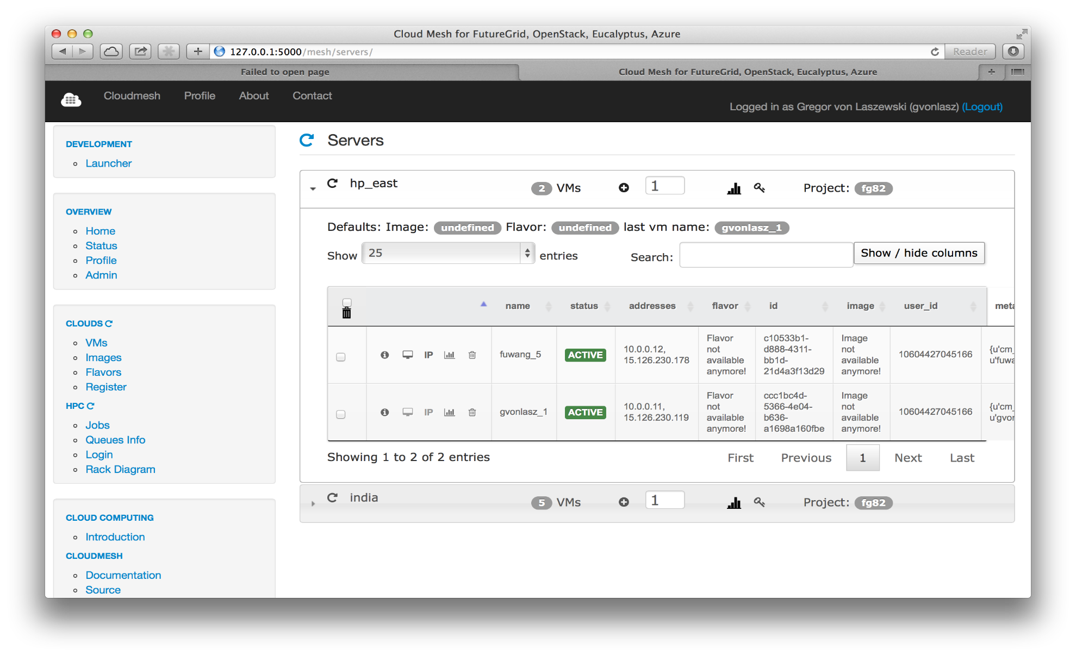
… Working with VMs in Cloudmesh
Search
VMs
Panel with VM Table (HP)

