Slide 1
CODES: Using Parallel Discrete-Event Simulation to Model Performance and Reliability of Extreme-Scale and Distributed Data-Intensive Systems
Robert Ross (PI), Phil Carns, John Jenkins, Misbah Mubarak, Shane Snyder
Argonne National Laboratory
Christopher Carothers (PI), Justin LaPre, Elsa Gonsiorowski, Caitlin Ross, Mark Blanco, Mark Plagge and Noah Wolfe
Rensselear Polytechnic Institute
PPAM 2015: September 6-9, Krakow, Poland

Slide 2
Outline
Research problems & simulation framework overview
Exploring design space of extreme-scale HPC networks
Resilience in distributed data-intensive storage systems
Data movement and access on data-intensive science & workflow platforms

Slide 3
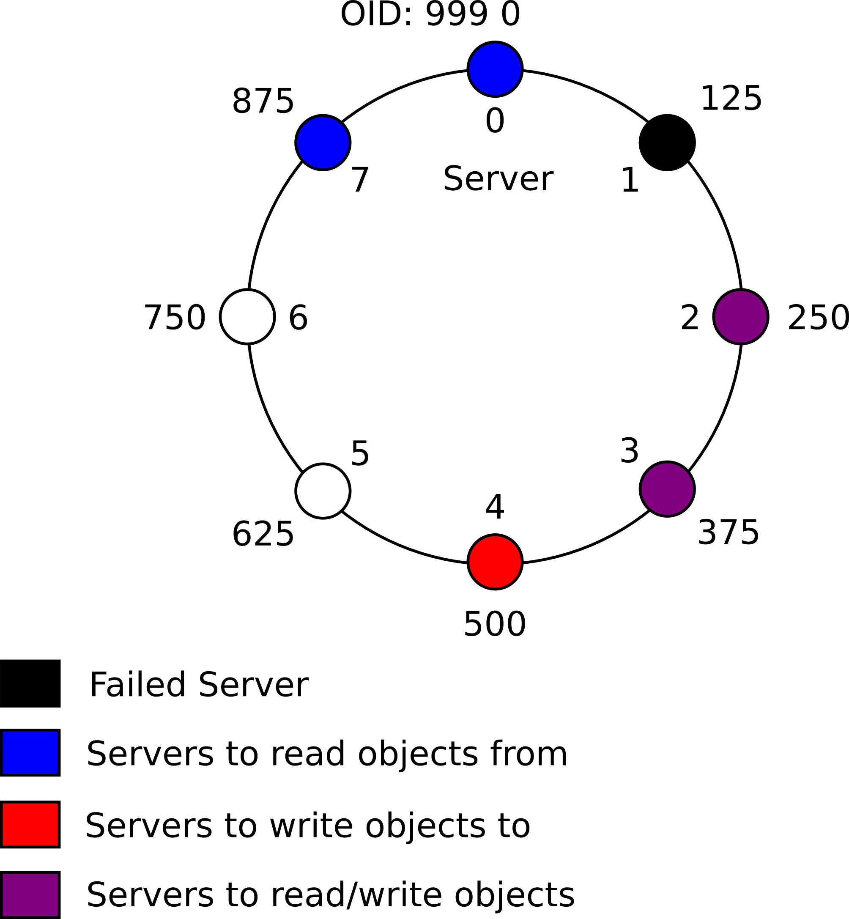
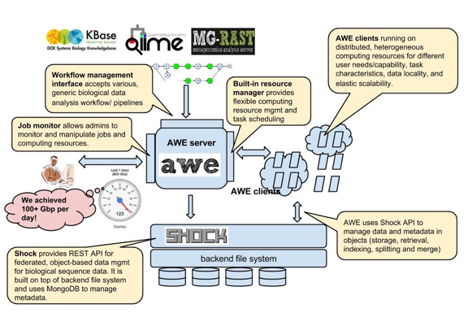
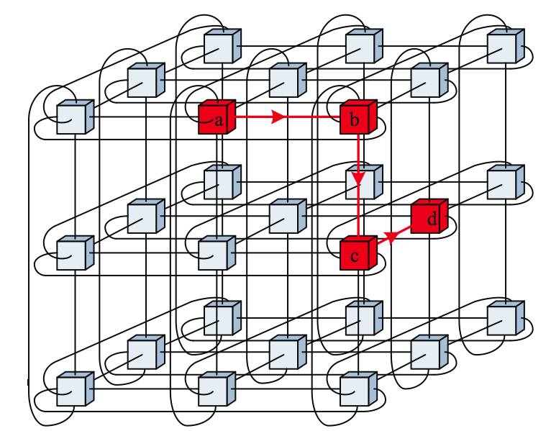
Understanding Performance and Reliability issues in HPC and distributed systems
Image credit: Wei Tang, ANL
MG-RAST Meta-genomic data-analytic service
Rebuild protocol in distributed object storage
Data movement and access on data-intensive science platforms
Resilience in distributed data-intensive
storage systems
Dragonfly Network Topology
Torus Network Topology
Dragonfly group
Dragonfly group
Design space of extreme-scale HPC networks

Slide 4
Key Research Problems
Extreme-scale Network and Storage Systems Co-design
  Design space exploration of massively parallel torus, dragonfly networks. Key questions: configuring link bandwidth, dimensionality, buffer space etc. under different workloads?
  Impact of Neuromorphic Processors on Extreme-Scale HPC Systems
Resilience in Distributed Storage Systems
  Efficient protocols in replicated object storage systems
  Interplay of different algorithmic components (membership, I/O traffic)
Distributed data-intensive science infrastructure and scientific workflows
  MG-RAST/Kbase (biosciences): provisioning, resource allocation, scheduling algorithms
  High-Energy Physics: resource allocation, cache life times, caching policies of Fermilab’s petabyte scale storage systems
  Panorama: Use of Pegsus workflow engine for science applications

Slide 5
CODES Simulation framework for extreme-scale HPC & Distributed Systems
Workflows
Detailed simulation of storage and network components, scientific workloads and the surrounding environment.
Modular simulation components
  Pluggable I/O and network workload components
  Pluggable high-performance network models
Incrementally develop simulation capability, validating approach and components along the way
Goal: provide a simulation toolkit to the community to enable broader investigation of the design space.
Workloads
Services
Protocols
Hardware/Networks
Simulation (PDES)
Notes:
- pluggable I/O and network workload models enable investigators to interchangeably use both application traces and synthetic workloads in their experiments.

Slide 6
Enabling CODES: parallel discrete-event simulation
Discrete event simulation (DES): a computer model for a system where changes in the state of the system occur at discrete points in simulation time
Parallel DES allows execution of simulation on a parallel platform
  Enables much richer simulations (e.g., more events) than otherwise possible
Rensselaer Optimistic Simulator System (ROSS) provides PDES capability for CODES
  Written in ANSI C
  Optimistically schedules events. Rollback realized via reverse computation
  Users provide functions for reverse computation – undo the effects of a particular event on the LP state
  Logical processes (LPs) model state of the system
  Scalable: can efficiently execute simulations with millions of network nodes at a flit-level fidelity
Simulation pre-reqs for co-design
Cost (Time + Memory)
Fidelity + Accuracy
Scalability

Slide 7
How to Synchronize Parallel Simulations?
parallel time-stepped simulation:
lock-step execution
parallel discrete-event simulation:
must allow for sparse, irregular
event computations
barrier
Problem: events arriving
in the past
Virtual
Time
Virtual
Time
Approach: Time Warp
PE 1
PE 2
PE 3
PE 1
PE 2
PE 3
processed event
“straggler” event

Slide 8
Massively Parallel Discrete-Event Simulation Via Time Warp
V
i
r
t
u
a
l
T
i
m
e
Local Control Mechanism:
error detection and rollback
V
i
r
t
u
a
l
T
i
m
e
Global Control Mechanism:
compute Global Virtual Time (GVT)
(1) undo
state Δ’s
(2) cancel
“sent” events
collect versions
of state / events
& perform I/O
operations
that are < GVT
GVT
LP 1
LP 2
LP 3
LP 1
LP 2
LP 3
processed event
unprocessed event
“straggler” event
“committed” event

Slide 9
ROSS: Local Control Implementation
MPI_ISend/MPI_Irecv used to send/recv off core events
Event & Network memory is managed directly.
  Pool is allocated @ startup
Event list keep sorted using a Splay Tree (logN)
LP-2-Core mapping tables are computed and not stored to avoid the need for large global LP maps
V
i
r
t
u
a
l
T
i
m
e
Local Control Mechanism:
error detection and rollback
(1) undo
state Δ’s
(2) cancel
“sent” events
LP 1
LP 2
LP 3

Slide 10
ROSS: Global Control Implementation
GVT (kicks off when memory is low):
  Each core counts #sent, #recv
  Recv all pending MPI msgs.
  MPI_Allreduce Sum on (#sent - #recv)
  If #sent - #recv != 0 goto 2
  Compute local core’s lower bound time-stamp (LVT).
  GVT = MPI_Allreduce Min on LVTs
gvt-interval/batch parameters control how frequently GVT is done.
Note, repurposed GVT to implement conservative YAWNS algorithm!
V
i
r
t
u
a
l
T
i
m
e
Global Control Mechanism:
compute Global Virtual Time (GVT)
collect versions
of state / events
& perform I/O
operations
that are < GVT
GVT
LP 1
LP 2
LP 3
So, how does this translate into ROSS performance on extreme-scale supercomputers?

Slide 11
ROSS Strong Scaling @ 1,966,080 cores
PHOLD w/ 256M+ LPs and ~4B active events
ROSS can process 33T events in 65 secs!
Deterministic parallel event processing!

Slide 12
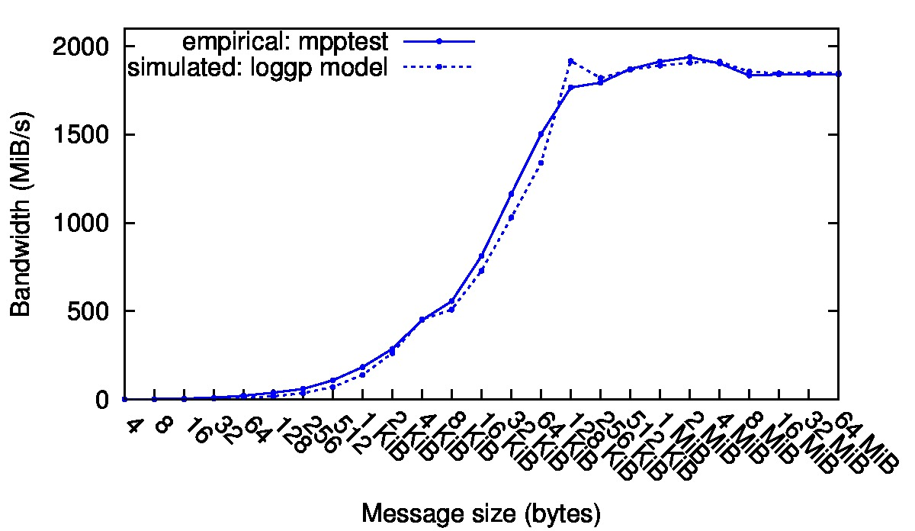
CODES Pluggable Network and I/O Models
Pluggable Network models:
  Models are decoupled from higher levels via a consistent API
  Analytic – based on LogGP
  Flit-level simulation of torus, dragonfly topologies at extreme scale
  Flit-level fat-tree and SlimFly models are being developed
Pluggable Network and I/O workloads
  I/O workload component: Allows arbitrary workload consumer components to obtain IO workloads from a diverse range of input sources including characterization tools like Darshan.
  Network workload component: Allows workloads from the Design Forward* program to be replayed on pluggable network models
MPI message latency of CODES logGP model and mpptest
  *http://portal.nersc.gov/project/CAL/doe-miniapps.htm
MPI message latency of CODES torus model vs. mpptest on Argonne BG/P (1 mid-plane) and RPI Amos BG/Q (1 rack) networks, 8 hops, 1 MPI rank per node

Slide 13
CODES Pluggable Network Models: Torus
N-ary k-cube network
Widely used: IBM Blue Gene, Cray XT5 and Cray XE6 systems
Validated the point-to-point messaging of the CODES torus model with the Blue Gene/P and Blue Gene/Q architectures
Complex HPC networks can be simulated at a flit-level fidelity
Ability to support synthetic and realistic network traces
  Network traces from the design forward program can be executed on top of the network models
Serial performance is 5 to 12x faster than “booksim”
Average and maximum latency of a 1,310,720 node 5-D, 7-D and 9-D torus model simulation with MPI rank communicating with 18 other ranks
MPI message latency of CODES torus with network traces from the Design Forward program (AMG, Nek 5000 and MiniFE applications)

Slide 14
CODES Pluggable Network Models: Dragonfly
Hierarchical topology: several groups connected via all-to-all links
Used in Edison (Cray XC30) and Cori architectures
CODES dragonfly model supports minimal, non-minimal and adaptive routing
Shown to scale on millions of network nodes with a simulation event-rate of up to 1.33 billion events/second on IBM Blue Gene/Q
Key Questions: Effect of dimensionality, network configuration and link bandwidth on performance?
Average (left) and maximum (right) latency of a 1.3M node dragonfly network model with global traffic pattern (minimal & non-minimal routing)
Million-node dragonfly simulation performance on 1 rack of Mira Blue Gene/Q

Slide 15
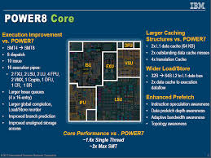
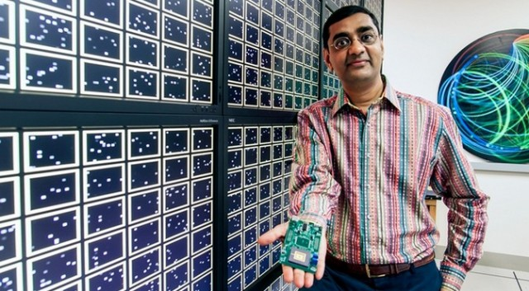

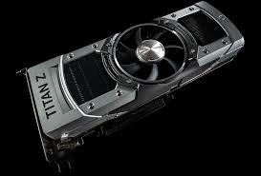
AFRL: Hybrid Neuromorphic Supercomputer?
Co-PI: Jim Hendler
The question: how might a neuromorphic “accelerator” type processor be used to improve the HPC application performance, power consumption and overall system reliability of future extreme-scale systems?
Driven by the recent DOE SEAB report on high-performance computing [22] which high-lights the neuromorphic architecture as one that “is an emergent area for exploitation”.
Address using CODES parallel discrete-event framework
15

Slide 16
Neuron Model From IBM TrueNorth
ROSS event-driven neuron model and will integrate into CODES framework
Performance: 1M neuron w/ 256M synapses executes 20M ev/sec using 32 Xeon cores

Slide 17
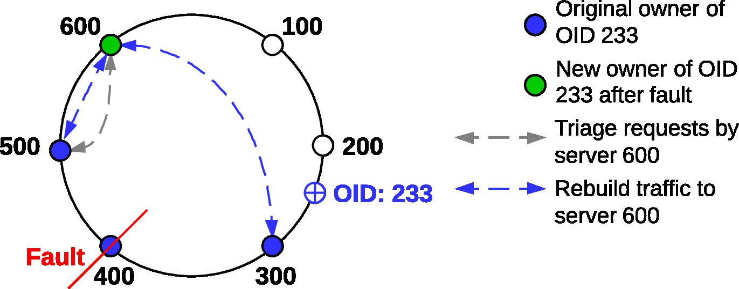
CODES Resilience Models: Distributed Object Storage Rebuild Simulation (P. Carns, ANL)
Some protocols of interest in a replicated object storage system:
  Rebuild – we’ve detected a server down, how do we re-replicate data?
  Forwarding – how do we propagate write data between servers efficiently?
Example: rebuild
Question: How do pipelining of data transfers and object placement affect rebuild performance?
Notes:
Pipelining is common technique for optimizing server data transfers [32–34]. In Tendril we implement pipelining by dividing objects into smaller buffers and then transferring those buffers with asynchronous network operations and multithreaded disk I/O. The pipeline buffer size should be large enough to amortize startup costs but small enough to maximize concurrency. Figure 8 shows the results of a simulated pipelined transfer of a single 1 TiB object be- tween two servers using the network and disk parameters obtained in Sections 5.2 and 5.3. Each server was con- figured to commit a maximum of 1 GiB of RAM to re- ceiving/writing data and 1 GiB of RAM to reading/sending data. The pipelined transfer reaches a near-peak rate of 1.5 GiB/s using a 16 MiB buffer size; both servers are bottle- necked by storage throughput. We also plot the transfer bandwidth with pipelining disabled, and we observe that the servers are unable to saturate their hardware resources in this configuration. Based on these results, we config- ured our storage system model to enable pipelining with a buffer size of 16 MiB.

Slide 18
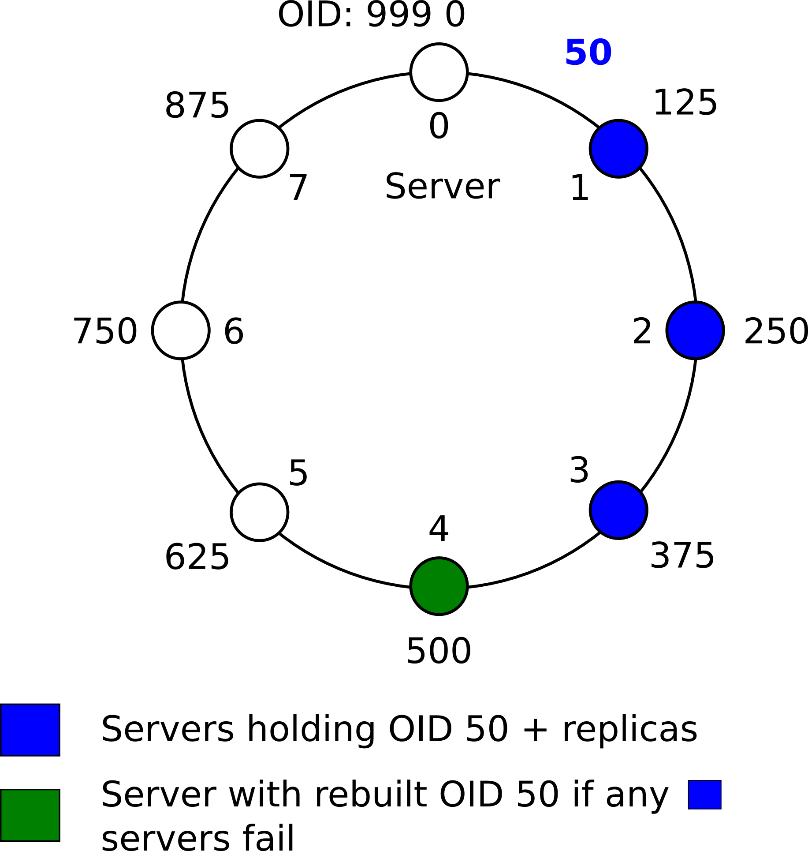
CODES Resilience Models: Distributed Object Storage Rebuild Simulation
Each element of the storage system identified by an integer ID
Each object N-way replicated (N=3 in the example)
Requirements for rebuild:
  Detect fault (duty of membership algorithm/protocol)
  Determine what objects need to be re-replicated
Work explores advanced placement algorithms e.g. multi-ring hash algorithm
Design questions: Determine the effect of algorithm/configuration on rebuild? (e.g., how many rings to use?)
Simulation was executed with 64 processes on a Linux cluster and produced between 97 million and 375 million events
1-d ring object
placement

Slide 19
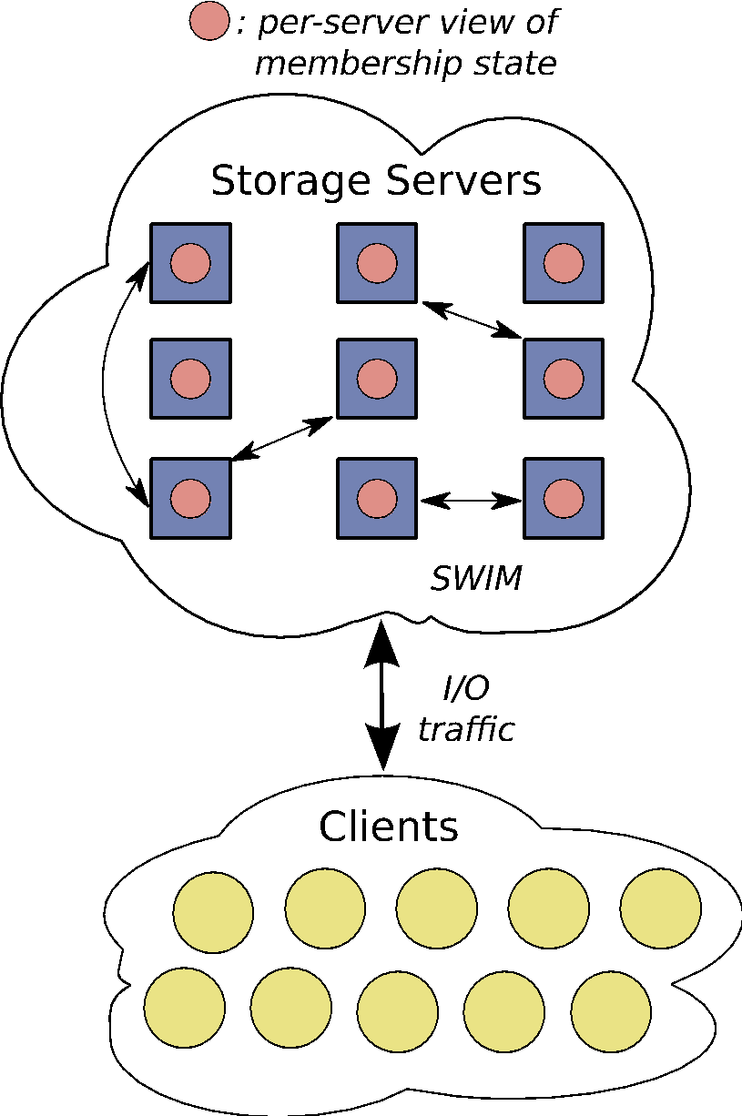
CODES Resilience Models: Group Membership with SWIM protocol
Scalable Weakly-consistent Infection-style Process Group Membership Protocol [1]
Developed a high-resolution model of the SWIM protocol
  Individual network message costs are calculated using the LogGP network model
  Full-duplex network message queuing at each node
  Use existing analytical models from the literature to choose initial parameters
  Use simulation to evaluate behavior that can’t be predicted using analytical models
Scale:
  O (thousands) of file servers
  Tolerate transient errors < 15 seconds
  Take action (confirm failure) within 30 seconds
Questions:
  How fast do membership updates propagate through the system?
  How much network traffic are we willing/able to incur?
[1] Das, A., Gupta, I., Motivala, A.: Swim: Scalable weakly-consistent infection-style process group membership protocol. In: Proceedings of the 2002 International Conference on Dependable Systems and Networks. pp. 303–312. DSN ’02, IEEE Computer Society Press, Washington, DC, USA (2002)

Slide 20

CODES Service Models: MGRAST Metagenomics Analytic Server
Simulation!
W. Tang, J. Wilkening, N. Desai, W. Gerlach, A. Wilke, F. Meyer, "A scalable data analysis platform for metagenomics," in Proc. of IEEE International Conference on Big Data, 2013
Credit: Wei Tang
Notes:
Metagenomics [10] is the study of microbial communities. Insight into these communities sheds light on a wide range of areas, including human health [6] and environmental processes [2]. It typically needs additional depth of sequencing; thus a low sequencing cost is beneficial.
MG-RAST (2007) is metagenomics analysis server, providing automated data analysis for metagenome data sets submitted by users via web interfaces.
Current usage stats:
# of metagenomes 207,598
# base pairs 83.09 Tbp
# of sequences 663.93 billion
# of public metagenomes 28,896
Qlime ==“ Chime”

Slide 21
CODES Service Models: MGRAST Metagenomics Analytic Server
Research Questions:
  Evaluate effects of various configurations on metagenomics / bioinformatics workflows
  Effectiveness of a resource configuration
  Exploring scheduling algorithms (data-aware scheduling)
  Distribute data to take advantage of locality of access
    Proxy servers, hierarchical server topology
Job response time
Utilization
Number of awe-clients
Credit: Wei Tang
Number of awe-clients
Notes:
Workload – MG-RAST trace, 1 week,
March
1,560 jobs, 42,962 workunits
1.1 TB input data

Slide 22
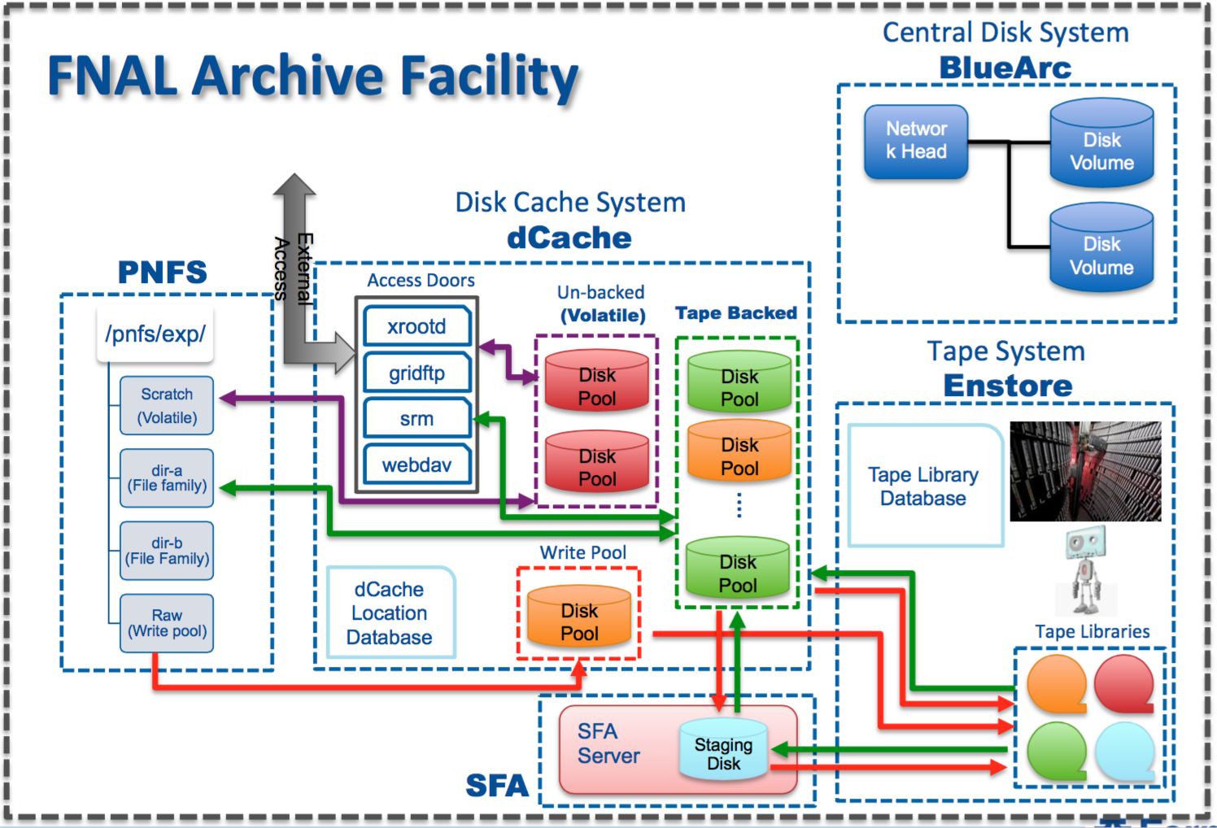
CODES Service Models: High-Energy Physics (HEP) Science Data Facility (R. Ross, M. Mubarak)
~85PB tape capacity w/ ~55PB currently used
Image Credit: Andrew Norman, Adam Lyon @ Fermilab
Notes:
FNAL = Fermi National Accelerator Lab

Slide 23
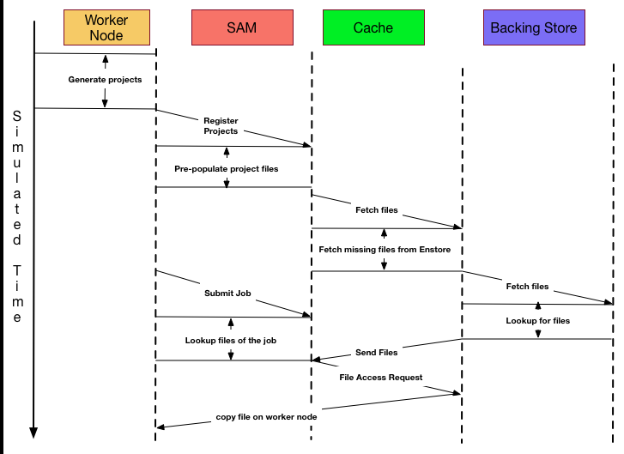
CODES Service Models: High-Energy Physics (HEP) Data Facility (R. Ross, M. Mubarak)
Experimental/observational data
processing pipeline @ Fermilab
Work underway to develop an end-to-end simulation of Fermilab’s HEP scientific data facility
  Validate the simulation against actual data facility logging information
  Use realistic HEP workflows scenarios
Research Questions:
  How best to configure existing peta-byte scale storage systems? E.g. how to increase cache life times, trying different cache policies
  How to quantify the value for deploying new hardware? E.g. adding more archival devices for e.g. tapes.
Fig: Initial simulation model of the Fermilab data-access facility
Notes:
Special-purpose hardware/software doing petabyte-scale
filtering/analysis
What is SAM?
Sam is a file based data management and access layer between the Storage Management System and the data processing layers. The goal of this SAM is to optimize the use of data storage and delivery resources, such as tape mounts, drive usage, and network bandwidth. In order to facilitate this goal, the primary objectives are:
Clustering the data onto tertiary storage in a manner corresponding to access patterns
Caching frequently accessed data on disk or tape
Organizing data requests to minimize tape mounts
Estimating the resources required for file requests before they are submitted and, with this information, making administrative decisions concerning data delivery priority.
In addition, it is desired to unload the burden of individual file tracking from the analysis physicists, and place it onto the data management system. This is an added bonus integrated into the SAM system.

Slide 24
Panorama: Predictive Modeling and Diagnostic Monitoring of Extreme Science Workflows
Deelman (ISI), Tierney (LBNL), Vetter (ORNL), Mandal (RENCI), Carothers (RPI)
Notes:
The main questions this work aims to address are: 1) how to develop analytical models that can predict the behavior of complex, data-aware scientific workflows executing in extreme scale infrastructures? 2) what monitoring information and information analysis is needed for performance prediction and anomaly detection in scientific workflow execution?, and 3) how to adapt the workflow execution and the infrastructure to achieve the potential performance predicted by the models. These questions will be addressed within the context of two DOE applications: Climate and Earth System Modeling (CESM), which processes large amount of community data and Spallation Neutron Source (SNS), which produces rich experimental data used in a variety of complex analysis.
The program of research focuses on data-aware workflow performance modeling, monitoring, and analysis and integrates this diverse information into knowledge about workflow behavior that can inform the scientist and the infrastructure providers about the observed performance issues and their causes. This work will develop end-to-end workflow-level analytical models that capture the behavior of the workflow tasks performance on a variety of systems as well as workflow data movement and storage across different networks and devices. The analytical models will be coupled with simulation-based models to increase fidelity of the predictions in dynamic environments. The models will be validated through experiments on DOE infrastructures (such as the ESnet testbed and production infrastructure, the ORNL facilities), on distributed testbeds like ExoGENI, and through simulations.

Slide 25
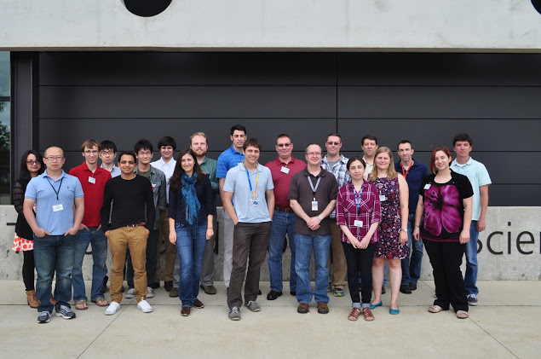
Summary, Repo access and acknowledgements
CODES is a growing framework being used to investigate design issues for a wide variety of extreme-scale systems design questions
  Parallel simulation enables high-fidelity models to be created that execute in a human relevant time-scale
  Enables @ scale design scenarios to be investigated
CODES developer access
  http://www.mcs.anl.gov/research/projects/codes/
  Documentation is contained with the repo
1st Summer of CODES workshop proceedings
  http://press3.mcs.anl.gov/summerofcodes2015/
Acknowledgements:
  Wolfgang Gerlach, Folker Meyer (ANL)
  Adam Lyon, Andrew Norman, James Kowalkowski (Fermilab)
  Wei Tang (Google)

