Slide 1
Building a Global Research Data Community
Dr. Francine Berman
Chair, Research Data Alliance / US
Hamilton Distinguished Professor in Computer Science, Rensselaer Polytechnic Institute

Slide 2
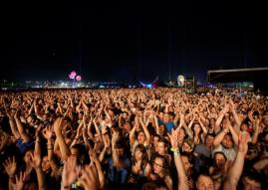
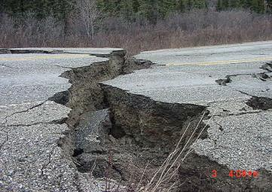
Research Data Driving Solutions to Complex Science and Societal Challenges
How does disease spread in large urban populations?
What is the likely impact of a large-scale earthquake?
Disease spread models couple
Medical data with
Population data,
Envt. Data,
Org. Data …
Earthquake simulations integrate
Fault geometry data with
Subsurface data,
Structure data,
Population data,
Physical infrastructure data, …
How can we increase wheat yields?
Productivity analysis leverages interoperability of
Germplasm data with
Genetic and phenotypic data,
Statistical data,
Bibliographic data, …
Fran Berman

Slide 3
Sharing and Exchange of Data Leading to an Acceleration of Innovation

Slide 4
Data Sharing in Astronomy: More life in the Universe?
June, 2013: Announcement of discovery of 3 “habitable” planets around the star Gliese 667C -- ~129 trillion miles (~ 22 light years) away*
Gliese 667C is 1/3 the size of the sun. Habitable (liquid water could exist, etc.) planets are more massive than earth.
International research team includes researchers from Germany, U.K., U.S., Finland, Chile
*Paper published in Astronomy and Astrophysics
http://www.eso.org/public/archives/releases/sciencepapers/eso1328/eso1328a.pdf

Slide 5
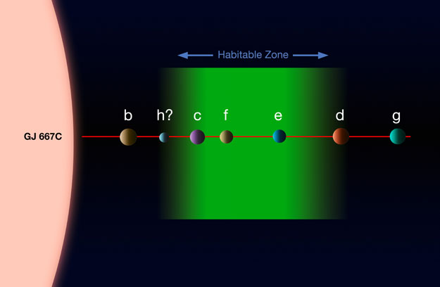
Data-Driven Discovery
“We identified 3 strong signals in the star before, but it was possible that smaller planets were hidden in the data. We re-examined the existing data, added some new observations and applied two different data analysis methods especially designed to deal with multi-planet signal detection.”
Guillem Anglada-Escude’ University of Gottingen, Germany

Slide 6
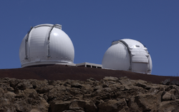
The Data “Backstory”
Data mostly from ESO Science Archive Facility. Data sets include HARPS-TERRA Doppler measurements, HIRES, and PFS.
Observations based in part from W. M. Keck Observatory, Magellan team (Doppler measurements), SIMBAD Data base (CDS in France).
Data infrastructure needed:
Data management, hosting and preservation infrastructure
Data analysis tools
Standards for astronomy data and metadata. Organizational policy and adoption in the use of standards.
Community practice and technological infrastructure enabling data sharing between researchers

Slide 7
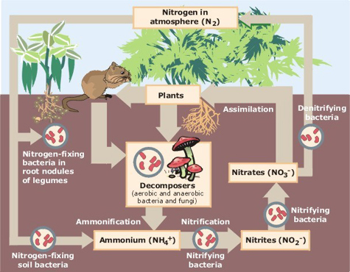
Data-Driven Research Requires an Ecosystem Impact is dependent on effective development and integration of all components
Social Infrastructure
Data-driven Innovation
Results
Publications
Apps
…
Data-driven Research
Organizational Policy
Institutional Practice
Standards Bodies
Legal and Regulatory Frameworks
Economic Models
Community Organizations
…
Tools
Systems
Frameworks
Databases
Data Portals
Data Centers
…
Technical Infrastructure

Slide 8
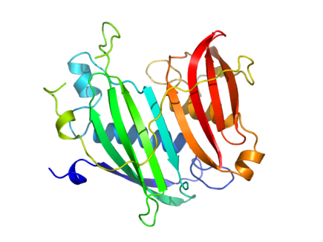
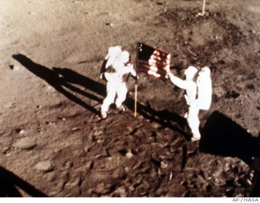
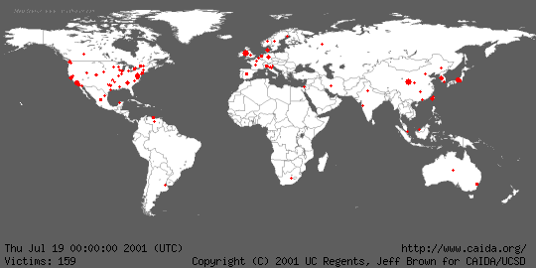
Technical Infrastructure, Social Infrastructure Provide the Foundation for Data-Driven Research
Data Access
Data
Sharing
Data Visualization
Data Analysis
Data Services
Data Mining
Data Sharing Practice
Data Management
Digital Object
Identifiers
Common Metadata Standards
Data Citation Standards
Data Access and Distribution Policy
Tools and infrastructure that promote Discoverability
Data Preservation
Data Storage
Sustainable Economic Model

Slide 9
Data Sharing Pre-Supposes Data Stewardship – including supporting infrastructure and economic models
Costs / components of Data infrastructure include
Maintenance and upkeep
Software tools and packages
Utilities (power, cooling)
Space
Networking
Security and failover systems
People (expertise, help, infrastructure management, development)
Training, documentation
Monitoring, auditing
Reporting costs
Costs of compliance with regulation, policy, etc. …
Resources and Resource Refresh
SDSC Data Storage Growth ‘97-’09
Most valuable data replicated
As research collections increase, storage capacity must stay ahead of demand
Information courtesy of Richard Moore, SDSC

Slide 10
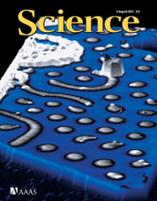
Data Economics: Who Pays the Bill for Public Access to Research Data?
Science article: Science Magazine, August 9, 2013

Slide 11
Potential Economic Solutions to Support Public Access Research Data in All Sectors
Multiple approaches can provide Stewardship Options:
PRIVATE SECTOR: Facilitate private sector stewardship of public access research data
ACADEMIC SECTOR: Use public sector investment to jumpstart sustainable academic sector stewardship solutions
PUBLIC SECTOR: Create and clarify public sector stewardship commitments for public access research data
RESEARCH COMMUNITY: Encourage research culture change to take advantage of what works in the private sector

Slide 12
Data-Driven Research Requires an Ecosystem Impact is dependent on effective development and integration of all components
Social Infrastructure
Data-driven Innovation
Results
Publications
Apps
…
Data-driven Research
Organizational Policy
Institutional Practice
Standards Bodies
Legal and Regulatory Frameworks
Economic Models
Community Organizations
…
Tools
Systems
Frameworks
Databases
Data Portals
Data Centers
…
Technical Infrastructure

Slide 13
The Power of Many: Community effort needed to move efforts beyond individuals / institutions
“Just do it” -- Focused efforts help communities drive tangible progress
Creation / adoption of data sharing policies have accelerated research innovation
Development of a public access to shared data collection enabling new results for Alzheimer’s
Development and adoption of parallel communication protocols through the MPI Forum drove a generation of advances
Now 25 years old, the Internet Engineering Task Force’s mission “to make the Internet work better” has resulted in key specifications of Internet community standards that support innovation

Slide 14
Development of Data Sharing Infrastructure has emerged as a Global Priority

Slide 15
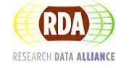
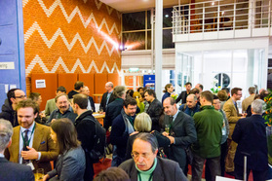
The Research Data Alliance (RDA)
Global community-driven organization launched in March 2013 to accelerate data-driven innovation
RDA focus is on building the social, organizational and technical infrastructure to
reduce barriers to data sharing and exchange
accelerate the development of coordinated global data infrastructure

Slide 16
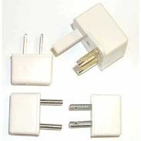
Goal of RDA Infrastructure: Support Data Sharing and Interoperability Across Cultures, Scales, Technologies
Common metadata standards
Interoperability / integration framework
Data access and preservation policy and practice
Harmonized standards
Common economic model for sustaining data
Digital object identifiers
Tools for data discoverability
Etc. …
Harmonized standards
Policy and Practice

Slide 17
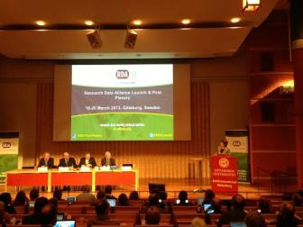
RDA Launch March 2013 Gothenburg, Sweden
Over 200 participants
31 countries
5 continents
> 6,400 tweets
Public, private, academic sectors
High-profile Govt. and Science speakers
Left photo courtesy of Leif Laaksonen

Slide 18
CREATE → ADOPT → USE
RDA Members come together as
Working Groups – 12-18 month efforts to build, adopt, and use specific pieces of infrastructure
Interest Groups – longer-lived discussion fora that spawn Working Groups as specific pieces of infrastructure to build are identified.
RDA efforts focus on the development and use of data sharing infrastructure
Focused pieces of adopted code, policy, infrastructure, standards, or best practices that enable data sharing
“Harvestable” efforts for which 12-18 months of work can eliminate a roadblock
Efforts that have substantive applicability to groups within the data community, but may not apply to everyone
Efforts for which working scientists and researchers can start today

Slide 19
RDA Interest Groups focusing on what infrastructure is needed for data sharing and exchange
Current RDA Interest Groups
Agricultural Data Interoperability
Big Data Analytics
Brokering
Data in Context
Defining Urban Data Exchange for Science
Engagement Gorup
Legal Interoperability (joint with CODATA)
Marine Data Harmonization
Data Citation
Preservation e-Infrastructure
Publishing Data
Repository Audit and Certification
Structural Biology
Community Capability Model
UPC Code for Data
Digital Practices in History and Enthnography
…

Slide 20
RDA Digital History and Ethnography Interest Group
What factors increase your risk of getting asthma?
What factors increase your ability to get better?
How do organizations respond to asthma?
How do communities respond to asthma?
Information courtesy of Kim Fortun

Slide 21
Asthma as a socio-cultural-health issue
How is asthma contracted, experienced and cared for in neighborhoods, cities, and countries?
Relevant data: Health, environmental, population, socio-cultural, historical data, etc. in the form of images, video, oral interviews, surveys, HIPAA-compliant data, etc.
Information courtesy of Kim Fortun

Slide 22
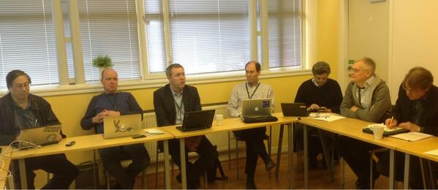
RDA Working Groups Creating a Pipeline of Impact-focused Deliverables
RDA Working Groups
PID Information Types
Data Type Registries
Data Foundation and Terminology
Practical Policy
Metadata Standards
Standardization of Data Categories
…

Slide 23
RDA Persistent Identifier (PID) Information Types Working Group
RDA Working Group Focus:
Harmonization of basic information types associated with persistent identifiers
Agreement about the information associated with PIDs allows programmers to implement the same API independent of the PID type being used
Impact:
Facilitates type harmonization and interoperability between data sharing tools in different infrastructures and domains
Deliverables:
Community-vetted list of common information types; framework to introduce more types; mechanisms to develop profiles, collections and typed references
Prototype API service for requesting PID information
Adopters:
Infrastructure supported by CNRI, California Digital Library
API will be used in practice by DKRZ, Data Conservancy, DARIAH (research data infrastructure in arts and humanities), EUDAT (EU Data Infrastructure collaborative)

Slide 24
Current Status: RDA Community = > 850 participants from 50+ countries
Albania
Australia
Austria
Bangladesh
Belgium
Bulgaria
Brazil
Canada
China
Congo
Czech Republic
Denmark
Estonia
Finland
France
Germany
Greece
Iceland
India
Iran
Ireland
Italy
Japan
Krygrystan
Kuwait
Netherlands
New Zealand
Norway
Palestine
Poland
Portugal
Russia
Serbia
Singapore
South Africa
South Korea
Spain
Sweden
Switzerland
Taiwan
Turkey
United Arab Emirates
United Kingdom
United States
…
Fran Berman

Slide 25
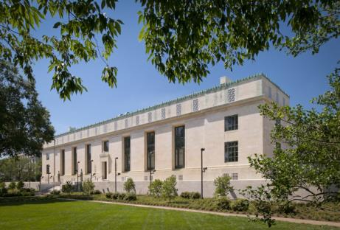
RDA Plenary 2: September 16-18 in Washington, DC
National Academies and Washington Marriott, September 16-18
Working Meeting for RDA Interest Groups and Working Groups
Plenary Speakers and Panels
RDA Business Meeting and Community Events
“Neutral space” to convene communities
RDA Plenary 3 in Dublin Ireland, March 26-28 2014, hosted by Australia and Ireland

Slide 26
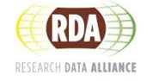
RDA – How to Get Involved (rd-alliance.org)
Join RDA to participate as an individual member. Register at rd-alliance.org. Membership is free.
Join as an Organizational Member (nominal fee) or an Organizational Affiliate (jointly sponsored efforts)
Initiate or Join an Interest Group Community members exploring infrastructure in topical areas
Propose or Join a Working Group (focused12-18 month efforts with measurable outcomes that accelerate data sharing and exchange)
Come to an RDA Plenary. Registration at rd-alliance.org

Slide 27
Building a Global Research Data Community Requires a Multi-Pronged Approach and Strategic Coordination
Broad Coordination
Technical infrastructure
Social infrastructure
Data-Driven Research
Practice and Policy
Community Organizations
Data Centers, Repositories, Archives
Data tools, Systems, Standards

Slide 28
Thank You!
enquiries@rd-alliance.org
bermaf@rpi.edu

