Slide 1
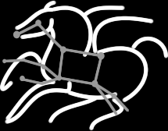
Challenges and Solutions in
Science Automation
Ewa Deelman
USC Information Sciences Institute
http://www.isi.edu/~deelman
Funding from DOE, NSF and NIH
http://pegasus.isi.edu

Slide 2
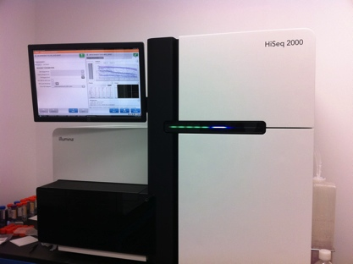
Simplified Experimental Science Lifecycle
Modify hypothesis
Modify model
Science Question
?
Hypothesis generation
Model development
Theoretical prediction
Compare & Improve theory
Empirical Results
Data Analysis
Data Collection
Data Integration
Modify
analysis
Modify data collection
New Knowledge
Select different data
Data repos.

Slide 3
Outline
Scientific Workflows
Issues in Resource Provisioning
Issues in Workflow Management
Application Resource Estimation
Conclusions

Slide 4
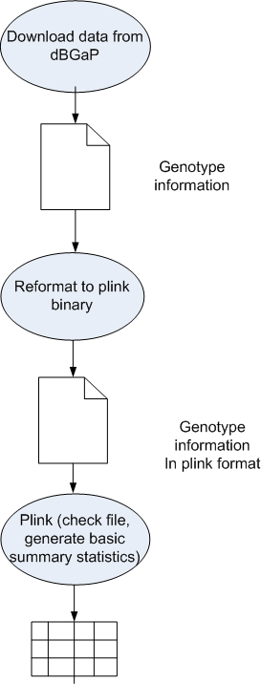
Scientific Workflows
Structure an overall computation
Define the computation steps and their parameters
Define the input/output data, parameters
Invoke the overall computation
Reuse with other data/parameters/algorithms and share
Workflows can be hidden behind a nice user interface (e.g. portal)

Slide 5
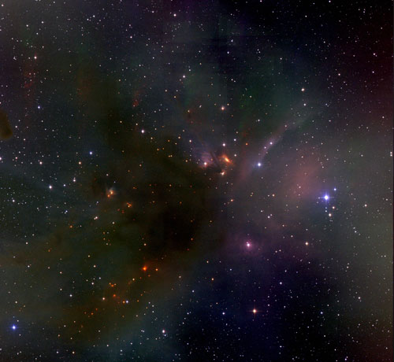
Science-grade Mosaic of the Sky

Slide 6
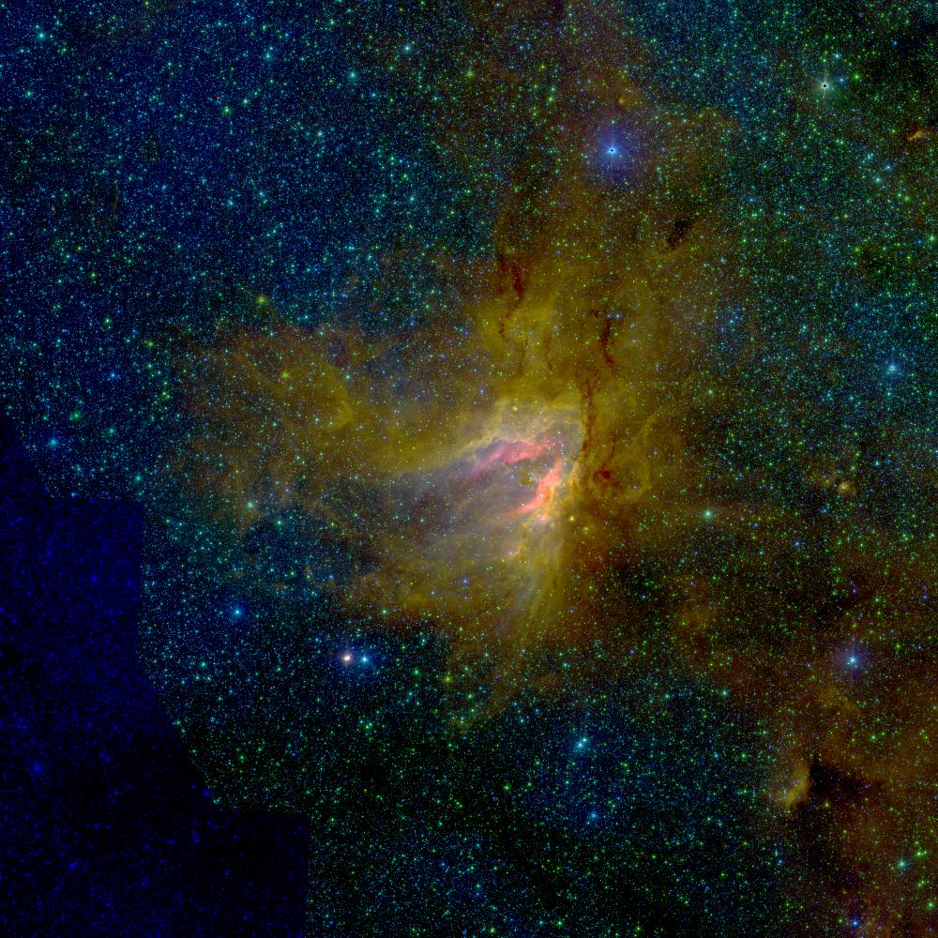
Science-grade Mosaic of the Sky
Input
Reprojection
Background Rectification
Co-addition
Output
Montage Workflow
Size of mosaic in degrees square | Number of input data files | Number of tasks | Number of intermediate files | Total data footprint | Cummulative wall time
1 | 84 | 387 | 850 | 1.9 GB | 21 mins
2 | 300 | 1442 | 3176 | 6.8 GB | 54 mins
4 | 685 | 3738 | 8258 | 18 GB | 3 hours, 18 mins
6 | 1461 | 7462 | 16458 | 37 GB | 7 hours, 7 mins
8 | 2565 | 12757 | 28113 | 64 GB | 11 hours, 44 mins

Slide 7
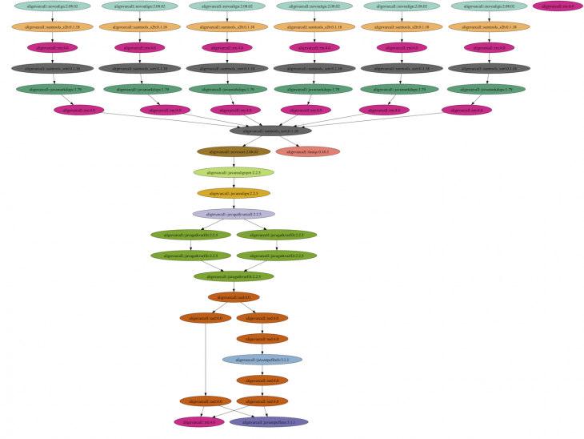
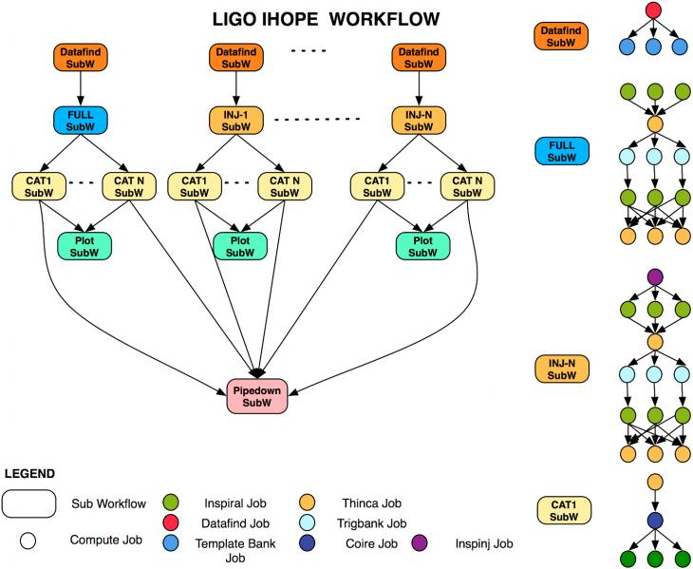
Some workflows are structurally complex
Gravitational-wave physics
Genomics Workflow

Slide 8
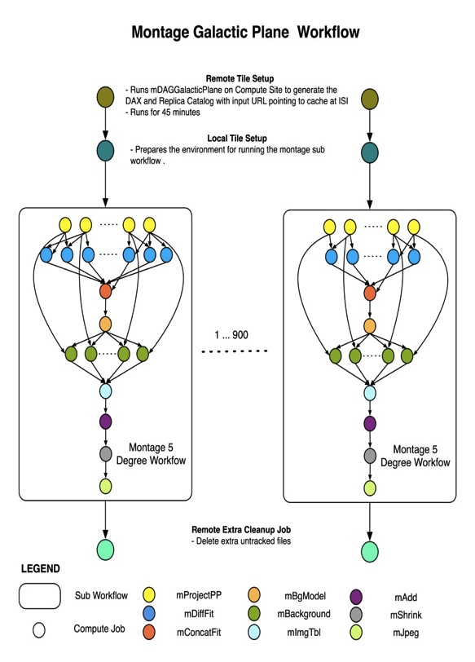

Some workflows are large-scale and data-intensive
John Good (Caltech)
Montage Galactic Plane Workflow
  18 million input images (~2.5 TB)
  900 output images (2.5 GB each, 2.4 TB total)
  10.5 million tasks (34,000 CPU hours)
Need to support hierarchical workflows and scale
× 17

Slide 9
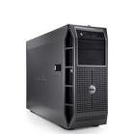
Sometimes the environment is complex and supports different protocols for data xfer and job submission
Data Storage
Campus Cluster
XSEDE
NERSC
ALCF
Open Science Grid
EGI
FutureGrid
Amazon Cloud
Work definition
Local Resource

Slide 10
Sometimes the environment is complex and supports different protocols for data xfer and job submission
Data Storage
data
Campus Cluster
XSEDE
NERSC
ALCF
Open Science Grid
EGI
FutureGrid
Amazon Cloud
Work definition
Workflow Management System
work
Submit host

Slide 11
Sometimes you may want to build your own execution environment
-- To ensure availability
-- To ensure compatibility with the application
Data Storage
Campus Cluster
XSEDE
NERSC
ALCF
Open Science Grid
EGI
FutureGrid
Amazon Cloud
data
resources
Work definition
Virtual Resource Pool
Workflow Management System
work
Submit host

Slide 12
To Build Your Own Environment Environment
You need a Resource Provisioner(s)
Data Storage
Campus Cluster
XSEDE
NERSC
ALCF
Open Science Grid
EGI
FutureGrid
Amazon Cloud
data
resources
Work definition
Virtual Resource Pool
Workflow Management System
work
Resources requests
Submit host
Resource
Provisioner

Slide 13
Generalized Data Analysis Process
Resource Provisioning
Mapping onto Resources
Execution
Results
Provisioning: find the right resources, provision them on behalf of the user, configure them (i.e. Condor Pool, filesystem), deprovision when not needed, auto-scale
Mapping: take a high-level description of the work and transform it into an executable form suitable to run on the available resources, optimize for performance, reliability
Execution: provide reliable execution, scalability, monitoring, debugging information, intervene if application is not behaving as expected

Slide 14
Generalized Data Analysis Process
Application Description
Application Resource Usage
Resource Provisioning
Mapping onto Resources
Execution
Results
Provisioning: find the right resources, provision them on behalf of the user, configure them (i.e. Condor Pool, filesystem), deprovision when not needed, auto-scale
Mapping: take a high-level description of the work and transform it into an executable form suitable to run on the available resources, optimize for performance, reliability
Execution: provide reliable execution, scalability, monitoring, debugging information, intervene if application is not behaving as expected

Slide 15
Outline
Scientific Workflows
Issues in Resource Provisioning (Cloud)
Issues in Workflow Management
Application Resource Estimation
Conclusions

Slide 16
Issues in Resource Provisioning
Find the necessary resources (type and amount)
Be able to use the right provisioning interface for a given resource and manage it using user’s credentials
Configure the resources
  Put on a scheduling system
  Set up a file system
Change the configuration of the resources over time
Add/remove resources over time
Recover from failures (at startup and during execution)

Slide 17
PRECIP- Pegasus Repeatable Experiments for the cloud in Python
A flexible experiment management API
Running experiments on FutureGrid infrastructures and also commercial clouds
Using basic Linux images
Notes:
Boto is used for EC2 connections
Paramiko is used for internal SSH connections

Slide 18
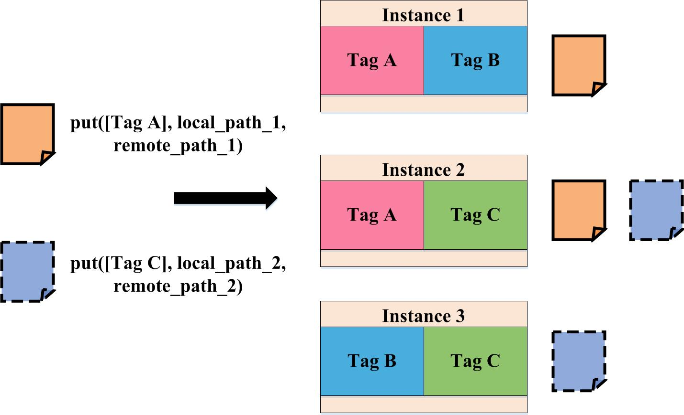
Precip Features
  Automatic handling of ssh keys and security groups
  Instance tagging
    Arbitrary tags can be added to instances
    Tags are the only handles available for addressing the instances, and used throughout the API
  Rebooting instances, which fail to boot correctly in the middle of the experiments according to users’ need

Slide 19
Experiments on Precip, http://pegasus.isi.edu/precip
  One can run a wide range of experiments on Precip:
    Networking Experiments
    Master- Worker Experiments
    Workflow Management Experiments
  Example:
# Create a new OpenStack based experiment.
exp = OpenStackExperiment(
os.environ['EC2_URL'],
os.environ['EC2_ACCESS_KEY'],
os.environ['EC2_SECRET_KEY'])
# Provision an instance.
exp.provision("ami-0000004c", tags=["test"], count=1)
# Wait for all instances to boot and become accessible.
exp.wait()
# Run a command on the instances having the "test" tag.
exp.run(["test"], "echo 'Hello world from a experiment instance'")
# deprovision the instances we have started.
exp.deprovision()

Slide 20
Outline
Scientific Workflows
Issues in Resource Provisioning
Issues in Workflow Management
Application Resource Estimation
Conclusions
Resource Provisioning
Mapping onto Resources
Execution
Results

Slide 21
There are a number of different resources and
You don’t want to recode your workflow for each one
User
Describes the workflow in abstract terms (data and computations)
Provides information about the environment, data, and code locations (some info can come directly from infrastructure)
System:
Maps the resource-independent “abstract” workflow onto resources and executes the “concrete” workflow
Takes care of data staging and registration and performs correct application invocation
Records what happened (provenance)

Slide 22
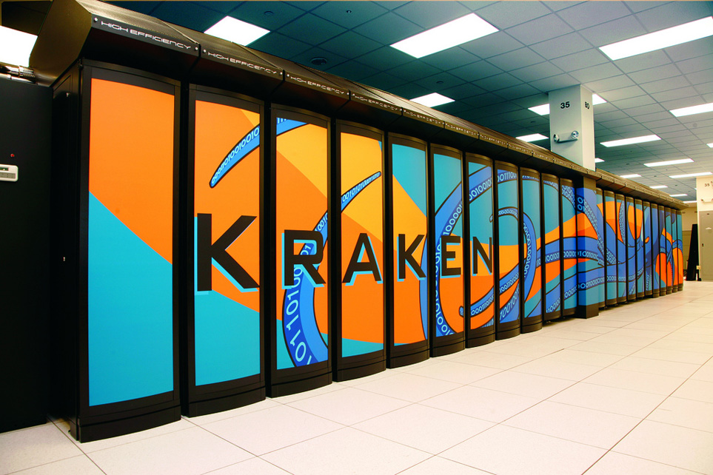
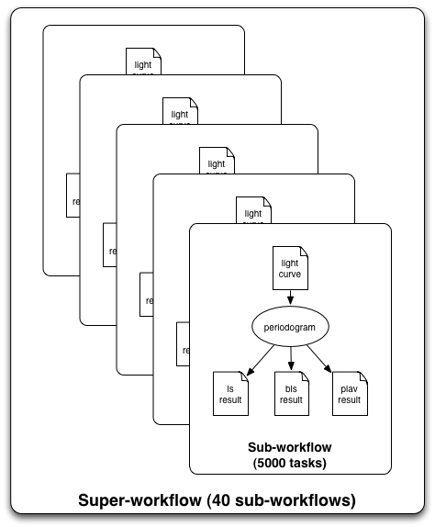
Sometimes the environment is just not exactly right
Single core workload
Queue delays in scheduling
Limited number of jobs you can submit to a queue
No outward network connectivity from worker nodes
Optimized for MPI

Slide 23
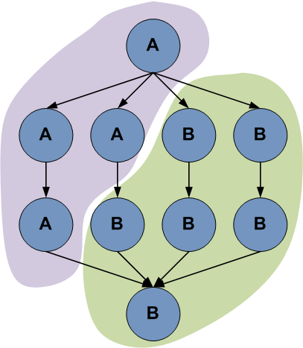
Solutions
tasks
Use “pilot” jobs to dynamically provision a number of resources at a time
Cluster tasks
Develop an MPI-based workflow management engine to manage sub-workflows
Pilot Job
time

Slide 24
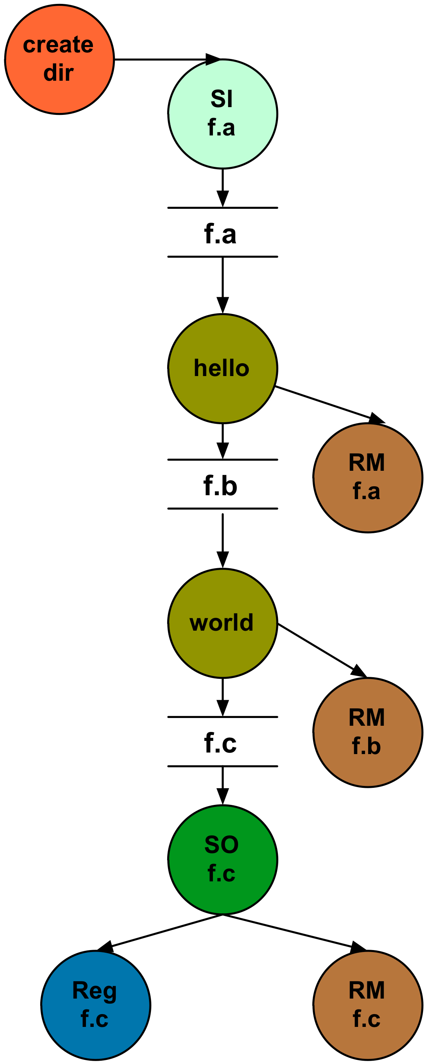
Storage limitations
“Small” amount of space
Automatically add tasks to “clean up” data no longer needed

Slide 25
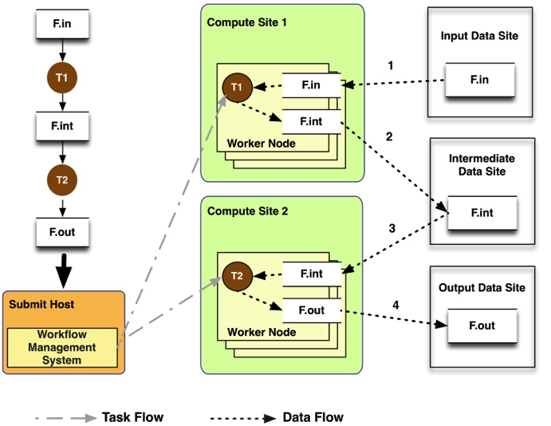
Storage limitations
Variety of file system deployments: shared vs non-shared
User workflow

Slide 26
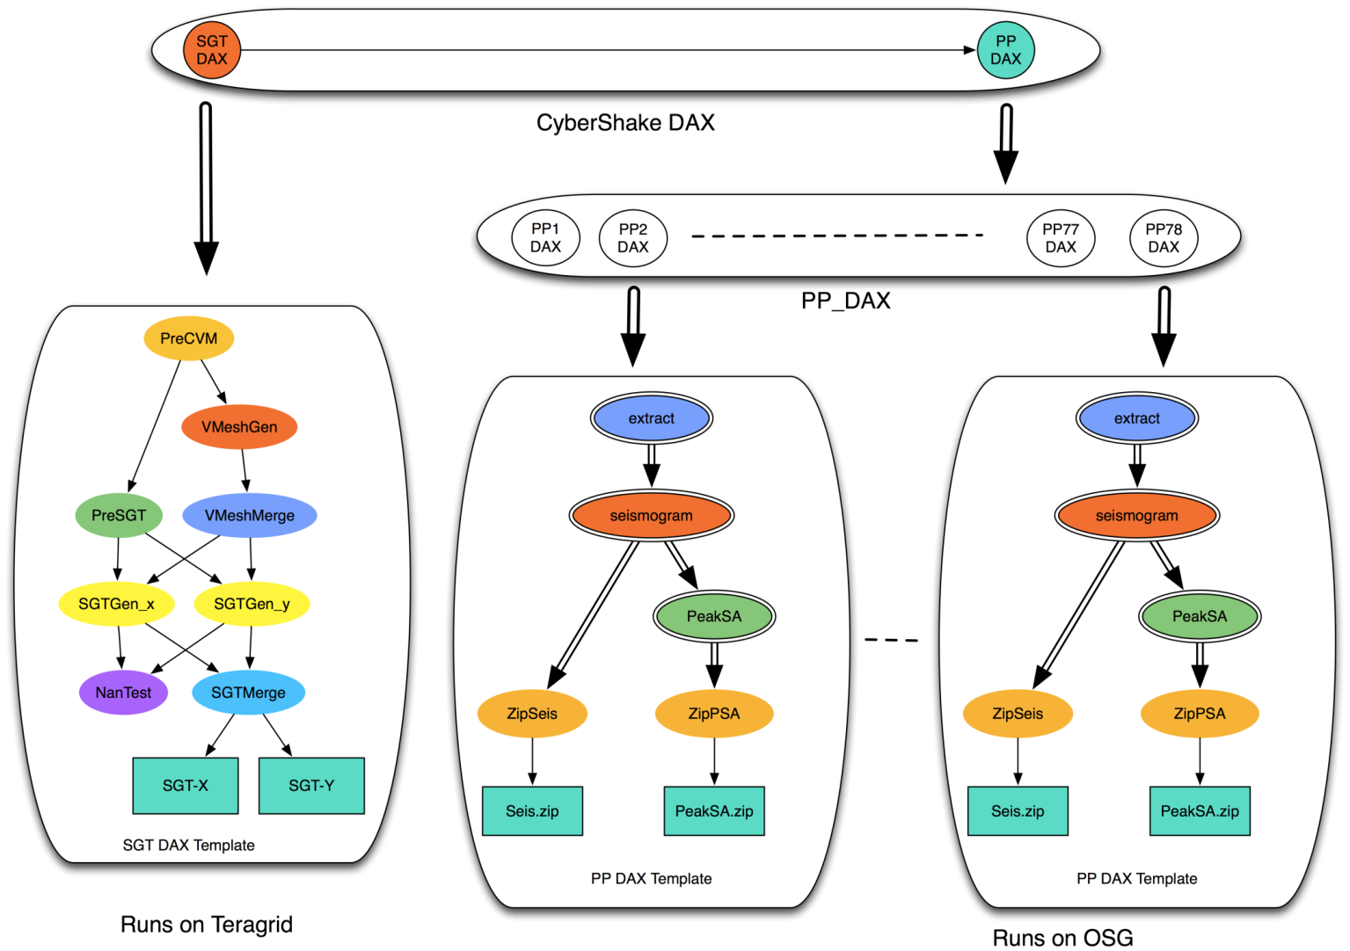
Robustness
When failures occur during execution
  Retries– retry a task or sub-workflow
  Re-planning– replan onto a different resource
  Workflow-level checkpointing (save data along the way)
Some workflows have millions of tasks: support hierarchical workflows

Slide 27
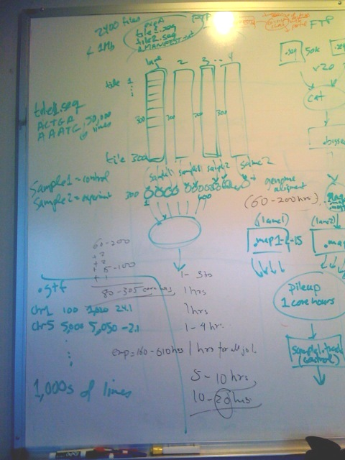
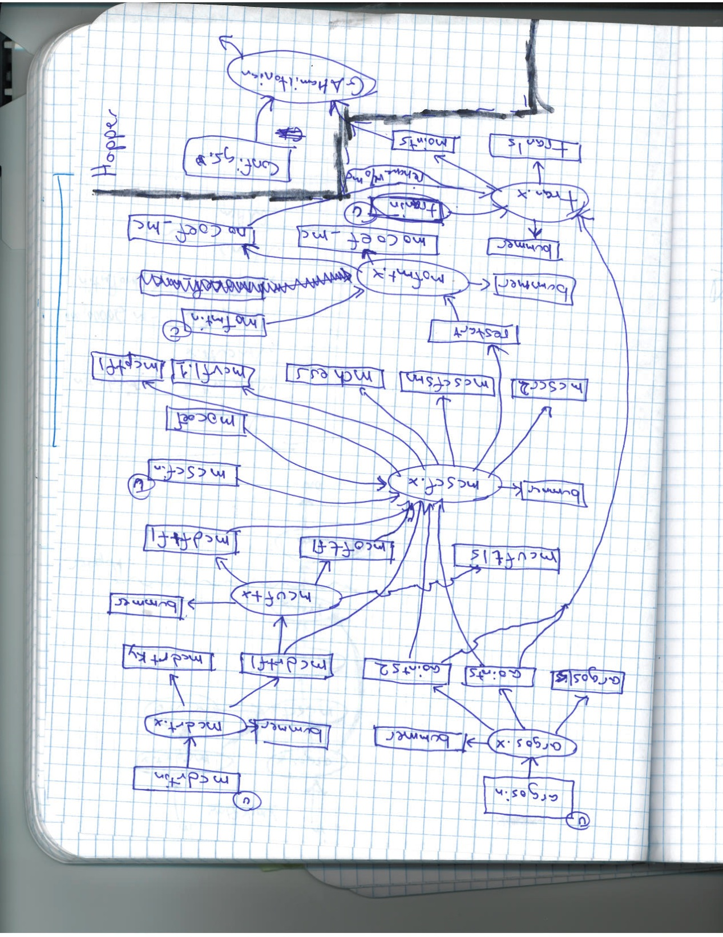
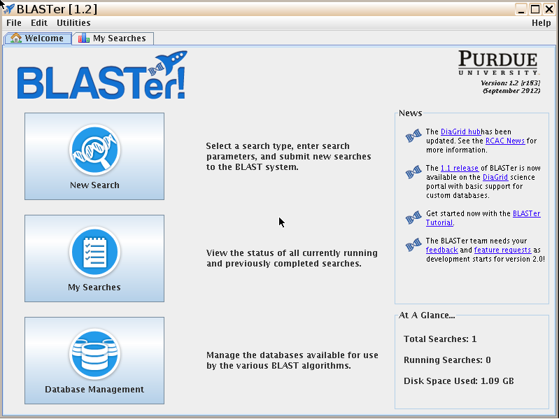
Interfacing with the user
There is no single user type!
#!/usr/bin/python
from Pegasus.DAX3 import *
import sys
import os
base_dir = os.getcwd()
##############################
## Number of receptors to group together in a sub workflow
numReceptoresSubWF = 25
## Location of receptor PDBQTs
receptorDir = base_dir + '/inputs/rec’
## Location of ligand PDBQTs
ligandpdbqtDir = base_dir + '/inputs/lig/pdbqt'
BLAST and HubZero at Purdue

Slide 28
Pegasus
Workflow Management System (est. 2001)
A collaboration between USC and the Condor Team at UW Madison (includes DAGMan)
Maps a resource-independent “abstract” workflow onto resources and executes the “concrete” workflow
Used by a number of applications in a variety of domains
Provides reliability—can retry computations from the point of failure
Provides scalability—can handle large data and many computations (kbytes-TB of data, 1-10⁶ tasks)
Infers data transfers, restructures workflows for performance
Automatically captures provenance information
Can run on resources distributed among institutions, laptop, campus cluster, Grid, Cloud

Slide 29
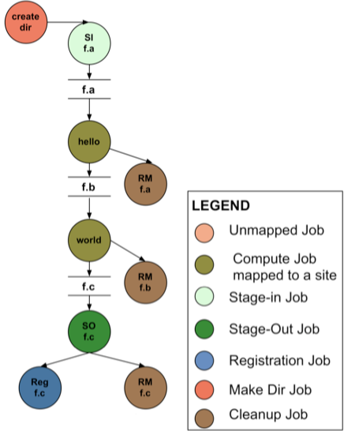
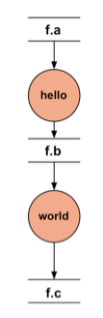




Pegasus
Executable Workflow
(After Pegasus Planning)
APIs for
workflow
specification
DAX
=
DAG in XML
Workflow
Spec

Slide 30
Outline
Scientific Workflows
Issues in Resource Provisioning
Issues in Workflow Management
Application Resource Estimation
Conclusions
Application Description
Application Resource Usage
Resource Provisioning
Mapping onto Resources
Execution
Results

Slide 31


dV/dt Accelerating the Rate of Progress towards Extreme Scale Collaborative Science
Miron Livny (UW), Ewa Deelman (USC/ISI), Douglas Thain (ND), Frank Wuerthwein (UCSD), Bill Allcock (ANL)
Goal
Further Science Automation: Enable scientists to easily launch complex applications on national computational resources and … walk away.
Approach
Develop a planning framework to seamlessly support “submit locally, compute globally” model
Focus on Estimating application resource needs, Finding the appropriate computing resources, Acquiring those resources, Deploying the applications and data on the resources, Managing applications and resources during run.
Funded by Scientific Collaborations at Extreme-Scale

Slide 32
Simplified Experimental Science Lifecycle
Modify hypothesis
Modify model
Science Question
?
Hypothesis generation
Model development
Theoretical prediction
Compare & Improve theory
Empirical Results
Data Analysis
Data Collection
Data Integration
Modify
analysis
Modify data collection
New Knowledge
Select different data
Data repos.

Slide 33
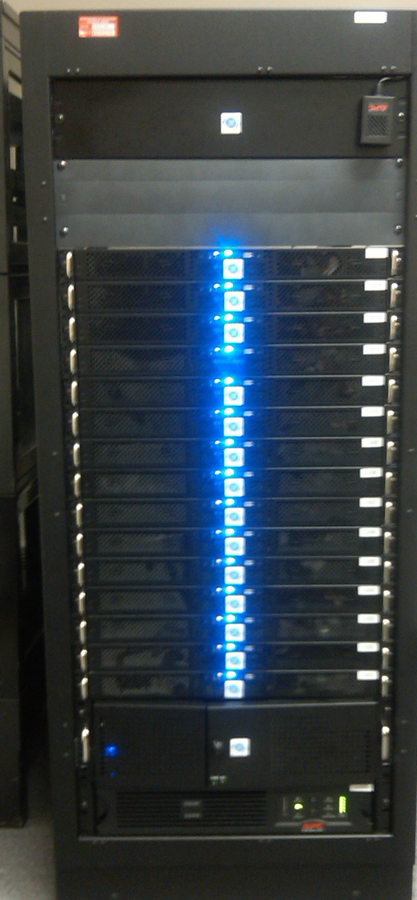
Estimating Application Resource Usage
Modify hypothesis
Modify model
How to predict the resource usage of an app?
Same types of apps have same profiles
Build regression tree
Resource usage estimate
Compare & Improve theory
Archive
Empirical Results
Extract relevant data
Monitoring System
Archive data
Modify
analysis
New Knowledge
Modify data collection

Slide 34
Workflow task characterization
Build regression tree
Resource usage estimate
Archive
Characterize workflow tasks based on their estimation capability
  Runtime, I/O write, memory peak ➔ estimated from I/O rea
Correlation statistics are enforced to identify statistical relationships between parameters
  High correlation values yield accurate estimations
  Density-based clustering identifies groups of high density areas where no correlation is found
Work of Rafael Silva, INSA Lyon

Slide 35
Task estimation process
Based on Regression Trees
  Built offline from historical data analyses
Tasks are classified by application, then by task type
Decides whether runtime, I/O write, or memory should be estimated
If parameter is strong correlated to the input data:
  Estimation based on the ratio parameter/input data size
  Otherwise, estimation based on the mean
Work of Rafael Silva, INSA Lyon

Slide 36
Online estimation process
Task executions are constantly monitored
Estimated values are updated, and a new prediction is done
Experimental results
  Poor output data estimations leads to a chain of estimation errors in scientific workflows
  The online process improves estimations up to a factor of 3 when compared to an offline process

Slide 37
Conclusions
The process of application execution automation is complex
  Difficult to estimate application resource needs
  Difficult to estimate the needed resources (that may change over time)
  Difficult to map and schedule applications
Need to deal with many unknowns and also with a changing application/system
Need to be able to also adapt to failures
Need to be able to work out the interplay of various system components, collect information about the system and application behavior, and have “reasonable” and “efficient” estimates
Thanks to the Pegasus team and collaborators!

